Slide 1
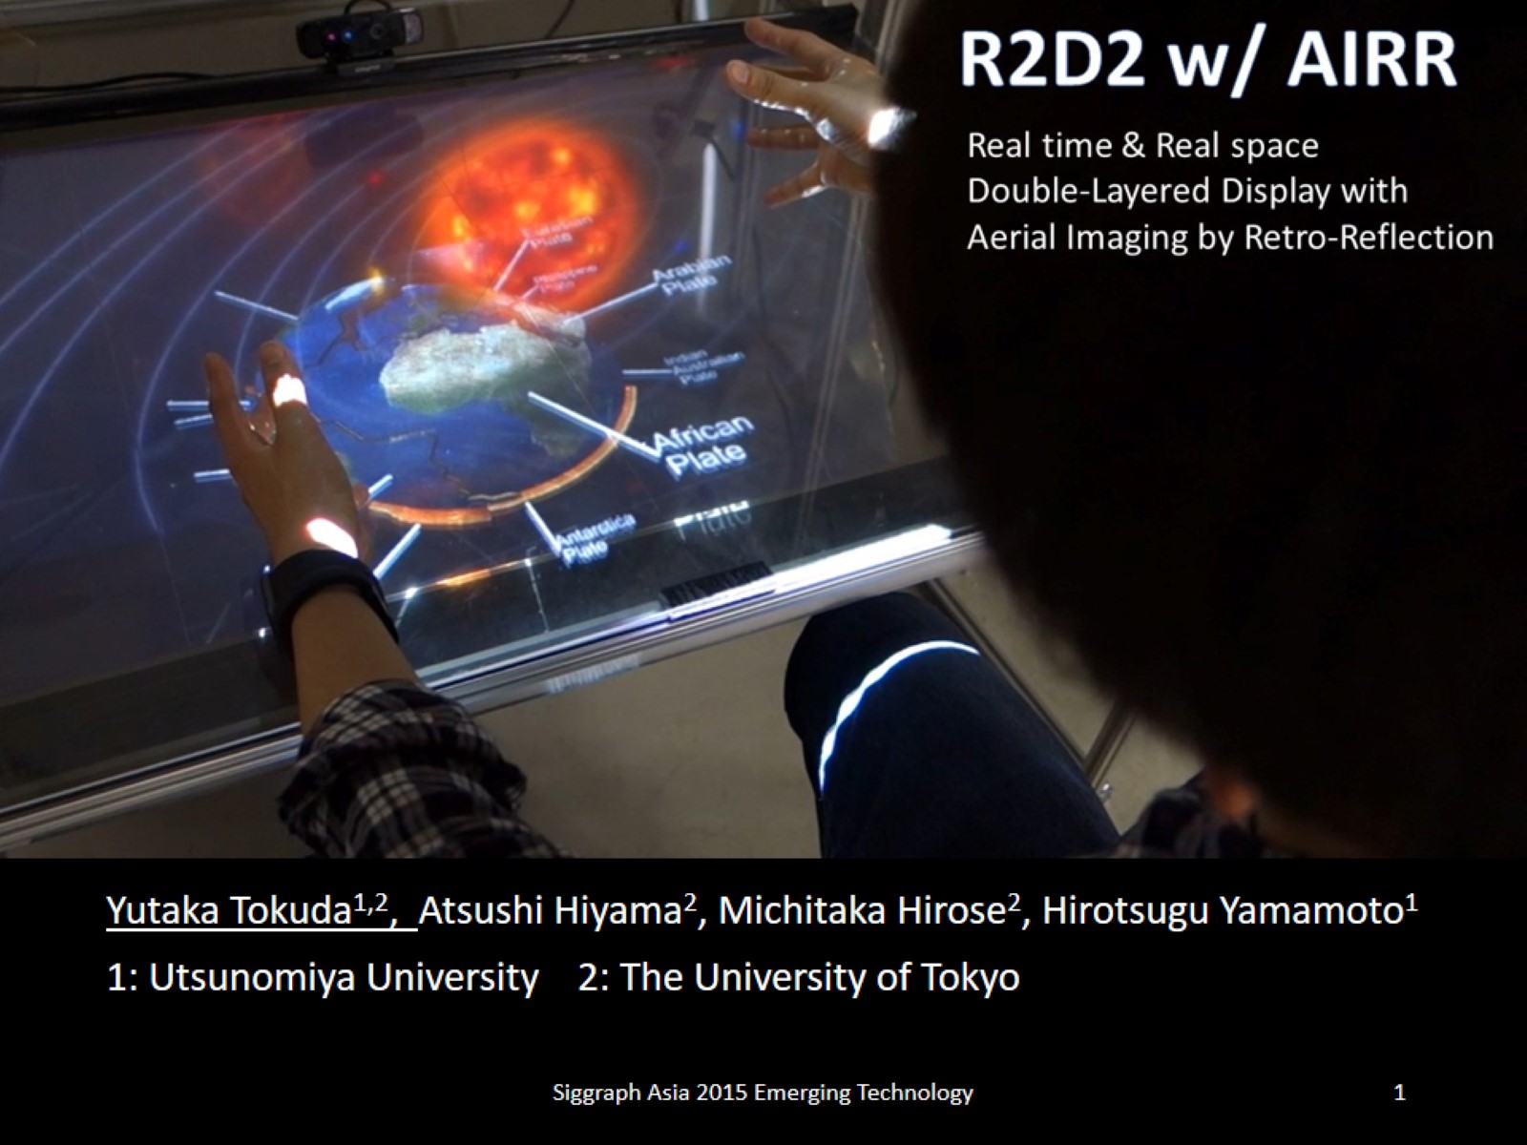

Slide 2
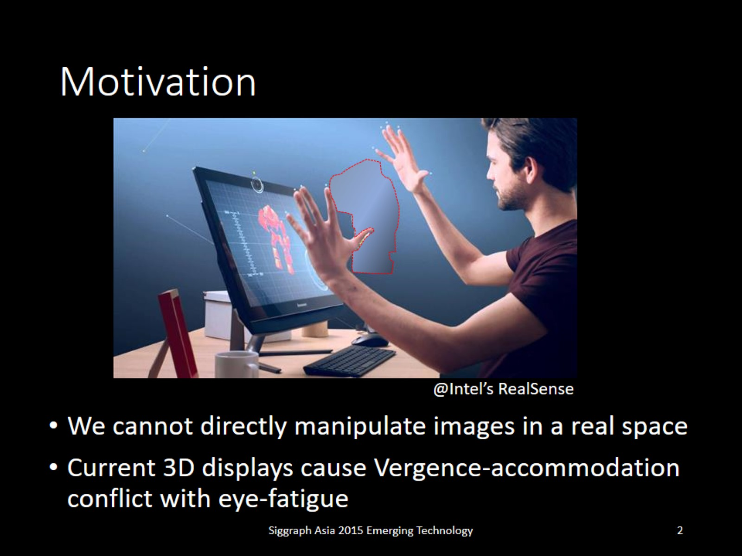
Motivation

Slide 3
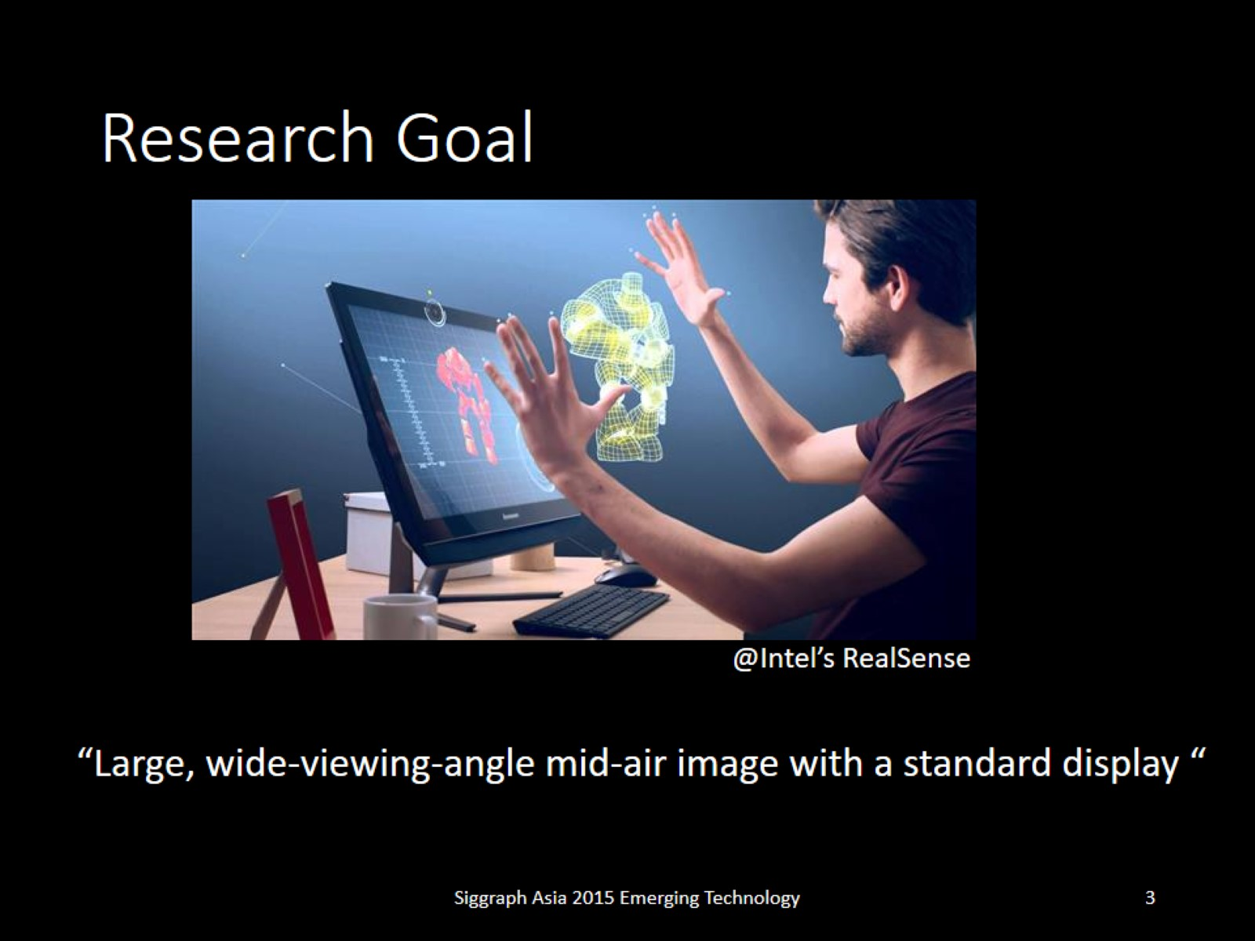
Research Goal

Slide 4
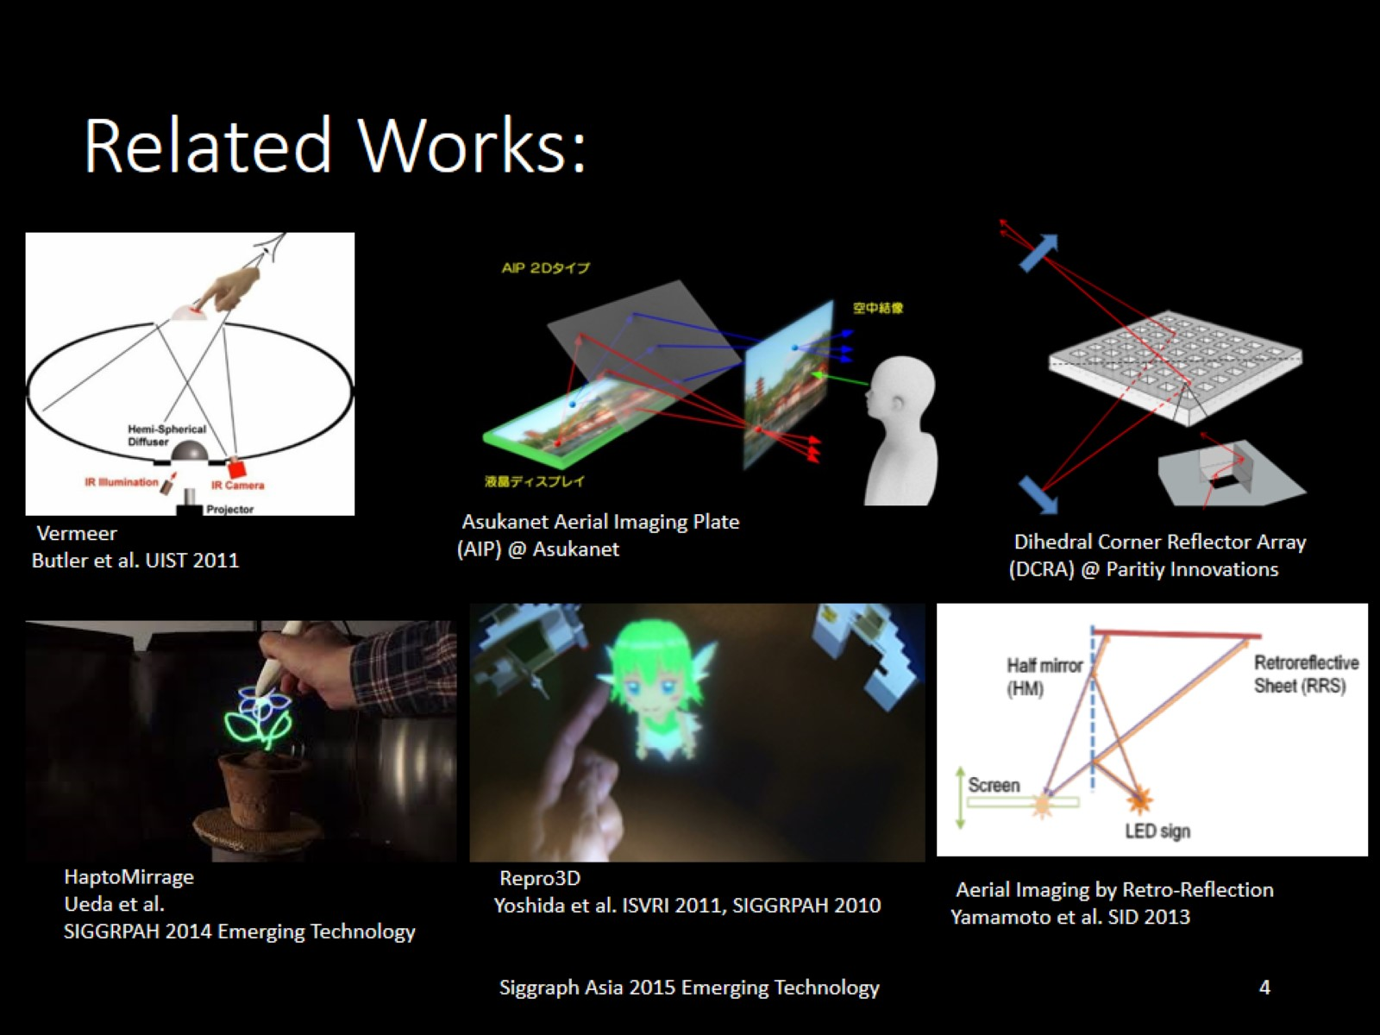
Related Works:

Slide 5
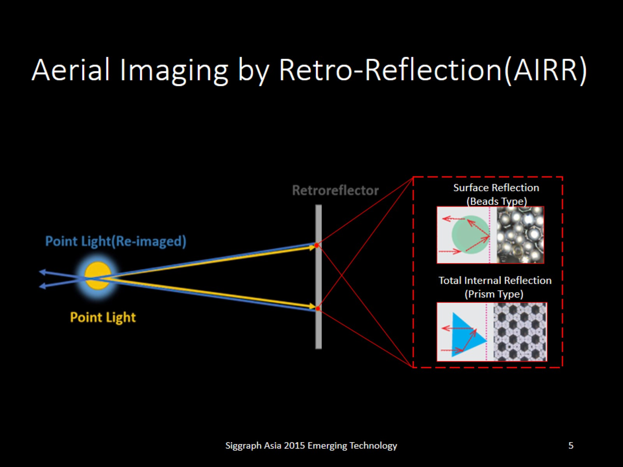
Aerial Imaging by Retro-Reflection(AIRR)

Slide 6
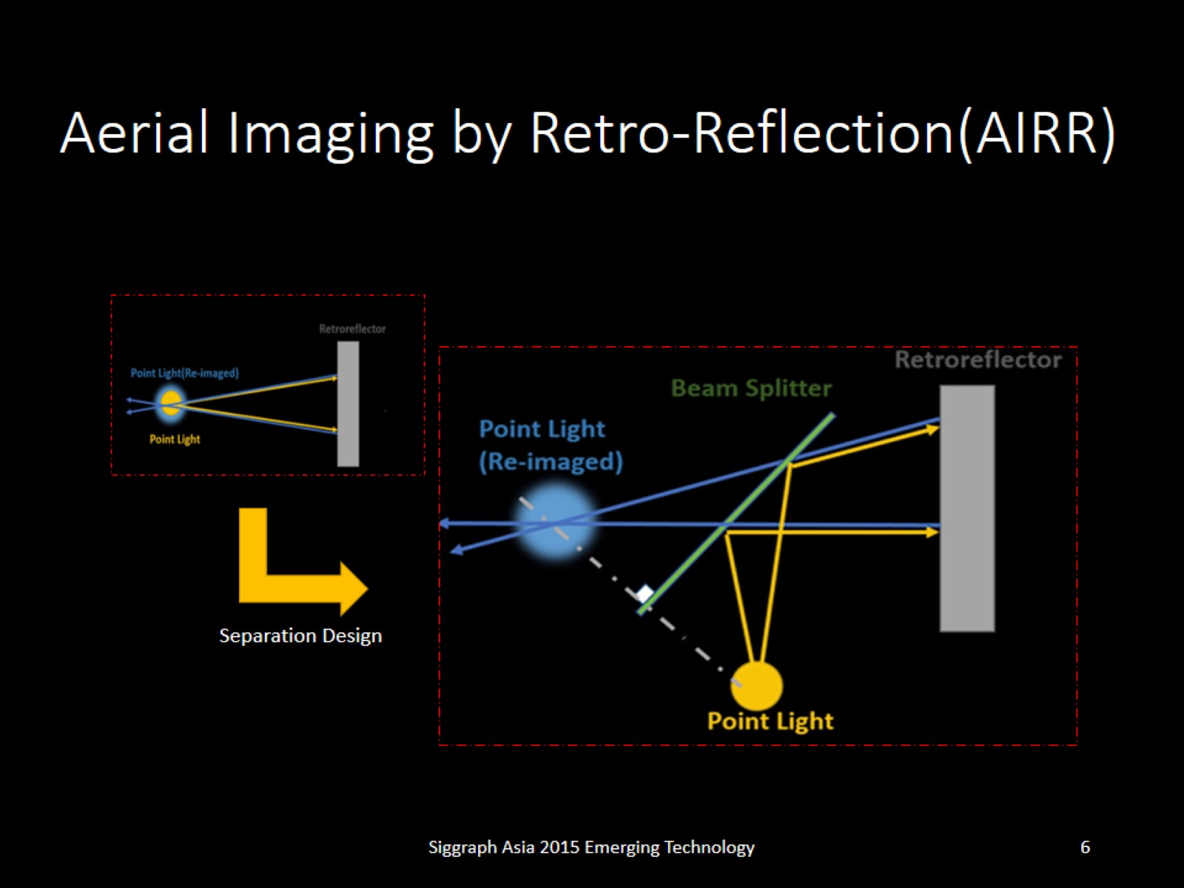
Aerial Imaging by Retro-Reflection(AIRR)

Slide 7
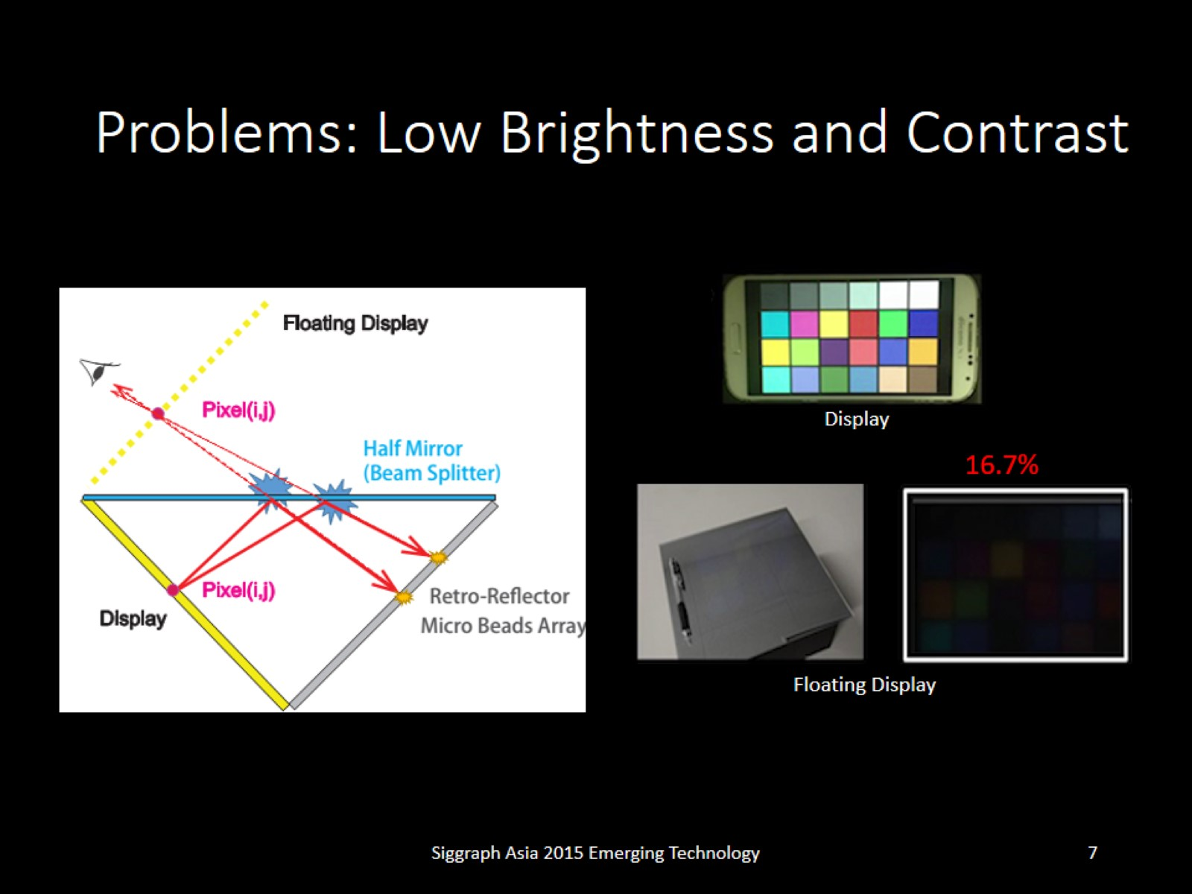
Problems: Low Brightness and Contrast

Slide 8
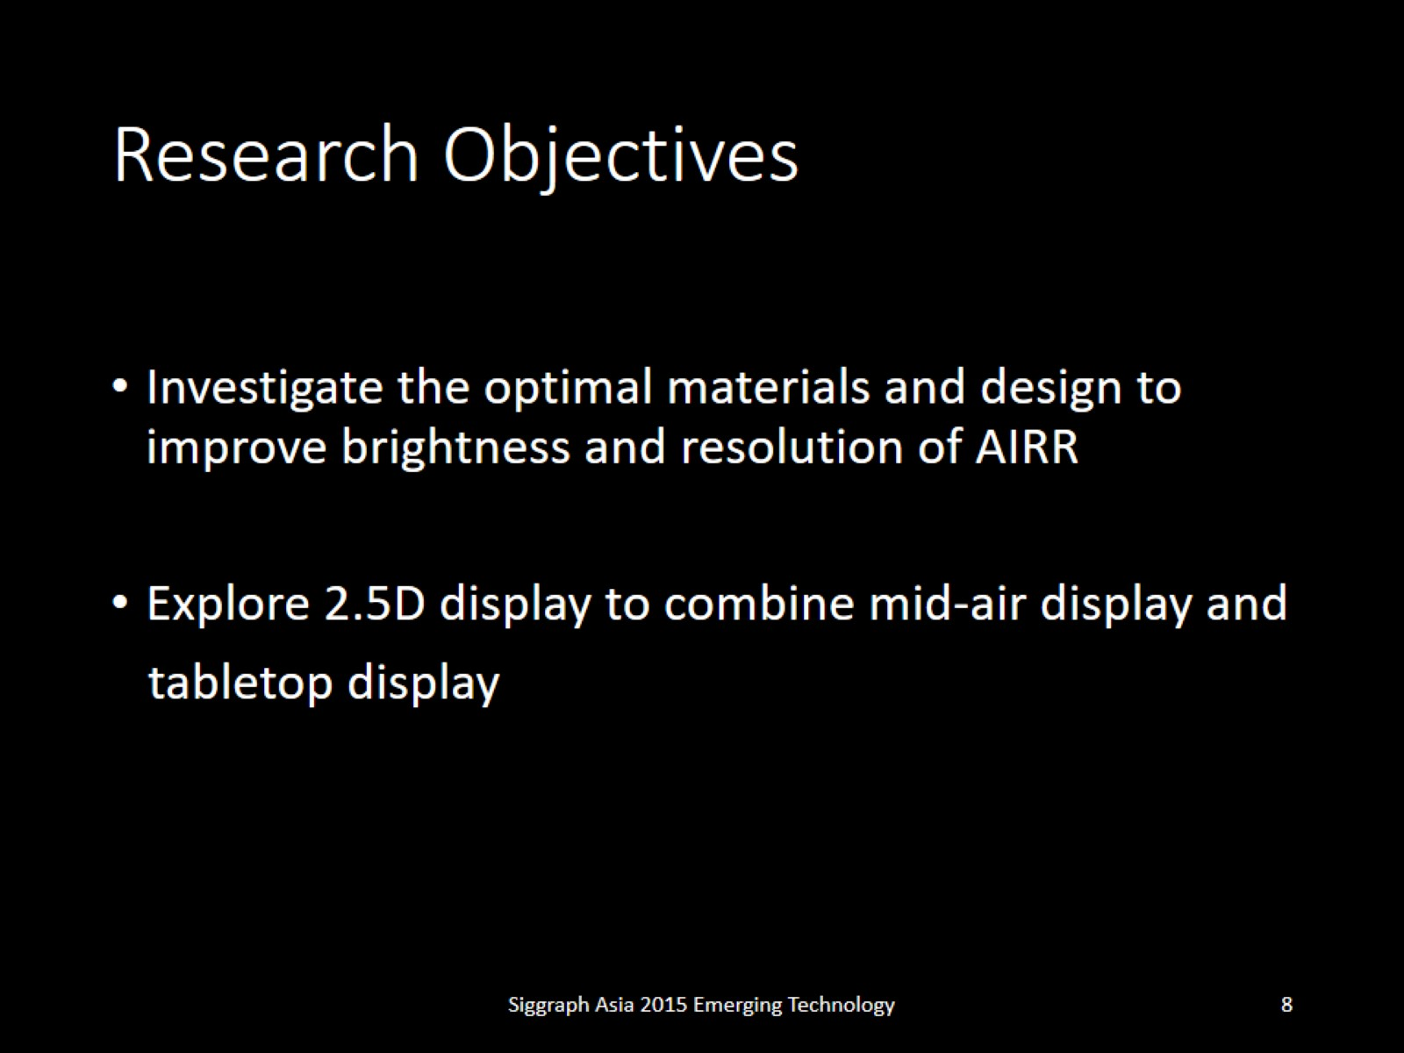
Research Objectives

Slide 9
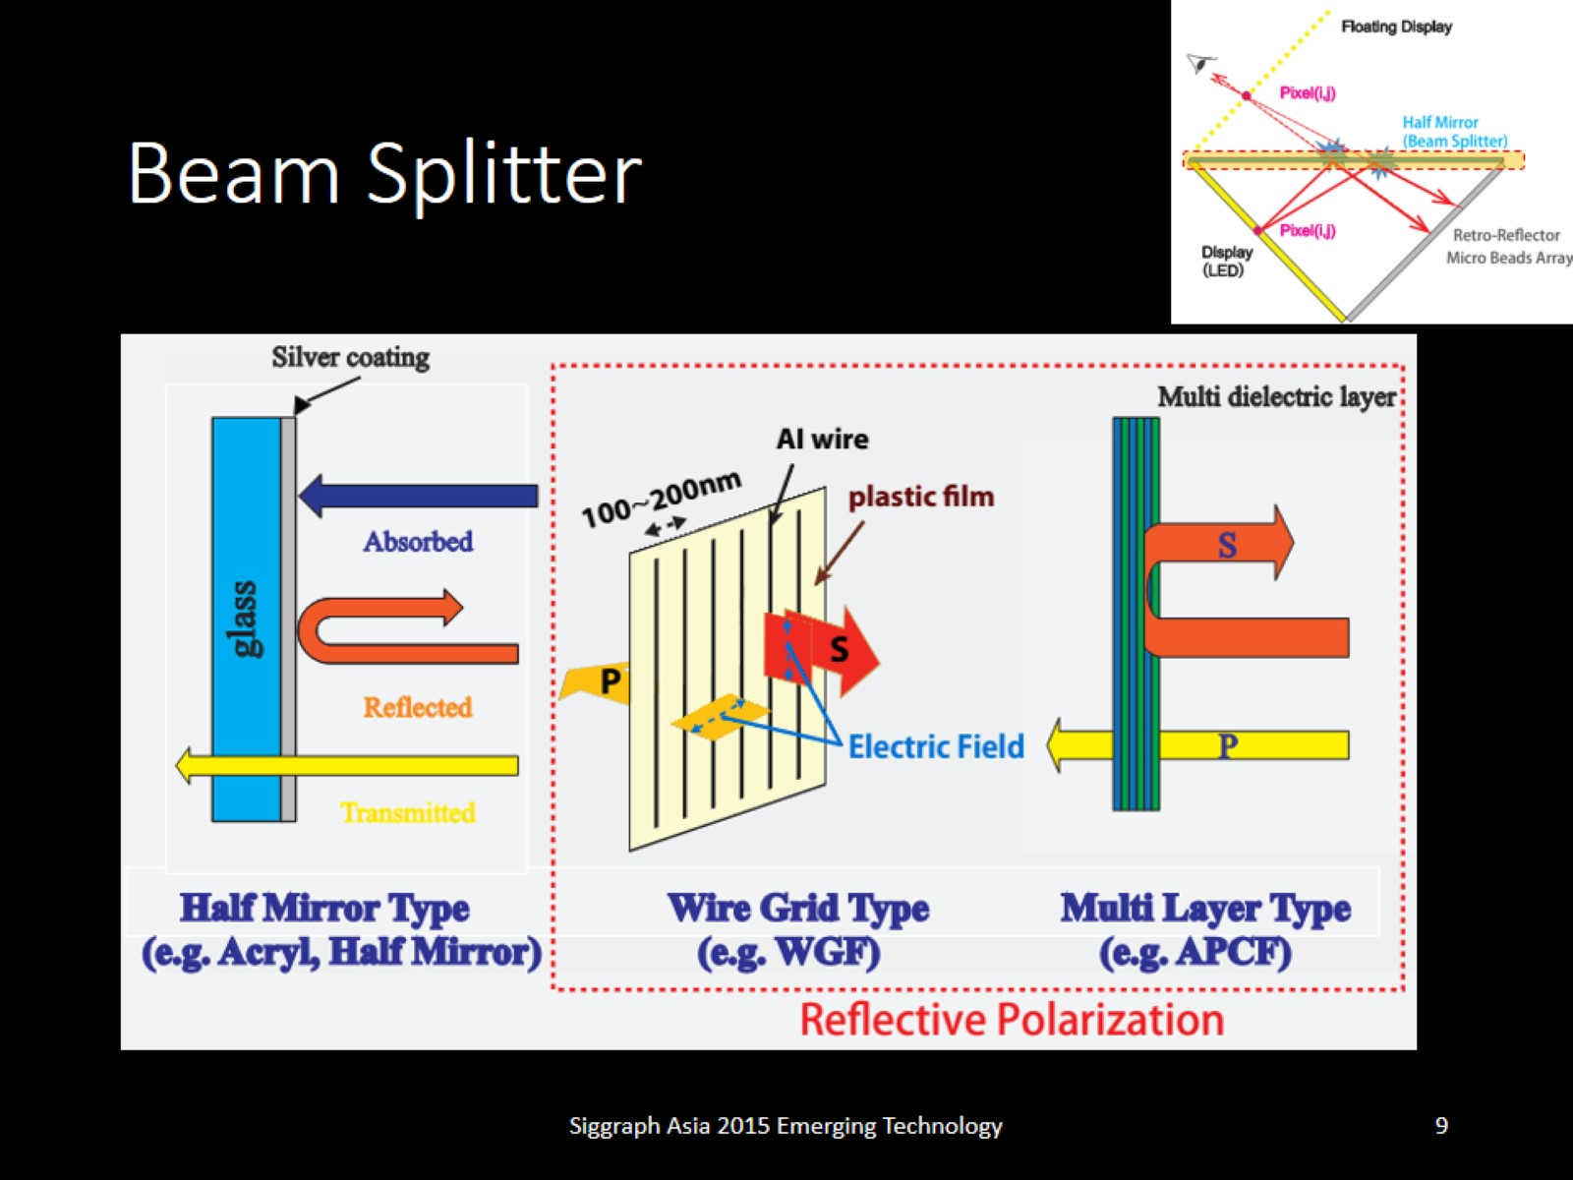
Beam Splitter

Slide 10
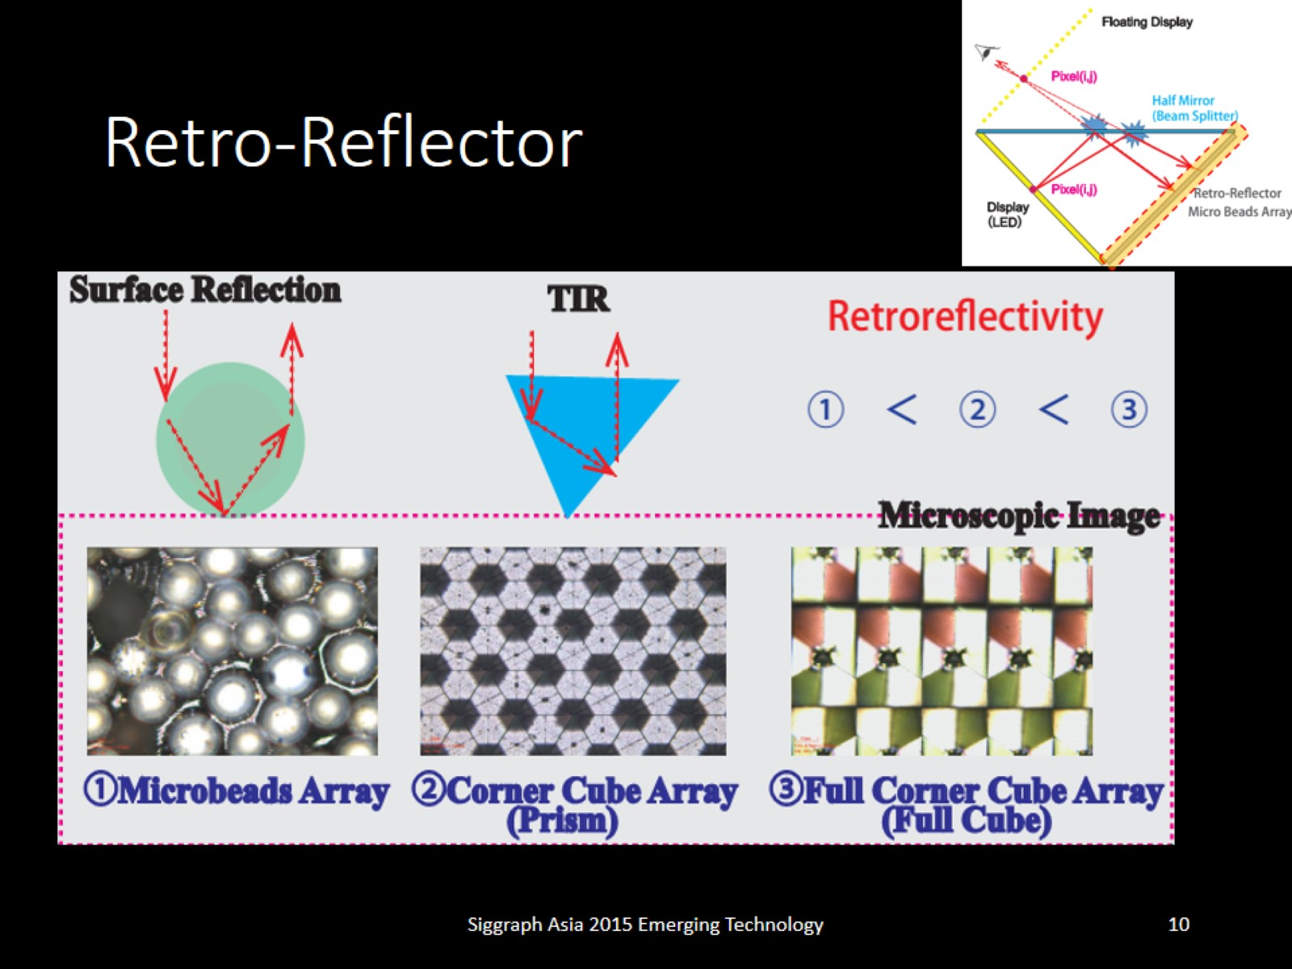
Retro-Reflector

Slide 11
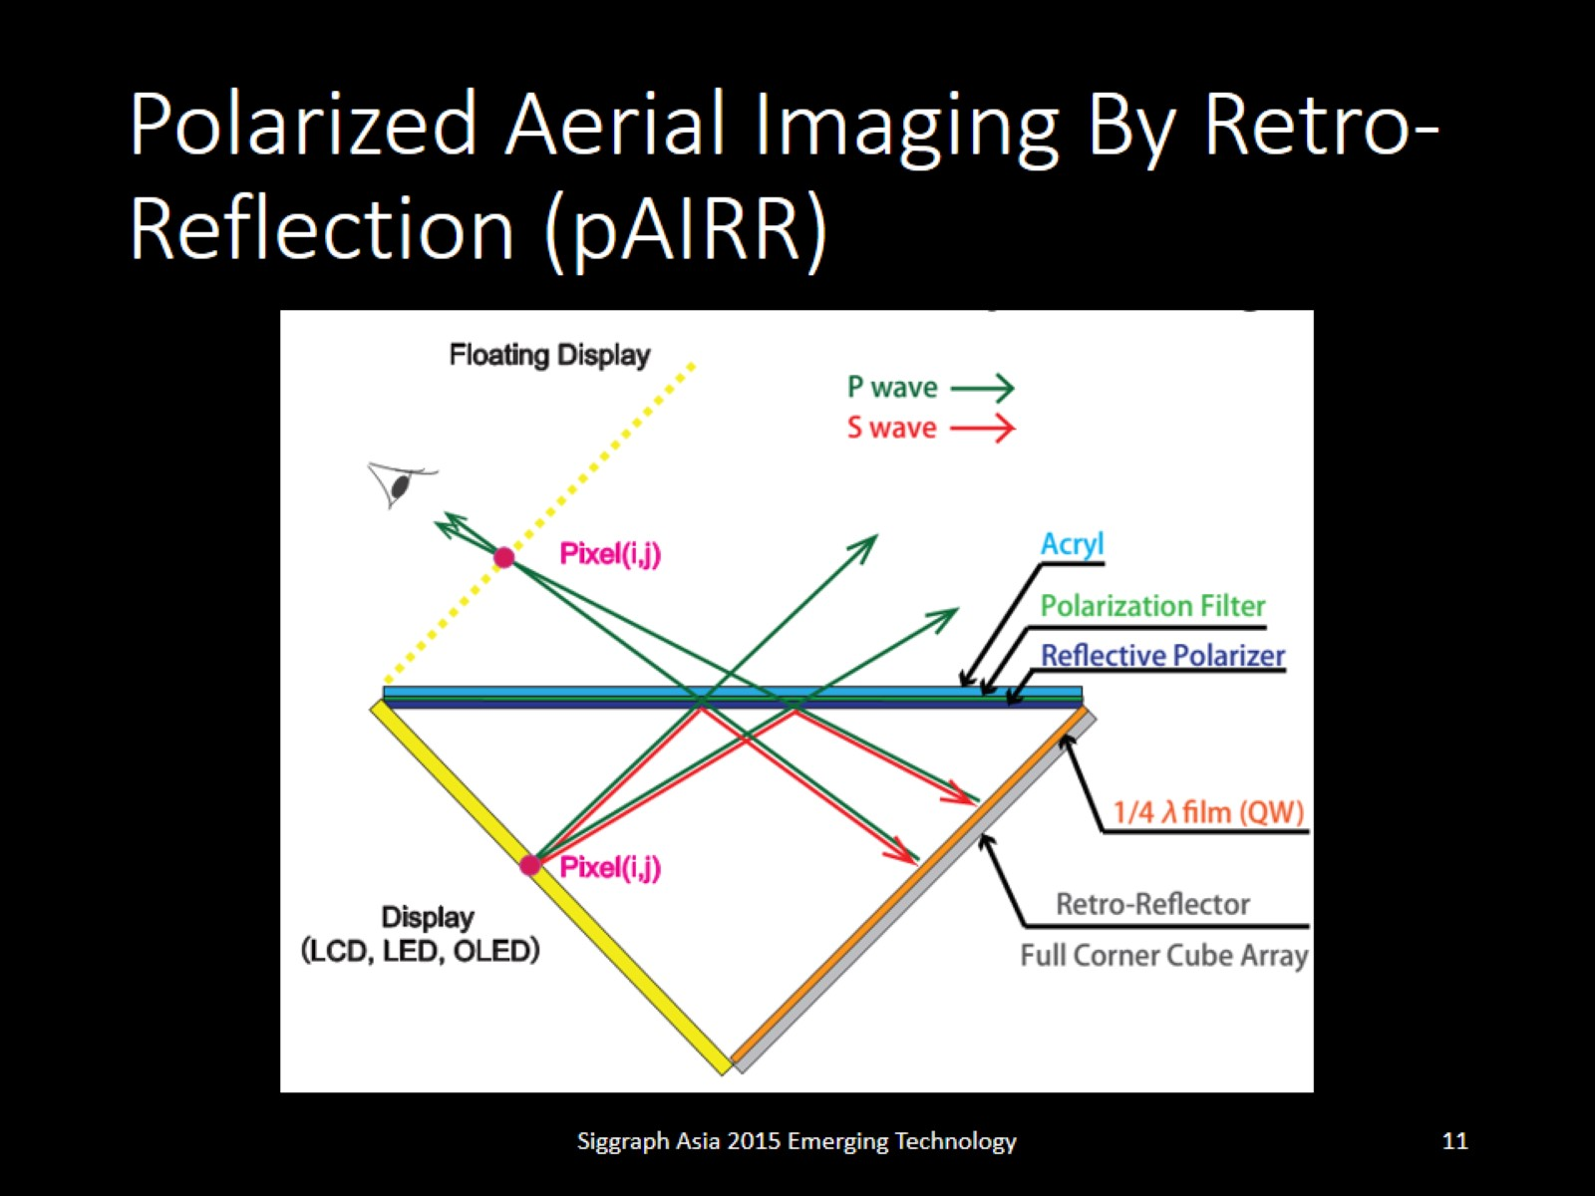
Polarized Aerial Imaging By Retro-Reflection (pAIRR)

Slide 12
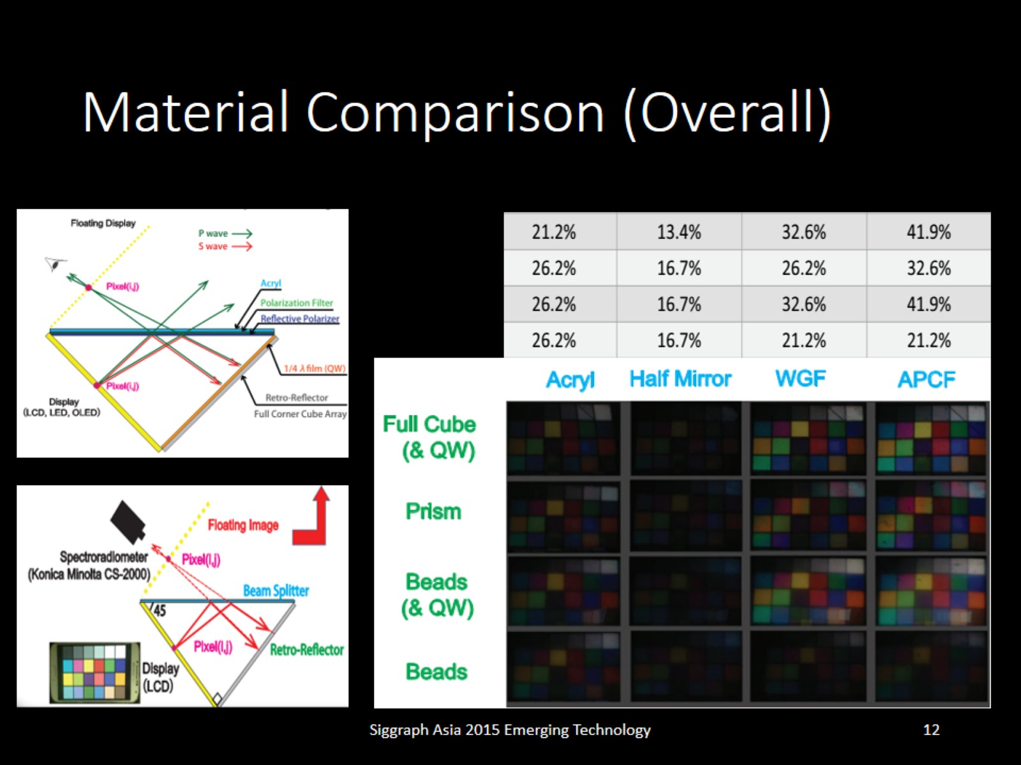
Material Comparison (Overall)

Slide 13
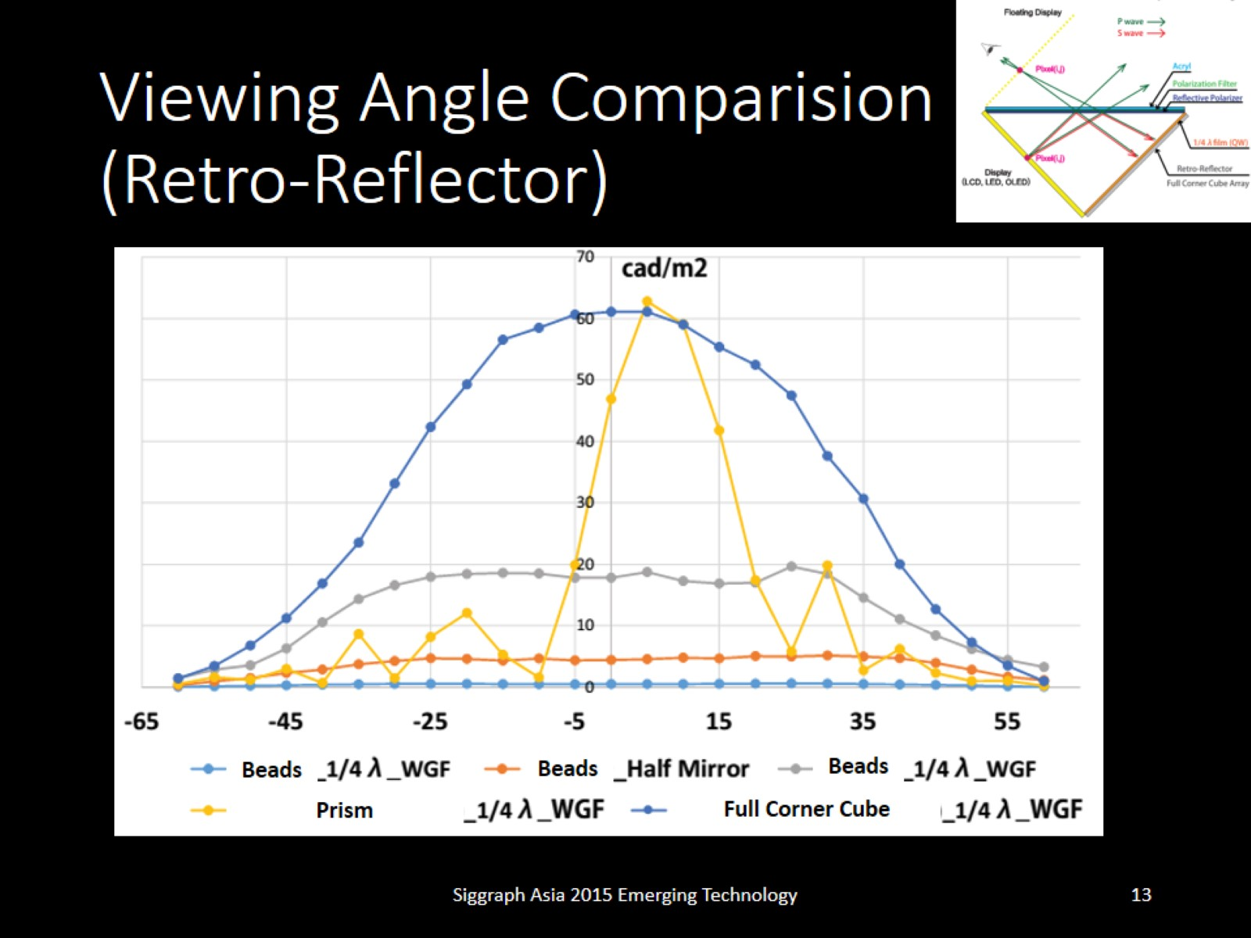
Viewing Angle Comparision (Retro-Reflector)

Slide 14
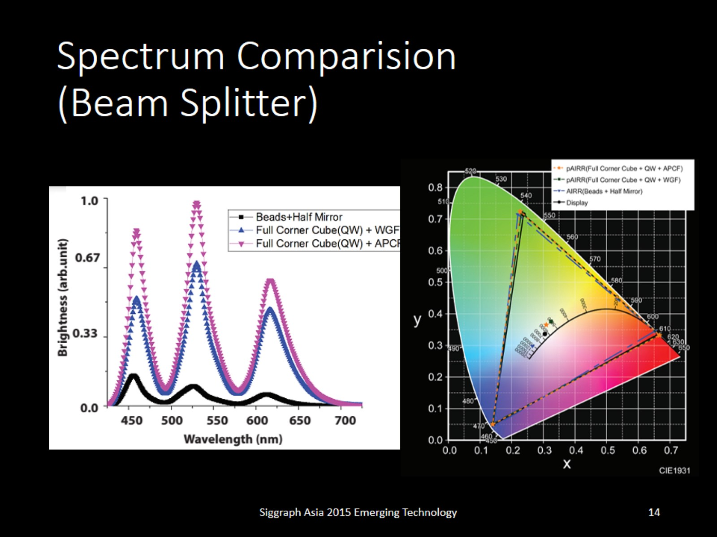
Spectrum Comparision (Beam Splitter)

Slide 15
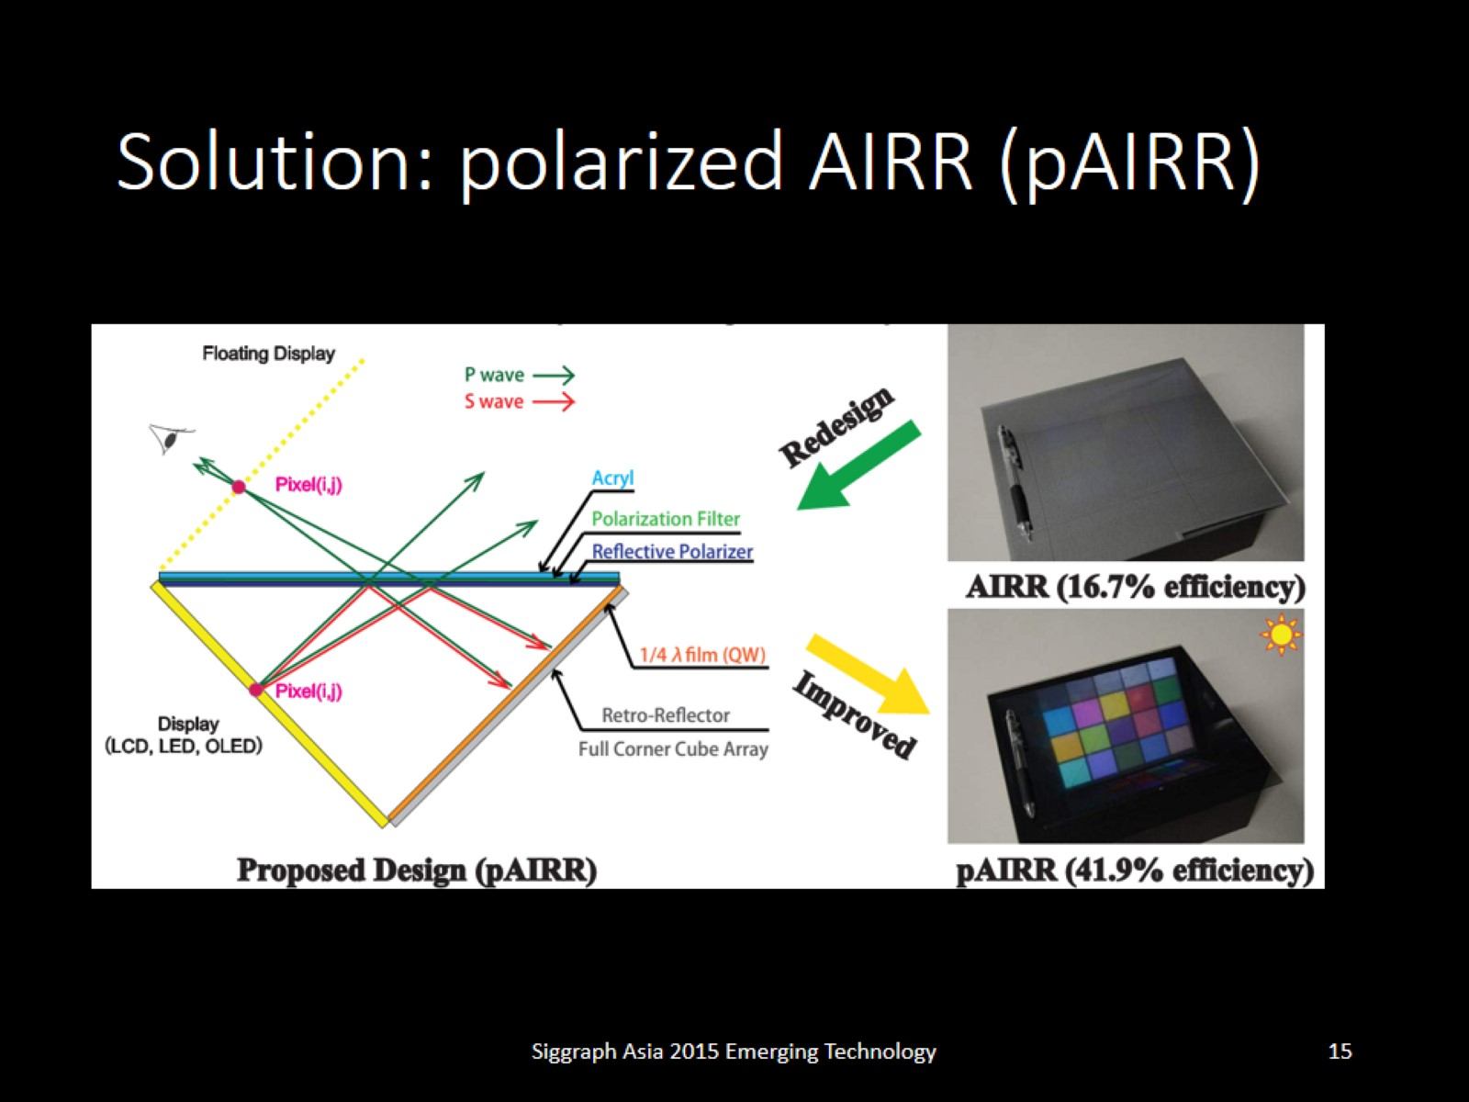
Solution: polarized AIRR (pAIRR)

Slide 16
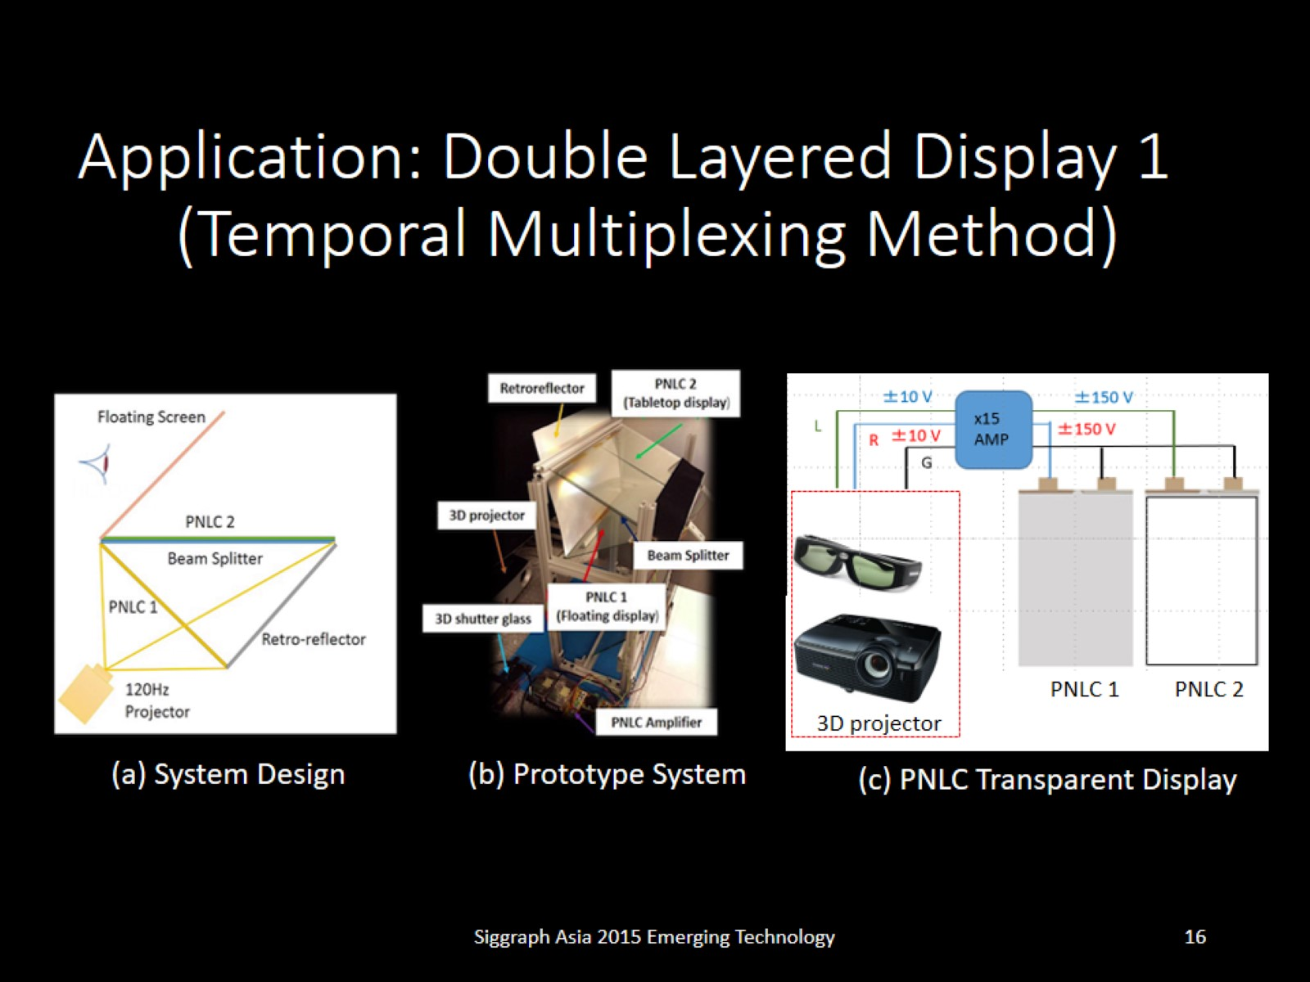
Application: Double Layered Display 1 (Temporal Multiplexing Method)

Slide 17
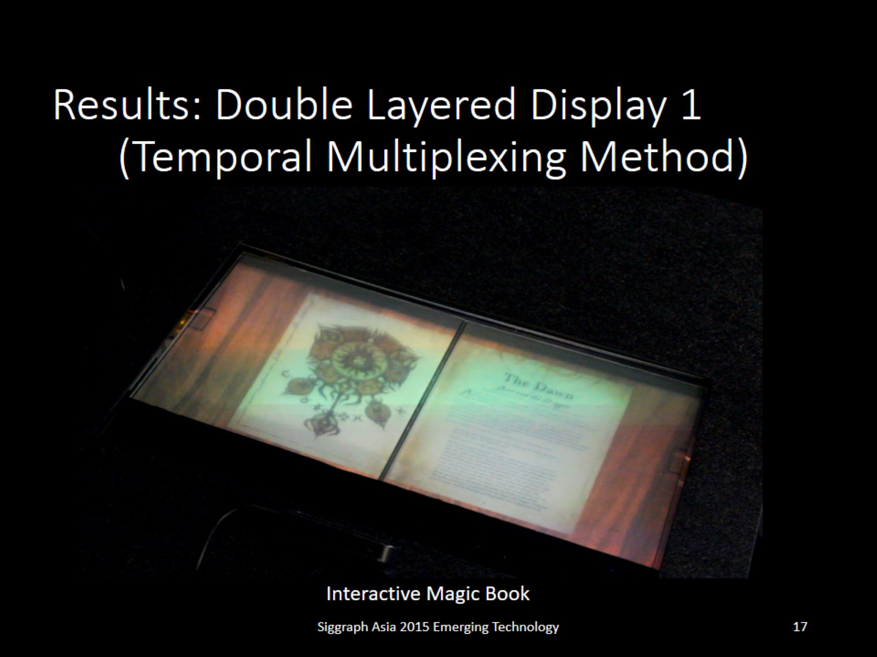
Results: Double Layered Display 1 (Temporal Multiplexing Method)

Slide 18
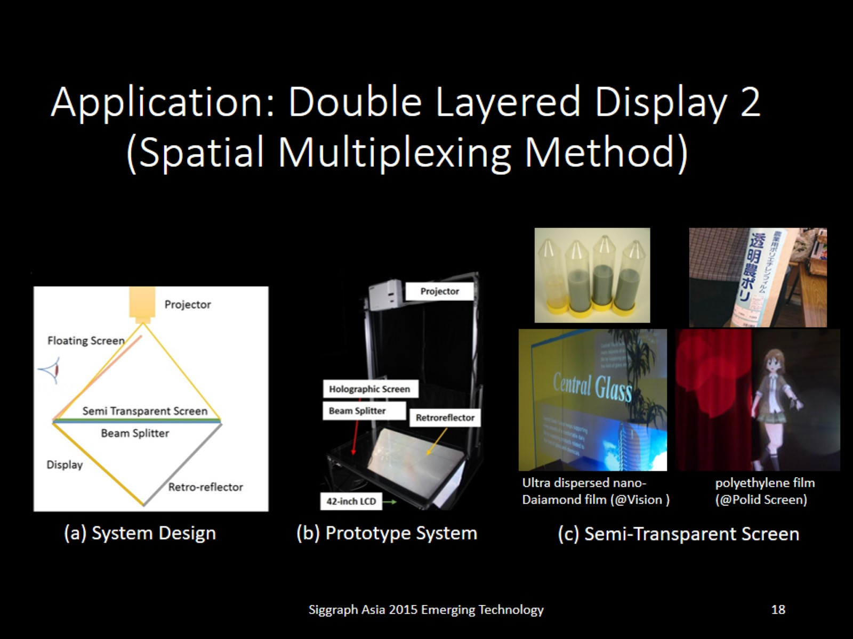
Application: Double Layered Display 2 (Spatial Multiplexing Method)

Slide 19
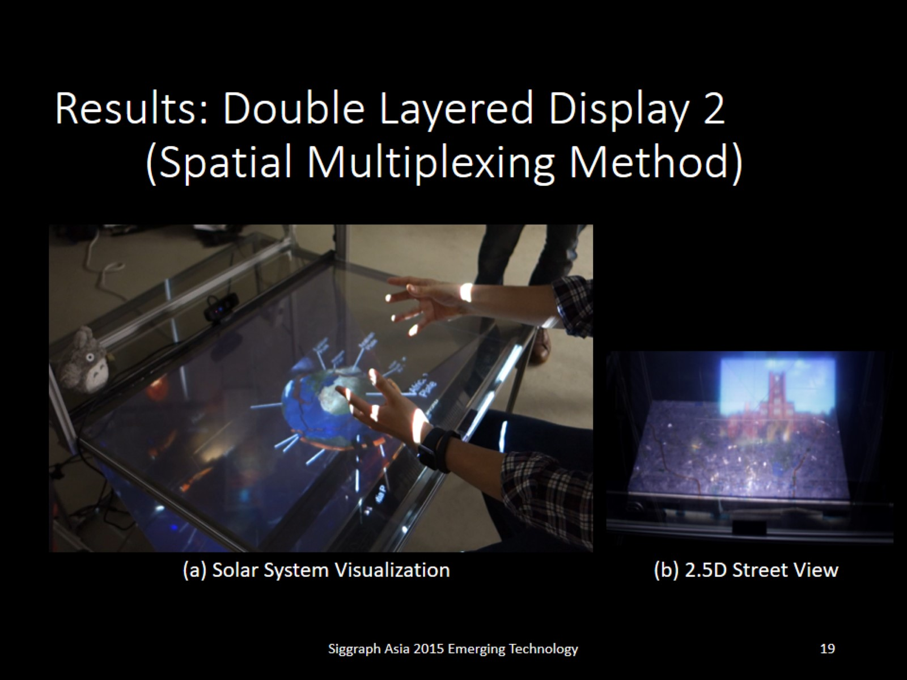
Results: Double Layered Display 2 (Spatial Multiplexing Method)

Slide 20
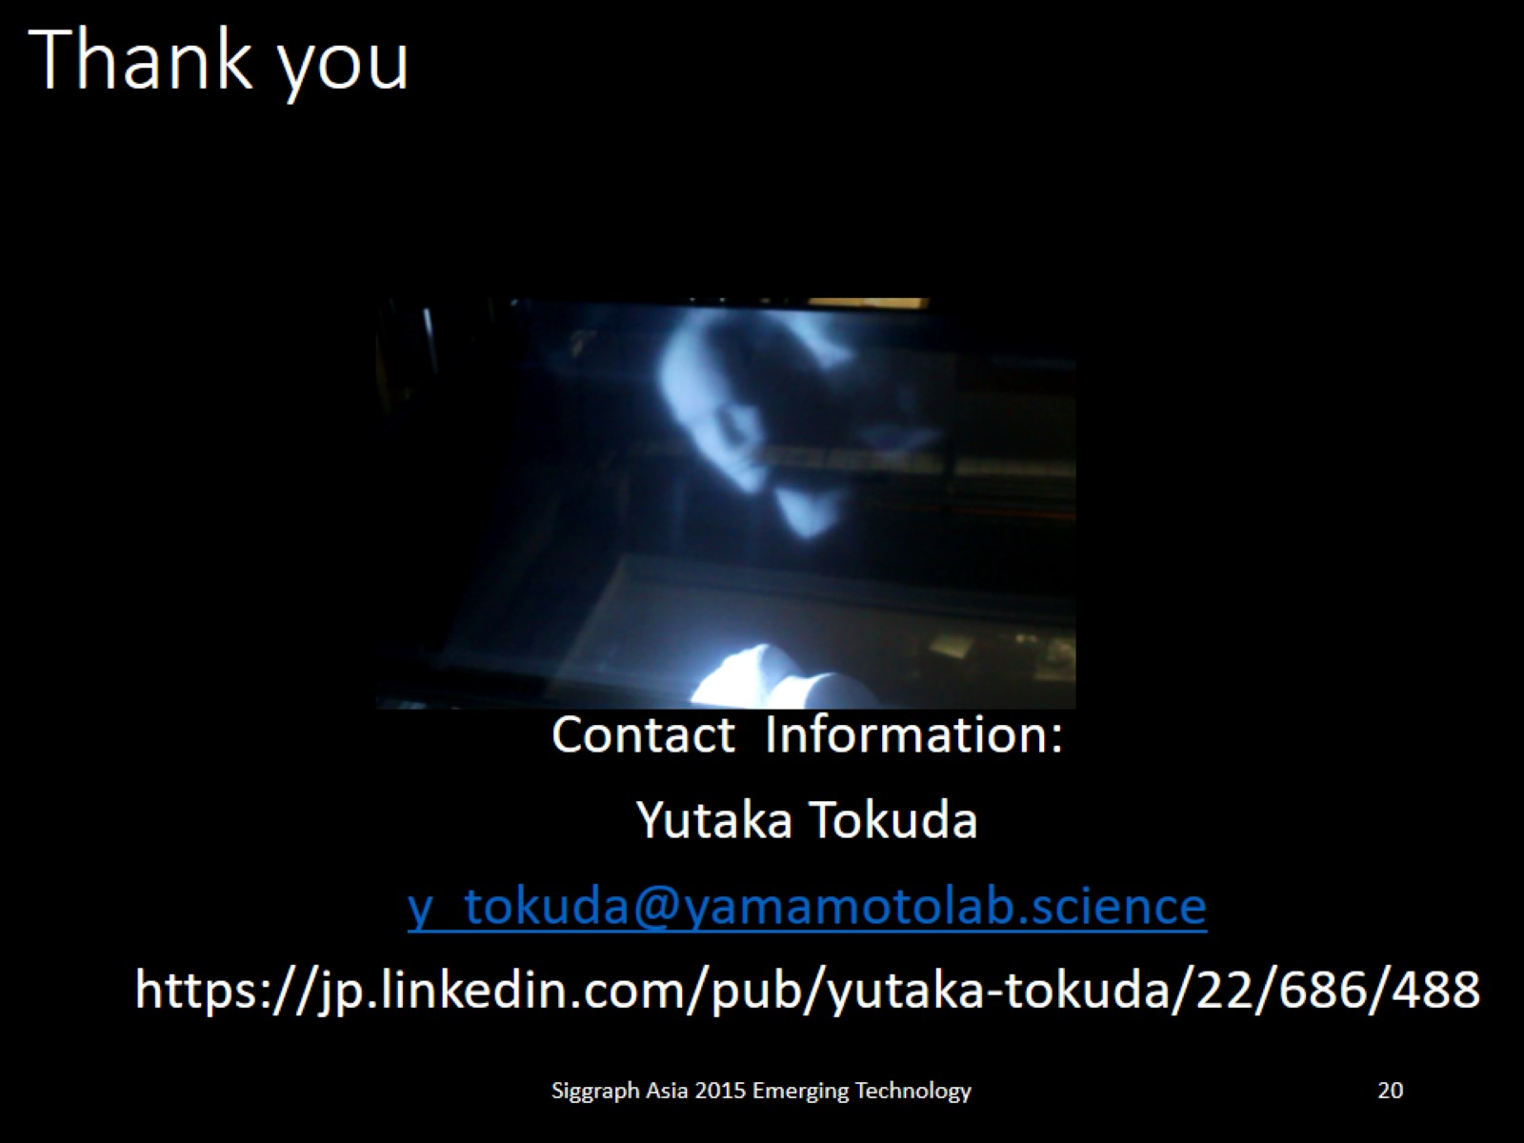
Thank you

