Slide 1
International Donors and Local Armed Groups:
Understanding the Subnational Effect of Aid on Conflict
Main points:
Analysis the relationship between international aid and conflict on a subnational level (ADM1)
Analysis of the effect that donor/location characteristics have on the relationship between aid and conflict

Slide 2
Donor and location characteristics
Adaptability of donors
  How are adaptable the donors ?
  The degree to which the projects of the donors allow alterations in location, time frame, thematic focus of aid
Local receptivity
  How receptive is the environment in which a project takes place?
  Operationalized by attacks on aid workers

Slide 3
Main hypotheses
Aid/conflict relationship is expected to be conditioned by the interaction of adaptability/receptivity score as follows:
DONORS | Local environment
 |  | High receptivity | Low receptivity
 | High adaptability | (Strong) decrease in the level of conflict | (Moderate) increase in the level of conflict
 | Low adaptability | (Moderate) decrease in the level of conflict | (Strong) increase in the level of conflict

Slide 4
Data sources
AidData provides geocoded information on the international aid projects, with info on $ amount, thematic focus, timeframe of the project.
Uppsala Conflict Data Program (UCDP) maintains geocoded datasets with information on individual conflict events (location, time, parties, amount of casulaties).
Aid Worker Security Database provides geocoded info on attacks and casualties of aid workers

Slide 5
Descriptive aspects of the data
First focus on one country – DRC
Data aggregated to (year, ADM1) level
Aid data:
  1999 - 2013
  2050 projects
Conflict data:
  2819 conflict events

Slide 6
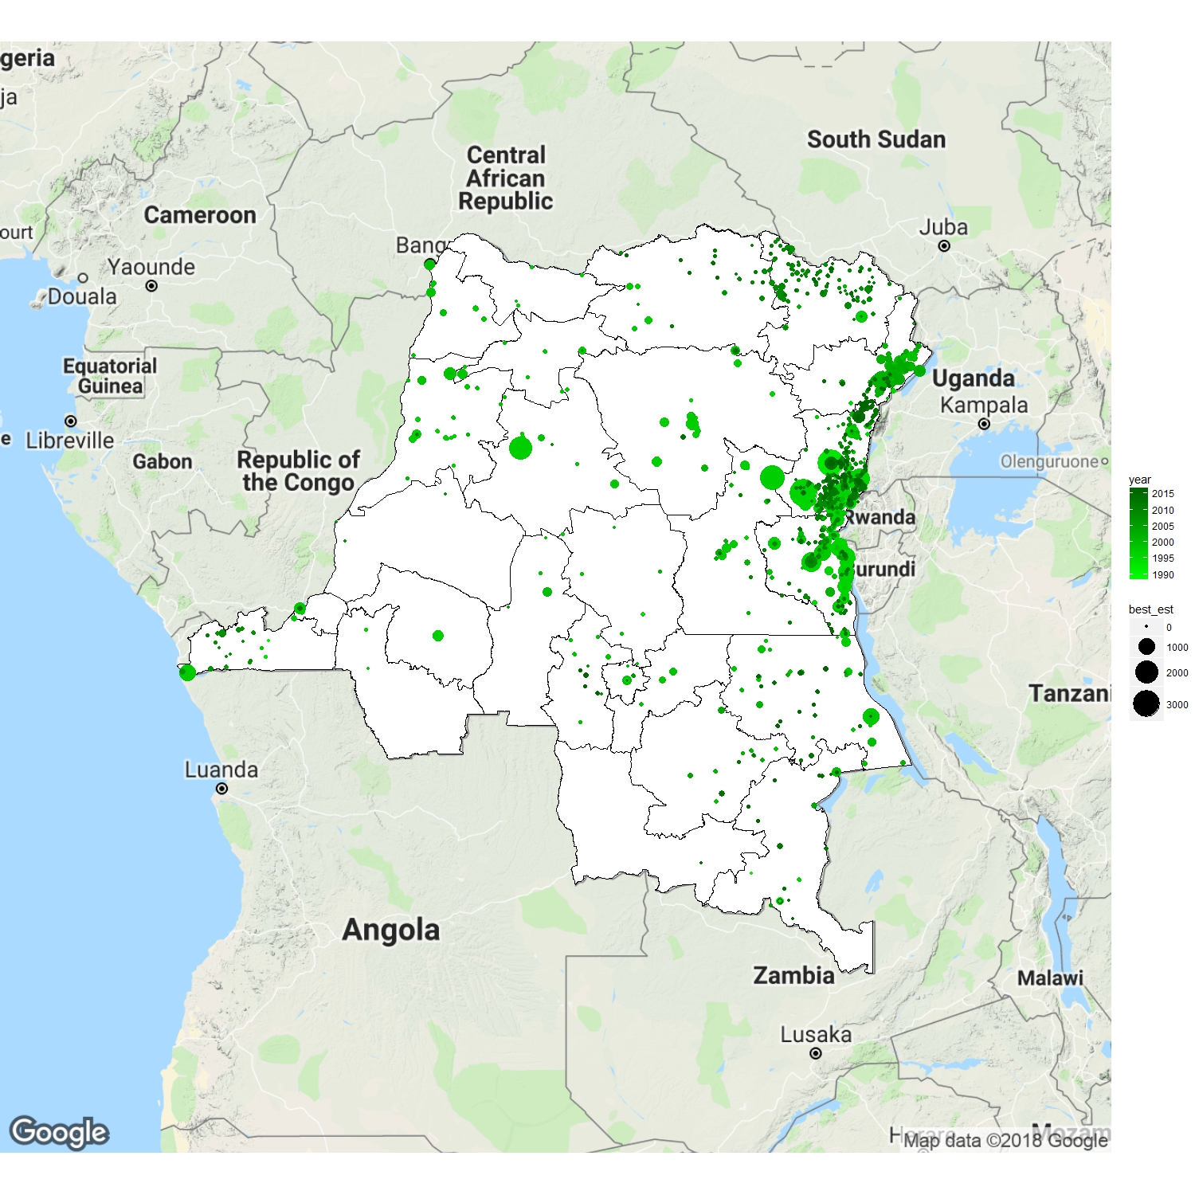

Slide 7
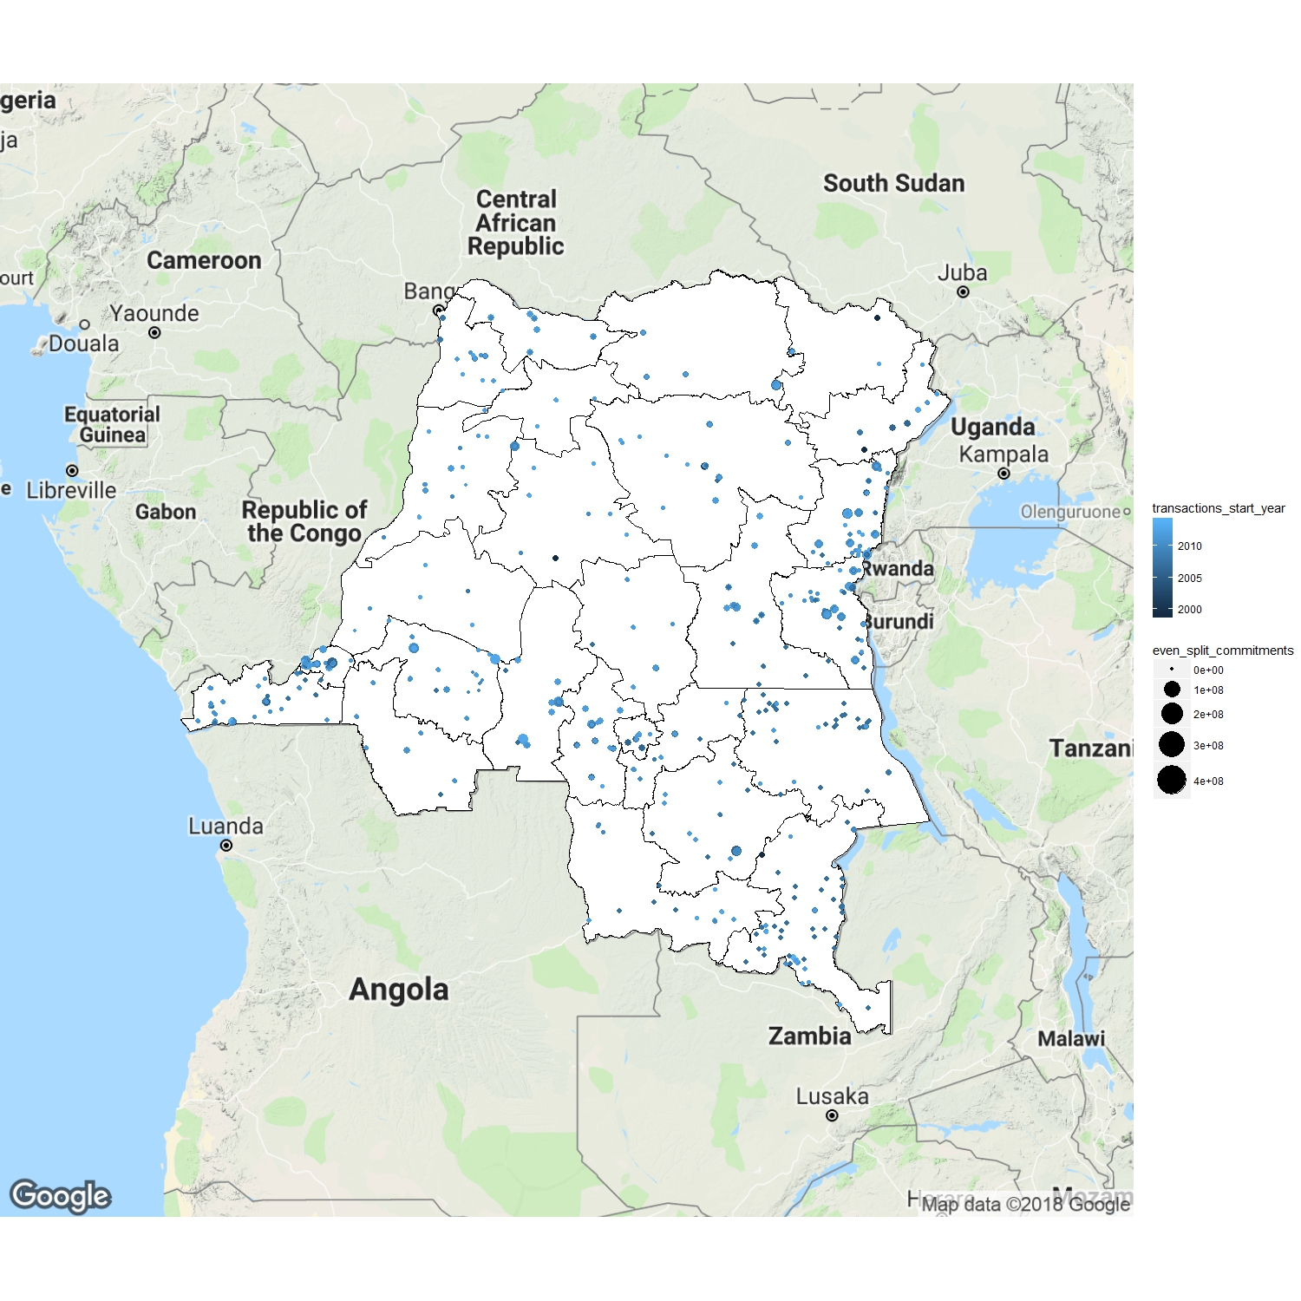

Slide 8
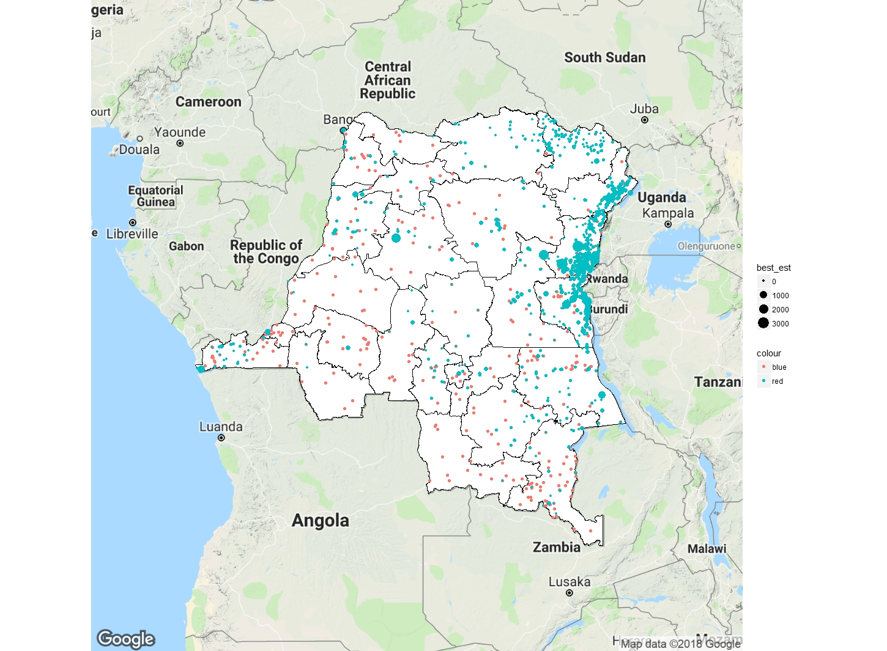

Slide 9
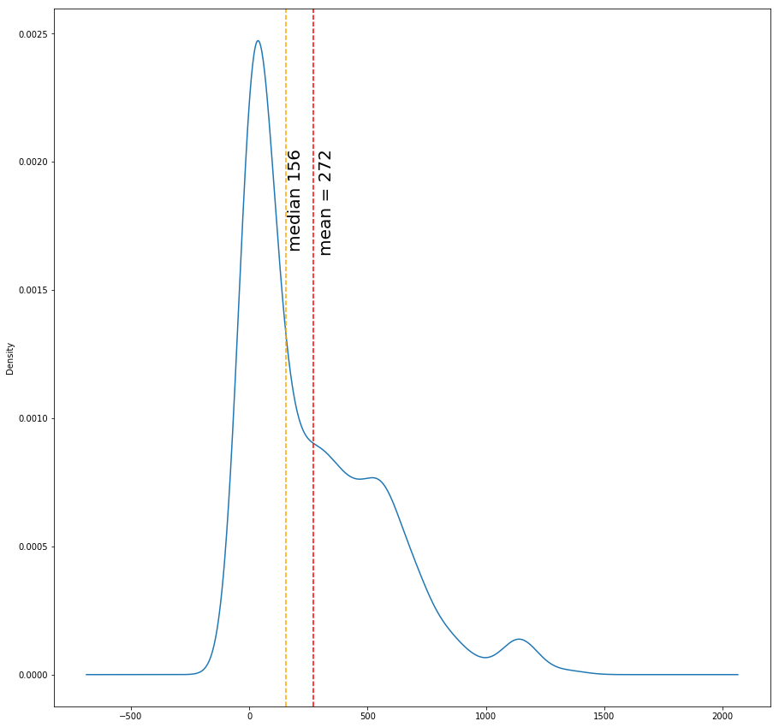
Distance to the nearest event
(aid ←-→ conflict)

Slide 10
ADM1 | Year | Commitments | Casualties
Nord-Kivu | 2007 | 1.749720e+08 | 682
Nord-Kivu | 2008 | 4.451359e+07 | 749
Nord-Kivu | 2009 | 2.610037e+07 | 2694
Nord-Kivu | 2010 | 3.252858e+07 | 304

Slide 11
Model: first-differences estimator
Regression of changes in conflict levels on changes in lagged aid allocations
Why FD? Controls for omitted variable bias in panel data
Why lagged? Aid data refers to commitments, not actual disbursements. A delay between commitment and disbursement (and impact) is expected.
I opted for Bayesian regression (uninformative prior) in order to inspect and assess the uncertainty (e.g. look at the distribution vs point estimate)

Slide 12
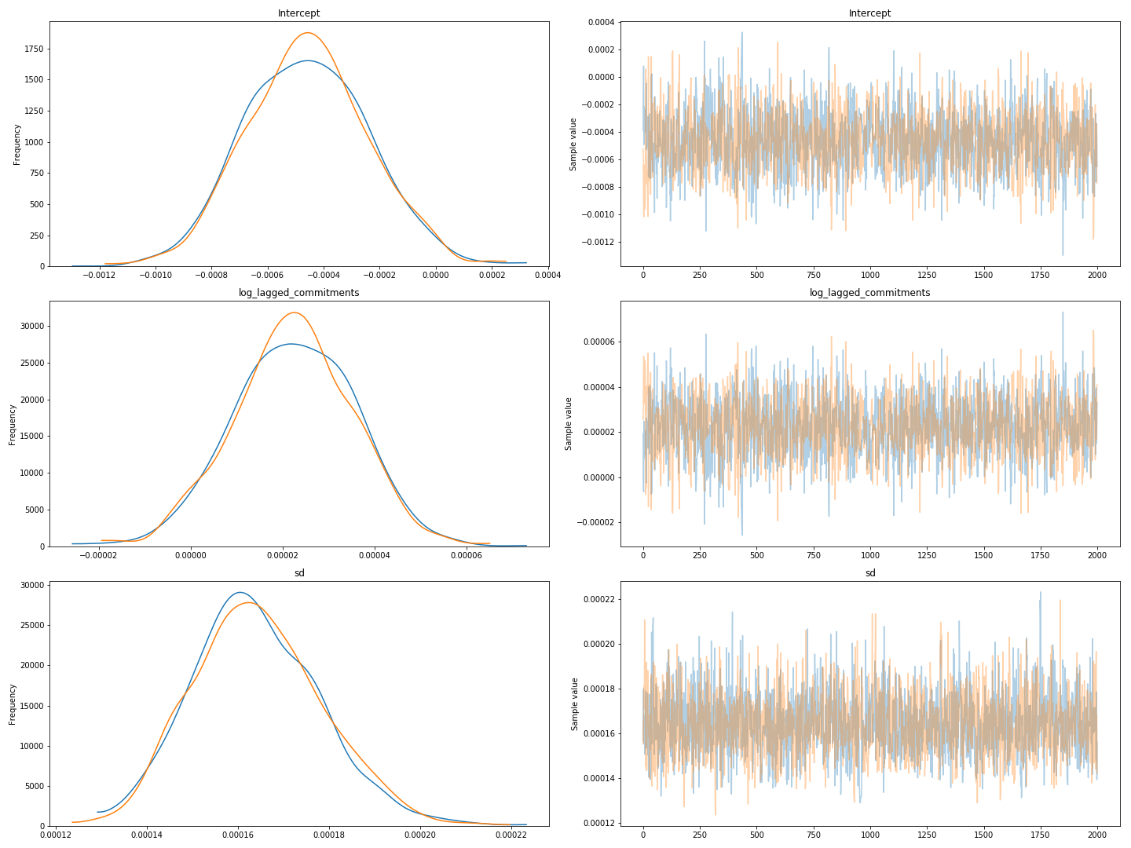
Result of regression (normalized values)

Slide 13
Further steps
Collect data on other countries
Collect covariates:
  population density, ethnic composition
  economic activity (night lights)
  Terrain, natural resources
Match units of analysis from 4 groups based on covariates

