Slide 1
2016/4/21
Weekly Report
16423 Yota Toyama

Slide 2
IMDb Dataset
Movie reviews
Average length of documents: 1310 letters
Pos data: 25'000
Neg data: 25'000
Link: http://ai.stanford.edu/~amaas/data/sentiment/aclImdb_v1.tar.gz

Slide 3
Multi-class IMDb
Hyper parameters
  Character embedding size: 64
  Document embedding size: 32
  Hidden layer size: 64
  Dropout probability: 0.5
  L2 regularization scale: 1e-6
  Context vector size: 16

Slide 4
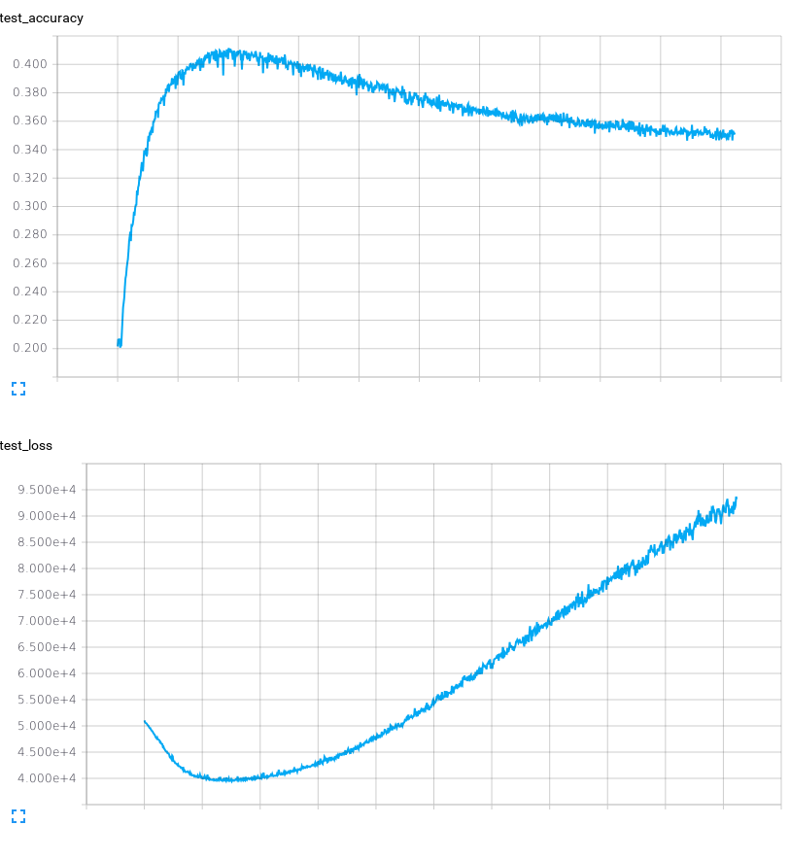
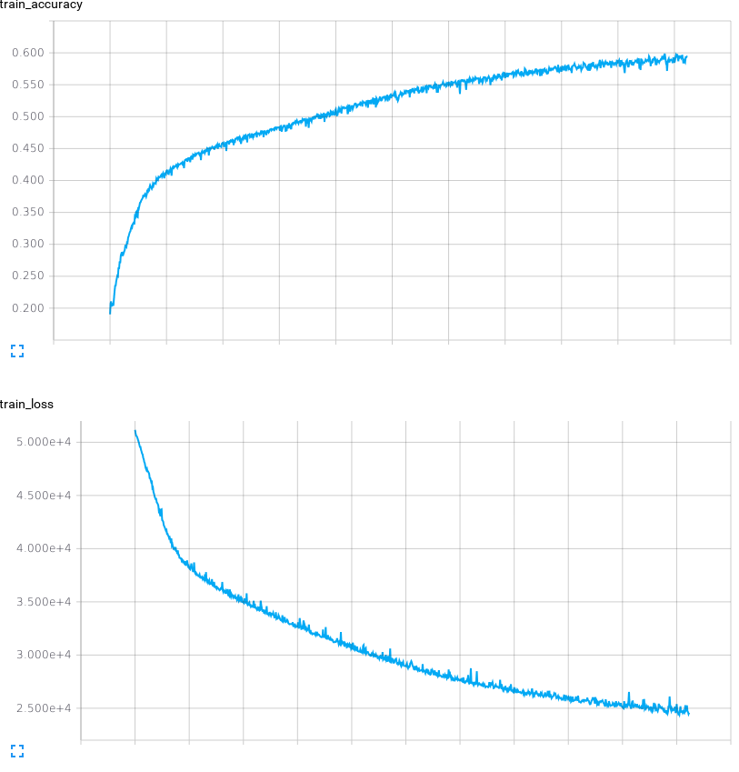
Multi-class IMDb

Slide 5
Binary IMDb
Hyper parameters
  same as the multi-class one

Slide 6
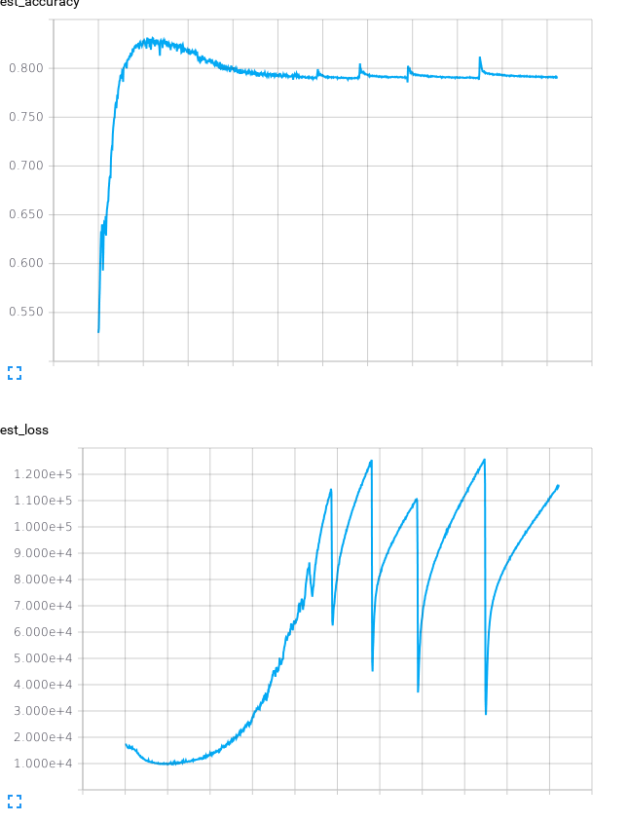
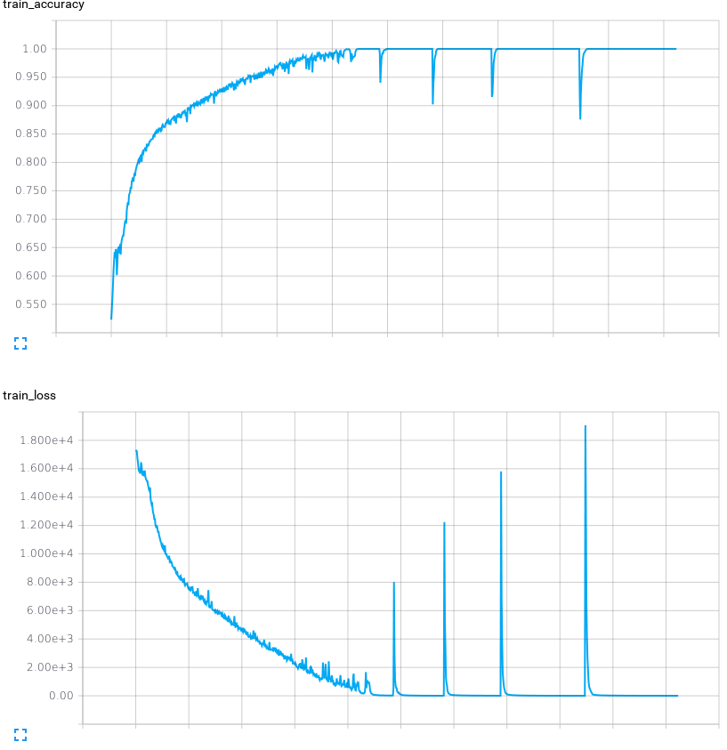
Binary IMDb

