Slide 1
Mental Health Stressors
Yash Patel

Slide 2
Introduction
Mental Health Association of New Jersey
correlations and patterns between linguistic features, sentiment, and mental health indicators
inform interventions, policies, and support systems aimed at promoting mental well-being

Slide 3
Methodology
Dataset: https://www.kaggle.com/datasets/bhavikjikadara/mental-health-dataset
287,162 people
gender, country, occupation, family history, treatment, days indoors, growing stress, mental health history, mood swings, work interest, social weakness
Jupyter Notebooks, Python, Pandas, NumPy, Matplotlib, Seaborn

Slide 4
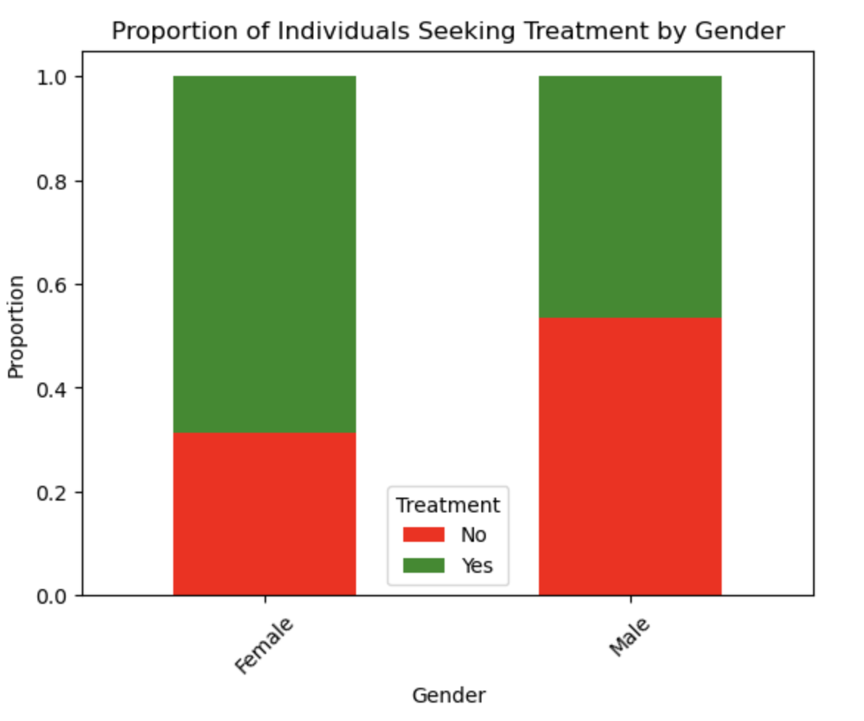
1. Is there a correlation between gender and treatment seeking?
From the data, we can answer question 1 by saying, proportionately, men seek treatment less than women. About 70% of women in the dataset seek treatment, whereas only about 45% of men seek treatment. Therefore, interventions, policies, and support systems should prioritize marketing towards males.

Slide 5
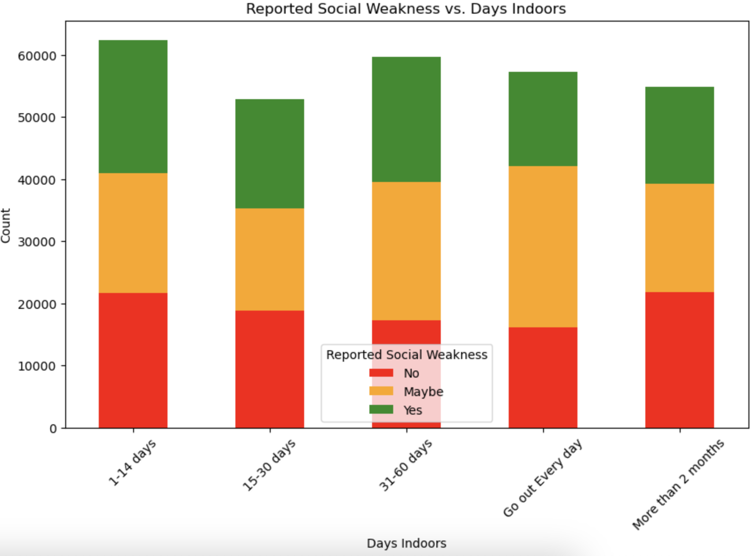
2. Is there a correlation between days spent indoors and social weakness?
From the data, we can answer question 2 by saying that those who go out every day report the lowest amount of social weakness. However, the quantitative data of all 4 columns are quite similar. Therefore, the data is somewhat inconclusive and we cannot make any generalizations/predictions.

Slide 6
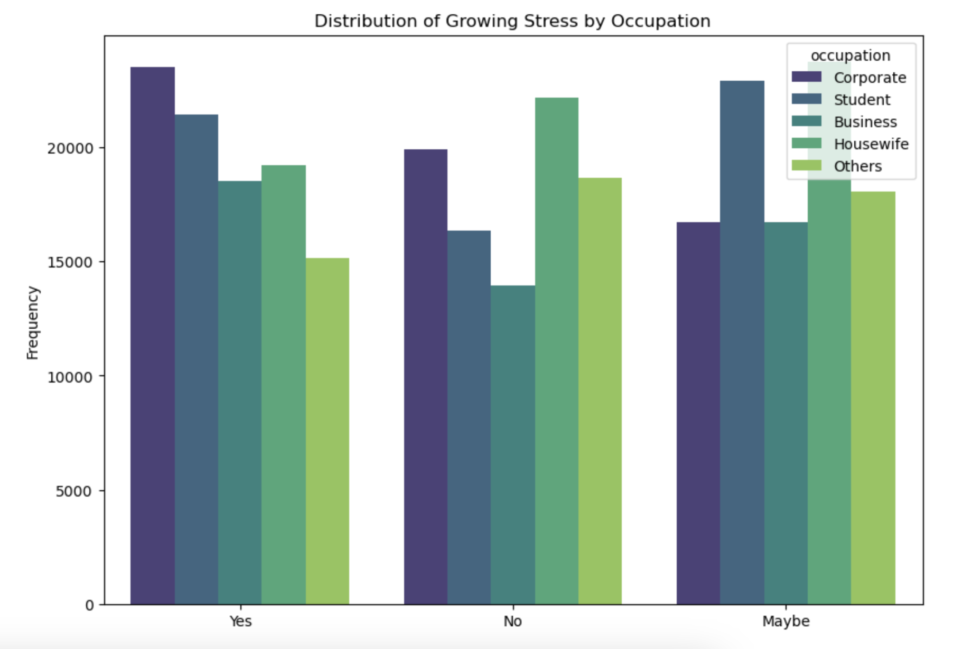
3. Is there a correlation between occupation and growing stress?
The graph shows us that the highest growing stress is found amongst the corporate individuals, students, and housewives. However, there's also a high number of corporate individuals and housewives that did not experience growing stress. Thus, one could assume that students have the highest rates of growing stress. However, this data is not concrete enough to support assumptions that occupations are directly responsible for growing stress due to the high number of maybes.

Slide 7
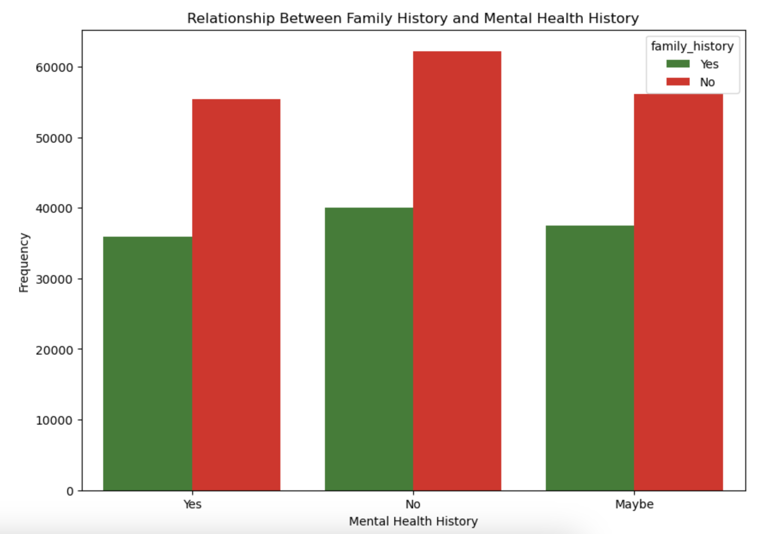
4. Is there a correlation between family history and personal mental health history?
Amongst the data of individuals with mental health history, there is a higher occurrence amongst those without family history. Surprisingly, this trend is also observed in two other groups of mental health history. Therefore, family history is not a good indicator of having mental health struggles.

Slide 8
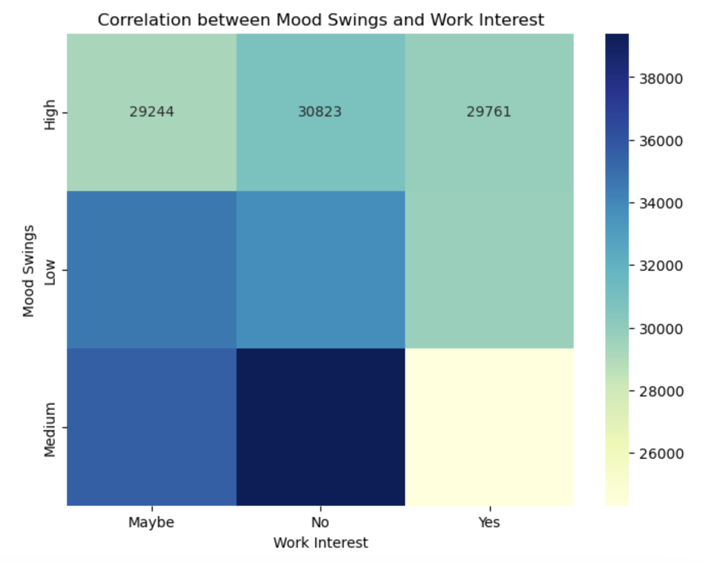
5. Is there a correlation between mood swings and work interest?
The heatmap shows us that there is a strong correlation between a medium level of mood swings and no work interest. There is also no correlation between mood swings and 'yes' for work interest. This heatmap proves that those who suffer from mood swings are less productive/willing to work. Mental health resources and methods to deal with mood swings should be provided by corporate workplaces to ensure worker productivity.

Slide 9
Recommendations/Future Work
Findings confirm common stressors to mental health regardless of age or gender (occupation, days spent indoors, mood swings, etc.).
Dataset was derived from a multiple-choice survey so the analysis is limited
Analyze another dataset with more specific questions where people have the ability to elaborate
The dataset offers opportunities for developing predictive models to identify or predict mental health outcomes based on textual data
Employ machine learning techniques to predict the trajectory of a person’s mental health
Early intervention and support

