Slide 1

SOVEREIGN GLOBAL TRAFFIC MANAGEMENT
01 / 19
Who controls
the failover?
Sovereign global traffic management
with Kubernetes
TRAFFIC MANAGEMENT
DNS STEERING
MULTI-REGION RESILIENCE
Yury Tsarev · Creator & Project Lead, k8gb
24 October 2026 · Saarbrücken
SOVEREIGN CLOUD DAYS 2026
YURY TSAREV / K8GB
Notes:
Target delivery: 0.5 minutes.
RUN OF SHOW: 0–0.5 minutes elapsed.
Open with one question: when a cluster disappears, who controls the next connection? Introduce yourself as k8gb creator and project lead. Set the route: first the product and a working local demo, then the operational cases to test. Reach Questions at minute 28; reserve seven minutes for discussion.
SOURCE CHECK
Local k8gb checkout: 330d33335981b9716bc8ca245660d90893eae272
https://www.sovereign-cloud-days.eu/event/sovereign-cloud-days-2026-1/track/who-controls-the-failover-sovereign-global-traffic-management-with-kubernetes-63

Slide 2
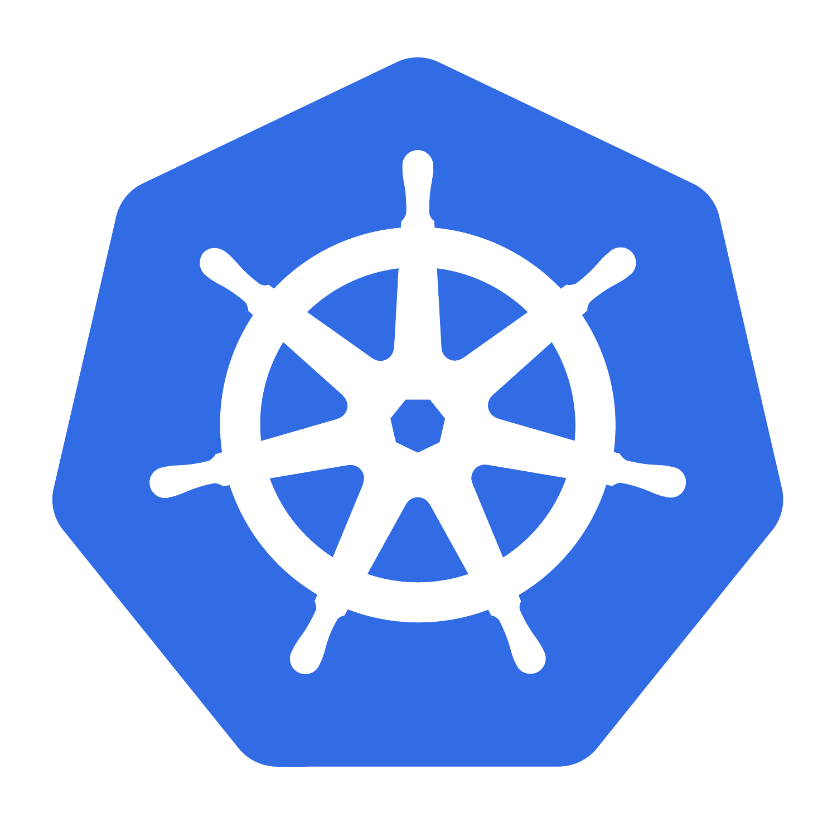
THE REACHABILITY PROBLEM
02 / 19
From node resilience to cluster failover
Spread replicas, then widen the failure boundary.
01
NODES
02
AVAILABILITY ZONES
03
CLUSTERS
One Kubernetes cluster
One Kubernetes cluster
Independent clusters
NODE 1
NODE 2
NODE 3
AZ 1
AZ 2
AZ 3
Pod
Pod
Pod
replica
replica
replica
replica
replica
replica
A
B
C
Spread replicas
Spread across zones
Steer across clusters
Survive a worker failure.
Survive a zone failure.
Keep one application hostname.
When an entire cluster is unavailable, who steers the next request?
SOVEREIGN CLOUD DAYS 2026
YURY TSAREV / K8GB
Notes:
Target delivery: 1.25 minutes.
RUN OF SHOW: 0.5–1.75 minutes elapsed.
Use this single progression: replicas across workers address node loss; a cluster spread across availability zones addresses a wider failure domain; independent clusters need traffic steering for the same hostname. Point to one failed member at each level, then ask who sends the next request to a surviving cluster. Keep the explanation at the reachability level.
SOURCE CHECK
Local k8gb checkout: 330d33335981b9716bc8ca245660d90893eae272
https://kubernetes.io/docs/concepts/scheduling-eviction/topology-spread-constraints/
https://kubernetes.io/docs/concepts/services-networking/service/
https://kubernetes.io/docs/concepts/workloads/controllers/deployment/
https://kubernetes.io/docs/setup/best-practices/multiple-zones/

Slide 3
PART 1 · WHAT K8GB ENABLES
03 / 19
k8gb in one minute
Two or more clusters. No fixed cluster-count limit in k8gb.
Kubernetes-native
Readiness becomes DNS eligibility.
Decentralized
A control loop at each participating cluster.
Declarative
CNCF INCUBATING
Review traffic steering in Git.
Global application reachability across Kubernetes clusters.
SOVEREIGN CLOUD DAYS 2026
YURY TSAREV / K8GB
Notes:
Target delivery: 1 minutes.
RUN OF SHOW: 1.75–2.75 minutes elapsed.
k8gb is Kubernetes-native, decentralized, and declarative. Each participating cluster has its own controller and authoritative DNS. There is no dedicated central management cluster. Mention two or more clusters and that the two-cluster drawings are examples; this is not a tested unlimited-scale claim. Readiness and the Gslb strategy determine eligible application targets. Move directly to the production origins.
SOURCE CHECK
Local k8gb checkout: 330d33335981b9716bc8ca245660d90893eae272
https://github.com/k8gb-io/k8gb/blob/330d33335981b9716bc8ca245660d90893eae272/controllers/providers/k8gbendpoint/applicationDNSEndpoint.go
https://github.com/k8gb-io/k8gb/blob/330d33335981b9716bc8ca245660d90893eae272/docs/resource_ref.md
https://github.com/k8gb-io/k8gb/blob/330d33335981b9716bc8ca245660d90893eae272/docs/dynamic_geotags.md
https://github.com/k8gb-io/k8gb/blob/330d33335981b9716bc8ca245660d90893eae272/api/v1beta1io/zonedelegation_types.go
https://github.com/k8gb-io/k8gb/blob/330d33335981b9716bc8ca245660d90893eae272/controllers/resolver/config.go
https://www.cncf.io/projects/k8gb/

Slide 4
A BRIEF HISTORY
04 / 19
From Absa production to CNCF incubation
An operational need grew into a community project.
PRODUCTION ORIGINS
30 MAR 2021
PUBLIC ADOPTION
18 JUL 2026
Born at
Absa
CNCF
Sandbox
Beyond
Absa
CNCF
Incubating
Multiple on-prem
datacenters, then
hybrid deployments
Contributed to the
cloud native
community
Millennium bcp
Open Systems
PagBank
A new milestone
for the project
and its community
Born from a production problem. Built with the community.
SOVEREIGN CLOUD DAYS 2026
YURY TSAREV / K8GB
Notes:
Target delivery: 0.5 minutes.
RUN OF SHOW: 2.75–3.25 minutes elapsed.
Thirty-second history: originated at Absa for real production needs across on-prem datacenters and later hybrid deployments; CNCF Sandbox in 2021; adoption beyond Absa; Incubating in July 2026. The timeline is context, not a separate project-history talk.
SOURCE CHECK
Local k8gb checkout: 330d33335981b9716bc8ca245660d90893eae272
https://github.com/k8gb-io/k8gb/blob/330d33335981b9716bc8ca245660d90893eae272/README.md#motivation-and-architecture
https://github.com/k8gb-io/k8gb/blob/330d33335981b9716bc8ca245660d90893eae272/ADOPTERS.md
https://www.cncf.io/projects/k8gb/
https://www.cncf.io/announcements/2026/08/05/k8gb-becomes-a-cncf-incubating-project/

Slide 5

REAL-WORLD ADOPTION
05 / 19
Resilience in production
Millennium bcp · Results reported in a CNCF case study
5
regions
DNS INCIDENT RESPONSE
70%
Two cloud providers
+ on-premises
Zero downtime
shorter response times
Reported during regional
failover tests
for DNS-related incidents
CNCF case study · 16 September 2025
cncf.io/case-studies/millennium-bcp
Published results from Millennium bcp’s deployment.
SOVEREIGN CLOUD DAYS 2026
YURY TSAREV / K8GB
Notes:
Target delivery: 0.75 minutes.
RUN OF SHOW: 3.25–4 minutes elapsed.
Use one production example to establish adoption. Millennium bcp reports five regions across two cloud providers and on-premises, shorter DNS incident response, and zero downtime in the reported regional failover tests. These are the case study’s reported results for that deployment. Keep to the three displayed facts and move to the architecture.
SOURCE CHECK
Local k8gb checkout: 330d33335981b9716bc8ca245660d90893eae272
https://www.cncf.io/case-studies/millennium-bcp/

Slide 6
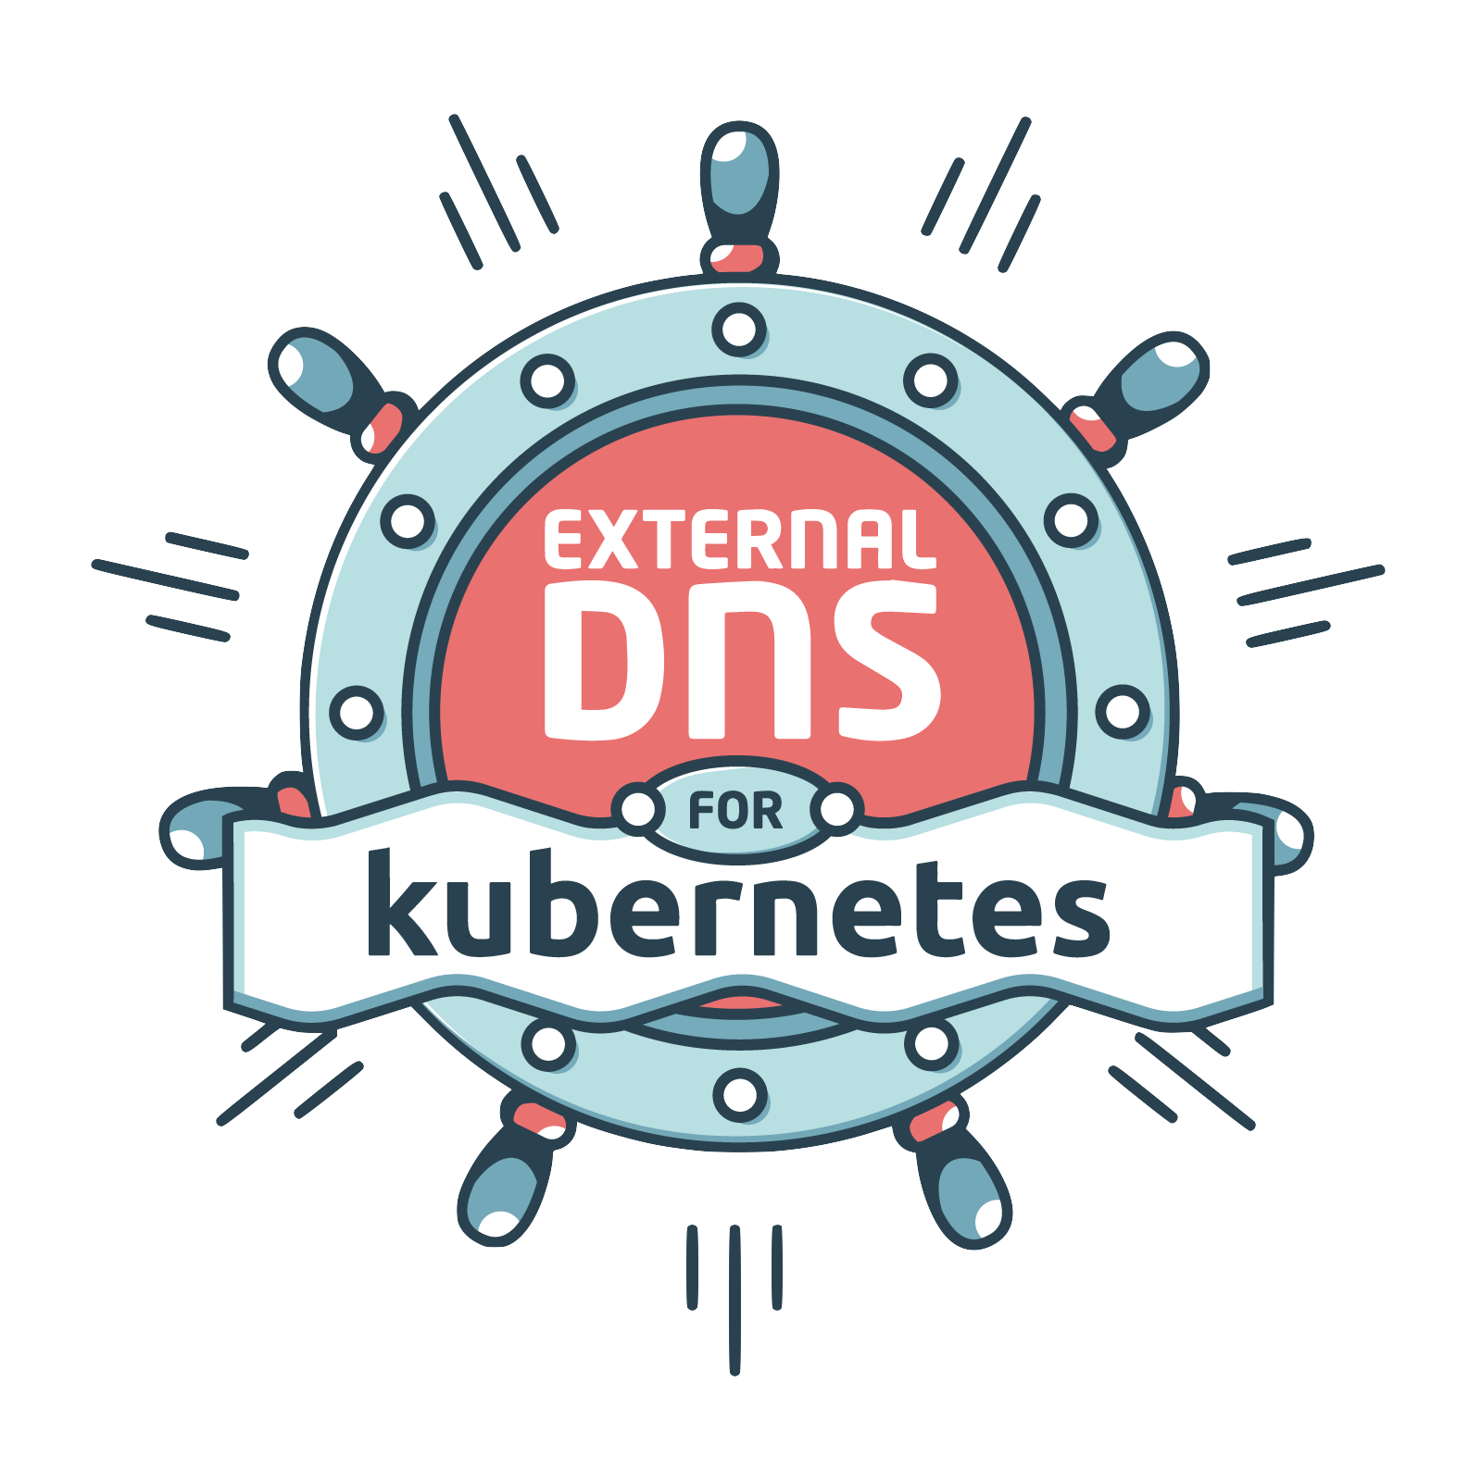

REFERENCE ARCHITECTURE
06 / 19
Independent clusters, shared DNS contract
Parent DNS · example.com
2 OF N CLUSTERS
NS + address updates
Shown for clarity
CLUSTER A
CLUSTER B
ExternalDNS
ExternalDNS
Gslb + ready endpoints
Gslb + ready endpoints
DNS state
DNS state
k8gb
CoreDNS
k8gb
CoreDNS
Authoritative application zone
Authoritative application zone
Peer health is learned through DNS
One direction shown; each controller queries peer CoreDNS.
SOVEREIGN CLOUD DAYS 2026
YURY TSAREV / K8GB
Notes:
Target delivery: 2 minutes.
RUN OF SHOW: 4–6 minutes elapsed.
This is the main architecture explanation. Each cluster runs the same three roles: k8gb evaluates readiness and the Gslb strategy, CoreDNS answers for the application zone, and ExternalDNS updates parent delegation. The parent directs resolvers to these authorities. Peer health is learned by querying peer CoreDNS; the controllers do not elect a central leader. Two of N clusters are shown. Detailed component, delegation and reconciliation diagrams are in the appendix. Do not open those during the prepared talk.
SOURCE CHECK
Local k8gb checkout: 330d33335981b9716bc8ca245660d90893eae272
https://github.com/k8gb-io/k8gb/blob/330d33335981b9716bc8ca245660d90893eae272/controllers/zones/authoritative.go
https://github.com/k8gb-io/k8gb/blob/330d33335981b9716bc8ca245660d90893eae272/controllers/providers/k8gbendpoint/applicationDNSEndpoint.go
https://github.com/k8gb-io/k8gb/blob/330d33335981b9716bc8ca245660d90893eae272/controllers/providers/dns/external.go

Slide 7
THE REQUEST PATH
07 / 19
DNS selects an address. The client connects.
DNS query
DNS query
Client
Resolver
CoreDNS
Caches answers
Authoritative
A answer
A answer
Application connection
Selected cluster
Gateway / Ingress
DNS is outside the application data path.
SOVEREIGN CLOUD DAYS 2026
YURY TSAREV / K8GB
Notes:
Target delivery: 1.25 minutes.
RUN OF SHOW: 6–7.25 minutes elapsed.
Walk the DNS lookup once: client, recursive resolver, authoritative CoreDNS, returned application address. Then point to the separate application connection through Gateway or Ingress. DNS is outside the application data path, so k8gb steers new connections without proxying application traffic. Save the cache-delay discussion for immediately after the demo.
SOURCE CHECK
Local k8gb checkout: 330d33335981b9716bc8ca245660d90893eae272
https://github.com/k8gb-io/k8gb/blob/330d33335981b9716bc8ca245660d90893eae272/docs/intro.md

Slide 8
TRAFFIC STEERING
08 / 19
Choose how eligible clusters are used
Illustrative DNS selections across Kubernetes clusters.
FAILOVER
PRIMARY
BACKUP
ROUND ROBIN
Prefer primary
A
B
Use healthy clusters
A
B
C
DNS
DNS
Return to primary on recovery
Active / active DNS answers
WEIGHTED ROUND ROBIN
RELATIVE WEIGHTS
GEOIP
Express preference
w=2
w=3
w=5
Map client subnets
A
B
DNS
Subnet A
Subnet B
Request shares are approximate
Needs GeoIP data + ECS
All modes change DNS answers, not existing connections.
SOVEREIGN CLOUD DAYS 2026
YURY TSAREV / K8GB
Notes:
Target delivery: 1.25 minutes.
RUN OF SHOW: 7.25–8.5 minutes elapsed.
Failover prefers a primary cluster and returns to it when ready again; this is the demo strategy. Introduce the other modes in one sentence each: round robin uses healthy clusters, weights express relative preference, GeoIP uses client subnet information. Keep the displayed DNS-level qualifications brief. Do not pre-explain the three failover states; the audience will see them in the demo.
SOURCE CHECK
Local k8gb checkout: 330d33335981b9716bc8ca245660d90893eae272
https://github.com/k8gb-io/k8gb/blob/330d33335981b9716bc8ca245660d90893eae272/docs/strategy.md
https://github.com/k8gb-io/k8gb/blob/330d33335981b9716bc8ca245660d90893eae272/docs/wrr_caveats.md
https://github.com/k8gb-io/k8gb/blob/330d33335981b9716bc8ca245660d90893eae272/controllers/providers/k8gbendpoint/applicationDNSEndpoint.go

Slide 9
DECLARATIVE CONFIGURATION
09 / 19
Traffic steering with a declarative manifest
Gslb is a Kubernetes custom resource.
gslb.yaml
KUBERNETES CUSTOM RESOURCE
Prefer A · eu
01
apiVersion:
k8gb.io/v1beta1
02
kind:
Gslb
03
metadata:
While it has
eligible targets.
04
name:
test-gslb-failover
05
namespace:
test-gslb
06
spec:
07
resourceRef:
apiVersion:
gateway.networking.k8s.io/v1
Deploy per cluster
08
09
kind:
HTTPRoute
Same configuration
10
name:
payments
11
strategy:
eu
us
12
type:
failover
13
primaryGeoTag:
eu
Each cluster observes health locally.
The route, zone, and matching geotags are prerequisites.
SOVEREIGN CLOUD DAYS 2026
YURY TSAREV / K8GB
Notes:
Target delivery: 1.25 minutes.
RUN OF SHOW: 8.5–9.75 minutes elapsed.
Show the familiar apiVersion, kind, metadata and spec: Gslb is a standard Kubernetes custom resource. primaryGeoTag: eu selects the cluster tagged eu, called Cluster A in the demo; Cluster B is us. The same steering configuration is deployed per cluster. The slide uses HTTPRoute; the local demo uses Ingress with the same failover strategy. The route and delegated zone are already prepared for the demo.
SOURCE CHECK
Local k8gb checkout: 330d33335981b9716bc8ca245660d90893eae272
https://github.com/k8gb-io/k8gb/blob/330d33335981b9716bc8ca245660d90893eae272/api/v1beta1io/gslb_types.go
https://github.com/k8gb-io/k8gb/blob/330d33335981b9716bc8ca245660d90893eae272/docs/resource_ref.md

Slide 10
DNS PORTABILITY
10 / 19
Choose parent DNS. Keep traffic steering.
Managed or self-hosted: the application zone stays with CoreDNS.
Managed DNS
Self-hosted DNS
Operated by your provider
Operated by your team · BIND9
OR
Provider API
RFC 2136 + TSIG
ExternalDNS
Updates parent-zone delegation
SAME TRAFFIC STEERING IN EVERY CLUSTER
Your choice of parent DNS.
Gslb + k8gb
CoreDNS
Your Gslb strategy stays the same.
SOVEREIGN CLOUD DAYS 2026
YURY TSAREV / K8GB
Notes:
Target delivery: 1.25 minutes.
RUN OF SHOW: 9.75–11 minutes elapsed.
The parent DNS can be provider-operated or team-operated. ExternalDNS uses the selected provider API, or RFC 2136 with TSIG for BIND9. The Gslb strategy and application-zone CoreDNS layer remain the same. This is the concrete sovereignty choice: your team chooses the parent authority and its integration. Provider changes still require configuration and delegation planning; avoid a second delegation walkthrough.
SOURCE CHECK
Local k8gb checkout: 330d33335981b9716bc8ca245660d90893eae272
https://github.com/k8gb-io/k8gb/blob/330d33335981b9716bc8ca245660d90893eae272/docs/provider_rfc2136.md
https://github.com/k8gb-io/k8gb/blob/330d33335981b9716bc8ca245660d90893eae272/controllers/providers/dns/external.go

Slide 11
YOUR SOVEREIGN BOUNDARIES
11 / 19
You define what a “region” means
Global traffic management can follow your own topology.
ILLUSTRATIVE clusterGeoTag VALUES
REGION
DATACENTER
RACK
SERVER
CUSTOM
eu-west
dc-1
rack-a
server-01
sovereign-a
Each tag identifies a k8gb cluster.
Rack or server boundaries use independent clusters, including single-node clusters.
Choose boundaries that match your sovereignty model.
SOVEREIGN CLOUD DAYS 2026
YURY TSAREV / K8GB
Notes:
Target delivery: 1 minutes.
RUN OF SHOW: 11–12 minutes elapsed.
Connect geotags to the audience’s topology. A tag identifies a participating k8gb cluster; it can represent a region, datacenter, rack, server, or another boundary. Rack or server examples still mean independent Kubernetes clusters, including single-node clusters. Our demo names them A/eu and B/us. End the capability section here and switch to the local setup at minute 12.
SOURCE CHECK
Local k8gb checkout: 330d33335981b9716bc8ca245660d90893eae272
https://github.com/k8gb-io/k8gb/blob/330d33335981b9716bc8ca245660d90893eae272/chart/k8gb/values.yaml
https://github.com/k8gb-io/k8gb/blob/330d33335981b9716bc8ca245660d90893eae272/docs/dynamic_geotags.md
https://github.com/k8gb-io/k8gb/blob/330d33335981b9716bc8ca245660d90893eae272/controllers/resolver/config.go
https://github.com/k8gb-io/k8gb/blob/330d33335981b9716bc8ca245660d90893eae272/controllers/resolver/config_validations.go
https://github.com/k8gb-io/k8gb/blob/330d33335981b9716bc8ca245660d90893eae272/controllers/providers/k8gbendpoint/applicationDNSEndpoint.go

Slide 12
LIVE DEMO · A / EU → B / US → A / EU
12 / 19
One hostname. Two clusters.
All local. Two application clusters represent different locations.
Local BIND9
Parent DNS · example.com
NS delegation
NS delegation
Delegates cloud.example.com
CLUSTER A
PRIMARY
CLUSTER B
SECONDARY
Geotag eu · primary application
Geotag us · secondary application
k8gb
CoreDNS
k8gb
CoreDNS
podinfo application · Ingress
podinfo application · Ingress
DNS + HTTP
CLI dashboard
DNS + HTTP
DNS · cache · HTTP responses
Observe A → remove A’s ready targets → watch B → restore A
SOVEREIGN CLOUD DAYS 2026
YURY TSAREV / K8GB
Notes:
Target delivery: 6 minutes.
RUN OF SHOW: 12–18 minutes elapsed.
SIX MINUTES INCLUDING INTRODUCTION. Spend about 45 seconds on this diagram: local BIND9 is the parent authority; A/eu is primary, B/us is secondary; the CLI observes DNS, the resolver, and actual HTTP identity. Then switch to the terminal. Show the Gslb failover strategy, compare both authoritative answers, remove A’s ready application endpoints, observe HTTP from B, restore the captured original replica count, and verify A again. Keep notes short and let the traffic pane show readiness and cache lag. Do not explain each Kubernetes object field or inspect unrelated internals. The operation is application endpoint loss, while DNS remains available. Launch the prepared presentation with ./demo/demo.sh up; the isolated recorded fallback is ./demo/demo.sh offline and is explicitly labelled recorded replay. This setup uses Ingress. Finish and restore A by minute 18. Return directly to the timing slide with: We have seen application failover and recovery. Now let us examine what changes when observations disagree or readiness gives the wrong signal.
SOURCE CHECK
Local k8gb checkout: 330d33335981b9716bc8ca245660d90893eae272
https://github.com/k8gb-io/k8gb/blob/330d33335981b9716bc8ca245660d90893eae272/hack/demo-failover.sh
https://github.com/k8gb-io/k8gb/blob/330d33335981b9716bc8ca245660d90893eae272/k3d/test-gslb1.yaml
https://github.com/k8gb-io/k8gb/blob/330d33335981b9716bc8ca245660d90893eae272/k3d/test-gslb2.yaml
https://github.com/k8gb-io/k8gb/blob/330d33335981b9716bc8ca245660d90893eae272/k3d/edge-dns.yaml
https://github.com/k8gb-io/k8gb/blob/330d33335981b9716bc8ca245660d90893eae272/deploy/edge/deployment.yaml
https://github.com/k8gb-io/k8gb/blob/330d33335981b9716bc8ca245660d90893eae272/deploy/edge/zone.yaml
https://github.com/k8gb-io/k8gb/blob/330d33335981b9716bc8ca245660d90893eae272/deploy/gslb/k8gb.absa.oss_v1beta1_gslb_cr_failover_ingress_ref.yaml

Slide 13
PART 2 · OPERATING K8GB
13 / 19
A new DNS answer is not an instant switch
Detection, DNS publication and client recovery happen at different times.
FAILURE
DETECTION
PUBLICATION
CLIENT
CLIENT DELAY
01
02
03
04
Workload or
cluster fails
Readiness +
reconciliation
Authority serves
new answer
Cache refresh +
connection retries
TIMING VARIES
Readiness · reconciliation · caches · retries
New DNS answer ≠ recovered clients
Measure recovery at the resolver and application.
SOVEREIGN CLOUD DAYS 2026
YURY TSAREV / K8GB
Notes:
Target delivery: 1.5 minutes.
RUN OF SHOW: 18–19.5 minutes elapsed.
Start Part 2 with what the audience just saw: readiness changes, controllers reconcile, authorities publish, resolvers refresh, clients retry. These moments are distinct. Existing connections do not migrate when DNS changes; reconnect and session behavior need testing with the actual application. Measure the return of successful requests, not only a controller update. Spend 90 seconds; detailed timer arithmetic belongs in questions.
SOURCE CHECK
Local k8gb checkout: 330d33335981b9716bc8ca245660d90893eae272
https://github.com/k8gb-io/k8gb/blob/330d33335981b9716bc8ca245660d90893eae272/chart/k8gb/values.yaml
https://github.com/k8gb-io/k8gb/blob/330d33335981b9716bc8ca245660d90893eae272/controllers/zone_delegation_reconciliation.go

Slide 14
OPERATING K8GB · APPLICATION READINESS
14 / 19
Readiness must reflect the real operation
Kubernetes runs Pod probes. k8gb consumes EndpointSlice readiness.
readinessProbe
Pod Ready
EndpointSlice
Gslb targets
Application-defined check
Kubernetes condition
Service endpoint readiness
Readiness + traffic strategy
HEALTH ENDPOINT
REAL REQUEST
GET /healthz
Payment cannot be saved
HTTP 200
Payment API
WRITE
Database
POST /payments
READ-ONLY
The shallow check passes.
Replication and safe writer ownership belong to the application.
k8gb steers traffic. The application must be ready to serve.
SOVEREIGN CLOUD DAYS 2026
YURY TSAREV / K8GB
Notes:
Target delivery: 2 minutes.
RUN OF SHOW: 19.5–21.5 minutes elapsed.
Use this single slide for application readiness and data safety. Kubernetes runs readinessProbe checks and reflects Pod readiness in EndpointSlices; k8gb consumes that state when selecting targets. The lower example is illustrative: GET /healthz returns 200 while a real payment write fails because the database is read-only. The application must define readiness around the operation it needs to serve. k8gb steers traffic; replication, safe writer ownership and fencing remain application responsibilities. State this once, using the example, then move on. Probe details and Any/All service aggregation can be discussed in questions; a readiness probe does not itself repair the database or guarantee every request.
SOURCE CHECK
Local k8gb checkout: 330d33335981b9716bc8ca245660d90893eae272
https://github.com/k8gb-io/k8gb/blob/330d33335981b9716bc8ca245660d90893eae272/controllers/runtime_shared.go
https://github.com/k8gb-io/k8gb/blob/330d33335981b9716bc8ca245660d90893eae272/api/v1beta1io/gslb_types.go
https://github.com/k8gb-io/k8gb/blob/330d33335981b9716bc8ca245660d90893eae272/controllers/providers/k8gbendpoint/applicationDNSEndpoint.go
https://kubernetes.io/docs/concepts/workloads/pods/probes/#readiness-probe
https://kubernetes.io/docs/concepts/services-networking/endpoint-slices/#conditions

Slide 15
THE DANGEROUS EDGE CASE
15 / 19
A partition can create two correct-looking answers
Both applications are ready. Clients can still reach both DNS authorities.
CLUSTER A
CLUSTER B
PRIMARY APPLICATION
APP READY
SECONDARY APPLICATION
APP READY
PEER QUERY
k8gb
CoreDNS
k8gb
CoreDNS
AUTHORITATIVE ANSWER
A
≠
AUTHORITATIVE ANSWER
B
Application IPs: A
Application IPs: B
B cannot obtain A’s peer-health answer.
A failed health query does not prove the application is down.
SOVEREIGN CLOUD DAYS 2026
YURY TSAREV / K8GB
Notes:
Target delivery: 2 minutes.
RUN OF SHOW: 21.5–23.5 minutes elapsed.
Now change the failure condition: both applications are ready and clients can reach both authorities, but B cannot obtain A’s peer-health answer. A can continue returning A while B returns B. The illustration shows a possible divergent state, not a claim that every partition has identical behavior. A failed observation is not proof that the remote application is down. Compare this with the clean workload failover the demo showed. Transition directly to how we observe the disagreement.
SOURCE CHECK
Local k8gb checkout: 330d33335981b9716bc8ca245660d90893eae272
https://github.com/k8gb-io/k8gb/blob/330d33335981b9716bc8ca245660d90893eae272/controllers/providers/k8gbendpoint/applicationDNSEndpoint.go
https://github.com/k8gb-io/k8gb/blob/330d33335981b9716bc8ca245660d90893eae272/controllers/zones/authoritative.go

Slide 16
OBSERVABILITY
16 / 19
Compare the answers your users can receive
During a partition, compare the same hostname from each viewpoint.
ILLUSTRATIVE PARTITION
Correlate the signals
CoreDNS A
Cluster A IPs
Pod readiness
k8gb errors and logs
CoreDNS B
Cluster B IPs
Application results
Resolver cache
May still return A
METRIC EXAMPLE · ONE HOSTNAME
Real request
Verify the result
1 cluster → 3 healthy IPs
Healthy-record count: 3
Query both authorities. Check the cache. Test a real request.
SOVEREIGN CLOUD DAYS 2026
YURY TSAREV / K8GB
Notes:
Target delivery: 1.25 minutes.
RUN OF SHOW: 23.5–24.75 minutes elapsed.
Query the same application name against each authority. Then compare what the recursive cache returns and test a real request. Correlate readiness, controller errors and application results. The metric example shows why three healthy IPs can belong to one cluster; do not spend time deriving the metric. This is the practical response to the partition diagram, not a separate monitoring-tool tour.
SOURCE CHECK
Local k8gb checkout: 330d33335981b9716bc8ca245660d90893eae272
https://github.com/k8gb-io/k8gb/blob/330d33335981b9716bc8ca245660d90893eae272/controllers/providers/metrics/prometheus.go
https://github.com/k8gb-io/k8gb/blob/330d33335981b9716bc8ca245660d90893eae272/controllers/runtime_shared.go

Slide 17
RESILIENCE TESTING
17 / 19
Perform end-to-end resilience tests
A is primary, B is healthy. Change one condition at a time.
CHANGE ONE CONDITION
VERIFY DNS + APPLICATION
Remove A’s ready endpoints
Both DNS answers → B
01 · WORKLOAD FAILURE
Verify successful requests to B.
Make cluster A unavailable
B serves DNS and application
02 · CLUSTER FAILURE
Test through a client resolver.
Block B’s peer-health lookup
A answers A · B answers B
03 · PEER DNS PARTITION
Check the impact on real requests.
Restore A’s readiness
Both DNS answers → A
04 · RECOVERY
Check requests and data correctness.
Time DNS convergence and the return of successful requests.
SOVEREIGN CLOUD DAYS 2026
YURY TSAREV / K8GB
Notes:
Target delivery: 1.25 minutes.
RUN OF SHOW: 24.75–26 minutes elapsed.
Turn the hard parts into four specific tests: remove ready application endpoints, lose a whole cluster, interrupt a peer-health lookup, and restore the primary. Verify authoritative answers, resolver behavior and successful real requests for each test. Automate the sequence and measure recovery. We exercised the workload case; the remaining rows are the production test plan. Finish this section by minute 26.
SOURCE CHECK
Local k8gb checkout: 330d33335981b9716bc8ca245660d90893eae272
https://github.com/k8gb-io/k8gb/blob/330d33335981b9716bc8ca245660d90893eae272/controllers/providers/k8gbendpoint/applicationDNSEndpoint.go
https://github.com/k8gb-io/k8gb/blob/330d33335981b9716bc8ca245660d90893eae272/controllers/runtime_shared.go
https://github.com/k8gb-io/k8gb/blob/330d33335981b9716bc8ca245660d90893eae272/controllers/zones/authoritative.go

Slide 18
CONTROL YOUR FAILOVER
18 / 19
Control traffic steering.
Test recovery end to end.
CONFIGURE
VERIFY
TEST
Version the Gslb
manifest.
Check DNS answers
and real requests.
Automate failover
and failback tests.
Test the full path: readiness → DNS → successful requests.
SOVEREIGN CLOUD DAYS 2026
YURY TSAREV / K8GB
Notes:
Target delivery: 2 minutes.
RUN OF SHOW: 26–28 minutes elapsed.
Close with configure, verify, test. k8gb automatically reconciles traffic failover and failback; the team automates end-to-end tests of that behavior. Version the Gslb manifest; choose and own the delegated DNS path; use multiple observable authorities; make readiness describe the real operation; verify client-visible requests; automate failure and recovery tests. These absorb the separate operational checklist. Return to the title: control comes from choosing the configuration, seeing the result, and repeatedly testing recovery. Do not reopen the data discussion or recap every slide. Invite questions by minute 28.
SOURCE CHECK
Local k8gb checkout: 330d33335981b9716bc8ca245660d90893eae272

Slide 19

DISCUSSION
19 / 19
Questions?
How would failover work in your environment?
Explore k8gb
Yury Tsarev
Creator & Project Lead · k8gb
linkedin.com/in/yurytsarev
SOURCE & CONTRIBUTIONS
github.com/k8gb-io/k8gb
PRODUCTION CASE STUDY
Millennium bcp
k8gb.io
cncf.io/case-studies/millennium-bcp
SOVEREIGN CLOUD DAYS 2026
YURY TSAREV / K8GB
Notes:
Target delivery: 7 minutes.
RUN OF SHOW: 28–35 minutes elapsed.
Reserve seven minutes for questions, from minute 28 to minute 35. Leave the QR code, project links and LinkedIn contact visible. Hidden appendix slides follow: A1 components (physical slide 20), A2 reconciliation (21), A3 delegation (22), A4 normal state (23), A5 failover (24), A6 failback (25), A7 availability responsibilities (26). Jump to one only when relevant to a question; hidden slides are skipped in the normal PowerPoint slideshow.
SOURCE CHECK
Local k8gb checkout: 330d33335981b9716bc8ca245660d90893eae272
https://www.sovereign-cloud-days.eu/event/sovereign-cloud-days-2026-1/track/who-controls-the-failover-sovereign-global-traffic-management-with-kubernetes-63
https://www.k8gb.io/
https://github.com/k8gb-io/k8gb
https://www.cncf.io/case-studies/millennium-bcp/
https://www.linkedin.com/in/yurytsarev/

Slide 20
APPENDIX · UNDER THE HOOD
A1 / 07
Three components. Three distinct jobs.
k8gb controller
CoreDNS
ExternalDNS
Readiness + strategy
→ eligible targets
Delegated zone
→ DNS answers
Delegation state
→ parent DNS updates
Decide locally. Answer authoritatively. Delegate explicitly.
SOVEREIGN CLOUD DAYS 2026
YURY TSAREV / K8GB
Notes:
Target delivery: 0 minutes.
BACKUP ONLY — hidden from the main slideshow. Use during questions if relevant.
Borrow the kiosk deck’s useful three-part explanation. k8gb calculates target eligibility and reconciles Kubernetes DNS resources. CoreDNS watches application DNS state and answers for the delegated zone. ExternalDNS watches delegation DNS resources and updates the parent provider. It does not run on each application DNS query. This slide describes the ExternalDNS provider path; other providers such as Infoblox have their own integration.
SOURCE CHECK
Local k8gb checkout: 330d33335981b9716bc8ca245660d90893eae272
https://github.com/k8gb-io/k8gb/blob/330d33335981b9716bc8ca245660d90893eae272/controllers/providers/dns/external.go
https://github.com/k8gb-io/k8gb/blob/330d33335981b9716bc8ca245660d90893eae272/controllers/providers/k8gbendpoint/applicationDNSEndpoint.go

Slide 21
APPENDIX · CURRENT IMPLEMENTATION
A2 / 07
Two k8gb reconciliation loops feed DNS
ZONE MEMBERSHIP + DELEGATION
ExternalDNS provider path
ZoneDelegation
DNSEndpoint
ExternalDNS
Zone + DNS-server state
Delegation NS + addresses
Sync parent records
Zone configuration
Parent delegation
CoreDNS
Parent DNS
Peer DNS IPs
Activate delegated zone
NS + address records
APPLICATION ANSWERS
Gslb + readiness
DNSEndpoint
CoreDNS
Strategy + ready endpoints
Eligible application IPs
Authoritative answers
Membership refresh and application reconciliation run separately.
SOVEREIGN CLOUD DAYS 2026
YURY TSAREV / K8GB
Notes:
Target delivery: 0 minutes.
BACKUP ONLY — hidden from the main slideshow. Use during questions if relevant.
This is a deliberately simplified view of the local checkout at 330d3333. ZoneDelegation manages zone configuration and DNS-server membership, including status.dnsServers. Gslb reconciliation evaluates Service EndpointSlices and uses those peer addresses for health queries. It writes the application DNSEndpoint consumed by CoreDNS. Therefore an edge-DNS interruption must be analysed separately from a failed peer-health query; an edge failure does not by itself prove immediate loss of all cached peer addresses. The chart has separate Gslb and ZoneDelegation reconciliation intervals. Do not present a single exact failover timer. This diagram shows the ExternalDNS provider path: ZoneDelegation reconciliation writes a delegation DNSEndpoint with NS and nameserver-address records. ExternalDNS consumes that resource and updates the parent DNS. A separate branch updates the CoreDNS zone ConfigMap. The lower DNSEndpoint contains application targets and is consumed by CoreDNS, not by ExternalDNS for parent delegation. The two CoreDNS boxes show two roles of the same per-cluster service. The title counts the two k8gb loops; ExternalDNS has its own reconciliation.
SOURCE CHECK
Local k8gb checkout: 330d33335981b9716bc8ca245660d90893eae272
https://github.com/k8gb-io/k8gb/blob/330d33335981b9716bc8ca245660d90893eae272/controllers/zone_delegation_reconciliation.go
https://github.com/k8gb-io/k8gb/blob/330d33335981b9716bc8ca245660d90893eae272/controllers/zones/zone_service.go
https://github.com/k8gb-io/k8gb/blob/330d33335981b9716bc8ca245660d90893eae272/controllers/zones/authoritative.go
https://github.com/k8gb-io/k8gb/blob/330d33335981b9716bc8ca245660d90893eae272/controllers/runtime_shared.go
https://github.com/k8gb-io/k8gb/blob/330d33335981b9716bc8ca245660d90893eae272/controllers/providers/dns/external.go
https://github.com/k8gb-io/k8gb/blob/330d33335981b9716bc8ca245660d90893eae272/controllers/providers/k8gbendpoint/delegationDNSEndpoint.go

Slide 22
APPENDIX · DNS OWNERSHIP
A3 / 07
Delegation is the authority boundary
Parent DNS delegates the zone. CoreDNS answers application lookups.
PARENT ZONE
DELEGATED ZONE
example.com
gslb.example.com
DELEGATES
NS RECORDS FOR
CLUSTER A
ns-a
CLUSTER B
ns-b
gslb.example.com
NS
CoreDNS
CoreDNS
ns-a
ns-b
Nameserver addresses published too.
Both serve the same application zone.
A
app.gslb.example.com
Eligible application IPs
Own the name, the delegation, and DNS recovery.
SOVEREIGN CLOUD DAYS 2026
YURY TSAREV / K8GB
Notes:
Target delivery: 0 minutes.
BACKUP ONLY — hidden from the main slideshow. Use during questions if relevant.
The parent zone publishes NS records for the delegated application subzone, plus the address records required by the chosen naming arrangement. Glue is specifically required for in-bailiwick nameserver names; do not use glue to mean every address record universally. The recursive resolver follows that delegation to a reachable CoreDNS authority. CoreDNS answers application A records. Redundant authority, public DNS reachability and recovery credentials remain production responsibilities. k8gb does not take ownership of the registrar or parent zone. The ns-a and ns-b labels abbreviate illustrative nameserver hostnames. Both cluster authorities serve the same delegated zone. The arrows represent delegation and a DNS answer, not application packets or a proxy hop through the parent DNS.
SOURCE CHECK
Local k8gb checkout: 330d33335981b9716bc8ca245660d90893eae272
https://github.com/k8gb-io/k8gb/blob/330d33335981b9716bc8ca245660d90893eae272/controllers/providers/k8gbendpoint/delegationDNSEndpoint.go
https://github.com/k8gb-io/k8gb/blob/330d33335981b9716bc8ca245660d90893eae272/docs/exposing_dns.md

Slide 23
APPENDIX · FAILOVER / 01
A4 / 07
Normal operation: both authorities prefer A
Both applications are ready. Cluster A is the preferred target.
CLUSTER A
CLUSTER B
PRIMARY APPLICATION
SECONDARY APPLICATION
Peer health
via DNS
LOCAL WORKLOAD
READY
LOCAL WORKLOAD
READY
CoreDNS answer
CoreDNS answer
APPLICATION TARGET
A
APPLICATION TARGET
A
Cluster A IPs
Cluster A IPs
Each k8gb controller queries peer CoreDNS.
Both authorities agree after reconciliation; client caches may lag.
SOVEREIGN CLOUD DAYS 2026
YURY TSAREV / K8GB
Notes:
Target delivery: 0 minutes.
BACKUP ONLY — hidden from the main slideshow. Use during questions if relevant.
Both applications are ready. Both clusters run independent k8gb and CoreDNS instances. With complete peer visibility, each authority publishes the primary application addresses. There is no active DNS-master election between the clusters. Passive describes application target selection in this strategy, not a powered-off controller or authority. The readiness badges describe application workloads, not whole-cluster availability. The dashed cluster-level connector summarizes peer-health queries: each k8gb controller queries the other cluster’s CoreDNS. It does not represent CoreDNS-to-CoreDNS replication or leader election. The matching answers show the converged state with peer visibility.
SOURCE CHECK
Local k8gb checkout: 330d33335981b9716bc8ca245660d90893eae272
https://github.com/k8gb-io/k8gb/blob/330d33335981b9716bc8ca245660d90893eae272/controllers/providers/k8gbendpoint/applicationDNSEndpoint.go

Slide 24
APPENDIX · FAILOVER / 02
A5 / 07
A loses ready targets: publish B
A’s application is unready; its DNS authority is still available.
CLUSTER A
CLUSTER B
PRIMARY APPLICATION
SECONDARY APPLICATION
Peer health
via DNS
LOCAL WORKLOAD
UNREADY
LOCAL WORKLOAD
READY
CoreDNS answer
CoreDNS answer
APPLICATION TARGET
B
APPLICATION TARGET
B
Cluster B IPs
Cluster B IPs
Each k8gb controller queries peer CoreDNS.
Both authorities agree after reconciliation; client caches may lag.
SOVEREIGN CLOUD DAYS 2026
YURY TSAREV / K8GB
Notes:
Target delivery: 0 minutes.
BACKUP ONLY — hidden from the main slideshow. Use during questions if relevant.
This is application failure, not loss of the entire cluster. A’s CoreDNS remains reachable while its workload has no ready endpoints. After reconciliation, A can publish B’s healthy targets, and B no longer finds healthy primary targets. Existing connections are not migrated and cached A answers may persist. If the whole primary cluster is lost, the surviving authority must also remain reachable by resolvers. The readiness badges describe application workloads, not whole-cluster availability. The dashed cluster-level connector summarizes peer-health queries: each k8gb controller queries the other cluster’s CoreDNS. It does not represent CoreDNS-to-CoreDNS replication or leader election. The matching answers show the converged state with peer visibility.
SOURCE CHECK
Local k8gb checkout: 330d33335981b9716bc8ca245660d90893eae272
https://github.com/k8gb-io/k8gb/blob/330d33335981b9716bc8ca245660d90893eae272/controllers/providers/k8gbendpoint/applicationDNSEndpoint.go

Slide 25
APPENDIX · FAILOVER / 03
A6 / 07
A recovers: the strategy returns to A
A’s application is ready again. The primary preference returns.
CLUSTER A
CLUSTER B
PRIMARY APPLICATION
SECONDARY APPLICATION
Peer health
via DNS
LOCAL WORKLOAD
READY
LOCAL WORKLOAD
READY
CoreDNS answer
CoreDNS answer
APPLICATION TARGET
A
APPLICATION TARGET
A
Cluster A IPs
Cluster A IPs
Each k8gb controller queries peer CoreDNS.
Both authorities agree after reconciliation; client caches may lag.
SOVEREIGN CLOUD DAYS 2026
YURY TSAREV / K8GB
Notes:
Target delivery: 0 minutes.
BACKUP ONLY — hidden from the main slideshow. Use during questions if relevant.
The code automatically prefers a healthy primary again. There is no implied built-in manual failback approval gate. If the application is not safe to receive traffic yet, its readiness and operational controls must prevent premature eligibility. Database leadership, replication consistency, fencing and session continuity belong to the application recovery design. The readiness badges describe application workloads, not whole-cluster availability. The dashed cluster-level connector summarizes peer-health queries: each k8gb controller queries the other cluster’s CoreDNS. It does not represent CoreDNS-to-CoreDNS replication or leader election. The matching answers show the converged state with peer visibility.
SOURCE CHECK
Local k8gb checkout: 330d33335981b9716bc8ca245660d90893eae272
https://github.com/k8gb-io/k8gb/blob/330d33335981b9716bc8ca245660d90893eae272/controllers/providers/k8gbendpoint/applicationDNSEndpoint.go

Slide 26
APPENDIX · AVAILABILITY MODEL
A7 / 07
Traffic recovery is one part of availability
DNS failover, data recovery, and sessions need separate plans.
k8gb · TRAFFIC STEERING
APPLICATION RESPONSIBILITY
FAILURE
DNS RESPONSE
APPLICATION
Exclude unready
targets
Readiness lost
STATEFUL DATA
Replication, fencing,
and recovery are yours.
CLUSTER / REGION
Publish healthy
cluster targets
Cluster unavailable
Plan session recovery too.
Traffic recovery ≠ data recovery ≠ session continuity.
SOVEREIGN CLOUD DAYS 2026
YURY TSAREV / K8GB
Notes:
Target delivery: 0 minutes.
BACKUP ONLY — hidden from the main slideshow. Use during questions if relevant.
If a Service has no ready endpoints, k8gb can exclude the local application target. A surviving cluster can serve new resolutions when its authority, application and required network paths remain available. This does not replicate data, fence a former database writer, or restore client sessions. Explicitly assign those responsibilities to the application recovery design. Read the left panel as two examples of DNS responses after observation and reconciliation, not as guaranteed instantaneous recovery or cluster restoration. The data and session responsibilities on the right require their own design and validation.
SOURCE CHECK
Local k8gb checkout: 330d33335981b9716bc8ca245660d90893eae272

