Slide 1
MEM T680 project Two-line element sets
Yanni Tsetsekos

Slide 2

Agenda
Introduction
Selected Data Set
Approach
Results

Slide 3

Introduction
More than ~5,500 operating satellites in orbit around Earth [1], and more than 27,000 pieces of debris [2]
Important satellites and debris are tracked and updated regularly
Satellite orbital data is recorded using Two-Line Element (TLE) Sets
[1] https://www.ucsusa.org/resources/satellite-database
[2] https://www.nasa.gov/mission_pages/station/news/orbital_debris.html

Slide 4


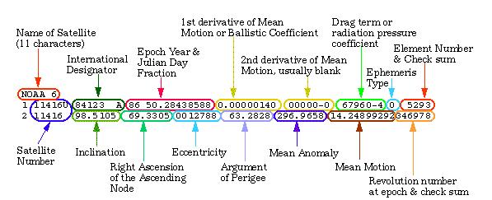
Introduction
Two-Line Element Sets
Can we predict when an active satellite is thrusting, from perturbations in its two-line element data set?

Slide 5
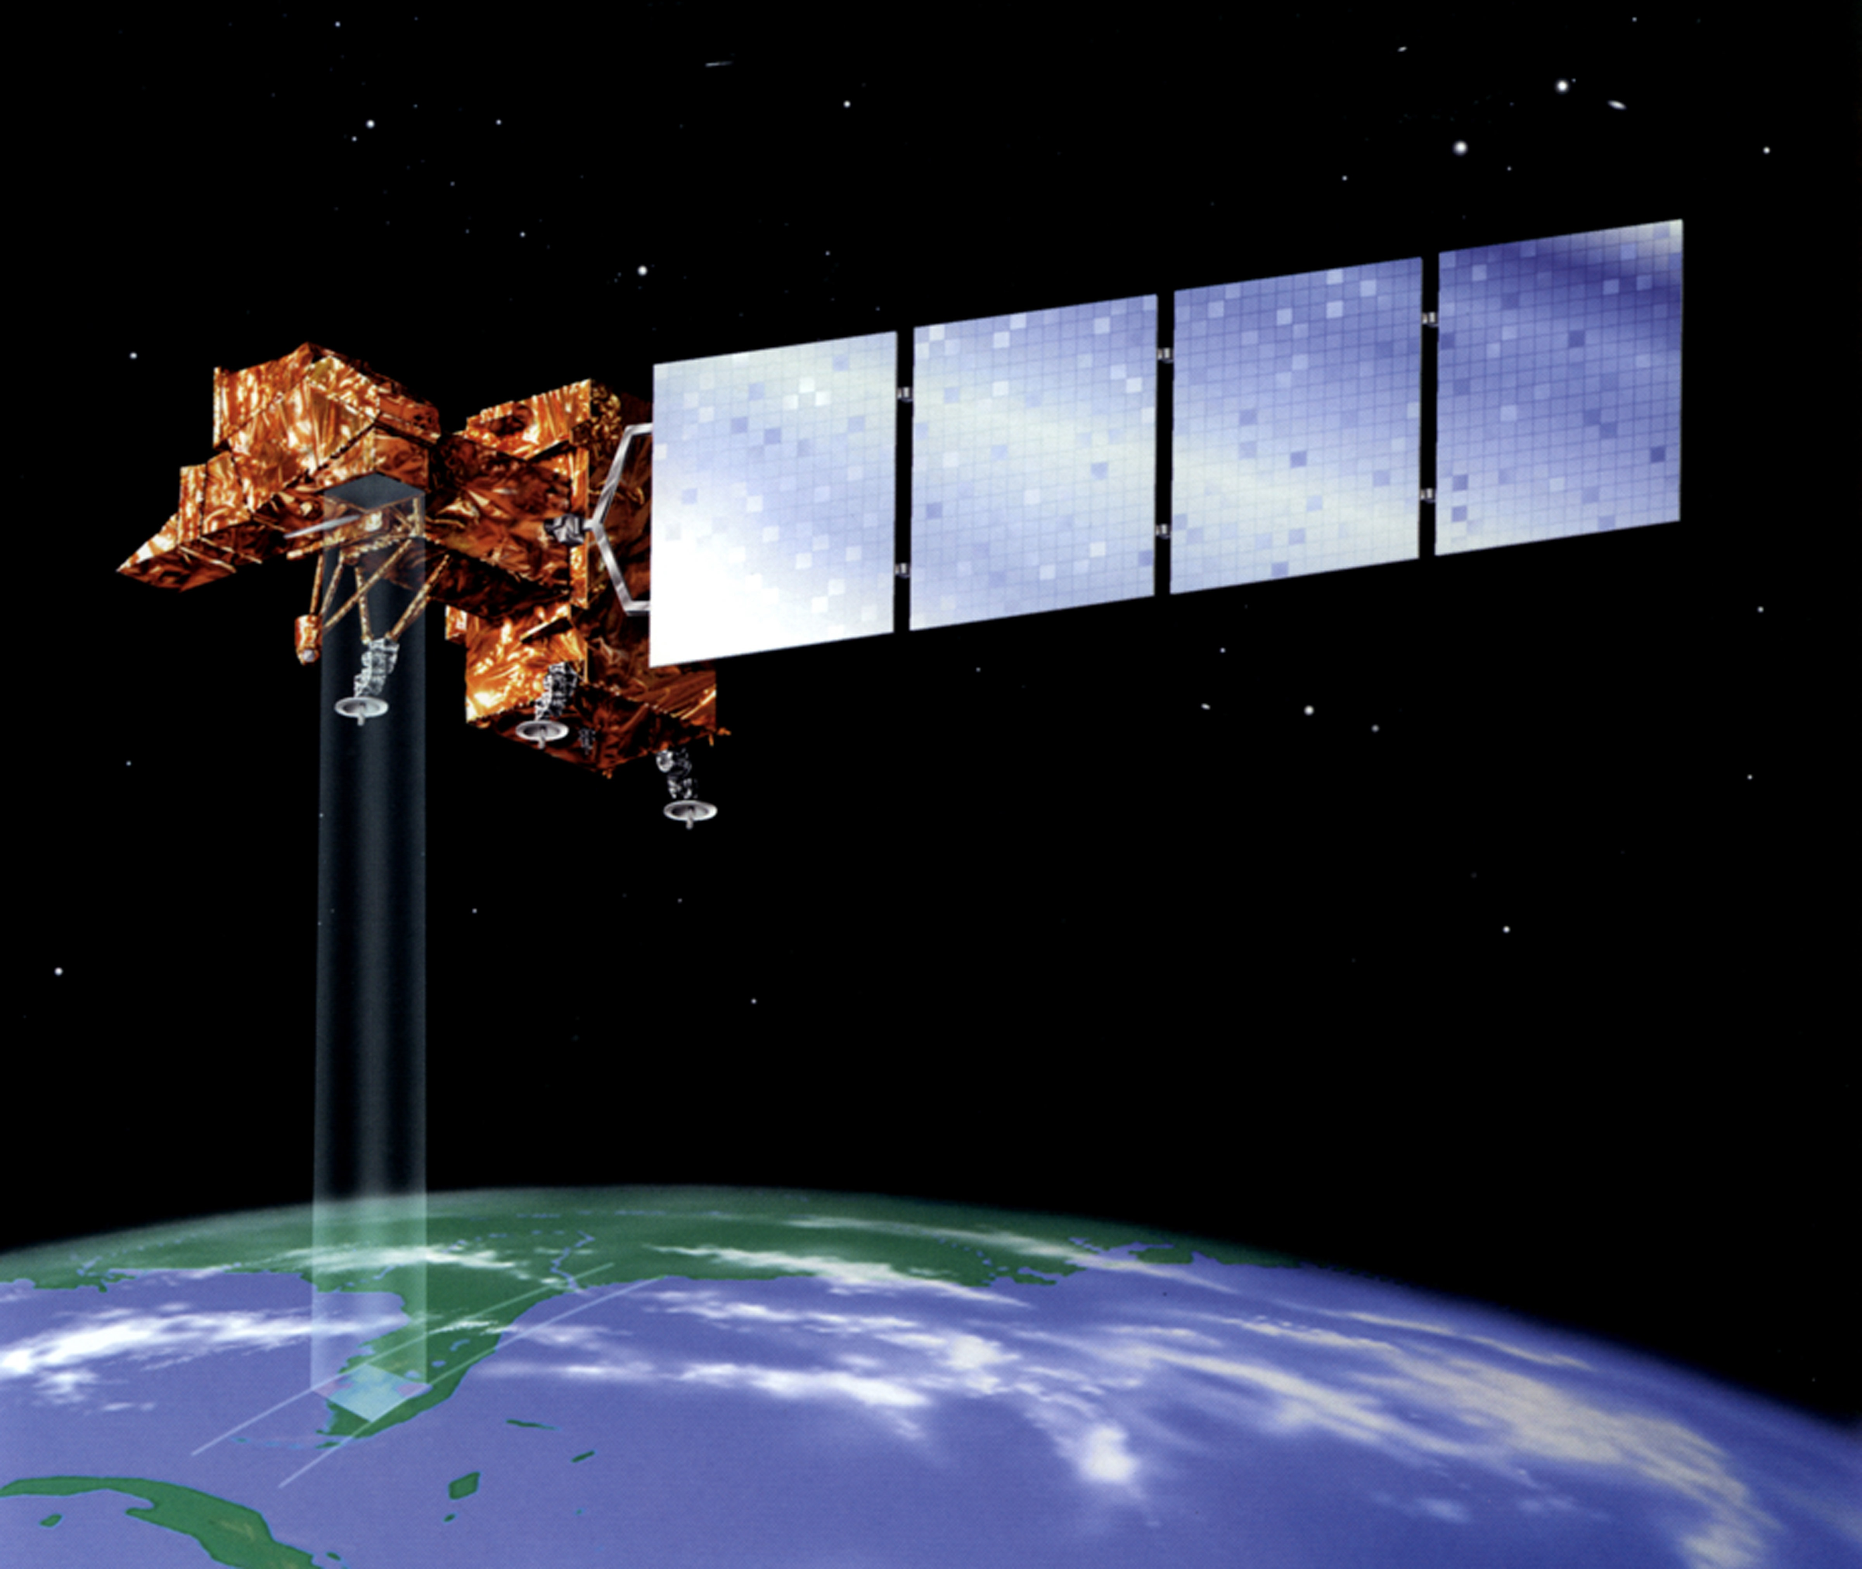
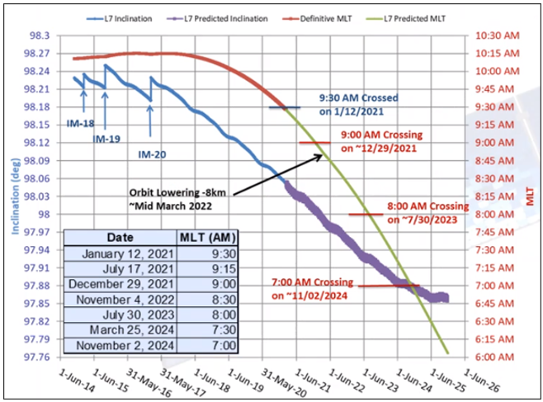

Selected data set
Landsat 7 (1999-2022)
Final inclination orbital maneuvers February 7, 2017 [3]
TLE data obtained from CelesTrak NORAD historical archives (1980-2004) [4]
[3] https://www.usgs.gov/landsat-missions/landsat-7
[4] https://celestrak.org/NORAD/archives/

Slide 6

Approach
Numpy, Matplotlib, Beyond
Autoencoding recurrent neural network (RNN) [5]
[5] https://arxiv.org/pdf/1711.10609.pdf

Slide 7
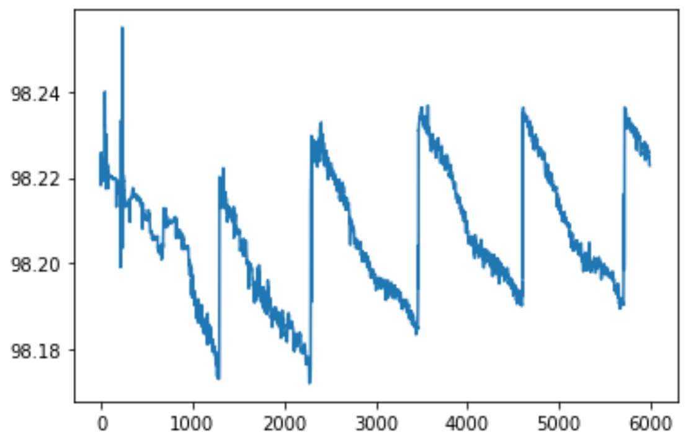
Results
Inclination (degrees) vs TLE. Data from 1999-2004
More data for use with Cesium
Transient analysis of TLE’s
Landsat 7 Inclination, 1999-2004
Inclination, degrees
TLE

Slide 8




Thank you

