Slide 1
Data Mining:
Concepts and Techniques
Assistant Prof.Songül Albayrak
Department of Computer Engineering
Yildiz Technical University
www.yildiz.edu.tr/~sbayrak
www.ce.yildiz.edu.tr

Slide 2
Introduction
Motivation: Why data mining?
What is data mining?
Data Mining: On what kind of data?
Data mining functionality
Are all the patterns interesting?
Classification of data mining systems
Data Mining Task Primitives
Integration of data mining system with a DB and DW System
Major issues in data mining

Slide 3
Why Data Mining?
The Explosive Growth of Data: from terabytes to petabytes
  Data collection and data availability
    Automated data collection tools, database systems, Web, computerized society
  Major sources of abundant data
    Business: Web, e-commerce, transactions, stocks, …
    Science: Remote sensing, bioinformatics, scientific simulation, …
    Society and everyone: news, digital cameras,
We are drowning in data, but starving for knowledge!
“Necessity is the mother of invention”—Data mining—Automated analysis of massive data sets

Slide 4
Evolution of Database Technology
1960s:
  Data collection, database creation, IMS and network DBMS
1970s:
  Relational data model, relational DBMS implementation
1980s:
  RDBMS, advanced data models (extended-relational, deductive, etc.)
  Application-oriented DBMS (spatial, scientific, engineering, etc.)
1990s:
  Data mining, data warehousing, multimedia databases, and Web databases
2000s
  Stream data management and mining
  Data mining and its applications
  Web technology (XML, data integration) and global information systems

Slide 5


What Is Data Mining?
Data mining (knowledge discovery from data)
  Extraction of interesting (non-trivial, implicit, previously unknown and potentially useful) patterns or knowledge from huge amount of data
  Data mining: a misnomer?
Alternative names
  Knowledge discovery (mining) in databases (KDD), knowledge extraction, data/pattern analysis, data archeology, data dredging, information harvesting, business intelligence, etc.
Watch out: Is everything “data mining”?
  Simple search and query processing
  (Deductive) expert systems

Slide 6
Why Data Mining?—Potential Applications
Data analysis and decision support
  Market analysis and management
    Target marketing, customer relationship management (CRM), market basket analysis, cross selling, market segmentation
  Risk analysis and management
    Forecasting, customer retention, improved underwriting, quality control, competitive analysis
  Fraud detection and detection of unusual patterns (outliers)
Other Applications
  Text mining (news group, email, documents) and Web mining
  Stream data mining
  Bioinformatics and bio-data analysis

Slide 7
Ex. 1: Market Analysis and Management
Where does the data come from?—Credit card transactions, loyalty cards, discount coupons, customer complaint calls, plus (public) lifestyle studies
Target marketing
  Find clusters of “model” customers who share the same characteristics: interest, income level, spending habits, etc.,
  Determine customer purchasing patterns over time
Cross-market analysis—Find associations/co-relations between product sales, & predict based on such association
Customer profiling—What types of customers buy what products (clustering or classification)
Customer requirement analysis
  Identify the best products for different customers
  Predict what factors will attract new customers
Provision of summary information
  Multidimensional summary reports
  Statistical summary information (data central tendency and variation)

Slide 8
Ex. 2: Corporate Analysis & Risk Management
Finance planning and asset evaluation
  cash flow analysis and prediction
  contingent claim analysis to evaluate assets
  cross-sectional and time series analysis (financial-ratio, trend analysis, etc.)
Resource planning
  summarize and compare the resources and spending
Competition
  monitor competitors and market directions
  group customers into classes and a class-based pricing procedure
  set pricing strategy in a highly competitive market

Slide 9
Ex. 3: Fraud Detection & Mining Unusual Patterns
Approaches: Clustering & model construction for frauds, outlier analysis
Applications: Health care, retail, credit card service, telecomm.
  Auto insurance: ring of collisions
  Money laundering: suspicious monetary transactions
  Medical insurance
    Professional patients, ring of doctors, and ring of references
    Unnecessary or correlated screening tests
  Telecommunications: phone-call fraud
    Phone call model: destination of the call, duration, time of day or week. Analyze patterns that deviate from an expected norm
  Retail industry
    Analysts estimate that 38% of retail shrink is due to dishonest employees
  Anti-terrorism

Slide 10
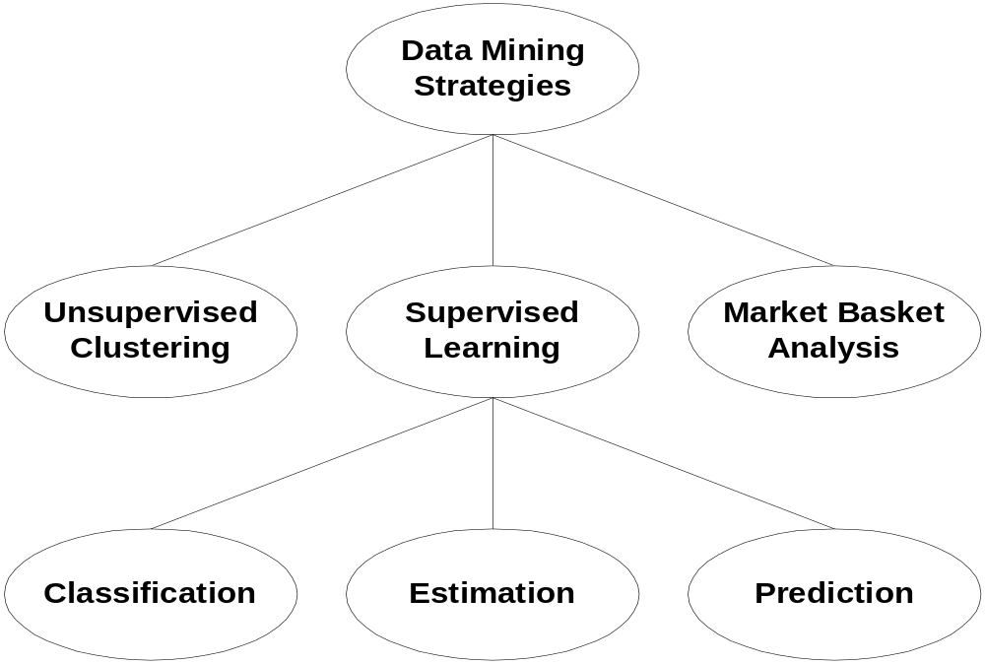
A hierarchy of data mining strategies

Slide 11
Supervised Learning
Build a learner model using data instances of known origin.
Use the model to determine the outcome new instances of unknown origin.

Slide 12
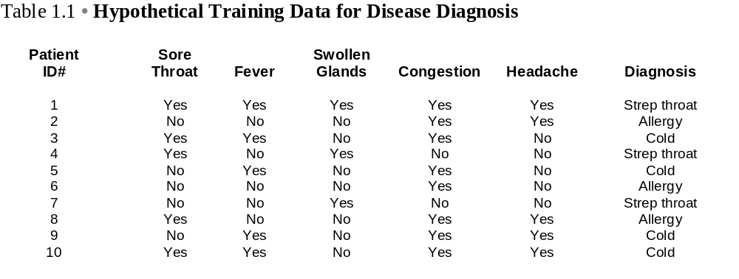
Supervised Learning: A Decision tree Example

Slide 13
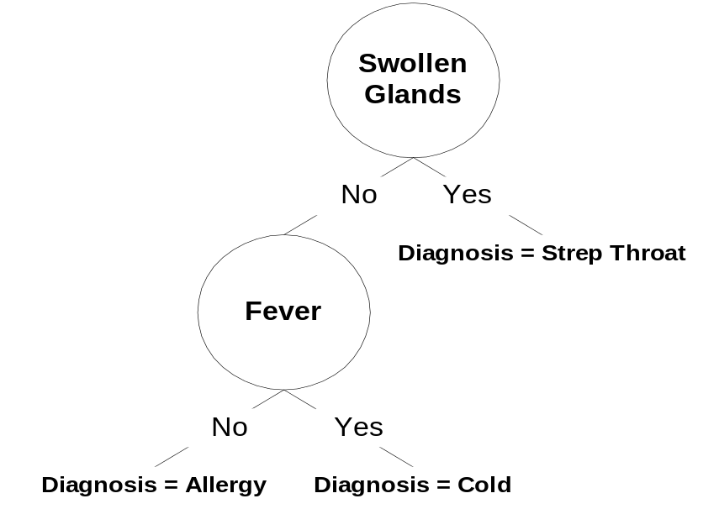
Supervised Learning: A Decision tree Example
A tree structure where non-terminal nodes represent tests on one or more attributes and terminal nodes reflect decision outcomes.

Slide 14
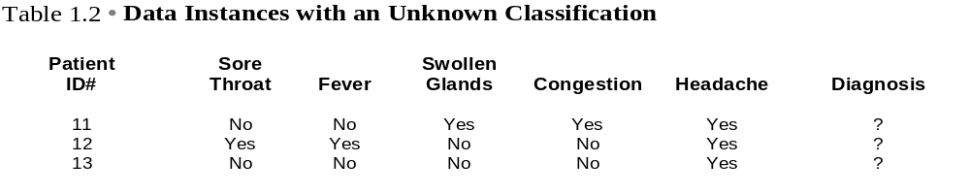
Decision Tree:

Slide 15
Unsupervised Clustering
A data mining method that builds models from data without predefined classes.

Slide 16
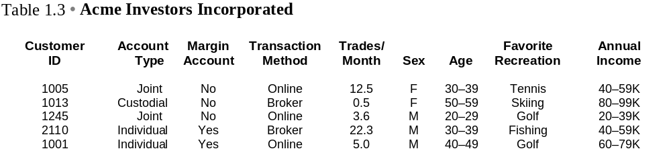
The Acme Investors Dataset

Slide 17
The Acme Investors Dataset & Supervised Learning
Can I develop a general profile of an online investor?
Can I determine if a new customer is likely to open a margin account?
Can I build a model predict the average number of trades per month for a new investor?
What characteristics differentiate female and male investors?

Slide 18
The Acme Investors Dataset & Unsupervised Clustering
What attribute similarities group customers of Acme Investors together?
What differences in attribute values segment the customer database?

Slide 19
Data Mining Strategies: Classification
Learning is supervised.
The dependent variable is categorical.
Well-defined classes.
Current rather than future behavior.

Slide 20
Data Mining Strategies:
Estimation
Learning is supervised.
The dependent variable is numeric.
Well-defined classes.
Current rather than future behavior.

Slide 21
Data Mining Strategies:
Prediction
The emphasis is on predicting future rather than current outcomes.
The output attribute may be categorical or numeric.

Slide 22
Data Mining Strategies:
Market Basket Analysis
Find interesting relationships among retail products.
Uses association rule algorithms.

Slide 23
Data Mining Strategies: Unsupervised Clustering
Unsupervised Clustering can be used to:
  determine if relationships can be found in the data.
  evaluate the likely performance of a supervised model.
  find a best set of input attributes for supervised learning.
  detect Outliers.

Slide 24
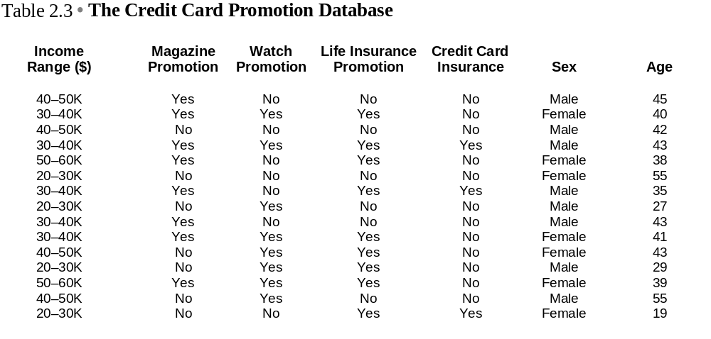
The Credit Card Promotion Database

Slide 25
A Hypothesis for the Credit Card Promotion Database
A combination of one or more of the dataset attributes differentiate Acme Credit Card Company card holders who have taken advantage of the life insurance promotion and those card holders who have chosen not to participate in the promotional offer.

Slide 26
Supervised Data Mining Techniques:
Production Rules
IF Sex = Female & 19 <=Age <= 43
THEN Life Insurance Promotion = Yes
Rule Accuracy: 100.00%
Rule Coverage: 66.67%
Rule accuracy is a between-class measure.
Rule coverage is a within-class measure.

Slide 27
Supervised Data Mining Techniques:
Production Rules
IF Sex = Male & Income Range=40-50
THEN Life Insurance Promotion = No
Rule Accuracy: ? %
Rule Coverage: ? %

Slide 28
Supervised Data Mining Techniques:
Production Rules
IF Sex = Male & Income Range=40-50
THEN Life Insurance Promotion = No
Rule Accuracy: 100 %
Rule Coverage: 50 %

Slide 29
Knowledge Discovery (KDD) Process
Knowledge
  Data mining—core of knowledge discovery process
Pattern Evaluation
Data Mining
Task-relevant Data
Data Warehouse
Selection
Data Cleaning
Data Integration
Databases

Slide 30
KDD Process: Several Key Steps
Learning the application domain
  relevant prior knowledge and goals of application
Creating a target data set: data selection
Data cleaning and preprocessing: (may take 60% of effort!)
Data reduction and transformation
  Find useful features, dimensionality/variable reduction, invariant representation
Choosing functions of data mining
  summarization, classification, regression, association, clustering
Choosing the mining algorithm(s)
Data mining: search for patterns of interest
Pattern evaluation and knowledge presentation
  visualization, transformation, removing redundant patterns, etc.
Use of discovered knowledge

Slide 31
Data Mining and Business Intelligence
Increasing potential
to support
business decisions
End User
Decision Making
Data Presentation
Business
Analyst
Visualization Techniques
Data Mining
Data
Analyst
Information Discovery
Data Exploration
Statistical Summary, Querying, and Reporting
Data Preprocessing/Integration, Data Warehouses
Data Sources
DBA
Paper, Files, Web documents, Scientific experiments, Database Systems

Slide 32
Data Mining: Confluence of Multiple Disciplines
Database
Technology
Statistics
Machine
Learning
Data Mining
Visualization
Pattern
Recognition
Other
Disciplines
Algorithm

Slide 33
Why Not Traditional Data Analysis?
Tremendous amount of data
  Algorithms must be highly scalable to handle such as tera-bytes of data
High-dimensionality of data
  Micro-array may have tens of thousands of dimensions
High complexity of data
  Data streams and sensor data
  Time-series data, temporal data, sequence data
  Structure data, graphs, social networks and multi-linked data
  Heterogeneous databases and legacy databases
  Spatial, spatiotemporal, multimedia, text and Web data
  Software programs, scientific simulations
New and sophisticated applications

Slide 34
Multi-Dimensional View of Data Mining
Data to be mined
  Relational, data warehouse, transactional, stream, object-oriented/relational, active, spatial, time-series, text, multi-media, heterogeneous, legacy, WWW
Knowledge to be mined
  Characterization, discrimination, association, classification, clustering, trend/deviation, outlier analysis, etc.
  Multiple/integrated functions and mining at multiple levels
Techniques utilized
  Database-oriented, data warehouse (OLAP), machine learning, statistics, visualization, etc.
Applications adapted
  Retail, telecommunication, banking, fraud analysis, bio-data mining, stock market analysis, text mining, Web mining, etc.

Slide 35
Data Mining: Classification Schemes
General functionality
  Descriptive data mining
  Predictive data mining
Different views lead to different classifications
  Data view: Kinds of data to be mined
  Knowledge view: Kinds of knowledge to be discovered
  Method view: Kinds of techniques utilized
  Application view: Kinds of applications adapted

Slide 36
Data Mining Functionalities
Multidimensional concept description: Characterization and discrimination
  Generalize, summarize, and contrast data characteristics, e.g., dry vs. wet regions
Frequent patterns, association, correlation vs. causality
  Diaper → Beer [0.5%, 75%] (Correlation or causality?)
Classification and prediction
  Construct models (functions) that describe and distinguish classes or concepts for future prediction
    E.g., classify countries based on (climate), or classify cars based on (gas mileage)
  Predict some unknown or missing numerical values

Slide 37
Data Mining Functionalities (2)
Cluster analysis
  Class label is unknown: Group data to form new classes, e.g., cluster houses to find distribution patterns
  Maximizing intra-class similarity & minimizing interclass similarity
Outlier analysis
  Outlier: Data object that does not comply with the general behavior of the data
  Noise or exception? Useful in fraud detection, rare events analysis
Trend and evolution analysis
  Trend and deviation: e.g., regression analysis
  Sequential pattern mining: e.g., digital camera → large SD memory
  Periodicity analysis
  Similarity-based analysis
Other pattern-directed or statistical analyses

Slide 38
Are All the “Discovered” Patterns Interesting?
Data mining may generate thousands of patterns: Not all of them are interesting
  Suggested approach: Human-centered, query-based, focused mining
Interestingness measures
  A pattern is interesting if it is easily understood by humans, valid on new or test data with some degree of certainty, potentially useful, novel, or validates some hypothesis that a user seeks to confirm
Objective vs. subjective interestingness measures
  Objective: based on statistics and structures of patterns, e.g., support, confidence, etc.
  Subjective: based on user’s belief in the data, e.g., unexpectedness, novelty, actionability, etc.

Slide 39
Find All and Only Interesting Patterns?
Find all the interesting patterns: Completeness
  Can a data mining system find all the interesting patterns? Do we need to find all of the interesting patterns?
  Heuristic vs. exhaustive search
  Association vs. classification vs. clustering
Search for only interesting patterns: An optimization problem
  Can a data mining system find only the interesting patterns?
  Approaches
    First general all the patterns and then filter out the uninteresting ones
    Generate only the interesting patterns—mining query optimization

Slide 40
Why Data Mining Query Language?
Automated vs. query-driven?
  Finding all the patterns autonomously in a database?—unrealistic because the patterns could be too many but uninteresting
Data mining should be an interactive process
  User directs what to be mined
Users must be provided with a set of primitives to be used to communicate with the data mining system
Incorporating these primitives in a data mining query language
  More flexible user interaction
  Foundation for design of graphical user interface
  Standardization of data mining industry and practice

Slide 41
Primitives that Define a Data Mining Task
Task-relevant data
Type of knowledge to be mined
Background knowledge
Pattern interestingness measurements
Visualization/presentation of discovered patterns

Slide 42
Primitive 1: Task-Relevant Data
Database or data warehouse name
Database tables or data warehouse cubes
Condition for data selection
Relevant attributes or dimensions
Data grouping criteria

Slide 43
Primitive 2: Types of Knowledge to Be Mined
Characterization
Discrimination
Association
Classification/prediction
Clustering
Outlier analysis
Other data mining tasks

Slide 44
Primitive 3: Background Knowledge
A typical kind of background knowledge: Concept hierarchies
Schema hierarchy
  E.g., street < city < province_or_state < country
Set-grouping hierarchy
  E.g., {20-39} = young, {40-59} = middle_aged
Operation-derived hierarchy
  email address: hagonzal@cs.uiuc.edu
    login-name < department < university < country
Rule-based hierarchy
  low_profit_margin (X) <= price(X, P₁) and cost (X, P₂) and (P₁ - P₂) < $50

Slide 45
Primitive 4: Pattern Interestingness Measure
Simplicity
  e.g., (association) rule length, (decision) tree size
Certainty
  e.g., confidence, P(A|B) = #(A and B)/ #(B), classification reliability or accuracy, certainty factor, rule strength, rule quality, discriminating weight, etc.
Utility
  potential usefulness, e.g., support (association), noise threshold (description)
Novelty
  not previously known, surprising (used to remove redundant rules, e.g., Illinois vs. Champaign rule implication support ratio)

Slide 46
Primitive 5: Presentation of Discovered Patterns
Different backgrounds/usages may require different forms of representation
  E.g., rules, tables, crosstabs, pie/bar chart, etc.
Concept hierarchy is also important
  Discovered knowledge might be more understandable when represented at high level of abstraction
  Interactive drill up/down, pivoting, slicing and dicing provide different perspectives to data
Different kinds of knowledge require different representation: association, classification, clustering, etc.

Slide 47
Architecture: Typical Data Mining System
Graphical User Interface
Pattern Evaluation
Knowledge-Base
Data Mining Engine
Database or Data Warehouse Server
data cleaning, integration, and selection
Data
Warehouse
World-Wide
Web
Other Info
Repositories
Database

Slide 48
Summary
Data mining: Discovering interesting patterns from large amounts of data
A natural evolution of database technology, in great demand, with wide applications
A KDD process includes data cleaning, data integration, data selection, transformation, data mining, pattern evaluation, and knowledge presentation
Mining can be performed in a variety of information repositories
Data mining functionalities: characterization, discrimination, association, classification, clustering, outlier and trend analysis, etc.
Data mining systems and architectures
Major issues in data mining

Slide 49
A Brief History of Data Mining Society
1989 IJCAI Workshop on Knowledge Discovery in Databases
  Knowledge Discovery in Databases (G. Piatetsky-Shapiro and W. Frawley, 1991)
1991-1994 Workshops on Knowledge Discovery in Databases
  Advances in Knowledge Discovery and Data Mining (U. Fayyad, G. Piatetsky-Shapiro, P. Smyth, and R. Uthurusamy, 1996)
1995-1998 International Conferences on Knowledge Discovery in Databases and Data Mining (KDD’95-98)
  Journal of Data Mining and Knowledge Discovery (1997)
ACM SIGKDD conferences since 1998 and SIGKDD Explorations
More conferences on data mining
  PAKDD (1997), PKDD (1997), SIAM-Data Mining (2001), (IEEE) ICDM (2001), etc.
ACM Transactions on KDD starting in 2007

Slide 50
Conferences and Journals on Data Mining
KDD Conferences
  ACM SIGKDD Int. Conf. on Knowledge Discovery in Databases and Data Mining (KDD)
  SIAM Data Mining Conf. (SDM)
  (IEEE) Int. Conf. on Data Mining (ICDM)
  Conf. on Principles and practices of Knowledge Discovery and Data Mining (PKDD)
  Pacific-Asia Conf. on Knowledge Discovery and Data Mining (PAKDD)
Other related conferences
  ACM SIGMOD
  VLDB
  (IEEE) ICDE
  WWW, SIGIR
  ICML, CVPR, NIPS
Journals
  Data Mining and Knowledge Discovery (DAMI or DMKD)
  IEEE Trans. On Knowledge and Data Eng. (TKDE)
  KDD Explorations
  ACM Trans. on KDD

Slide 51
Where to Find References? DBLP, CiteSeer, Google
Data mining and KDD (SIGKDD: CDROM)
  Conferences: ACM-SIGKDD, IEEE-ICDM, SIAM-DM, PKDD, PAKDD, etc.
  Journal: Data Mining and Knowledge Discovery, KDD Explorations, ACM TKDD
Database systems (SIGMOD: ACM SIGMOD Anthology—CD ROM)
  Conferences: ACM-SIGMOD, ACM-PODS, VLDB, IEEE-ICDE, EDBT, ICDT, DASFAA
  Journals: IEEE-TKDE, ACM-TODS/TOIS, JIIS, J. ACM, VLDB J., Info. Sys., etc.
AI & Machine Learning
  Conferences: Machine learning (ML), AAAI, IJCAI, COLT (Learning Theory), CVPR, NIPS, etc.
  Journals: Machine Learning, Artificial Intelligence, Knowledge and Information Systems, IEEE-PAMI, etc.
Web and IR
  Conferences: SIGIR, WWW, CIKM, etc.
  Journals: WWW: Internet and Web Information Systems,
Statistics
  Conferences: Joint Stat. Meeting, etc.
  Journals: Annals of statistics, etc.
Visualization
  Conference proceedings: CHI, ACM-SIGGraph, etc.
  Journals: IEEE Trans. visualization and computer graphics, etc.

Slide 52
Recommended Reference Books
S. Chakrabarti. Mining the Web: Statistical Analysis of Hypertex and Semi-Structured Data. Morgan Kaufmann, 2002
R. O. Duda, P. E. Hart, and D. G. Stork, Pattern Classification, 2ed., Wiley-Interscience, 2000
T. Dasu and T. Johnson. Exploratory Data Mining and Data Cleaning. John Wiley & Sons, 2003
U. M. Fayyad, G. Piatetsky-Shapiro, P. Smyth, and R. Uthurusamy. Advances in Knowledge Discovery and Data Mining. AAAI/MIT Press, 1996
U. Fayyad, G. Grinstein, and A. Wierse, Information Visualization in Data Mining and Knowledge Discovery, Morgan Kaufmann, 2001
J. Han and M. Kamber. Data Mining: Concepts and Techniques. Morgan Kaufmann, 2nd ed., 2006
D. J. Hand, H. Mannila, and P. Smyth, Principles of Data Mining, MIT Press, 2001
T. Hastie, R. Tibshirani, and J. Friedman, The Elements of Statistical Learning: Data Mining, Inference, and Prediction, Springer-Verlag, 2001
T. M. Mitchell, Machine Learning, McGraw Hill, 1997
G. Piatetsky-Shapiro and W. J. Frawley. Knowledge Discovery in Databases. AAAI/MIT Press, 1991
P.-N. Tan, M. Steinbach and V. Kumar, Introduction to Data Mining, Wiley, 2005
S. M. Weiss and N. Indurkhya, Predictive Data Mining, Morgan Kaufmann, 1998
I. H. Witten and E. Frank, Data Mining: Practical Machine Learning Tools and Techniques with Java Implementations, Morgan Kaufmann, 2nd ed. 2005

