Slide 1
Chapter 5 - Functions
Outline
5.1 Introduction
5.2 Program Modules in C
5.3 Math Library Functions
5.4 Functions
5.5 Function Definitions
5.6 Function Prototypes
5.7 Header Files
5.8 Calling Functions: Call by Value and Call by Reference
5.9 Random Number Generation
5.10 Example: A Game of Chance
5.11 Storage Classes
5.12 Scope Rules
5.13 Recursion
5.14 Example Using Recursion: The Fibonacci Series
5.15 Recursion vs. Iteration

Slide 2
Objectives
In this chapter, you will learn:
  To understand how to construct programs modularly from small pieces called functions..
  To introduce the common math functions available in the C standard library.
  To be able to create new functions.
  To understand the mechanisms used to pass information between functions.
  To introduce simulation techniques using random number generation.
  To understand how to write and use functions that call themselves.

Slide 3
5.1 Introduction
Divide and conquer
  Construct a program from smaller pieces or components
    These smaller pieces are called modules
  Each piece more manageable than the original program

Slide 4
5.2 Program Modules in C
Functions
  Modules in C
  Programs combine user-defined functions with library functions
    C standard library has a wide variety of functions
Function calls
  Invoking functions
    Provide function name and arguments (data)
    Function performs operations or manipulations
    Function returns results
  Function call analogy:
    Boss asks worker to complete task
      Worker gets information, does task, returns result
      Information hiding: boss does not know details

Slide 5
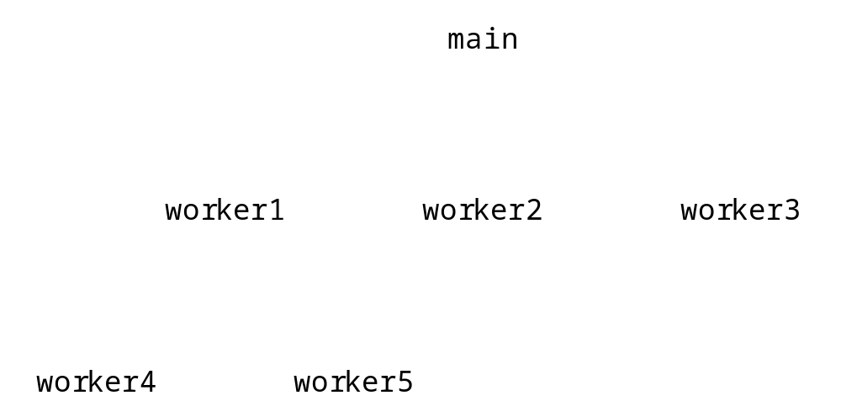
5.2 Program Modules in C
Fig. 5.1 Hierarchical boss function/worker function relationship.

Slide 6
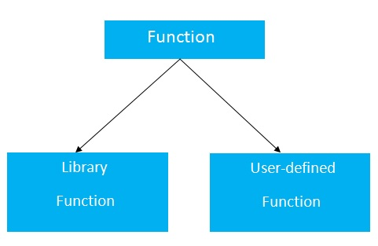
Function Types
Types of Functions
There are two types of functions in C programming:
Library Functions: are the functions which are declared in the C header files such as scanf(), printf(), gets(), puts(), ceil(), floor() etc.
User-defined functions: are the functions which are created by the C programmer, so that he/she can use it many times.
It reduces complexity of a big program and optimizes the code.

Slide 7
Function Definition
Return Value(void or others)
Example without return value:
void hello(){
printf("hello c");
}
Example with return value:
int get(){
return 10; // an integer returns
}

Slide 8
Function Definition
Parameters in C Function(#0 or #N)
Example of a function that has 0 param.
void hello(){
printf("hello c");
}
Example of a function that has 1 param.:
int cube(int n){
return n*n*n;
}
Example of a function that has 2 param.:
int add(int a, int b){
return a+b;
}

Slide 9
CALLING a Function
hello();//calls function that doesn't return a value
int value=get();//calls function that returns value
int value2=add(10,20);//calls parameterized function by passing 2 values
void hello(){
printf("hello c");
}
int get(){
return 10; // an integer returns
}
int add(int a, int b){
return a+b;
}

Slide 10
5.3 Math Library Functions
Math library functions
  perform common mathematical calculations
  #include <math.h>
Format for calling functions
  FunctionName( argument );
    If multiple arguments, use comma-separated list
  printf( "%.2f", sqrt( 900.0 ) );
    Calls function sqrt, which returns the square root of its argument
    All math functions return data type double
  Arguments may be constants, variables, or expressions

Slide 11
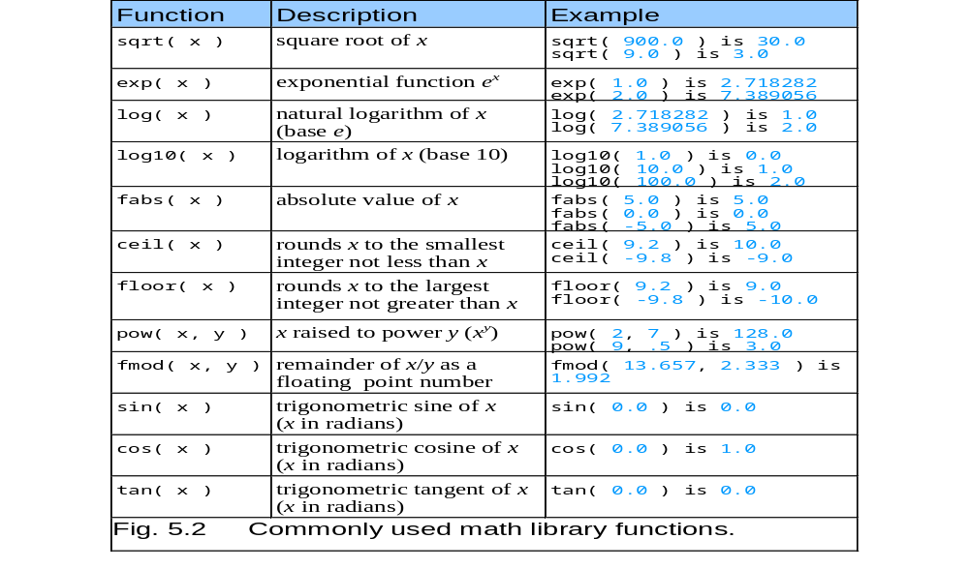
5.3 Math Library Functions

Slide 12
5.4 Functions
Functions
  Modularize a program
  All variables defined inside functions are local variables
    Known only in function defined
  Parameters
    Communicate information between functions
    Local variables
Benefits of functions
  Divide and conquer
    Manageable program development
  Software reusability
    Use existing functions as building blocks for new programs
    Abstraction - hide internal details (library functions)
  Avoid code repetition

Slide 13
5.5 Function Definitions
Function definition format
    return-value-type function-name( parameter-list )
    {
    declarations and statements
    }
  Function-name: any valid identifier
  Return-value-type: data type of the result (default int)
    void – indicates that the function returns nothing
  Parameter-list: comma separated list, declares parameters
    A type must be listed explicitly for each parameter unless, the parameter is of type int

Slide 14
5.5 Function Definitions
Function definition format (continued)
    return-value-type function-name( parameter-list )
    {
    declarations and statements
    }
  Definitions and statements: function body (block)
    Variables can be defined inside blocks (can be nested)
    Functions can not be defined inside other functions
  Returning control
    If nothing returned
      return;
      or, until reaches right brace
    If something returned
      return expression;

Slide 15
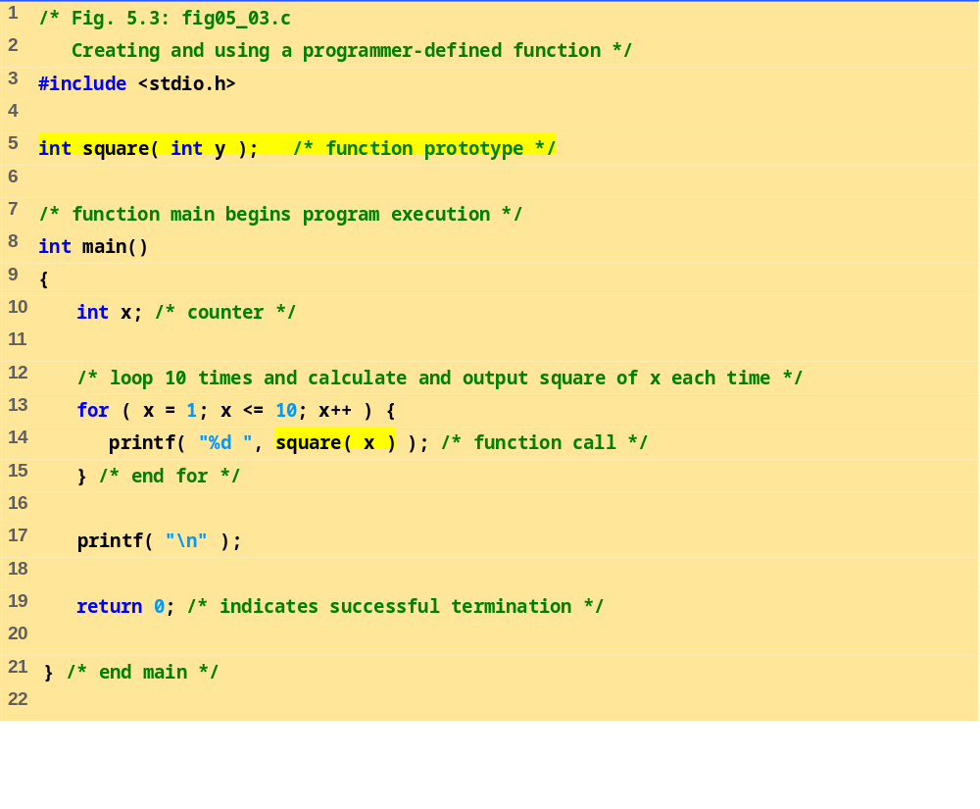
fig05_03.c (Part 1 of 2)

Slide 16
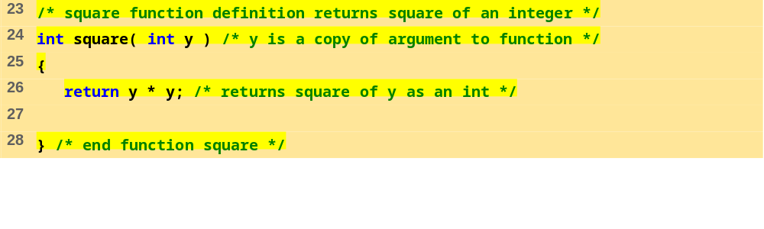
fig05_03.c (Part 2 of 2)
Program Output
1 4 9 16 25 36 49 64 81 100

Slide 17
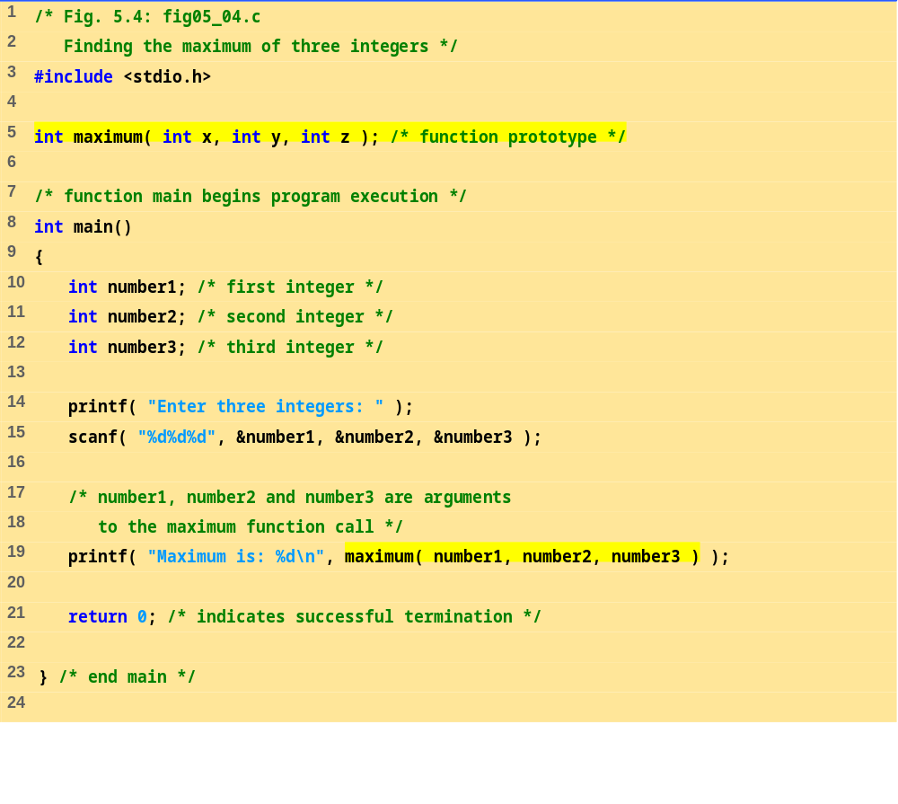
fig05_04.c (Part 1 of 2)

Slide 18
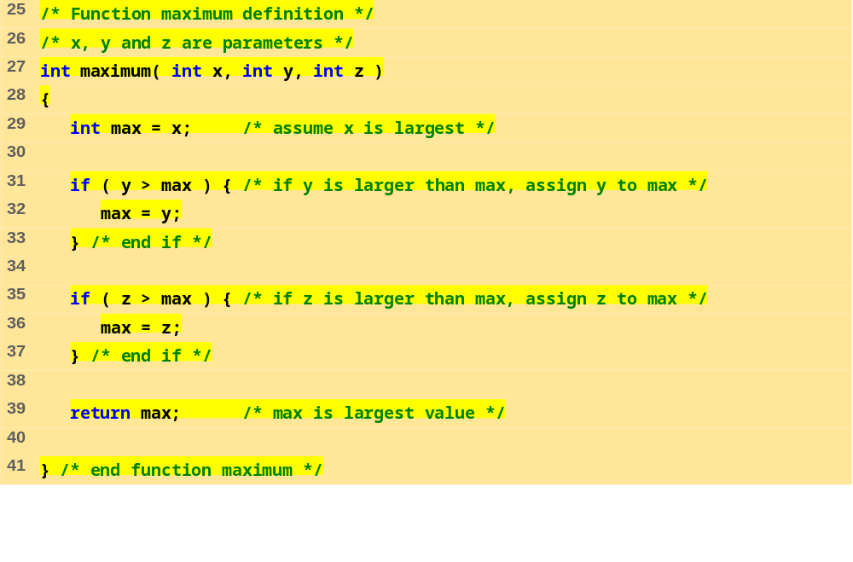
fig05_04.c (Part 2 of 2)
Program Output
Enter three integers: 22 85 17
Maximum is: 85
Enter three integers: 85 22 17
Maximum is: 85
Enter three integers: 22 17 85
Maximum is: 85

Slide 19
5.6 Function Prototypes
Function prototype
  Function name
  Parameters – what the function takes in
  Return type – data type function returns (default int)
  Used to validate functions
  Prototype only needed if function definition comes after use in program
  The function with the prototype
    int maximum( int x, int y, int z );
    Takes in 3 ints
    Returns an int
Promotion rules and conversions
  Converting to lower types can lead to errors

Slide 20
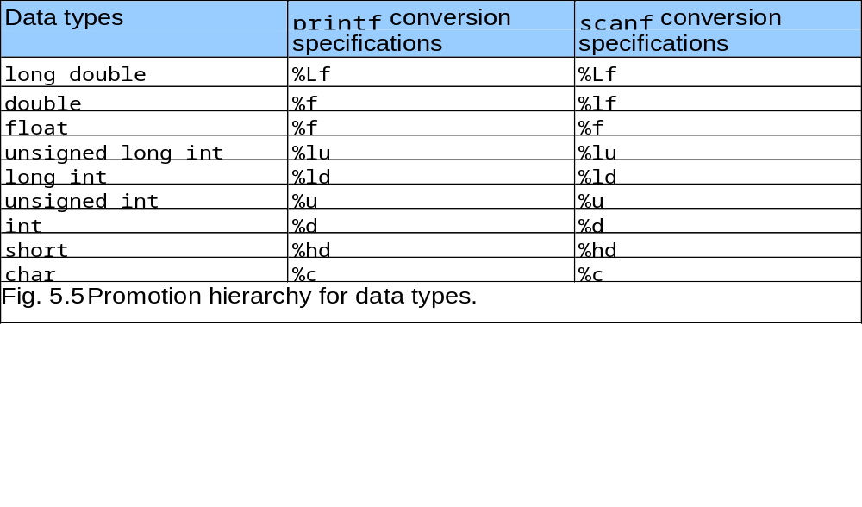
5.6 Function Prototypes

Slide 21
5.7 Header Files
Header files
  Contain function prototypes for library functions
  <stdlib.h> , <math.h> , etc
  Load with #include <filename>
    #include <math.h>
Custom header files
  Create file with functions
  Save as filename.h
  Load in other files with #include "filename.h"
  Reuse functions

Slide 22
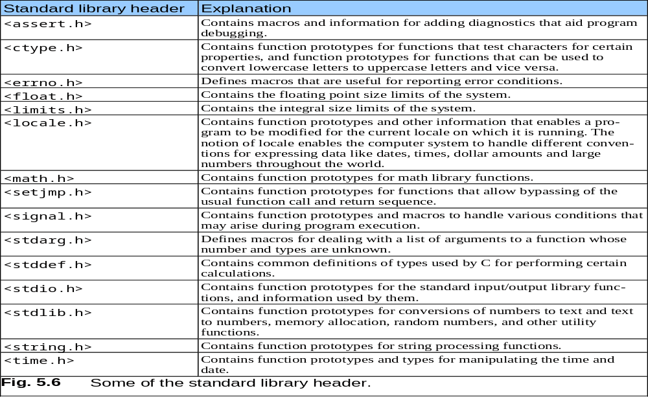
5.7 Header Files

Slide 23
5.8 Calling Functions: Call by Value and Call by Reference
Call by value
  Copy of argument passed to function
  Changes in function do not effect original
  Use when function does not need to modify argument
    Avoids accidental changes
Call by reference
  Passes original argument
  Changes in function effect original
  Only used with trusted functions
For now, we focus on call by value

Slide 24
5.9 Random Number Generation
rand function
  Load <stdlib.h>
  Returns "random" number between 0 and RAND_MAX (at least 32767)
      i = rand();
  Pseudorandom
    Preset sequence of "random" numbers
    Same sequence for every function call
Scaling
  To get a random number between 1 and n
      1 + ( rand() % n )
    rand() % n returns a number between 0 and n - 1
    Add 1 to make random number between 1 and n
      1 + ( rand() % 6)
      number between 1 and 6

Slide 25
5.9 Random Number Generation
srand function
  <stdlib.h>
  Takes an integer seed and jumps to that location in its "random" sequence
    srand( seed );
  srand( time( NULL ) );/*load <time.h> */
    time( NULL )
      Returns the time at which the program was compiled in seconds
      “Randomizes" the seed

Slide 26
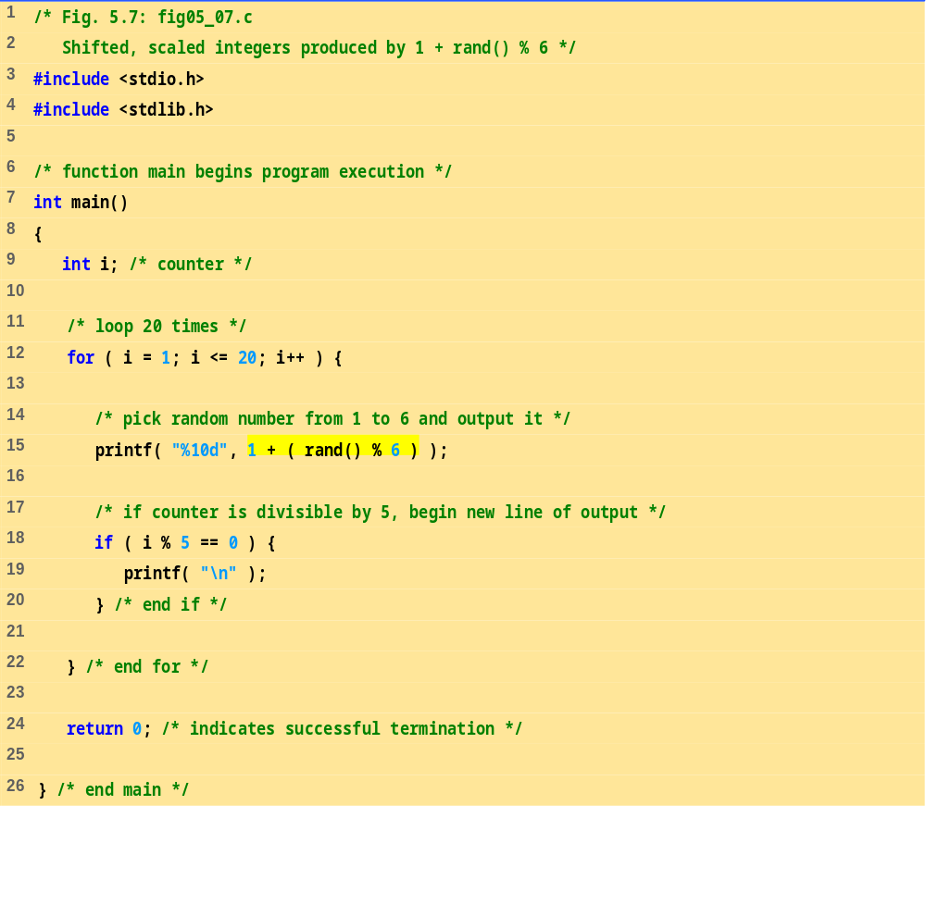
fig05_07.c

Slide 27
Program Output
6 6 5 5 6
5 1 1 5 3
6 6 2 4 2
6 2 3 4 1

Slide 28
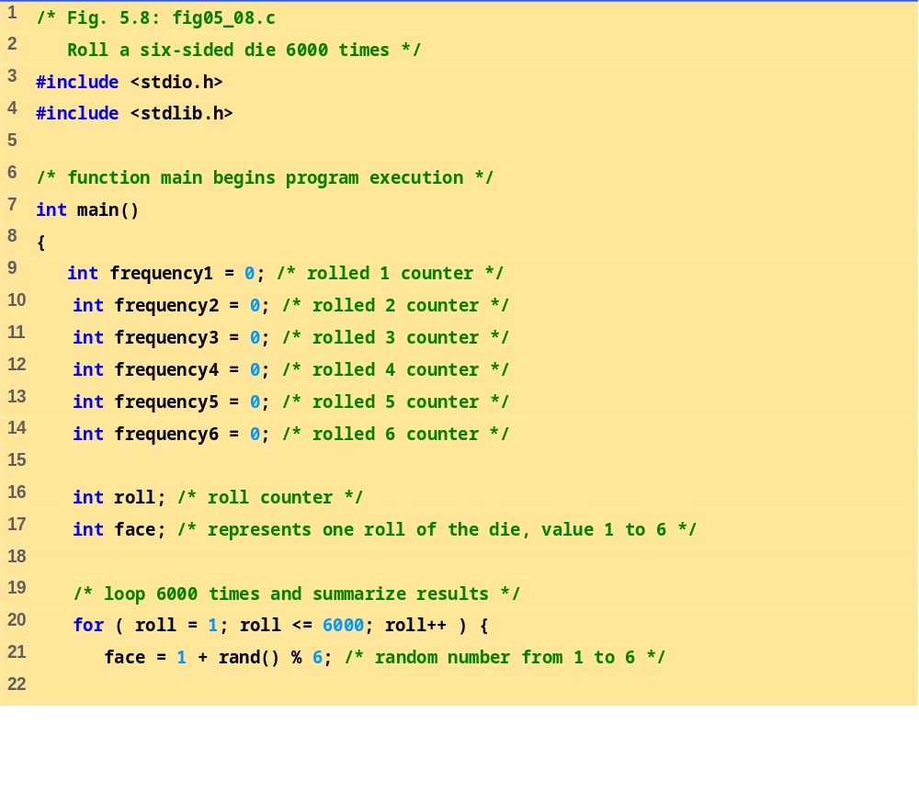
fig05_08.c (Part 1 of 3)

Slide 29
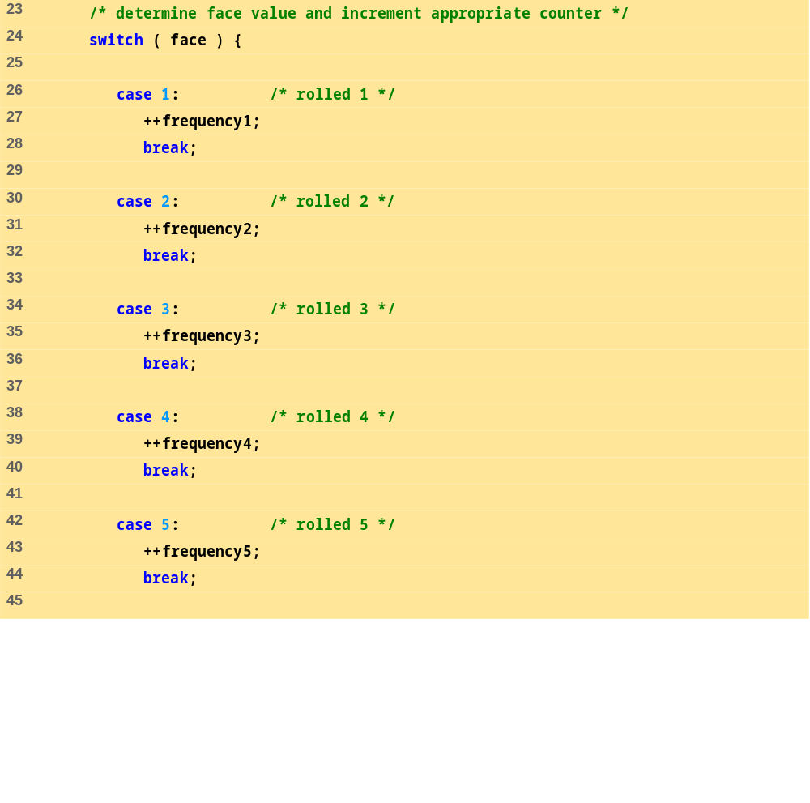
fig05_08.c (Part 2 of 3)

Slide 30
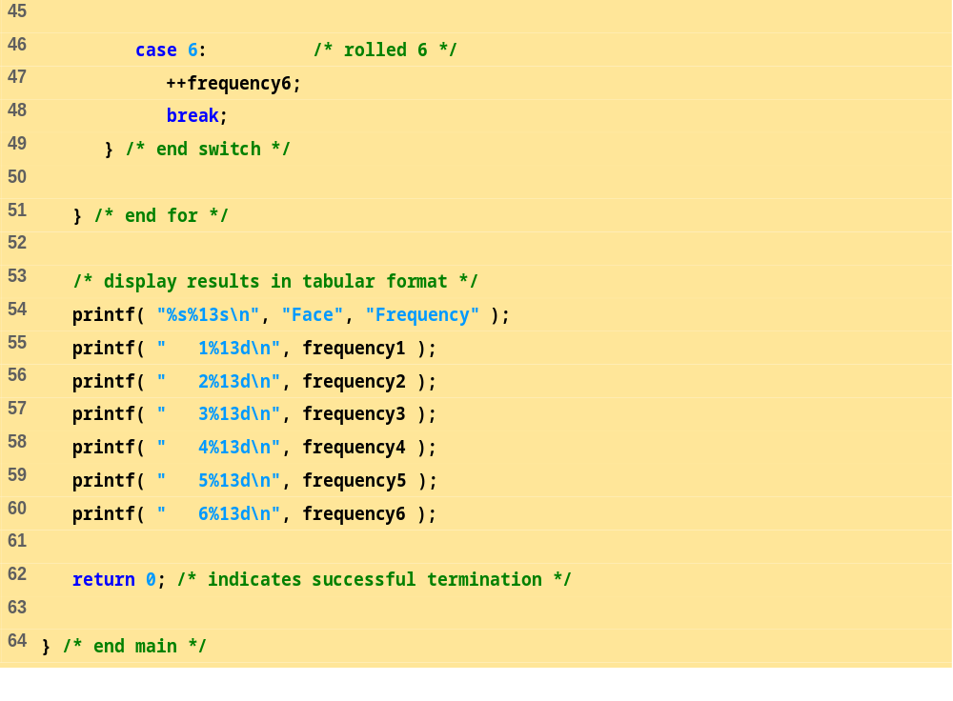
fig05_08.c (Part 3 of 3)
Program Output
Face Frequency
1 1003
2 1017
3 983
4 994
5 1004
6 999

Slide 31
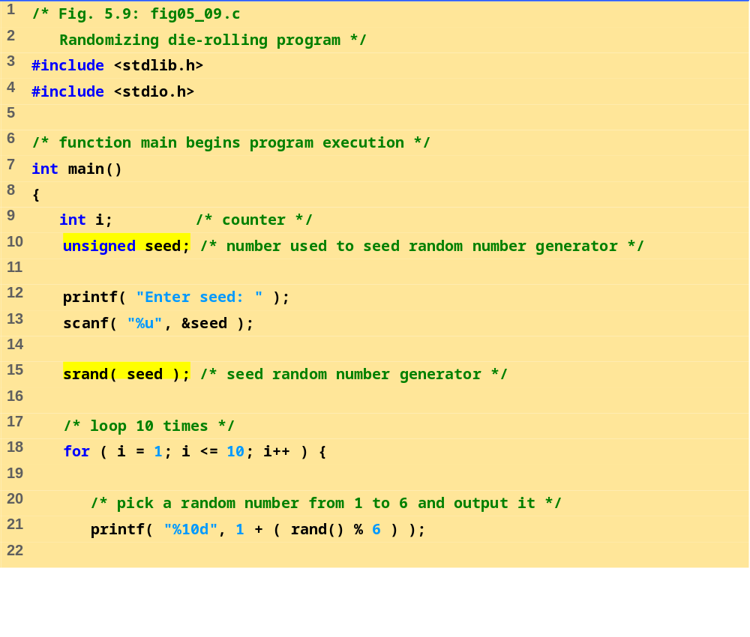
fig05_09.c (Part 1 of 2)

Slide 32
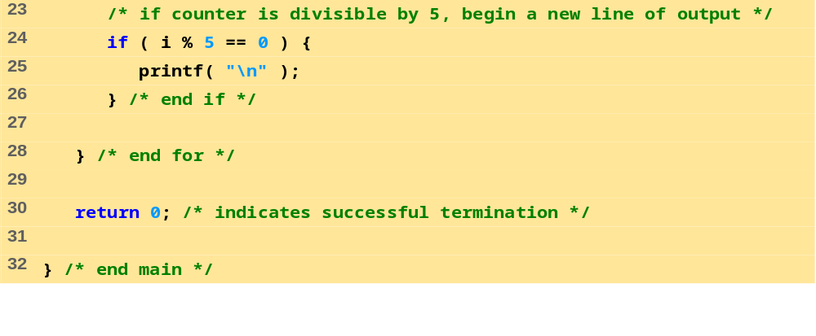
fig05_09.c (Part 2 of 2)
Program Output
Enter seed: 67
6 1 4 6 2
1 6 1 6 4
Enter seed: 867
2 4 6 1 6
1 1 3 6 2
Enter seed: 67
6 1 4 6 2
1 6 1 6 4

Slide 33
5.10 Example: A Game of Chance
Craps simulator
Rules
  Roll two dice
    7 or 11 on first throw, player wins
    2, 3, or 12 on first throw, player loses
    4, 5, 6, 8, 9, 10 - value becomes player's "point"
  Player must roll his point before rolling 7 to win

Slide 34
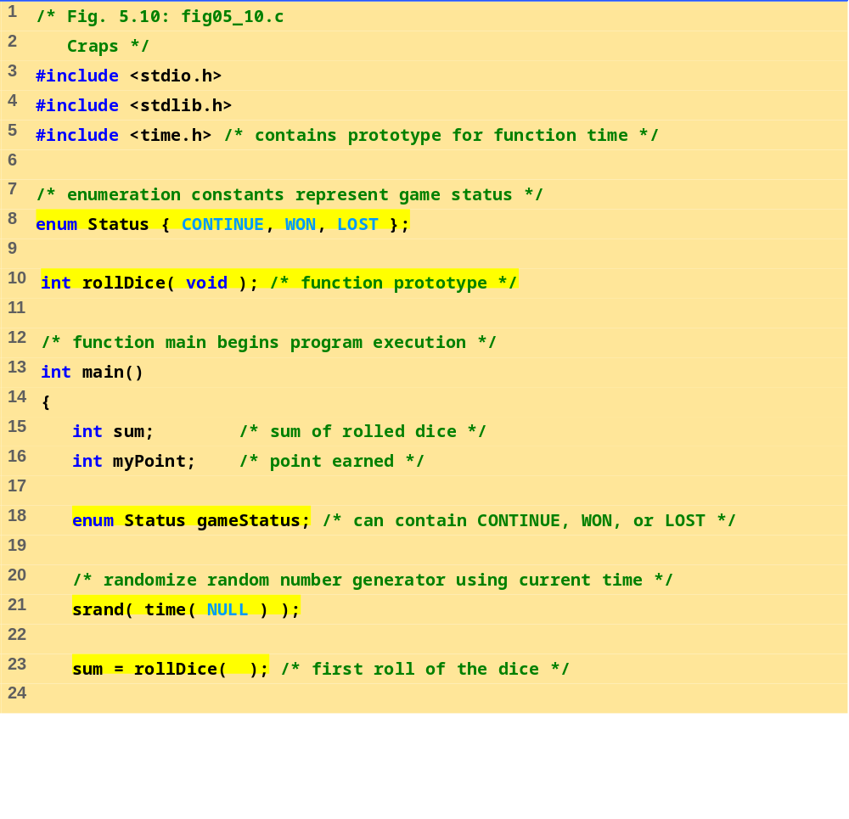
fig05_10.c (Part 1 of 4)

Slide 35
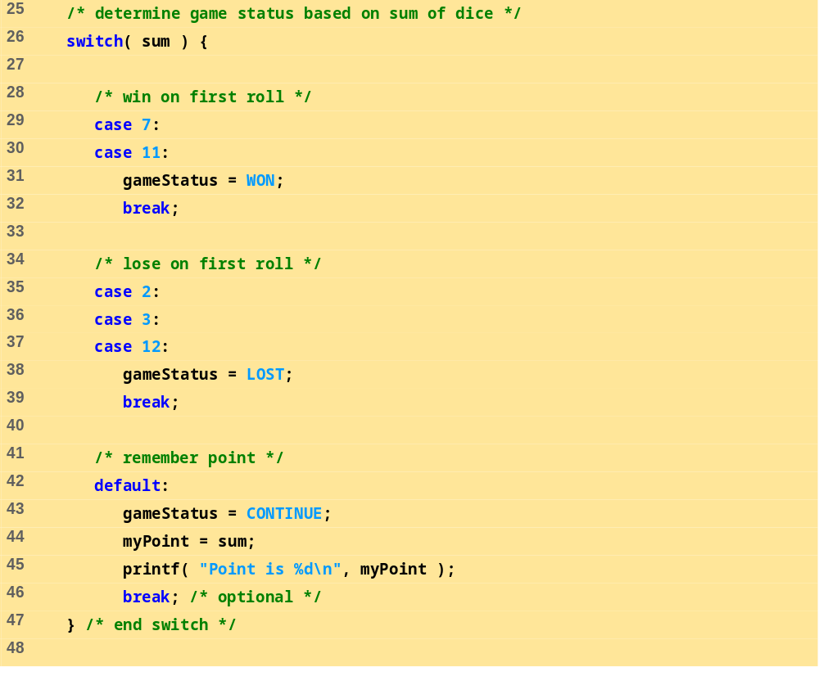
fig05_10.c (Part 2 of 4)

Slide 36
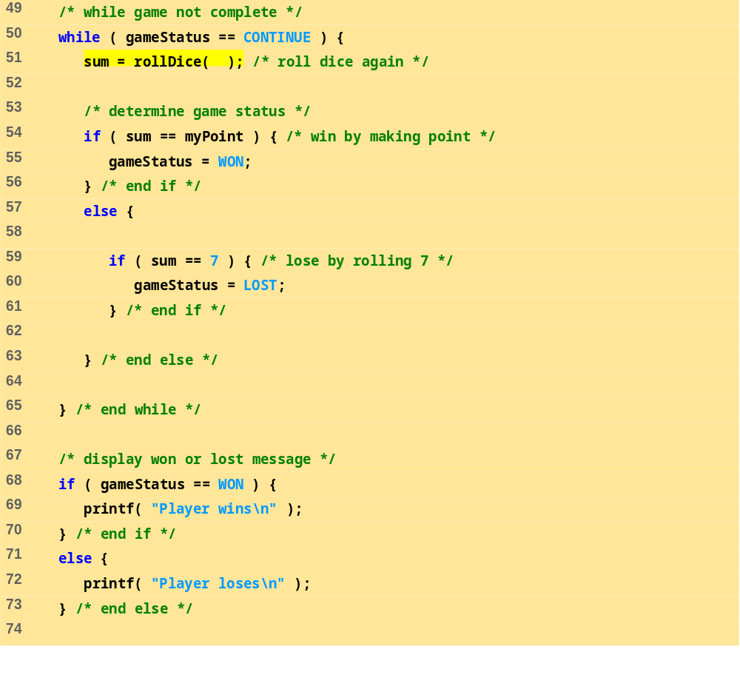
fig05_10.c (Part 3 of 4)

Slide 37
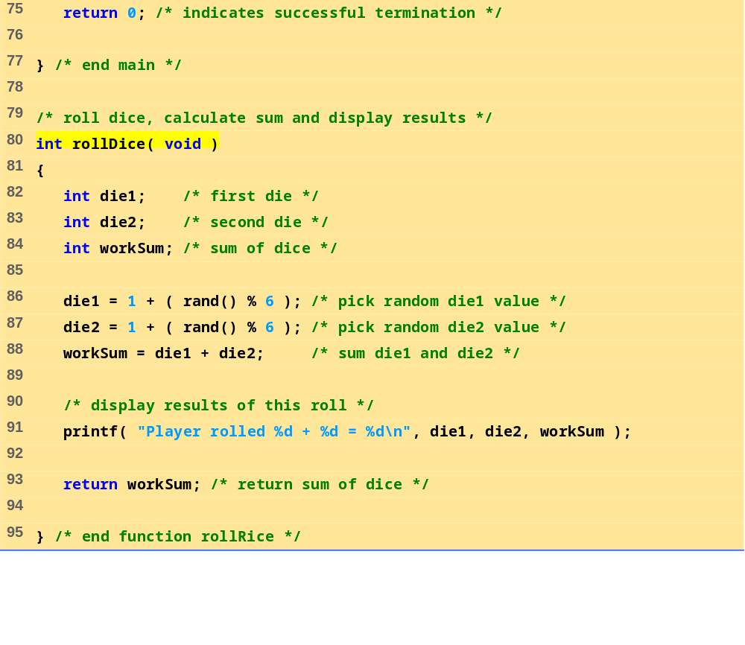
fig05_10.c (Part 4 of 4)

Slide 38
Program Output
Player rolled 5 + 6 = 11
Player wins
Player rolled 4 + 1 = 5
Point is 5
Player rolled 6 + 2 = 8
Player rolled 2 + 1 = 3
Player rolled 3 + 2 = 5
Player wins
Player rolled 1 + 1 = 2
Player loses
Player rolled 1 + 4 = 5
Point is 5
Player rolled 3 + 4 = 7
Player loses

Slide 39
5.11 Storage Classes
Storage class specifiers
  Storage duration – how long an object exists in memory
  Scope – where object can be referenced in program
  Linkage – specifies the files in which an identifier is known (more in Chapter 14)
Automatic storage
  Object created and destroyed within its block
  auto: default for local variables
      auto double x, y;
  register: tries to put variable into high-speed registers
    Can only be used for automatic variables
      register int counter = 1;

Slide 40
5.11 Storage Classes
Static storage
  Variables exist for entire program execution
  Default value of zero
  static: local variables defined in functions.
    Keep value after function ends
    Only known in their own function
  extern: default for global variables and functions
    Known in any function

Slide 41
5.12 Scope Rules
File scope
  Identifier defined outside function, known in all functions
  Used for global variables, function definitions, function prototypes
Function scope
  Can only be referenced inside a function body
  Used only for labels (start:, case: , etc.)

Slide 42
5.12 Scope Rules
Block scope
  Identifier declared inside a block
    Block scope begins at definition, ends at right brace
  Used for variables, function parameters (local variables of function)
  Outer blocks "hidden" from inner blocks if there is a variable with the same name in the inner block
Function prototype scope
  Used for identifiers in parameter list

Slide 43
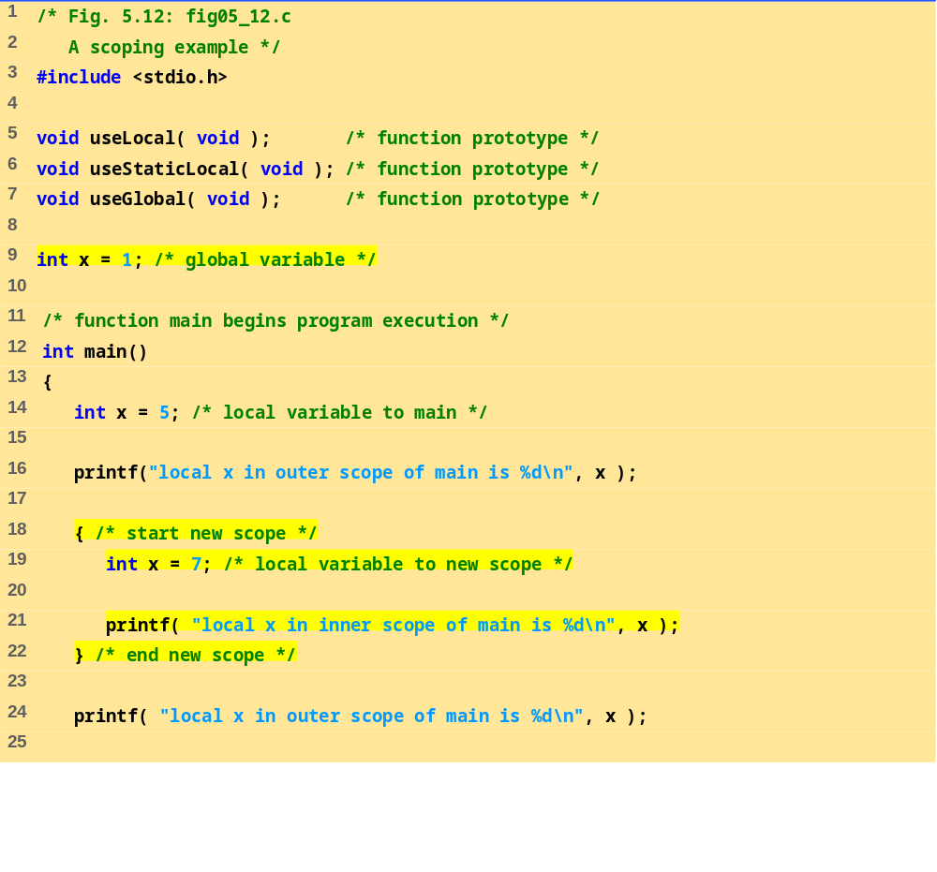
fig05_12.c (Part 1 of 3)

Slide 44
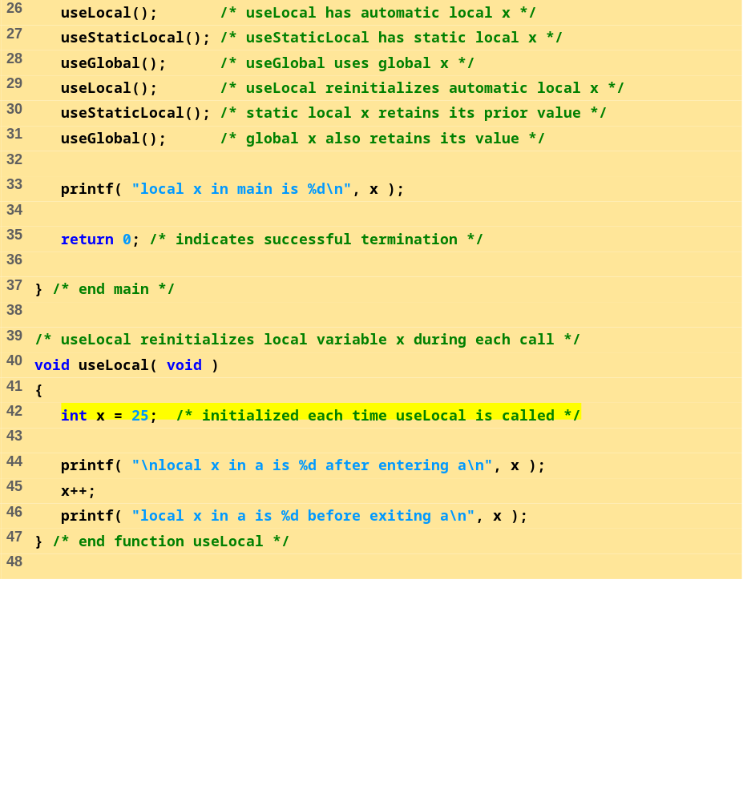
fig05_12.c (Part 2 of 3)

Slide 45
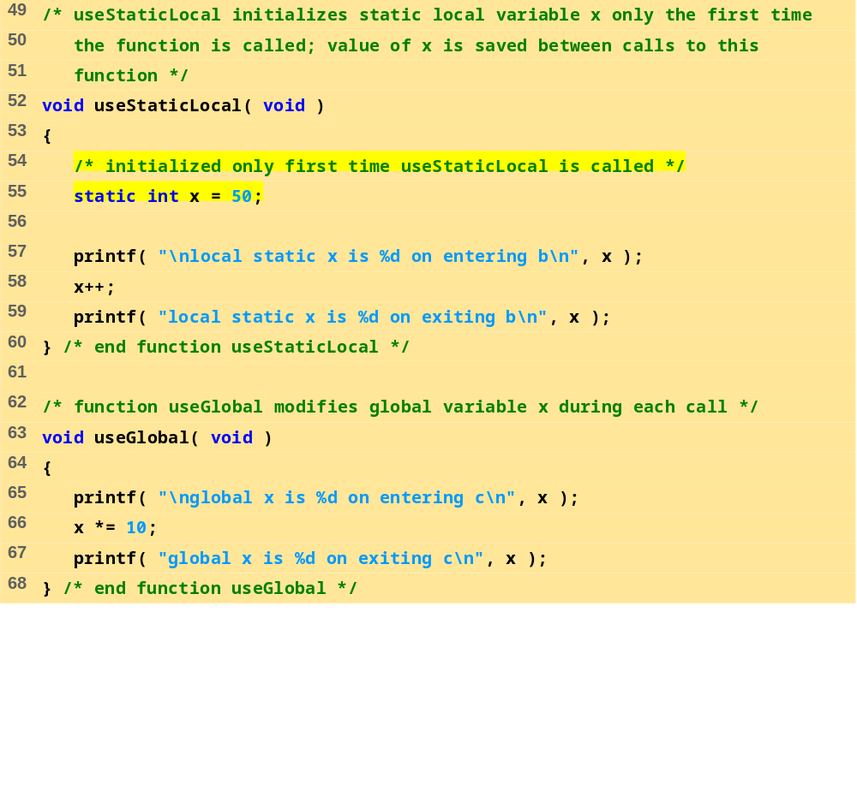
fig05_12.c (Part 3 of 3)

Slide 46
Program Output
local x in outer scope of main is 5
local x in inner scope of main is 7
local x in outer scope of main is 5
local x in a is 25 after entering a
local x in a is 26 before exiting a
local static x is 50 on entering b
local static x is 51 on exiting b
global x is 1 on entering c
global x is 10 on exiting c
local x in a is 25 after entering a
local x in a is 26 before exiting a
local static x is 51 on entering b
local static x is 52 on exiting b
global x is 10 on entering c
global x is 100 on exiting c
local x in main is 5

Slide 47
5.13 Recursion
Recursive functions
  Functions that call themselves
  Can only solve a base case
  Divide a problem up into
    What it can do
    What it cannot do
      What it cannot do resembles original problem
      The function launches a new copy of itself (recursion step) to solve what it cannot do
  Eventually base case gets solved
    Gets plugged in, works its way up and solves whole problem

Slide 48
5.13 Recursion
Example: factorials
  5! = 5 * 4 * 3 * 2 * 1
  Notice that
    5! = 5 * 4!
    4! = 4 * 3! ...
  Can compute factorials recursively
  Solve base case (1! = 0! = 1) then plug in
    2! = 2 * 1! = 2 * 1 = 2;
    3! = 3 * 2! = 3 * 2 = 6;

Slide 49
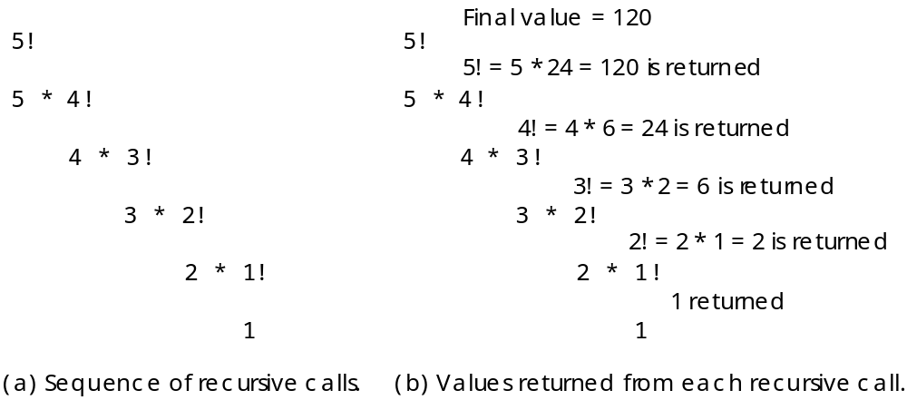
5.13 Recursion

Slide 50
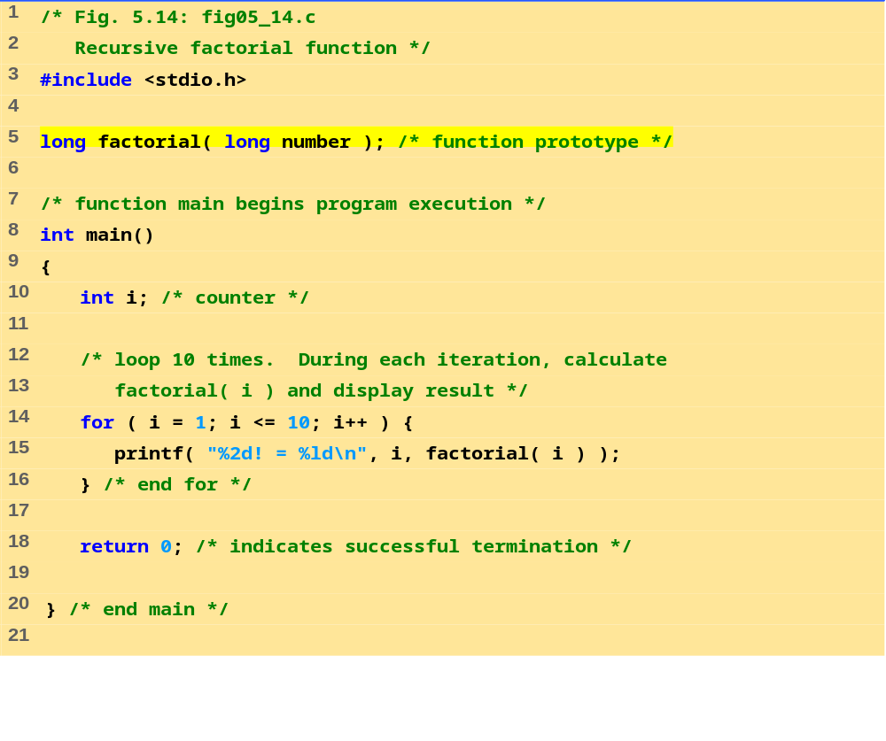
fig05_14.c (Part 1 of 2)

Slide 51
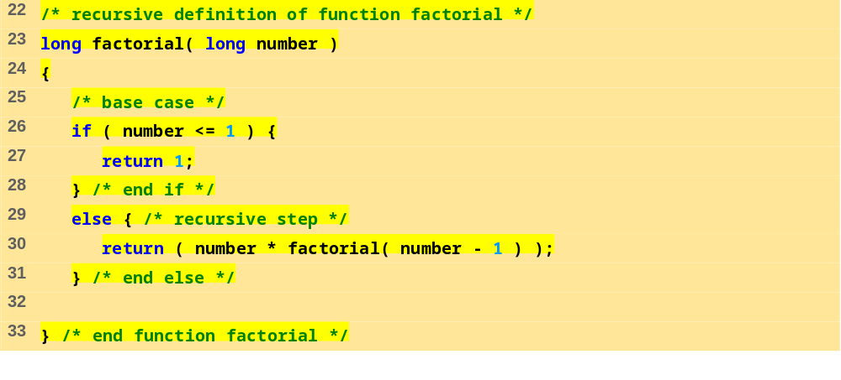
fig05_14.c (Part 2 of 2)
1! = 1
2! = 2
3! = 6
4! = 24
5! = 120
6! = 720
7! = 5040
8! = 40320
9! = 362880
10! = 3628800

Slide 52
5.14 Example Using Recursion: The Fibonacci Series
Fibonacci series: 0, 1, 1, 2, 3, 5, 8...
  Each number is the sum of the previous two
  Can be solved recursively:
    fib( n ) = fib( n - 1 ) + fib( n – 2 )
  Code for the fibonacci function
    long fibonacci( long n )
    {
    if (n == 0 || n == 1) // base case
    return n;
    else
    return fibonacci( n - 1) +
    fibonacci( n – 2 );
    }

Slide 53
5.14 Example Using Recursion: The Fibonacci Series
Set of recursive calls to function fibonacci
f( 3 )
return
f( 2 )
+
f( 1 )
return
f( 1 )
+
f( 0 )
return 1
return 1
return 0

Slide 54
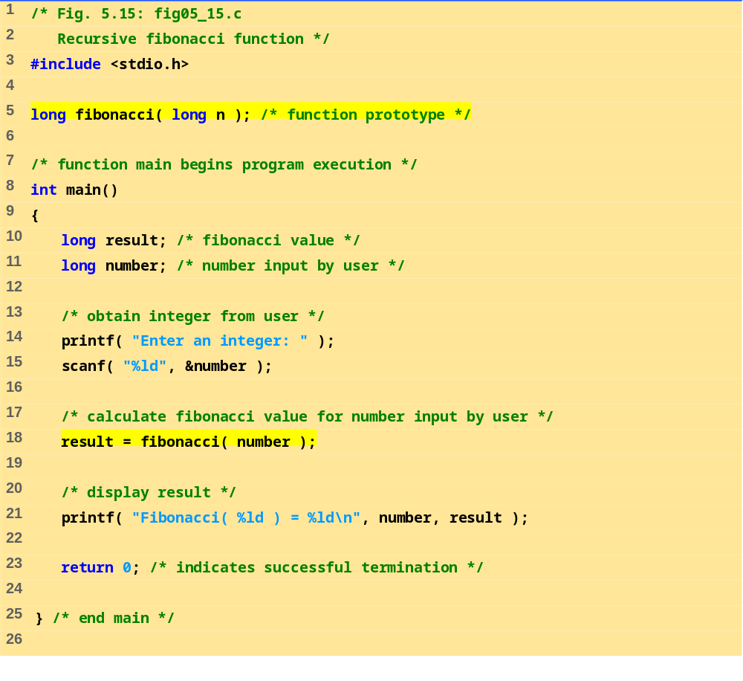
fig05_15.c (Part 1 of 2)

Slide 55
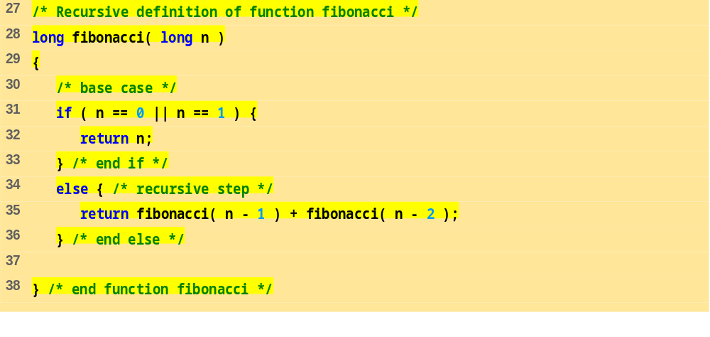
fig05_15.c (Part 2 of 2)
Program Output
Enter an integer: 0
Fibonacci( 0 ) = 0
Enter an integer: 1
Fibonacci( 1 ) = 1
Enter an integer: 2
Fibonacci( 2 ) = 1
Enter an integer: 3
Fibonacci( 3 ) = 2
Enter an integer: 4
Fibonacci( 4 ) = 3

Slide 56
Program Output (continued)
Enter an integer: 5
Fibonacci( 5 ) = 5
Enter an integer: 6
Fibonacci( 6 ) = 8
Enter an integer: 10
Fibonacci( 10 ) = 55
Enter an integer: 20
Fibonacci( 20 ) = 6765
Enter an integer: 30
Fibonacci( 30 ) = 832040
Enter an integer: 35
Fibonacci( 35 ) = 9227465

Slide 57
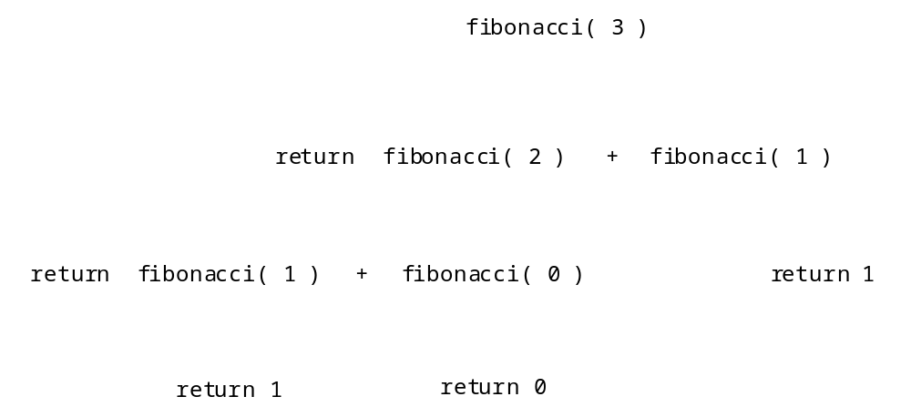
5.14 Example Using Recursion: The Fibonacci Series

Slide 58
5.15 Recursion vs. Iteration
Repetition
  Iteration: explicit loop
  Recursion: repeated function calls
Termination
  Iteration: loop condition fails
  Recursion: base case recognized
Both can have infinite loops
Balance
  Choice between performance (iteration) and good software engineering (recursion)

Slide 59
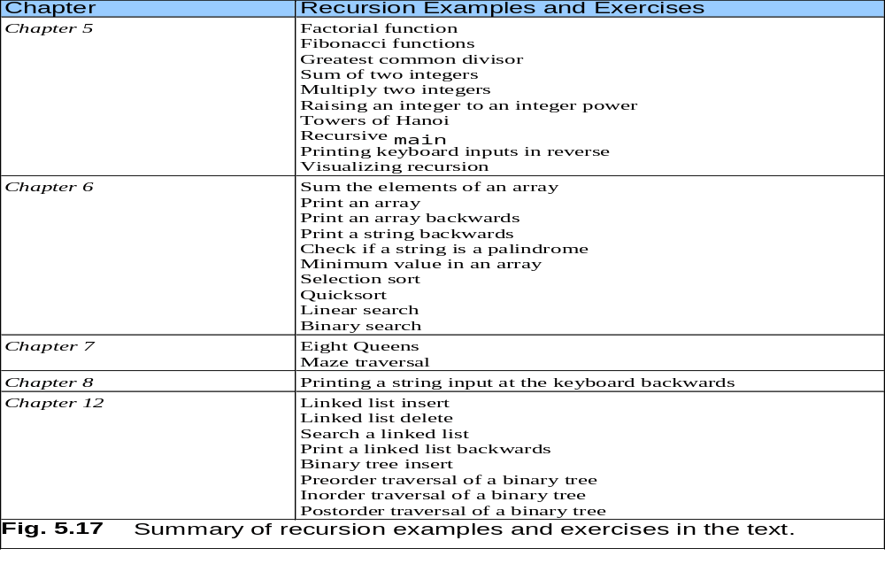
5.15 Recursion vs. Iteration

