Slide 1
Computer System Overview
Chapter 1

Slide 2
Operating System
Exploits the hardware resources of one or more processors
Provides a set of services to system users
Manages secondary memory and I/O devices

Slide 3
Basic Elements
Processor
Main Memory
  referred to as real memory or primary memory
  volatile
I/O modules
  secondary memory devices
  communications equipment
  terminals
System bus
  communication among processors, memory, and I/O modules

Slide 4
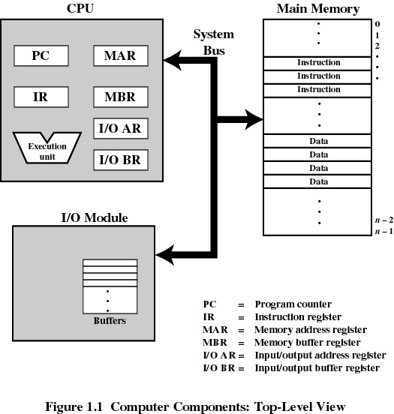
Top-Level Components

Slide 5
Processor Registers
User-visible registers
  Enable programmer to minimize main-memory references by optimizing register use
Control and status registers
  Used by processor to control operating of the processor
  Used by operating-system routines to control the execution of programs

Slide 6
User-Visible Registers
May be referenced by machine language
Available to all programs - application programs and system programs
Types of registers
  Data
  Address
    Index
    Segment pointer
    Stack pointer

Slide 7
User-Visible Registers
Address Registers
  Index
    involves adding an index to a base value to get an address
  Segment pointer
    when memory is divided into segments, memory is referenced by a segment and an offset
  Stack pointer
    points to top of stack

Slide 8
Control and Status Registers
Program Counter (PC)
  Contains the address of an instruction to be fetched
Instruction Register (IR)
  Contains the instruction most recently fetched
Program Status Word (PSW)
  condition codes
  Interrupt enable/disable
  Supervisor/user mode

Slide 9
Control and Status Registers
Condition Codes or Flags
  Bits set by the processor hardware as a result of operations
  Can be accessed by a program but not altered
  Examples
    positive result
    negative result
    zero
    Overflow

Slide 10
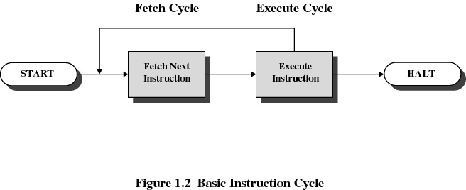
Instruction Cycle

Slide 11
Instruction Fetch and Execute
The processor fetches the instruction from memory
Program counter (PC) holds address of the instruction to be fetched next
Program counter is incremented after each fetch

Slide 12
Instruction Register
Fetched instruction is placed in the instruction register
Types of instructions
  Processor-memory
    transfer data between processor and memory
  Processor-I/O
    data transferred to or from a peripheral device
  Data processing
    arithmetic or logic operation on data
  Control
    alter sequence of execution

Slide 13
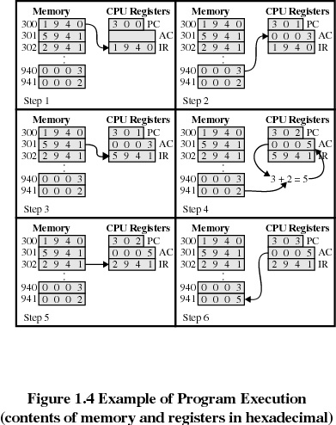
Example of Program Execution

Slide 14
Direct Memory Access (DMA)
I/O exchanges occur directly with memory
Processor grants I/O module authority to read from or write to memory
Relieves the processor responsibility for the exchange
Processor is free to do other things

Slide 15
Interrupts
An interruption of the normal sequence of execution
Improves processing efficiency
Allows the processor to execute other instructions while an I/O operation is in progress
A suspension of a process caused by an event external to that process and performed in such a way that the process can be resumed

Slide 16
Classes of Interrupts
Program
  arithmetic overflow
  division by zero
  execute illegal instruction
  reference outside user’s memory space
Timer
I/O
Hardware failure

Slide 17
Interrupt Handler
A program that determines nature of the interrupt and performs whatever actions are needed
Control is transferred to this program
Generally part of the operating system

Slide 18
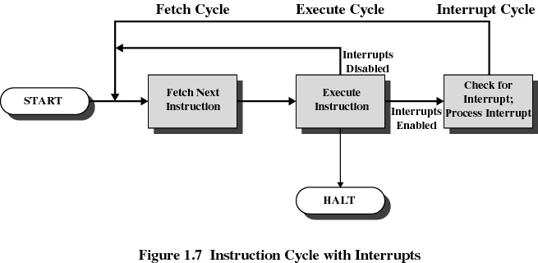
Interrupt Cycle

Slide 19
Interrupt Cycle
Processor checks for interrupts
If no interrupts fetch the next instruction for the current program
If an interrupt is pending, suspend execution of the current program, and execute the interrupt handler

Slide 20
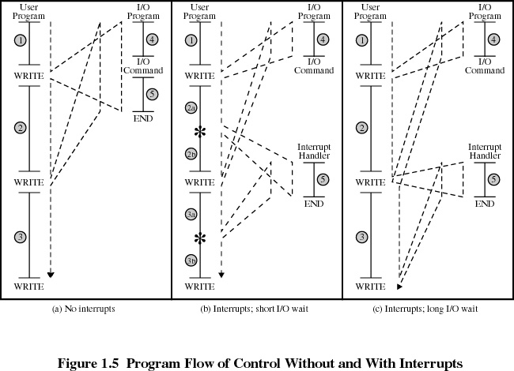

Slide 21
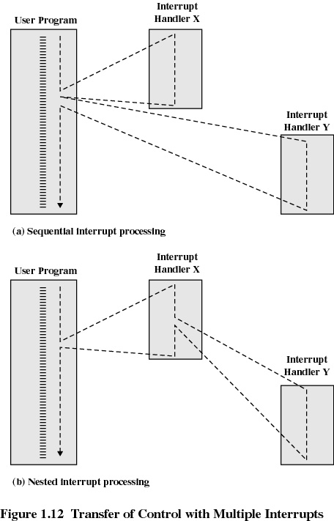
Multiple Interrupts
Disable interrupts while an interrupt is being processed
  Processor ignores any new interrupt request signals

Slide 22
Multiple Interrupts
Sequential Order
Disable interrupts so processor can complete task
Interrupts remain pending until the processor enables interrupts
After interrupt handler routine completes, the processor checks for additional interrupts

Slide 23
Multiple Interrupts
Priorities
Higher priority interrupts cause lower-priority interrupts to wait
Causes a lower-priority interrupt handler to be interrupted
Example when input arrives from communication line, it needs to be absorbed quickly to make room for more input

Slide 24
Multiprogramming
Processor has more than one program to execute
The sequence the programs are executed depend on their relative priority and whether they are waiting for I/O
After an interrupt handler completes, control may not return to the program that was executing at the time of the interrupt

Slide 25
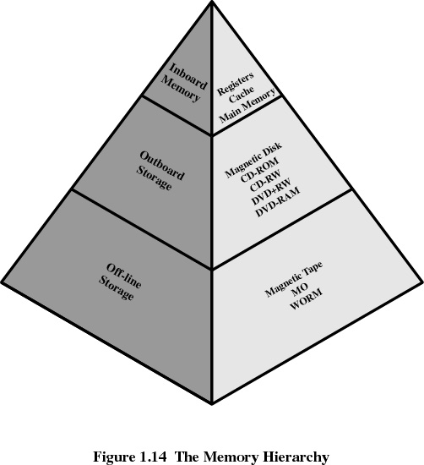
Memory Hierarchy

Slide 26
Going Down the Hierarchy
Decreasing cost per bit
Increasing capacity
Increasing access time
Decreasing frequency of access of the memory by the processor
  locality of reference

Slide 27
Disk Cache
A portion of main memory used as a buffer to temporarily to hold data for the disk
Disk writes are clustered
Some data written out may be referenced again. The data are retrieved rapidly from the software cache instead of slowly from disk

Slide 28
Cache Memory
Invisible to operating system
Increase the speed of memory
Processor speed is faster than memory speed

Slide 29
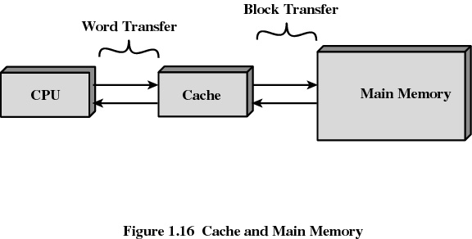
Cache Memory

Slide 30
Cache Memory
Contains a portion of main memory
Processor first checks cache
If not found in cache, the block of memory containing the needed information is moved to the cache

Slide 31
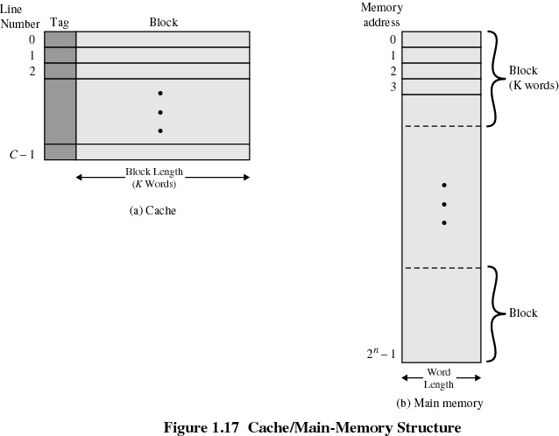
Cache/Main Memory System

Slide 32
Cache Design
Cache size
  small caches have a significant impact on performance
Block size
  the unit of data exchanged between cache and main memory
  hit means the information was found in the cache
  larger block size more hits until probability of using newly fetched data becomes less than the probability of reusing data that has been moved out of cache

Slide 33
Cache Design
Mapping function
  determines which cache location the block will occupy
Replacement algorithm
  determines which block to replace
  Least-Recently-Used (LRU) algorithm

Slide 34
Cache Design
Write policy
  When the memory write operation takes place
  Can occur every time block is updated
  Can occur only when block is replaced
    Minimizes memory operations
    Leaves memory in an obsolete state

Slide 35
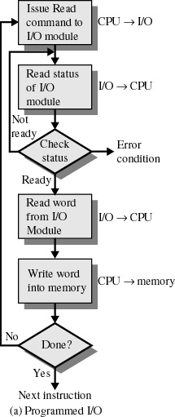
Programmed I/O
I/O module performs the action, not the processor
Sets appropriate bits in the I/O status register
No interrupts occur
Processor checks status until operation is complete

Slide 36
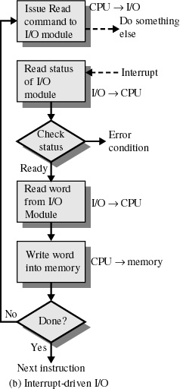
Interrupt-Driven I/O
Processor is interrupted when I/O module ready to exchange data
Processor is free to do other work
No needless waiting
Consumes a lot of processor time because every word read or written passes through the processor

Slide 37
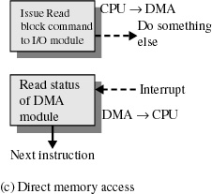
Direct Memory Access
Transfers a block of data directly to or from memory
An interrupt is sent when the task is complete
The processor is only involved at the beginning and end of the transfer

