Slide 1
Operating System Overview
Chapter 2

Slide 2
Operating System
A program that controls the execution of application programs
An interface between applications and hardware

Slide 3
Operating System Objectives
Convenience
  Makes the computer more convenient to use
Efficiency
  Allows computer system resources to be used in an efficient manner
Ability to evolve
  Permit effective development, testing, and introduction of new system functions without interfering with service

Slide 4
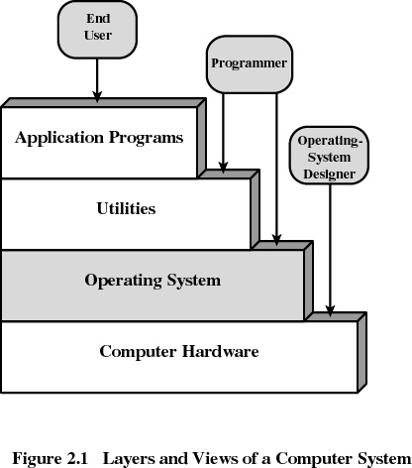
Layers of Computer System

Slide 5
Services Provided by the Operating System
Program development
  Editors and debuggers
Program execution
Access to I/O devices
Controlled access to files
System access

Slide 6
Services Provided by the Operating System
Error detection and response
  internal and external hardware errors
    memory error
    device failure
  software errors
    arithmetic overflow
    access forbidden memory locations
  operating system cannot grant request of application

Slide 7
Services Provided by the Operating System
Accounting
  collect statistics
  monitor performance
  used to anticipate future enhancements
  used for billing users

Slide 8
Operating System
Functions same way as ordinary computer software
  It is program that is executed
Operating system relinquishes control of the processor to execute other programs

Slide 9
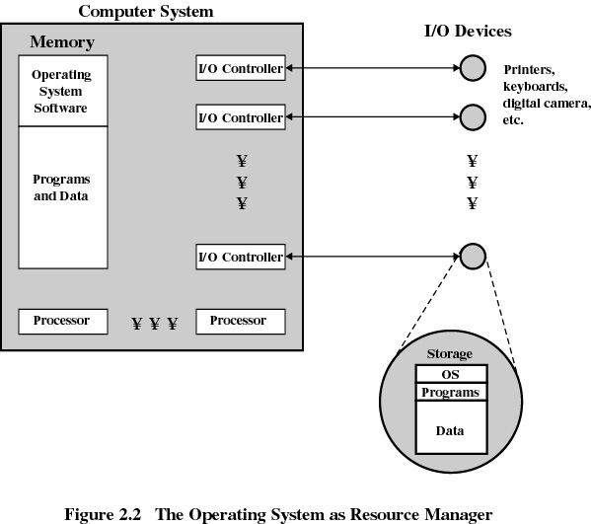

Slide 10
Kernel
Portion of operating system that is in main memory
Contains most-frequently used functions
Also called the nucleus

Slide 11
Evolution of an Operating System
Hardware upgrades and new types of hardware
New services
Fixes

Slide 12
Evolution of Operating Systems
Serial Processing
  No operating system
  Machines run from a console with display lights and toggle switches, input device, and printer
  Schedule tome
  Setup included loading the compiler, source program, saving compiled program, and loading and linking

Slide 13
Evolution of Operating Systems
Simple Batch Systems
  Monitors
    Software that controls the running programs
    Batch jobs together
    Program branches back to monitor when finished
    Resident monitor is in main memory and available for execution

Slide 14
Job Control Language (JCL)
Special type of programming language
Provides instruction to the monitor
  what compiler to use
  what data to use

Slide 15
Hardware Features
Memory protection
  do not allow the memory area containing the monitor to be altered
Timer
  prevents a job from monopolizing the system

Slide 16
Hardware Features
Memory protection
  do not allow the memory area containing the monitor to be altered
Timer
  prevents a job from monopolizing the system

Slide 17

Uniprogramming
Processor must wait for I/O instruction to complete before preceding

Slide 18
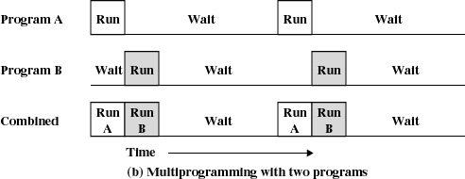
Multiprogramming
When one job needs to wait for I/O, the processor can switch to the other job

Slide 19
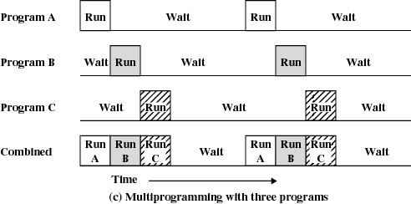
Multiprogramming

Slide 20
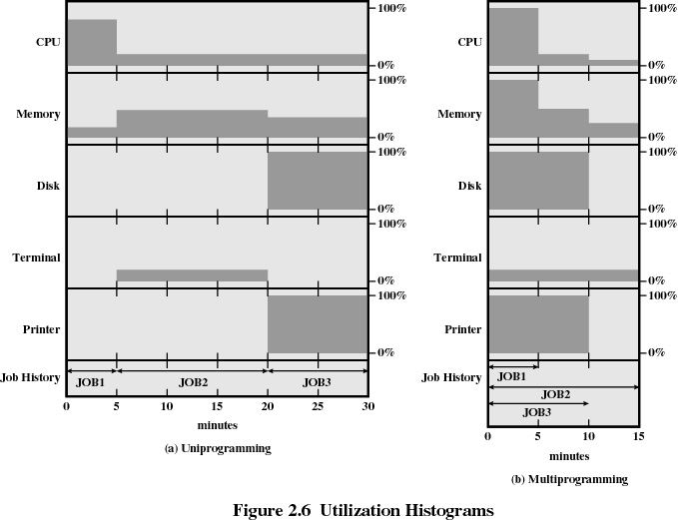

Slide 21
Example
JOB1 JOB2 JOB3
Type of job Heavy compute Heavy I/O Heavy I/O
Duration 5 min. 15 min. 10 min.
Memory required 50K 100 K 80 K
Need disk? No No Yes
Need terminal No Yes No
Need printer? No No Yes

Slide 22
Effects of Multiprogramming
Uniprogramming Multiprogramming
Processor use 22% 43%
Memory use 30% 67%
Disk use 33% 67%
Printer use 33% 67%
Elapsed time 30 min. 15 min.
Throughput rate 6 jobs/hr 12 jobs/hr
Mean response time 18 min. 10 min.

Slide 23
Time Sharing
Using multiprogramming to handle multiple interactive jobs
Processor’s time is shared among multiple users
Multiple users simultaneously access the system through terminals

Slide 24
Batch Multiprogramming versus Time Sharing
 | Batch Multiprogramming | Time Sharing
Principal objective | Maximize processor use | Minimize response time
Source of directives to operating system | Job control language commands provided with the job | Commands entered at the terminal

Slide 25
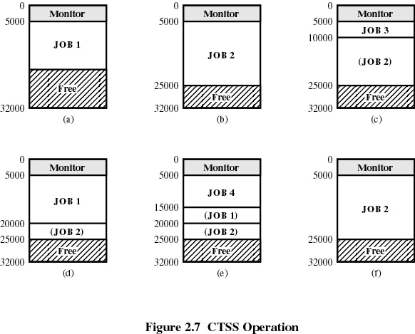

Slide 26
Major Achievements
Processes
Memory Management
Information protection and security
Scheduling and resource management
System structure

Slide 27
Processes
A program in execution
An instance of a program running on a computer
The entity that can be assigned to and executed on a processor
A unit of activity characterized by a single sequential thread of execution, a current state, and an associated set of system resources

Slide 28
Difficulties with Designing
System Software
Improper synchronization
  ensure a process waiting for an I/O device receives the signal
Failed mutual exclusion
Nondeterminate program operation
  program should only depend on input to it, not relying on common memory areas
Deadlocks

Slide 29
Process
Consists of three components
  An executable program
  Associated data needed by the program
  Execution context of the program
    All information the operating system needs to manage the process

Slide 30
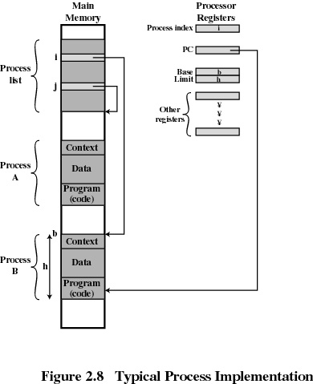
Process

Slide 31
Memory Management
Process isolation
Automatic allocation and management
Support for modular programming
Protection and access control
Long-term storage

Slide 32
Virtual Memory
Allows programmers to address memory from a logical point of view
While one process is written out to secondary store and the successor process read in there in no hiatus

Slide 33
File System
Implements long-term store
Information stored in named objects called files

Slide 34
Paging
Allows process to be comprised of a number of fixed-size blocks, called pages
Virtual address is a page number and an offset within the page
Each page may be located any where in main memory
Real address or physical address in main memory

Slide 35
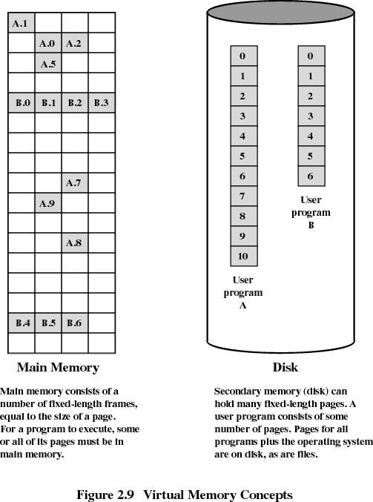

Slide 36
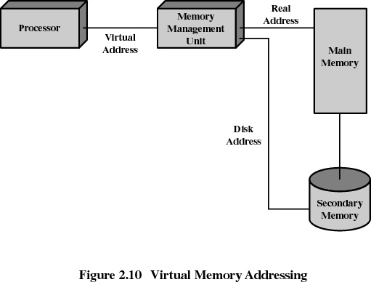
Virtual Memory Addressing

Slide 37
Information Protection and Security
Access control
  regulate user access to the system
Information flow control
  regulate flow of data within the system and its delivery to users
Certification
  proving that access and flow control perform according to specifications

Slide 38
Scheduling and Resource Management
Fairness
  give equal and fair access to all processes
Differential responsiveness
  discriminate between different classes of jobs
Efficiency
  maximize throughput, minimize response time, and accommodate as many uses as possible

Slide 39
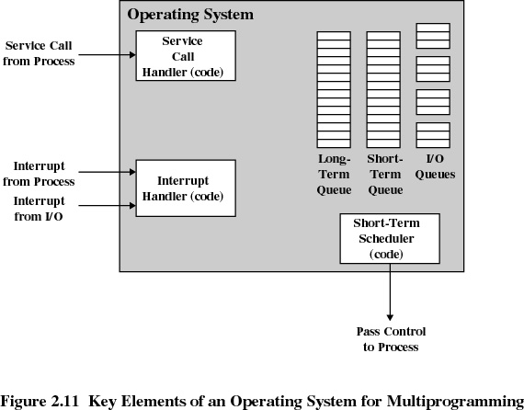
Major Elements of
Operating System

Slide 40
System Structure
View the system as a series of levels
Each level performs a related subset of functions
Each level relies on the next lower level to perform more primitive functions
This decomposes a problem into a number of more manageable subproblems

Slide 41
Operating System Design Hierarchy
Level Name Objects Example Operations
13 Shell User programming Statements in shell language
environment
12 User processes User processes Quit, kill, suspend, resume
11 Directories Directories Create, destroy, attach, detach,
search, list
10 Devices External devices, such Open, close,
as printer, displays read, write
and keyboards
9 File system Files Create, destroy, open, close
read, write
8 Communications Pipes Create, destroy, open. close,
read, write

Slide 42
Operating System Design Hierarchy
Level Name Objects Example Operations
7 Virtual Memory Segments, pages Read, write, fetch
6 Local secondary Blocks of data, device Read, write, allocate, free
store channels
5 Primitive processes Primitive process, Suspend, resume, wait, signal
semaphores, ready
list

Slide 43
Operating System Design Hierarchy
Level Name Objects Example Operations
4 Interrupts Interrupt-handling Invoke, mask, unmask, retry
programs
Procedures Procedures, call stack, Mark stack, call, return
display
2 Instruction Set Evaluation stack, micro- Load, store, add, subtract
program interpreter, branch
scalar and array data
1 Electronic circuits Registers, gates, buses, Clear, transfer, activate,
etc. complement

Slide 44
Characteristics of Modern Operating Systems
Microkernel architecture
  assigns only a few essential functions to the kernel
    address space
    interprocess communication (IPC)
    basic scheduling

Slide 45
Characteristics of Modern Operating Systems
Multithreading
  process is divided into threads that can run simultaneously
Thread
  dispatchable unit of work
  executes sequentially and is interruptable
Process is a collection of one or more threads

Slide 46
Characteristics of Modern Operating Systems
Symmetric multiprocessing
  there are multiple processors
  these processors share same main memory and I/O facilities
  All processors can perform the same functions

Slide 47
Characteristics of Modern Operating Systems
Distributed operating systems
  provides the illusion of a single main memory and single secondary memory space
  used for distributed file system

Slide 48
Characteristics of Modern Operating Systems
Object-oriented design
  used for adding modular extensions to a small kernel
  enables programmers to customize an operating system without disrupting system integrity

Slide 49
Windows 2000
Exploits the power of today’s 32-bit microprocessors
Provides full multitasking in a single-user environment
Client/Server computing

Slide 50
Windows 2000 Architecture
Modular structure for flexibility
Executes on a variety of hardware platforms
Supports application written for a variety of other operating system

Slide 51
OS Organization
Modified microkernel architecture
  Not a pure microkernel
  Many system functions outside of the microkernel run in kernel mode
Any module can be removed, upgraded, or replaced without rewriting the entire system

Slide 52
Layered Structure
Hardware abstraction layer (HAL)
  Isolates the operating system from platform-specific hardware differences
Microkernel
  Most-used and most fundamental components of the operating system
Device drivers
  Translate user I/O function calls into specific hardware device I/O requests

Slide 53
W2K Executive
I/O manager
Object manager
Security reference monitor
Process/thread manager
Local procedure call (LPC) Facility
Virtual memory manager
Cache manager
Windows/graphics modules

Slide 54
User Processes
Special system support processes
  Ex: logon process and the session manager
Server processes
Environment subsystems
User applications

Slide 55
Client/Server Model
Simplifies the Executive
  possible to construct a variety of APIs
Improves reliability
  each service runs as a separate process with its own partition of memory
  clients cannot not directly access hardware
Provides a uniform means fro applications to communicate via LPC
Provides base for distributed computing

Slide 56
Threads and SMP
Different routines can execute simultaneously on different processors
Multiple threads of execution within a single process may execute on different processors simultaneously
Server processes may use multiple threads
Share data and resources between process

Slide 57
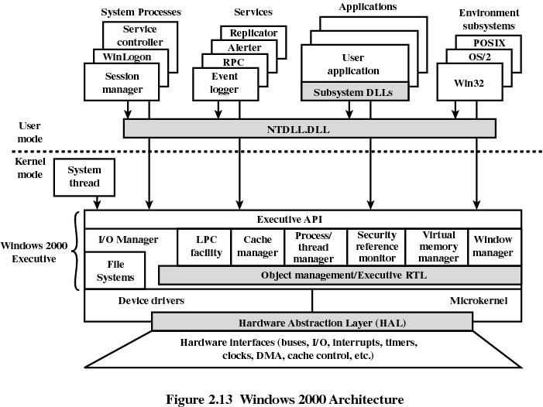

Slide 58
UNIX
Hardware is surrounded by the operating-system
Operating system is called the kernel
Comes with a number of user services and interfaces
  shell
  C compiler

Slide 59
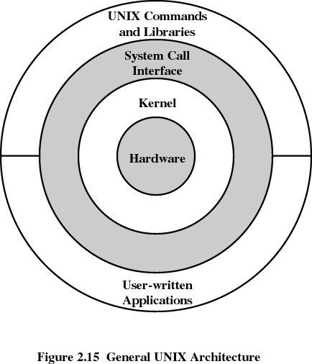
UNIX

Slide 60
Modern UNIX Systems
System V Release 4 (SVR4)
Solaris 2.x
4.4BSD
Linux

