Slide 1
Uniprocessor Scheduling
Chapter 9

Slide 2
Aim of Scheduling
Response time
Throughput
Processor efficiency

Slide 3
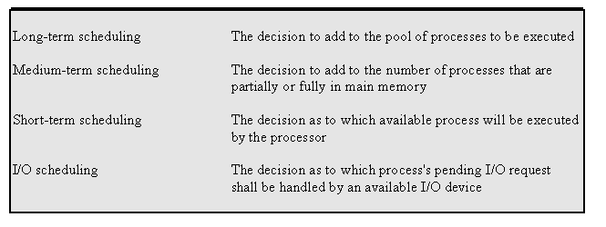
Types of Scheduling

Slide 4
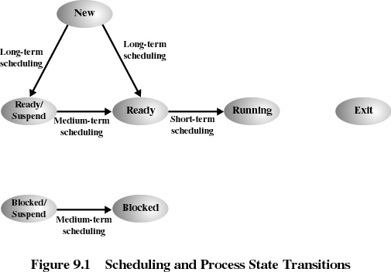

Slide 5
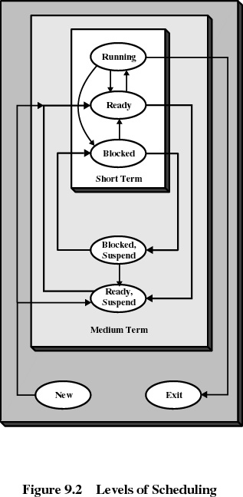

Slide 6
Long-Term Scheduling
Determines which programs are admitted to the system for processing
Controls the degree of multiprogramming
More processes, smaller percentage of time each process is executed

Slide 7
Medium-Term Scheduling
Part of the swapping function
Based on the need to manage the degree of multiprogramming

Slide 8
Short-Term Scheduling
Known as the dispatcher
Executes most frequently
Invoked when an event occurs
  Clock interrupts
  I/O interrupts
  Operating system calls
  Signals

Slide 9
Short-Tem Scheduling Criteria
User-oriented
  Response Time
    Elapsed time between the submission of a request until there is output.
System-oriented
  Effective and efficient utilization of the processor

Slide 10
Short-Term Scheduling Criteria
Performance-related
  Quantitative
  Measurable such as response time and throughput
Not performance related
  Qualitative
  Predictability

Slide 11
Priorities
Scheduler will always choose a process of higher priority over one of lower priority
Have multiple ready queues to represent each level of priority
Lower-priority may suffer starvation
  allow a process to change its priority based on its age or execution history

Slide 12
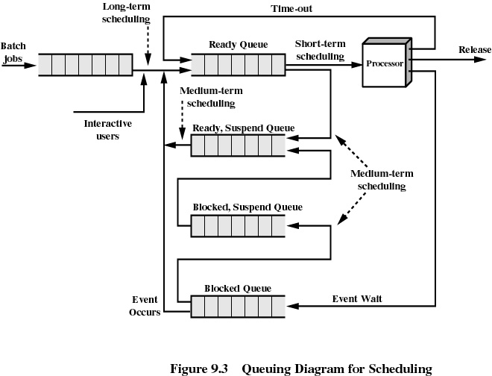

Slide 13
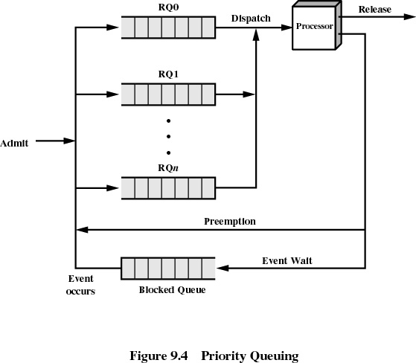

Slide 14
Decision Mode
Nonpreemptive
  Once a process is in the running state, it will continue until it terminates or blocks itself for I/O
Preemptive
  Currently running process may be interrupted and moved to the Ready state by the operating system
  Allows for better service since any one process cannot monopolize the processor for very long

Slide 15
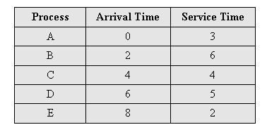
Process Scheduling Example

Slide 16
First-Come-First-Served
(FCFS)
Each process joins the Ready queue
When the current process ceases to execute, the oldest process in the Ready queue is selected
0
5
10
15
20
1
2
3
4
5

Slide 17
First-Come-First-Served
(FCFS)
A short process may have to wait a very long time before it can execute
Favors CPU-bound processes
  I/O processes have to wait until CPU-bound process completes

Slide 18
Round-Robin
Uses preemption based on a clock
An amount of time is determined that allows each process to use the processor for that length of time
0
5
10
15
20
1
2
3
4
5

Slide 19
Round-Robin
Clock interrupt is generated at periodic intervals
When an interrupt occurs, the currently running process is placed in the read queue
  Next ready job is selected
Known as time slicing

Slide 20
Shortest Process Next
5
Nonpreemptive policy
Process with shortest expected processing time is selected next
Short process jumps ahead of longer processes
0
10
15
20
1
2
3
4
5

Slide 21
Shortest Process Next
Predictability of longer processes is reduced
If estimated time for process not correct, the operating system may abort it
Possibility of starvation for longer processes

Slide 22
Shortest Remaining Time
Preemptive version of shortest process next policy
Must estimate processing time
0
5
10
15
20
1
2
3
4
5

Slide 23
Highest Response Ratio Next (HRRN)
Choose next process with the lowest ratio
0
5
10
15
20
1
2
3
4
5
time spent waiting + expected service time
expected service time

Slide 24
Feedback
5
Penalize jobs that have been running longer
Don’t know remaining time process needs to execute
0
10
15
20
1
2
3
4
5

Slide 25
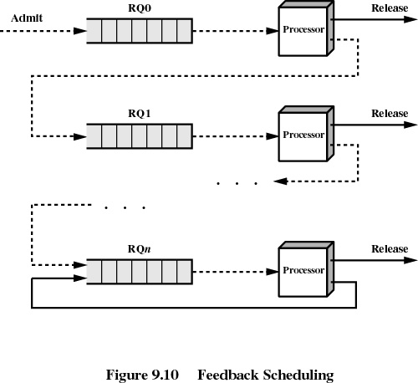

Slide 26
Fair-Share Scheduling
User’s application runs as a collection of processes (threads)
User is concerned about the performance of the application
Need to make scheduling decisions based on process sets

Slide 27
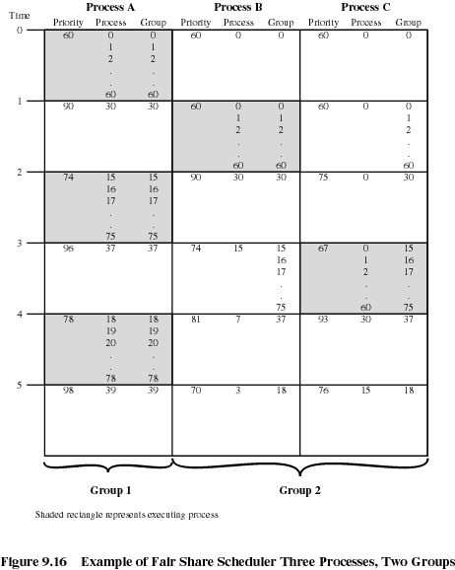

Slide 28
Traditional
UNIX Scheduling
Multilevel feedback using round robin within each of the priority queues
Priorities are recomputed once per second
Base priority divides all processes into fixed bands of priority levels
Adjustment factor used to keep process in its assigned band

Slide 29
Bands
Decreasing order of priority
  Swapper
  Block I/O device control
  File manipulation
  Character I/O device control
  User processes

Slide 30
