Slide 1
The Transport Layer
Chapter 6

Slide 2
Transport Service
Upper Layer Services
Transport Service Primitives
Berkeley Sockets
Example of Socket Programming:
Internet File Server

Slide 3
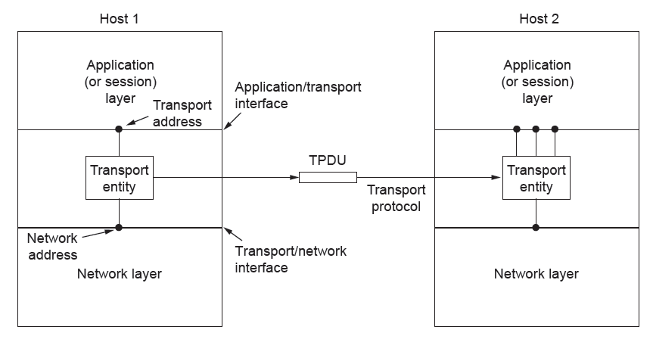
Services Provided to the Upper Layers
The network, transport, and application layers

Slide 4
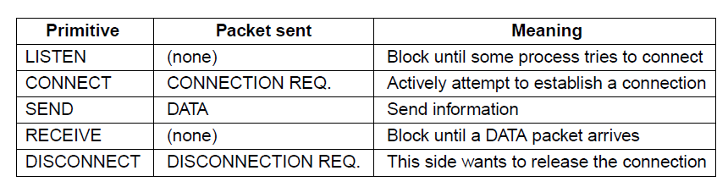
Transport Service Primitives (1)
The primitives for a simple transport service

Slide 5
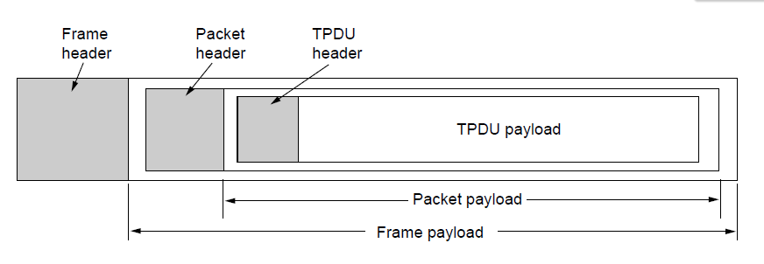
Transport Service Primitives (2)
Nesting of TPDUs, packets, and frames.

Slide 6
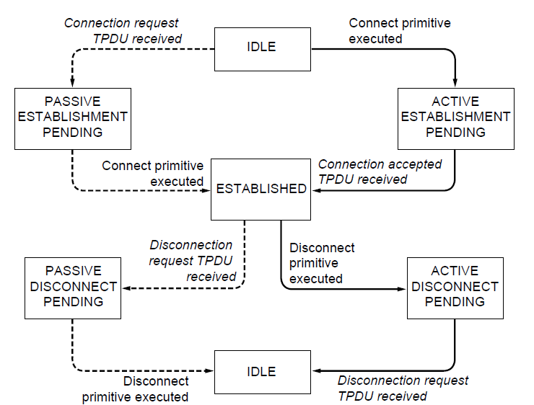
Berkeley Sockets (1)
A state diagram for a simple connection management scheme. Transitions labeled in italics are caused by packet arrivals. The solid lines show the client’s state sequence. The dashed lines show the server’s state sequence.

Slide 7
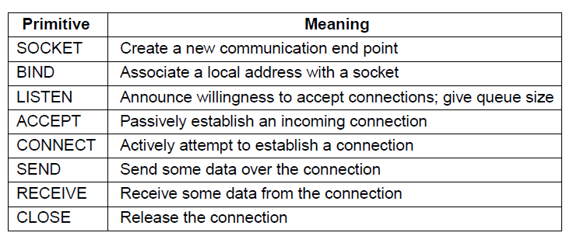
Berkeley Sockets (2)
The socket primitives for TCP

Slide 8
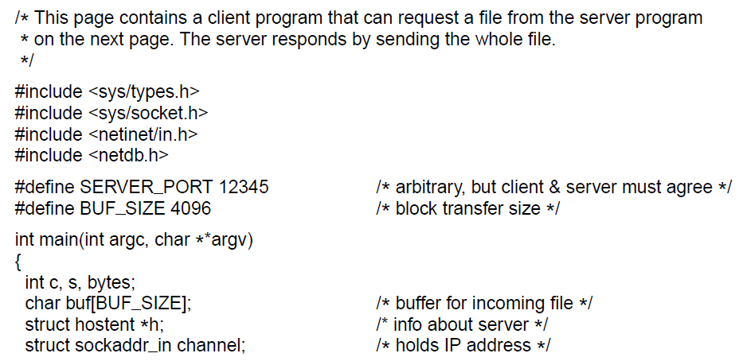
Example of Socket Programming:
An Internet File Server (1)
. . .
Client code using sockets

Slide 9
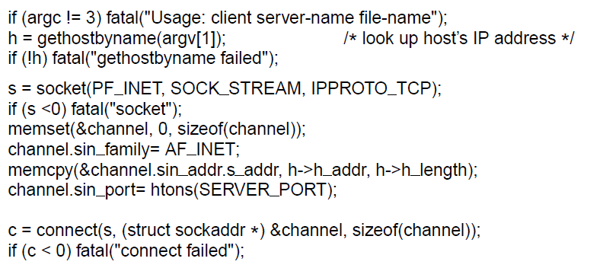
Example of Socket Programming:
An Internet File Server (2)
. . .
. . .
Client code using sockets

Slide 10
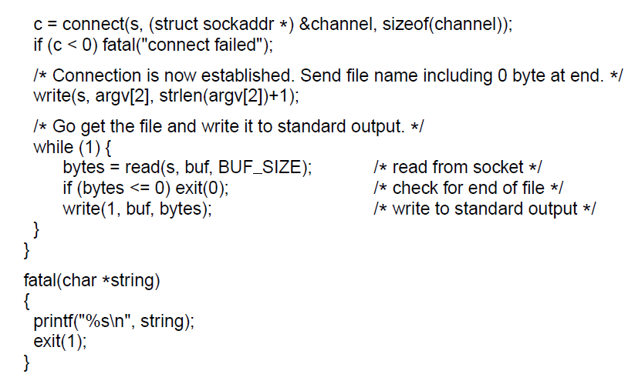
Example of Socket Programming:
An Internet File Server (3)
. . .
Client code using sockets

Slide 11
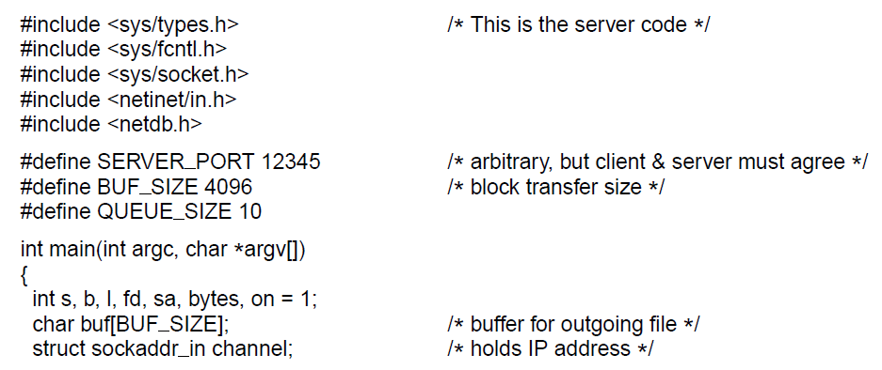
Example of Socket Programming:
An Internet File Server (4)
. . .
Server code

Slide 12
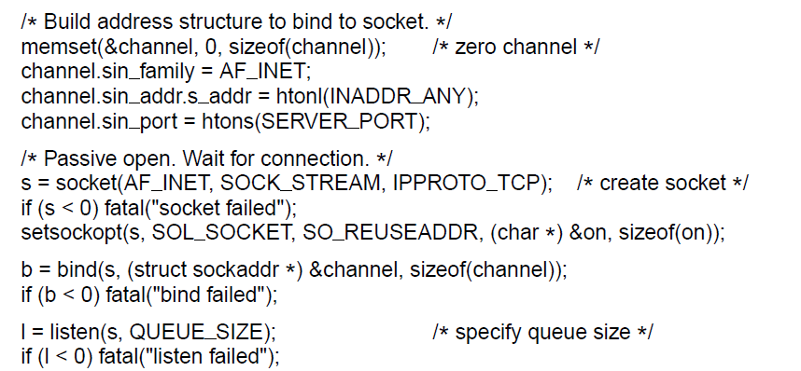
Example of Socket Programming:
An Internet File Server (5)
. . .
. . .
Server code

Slide 13
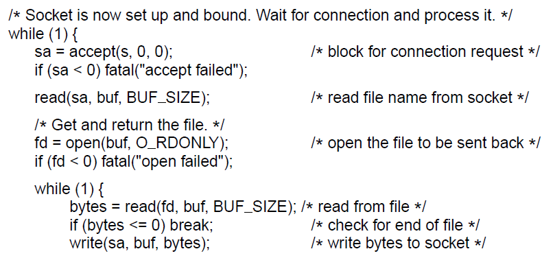
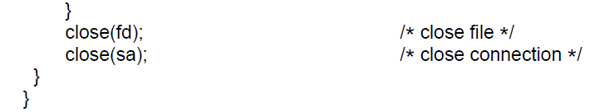
Example of Socket Programming:
An Internet File Server (6)
. . .
Server code

Slide 14
Elements of Transport Protocols (1)
Addressing
Connection establishment
Connection release
Error control and flow control
Multiplexing
Crash recovery

Slide 15
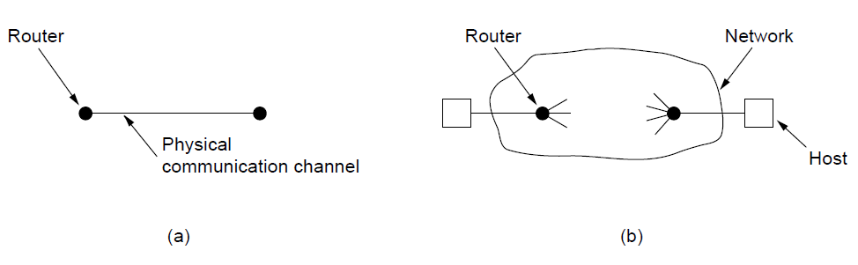
Elements of Transport Protocols (2)
Environment of the data link layer.
Environment of the transport layer.

Slide 16
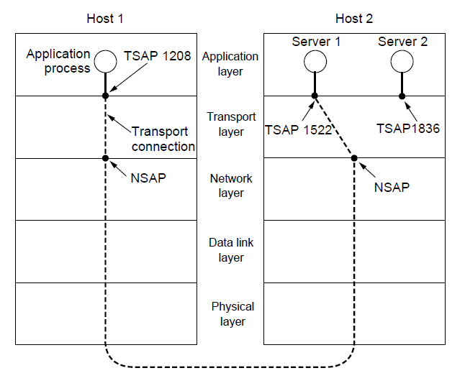
Addressing (1)
TSAPs, NSAPs, and transport connections

Slide 17
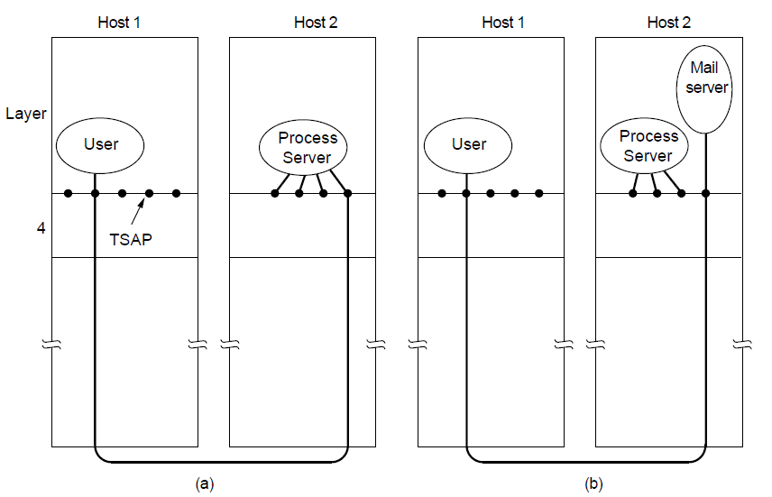
Addressing (2)
How a user process in host 1 establishes a connection
with a mail server in host 2 via a process server.

Slide 18
Connection Establishment (1)
Techniques for restricting packet lifetime
Restricted network design.
Putting a hop counter in each packet.
Timestamping each packet.

Slide 19
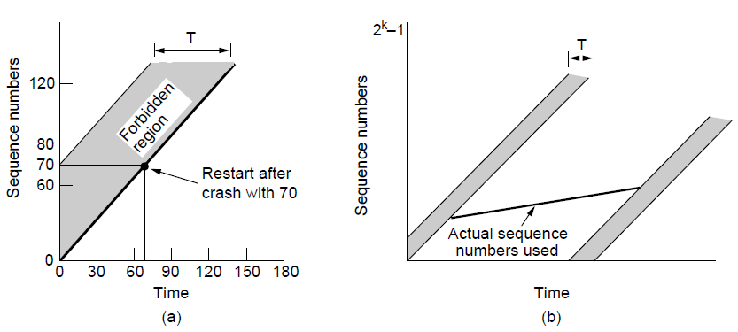
Connection Establishment (2)
TPDUs may not enter the forbidden region.
The resynchronization problem.

Slide 20
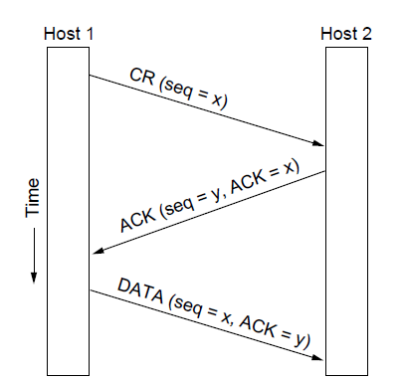
Connection Establishment (3)
Three protocol scenarios for establishing a connection using a
three-way handshake. CR denotes CONNECTION REQUEST. Normal operation.

Slide 21
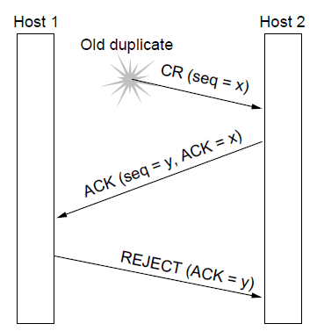
Connection Establishment (4)
Three protocol scenarios for establishing a connection using a
three-way handshake. CR denotes CONNECTION REQUEST. Old duplicate CONNECTION REQUEST appearing out of nowhere.

Slide 22
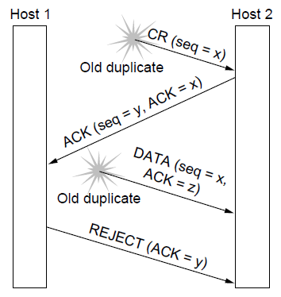
Connection Establishment (5)
Three protocol scenarios for establishing a connection using a
three-way handshake. CR denotes CONNECTION REQUEST. Duplicate CONNECTION REQUEST and duplicate ACK

Slide 23
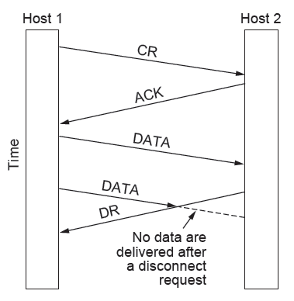
Connection Release (1)
Abrupt disconnection with loss of data

Slide 24
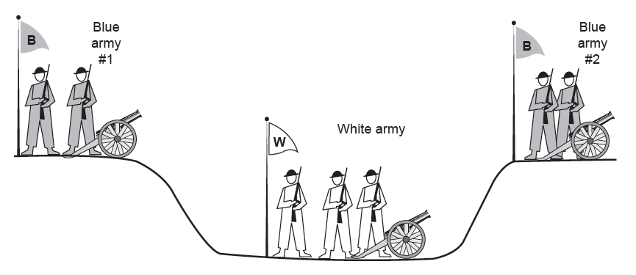
Connection Release (2)
The two-army problem

Slide 25
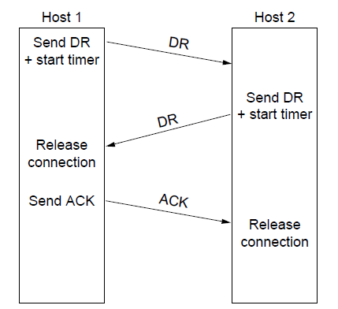
Connection Release (3)
Four protocol scenarios for releasing a connection.
(a) Normal case of three-way handshake

Slide 26
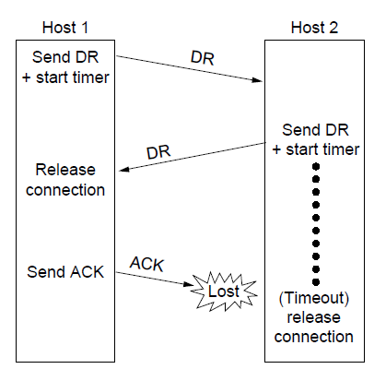
Connection Release (4)
Four protocol scenarios for releasing a connection.
(b) Final ACK lost.

Slide 27
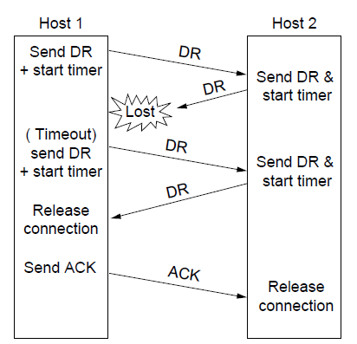
Connection Release (5)
Four protocol scenarios for releasing a connection.
(c) Response lost

Slide 28
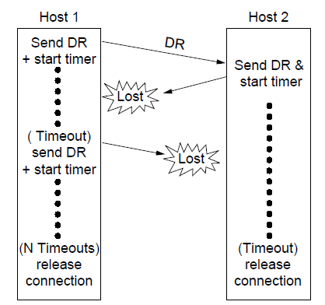
Connection Release (6)
Four protocol scenarios for releasing a connection.
(d) Response lost and subsequent DRs lost.

Slide 29
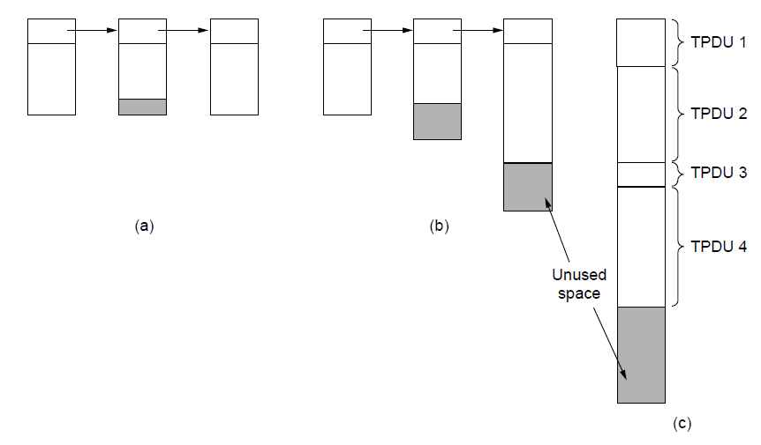
Error Control and Flow Control (1)
(a) Chained fixed-size buffers. (b) Chained variable-sized buffers. (c) One large circular buffer per connection.

Slide 30
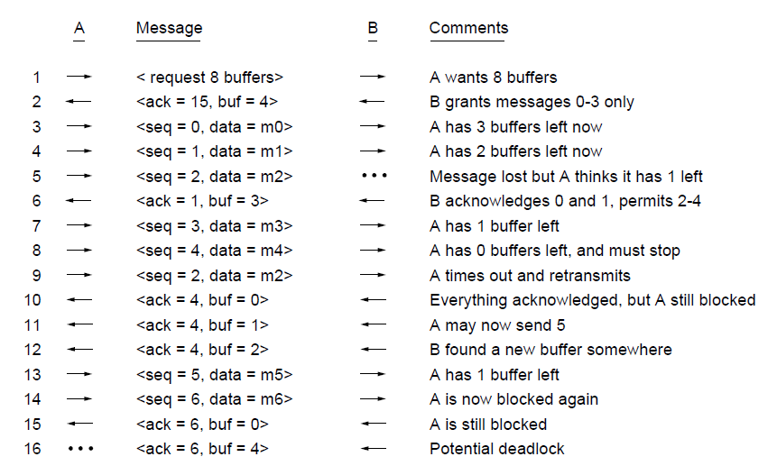
Error Control and Flow Control (2)
Dynamic buffer allocation. The arrows show the direction of transmission. An ellipsis (...) indicates a lost TPDU

Slide 31
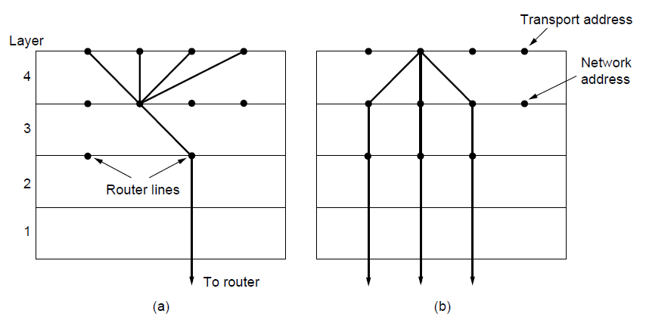
Multiplexing
(a) Multiplexing. (b) Inverse multiplexing.

Slide 32
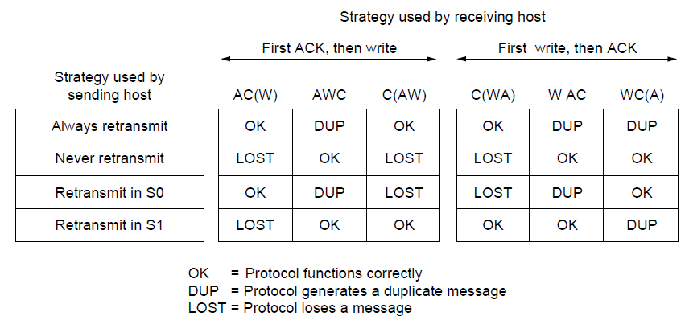
Crash Recovery
Different combinations of client and server strategy

Slide 33
Congestion Control
Desirable bandwidth allocation
Regulating the sending rate

Slide 34
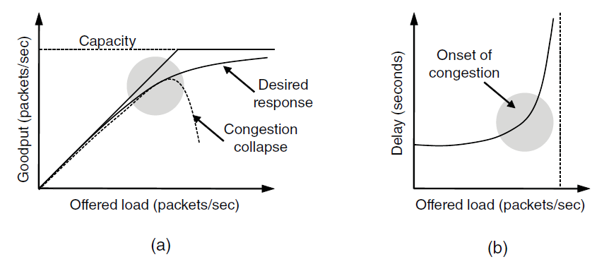
Desirable Bandwidth Allocation (1)
(a) Goodput and (b) delay as a function of offered load

Slide 35
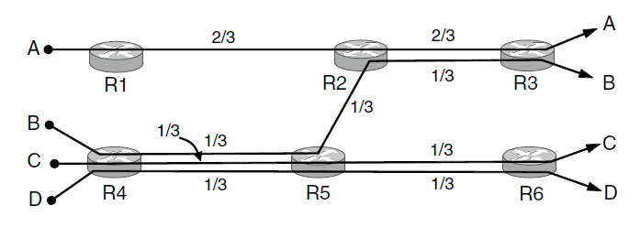
Desirable Bandwidth Allocation (2)
Max-min bandwidth allocation for four flows

Slide 36
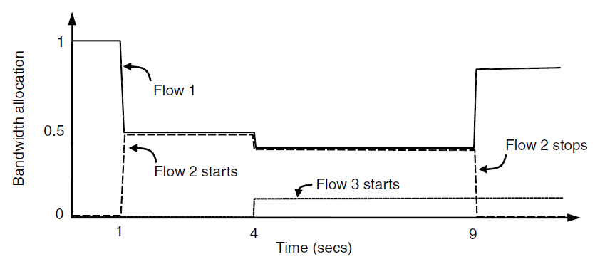
Desirable Bandwidth Allocation (3)
Changing bandwidth allocation over time

Slide 37
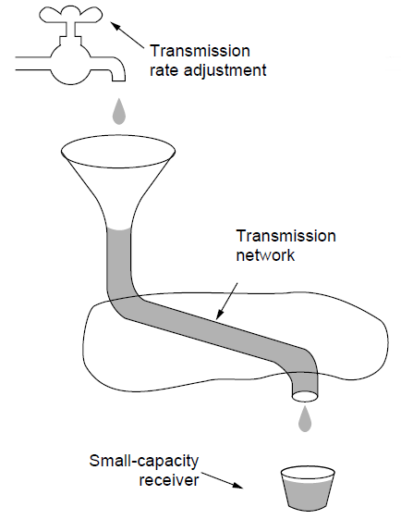
Regulating the Sending Rate (1)
A fast network feeding a low-capacity receiver

Slide 38
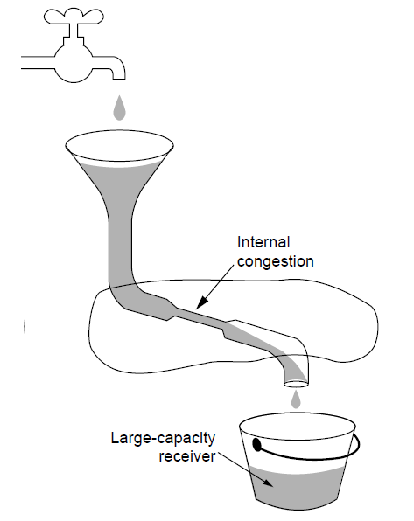
Regulating the Sending Rate (2)
A slow network feeding a high-capacity receiver

Slide 39
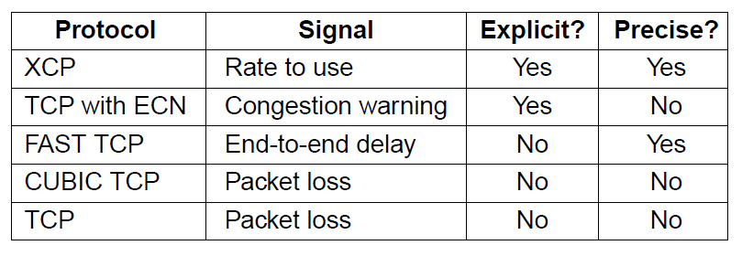
Regulating the Sending Rate (3)
Some congestion control protocols

Slide 40
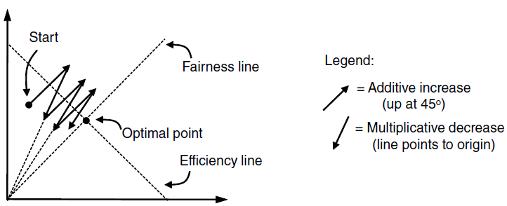
Regulating the Sending Rate (4)
User 2’s allocation
User 1’s allocation
Additive Increase Multiplicative Decrease (AIMD) control law.

Slide 41
The Internet Transport Protocols: UDP
Introduction to UDP
Remote Procedure Call
Real-Time Transport

Slide 42
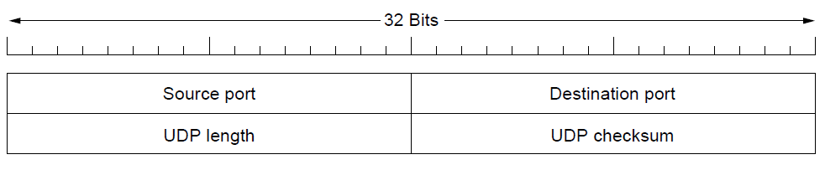
Introduction to UDP (1)
The UDP header.

Slide 43
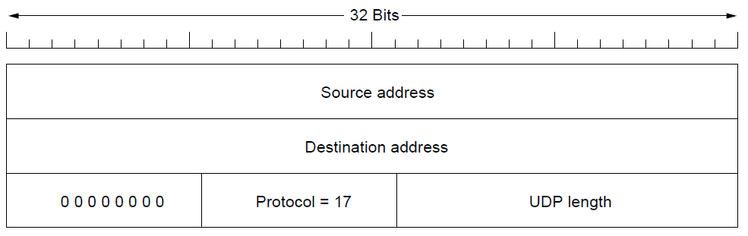
Introduction to UDP (2)
The IPv4 pseudoheader included in the UDP checksum.

Slide 44
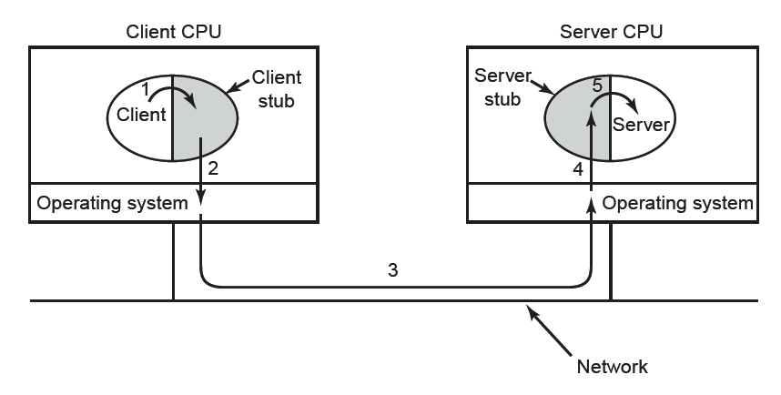
Remote Procedure Call
Steps in making a remote procedure call. The stubs are shaded.

Slide 45
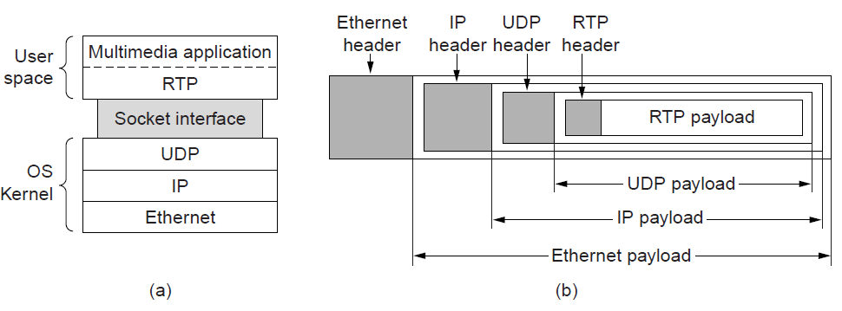
Real-Time Transport (1)
(a) The position of RTP in the protocol stack. (b) Packet nesting.

Slide 46
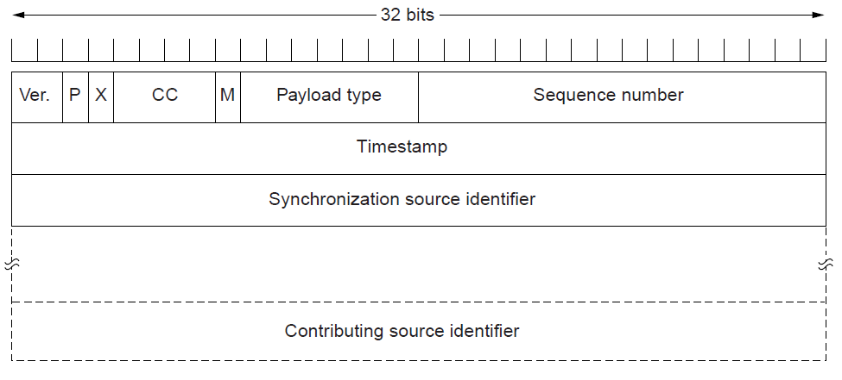
Real-Time Transport (2)
The RTP header

Slide 47
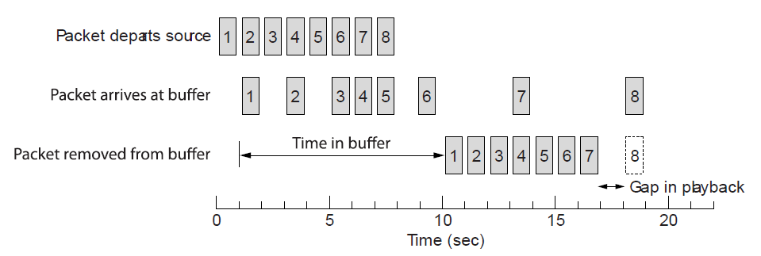
Real-Time Transport (3)
Smoothing the output stream by buffering packets

Slide 48
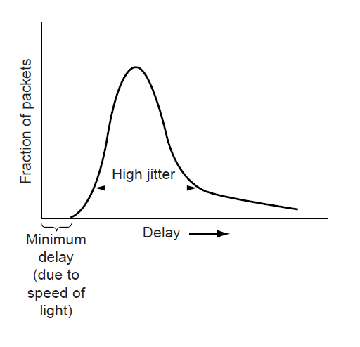
Real-Time Transport (3)
High jitter

Slide 49
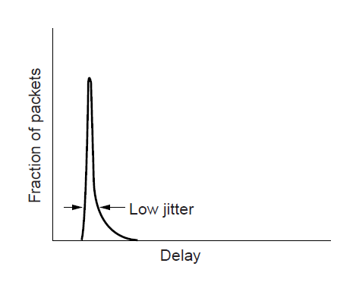
Real-Time Transport (4)
Low jitter

Slide 50
The Internet Transport Protocols: TCP (1)
Introduction to TCP
The TCP service model
The TCP protocol
The TCP segment header
TCP connection establishment
TCP connection release

Slide 51
The Internet Transport Protocols: TCP (2)
TCP connection management modeling
TCP sliding window
TCP timer management
TCP congestion control
TCP futures

Slide 52
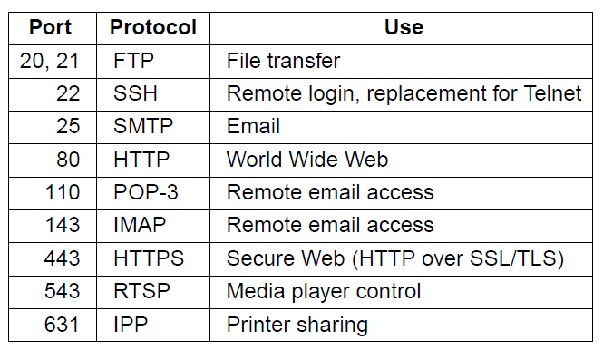
The TCP Service Model (1)
Some assigned ports

Slide 53
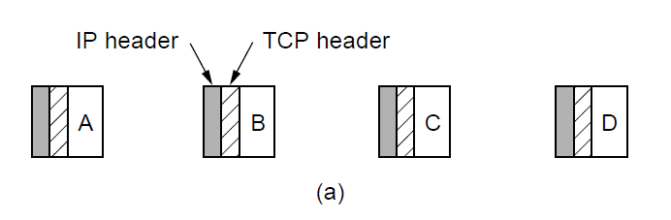
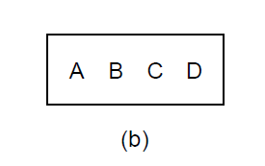
The TCP Service Model (2)
Four 512-byte segments sent as separate IP diagrams
The 2048 bytes of data delivered to the application in a single READ call

Slide 54
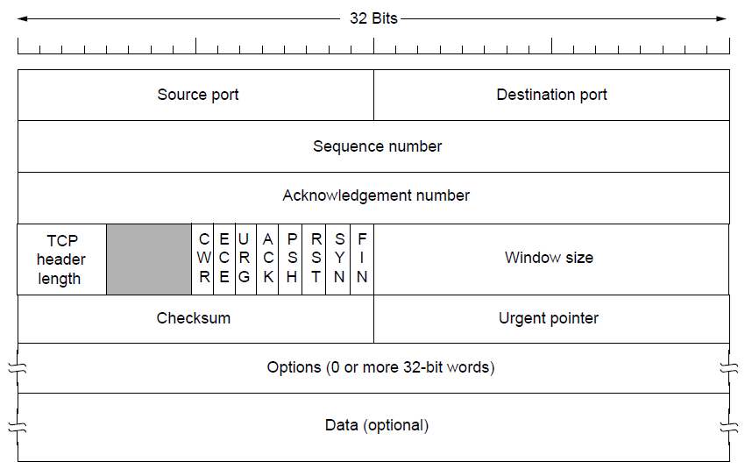
The TCP Segment Header
The TCP header.

Slide 55
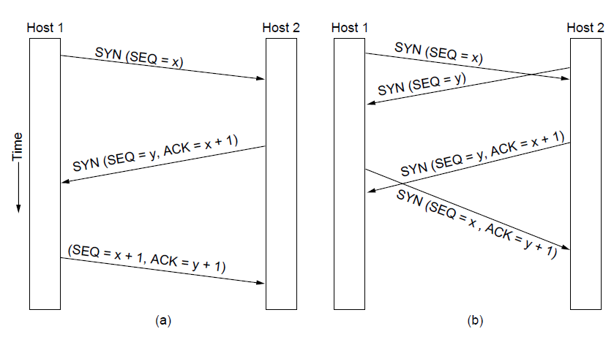
TCP Connection Establishment
TCP connection establishment in the normal case.
Simultaneous connection establishment on both sides.

Slide 56
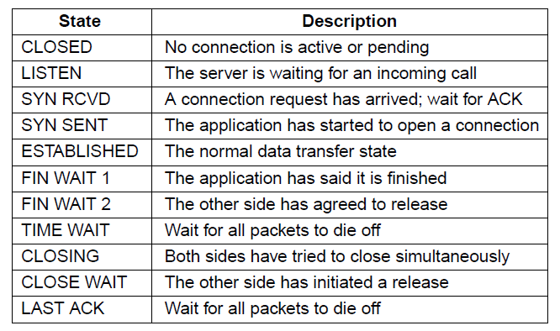
TCP Connection Management Modeling (1)
The states used in the TCP connection
management finite state machine.

Slide 57

TCP Connection Management Modeling (2)
TCP connection management finite state machine.
The heavy solid line is the normal path for a client. The heavy dashed line is the normal path for a server. The light lines are unusual events. Each transition is labeled by the event causing it and the action resulting from it, separated by a slash.

Slide 58

TCP Sliding Window (1)
Window management in TCP

Slide 59

TCP Sliding Window (2)
Silly window syndrome

Slide 60

TCP Timer Management
Probability density of acknowledgment arrival times in data link layer. (b) … for TCP

Slide 61

TCP Congestion Control (1)
Slow start from an initial congestion window of 1 segment

Slide 62

TCP Congestion Control (2)
Additive increase from an initial congestion
window of 1 segment.

Slide 63

TCP Congestion Control (3)
Slow start followed by additive increase in TCP Tahoe.

Slide 64

TCP Congestion Control (4)
Fast recovery and the sawtooth pattern of TCP Reno.

Slide 65
Performance Issues
Performance problems in computer networks
Network performance measurement
System design for better performance
Fast TPDU processing
Protocols for high-speed networks

Slide 66

Performance Problems in Computer Networks
The state of transmitting one megabit from San Diego to Boston. (a) At t = 0. (b) After 500 μ sec.
(c) After 20 msec. (d) After 40 msec.

Slide 67
Network Performance Measurement (1)
Steps to performance improvement
Measure relevant network parameters, performance.
Try to understand what is going on.
Change one parameter.

Slide 68
Network Performance Measurement (2)
Issues in measuring performance
Sufficient sample size
Representative samples
Clock accuracy
Measuring typical representative load
Beware of caching
Understand what you are measuring
Extrapolate with care

Slide 69

Network Performance Measurement (3)
Response as a function of load.

Slide 70
System Design for Better Performance (1)
Rules of thumb
CPU speed more important than network speed
Reduce packet count to reduce software overhead
Minimize data touching
Minimize context switches
Minimize copying
You can buy more bandwidth but not lower delay
Avoiding congestion is better than recovering from it
Avoid timeouts

Slide 71

System Design for Better Performance (2)
Four context switches to handle one packet
with a user-space network manager.

Slide 72

Fast TPDU Processing (1)
The fast path from sender to receiver is shown with a heavy line. The processing steps on this path are shaded.

Slide 73

Fast TPDU Processing (2)
(a) TCP header. (b) IP header. In both cases, the shaded fields are taken from the prototype without change.

Slide 74

Protocols for High-Speed Networks (1)
A timing wheel

Slide 75

Protocols for High-Speed Networks (2)
Time to transfer and acknowledge a
1-megabit file over a 4000-km line

Slide 76
Delay Tolerant Networking
DTN Architecture
The Bundle Protocol

Slide 77

DTN Architecture (1)
Delay-tolerant networking architecture

Slide 78

DTN Architecture (2)
Use of a DTN in space.

Slide 79

The Bundle Protocol (1)
Delay-tolerant networking protocol stack.

Slide 80

The Bundle Protocol (2)
Bundle protocol message format.

Slide 81
End
Chapter 6

