Slide 1
Part 4: Network Layer
Part B: The Internet Routing Protocols

Slide 2
Summary
The IP Protocol
IP Addresses
Internet Control Protocols (ICMP, ARP, RARP, BOOTP, and DHCP)
Intra-Autonomous System Routing: RIP and OSPF
Inter-Autonomous System Routing: BGP

Slide 3
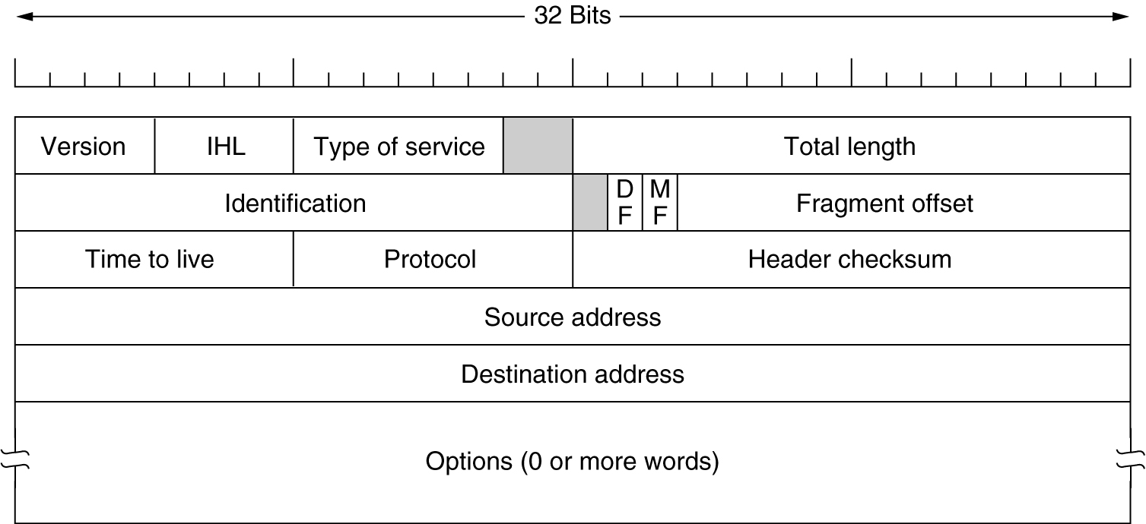
1. The IP Protocol (1)
The IPv4 (Internet Protocol) header.

Slide 4
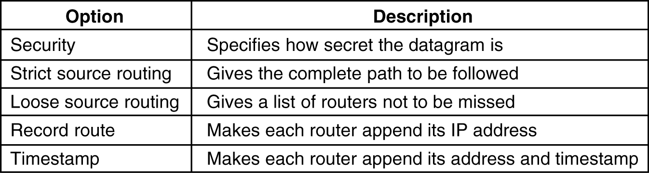
1. The IP Protocol (2)
Some of the IP options.
5-54

Slide 5
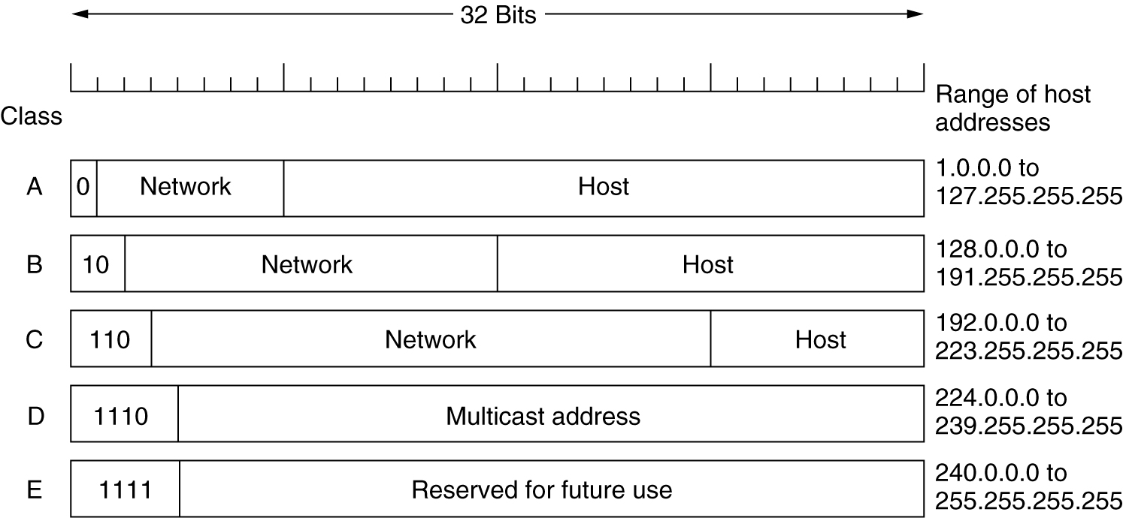
2. IP Addresses (1)
IP address formats.

Slide 6
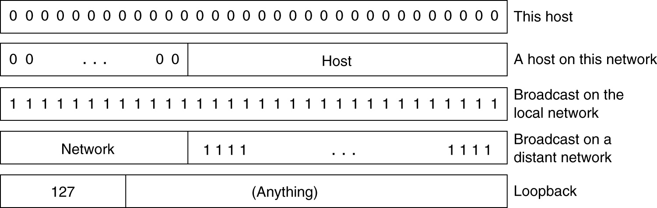
2. IP Addresses (2)
Special IP addresses.

Slide 7

2. IP Addresses: Subnets (1)
IP address:
  subnet part (high order bits)
  host part (low order bits)
What’s a subnet ?
  device interfaces with same subnet part of IP address
  can physically reach each other without intervening router
223.1.1.1
223.1.2.1
223.1.1.2
223.1.1.4
223.1.2.9
223.1.1.3
223.1.2.2
223.1.3.27
subnet
223.1.3.1
223.1.3.2
network consisting of 3 subnets

Slide 8
2. IP Addresses: Subnets (2)
223.1.1.0/24
223.1.2.0/24
Recipe
To determine the subnets, detach each interface from its host or router, creating islands of isolated networks. Each isolated network is called a subnet.
223.1.3.0/24
Subnet mask: /24

Slide 9
2. IP Addresses:
Subnets (3)
223.1.1.2
223.1.1.1
223.1.1.4
223.1.1.3
223.1.9.2
223.1.7.0
223.1.9.1
223.1.7.1
223.1.8.1
223.1.8.0
223.1.2.6
223.1.3.27
223.1.2.1
223.1.2.2
223.1.3.1
223.1.3.2
Notes:
How Many?

Slide 10
2. IP addressing: CIDR
CIDR: Classless InterDomain Routing
  subnet portion of address of arbitrary length
  address format: a.b.c.d/x, where x is # bits in subnet portion of address
subnet
part
host
part
11001000 00010111 00010000 00000000
200.23.16.0/23

Slide 11
2. IP addresses: how to get one? (1)
Q: How does host get IP address?
hard-coded by system admin in a file
  Wintel: control-panel->network->configuration->tcp/ip->properties
  UNIX: /etc/rc.config
DHCP: Dynamic Host Configuration Protocol: dynamically get address from as server
  “plug-and-play”

Slide 12
2. IP addresses: how to get one? (2)
Q: How does network get subnet part of IP addr?
A: gets allocated portion of its provider ISP’s address space
ISP's block 11001000 00010111 00010000 00000000 200.23.16.0/20
Organization 0 11001000 00010111 00010000 00000000 200.23.16.0/23
Organization 1 11001000 00010111 00010010 00000000 200.23.18.0/23
Organization 2 11001000 00010111 00010100 00000000 200.23.20.0/23
... ….. …. ….
Organization 7 11001000 00010111 00011110 00000000 200.23.30.0/23

Slide 13
2. IP Addresses: Hierarchical addressing (1)
Hierarchical addressing allows efficient advertisement of routing
information:
Organization 0
200.23.16.0/23
Organization 1
200.23.18.0/23
“Send me anything
with addresses
beginning
200.23.16.0/20”
Organization 2
200.23.20.0/23
.
Fly-By-Night-ISP
.
.
.
.
Internet
Organization 7
.
200.23.30.0/23
ISPs-R-Us
“Send me anything
with addresses
beginning
199.31.0.0/16”

Slide 14
2. IP Addresses: Hierarchical addressing (2)
ISPs-R-Us has a more specific route to Organization 1
Organization 0
200.23.16.0/23
“Send me anything
with addresses
beginning
200.23.16.0/20”
Organization 2
200.23.20.0/23
.
Fly-By-Night-ISP
.
.
.
.
Internet
Organization 7
.
200.23.30.0/23
ISPs-R-Us
“Send me anything
with addresses
beginning 199.31.0.0/16
or 200.23.18.0/23”
Organization 1
200.23.18.0/23

Slide 15
2. IP Addresses: NAT (Network Address Translation) (1)
rest of
Internet
local network
(e.g., home network)
10.0.0/24
10.0.0.1
10.0.0.4
10.0.0.2
138.76.29.7
10.0.0.3
All datagrams leaving local
network have same single source NAT IP address: 138.76.29.7,
different source port numbers
Datagrams with source or
destination in this network
have 10.0.0/24 address for
source, destination (as usual)

Slide 16
2. IP Addresses: NAT (2)
Motivation: local network uses just one IP address as far as outside world is concerned:
  no need to be allocated range of addresses from ISP: - just one IP address is used for all devices
  can change addresses of devices in local network without notifying outside world
  can change ISP without changing addresses of devices in local network
  devices inside local net not explicitly addressable, visible by outside world (a security plus).

Slide 17
2. IP Addresses: NAT (3)
Implementation: NAT router must:
  outgoing datagrams: replace (source IP address, port #) of every outgoing datagram to (NAT IP address, new port #)
    . . . remote clients/servers will respond using (NAT IP address, new port #) as destination addr.
  remember (in NAT translation table) every (source IP address, port #) to (NAT IP address, new port #) translation pair
  incoming datagrams: replace (NAT IP address, new port #) in dest fields of every incoming datagram with corresponding (source IP address, port #) stored in NAT table

Slide 18
2. IP Addresses: NAT (4)
NAT translation table
WAN side addr LAN side addr
1: host 10.0.0.1
sends datagram to
128.119.40.186, 80
2: NAT router
changes datagram
source addr from
10.0.0.1, 3345 to
138.76.29.7, 5001,
updates table
138.76.29.7, 5001 10.0.0.1, 3345
…… ……
S: 10.0.0.1, 3345
D: 128.119.40.186, 80
10.0.0.1
1
2
S: 138.76.29.7, 5001
D: 128.119.40.186, 80
10.0.0.4
10.0.0.2
138.76.29.7
S: 128.119.40.186, 80
D: 10.0.0.1, 3345
4
S: 128.119.40.186, 80
D: 138.76.29.7, 5001
3
10.0.0.3
4: NAT router
changes datagram
dest addr from
138.76.29.7, 5001 to 10.0.0.1, 3345
3: Reply arrives
dest. address:
138.76.29.7, 5001

Slide 19
2. IP Addresses: NAT (5)
16-bit port-number field:
  60,000 simultaneous connections with a single LAN-side address!
NAT is controversial:
  routers should only process up to layer 3
  violates end-to-end argument
    NAT possibility must be taken into account by app designers, eg, P2P applications
  address shortage should instead be solved by IPv6

Slide 20
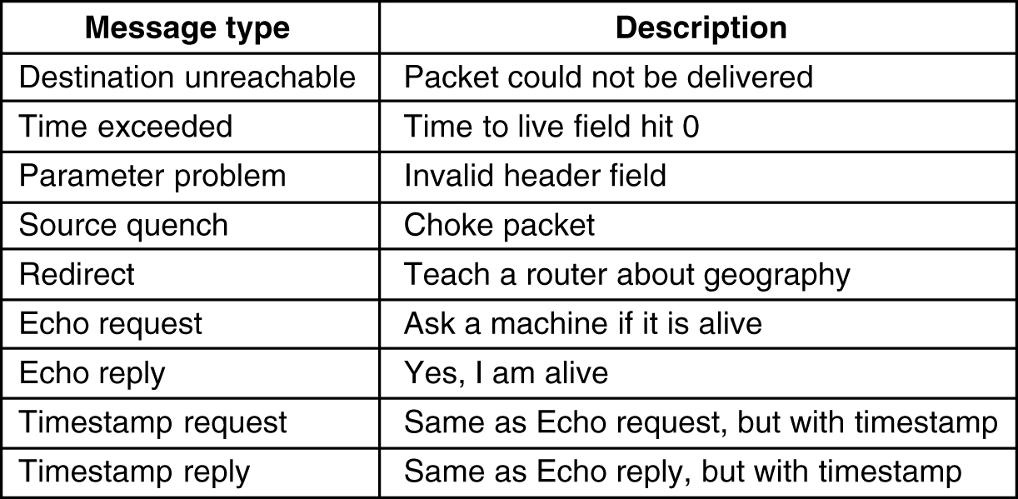
3. ICMP
The principal ICMP message types.
5-61

Slide 21
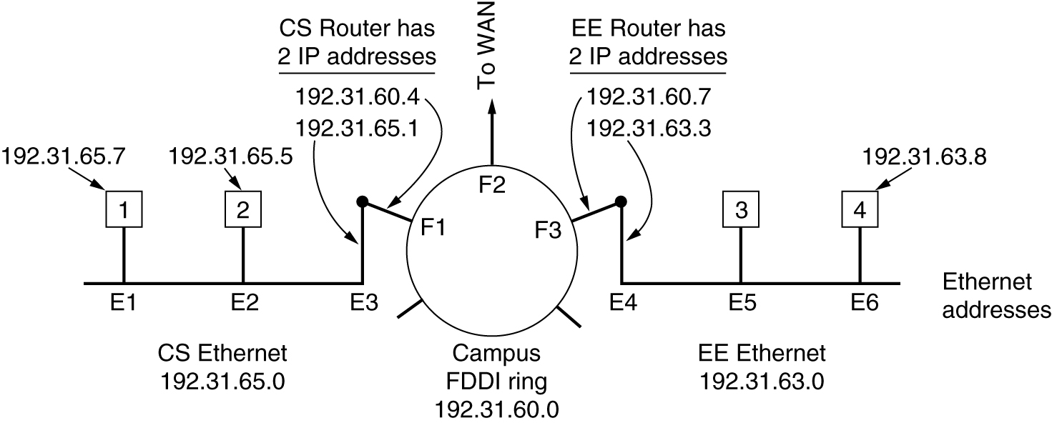
3. ARP– The Address Resolution Protocol
Three interconnected /24 networks: two Ethernets and an FDDI ring.

Slide 22
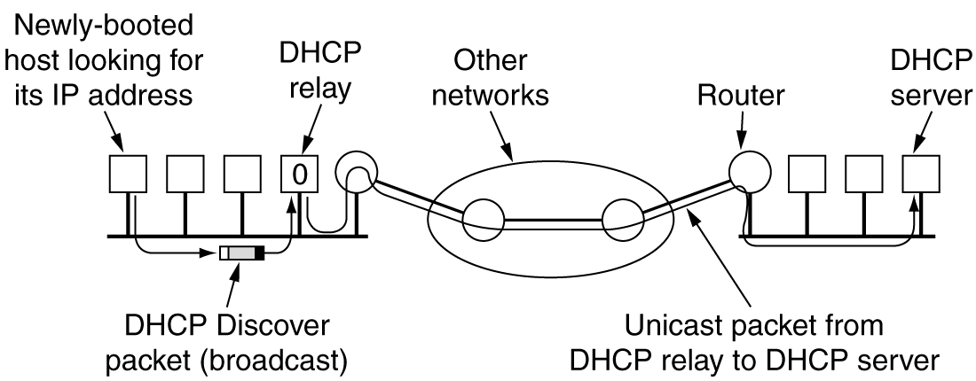
3. DHCP – Dynamic Host Configuration Protocol
Operation of DHCP.

Slide 23
4. RIP ( Routing Information Protocol) (1)
Distance vector algorithm
Included in BSD-UNIX Distribution in 1982
Distance metric: # of hops (max = 15 hops)
From router A to subsets:
destination hops
u 1
v 2
w 2
x 3
y 3
z 2
u
v
A
B
w
x
z
C
D
y

Slide 24
4. RIP (2): advertisements
Distance vectors: exchanged among neighbors every 30 sec via Response Message (also called advertisement)
Each advertisement: list of up to 25 destination nets within AS

Slide 25
4. RIP (3): Example
z
w
x
y
A
D
B
C
Destination Network Next Router Num. of hops to dest.
w A 2
y B 2
z B 7
x -- 1
…. …. ....
Routing table in D

Slide 26
4. RIP (4) : Example
Dest Next hops
w - 1
x - 1
z C 4
…. … ...
Advertisement
from A to D
z
w
x
y
A
D
B
C
Destination Network Next Router Num. of hops to dest.
w A 2
y B 2
z B A 7 5
x -- 1
…. …. ....
Routing table in D

Slide 27
4. RIP (5): Link Failure and Recovery
If no advertisement heard after 180 sec --> neighbor/link declared dead
  routes via neighbor invalidated
  new advertisements sent to neighbors
  neighbors in turn send out new advertisements (if tables changed)
  link failure info quickly propagates to entire net
  poison reverse used to prevent ping-pong loops (infinite distance = 16 hops)

Slide 28
4. RIP (6): Table processing
RIP routing tables managed by application-level process called route-d (daemon)
advertisements sent in UDP packets, periodically repeated
routed
routed
Transport
(UDP)
Transport
(UDP)
network forwarding
(IP) table
network
(IP)
forwarding
table
link
link
physical
physical

Slide 29
4. OSPF (1) (Open Shortest Path First)
“open”: publicly available
Uses Link State algorithm
    LS packet dissemination
    Topology map at each node
    Route computation using Dijkstra’s algorithm
OSPF advertisement carries one entry per neighbor router
Advertisements disseminated to entire AS (via flooding)
  Carried in OSPF messages directly over IP (rather than TCP or UDP

Slide 30

4. Hierarchical OSPF (2)

Slide 31
4. Hierarchical OSPF (3)
Two-level hierarchy: local area, backbone.
    Link-state advertisements only in area
    each nodes has detailed area topology; only know direction (shortest path) to nets in other areas.
Area border routers: “summarize” distances to nets in own area, advertise to other Area Border routers.
Backbone routers: run OSPF routing limited to backbone.
Boundary routers: connect to other AS’s.

Slide 32
5. BGP (1)
BGP (Border Gateway Protocol): the de facto standard
BGP provides each AS a means to:
    Obtain subnet reachability information from neighboring ASs.
    Propagate the reachability information to all routers internal to the AS.
    Determine “good” routes to subnets based on reachability information and policy.
Allows a subnet to advertise its existence to rest of the Internet: “I am here”

Slide 33
5. BGP (2): basics
Pairs of routers (BGP peers) exchange routing info over semi-permanent TCP connections: BGP sessions
Note that BGP sessions do not correspond to physical links.
When AS2 advertises a prefix to AS1, AS2 is promising it will forward any datagrams destined to that prefix towards the prefix.
    AS2 can aggregate prefixes in its advertisement
3c
3a
2c
3b
2a
AS3
2b
1c
AS2
1a
1b
AS1
1d
eBGP session
iBGP session

Slide 34
5. BGP (3): Distributing reachability info
With eBGP session between 3a and 1c, AS3 sends prefix reachability info to AS1.
1c can then use iBGP do distribute this new prefix reach info to all routers in AS1.
1b can then re-advertise the new reach info to AS2 over the 1b-to-2a eBGP session.
When router learns about a new prefix, it creates an entry for the prefix in its forwarding table.
3c
3a
2c
3b
2a
AS3
2b
1c
AS2
1a
1b
AS1
1d
eBGP session
iBGP session

Slide 35
5. BGP (4): Path attributes & BGP routes
When advertising a prefix, advert includes BGP attributes.
    prefix + attributes = “route”
Two important attributes:
    AS-PATH: contains the ASs through which the advert for the prefix passed: AS 67 AS 17
    NEXT-HOP: Indicates the specific internal-AS router to next-hop AS. (There may be multiple links from current AS to next-hop-AS.)
When gateway router receives route advert, uses import policy to accept/decline.

Slide 36
5. BGP (5): route selection
Router may learn about more than 1 route to some prefix. Router must select route.
Elimination rules:
    Local preference value attribute: policy decision
    Shortest AS-PATH
    Closest NEXT-HOP router: hot potato routing
    Additional criteria

Slide 37
5. BGP (6): messages
BGP messages exchanged using TCP.
BGP messages:
    OPEN: opens TCP connection to peer and authenticates sender
    UPDATE: advertises new path (or withdraws old)
    KEEPALIVE keeps connection alive in absence of UPDATES; also ACKs OPEN request
    NOTIFICATION: reports errors in previous msg; also used to close connection

Slide 38
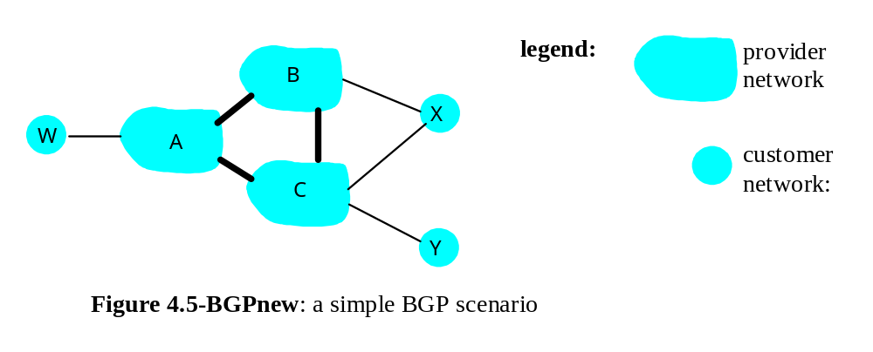
5. BGP (7): routing policy
A,B,C are provider networks
X,W,Y are customer (of provider networks)
X is dual-homed: attached to two networks
    X does not want to route from B via X to C
    .. so X will not advertise to B a route to C

Slide 39
5. BGP (8): routing policy
A advertises to B the path AW
B advertises to X the path BAW
Should B advertise to C the path BAW?
    No way! B gets no “revenue” for routing CBAW since neither W nor C are B’s customers
    B wants to force C to route to w via A
    B wants to route only to/from its customers!

