Slide 1
Scalable Multiprocessors

Slide 2
Topics
Scalability issues
Low level and high level communication abstractions in scalable systems
Network interface
Common techniques for high performance communication

Slide 3
Scalable computers
Almost all computers allow the capability of the systems to be increased
  Add memory, add disk, upgrade processor, etc.
A scalable system attempt to avoid inherent design limits on the extent to which resources can be added to the system.
  Total communication bandwidth increases with P.
  Latency (time per operation) remains a constant (not increase with P).
  Cost increases slowly (at most linearly) with P.
  How to package the (large/scalable) systems. Or, can we build a large systems with the design?

Slide 4
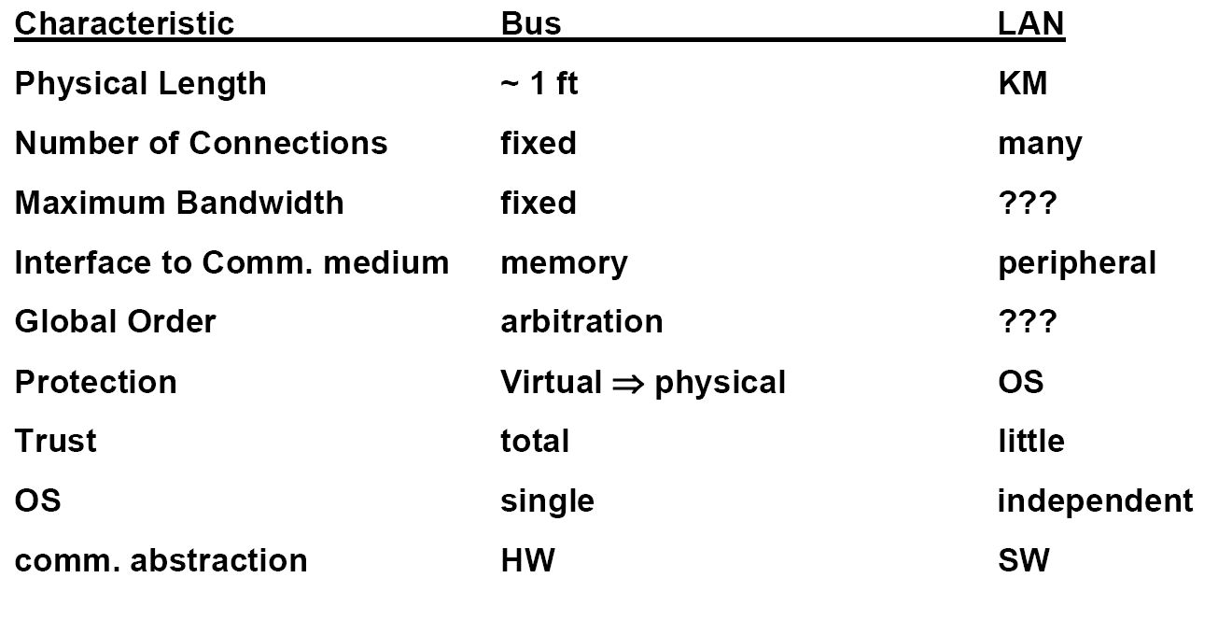
Example: Bus based SMPs and Ethernet clusters
These are two extreme cases, but both are not scalable systems.
  Bus: Close coupling among components, but has a scaling limit.
  Ethernet: no limit to physical scaling, little trust, no global order, independent failure and restart. Bandwidth does not scale.

Slide 5
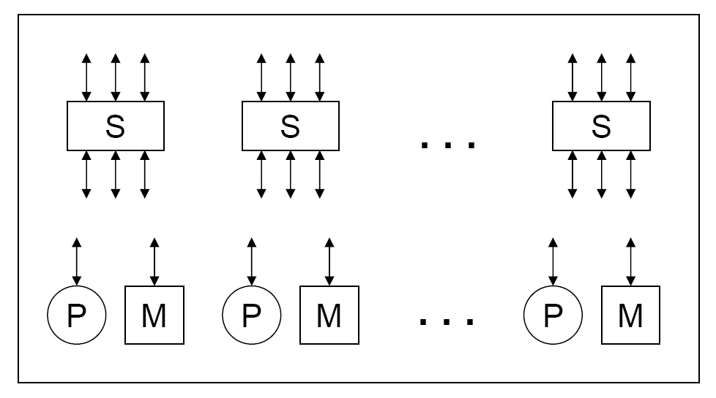
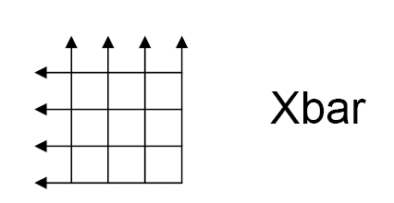
Bandwidth Scalability
What fundamentally limits bandwidth?
  The set of wires
Processors and memory modules must have independent wires.
Modules must be connected through “switches” (or scalable interconnects) that allows wires connected to the ports to be independent.

Slide 6
Latency scalability
Latency = overhead + channel time + routing delay.
Overhead: software/hardware processing time before the message is sent.
Channel time: message size / channel bandwidth* # of channels.
  # of channels usually increases as P increases.
Routing delay: is usually a function of H (number of hops between two nodes) and P.
  H usually increases as P increases.
To make latency scalable: channel time and routing delay needs to be a constant.

Slide 7
Cost scaling
cost(p, m) = fixed cost + incremental cost (p, m)
  Scalable machines must support many configurations.
  Both are important:
    Without volume, fixed cost can be very high.

Slide 8
Communication abstractions
High level and low level communication abstractions in scalable systems are usually separated.
  Layered design principle.
  Low level:
    Provide accesses to communication hardware.
    Perform primitive network transactions.
  High level:
    Provide functionality for communications in different programming models.
      Shared memory space abstraction
      Message passing abstraction

Slide 9
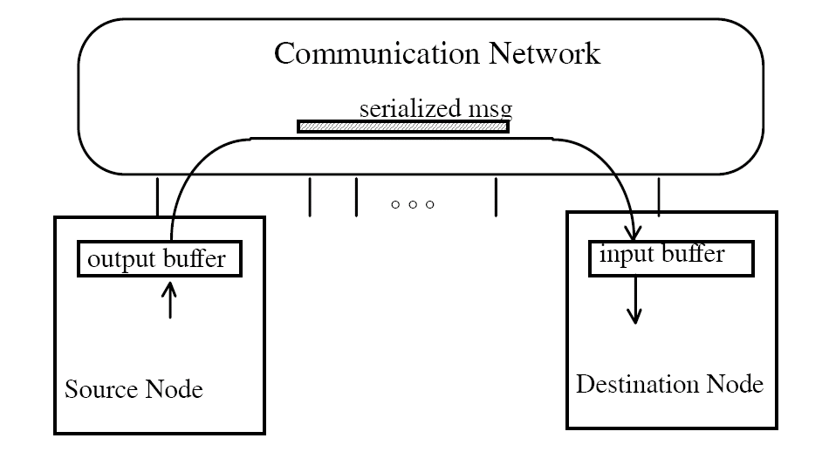
Network Transaction Primitive
(low level)
One-way transfer of information from a source output buffer to a destination input buffer.
  causes some action at the destination
  occurrence is not directly visible at source
Deposit data, state change, reply

Slide 10
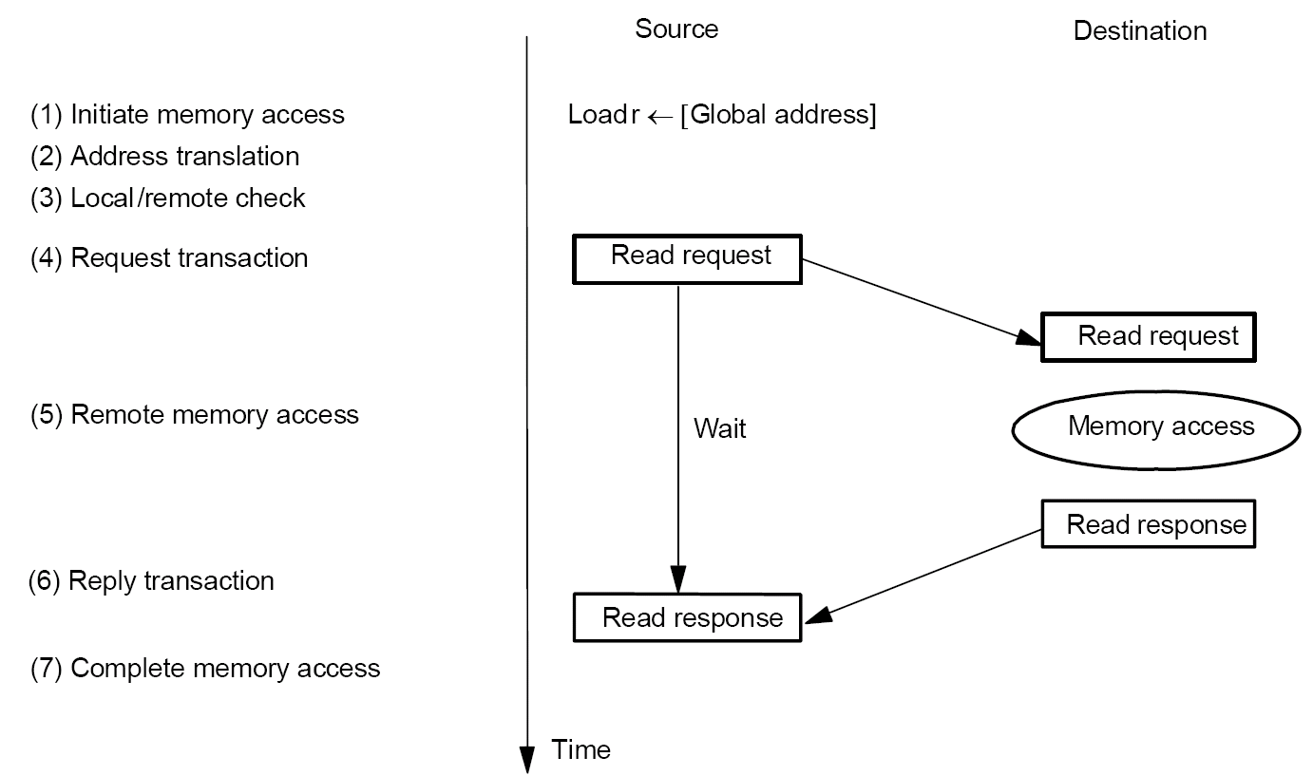
Shared Address Space Abstraction
Fundamentally a two way request/response protocol.
  Write have an acknowledge.

Slide 11
Shared Address space issues
Fixed or variable length (bulk) transfers.
Remote virtual or physical address?
Deadlock avoidance and input buffer full

Slide 12
Key properties of shared address space abstraction
Source and destination data addresses are specified by the source of the request.
  A degree of logical coupling and trust.
No storage logically “outside” the application address space.
Operations are fundamentally request/reply.
Remote operation can be performed on remote memory
  Logically does not require intervention of the remote processor.

Slide 13
Message passing
Complex synchronization semantics
  Complex protocols
  Synchronous message passing
    Send completes after matching recv and source data sent
    Recv completes after data transfer complete from matching send
  Asynchronous message passing
    Send completes after send buffer may be reused.

Slide 14
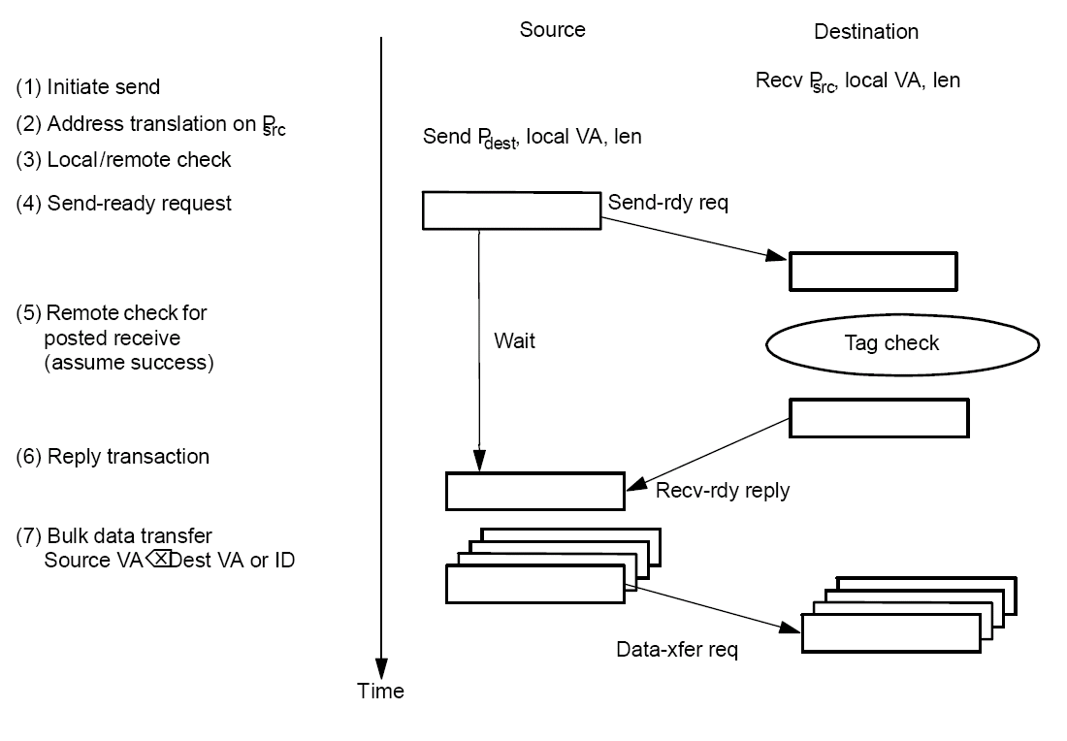
Synchronous Message Passing
Constrained programming model

Slide 15
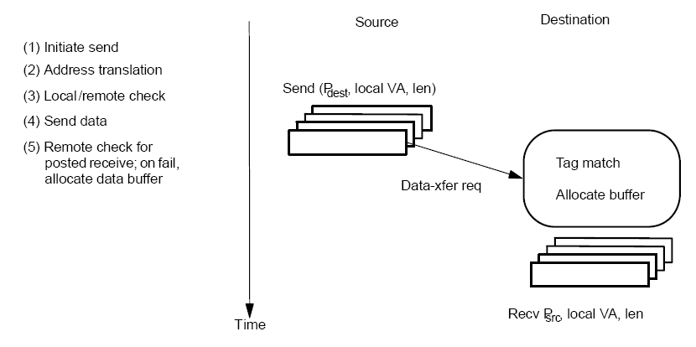
Asynchronous Message Passing: Optimistic
More powerful programming model
Wildcard receive ➔ non-deterministic
Storage requirement within messaging layer.

Slide 16
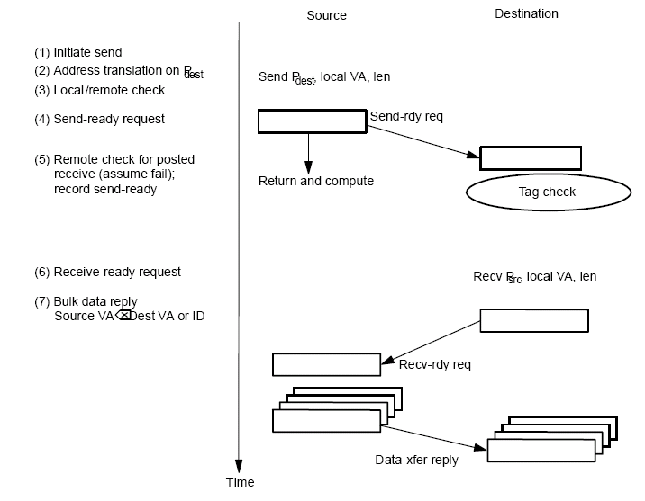
Asynchronous Message Passing: Conservative
Where is the buffering
Contention control? Receiver initiated protocol
Short message optimizations

Slide 17
Key features of message passing abstraction
Source knows send data address, destination knows receive data address
  After handshake, they both know
Arbitrary storage outside the local address space
  May post many sends before any receives
  Non-blocking asynchronous sends reduces the requirement to an arbitrary number of descriptors
    There are limits to these too.
Fundamentally a 3-phase transaction
  Includes a request/response
  Can use optimistic 1-phase in limited safe cases

Slide 18
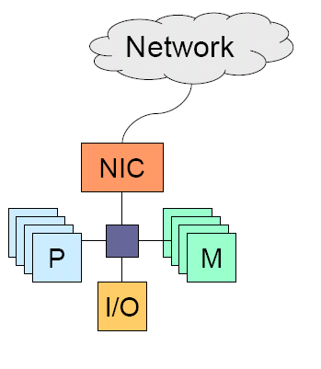
Network interface
Transfer between local memory and NIC buffers. Basic operations
  SW translates VA⬅➔ PA
  SW initiate DMA
  SW does buffer management
  NIC initiates interrupts on receive
  Provides protection
Transfer between NIC buffers and the network
  Generate packets
  Flow control with the network

Slide 19
Typical sender/receiver operations in a low end NIC
Sender:
  Trap into operating systems
  Translate (logical) destination address into physical address or the route to the destination
  Copy data into OS and construct the whole packet
  Select the outgoing channel, set the status registers (starting address, count, etc), and start the communication.
    Depending on NIC hardware, starting comm may take many instructions
Receiver:
  An interrupt is generated
  The processor reads the received data into a OS region.
CPU is still quite involving:
Can Off-load the work to a
Dedicated communication
processor.

Slide 20
Protected User-level Communication
Traditional NIC (e.g. Ethernet) requires the OS kernel to initiate DMA and to manage buffers.
  Protection
  High overhead
Newer NICs (InfiniBand, Myrinet)
  OS initializes the network ports to provide protection.
  Applications access the ports from the user domain.

Slide 21
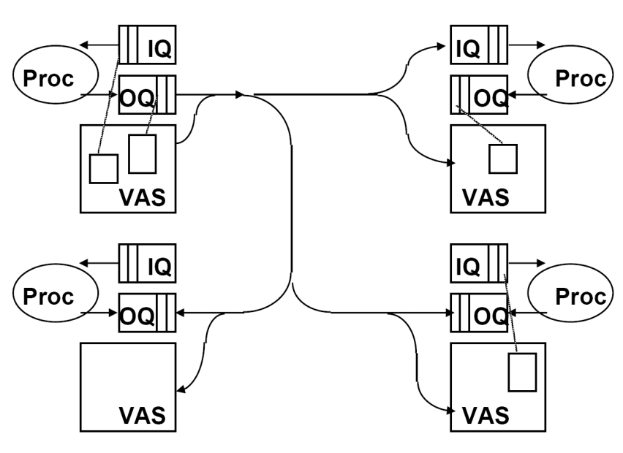
User-level communication abstraction
Any user process can post a transaction for any other in protection domain
  Communication layer moves the source OQ to the desitnation IQ
  May involve indirection: the source virtual memory to destination virtual memory (RDMA).

Slide 22
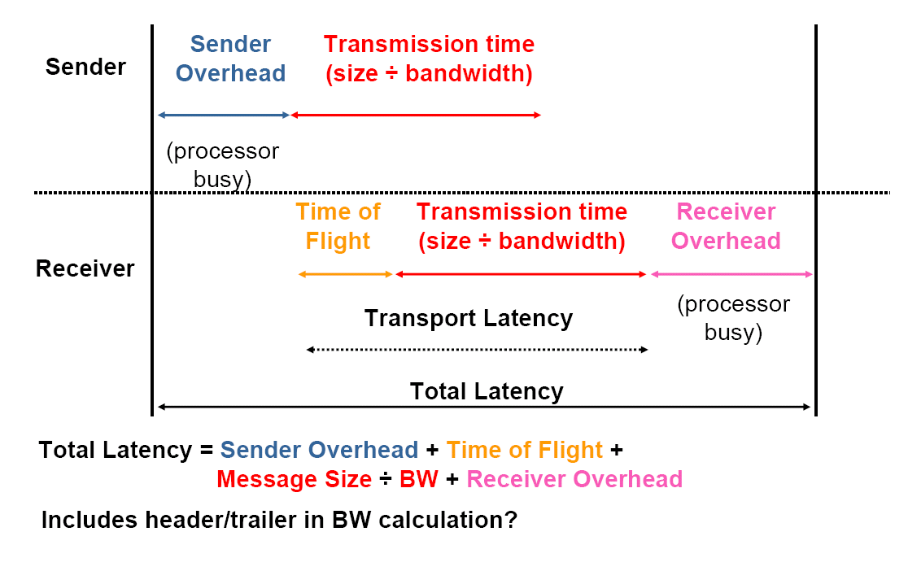
Network performance metrics

