Slide 1
Parallel and Distributed Systems
Instructor: Xin Yuan
Department of Computer Science
Florida State University

Slide 2
Parallel and distributed systems
What is a parallel computer?
  A collection of processing elements that communicate and coorperate to solve large problems fast.
What is a distributed system?
  A collection of independent computers that appear to its users as a single coherent system.
  A parallel computer is implicitly a distributed system.

Slide 3
What are they?
More than one processing element
Elements communicate and cooperate
Appear as one system
PDS hardware is everywhere.
  diablo.cs.fsu.edu (2-CPU SMP)
  Multicore workstations/laptops
  linprog.cs.fsu.edu (4-node cluster, 2-CPU SMP, 8 cores per node)
  Hadoop clusters
  IBM Blue Gene/L at DOE/NNSA/LLNL (262992 processors).
  Data centers
  SETI@home.

Slide 4
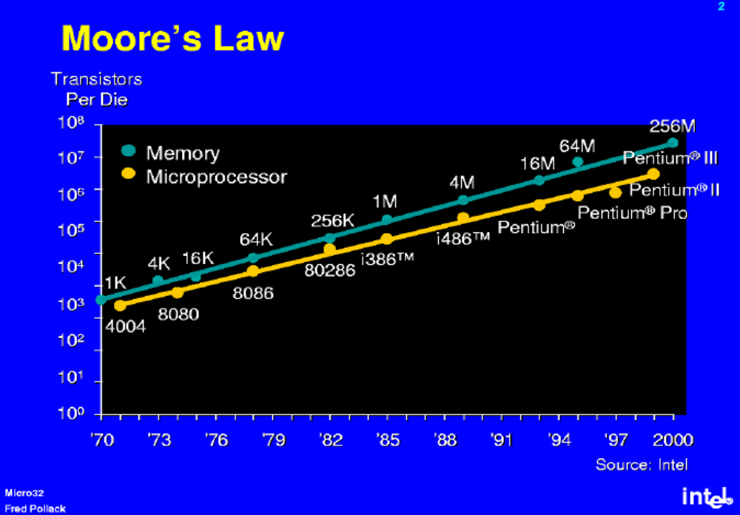
Why parallel and distributed computing?
Moore’s law: the number of transistors double every 18 months.

Slide 5
Why parallel and distributed computing?
How to make good use of the increasing number of transistors on a chip?
  Increase the computation width (70’s and 80’s)
    4bit->8bit->16bit->32bit->64bit->….
  Instruction level parallelism (90’s)
    Pipeline, LIW, etc
  ILP to the extreme (early 00’s)
    Out of order execution, 6-way issues, etc
  Sequential program performance keeps increasing.
    The clock rate keeps increasing, clock cycles get smaller and smaller.

Slide 6
Why parallel and distributed computing?
The fundament limit of the speed of a sequential processor.
  Power wall (high frequency results in heat)
  Latency wall (speed of light does not change)

Slide 7
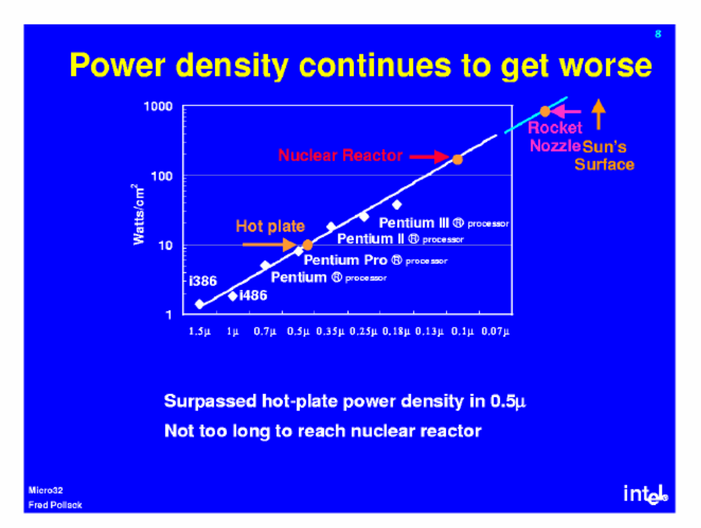
Power wall: what will happen if we keep pushing ILP?

Slide 8
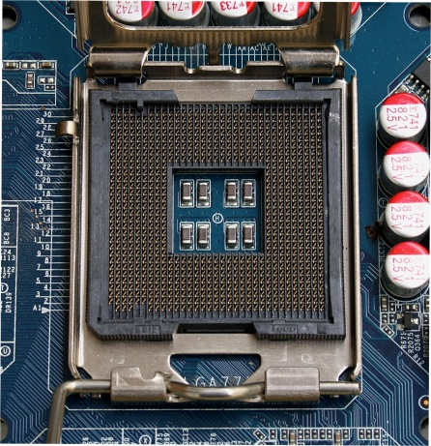
Latency wall
Speed of light = 300000000m/s
One cycle at 4Ghz = 0.00000000025s
The distance that the light can move at one cycle:
  0.00000000025 * 300000000 = 7.5cm
Intel chip dimension = 1.47 in x 1.47 in
= 3.73cm x 3.73cm

Slide 9
Why parallel and distributed computing?
Power wall and latency wall indicate that the era of single thread performance improvement through Moore’s law is ending/has ended.
More transistors on a chip are now applied to increase system throughput, the total number of instructions executed, but not latency, the time for a job to finish.
  Improving ILP improves both.
  We see a multi-core era

Slide 10
The marching of multi-core (2004-now)
  Mainstream processors:
    INTEL Quad-core Xeon (4 cores),
    AMD Quad-core Opteron (4 cores),
    SUN Niagara (8 cores),
    IBM Power6 (2 cores)
  Others
    Intel Tflops (80 cores)
    CISCO CSR-1 (180 cores) (network processors)
  Increase the throughput without increasing the clock rate.

Slide 11
Why parallel and distributed computing?
  Programming multi-core systems is fundamentally different from programming traditional computers.
    Parallelism needs to be explicitly expressed in the program.
  This is traditionally referred to as parallel computing.
    PDC is not really a choice anymore.

Slide 12
For (I=0; I<500; I++)
a[I] = 0;
GO PARALLEL
Performance
1970
1980
1990
2000
2006

Slide 13
In the foreseeable future, parallel systems with multi-core processors are going mainstream.
  Lots of hardware, software, and human issues in mainstream parallel/distributed computing
    How to make use a large number of processors simultaneously
    How to write parallel programs easily and efficiently?
    What kind of software supports is needed?
    Analyzing and optimizing parallel programs is still a hard problem.
    How to debug concurrent program?

Slide 14
Parallel computing issues
Data sharing – single versus multiple address space.
Process coordination – synchronization using locks, messages, and other means.
Distributed versus centralized memory.
Connectivity – single shared bus versus network with many different topologies.
Fault tolerance/reliability.

Slide 15
Distributed systems issues
Transparency
  Access (data representation), location, migration, relocation, replication, concurrency, failure, persistence
Scalability
  Size, geographically
Reliability/fault tolerance

Slide 16
What we will be doing in this course?
This is the first class in PDC.
  Systematically introduce most mainstream parallel computing platforms and programming paradigms.
The coverage is not necessary in depth.

