Slide 1
Optimizing single thread performance
Locality and array allocation
Dependence
Loop transformations

Slide 2
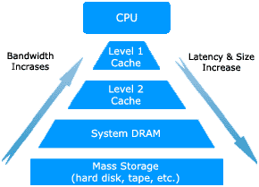
Computer memory hierarchy
Implication:
  Explore data locality to achieve high performance
  Make sure that a program has a small footprint (to fix the upper level cache/registers).
Cache line (64 bytes in x86)
  In a cache miss, a while cache line is brought in – good for sequential access.

Slide 3
Optimizing single thread performance
Explore data locality
  Need to understand how arrays are dealt with at the low level
How is array a[i][j] accessed?
  Compute the offset
  Add the starting address to access the location
How is multi-dimensional array allocated in memory?
  Row major and column major
Row major:
a[0][0], a[0][1], …, a[0][100], a[1][0], …, a[1][100], …, a[100][0], … a[100][100]
Column major:
a[0][0], a[1][0], …, a[100][0], a[0][1], …, a[100][1], …, a[0][100], …, a[100][100]

Slide 4
Optimizing single thread performance
Assuming that all instructions are doing useful work, how can you make the code run faster?
  Some sequence of code runs faster than other sequence
    Optimize for memory hierarchy
    Optimize for specific architecture features such as pipelining
  Both optimization requires changing the execution order of the instructions.
A[0][0] = 0.0;
A[1][0] = 0.0;
…
A[1000][1000] = 0.0;
A[0][0] = 0.0;
A[0][1] = 0.0;
…
A[1000][1000] = 0.0;
Both code initializes A, is one better than the other?

Slide 5
Changing the order of instructions without changing the semantics of the program
The semantics of a program is defined by the sequential execution of the program.
  Optimization should not change what the program does.
    Parallel execution also changes the order of instructions.
  When is it safe to change the execution order (e.g. run instructions in parallel)?
A=1
B=2
C=3
D=4
A=1
B=A+1
C=B+1
D=C+1
A=1; B=A+1
C=B+1;D=C+1
A=1; B=2
C=3; D=4
A=1, B=?, C=?, D=?
A=1,B=2, C=3, D=4

Slide 6
When is it safe to change order?
  When can you change the order of two instructions without changing the semantics?
    They do not operate (read or write) on the same variables.
    They can be only read the same variables
    One read and one write is bad (the read will not get the right value)
    Two writes are also bad (the end result is different).
  This is formally captured in the concept of data dependence
    True dependence: Write X-Read X (RAW)
    Output dependence: Write X – Write X (WAW)
    Anti dependence: Read X – Write X (WAR)
    What about RAR?

Slide 7
Data dependence examples
A=1
B=2
C=3
D=4
A=1
B=A+1
C=B+1
D=C+1
A=1; B=A+1
C=B+1;D=C+1
A=1; B=2
C=3; D=4
When two instructions have no dependence, their execution order can
be changed, or the two instructions can be executed in parallel

Slide 8
Data dependence in loops
For (I=1; I<500; i++)
a(I) = 0;
For (I=1; I<500; i++)
a(I) = a(I-1) + 1;
Loop-carried dependency
When there is no loop-carried dependency, the order for executing
the loop body does not matter: the loop can be parallelized (executed in
parallel)

Slide 9
Loop-carried dependence
A loop-carried dependence is a dependence that is present only when the dependence is between statements in different iterations of a loop.
Otherwise, we call it loop-independent dependence.
Loop-carried dependence is what prevents loops from being parallelized.
  Important since loops contains most parallelism in a program.
Loop-carried dependence can sometimes be represented by dependence vector (or direction) that tells which iteration depends on which iteration.
  When one tries to change the loop execution order, the loop carried dependence needs to be honored.

Slide 10
Dependence and parallelization
For a set of instruction without dependence
    Execution in any order will produce the same results
    The instructions can be executed in parallel
For two instructions with dependence
  They must be executed in the original sequence
  They cannot be executed in parallel
Loops with no loop carried dependence can parallelized (iterations executed in parallel)
Loops with loop carried dependence cannot be parallelized (must be executed in the original order).

Slide 11
Optimizing single thread performance through loop transformations
90% of execution time in 10% of the code
  Mostly in loops
Relatively easy to analyze
Loop optimizations
  Different ways to transform loops with the same semantics
  Objective?
    Single-thread system: mostly optimizing for memory hierarchy.
    Multi-thread system: loop parallelization
      Parallelizing compiler automatically finds the loops that can be executed in parallel.

Slide 12
Loop optimization: scalar replacement of array elements
For (i=0; i<N; i++)
for(j=0; j<N; j++)
for (k=0; k<N; k++)
c(I, j) = c(I, j) + a(I, k)* b(k, j);
Registers are almost never allocated to array elements. Why?
Scalar replacement Allows registers to be allocated
to the scalar, which reduces
memory reference.
Also known as register pipelining.
For (i=0; i<N; i++)
for(j=0; j<N; j++) {
ct = c(I, j)
for (k=0; k<N; k++)
ct = ct + a(I, k)* b(k, j);
c(I, j) = ct;
}

Slide 13
Loop normalization
For (i=a; i<=b; i+= c) {
……
}
For (ii=1; ii<???; ii++) {
i = a + (ii-1) *b;
……
}
Loop normalization does not do too much by itself.
But it makes the iteration space much easy to manipulate, which enables other optimizations.

Slide 14
Loop transformations
Change the shape of loop iterations
  Change the access pattern
    Increase data reuse (locality)
    Reduce overheads
  Valid transformations need to maintain the dependence.
    If (i1, i2, i3, …in) depends on (j1, j2, …, jn), then
    (j1’, j2’, …, jn’) needs to happen before (i1’, i2’, …, in’) in a valid transformation.

Slide 15
Loop transformations
Unimodular transformations
  Loop interchange, loop permutation, loop reversal, loop skewing, and many others
Loop fusion and distribution
Loop tiling
Loop unrolling

Slide 16
Unimodular transformations
A unimodular matrix is a square matrix with all integral components and with a determinant of 1 or –1.
Let the unimodular matrix be U, it transforms iteration I = (i1, i2, …, in) to iteration U I.
  Applicability (proven by Michael Wolf)
    A unimodular transformation represented by matrix U is legal when applied to a loop nest with a set of distance vector D if and only if for each d in D, Ud >= 0.
      Distance vector tells the dependences in the loop.

Slide 17
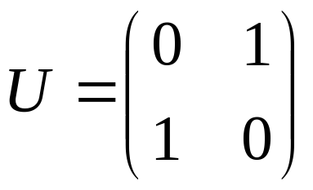
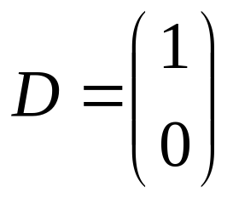
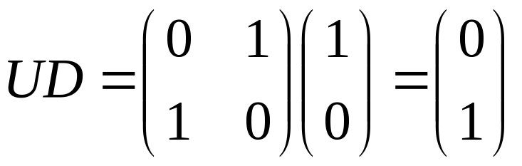
Unimodular transformations example: loop interchange
For (I=0; I<n; I++)
for (j=0; j < n; j++)
a(I,j) = a(I-1, j) + 1;
For (j=0; j<n; j++)
for (i=0; i < n; i++)
a(i,j) = a(i-1, j) + 1;
Why is this transformation valid?
The calculation of a(i-1,j)
must happen before a(I, j)

Slide 18
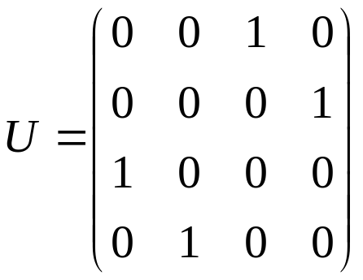
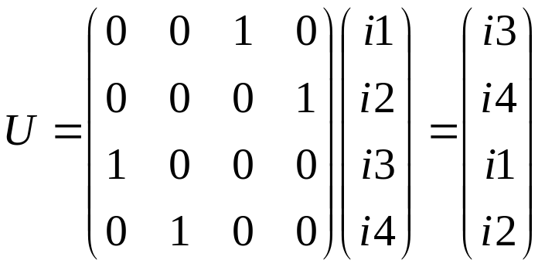
Unimodular transformations example: loop permutation
For (I=0; I<n; I++)
for (j=0; j < n; j++)
for (k=0; k < n; k++)
for (l=0; l<n; l++)
……

Slide 19
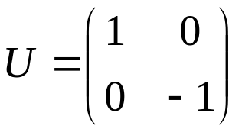
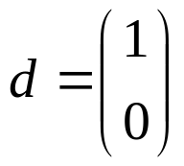
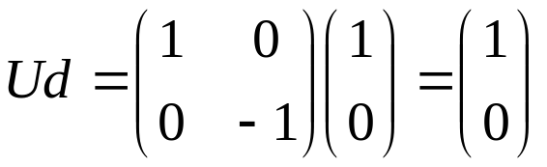
Unimodular transformations example: loop reversal
For (I=0; I<n; I++)
for (j=0; j < n; j++)
a(I,j) = a(I-1, j) + 1.0;
For (I=0; I<n; I++)
for (j=n-1; j >=0; j--)
a(I,j) = a(I-1, j) + 1.0;

Slide 20
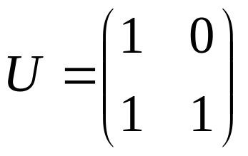
Unimodular transformations example: loop skewing
For (I=0; I<n; I++)
for (j=0; j < n; j++)
a(I) = a(I+ j) + 1.0;
For (I=0; I<n; I++)
for (j=I+1; j <i+n; j++)
a(i) = a(j) + 1.0;

Slide 21
Loop fusion
Takes two adjacent loops that have the same iteration space and combines the body.
  Legal when there are no flow, anti- and output dependences in the fused loop.
  Why
    Increase the loop body, reduce loop overheads
    Increase the chance of instruction scheduling
    May improve locality
For (I=0; I<n; I++)
a(I) = 1.0;
For (j=0; j<n; j++)
b(j) = 1.0
For (I=0; I<n; I++) {
a(I) = 1.0;
b(i) = 1.0;
}

Slide 22
Loop distribution
Takes one loop and partition it into two loops.
  Legal when no dependence loop is broken.
  Why
    Reduce memory trace
    Improve locality
    Increase the chance of instruction scheduling
For (I=0; I<n; I++) {
a(I) = 1.0;
b(i) = a(I);
}
For (I=0; I<n; I++)
a(I) = 1.0;
For (j=0; j<n; j++)
b(j) = a(I)

Slide 23
Loop tiling
Replaceing a single loop into two loops.
  for(I=0; I<n; I++) … → for(I=0; I<n; I+=t) for (ii=I, ii < min(I+t,n); ii++) …
    T is call tile size;
N-deep nest can be changed into n+1-deep to 2n-deep nest.
For (i=0; i<n; i++)
for (j=0; j<n; j++)
for (k=0; j<n; k++)
For (i=0; i<n; i+=t)
for (ii=I; ii<min(i+t, n); ii++)
for (j=0; j<n; j+=t)
for (jj=j; jj < min(j+t, n); jj++)
for (k=0; j<n; k+=t)
for (kk = k; kk<min(k+t, n); kk++)

Slide 24
Loop tiling
  When using with loop interchange, loop tiling create inner loops with smaller memory trace – great for locality.
  Loop tiling is one of the most important techniques to optimize for locality
    Reduce the size of the working set and change the memory reference pattern.
For (i=0; i<n; i+=t)
for (ii=I; ii<min(i+t, n); ii++)
for (j=0; j<n; j+=t)
for (jj=j; jj < min(j+t, n); jj++)
for (k=0; j<n; k+=t)
for (kk = k; kk<min(k+t, n); kk++)
For (i=0; i<n; i+=t)
for (j=0; j<n; j+=t)
for (k=0; k<n; k+=t)
for (ii=I; ii<min(i+t, n); ii++)
for (jj=j; jj < min(j+t, n); jj++)
for (kk = k; kk<min(k+t, n); kk++)
Inner loop with much smaller memory footprint

Slide 25
Loop unrolling
For (I=0; I<100; I++) a(I) = 1.0;
For (I=0; I<100; I+=4) {
a(I) = 1.0;
a(I+1) = 1.0;
a(I+2) = 1.0;
a(I+3) = 1.0;
}
Reduce control overheads.
Increase chance for instruction scheduling.
Large body may require more resources (register).
This can be very effective!!!!

Slide 26
Loop optimization in action
Optimizing matrix multiply:
For (i=1; i<=N; i++)
for (j=1; j<=N; j++)
for(k=1; k<=N; k++)
c(I, j) = c(I, j) + A(I, k)*B(k, j)
Where should we focus on the optimization?
  Innermost loop.
  Memory references: c(I, j), A(I, 1..N), B(1..N, j)
    Spatial locality: memory reference stride = 1 is the best
    Temporal locality: hard to reuse cache data since the memory trace is too large.

Slide 27
Loop optimization in action
Initial improvement: increase spatial locality in the inner loop, references to both A and B have a stride 1.
  Transpose A before go into this operation (assuming column-major storage).
  Demonstrate my_mm.c method 1
Transpose A /* for all I, j, A’(I, j) = A(j, i) */
For (i=1; i<=N; i++)
for (j=1; j<=N; j++)
for(k=1; k<=N; k++)
c(I, j) = c(I, j) + A’(k, I)*B(k, j)

Slide 28
Loop optimization in action
C(i, j) are repeatedly referenced in the inner loop: scalar replacement (method 2)
Transpose A
For (i=1; i<=N; i++)
for (j=1; j<=N; j++)
for(k=1; k<=N; k++)
c(I, j) = c(I, j) + A(k, I)*B(k, j)
Transpose A
For (i=1; i<=N; i++)
for (j=1; j<=N; j++) {
t = c(I, j);
for(k=1; k<=N; k++)
t = t + A(k, I)*B(k, j);
c(I, j) = t;
}

Slide 29
Loop optimization in action
Inner loops memory footprint is too large:
  A(1..N, i), B(1..N, i)
  Loop tiling + loop interchange
    Memory footprint in the inner loop A(1..t, i), B(1..t, i)
    Using blocking, one can tune the performance for the memory hierarchy:
      Innermost loop fits in register; second innermost loop fits in L2 cache, …
Method 4
for (j=1; j<=N; j+=t)
for(k=1; k<=N; k+=t)
for(I=1; i<=N; i+=t)
for (ii=I; ii<=min(I+t-1, N); ii++)
for (jj = j; jj<=min(j+t-1,N);jj++) {
t = c(ii, jj);
for(kk=k; kk <=min(k+t-1, N); kk++)
t = t + A(kk, ii)*B(kk, jj)
c(ii, jj) = t
}

Slide 30
Loop optimization in action
Loop unrolling (method 5)
for (j=1; j<=N; j+=t)
for(k=1; k<=N; k+=t)
for(I=1; i<=N; i+=t)
for (ii=I; ii<=min(I+t-1, N); ii++)
for (jj = j; jj<=min(j+t-1,N);jj++) {
t = c(ii, jj);
t = t + A(kk, ii) * B(kk, jj);
t = t + A(kk+1, ii) * B(kk+1, jj);
……
t = t + A(kk+15, ii) * B(kk + 15, jj);
c(ii, jj) = t
}
This assumes the loop can be nicely unrolled, you need to take care of the boundary condition.

Slide 31
Loop optimization in action
Instruction scheduling (method 6)
  ‘+’ would have to wait on the results of ‘*’ in a typical processor.
  ‘*’ is often deeply pipelined: feed the pipeline with many ‘*’ operation.
for (j=1; j<=N; j+=t)
for(k=1; k<=N; k+=t)
for(I=1; i<=N; i+=t)
for (ii=I; ii<=min(I+t-1, N); ii++)
for (jj = j; jj<=min(j+t-1,N);jj++) {
t0 = A(kk, ii) * B(kk, jj);
t1 = A(kk+1, ii) * B(kk+1, jj);
……
t15 = A(kk+15, ii) * B(kk + 15, jj);
c(ii, jj) = c(ii, jj) + t0 + t1 + … + t15;
}

Slide 32
Loop optimization in action
Further locality improve: block order storage of A, B, and C. (method 7)
for (j=1; j<=N; j+=t)
for(k=1; k<=N; k+=t)
for(I=1; i<=N; i+=t)
for (ii=I; ii<=min(I+t-1, N); ii++)
for (jj = j; jj<=min(j+t-1,N);jj++) {
t0 = A(kk, ii) * B(kk, jj);
t1 = A(kk+1, ii) * B(kk+1, jj);
……
t15 = A(kk+15, ii) * B(kk + 15, jj);
c(ii, jj) = c(ii, jj) + t0 + t1 + … + t15;
}

Slide 33
Loop optimization in action
See the ATLAS paper for the complete story:
C. Whaley, et. al, "Automated Empirical Optimization of Software and the ATLAS Project," Parallel Computing, 27(1-2):3-35, 2001.

Slide 34
Summary
Dependence and parallelization
What can a loop be parallelized?
Loop transformations
  What do they do?
  When is a loop transformation valid?
  Examples of loop transformations.

