Slide 1
Shared memory architectures

Slide 2
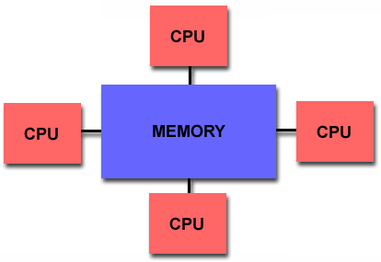
Shared memory architectures
Multiple CPU’s (or cores)
One memory with a global address space
  May have many modules
  All CPUs access all memory through the global address space
All CPUs can make changes to the shared memory
  Changes made by one processor are visible to all other processors?
Data parallelism or function parallelism?

Slide 3
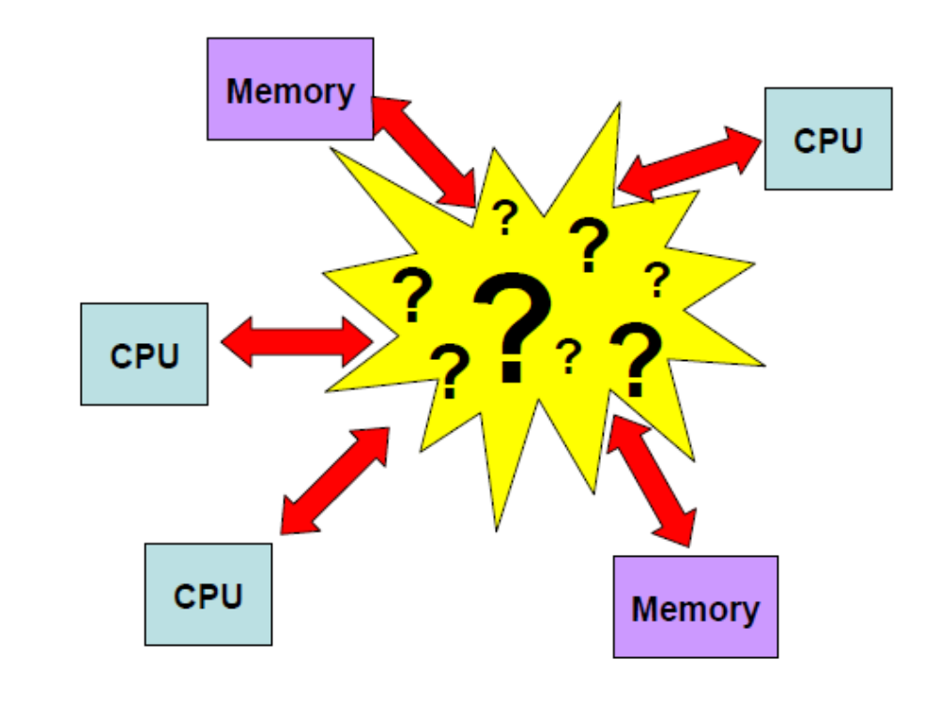
Shared memory architectures
How to connect CPUs and memory?

Slide 4
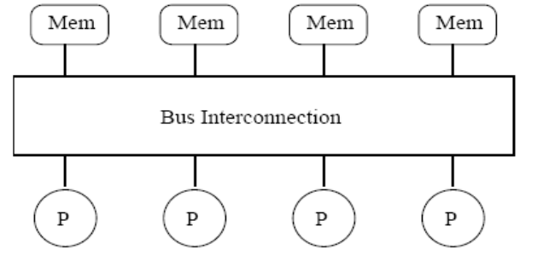
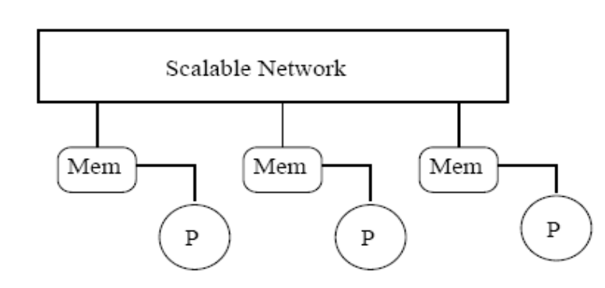
Shared memory architectures
One large memory
  One the same side of the interconnect
    Mostly Bus
  Memory reference has the same latency
  Uniform memory access (UMA)
Many small memories
  Local and remote memory
  Memory latency is different
  Non-uniform memory access (NUMA)

Slide 5
UMA Shared memory architecture (mostly bus-based MPs)
Many CPUs and memory modules connect to the bus
  dominates server and enterprise market, moving down to desktop
Faster processors began to saturate bus, then bus technology advanced
  today, range of sizes for bus-based systems, desktop to large servers (Symmetric Multiprocessor (SMP) machines).

Slide 6
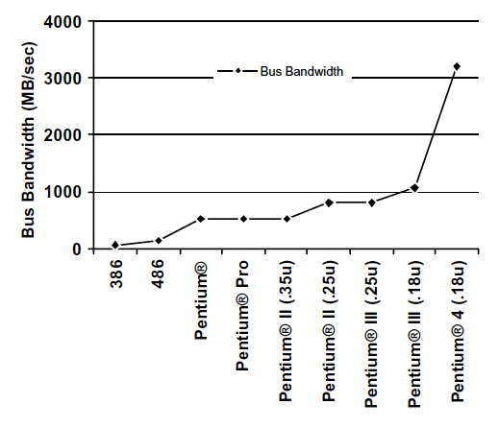
Bus bandwidth in Intel systems

Slide 7
Front side bus(FSB) bandwidth in Intel systems
Pentium D | 133 MHz-200 MHz | 4 | 64-bit | 4256 MB/s-6400 MB/s
Pentium Extreme Edition | 200 MHz-266 MHz | 4 | 64-bit | 6400 MB/s-8512 MB/s
Pentium M | 100 MHz-133 MHz | 4 | 64-bit | 3200 MB/s-4256 MB/s
Core Solo | 133 MHz-166 MHz | 4 | 64-bit | 4256 MB/s-5312 MB/s
Core Duo | 133 MHz-166 MHz | 4 | 64-bit | 4256 MB/s-5312 MB/s
Core 2 Solo | 133 MHz-200 MHz | 4 | 64-bit | 4256 MB/s-6400 MB/s
Core 2 Duo | 133 MHz-333 MHz | 4 | 64-bit | 4256 MB/s-10656 MB/s
Core 2 Quad | 266 MHz-333 MHz | 4 | 64-bit | 8512 MB/s-10656 MB/s
Core 2 Extreme | 200 MHz-400 MHz | 4 | 64-bit | 6400 MB/s-12800 MB/s

Slide 8
NUMA Shared memory architecture
Identical processors, processors have different time for accessing different part of the memory.
Often made by physically linking SMP machines (Origin 2000, up to 512 processors).
The current generation SMP interconnects (Intel Common System interface (CSI) and AMD hypertransport) have this flavor, but the processors are close to each other.

Slide 9
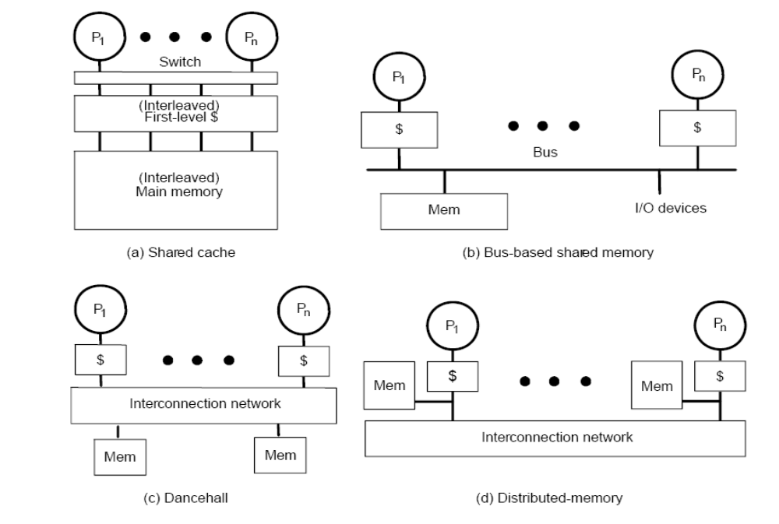
Various SMP hardware organizations

Slide 10
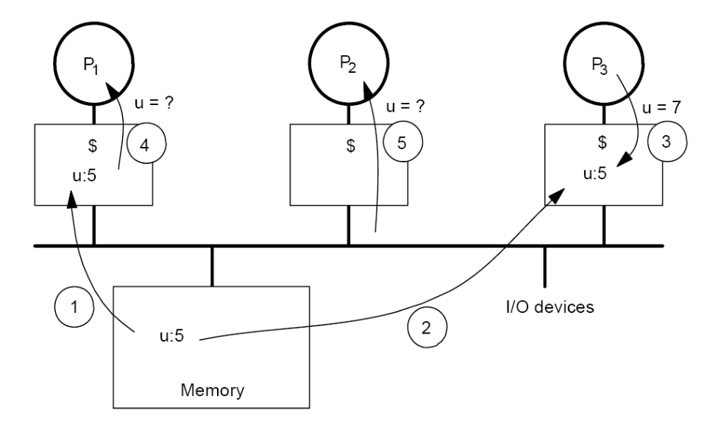
Cache coherence problem
Due to the cache copies of the memory, different processors may see the different values of the same memory location.
Processors see different values for u after event 3.
With a write-back cache, memory may store the stale date.
This happens frequently and is unacceptable to applications.

Slide 11
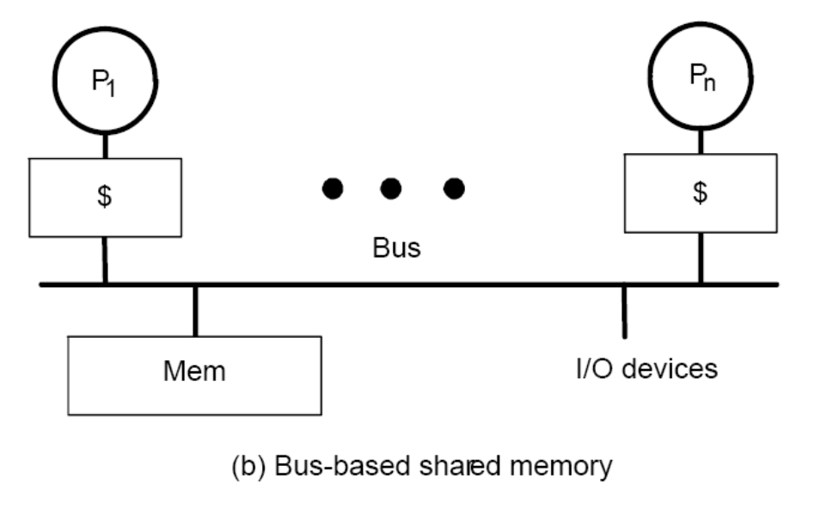
Bus Snoopy Cache Coherence protocols
Memory: centralized with uniform access time and bus interconnect.
Example: All Intel MP machines like diablo

Slide 12
Bus Snooping idea
Send all requests for data to all processors (through the bus)
Processors snoop to see if they have a copy and respond accordingly.
  Cache listens to both CPU and BUS.
  The state of a cache line may change by (1) CPU memory operation, and (2) bus transaction (remote CPU’s memory operation).
Requires broadcast since caching information is at processors.
  Bus is a natural broadcast medium.
  Bus (centralized medium) also serializes requests.
Dominates small scale machines.

Slide 13
Types of snoopy bus protocols
Write invalidate protocols
  Write to shared data: an invalidate is sent to the bus (all caches snoop and invalidate copies).
Write broadcast protocols (typically write through)
  Write to shared data: broadcast on bus, processors snoop and update any copies.

Slide 14
An Example Snoopy Protocol (MSI)
Invalidation protocol, write-back cache
Each block of memory is in one state
  Clean in all caches and up-to-date in memory (shared)
  Dirty in exactly one cache (exclusive)
  Not in any cache
Each cache block is in one state:
  Shared: block can be read
  Exclusive: cache has only copy, its writable and dirty
  Invalid: block contains no data.
Read misses: cause all caches to snoop bus (bus transaction)
Write to a shared block is treated as misses (needs bus transaction).

Slide 15
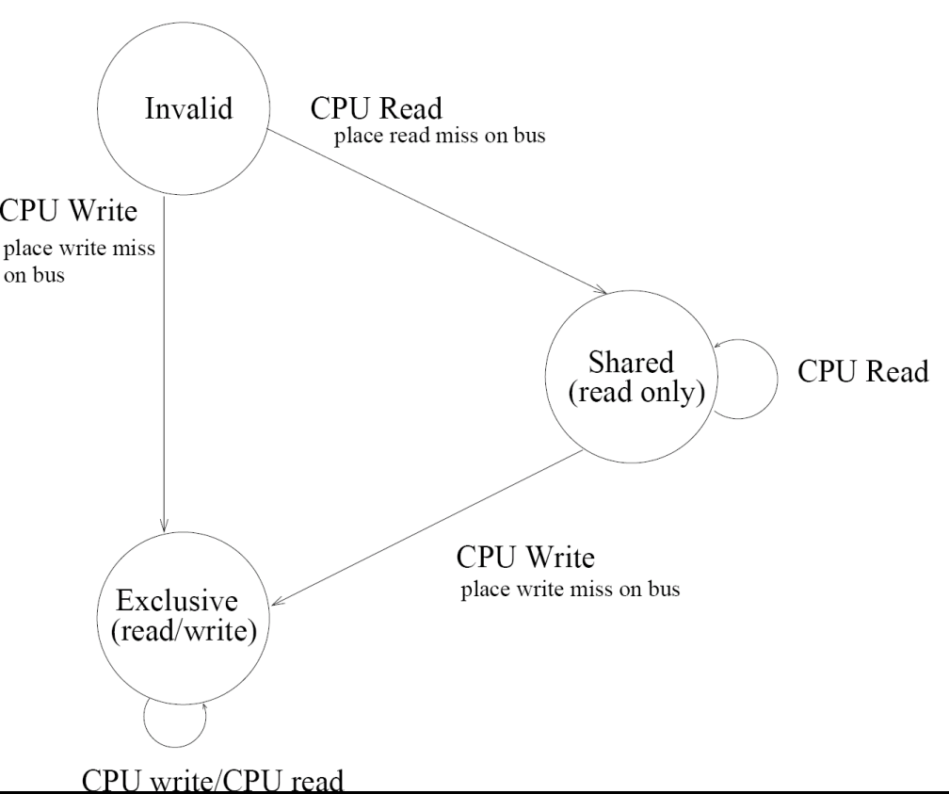
MSI protocol state machine for CPU requests

Slide 16
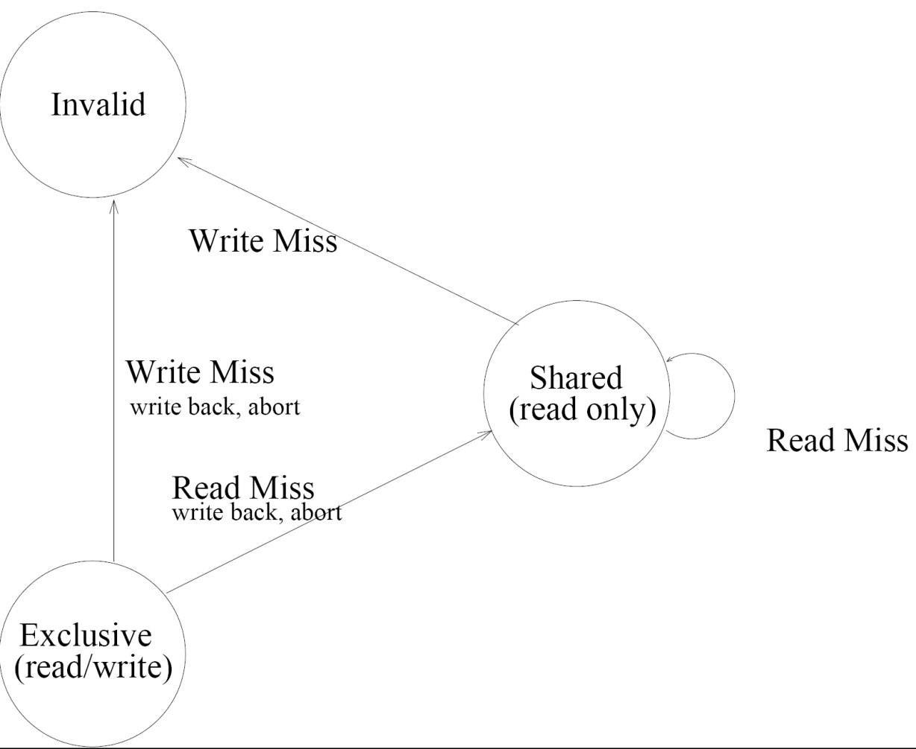
MSI protocol state machine for Bus requests

Slide 17
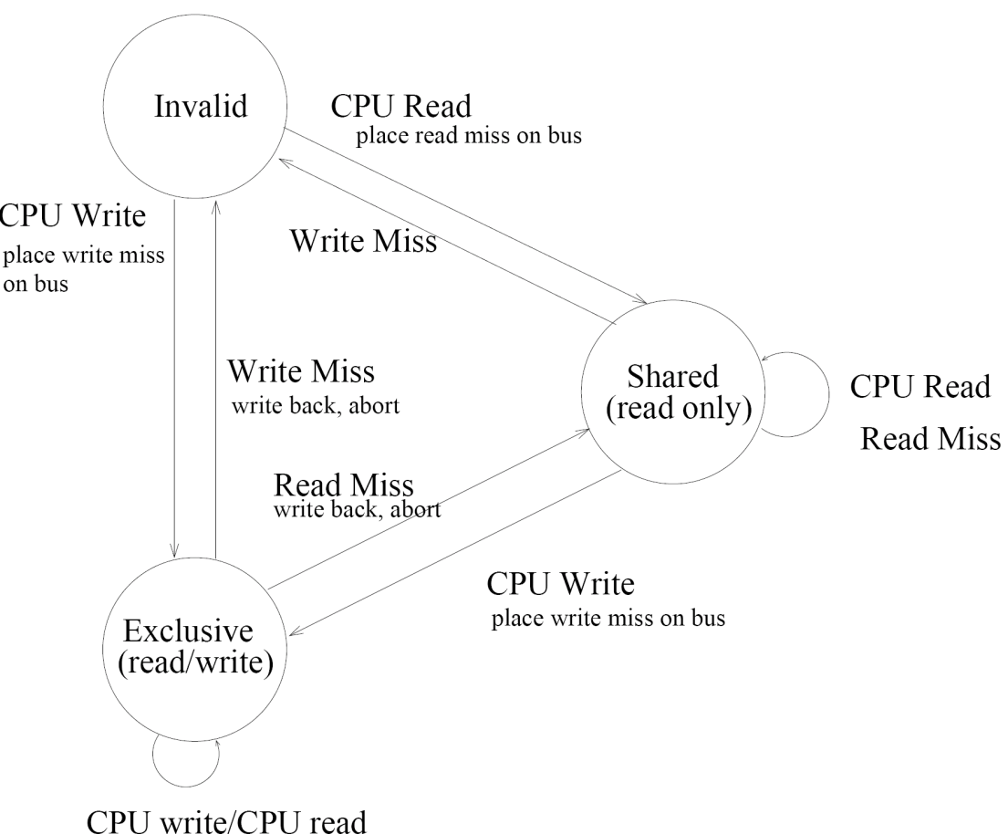
MSI protocol state machine (combined)

Slide 18
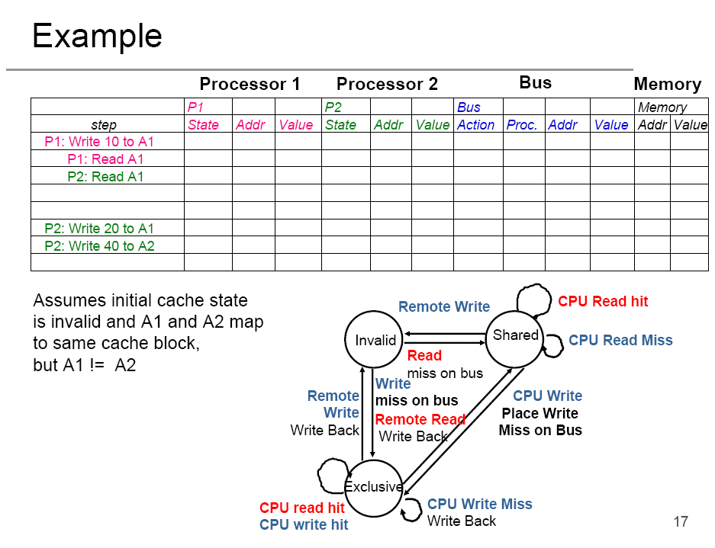
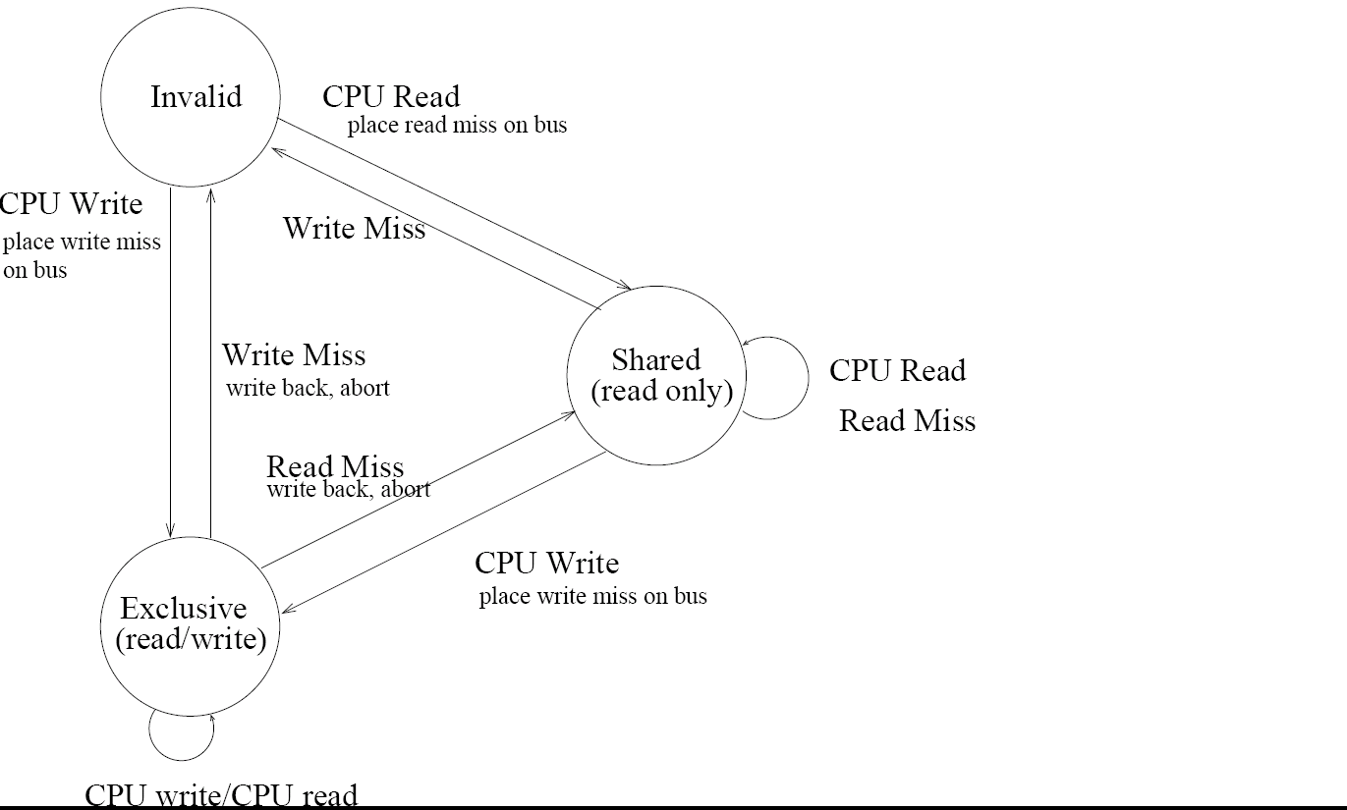


Slide 19
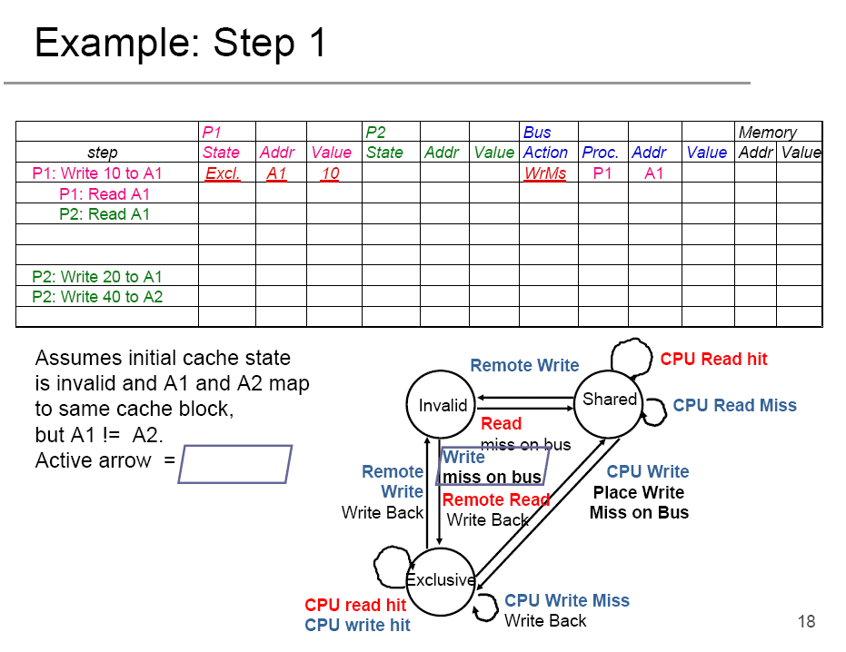


Slide 20
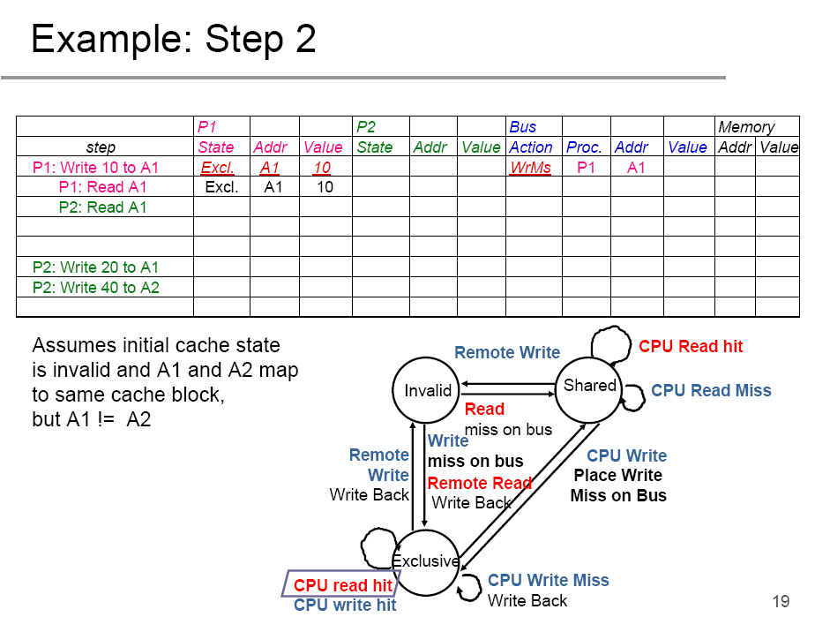

Slide 21
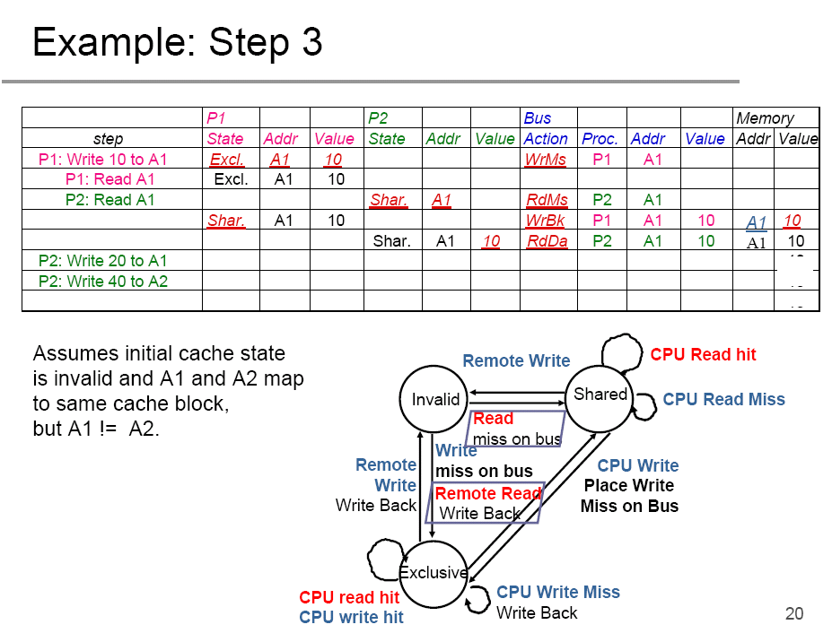

Slide 22
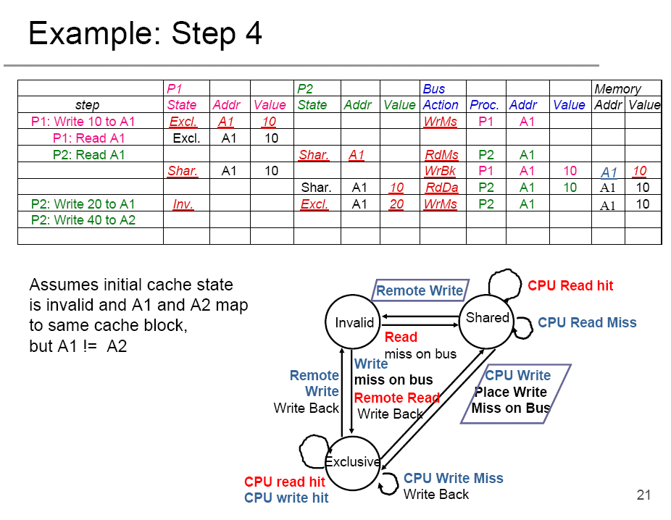

Slide 23
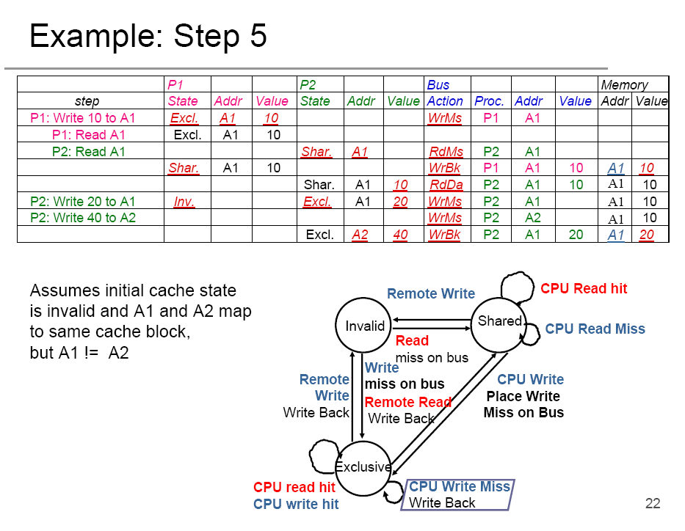

Slide 24
Some snooping cache variations
Basic Protocol
  Three states: MSI.
  Can optimize by refining the states so as to reduce the bus transactions in some cases.
Berkeley protocol
  Five states, M → owned, exclusive, owned shared.
Illinois protocols (five states)
MESI protocol (four states)
  M → modified and Exclusive.
  Used by Intel MP systems.

Slide 25
Multiple levels of caches
Most processors today have on-chip L1 and L2 caches.
Transactions on L1 cache are not visible to bus (needs separate snooper for coherence, which would be expensive).
Typical solution:
  Maintain inclusion property on L1 and L2 cache so that all bus transactions that are relevant to L1 are also relevant to L2: sufficient to only use the L2 controller to snoop the bus.
  Propagating transactions for coherence in the hierarchy.

Slide 26
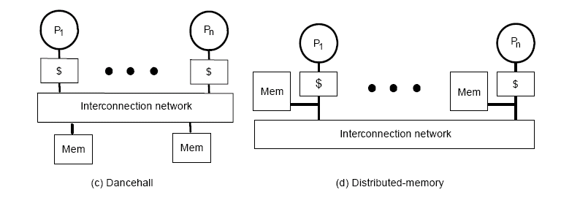
Large share memory multiprocessors
The interconnection network is usually not a bus.
No broadcast medium → cannot snoop.
Needs a different kind of cache coherence protocol.

Slide 27
Basic idea
Use a similar idea of snoopy bus
  Snoopy bus with the MSI protocol
    Cache line has three states (M, S, and I)
    Whenever we need a cache coherence operation, we tell the bus (central authority).
  CC protocol for large SMPs
    Cache line has three states
    Whenever we need a cache coherence operation, we tell the central authority
      serializes the access
      performs the cache coherence operations using point-to-point communication.
        It needs to know who has a cache copy, this information is stored in the directory.

Slide 28
Cache coherence for large SMPs
Use a directory for each cache line to track the state of every block in the cache.
  Can also track the state for all memory blocks → directory size = O(memory size).
Need to used distributed directory
  Centralized directory becomes the bottleneck.
    Who is the central authority for a given cache line?
Typically called cc-NUMA multiprocessors

Slide 29
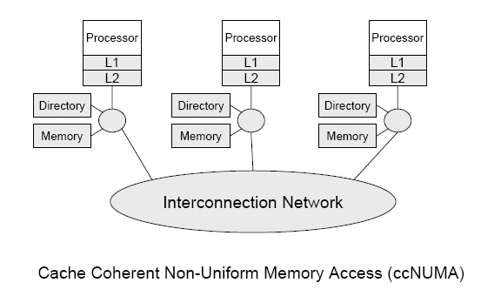
ccNUMA multiprocessors

Slide 30
Directory based cache coherence protocols
Similar to snoopy protocol: three states
  Shared: > 1 processors have the data, memory up-to-date
  Uncached: not valid in any cache
  Exclusive: 1 processor has data, memory out-of-date
Directory must track:
  Cache state
  Which processors have data when it is in shared state
    Bit vector, 1 if a particular processor has a copy
    Id and bit vector combination

Slide 31
Directory based cache coherence protocols
No bus and do not want to broadcast
Typically 3 processors involved:
  Local node where a request originates
  Home node where the memory location of an address resides (this is the central authority for the page)
  Remote node has a copy a cache block (exclusive or shared)

Slide 32
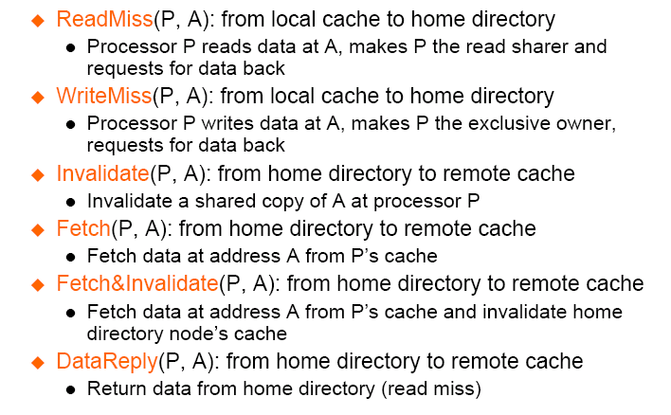
Directory protocol messages example

Slide 33
Directory based CC protocl in action
Local node (L): WriteMiss(P, A) to home node
Home node: cache line in shared state at processors P1, P2, P3
Home node to P1, P2, P3: invalidate(P, A)
Home node: cache line in exclusive state at processor L.

Slide 34
Summary
Share memory architectures
  UMA and NUMA
  Bus based systems and interconnect based systems
Cache coherence problem
Cache coherence protocols
  Snoopy bus
  Directory based

