Slide 1
Pthreads: A shared memory programming model
POSIX standard shared memory multithreading interface.
Not just for parallel programming, but for general multithreaded programming
Provide primitives for thread management and synchronization.
Threads are commonly associated with shared memory architectures and operating systems.
  Necessary for unleashing the computing power of SMT and CMP processors.
  Making it easy and efficient is very important at this time.

Slide 2
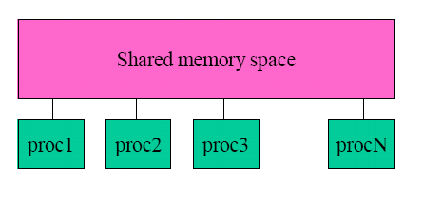
Pthreads: execution model
A single process can have multiple, concurrent execution paths.
  a.out creates a number of threads that can be scheduled and run concurrently.
  Each thread has local data, but also, shares the entire resources (global data) of a.out.
  Any thread can execute any subroutine at the same time as other threads.
  Threads communicate through global memory.

Slide 3
Fork-join model for executing threads in an application
Master thread
Fork
Parallel region
Join

Slide 4
What does the developer have to do?
Decide how to decompose the computation into parallel parts.
Create and destroy threads to support the decomposition
Add synchronization to make sure dependences are covered.

Slide 5
Creation
Thread equivalent of fork()
int pthread_create(
  pthread_t * thread,
  pthread_attr_t * attr,
  void * (*start_routine)(void *),
  void * arg
  );
Returns 0 if OK, and non-zero (> 0) if error.
Start_routine is what the thread will execute.

Slide 6
Termination
Thread Termination
  Return from initial function.
  void pthread_exit(void * status)
Process Termination
  exit() called by any thread
  main() returns

Slide 7
Waiting for child thread
int pthread_join( pthread_t tid, void **status)
Equivalent of waitpid()for processes

Slide 8
Detaching a thread
The detached thread can act as daemon thread
The parent thread doesn’t need to wait: the tid storage is reclaimed when the thread is done.
  Mainly to save space.
int pthread_detach(pthread_t tid)
Detaching self :
pthread_detach(pthread_self())

Slide 9
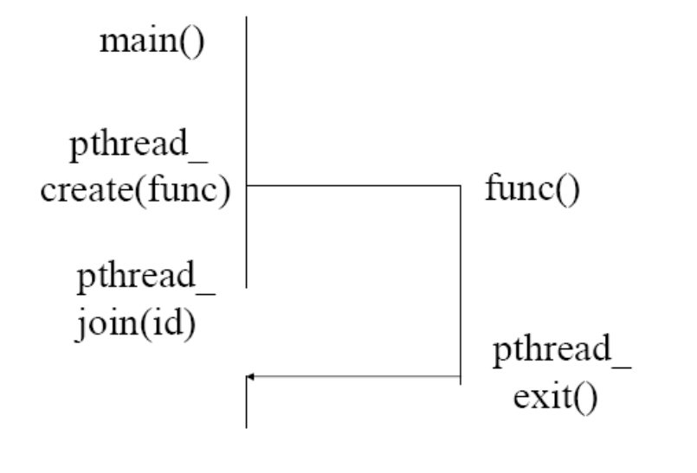
Example of thread creation

Slide 10
General pthread structure
A thread is a concurrent execution of a function
The threaded version of the program must be restructured such that the parallel part forms a separate function.
See example1.c
  Include <pthread.h>, link (gcc) with -lpthread

Slide 11
Matrix Multiply
For (I=0; I<n; I++)
for (j=0; j<n; j++)
c[I][j] = 0;
for (k=0; k<n; k++)
c[I][j] = c[I][j] + a[I][k] * b[k][j];

Slide 12
Parallel Matrix Multiply
All I- or j-iterations can be run in parallel
If we have p processors, n/p rows to each processor
  Corresponds to partitioning I-loop

Slide 13
Matrix Multiply: parallel part
void mmult(void *s)
{
int whoami = *(int *) s;
int from = whoami *n / p;
int to =((whoami +1)*n/p);
for (I=from; I<to; I++) {
for (j=0; j<n; j++) {
c[I][j] = 0;
for (k=0; k<n; k++)
c[I][j] += a[I][k]*b[k][j];
}
}
}
In the parallel version:
We will need to know:
Number of threads (p)
My ID – mmult has a parameter for myid.

Slide 14
Matrix Multiply: Main
int main()
{
pthread_t thrd[p];
int para[p];
for (I=0; I<p; I++) {
para[I] = I; /* why do we need this, see example2.c */
pthread_create(&thrd[I], NULL, mmult, (void *)&para[I]);
}
for (I=from; I<to; I++)
pthread_join(thrd[I], NULL);
}

Slide 15
General Program Structure
Encapsulate parallel parts in functions.
Use function arguments to parametrize what a particular thread does.
Call pthread_create() with the function and arguments, save thread identifier returned.
Call pthread_join() with that thread identifier

Slide 16
Pthreads synchronization
Create/exit/join
  Provides coarse grain synchronizations
  Requires thread creation/destruction
Need for finer-grain synchronization
  Mutex locks, condition variables, semaphores

Slide 17
Mutex lock– for mutual exclusion
int counter = 0;
void *thread_func(void *arg)
{
int val;
/* unprotected code – why? See example3.c */
val = counter;
counter = val + 1;
return NULL;
}

Slide 18
Mutex locks: lock
pthread_mutex_lock(pthread_mutex_t *mutex);
Tries to acquire the lock specified by mutex
If mutex is already locked, then the calling thread blocks until mutex is unlocked.

Slide 19
Mutex locks: unlock
pthread_mutex_unlock(pthread_mutex_t *mutex);
If the calling thread has mutex currently locked, this will unlock the mutex.
If other threads are blocked waiting on this mutex, one will unblock and acquire mutex.
Which one is determined by the scheduler.

Slide 20
Mutex example
int counter = 0;
ptread_mutex_t mutex = PTHREAD_MUTEX_INITIALIZER;
void *thread_func(void *arg)
{
int val;
/* protected by mutex, see example4.c*/
Pthread_mutex_lock( &mutex );
val = counter;
counter = val + 1;
Pthread_mutex_unlock( &mutex );
return NULL;
}

