Slide 1
Introduction to OpenMP
Introduction
OpenMP basics
OpenMP directives, clauses, and library routines

Slide 2
Motivation
Pthread is too tedious: explicit thread management is often unnecessary
  Consider the matrix multiply example
    We have a sequential code, we know which loop can be executed in parallel; the program conversion is quite mechanic: we should just say that the loop is to be executed in parallel and let the compiler do the rest.
    OpenMP does exactly that!!!

Slide 3
What is OpenMP?
What does OpenMP stands for?
  Open specifications for Multi Processing via collaborative work between interested parties from the hardware and software industry, government and academia.
OpenMP is an Application Program Interface (API) that may be used to explicitly direct multi-threaded, shared memory parallelism.
    API components: Compiler Directives, Runtime Library Routines. Environment Variables
OpenMP is a directive-based method to invoke parallel computations on share-memory multiprocessors

Slide 4
What is OpenMP?
OpenMP API is specified for C/C++ and Fortran.
OpenMP is not intrusive to the original serial code: instructions appear in comment statements for fortran and pragmas for C/C++.
OpenMP website: http://www.openmp.org
  Materials in this lecture are taken from various OpenMP tutorials in the website and other places.

Slide 5
Why OpenMP?
OpenMP is portable: supported by HP, IBM, Intel, SGI, SUN, and others
  It is the de facto standard for writing shared memory programs.
  To become an ANSI standard?
OpenMP can be implemented incrementally, one function or even one loop at a time.
  A nice way to get a parallel program from a sequential program.

Slide 6
How to compile and run OpenMP programs?
Gcc 4.2 and above supports OpenMP 3.0
  gcc –fopenmp a.c
  Try example1.c
To run: ‘a.out’
  To change the number of threads:
    setenv OMP_NUM_THREADS 4 (tcsh) or export OMP_NUM_THREADS=4(bash)

Slide 7
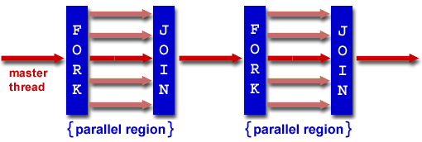
OpenMP execution model
OpenMP uses the fork-join model of parallel execution.
  All OpenMP programs begin with a single master thread.
  The master thread executes sequentially until a parallel region is encountered, when it creates a team of parallel threads (FORK).
  When the team threads complete the parallel region, they synchronize and terminate, leaving only the master thread that executes sequentially (JOIN).

Slide 8
OpenMP general code structure
#include <omp.h>
main () {
int var1, var2, var3;
Serial code
. . .
/* Beginning of parallel section. Fork a team of threads. Specify variable scoping*/
#pragma omp parallel private(var1, var2) shared(var3)
{
/* Parallel section executed by all threads */
. . .
/* All threads join master thread and disband*/
}
Resume serial code
. . .
}

Slide 9
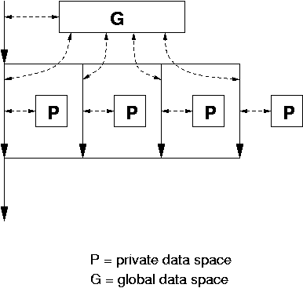
Data model
Private and shared variables
  Variables in the global data space are accessed by all parallel threads (shared variables).
  Variables in a thread’s private space can only be accessed by the thread (private variables)
    several variations, depending on the initial values and whether the results are copied outside the region.

Slide 10
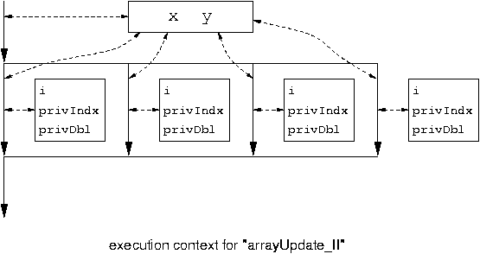
#pragma omp parallel for private( privIndx, privDbl )
for ( i = 0; i < arraySize; i++ ) {
for ( privIndx = 0; privIndx < 16; privIndx++ ) { privDbl = ( (double) privIndx ) / 16;
y[i] = sin( exp( cos( - exp( sin(x[i]) ) ) ) ) + cos( privDbl );
}
}
Parallel for loop index is
Private by default.

Slide 11
OpenMP directives
Format:
  #progma omp directive-name [clause,..] newline
  (use ‘\’ for multiple lines)
Example:
  #pragma omp parallel default(shared) private(beta,pi)
Scope of a directive is one block of statements { …}

Slide 12
Parallel region construct
A block of code that will be executed by multiple threads.
  #pragma omp parallel [clause …]
  {
  ……
  } (implied barrier)
  Clauses: if (expression), private (list), shared (list), default (shared | none), reduction (operator: list), firstprivate(list), lastprivate(list)
  if (expression): only in parallel if expression evaluates to true
  private(list): everything private and local (no relation with variables outside the block).
  shared(list): data accessed by all threads
  default (none|shared)

Slide 13
The reduction clause:
Sum = 0.0;
#pragma parallel default(none) shared (n, x) private (I) reduction(+ : sum)
{
For(I=0; I<n; I++) sum = sum + x(I);
}
  Updating sum must avoid racing condition
  With the reduction clause, OpenMP generates code such that the race condition is avoided.
Firstprivate(list): variables are initialized with the value before entering the block
Lastprivate(list): variables are updated going out of the block.

Slide 14
Work-sharing constructs
#pragma omp for [clause …]
#pragma omp section [clause …]
#pragma omp single [clause …]
The work is distributed over the threads
Must be enclosed in parallel region
No implied barrier on entry, implied barrier on exit (unless specified otherwise)

Slide 15
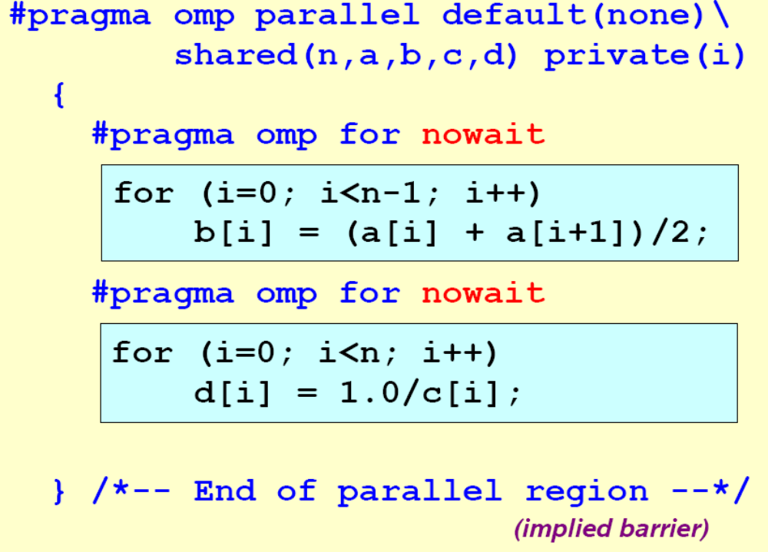
The omp for directive: example

Slide 16
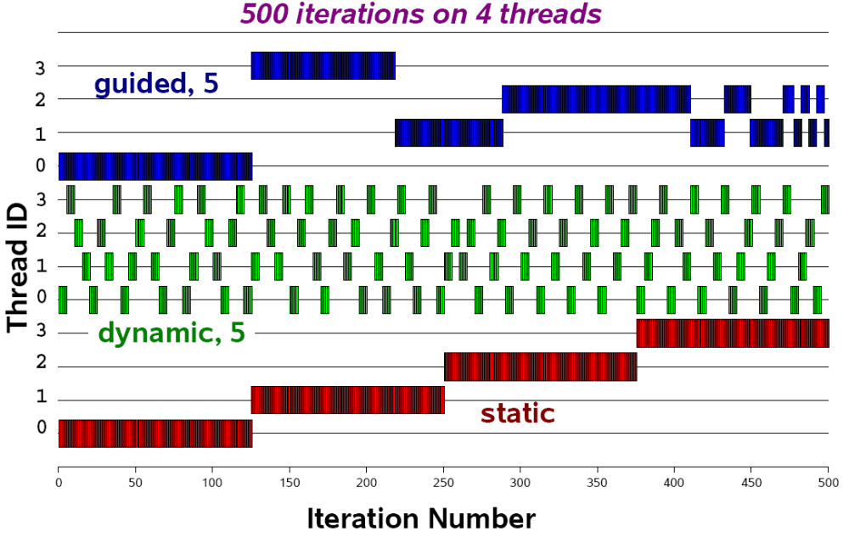
Schedule clause (decide how the iterations are executed in parallel):
  schedule (static | dynamic | guided [, chunk])

Slide 17
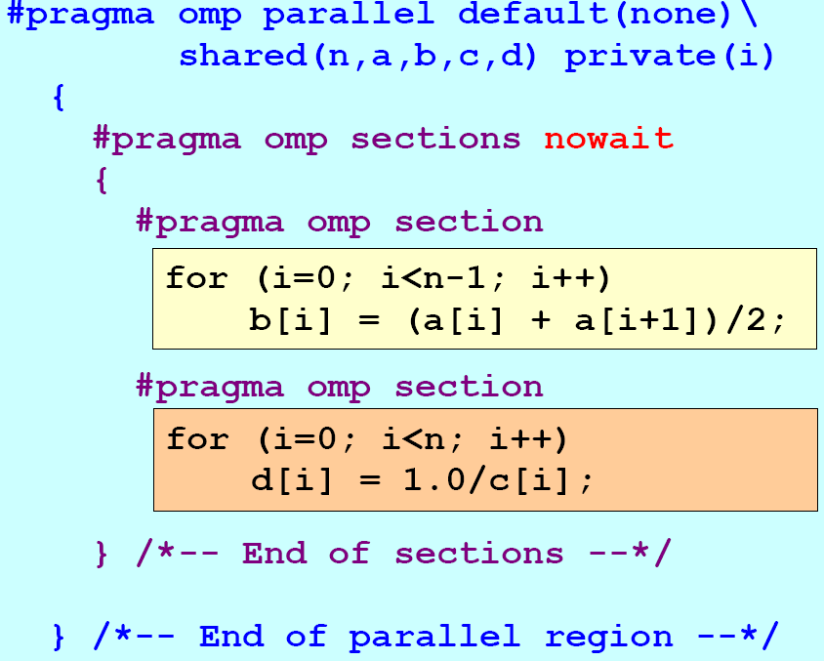
The omp session clause - example

Slide 18
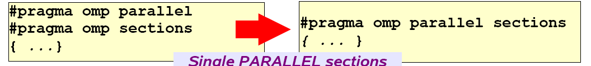

Slide 19
Synchronization: barrier
For(I=0; I<N; I++)
a[I] = b[I] + c[I];
For(I=0; I<N; I++)
d[I] = a[I] + b[I]
Both loops are in parallel region
With no synchronization in between.
What is the problem?
Fix:
For(I=0; I<N; I++)
a[I] = b[I] + c[I];
#pragma omp barrier
For(I=0; I<N; I++)
d[I] = a[I] + b[I]

Slide 20
Critical session
For(I=0; I<N; I++) {
……
sum += A[I];
……
}
Cannot be parallelized if sum is shared.
Fix:
For(I=0; I<N; I++) {
……
#pragma omp critical
{
sum += A[I];
}
……
}

Slide 21
OpenMP environment variables
OMP_NUM_THREADS
OMP_SCHEDULE

Slide 22
OpenMP runtime environment
omp_get_num_threads
omp_get_thread_num
omp_in_parallel
Routines related to locks
……

Slide 23
OpenMP example
See pi.c

Slide 24
Sequential Matrix Multiply
For (I=0; I<n; I++)
for (j=0; j<n; j++)
c[I][j] = 0;
for (k=0; k<n; k++)
c[I][j] = c[I][j] + a[I][k] * b[k][j];

Slide 25
OpenMP Matrix Multiply
#pragma omp parallel for private(j, k)
For (I=0; I<n; I++)
for (j=0; j<n; j++)
c[I][j] = 0;
for (k=0; k<n; k++)
c[I][j] = c[I][j] + a[I][k] * b[k][j];

Slide 26
Travelling Salesman Problem(TSP)
The map is represented as a graph with nodes representing cities and edges representing the distances between cities.
A special node (cities) is the starting point of the tour.
Travelling salesman problem is to find the circle (starting point) that covers all nodes with the smallest distance.
This is a well known NP-complete problem.

Slide 27
Sequential TSP
Init_q(); init_best();
While ((p = dequeue()) != NULL) {
for each expansion by one city {
q = addcity (p);
if (complete(q)) {update_best(q);}
else enqueue(q);
}
}

Slide 28
OpenMP TSP
Do_work() {
While ((p = dequeue()) != NULL) {
for each expansion by one city {
q = addcity (p);
if (complete(q)) {update_best(q);}
else enqueue(q);
}
}
}
main() {
init_q(); init_best();
#pragma omp parallel for
for (i=0; I < NPROCS; i++)
do_work();
}

Slide 29
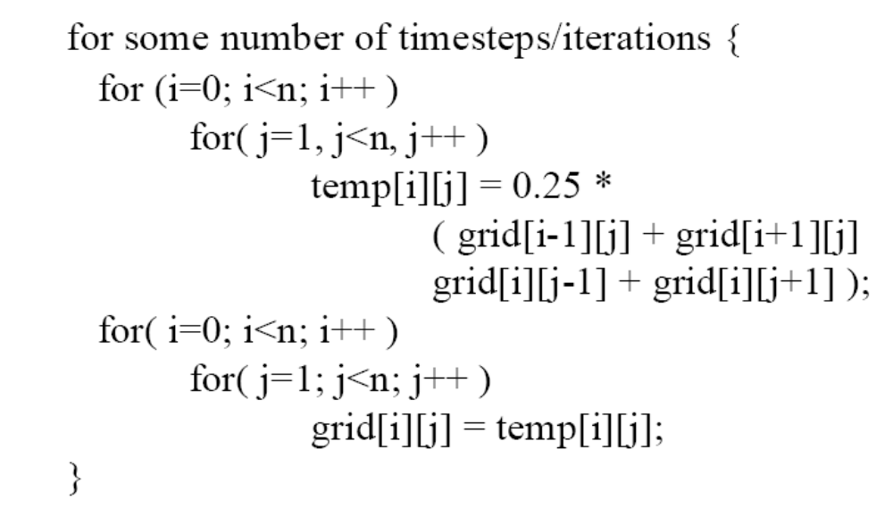
Sequential SOR
OpenMP version?

Slide 30
Summary:
  OpenMP provides a compact, yet powerful programming model for shared memory programming
    It is very easy to use OpenMP to create parallel programs.
  OpenMP preserves the sequential version of the program
  Developing an OpenMP program:
    Start from a sequential program
    Identify the code segment that takes most of the time.
    Determine whether the important loops can be parallelized
      The loops may have critical sections, reduction variables, etc
    Determine the shared and private variables.
    Add directives

Slide 31
OpenMP discussion
Ease of use
  OpenMP takes cares of the thread maintenance.
    Big improvement over pthread.
  Synchronization
    Much higher constructs (critical section, barrier).
    Big improvement over pthread.
OpenMP is easy to use!!

Slide 32
OpenMP discussion
Expressiveness
  Data parallelism:
    MM and SOR
    Fits nicely in the paradigm
  Task parallelism:
    TSP
    Somewhat awkward. Use OpenMP constructs to create threads. OpenMP is not much different from pthread.

Slide 33
OpenMP discussion
Exposing architecture features (performance):
  Not much, similar to the pthread approach
    Assumption: dividing job into threads = improved performance.
    How valid is this assumption in reality?
      Overheads, contentions, synchronizations, etc
  This is one weak point for OpenMP: the performance of an OpenMP program is somewhat hard to understand.

Slide 34
OpenMP final thoughts
Main issues with OpenMP: performance
  Is there any obvious way to solve this?
    Exposing more architecture features?
  Is the performance issue more related to the fundamantal way that we write parallel program?
    OpenMP programs begin with sequential programs.
    May need to find a new way to write efficient parallel programs in order to really solve the problem.

