Slide 1
Ad hoc and Sensor Networks
Chapter 12: Data-centric and content-based networking
Holger Karl

Slide 2
Goal of this chapter
Apart from routing protocols that use a direct identifier of nodes (either unique id or position of a node), networking can talk place based directly on content
Content can be collected from network, processed in the network, and stored in the network
This chapter looks at such content-based networking and data aggregation mechanisms

Slide 3
Overview
Interaction patterns and programming model
Data-centric routing
Data aggregation
Data storage

Slide 4
Desirable interaction paradigm properties
Standard networking interaction paradigms:
Client/server, peer-to-peer
  Explicit or implicit partners, explicit cause for communication
Desirable properties for WSN (and other applications)
  Decoupling in space – neither sender nor receiver need to know their partner
  Decoupling in time – “answer” not necessarily directly triggered by “question”, asynchronous communication

Slide 5
Interaction paradigm: Publish/subscribe
Achieved by publish/subscribe paradigm
  Idea: Entities can publish data under certain names
  Entities can subscribe to updates of such named data
Conceptually: Implemented by a software bus
  Software bus stores subscriptions, published data; names used as filters; subscribers notified when values of named data changes
Variations
  Topic-based P/S – inflexible
  Content-based P/S – use general predicates over named data
Software bus
Publisher 1
Publisher 2
Subscriber 1
Subscriber 2
Subscriber 3

Slide 6
Publish/subscribe implementation options
Central server – mostly not applicable
Topic-based P/S: group communication protocols
Content-based networking does not directly map to multicast groups
  Needs content-based routing/forwarding for efficient networking
t < 10
t = 35!
t > 20
t = 35!
t > 20
t = 35!
t < 10 or
t > 20
t > 30
t = 35!
t < 10 or
t > 20
t = 35!
t > 20
t < 10

Slide 7
Overview
Interaction patterns and programming model
Data-centric routing
Data aggregation
Data storage

Slide 8
One-shot interactions with big data sets
Scenario
  Large amount of data are to be communicated – e.g., video picture
  Can be succinctly summarized/described
Idea: Only exchange characterization with neighbor, ask whether it is interested in data
  Only transmit data when explicitly requested
  Nodes should know about interests of further away nodes
! Sensor Protocol for Information via Negotiation (SPIN)

Slide 9
SPIN example
(1)
(2)
(3)
ADV
REQ
DATA
ADV
(4)
ADV
(5)
REQ
(6)
DATA
ADV
ADV
REQ
DATA

Slide 10
Repeated interactions
More interesting: Subscribe once, events happen multiple times
  Exploring the network topology might actually pay off
  But: unknown which node can provide data, multiple nodes might ask for data
  ! How to map this onto a “routing” problem?
Idea: Put enough information into the network so that publications and subscriptions can be mapped onto each other
  But try to avoid using unique identifiers: might not be available, might require too big a state size in intermediate nodes
! Directed diffusion as one option for implementation
  Try to rely only on local interactions for implementation

Slide 11
Directed diffusion – Two-phase pull
Phase 1: nodes distribute interests in certain kinds of named data
  Specified as attribute-value pairs (cp. Chapter 7)
Interests are flooded in the network
  Apparently obvious solution: remember from where interests came, set up a convergecast tree
  Problem: Node X cannot distinguish, in absence of unique identifiers, between the two situations on the right – set up only one or three convergecast trees?
Sink 1
Sink 2
X
Source
Sink 3
Sink
X
Source

Slide 12
Direction diffusion – Gradients in two-phase pull
Option 1: Node X forwarding received data to all “parents” in a “convergecast tree”
  Not attractive, many needless packet repetitions over multiple routes
Option 2: node X only forwards to one parent
  Not acceptable, data sinks might miss events
Option 3: Only provisionally send data to all parents, but ask data sinks to help in selecting which paths are redundant, which are needed
  Information from where an interest came is called gradient
  Forward all published data along all existing gradients

Slide 13
Gradient reinforcement
Gradients express not only a link in a tree, but a quantified “strength” of relationship
  Initialized to low values
  Strength represents also rate with which data is to be sent
Intermediate nodes forward on all gradients
  Can use a data cache to suppress needless duplicates
Second phase: Nodes that contribute new data (not found in cache) should be encouraged to send more data
  Sending rate is increased, the gradient is reinforced
  Gradient reinforcement can start from the sink
  If requested rate is higher than available rate, gradient reinforcement propagates towards original data sources
Adapts to changes in data sources, topology, sinks

Slide 14
Directed diffusion – extensions
Two-phase pull suffers from interest flooding problems
  Can be ameliorated by combining with topology control, in particular, passive clustering
Geographic scoping & directed diffusion
Push diffusion – few senders, many receivers
  Same interface/naming concept, but different routing protocol
  Here: do not flood interests, but flood the (relatively few) data
  Interested nodes will start reinforcing the gradients
Pull diffusion – many senders, few receivers
  Still flood interest messages, but directly set up a real tree

Slide 15
Overview
Interaction patterns and programming model
Data-centric routing
Data aggregation
Data storage

Slide 16
Data aggregation
Any packet not transmitted does not need energy
To still transmit data, packets need to combine their data into fewer packets ! aggregation is needed
Depending on network, aggregation can be useful or pointless

Slide 17
Metrics for data aggregation
Accuracy: Difference between value(s) the sink obtains from aggregated packets and from the actual value (obtained in case no aggregation/no faults occur)
Completeness: Percentage of all readings included in computing the final aggregate at the sink
Latency
Message overhead

Slide 18
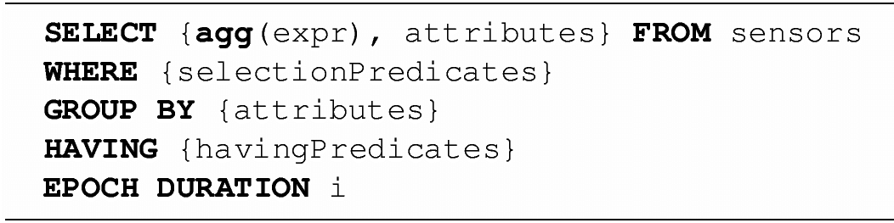
How to express aggregation request?
One option: Use database abstraction of WSN
Aggregation is requested by appropriate SQL clauses
  Agg(expr): actual aggregation function, e.g., AVG(temperature)
  WHERE: filter on value before entering aggregation process
    Usually evaluated locally on an observing node
  GROUP BY: partition into subsets, filtered by HAVING
    GROUP BY floor HAVING floor > 5

Slide 19
Partial state records
Partial state records to represent intermediate results
  E.g., to compute average, sum and number of previously aggregated values is required – expressed as <sum,count>
  Update rule:
  Final result is simply s/c

Slide 20
Aggregation operations – categories
Duplicate sensitive, e.g., median, sum, histograms; insensitive: maximum or minimum
Summary or examplary
Composable: for f aggregation function, there exist g such that f(W) = g(f(W₁), f(W₂)) for W = W₁ [ W₂
Behavior of partial state records
  Distributive – end results directly as partial state record, e.g., MIN
  Algebraic – p.s.r. has constant size; end result easily derived
  Content-sensitive – size and structure depend on measured values (e.g., histogram)
  Holistic – all data need to be included, e.g., median
Monotonic

Slide 21
Placement of aggregation points
Convergecast trees provide natural aggregation points
But: what are good aggregation points?
  Ideally: choose tree structure such that the size of the aggregated dat to be communicated is minimized
  Figuratively: long trunks, bushy at the leaves
  In fact: again a Steiner tree problem in disguise
Good aggregation tree structure can be obtained by slightly modifying Takahashi-Matsuyama heuristic
Alternative: look at parent selection rule in a simple flooding-based tree construction
  E.g., first inviter as parent, random inviter, nearest inviter, …
  Result: no simple rule guarantees an optimal aggregation structure
Can be regarded as optimization problem as well

Slide 22
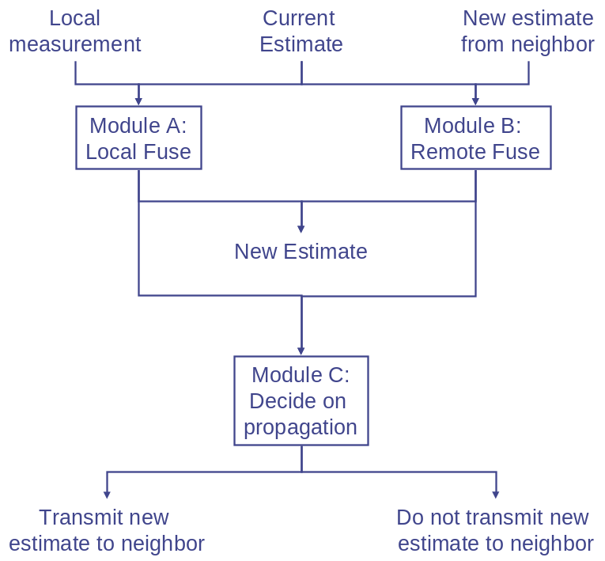
Alternative: broadcasting an aggregated value
Goal is to distribute an aggregate of all nodes’ measurements to all nodes in turn
  Setting up |V| convergecast trees not appropriate
Idea: Use gossiping combined with aggregation
  When new information is obtained, locally or from neighbor, compute new estimate by aggregation
  Decide whether to gossip this new estimate, detect whether a change is “significant”

Slide 23
Overview
Interaction patterns and programming model
Data-centric routing
Data aggregation
Data storage

Slide 24
Data-centric storage
Problem: Sometimes, data has to be stored for later retrieval – difficult in absence of gateway nodes/servers
Question: Where/on which node to put a certain datum?
  Avoid a complex directory service
Idea: Let name of data describe which node is in charge
  Data name is hashed to a geographic position
  Node closest to this position is in charge of holding data
  Akin to peer-to-peer networking/distributed hash tables
  Hence name of one approach: Geographic Hash Tables (GHT)
  Use geographic routing to store/retrieve data at this “location” (in fact, the node)

Slide 25
Geographic hash tables – Some details
Good hash function design
Nodes not available at the hashed location – use “nearest” node as determined by a geographic routing protocol
  E.g., the node where an initial packet started circulating the “hole”
  Other nodes around hole are informed about node taking charge
Handling failing and new nodes
  Failure detected by timeout, apply similar procedure as for initially storing data
Limited storage per node
  Distribute data to other nodes on same face
Key
location
Timeout
New key
location

Slide 26
Conclusion
Using data names or predicates over data to describe the destination of packets/data opens new options for networking
Networking based on such “data-centric addresses” nicely supports an intuitive programming model – publish/subscribe
Aggregation a key enabler for efficient networking
Other options – data storage, bradcasting aggregates – also well supportable

