Slide 1
Ad hoc and Sensor Networks
Chapter 13a: Protocols for dependable data transport
Holger Karl
Notes:
Note: This chapter is missing a section on transport protocols in ad hoc networks, especially the TCP over multihop issues. This will be added in a later version.

Slide 2
Overview
Dependability requirements
Delivering single packets
Delivering blocks of packets
Delivering streams of packets

Slide 3
Dependability aspects
Coverage & deployment
  Is there a sufficient number of nodes such that an event can be detected at all? Such that data can accurately measured?
  How do they have to be deployed?
Information accuracy
  Which of the measured data have to be transported where such that a desired accuracy is achieved?
  How to deal with inaccurate measurements in the first place?
Dependable data transport
  Once it is clear which data should arrive where, how to make sure that it actually arrives?
  How to deal with transmission errors and omission errors/congestion?
Focus of this tutorial

Slide 4
Dependability: Terminology
“Dependable” is an umbrella term
Main numerical metrics
  (Steady state) availability – probability that a system is operational at any given point in time
    Assumption: System can fail and will repair itself
  Reliability at time t – Probability that system works correctly during the entire interval [0,t)
    Assumption: It worked correctly at system start t=0
  Responsiveness – Probability of meeting a deadline
    Even in presence of some – to be defined – faults
  Packet success probability – Probability that a packet (correctly) reaches its destination
    Related: packet error rate, packet loss rate
  Bit error rate – Probability of an incorrect bit
    Channel model determines precise error patterns

Slide 5
Dependability constraints
Wireless sensor networks (WSN) have unique constraints for dependable data delivery
  Transmission errors over a wireless channel
  Limited computational resources in a WSN node
  Limited memory
  Limited time (deadlines)
  Limited dependability of individual nodes
Standard mechanisms: Redundancy
  Redundancy in nodes, transmission
  Forward and backward error recovery
  Combinations are necessary!

Slide 6
Dependable data transport – context
Items to be delivered
  Single packet
  Block of packets
  Stream of packets
Level of guarantee
  Guaranteed delivery
  Stochastic delivery
Involved entities
  Sensor(s) to sink
  Sink to sensors
  Sensors to sensors
50% delivered

Slide 7
Constraints
Energy
  Send as few packets as possible
  Send with low power ! high error rates
  Avoid retransmissions
  Short packets ! weak FEC
  Balance energy consumption in network
Processing power
  Only simple FEC schemes
  No complicated algorithms (coding)
Memory
  Store as little data as briefly as possible

Slide 8
Overview
Dependability requirements
Delivering single packets
  Single path
  Multiple paths
  Gossiping-based approaches
  Multiple receivers
Delivering blocks of packets
Delivering streams of packets

Slide 9
Delivering single packets – main options
What are the intended receivers?
  A single receiver?
  Multiple receivers?
    In close vicinity? Spread out?
  Mobile?
Which routing structures are available?
  Unicast routing along a single path?
  Routing with multiple paths between source/destination pairs?
  No routing structure at all – rely on flooding/gossiping?

Slide 10
Single packet to single receiver over single path
Single, multi-hop path is giving by some routing protocol
Issues: Which node
  Detects losses (using which indicators)?
  Requests retransmissions?
  Carries out retransmissions?

Slide 11
Detecting & signaling losses in single packet delivery
Detecting loss of a single packet:
Only positive acknowledgements (ACK) feasible
  Negative acks (NACK) not an option – receiver usually does not know a packet should have arrived, has no incentive to send a NACK
Which node sends ACKs (avoiding retransmissions)?
  At each intermediate node, at MAC/link level
    Usually accompanied by link layer retransmissions
    Usually, only a bounded number of attempts
  At the destination node
    Transport layer retransmissions
    Problem: Timer selection

Slide 12
Carrying out retransmissions
For link layer acknowledgements: Neighboring node
For transport layer acknowledgements:
  Source node ! end-to-end retransmissions
Question: Could an intermediate node help in an end-to-end scheme? How to detect need for retransmissions? How to retransmit?

Slide 13
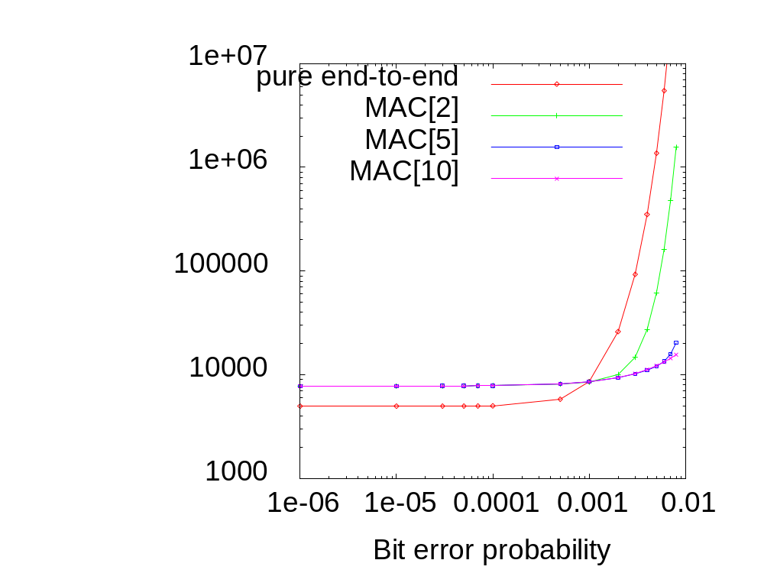
Tradeoff: End-to-end vs. link-layer retransmission
Scenario: Single packet,
n hops from source to destination, BSC channel
Transport-layer, end-to-end retransmission: Always
Link-layer retransmissions: Vary number of maximum attempts
  Drop packet if not successful within that limit
! For good channels, use end-to-end scheme; else local retransmit
Expected energy cost

Slide 14
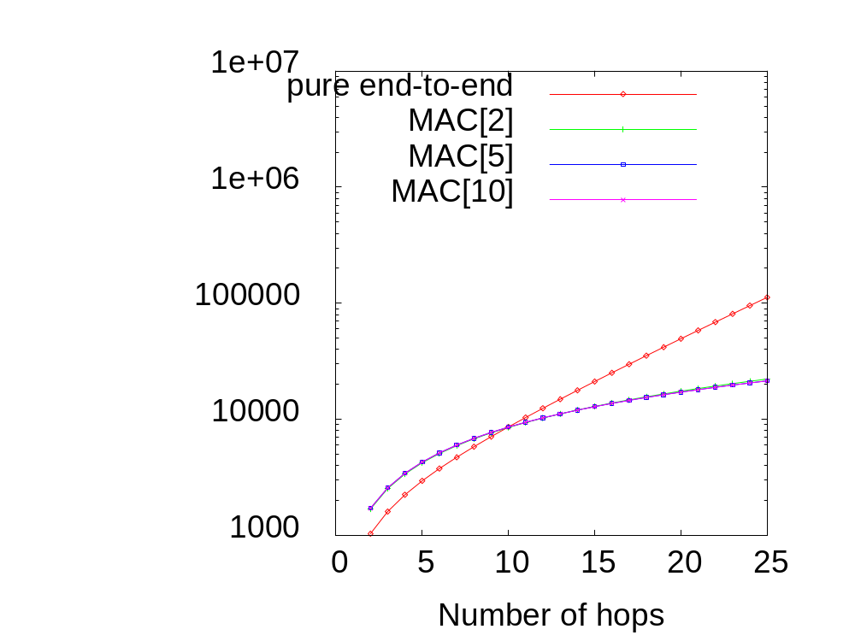
Tradeoff: End-to-end vs. link-layer retransmission
Same scenario, varying number of hops
  BER=0.001 of BSC channel fixed
! Use link-layer retransmissions only for longer routes
Expected energy cost
In both figures, difference between maximum link-layer retries schemes is small. Why?

Slide 15
Example schemes: HHR and HHRA
Hop-by-hop reliability (HHR)
  Idea: Locally improve probability of packet transmission, but do not use packet retransmission
  Instead, simply repeat packet a few times – a repetition code
  Choose number of repetitions per node such that resulting end-to-end delivery probability matches requirements
Hop-by-hop reliability with Acknowledgements (HHRA)
  Node sends a number of packets, but pauses after each packet to wait for acknowledgement
  If received, abort further packet transmissions
What happens in bursty channels?

Slide 16
Multiple paths
Types of : disjoint or braided
Usage: default and alternative routes
Usage: simultaneous
  Send same packet
  Send redundant fragments
Example: ReInForM

Slide 17
Multiple paths: Disjoint or braided
Disjoint paths
Secondary path
Source
Sink
Primary path
Braided paths
Source
Sink
Primary path

Slide 18
Using multiple paths
Alternating use
  Send packet over the currently “selected” path
  If path breaks, select alternative path
  Or/and: repair original path locally
Simultaneous use
  Send the complete packet over some or all of the multiple paths simultaneously
  Send packet fragments over several paths
    But endow fragments with redundancy
    Only some fragments suffice to reconstruct original packet

Slide 19
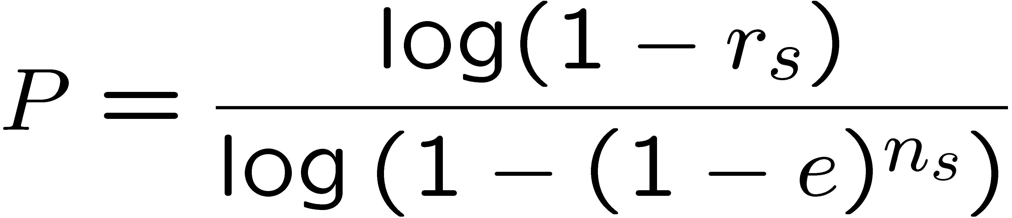
Example: ReInForM
Goal: Send packet over multiple paths to meet a delivery probability P
Assumptions:
  Independent paths, BSC
  Nodes know their “local” packet error rate e
Step 1: Source node decides how many paths to use
  Success probability over a single path with n_{s} hops: 1-(1-e)^{ns}
  Success probability over P paths: 1-(1-(1-e)^{ns})^{P}
  Should be ¸ r_{s}, solve for P:
  Note there is no floor/ceiling in this formula

Slide 20
ReInForM – Forwarding to neighbors
Source node picks a forwarder closer to destination than itself
Remaining neighbors:
P´ = P – (1-e_{s})
Choose P´ neighbors to additionally forward packet
  If possible, only neighbors closer to destination
  If not sufficient, use neighbors same hop distance
  If not sufficient, use further away neighbors
Source
Desti-
nation
Forwarder
Packet contains
  Source & destination
  Forwarder identity
  Source packet error rate
  Number of paths each neighbor should construct

Slide 21
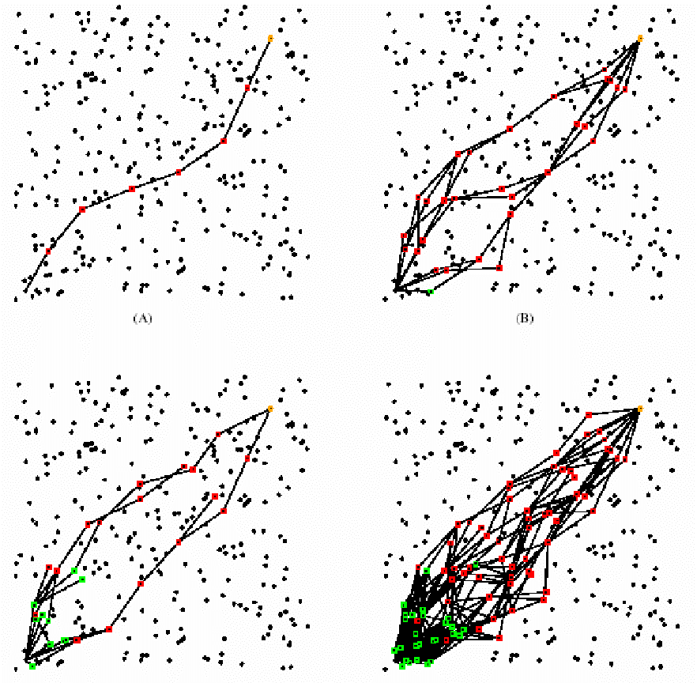
ReInForM – Behavior of neighbors
Forwarder behaves just like a source
Non-primary forwarders locally compute over how many paths they are supposed to forward the packet
  If number of paths
  < 1, node only forwards with according probability
ReInForM load-balancing behavior
for multiple packet transmissions

Slide 22
Gossiping-based approaches
What to do when not routes are available?
  Flooding – all nodes rebroadcast a received packet – not efficient
  Gossiping – only some nodes rebroadcast?
Problem: Which node rebroadcasts?
  Deterministic choice (e.g., backbone construction): Overhead
  Random choice: Forwarding probability?
Gossiping is greatly helped by direction to destination!

Slide 23
Forwarding probability for gossiping
Assumption: All nodes know
  destination to direction,
  number of neighbors k,
  packet error probability e
Goal: On average, a single node should forward packet
Expected number of packets received: k(1-e)
Each node receiving a packet forwards with probability P_{forward} = 1/k(1-e)
  Packet needs to contain k, e
Problem: Gossip might die out

Slide 24
Flooding based on neighborhood behavior
Suppose a packet should be distributed to all nodes
Suppose a node can observe behavior of its neighbors
When to actually forward a new packet?
  Immediately? All nodes will then forward, some needlessly
  Wait and check neighbors? When many neighbors have already forwarded the packet, is it worthwhile to do so as well?
Observation (for uniformly distributed networks):
  When k ¸ 4 neighbors have already forwarded a packet,
  the additional coverage gained by forwarding it
  one more time is · 0.05%
  ! Wait random time, count neighbors’ forwards, only forward when not already done so in neighborhood

Slide 25
Multiple receivers
Deliver a single packet to multiple receivers: Multicast
  Formally: Steiner tree problem, NP complete
  Constructing Steiner tree for a single packet probably excessive; might pay off for multiple packets
Problem: ACK implosion
  Many receivers send ACKs to a single source
  Source/nodes near source are overloaded
Combination with ACK aggregation

Slide 26
Overview
Dependability requirements
Delivering single packets
Delivering blocks of packets
  Opportunity: Caching in intermediate nodes
  Example: Pump Slowly, Fetch Quickly (PSFQ)
  Example: Reliable Multisegment Transport (RMST)
Delivering streams of packets

Slide 27
Delivering blocks of packets
Goal: Deliver large amounts of data
  E.g., code update, large observations
  Split data into several packets (reduce packet error rate)
  Transfer this block of packets
Main difference to single packet delivery: Gaps in sequence number can be detected and exploited
  For example, by intermediate nodes sending NACKs
2?
To answer NACK locally, intermediate nodes must cache packets
Which packets? For how long?
1
3
2
Where
is
packet 2?

Slide 28
Example: Pump Slowly Fetch Quickly (PSFQ)
Goal: Distribute block of packets to from one sender to multiple receivers (sink to sensors)
  E.g., code update ! losses are not tolerable, delay not critical
  Routing structure is assumed to be known
Basic operation
  Source pumps data into network
    Using broadcast, large inter-packet gap time
  Intermediate nodes store packets, forward if in-sequence
  Out-of-sequence: buffer, request missing packet(s) – fetch operation (a NACK)
    Previous node resends missing packet ! local recovery
    Assumption: packet is available Ã no congestion, only channel errors
  ! Pumping is slow, fetching is quick

Slide 29
PSFQ protocol details
How big an inter-packet gap?
  Big enough to accommodate at least one, better several fetch operations
  Probability that next packet arrives when the previous one has not yet been repaired should be small
When to forward an in-sequence packet?
  Wait random time, only forward when · 3 neighbors have forwarded
Handle out-of-order packet?
  Do not forward, fill the gap first by fetching ! avoid loss propagation

Slide 30
PSFQ protocol details (2)
How to handle fetch requests (NACKs)?
  Fetch request are broadcast, might arrive at multiple nodes
  Nodes receiving NACK might themselves not have all requested packets
  Use a slotted resend mechanism for requested packets – each one corresponds to a time slot, filled by node if requested packet available
  Example: Node C requests 3,6,7,9 in NACK
A
A
A
A
Has
1-6
6
3,6,7,9?
3,6,7,9?
3
3
C
C
C
7
Has
1-10
C
B
B
B
B
Time slot
for packet 3
Time slot
for packet 6
Time slot
for packet 7

Slide 31
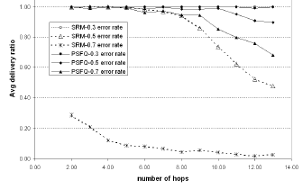
PSFQ performance: Comparison with multicast
Comparison case: Scalable Reliable Mutlicast (SRM)
  Provides similar service
  Main difference: in-sequence not enforced, end-of-block treatment differs
PSFQ
works
up to
higher
error
rates

Slide 32
Reliable Multisegment Transport (RMST)
Goal: Dependable delivery of large data blocks from multiple sensors to a single sink
  Data block is fragmented – collect all fragments, deliver to sink
  Tightly coupled with directed diffusion
  Does not include congestion control, time bounds
Basic RMST mechanisms
  MAC-layer retransmissions (802.11, full procedure: RTS/CTS, …)
  RMST caches fragments, checks for missing fragments
  When gap is detected NACKs are sent back towards the sources
  NACKs are served by intermediate node if fragment is present
  Else: NACK forwarded, but only rarely – e.g., when path has not changed
  To catch remaining errors, sources occasionally retransmit all

Slide 33
Overview
Dependability requirements
Delivering single packets
Delivering blocks of packets
Delivering streams of packets
  Additional opportunity: Control rate
  Control rate of individual nodes: ESRT
  Control number of active nodes: Gur game

Slide 34
Streams of packets may lead to congestion
When several sensors observe an event and try to periodically report it, congestion around event may set it
When many sensors stream data to a sink, congestion around the sink may occur

Slide 35
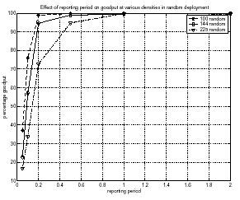
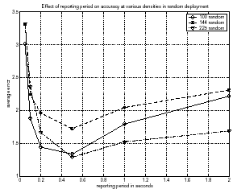
Consequences of congestion
Congestion can have surprising consequences
More frequently reporting readings can reduce goodput and accuracy
  Owing to increased packet loss
Using more nodes can reduce network lifetime

Slide 36
Detecting congestion
TCP: Detect congestion by missing acknowledgements
  Here not applicable if no ACKs are used
Locally detect congestion
  Intuition: Node is congested if its buffer fills up
  Rule: “Congested = buffer level above threshold” is overly simplistic
  Need to take growth rate into account as well
    Occupancy not a good indicator when packets can be lost in the channel
Problematic: Interaction with MAC
  CSMA-type MACs: high channel utilization = congestion; easy to detect
  TDMA-type MACs: high channel utilization not problematic for throughput; congestion more difficult to detect

Slide 37
Congestion handling
Once congestion is (locally) detected, how to handle it?
Option 1: Drop packets
  No alternative anyways when buffers overflow
  Drop tail, random (early) drop (for TCP), …
  Better: drop semantically less important packet
Option 2: Control sending rate of individual node
  Rate of locally generated packets
  Rate of remote packets to be forwarded ! backpressure
Option 3: Control how many nodes are sending
Option 4: Aggregation, in-network processing

Slide 38
Rate control: Event-to-Sink Reliable Transport (ESRT)
Situation: Multiple sensors periodically report to sink
  Sink needs sufficient number of packets, from any source
Control knob: control sensors’ reporting rate f_{i}
  Ensure: per decision period τ, +/- R packets are delivered
  Formally: r_{i} packets actually received in period i,
  Target: η_{i} = r_{i}/R 2 [1-ε, 1+ε]
Sink computes f_{i+1} based on f_{i}, η_{i}
  Broadcasts to all sources directly (high power)

Slide 39
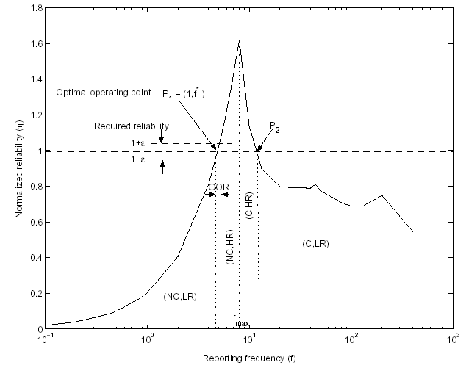
ESRT rate control tradeoff
Optimal operating region
No congestion, high reliability – more data than necessary
No congestion,
low reliability
(NC, LR)
Congestion, but still high reliability – more data injected than delivered
Congestion, and not even high reliability

Slide 40
ESRT’s adaptation of source frequencies
No congestion, low reliability: Increase data rate
  f_{i+1} = f_{i} / η_{i}
  Note: η_{i} < 1 here (less data arrives than necessary)
Optimal operating region: do nothing
No congestion, high reliability: moderate reduction of sending rate useful
  f_{i+1} = f_{i}/2 (1 + 1/η_{i})
Congestion, high reliability: quicker reduction of rate
  f_{i+1} = f_{i} / η_{I}
  Note: η_{i} > 1 here (more data arrives than necessary)
Congestion, low reliability: even quicker reduction of rate
  f_{i+1} = f_{i} ^{η}i^{/k}
  k: number of consecutive rounds in this state
Notes:
Mention: ESRT converges to optimal operating point if not congested

Slide 41
Control how many nodes are sending
Scenario: Nodes send at a given rate, cannot be controlled
Option: Turn on or off nodes to avoid congestion, achieve desired target number of packets k* per round
  If total number of nodes N known, easy: Simply send probability k*/N to all nodes; each node sends with this probability
What to do if number of nodes N not known?
! Gur game

Slide 42
Gur game
N nodes, unaware of each other; 1 referee
Referee, in each round:
  Counts number k of packets (assumption: no packet loss)
  Determines reward probability r(k), sends r(k) to all nodes
Each player: rewards itself with probability r(k), penalizes with probability 1-r(k)
  Rewards/penalties: Moves in finite state machine
Reward: r(k)
Reward: r(k)
r(k)
r(k)
-M
…
-3
-2
-1
1
2
3
…
M
Penalty: 1-r(k)
Penalty: 1-r(k)
Do not send in the next round
Send in the next round

Slide 43
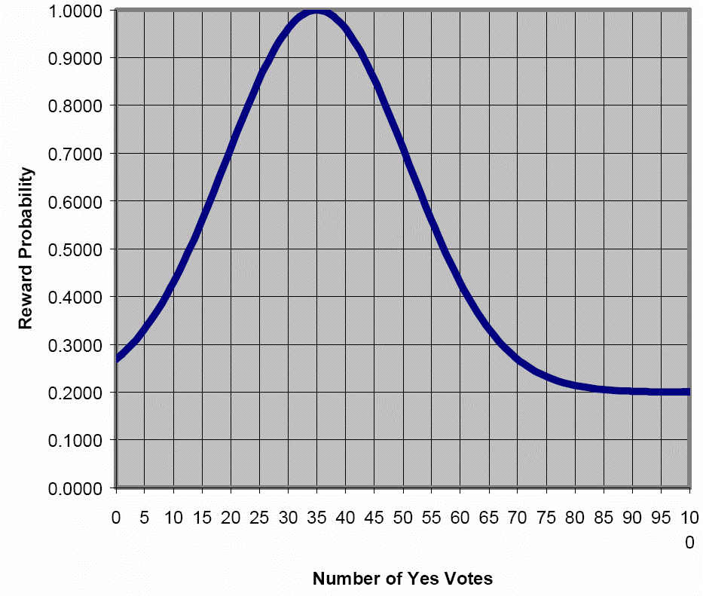
Gur game: How to choose r(k)?
Intuition
  When received number of packets k is close to k*, the right number of nodes are sending
  Thus, the right mixture of send/not send states is present
  ! Nodes should stay on the side where they are
  ! Rewards should be high
Formally
  Reward function
  is maximal at k*
  Example: See figure

Slide 44
Conclusion
Transport protocols have considerable impact on the service rendered by a wireless sensor networks
Various facets – no “one size fits all” solution in sight
Still a relatively unexplored areas
Items not covered
  Relation to coverage issues
  TCP in WSN? Gateways?
  Aggregation? In-network processing?

