Slide 1
Ad hoc and Sensor Networks
Chapter 8: Time Synchronization
Andreas Willig

Slide 2
Goals of this chaper
Understand the importance of time synchronization in WSNs
Understand typical strategies for time synchronization and how they are applied in WSNs

Slide 3
Overview
The time synchronization problem
Protocols based on sender/receiver synchronization
Protocols based on receiver/receiver synchronization
Summary

Slide 4
Overview
The time synchronization problem
Protocols based on sender/receiver synchronization
Protocols based on receiver/receiver synchronization
Summary

Slide 5
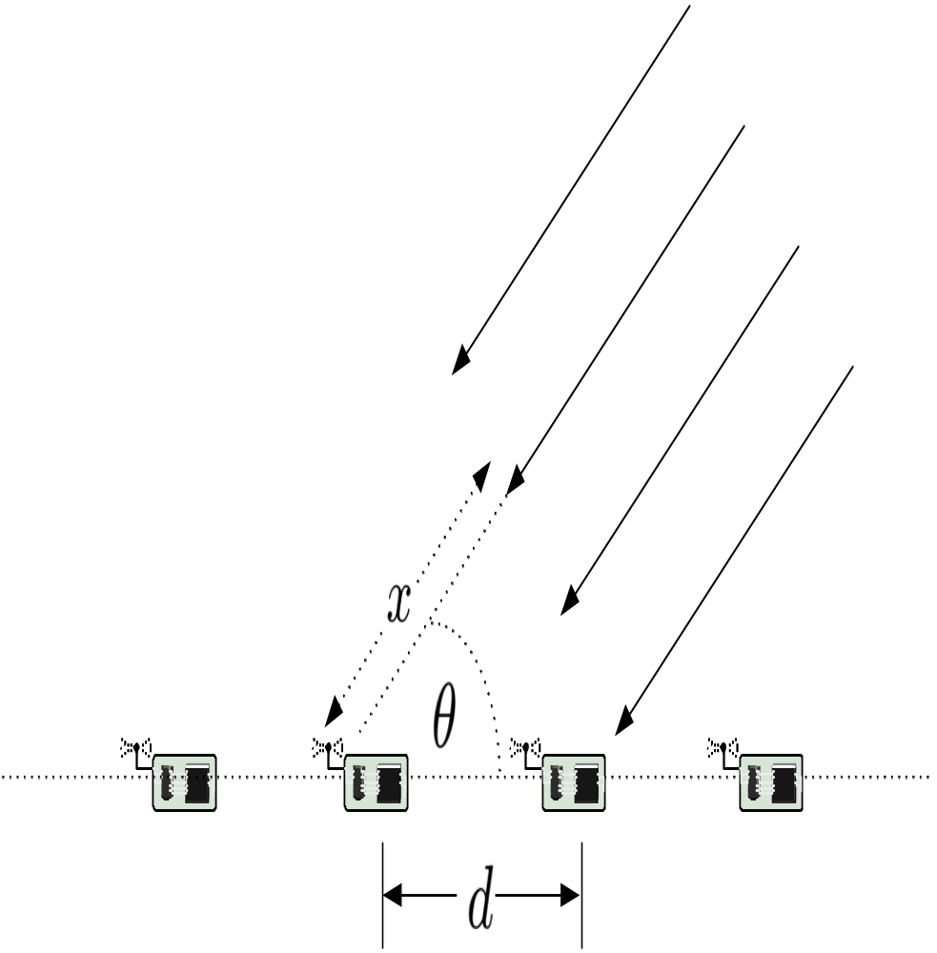

Example
Goal: estimate angle of arrival of a very distant sound event using an array of acoustic sensors
From the figure, θ can be estimated when x and d are known:
d is known a priori, x must be estimated from differences in time of arrival
  x = C Δ_{t} where C is the speed of sound
  For d=1 m and Δ_{t}=0.001 we get θ = 0.336 radians
  When Δ_{t} is estimated with 500 μs error, the θ estimates can vary between 0.166 and 0.518
Morale: a seemingly small error in time synch can lead to significantly different angle estimates

Slide 6
The role of time in WSNs
Time synchronization algorithms can be used to better synchronize clocks of sensor nodes
Time synchronization is needed for WSN applications and protocols:
  Applications: AOA estimation, beamforming
  Protocols: TDMA, protocols with coordinated wakeup, ...
  Distributed debugging: timestamping of distributed events is needed to figure out their correct order of appearance
WSN have a direct coupling to the physical world, hence their notion of time should be related to physical time:
  physical time = wall clock time, real-time, i.e. one second of a WSN clock should be close to one second of real time
  Commonly agreed time scale for real time is UTC, generated from atomic clocks and modified by insertion of leap seconds to keep in synch with astronomical timescales (one rotation of earth)
  Other concept: logical time (Lamport), where only the relative ordering of events counts but not their relation to real time

Slide 7
Clocks in WSN nodes
Often, a hardware clock is present:
  An oscillator generates pulses at a fixed nominal frequency
  A counter register is incremented after a fixed number of pulses
    Only register content is available to software
    Register change rate gives achievable time resolution
  Node i’s register value at real time t is H_{i}(t)
    Convention: small letters (like t, t’) denote real physical times, capital letters denote timestamps or anything else visible to nodes
A (node-local) software clock is usually derived as follows:
  L_{i}(t) = θ_{i} H_{i}(t) + φ_{i} (not considering overruns of the counter-register)
  θ_{i} is the (drift) rate, φ_{i} the phase shift
  Time synchronization algorithms modify θ_{i} and φ_{i}, but not the counter register

Slide 8
Synchronization accuracy / agreement
External synchronization:
  synchronization with external real time scale like UTC
  Nodes i=1, ..., n are accurate at time t within bound δ when
  |L_{i}(t) – t|<δ for all i
    Hence, at least one node must have access to the external time scale
Internal synchronization
  No external timescale, nodes must agree on common time
  Nodes i=1, ..., n agree on time within bound δ when |L_{i}(t) – L_{j}(t)|<δ for all i,j

Slide 9
Sources of inaccuracies
Nodes are switched on at random times, phases θ_{i} hence can be random
Actual oscillators have random deviations from nominal frequency (drift, skew)
  Deviations are specified in ppm (pulses per million), the ppm value counts the additional pulses or lost pulses over the time of one million pulses at nominal rate
  The cheaper the oscillators, the larger the average deviation
    For sensor nodes values between 1 ppm (one second every 11 days) and 100 ppm (one second every 2.8 hours) are assumed, Berkeley motes have an average drift of 40 ppm
Oscillator frequency depends on time (oscillator aging) and environment (temperature, pressure, supply voltage, ...)
  Especially the time-dependent drift rates call for frequent re-synchronization, as one-time synchronization is not sufficient
  However, stability over tens of minutes is often a reasonable assumption

Slide 10
General properties of time synchronization algorithms
Physical time vs. logical time
External vs. internal synchronization
Global vs. local algorithms
  Keep all nodes of a WSN synchronized or only a local neighbourhood?
Absolute vs. relative time
Hardware vs. software-based mechanisms
  A GPS receiver would be a hardware solution, but often too heavyweight/costly/energy-consuming in WSN nodes, and in addition a line-of-sight to at least four satellites is required
A-priori vs. a-posteriori synchronization
  Is time synchronization achieved before or after an interesting event?
    ➔ Post-facto synchronization
Deterministic vs. stochastic precision bounds
Local clock update discipline
  Should backward jumps of local clocks be avoided? (Users of make say yes here ....)
  Avoid sudden jumps?

Slide 11
Performance metrics and fundamental structure
Metrics:
  Precision: maximum synchronization error for deterministic algorithms, error mean / stddev / quantiles for stochastic ones
  Energy costs, e.g. # of exchanged packets, computational costs
  Memory requirements
  Fault tolerance: what happens when nodes die?
Fundamental building blocks of time synchronization algorithms:
  Resynchronization event detection block: when to trigger a time synchronization round? Periodically? After external event?
  Remote clock estimation block: figuring out the other nodes clocks with the help of exchanging packets
  Clock correction block: compute adjustments for own local clock based on estimated clocks of other nodes
  Synchronization mesh setup block: figure out which node synchronizes with which other nodes

Slide 12
Constraints for Time Synchronization in WSNs
An algorithm should scale to large networks of unreliable nodes
Quite diverse precision requirements, from ms to tens of seconds
Use of extra hardware (like GPS receivers) is mostly not an option
low mobility
Often there are no fixed upper bounds on packet delivery times (due to MAC delays, buffering, ...)
Negligible propagation delay between neighboring nodes
Manual node configuration is not an option

Slide 13
Post-facto synchronization
Basic idea:
  Keeping nodes synchronized all the time incurs substantial energy costs due to need for frequent resynchronization
    Especially true for networks which become active only rarely
  When a node observes an external event at time t, it stores its local timestamp L_{i}(t), achieves synchronization with neighbor node / sink node and converts L_{i}(t) accordingly
Can be implemented in different ways, to be discussed later

Slide 14
Overview
The time synchronization problem
Protocols based on sender/receiver synchronization
Protocols based on receiver/receiver synchronization
Summary

Slide 15
Protocols based on sender/receiver synchronization
In this kind of protocols, a receiver synchronizes to the clock of a sender
We have to consider two steps:
  Pairwise synchronization: how does a single receiver synchronize to a single sender?
  Networkwide synchronization: how to figure out who synchronizes with whom to keep the whole network / parts of it synchronized?
The classical NTP protocol [Mills, RFC 1305] belongs to this class

Slide 16
LTS – Lightweight Time Synchronization
Overall goal: synchronize the clocks of all sensor nodes / of a subset of nodes to one reference clock (e.g. equipped with GPS receivers)
It allows to synchronize the whole network, parts of it and it also supports post-facto synchronization
It considers only phase shifts and does not try to correct different drift rates
Two components:
  pairwise synchronization: based on sender/receiver technique
  networkwide synchronization: minimum spanning tree construction with reference node as root

Slide 17
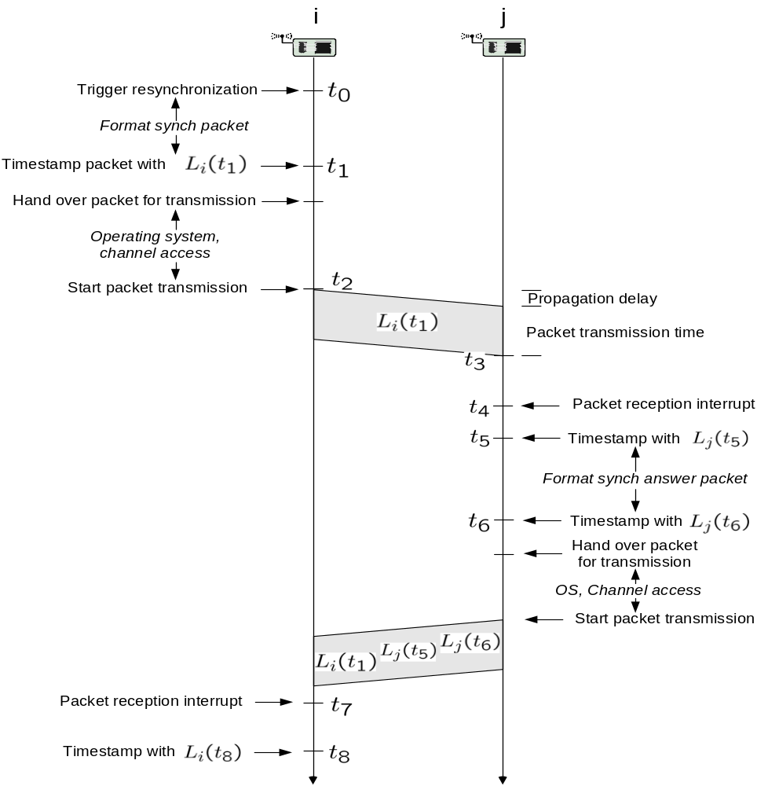
LTS – Pairwise Synchronization

Slide 18
LTS – Pairwise Synchronization
Node i wants to synchronize its clock to node j’s clock
Timeline:
  Node i triggers resynchronization at time t₀, formats packet, timestamps it at t₁ with L_{i}(t₁) and hands it over to transmission (with L_{i}(t₁) as payload)
  At t₂ the first bit appears on the channel, at t₃ the receiver receives last bit, packet reception is signaled at t₄, and at t₅ node j timestamps it with L_{j}(t₅)
  Node j formats answer packet, timestamps it at time t₆ with L_{j}(t₆) and hands it over for transmission – as payload the timestamps L_{i}(t₁), L_{j}(t₅) and L_{j}(t₆) are included
  The arrival of the answer packet is signaled at time t₇ to node i, and i timestamps it afterwards with L_{i}(t₈)
After time t₈, node i possesses four values: L_{i}(t₁), L_{j}(t₅), L_{j}(t₆) and L_{i}(t₈) and wants to estimate its clock offset to node j – but how?

Slide 19
LTS – Pairwise Synchronization
Assumptions:
  Node i’s original aim is to estimate the true offset O=Δ(t₁)=L_{i}(t₁) – L_{j}(t₁)
  During the whole process the drift is negligible
  ➔ the algorithm in fact estimates Δ(t₅) and assumes Δ(t₅) = Δ(t₁)
  Propagation delay τ the same in both directions, request and answer packets have duration t_{p}, both parameters are known to i
Approach:
  Node i estimates Δ(t₅)=L_{i}(t₅)-L_{j}(t₅) and therefore needs to estimate L_{j}(t₅), which is generated “somewhere” between t₁ and t₈
  When t₈ – t₁ is very small, we might be willing to approximate O ¼ L_{i}(t₁) – L_{j}(t₅) or as ¼ L_{i}(t₈) – L_{j}(t₅)
But we can reduce uncertainty:
  after t₁ we have at least one propagation delay and packet transmission time (for the request packet)
  before t₈ we have another propagation delay and packet transmission time (for the response packet)
  There passes also time between L_{j}(t₅) and L_{j}(t₆), and L_{i}(t₅) must be before this interval

Slide 20
LTS – Pairwise Synchronization
Under the assumption that the remaining uncertainty is allocated equally to both i and j, node i can estimate L_{j}(t₅) as
This means:

Slide 21
LTS – Pairwise Synchronization -- Discussion
Node i can figure out the offset to node j based on the known values L_{i}(t₁), L_{j}(t₅), L_{j}(t₆), L_{i}(t₈)
This exchange takes two packets – if node j should also learn about the offset, a third packet is needed from i to j carrying O
The uncertainty is in the interval
I = [L_{i}(t₁)+τ+t_{p}, L_{i}(t₈) - τ – t_{p} – (L_{j}(t₆) – L_{j}(t₅)],
and by picking the mid-point of the interval as L_{i}(t₅), the maximum uncertainty is |I|/2

Slide 22
LTS – Pairwise Synchronization -- Discussion
Sources of inaccuracies:
  MAC delay
  interrupt latencies upon receiving packets
  Delays between packet interrupts and timestamping operation
  Delay in operating system and protocol stack
Improvements:
  Let i timestamp its packet after the MAC delay, immediately before transmitting the first bit
    This would remove the uncertainty due to i’s operating system / protocol stack and the MAC delay!!
  Let j timestamp receive packets as early as possible, e.g. in the interrupt routine
    this removes the delay between packet interrupts and timestamping from the uncertainty, and leaves only interrupt latencies
  these things are hard to do when COTS hardware is used, but easy when full source code of MAC and direct access to hardware are available

Slide 23
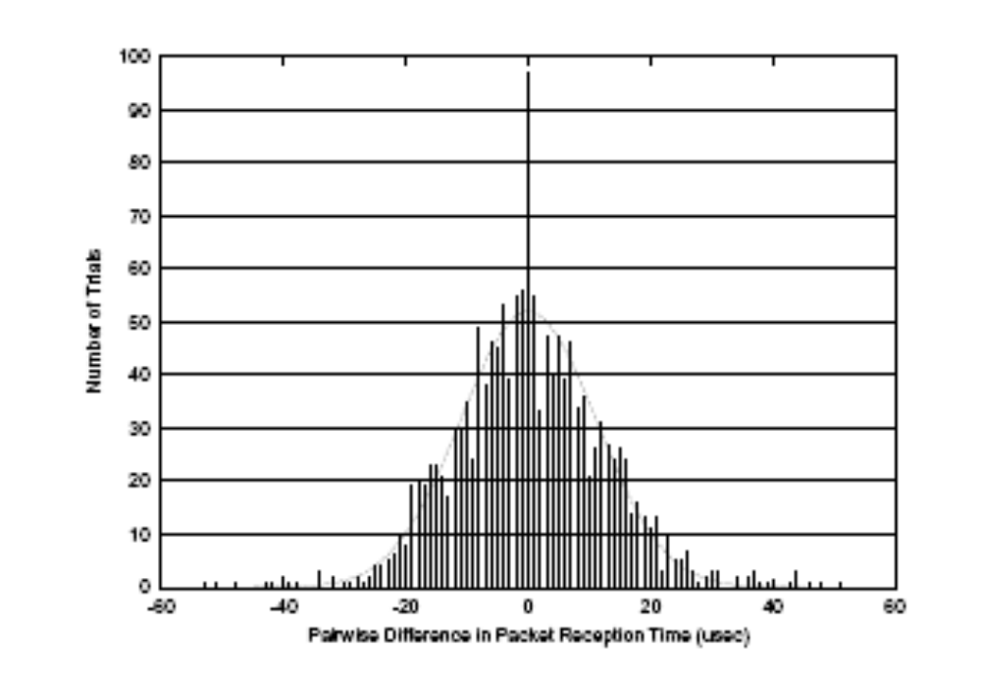
LTS – Pairwise Synchronization – Error Analysis
Elson et al measured pairwise differences in timestamping times at a set of receivers when timestamping happens in the interrupt routine (Berkeley motes)
Estimated distribution:
  normal random variable (rv) with zero mean/stddev of 11.1 μs
Additional assumption: uncer-tainty on the transmitter side has same distrib. and is independent
Hence:
  total uncertainty is a zero-mean normal rv with variance 4 σ²
  For a normal rv 99% of all outcomes have maximum distance of 2.3σ to mean
  ➔ the maximum synchronization error is with 99% probability smaller than 2.3 * 2 * σ

Slide 24
LTS – Networkwide Synchronization
We are given one reference node R, to which all other nodes / a subset of nodes want to synchronize
  R’s direct neighbors (level-1 neighbors) synchronize with R
  Two-hop (level-2) neighbors synchronize with level-1 neighbors
  ....
This way a spanning tree is created
But one should not allow arbitrary spanning trees:
  Consider a node i with hop distance h_{i} to the root node
  Assume that:
    all synchronization errors are independent
    all synch errors are identically normally distributed with zero mean and variance 4σ²
  Then node i’s synchronization error is a zero-mean normal rv with variance h_{i} 4 σ²
  Hence, a minimum spanning tree minimizes synchronization errors

Slide 25
LTS – Centralized Multihop LTS
Reference node R triggers construction of a spanning tree, it first synchronizes its neighbors, then the first-level neighbors synchronize second-level neighbors and so on
Different distributed algorithms for construction of spanning tree can be used, e.g. DDFS, Echo algorithm
Communication costs:
  Costs for construction of spanning tree
  Synchronizing two nodes costs 3 packets, synchronizing n nodes costs 3n packets

Slide 26
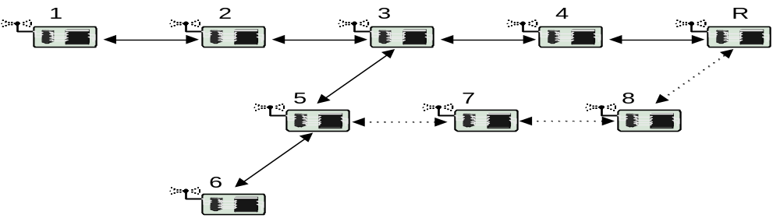
LTS – Distributed Multihop LTS
No explicit construction of spanning tree needed, but each node knows identity of reference node(s) and routes to them
When node 1 wants to synchronize with R, an appropriate request travels to R – following this, 4 synchronizes to R, 3 synchronizes to 4, 2 synchronizes to 3, 1 synchronizes to 2
  By-product: nodes 2, 3, and 4 are synchronized with R
Minimum spanning tree constructed implicitly: node 1 should know shortest route to the closest reference node

Slide 27
LTS – Distributed Multihop LTS -- Variations
When node 5 wants to synchronize with R, it can:
  issue its own synchronization request using route over 3, 4 and put additional synchronization burden on them
  ask in its local neighborhood whether someone is synchronized or has an ongoing synchronization request and benefit from that later on
  Enforce usage of path over 7, 8 (path diversification) to also synchronize these nodes
Discussion:
  Simulation shows that distributed multihop LTS needs more packets (between 40% and 100%) when all nodes have to be synchronized, even with optimizations
  Distributed multihop LTS allows to synchronize only the minimally required set of nodes → post-facto synchronization

Slide 28
Other Sender-/Receiver-based Protocols
These protocols work similar to LTS, with some differences in:
  Method of spanning tree construction
  How and when to take timestamps
  How to achieve post-facto synchronization
One variant: TPSN (Timing-Sync Protocol for Sensor Nets)
  Pairwise-protocol similar to LTS, but timestamping at node i happens immediately before first bit appears on the medium, and timestamping at node j happens in interrupt routine
  Spanning tree construction based on level-discovery protocol:
    root issues level_discovery packet with level 0
    neighbors assign themselves level 1 + level value from level_discovery
    neighbors wait for some random time before they issue level_discovery packets indicating their own level
    Nodes missing level_discovery packets for long time ask their neighborhood

Slide 29
TSync
TSync combines:
  HRTS (Hierarchy Referencing Time Synchronization): a protocol to synchronize a broadcast domain to one of its members
  ITR (Individual-based Time Request): a sender-/receiver protocol similar to LTS/TPSN
  A networkwide synchronization protocol
HRTS provides a technique to synchronize a group of nodes to a reference node with only three packets!

Slide 30
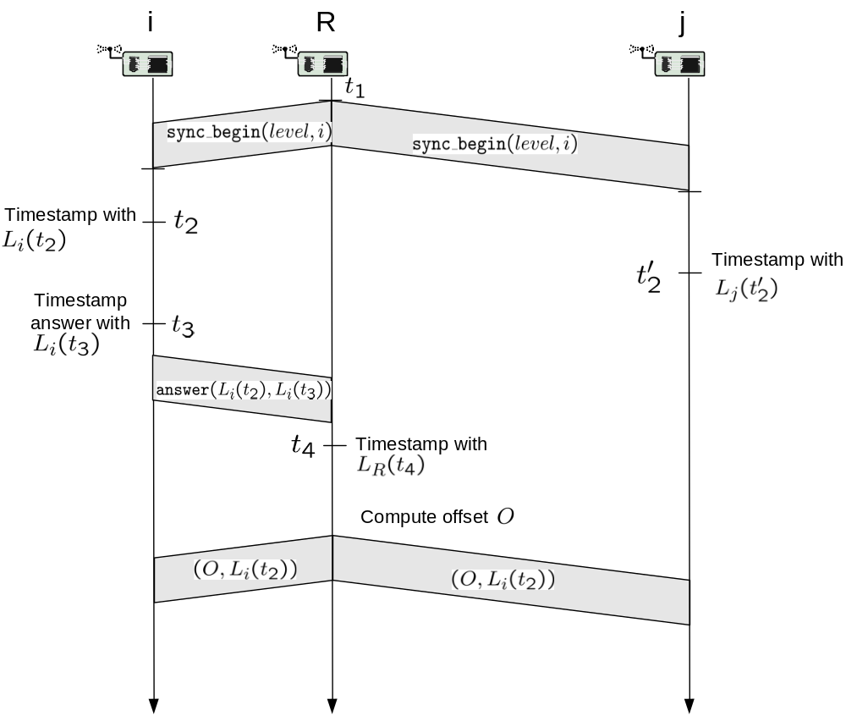
HRTS

Slide 31
HRTS
Node i and j want to synchronize to R’s clock, but cannot hear each other
Timeline:
  Root node triggers time synchronization at time t₁ at local time L_{R}(t₁), it formats a sync_begin packet and includes i’s address and a level value
  Node i timestamps packet at time t₂ with L_{i}(t₂) and node j timestamps it at t₂’ with L_{j}(t₂’)
  Node i formats an answer packet and timestamps it at time t₃ with L_{i}(t₃) – the packet includes the values L_{i}(t₂) and L_{i}(t₃)
  Root node R timestamps the answer packet at time t₄ with L_{R}(t₄) and computes its offset O_{R,i} with node i’s clock (it can do this similar to LTS)
  Root node R formats another packet including the values O_{R,i} and L_{i}(t₂) and broadcasts this packet
Node j possesses the values L_{j}(t₂’), O_{R,i} and L_{i}(t₂) and wants to determine O_{R,j} out of these values – but how?
  Node i already knows its offset O_{i,R} when it has received O_{R,i}

Slide 32
HRTS
Node j’s evaluation is based on the assumption that t₂ = t₂’
  reasonable when both nodes timestamp in their interrupt routines and propagation delay is small
Please note that under this assumption we have:
  L_{i}(t₂) = L_{j}(t₂’) + O_{j,i} ➔ O_{j,i} = L_{i}(t₂) – L_{j}(t₂’)
  L_{i}(t₂) = L_{R}(t₂) + O_{R,i}
  L_{j}(t₂’) = L_{R}(t₂) + O_{R,j}
This gives:
  O_{R,j} = L_{j}(t₂’) – L_{R}(t₂) ¼ L_{j}(t₂’) – (L_{i}(t₂) – O_{R,i} )

Slide 33
HRTS -- Discussion
Node j is not involved in any packet exchange ➔ by this scheme it is possible to synchronize an arbitrary number of nodes to R’s clock with only three packets!!
The synchronization uncertainty comes from:
  The error introduced by R when estimating O_{R,i}
  The error introduced by setting t₂ = t₂’
    This makes HRTS only feasible for geographically small broadcast domains
Both kinds of uncertainty can again be reduced by:
  timestamping outgoing packets as lately as possible (relevant for t₁ and t₃)
  timestamping incoming packets as early as possible (relevant for t₂, t₂’, t₄
The authors propose to use extra channels for synchronization traffic (control_channel for sync_begin, clock_channel for answer packets) when late timestamping of outgoing packets is not an option
  Rationale: keep MAC delay small

Slide 34
TSync – Networkwide Synchronization
It is assumed that some reference nodes are present in the network, e.g. having a GPS receiver
Initialization:
  Reference nodes assign themselves a level of 0
  All other nodes assign themselves a level of 1
  The reference node becomes a root node and synchronizes its neighbors
Whenever any node receives a sync_begin packet with a smaller level x than its current level y:
  It synchronizes to the issueing node
  It assigns itself a level y := x+1
  It synchronizes its neighbors
This way a minimal spanning tree is constructed

Slide 35
Overview
The time synchronization problem
Protocols based on sender/receiver synchronization
Protocols based on receiver/receiver synchronization
Summary

Slide 36
Protocols based on receiver/receiver synchronization
In this class of schemes the receivers of packets synchronize among each other, not with the transmitter of the packet
RBS = Reference Broadcast Synchronization (Elson et al)
RBS has two components:
  Synchronize receivers within a single broadcast domain
  A scheme for relating timestamps between nodes in different domains
RBS does not modify the local clocks of nodes, but computes a table of conversion parameters for each peer in a broadcast domain
RBS allows for post-facto synchronization

Slide 37
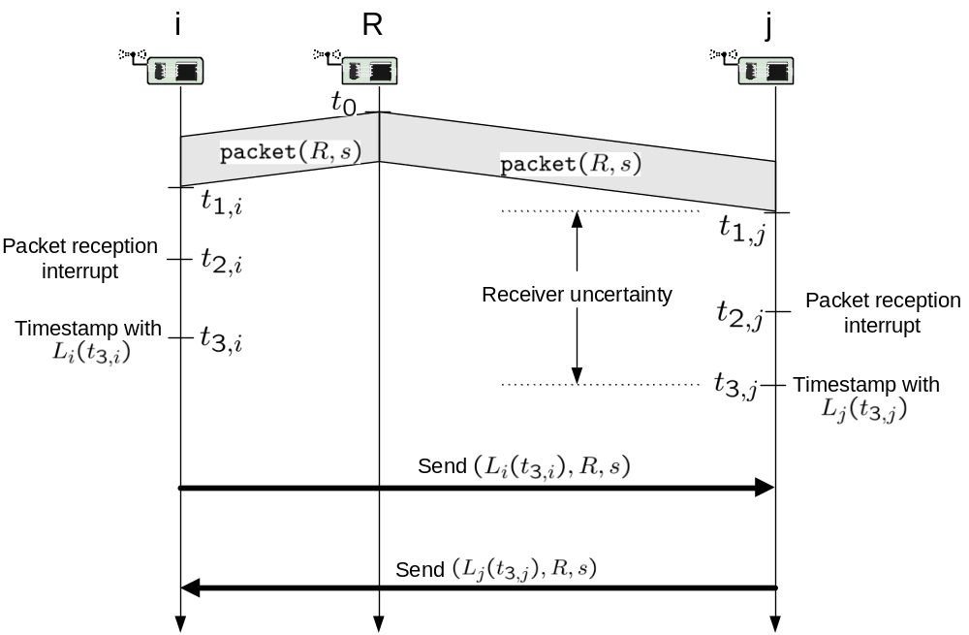
RBS – Synchronization in a Broadcast Domain

Slide 38
RBS – Synchronization in a Broadcast Domain
The goal is to synchronize i’s and j’s clocks to each other
Timeline:
  Reference node R broadcasts at time t₀ some synchronization packet carrying its identification R and a sequence number s
  Receiver i receives the last bit at time t_{1,i}, gets the packet interrupt at time t_{2,i} and timestamps it at time t_{3,i}
  Receiver j is doing the same
  At some later time node i transmits its observation (L_{i}(t_{3,i}), R, s) to node j
  At some later time node j transmits its observation (L_{j}(t_{3,j}), R, s) to node i
  The whole procedure is repeated periodically, the reference node transmits its synchronization packets with increasing sequence numbers
    R could also use ordinary data packets as long as they have sequence numbers ...
Under the assumption t_{3,i} = t_{3,j} node j can figure out the offset O_{i,j} = L_{j}(t_{3,j}) – L_{i}{t_{3,i}) after receiving node i’s final packet – of course, node i can do the same

Slide 39
RBS – Synchronization in a Broadcast Domain
The synchronization error in this scheme can have two causes:
  There is a difference between t_{3,i} and t_{3,j}
  Drift between t_{3,i} and the time where node i transmits its observations to j
But:
  In small broadcast domains and when received packets are timestamped as early as possible the difference between t_{3,i} and t_{3,j} is very small
    As compared to sender-/receiver based schemes the MAC delay and operating system delays experienced by the reference node play no role!!
  Drift can be neglected when observations are exchanged quickly after reference packets
  Drift can be estimated jointly with Offset O when a number of periodic observations of O_{i,j} have been collected
    This amounts to a standard least-squares line regression problem

Slide 40
RBS – Synchronization in a Broadcast Domain
Remember?
Elson et al measured pairwise differences in timestamping times at a set of receivers when timestamping happens in the interrupt routine (Berkeley motes)
This is just the distribution of the differences t_{3,i}-t_{3,j} !

Slide 41
RTS – Synchronization in a Broadcast Domain
Communication costs:
  Be m the number of nodes in the broadcast domain
  First scheme: reference node collects the observations of the nodes, computes the offsets and sends them back ➔ 2 m packets
  Second scheme: reference node collects the observations of the nodes, computes the offsets and keeps them, but has responsibility for timestamp conversions and forwarder selection ➔ m packets
  Third scheme: each node transmits its observation individually to the other members of the broadcast domain ➔ m (m-1) packets
  Fourth scheme: each node broadcasts its observation ➔ m packets, but unreliable delivery
Collisions are a problem:
  The reference packets trigger all nodes simultaneously to tell the world about their observations
Computational costs: least-squares approximation is not cheap!

Slide 42
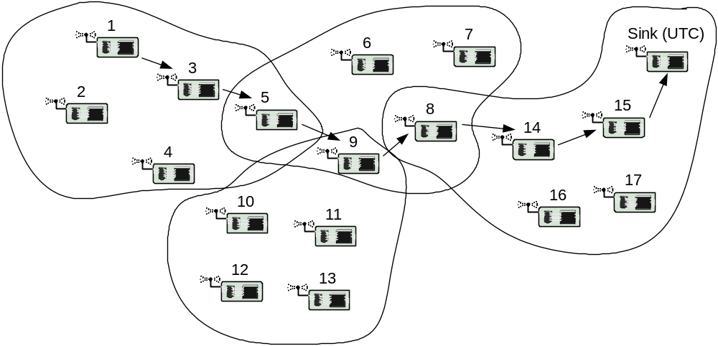
RBS – Network Synchronization

Slide 43
RBS – Network Synchronization
Suppose that:
  node 1 has detected an event at time L₁(t)
  the sink is connected to a GPS receiver and has UTC timescale
  node 1 wants to inform the sink about the event such that the sink receives a timestamp in UTC timescale
  Broadcast domains are indicated by “circles”
Timestamp conversion approach:
  Idea: do not synchronize all nodes to UTC time, but convert timestamps as packet is forwarded from node 1 to the sink ➔ avoids global synch!!!
  Node 1 picks node 3 as forwarder – as they are both in the same broadcast domain, node 1 can convert the timestamp L₁(t) into L₃(t)
  Node 3 picks node 5 in the same way
  Node 5 is member in two broadcast domains and knows also the conversion parameters for the next forwarder 9
  And so on ...
  Result: the sink receives a timestamp in UTC timescale!
  Nodes 5, 8 and 9 are gateway nodes!

Slide 44
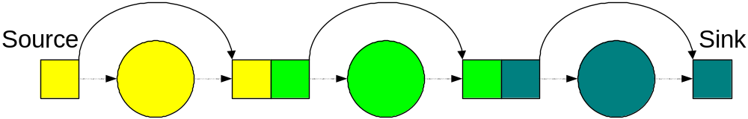
RBS – Network Synchronization
Forwarding options:
  Let each node pick its forwarder directly and perform conversion, the reference nodes act as mere pulse senders
  Let each node transmit its packet with timestamp to reference node, which converts timestamp and picks forwarder
    This way a broadcast domain is not required to be fully connected
  In either case the clock of the reference nodes is unimportant
How to create broadcast domains?
  In large domains (large m) more packets have to be exchanged
  In large domains fewer domain-changes have to be made end-to-end, which in turn reduces synchronization error
  This is essentially a clustering problem, forwarding paths and gateways have to be identified by routing mechanisms

Slide 45
Overview
The time synchronization problem
Protocols based on sender/receiver synchronization
Protocols based on receiver/receiver synchronization
Summary

Slide 46
Summary
Time synchronization is important for both WSN applications and protocols
Using hardware like GPS receivers is typically not an option, so extra protocols are needed
Post-facto synchronization allows for time-synchronization on demand, otherwise clock drifts would require frequent re-synchronization and thus a constant energy drain
Some of the presented protocols take significant advantage of WSN peculiarities like:
  small propagation delays
  the ability to influence the node firmware to timestamp outgoing packets late, incoming packets early
Of course, there are many, many more schemes ....

