Slide 1
Chapter 1
The World of the
Modern Systems Analyst

Slide 2
Objectives
Explain key role of a systems analyst in business
Describe various types of systems an analyst might work on
Explain the importance of technical, people, and business skills for an analyst
Explain why ethical behavior is crucial for a systems analyst’s career

Slide 3
Objectives
Describe the many types of technology an analyst needs to understand
Describe various job titles and places of employment where analysis and design work is done
Discuss the analyst’s role in strategic planning for an organization
Describe the analyst’s role in a system development project

Slide 4
The Analyst
Business problem solver
  Has practical knowledge
    Computers
    Programming
  Understands business problems
  Uses logical methods for solving problems

Slide 5
Analyst’s Approach to Problem Solving
Figure 1-1
Research and understand the problem
Verify that the benefits of solving the problem outweigh the costs
Define the requirements for solving the problem
Develop a set of possible solutions (alternatives)
Decide which solution is best and make a recommendation
Define the details of the chosen solution
Implement the solution
Monitor to make sure that you obtain the desired results

Slide 6
Systems that Solve
Business Problems
Information systems
  Collection of interrelated components that collect, process, store, and provide as output the information needed to complete business tasks
Subsystems
Supersystems
Functional decomposition
  Dividing a system into components based on subsystems that are in turn, divided into smaller subsystems

Slide 7
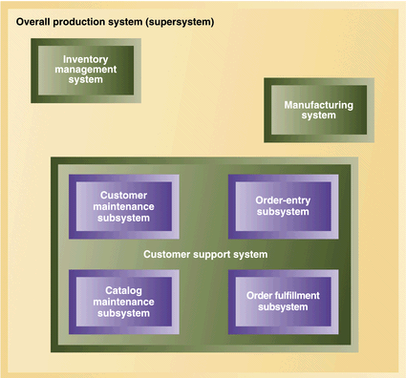
Information Systems and Subsystems
Figure 1-2

Slide 8
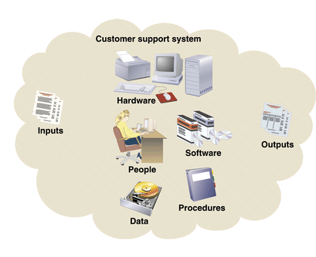
Information Systems and Component Parts
Figure 1-3

Slide 9
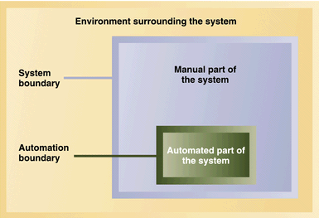
System Boundary
vs. Automation Boundary
Figure 1- 4

Slide 10
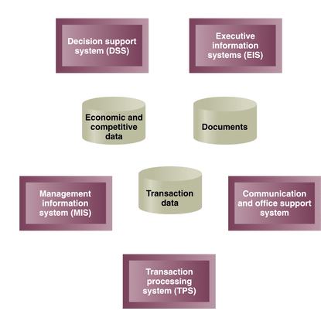
Types of Information Systems
Figure 1-5
Notes:
TPS – Wal-Mart checkout
MIS – managers reports – manage day to day operations
EIS – executives use to monitor competitive environment – strategic planning
DSS – play what if games – what if sales go down and interest rates go up – etc.
Communication support systems – allow employees to collaborate with each other and communicate with customers, suppliers, etc.
Office support systems – create documents (proposals, memos, etc)

Slide 11
Technical Knowledge and
Skills of the Analyst
Technology
  Understanding of Computers / Peripheral devices
Tools
  Software packages
  Integrated development environments (IDEs)
  CASE tools / Support packages
Techniques
  Planning, analysis, design, construction, implementation, and support

Slide 12
Business Knowledge and
Skills of the Analyst
Business functions
Organizational structure
Management techniques
Functional work processes

Slide 13
People Knowledge and Skills of the Analyst
Understand how people:
  Think
  Learn
  React to change
  Communicate
  Work
Integrity and Ethics

Slide 14
Environment Surrounding the Analyst
Types of technology systems encountered
  Desktop
  Networked desktops
  Client-server
  Mainframe
  Internet, intranet, and extranet
Job titles of systems analyst vary greatly
Places of employment vary from small businesses to large corporations
Notes:
Programmer Analyst, Business Systems Analyst, System Liaison, End-user Analyst, Business Consultant, Systems Consultant, Systems Support Analyst, Systems Designer, Software Engineer, Systems Architect, (NOT Webmaster), (NOT Web developer), (NOT Project Manager), Project Lead (maybe)

Slide 15
Analyst’s Role in Strategic Planning
Work on special projects affecting executives
  Business process reengineering
Involvement in strategic plan development process
Provide inputs to information systems strategic plan
  Application architecture plan
  Technology architecture plan
Implement enterprise resource planning (ERP) systems
Notes:
ERP – works in some cases, not in others – if it is a good match it work, if a bad match it won’t. Example of a bad match?

Slide 16
Introduction to Rocky Mountain Outfitters
Began supplying winter sports clothes in Park City, Utah in 1978
Expanded into direct mail-order sales
Became large, regional sports clothing distributor by early 2000’s
Currently over $100 million in annual sales and 600 employees
Increased essential mail-order revenue to $60 million

Slide 17

Early RMO Catalog Cover (Spring, 1978)
Figure 1-6

Slide 18

Current RMO Catalog Cover (Spring 2003)
Figure 1-7

Slide 19
RMO Strategic Issues
Innovational clothing distributor that featured products on Web site
Original Web site functions:
  Enhance image
  Request copy of catalog
  Portal to Outdoor Web sites
Detailed IS strategic plan from consulting firm
  Supply chain management
  Customer relationship management

Slide 20
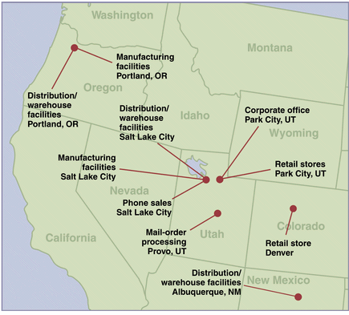
RMO Locations
Figure 1-9

Slide 21
RMO Information Systems Department
Mac Preston: assistant vice- president and IS department leader
  Successful completion of process that implemented strategic plan
50 employees in department
IS organization
  Systems support
  Systems development

Slide 22
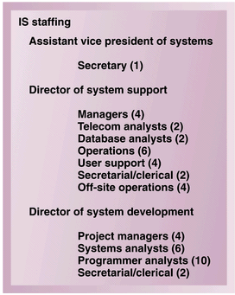
IS Department Staffing
Figure 1-10

Slide 23
Existing RMO Systems
Most IS staff and technology located in data center at Park City
  Mainframe-based system supported inventory, mail-order, accounting and human resources
  Central office functions, distribution centers, and manufacturing centers supported with LANs
  Dial-up capability to mainframe
  RMO informational Website hosted by Internet service provider (ISP)

Slide 24
Existing Systems at RMO
Merchandising/Distribution
  Mainframe application with COBOL/CICS, IBM DB2 and VSAM developed in-house
Mail order
  COBOL application developed in-house
Phone order
  Oracle and Visual Basic system developed in-house

Slide 25
Existing Systems at RMO
Retail store systems
  Point-of-sale and batch inventory updated with mainframe
Office systems
  LAN with office software, Internet and e-mail
Human resources
  Mainframe-based application developed in-house
Accounting/Finance
  Mainframe packaged from leading vendor

Slide 26
IS Strategic Plan at RMO
Build more direct customer contact
Expand beyond Western states

Slide 27
RMO Technology Architecture Plan
Distribute business applications
  Reserve mainframe for database, Web server, and telecommunications
Move toward conducting strategic business processes via Internet
  Supply chain
  Customer ordering
  Customer relationship management
Anticipate eventual move toward intranet solutions

Slide 28
RMO Application Architecture Plan
Supply chain management (SCM)
Customer support system (CSS)
Strategic information system (SIMS)
Retail store system (RSS)
Accounting/Finance system
Human resource system

Slide 29
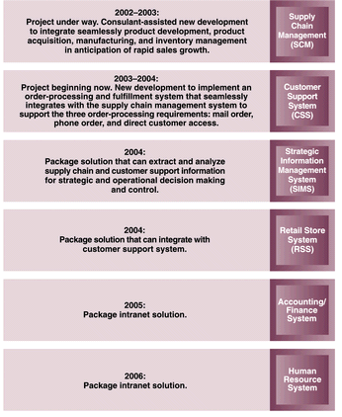
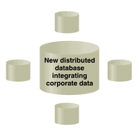
RMO Application Architecture Plan
Figure 1-11

Slide 30
Analyst as a System Developer
Part 1: The modern systems analyst
Part 2: Systems analysis tasks
Part 3: Systems design tasks
Part 4: Implementation and support

