Slide 1
Chapter 2
The Analyst as a
Project Manager

Slide 2
Objectives
Explain the purpose and various phases of the systems development lifecycle (SDLC)
Explain the elements of project management and the responsibilities of a project manager
Explain the activities in the project planning phase of the SDLC

Slide 3
Objectives
Describe how the scope of a new system is determined
Develop a cost/benefit analysis of a proposed project
Develop a project schedule using PERT and Gantt charts

Slide 4
System Development Life Cycle (SDLC)
Systems development project
  Planned undertaking
  Large job
  Produces new system
Successful project requirements
  Detailed plans
  Organized, methodical sequence of tasks and activities

Slide 5
Systems Development Lifecycle (SDLC)
Three major activities
  Analysis: understanding business needs
  Design: conceptualizing computer-system solution
  Implementation: construction, testing, and installation
Two additional phases
  Project planning
  Support

Slide 6
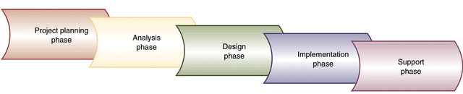
IS Development Phases
Figure 2-1

Slide 7
SDLC Concepts
All projects use some variation of the SDLC
SDLC is more than phases
  Principles of management
  Planning and control
  Organization and scheduling
  Problem solving

Slide 8
Planning Phase
Define problem
Confirm project feasibility
Produce project schedule
Staff the project
Launch the project

Slide 9
Analysis Phase
Gather information
  Problem Domain
  Application
Define system requirements
Build prototypes for discovery of requirements
Prioritize requirements
Generate and evaluate alternatives
Review recommendations with management

Slide 10
Design Phase
Design and integrate the network
Design the application architecture
Design the user interfaces
Design the system interfaces
Design and integrate the database
Prototype for design details
Design and integrate the system controls

Slide 11
Implementation Phase
Construct software components
Verify and test
Convert data
Train users and document the system
Install the system

Slide 12
Support Phase
Maintain the system
Enhance the system
Support the users
  Help desk

Slide 13
Scheduling of Project Phases
Considerations
  Migration from waterfall approach to
  overlapping and concurrent phases
  Efficiency
  Dependency
  Iteration
  Ripple effect

Slide 14
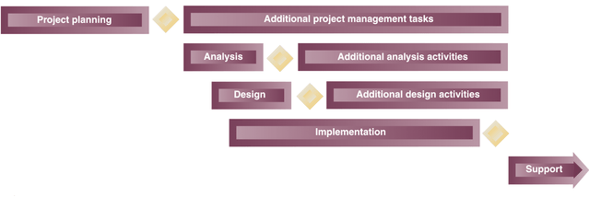
Overlap of Systems Development Activities
Figure 2-2

Slide 15
Project Management
People
  Organizing
  Directing
Planned result
  Scheduling
  Budgeting

Slide 16
Reasons for Project Failure
Incomplete or changing requirements
Limited user involvement
Lack of executive support
Lack of technical support
Poor Planning
Unclear objectives
Lack of required resources

Slide 17
Reasons for Project Success
Clear system requirement definitions
Substantial user involvement
Support from upper management
Thorough and detailed project plans
Realistic work schedules and milestones

Slide 18
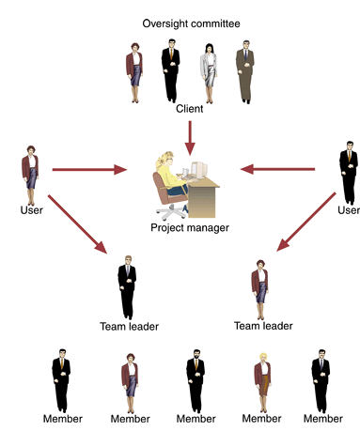
Participants in Development Project
Figure 2-3

Slide 19
Project Management Body of Knowledge
Scope management
Time management
Cost management
Quality management
Human resource management
Communications management
Risk management
Procurement management

Slide 20
Project Initiation
Driving forces
  Respond to opportunity
  Resolve problem
  Conform to directive

Slide 21
Project Initiation
Long-term IS strategic plan (top-down)
  Weighted Scoring
Department managers or process managers (bottom-up)
Response to outside forces

Slide 22
Project Initiation for RMO
Use strategic IS plan to direct project development priorities
Customer support system development selected as top priority
  John MacMurty - create project charter
  Barbara Halifax - project manager
  Steven Deerfield - senior systems analyst
  Support all types of customer services
    Ordering, returns, on-line catalog, et cetera

Slide 23
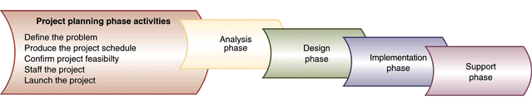
Activities of the Project Planning Phase
Figure 2-6

Slide 24
Defining the Problem at RMO
Review business needs
  Use planning documents
  Develop list of expected business benefits
Identify expected system capabilities
  Define requirements
  Create system scope document
  Create context diagram

Slide 25
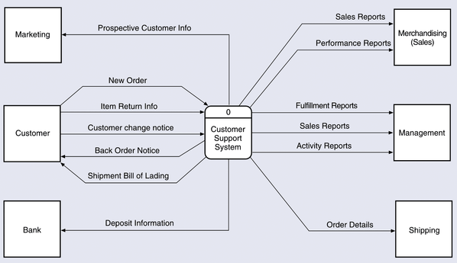
System Context Diagram for CSS
Figure 2-8

Slide 26
Defining the Problem at RMO
Completion of problem definition activity
Preliminary investigation of alternative solutions
Reassess preliminary assumptions regarding schedule and budget
Barbara: Completed problem definition statement
Steve: Conducted preliminary research on possible solutions

Slide 27
Producing Project Schedule
Develop work breakdown schedule
  List of tasks required for project
  Like an outline
Build a PERT/CPM chart
  Assists in assigning tasks
  Critical path method
  Tracking GANTT chart

Slide 28
Confirming Project Feasibility
Economic
  Cost/benefit analysis
  Cash flow analysis
Organizational and cultural
Technological
Schedule
Resource

Slide 29
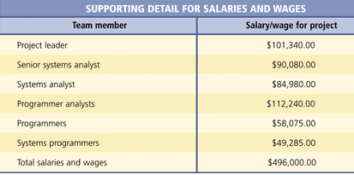
Supporting Detail for Salaries
and Wages for RMO
Figure 2-12

Slide 30
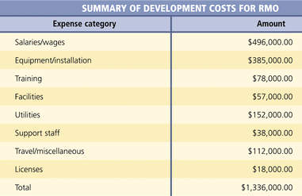
Summary of Development Costs for RMO
Figure 2-13

Slide 31
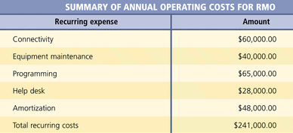
Summary of Annual Operating Costs
for RMO
Figure 2-14

Slide 32
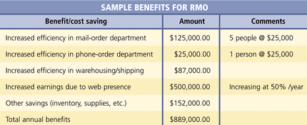
Sample Benefits for RMO
Figure 2-15

Slide 33
Intangibles in Economic Feasibility
Costs and benefits cannot always be measured
Intangible Benefits
  Increased levels of service
  Customer satisfaction
  Survival
  Need to develop in-house expertise
Intangible Costs
  Reduced employee moral
  Lost productivity
  Lost customers or sales

Slide 34
Organizational and Cultural Feasibility
Each company has own culture
New system must fit into culture
Evaluate related issues for potential risks
  Computer competency
  Computer phobia
  Perceived loss of control
  Shift in power
  Fear of job changes
  Fear of employment loss
  Reversal of longstanding procedures

Slide 35
Technological Feasibility
Does system stretch state-of-the-art?
Does expertise exist in-house for development?
Does a third party need to be involved?

Slide 36
Schedule Feasibility
Interim evaluations to reassess completion dates
Realistic assumptions and estimates
  Completion date flexibility
  Involvement of experienced personnel
  Proper allocation of resources

Slide 37
Resource Feasibility
Team member availability
Team skill levels
Equipment and supplies
Support staff
Physical facilities

Slide 38
Project Staffing
Develop resource plan for the project
Identify and request specific technical staff
Identify and request specific user staff
Organize the project team into work groups
Conduct preliminary training and team building exercises

Slide 39
Launching Project
Oversight committee is finalized and meets to give go-ahead
Formal announcement made
Key question: “Are we ready to start?”

Slide 40
Project Planning for RMO
Barbara and Steve: Created schedule and plans
Addressed all aspects of project management
Identified desired team members
  Teach about tools and techniques
  Refine internal working procedures
Made considerations throughout each SDLC phase

