Slide 1
Chapter 4
Beginning the Analysis:
Investigating System
Requirements

Slide 2
Objectives
Describe the activities of the systems analysis life cycle
Describe the difference between functional and technical system requirements
Identify and understand the different types of users who will be involved in investigating system requirements
Describe the kind of information that is required to develop system requirements

Slide 3
Objectives
Determine system requirements through review of documentation, interviews, observation, prototypes, questionnaires, vendor research, and joint application design sessions
Explain the contribution of business process reengineering to the definition of requirements
Discuss the need for validation of system requirements to ensure accuracy and completeness and the use of a structured walkthrough

Slide 4
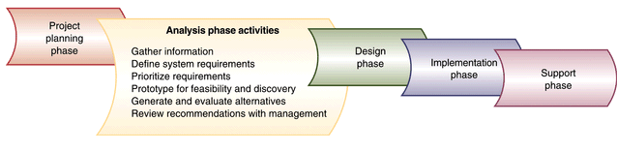
Analysis Phase in More Detail
Figure 4-1

Slide 5
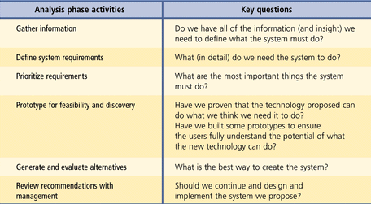
Activities of the Analysis Phase and Key Questions
Figure 4-2

Slide 6
Functional and Technical Requirements
System requirements – all capabilities and constraints
  Functional requirements
    Activities the system must perform
    Based on procedures and business functions
    Documented in analysis models
  Technical requirements
    Describes operating environment or performance objectives
    Documented in narrative descriptions of technical requirements

Slide 7
Stakeholders
People with interest in system success
Three primary groups
  Users (use system)
  Clients (pay for system)
  Technical staff (ensure system operation)

Slide 8
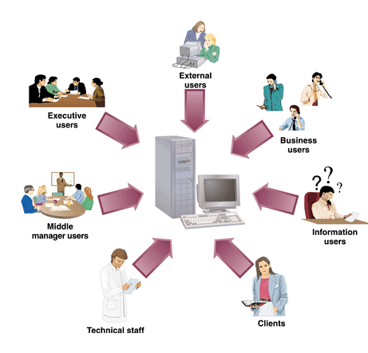
Stakeholders Interested in New Development
Figure 4-3

Slide 9
Users as Stakeholders
User roles
  Horizontal - information flow across departments
  Vertical - information needs of clerical staff, middle management, and senior executives
Business users
Information users
Management users
Executive users
External users
Client stakeholders
Technical stakeholders

Slide 10
Techniques for Information Gathering
Objective of analysis phase is to understand business functions and develop requirements
Original approach involved modeling of existing system
Current approach involves identifying logical requirements for new system

Slide 11
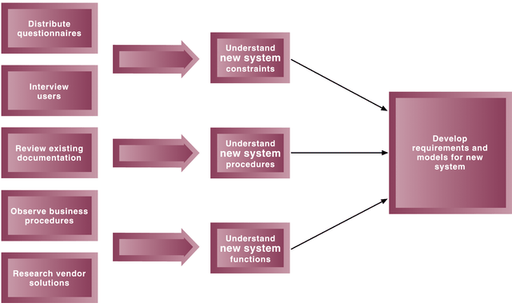
Information Gathering and Model Building
Figure 4-5

Slide 12
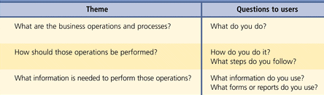
Themes for Information-Gathering Questions
Figure 4-6

Slide 13
Fact Finding Methods
Review existing reports, forms, and procedure descriptions
Conduct interviews and discussion with users
Observe and document business processes
Build prototypes
Distribute and collect questionnaires
Conduct JAD sessions
Research vendor solutions

Slide 14
Review Existing Reports, Forms, and Procedure Descriptions
First technique in fact-finding
Purposes
  Preliminary understanding of processes
  Guidelines / visual cues to guide interviews
Identify business rules, discrepancies, and redundancies
Be cautious of outdated material

Slide 15
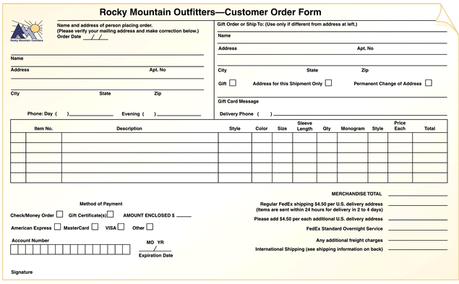
Sample Order Form for RMO
Figure 4-7

Slide 16
Conduct Interviews and Discussions with Users
Most effective way to understand business functions and rules
Time-consuming and resource-expensive
May require multiple sessions

Slide 17
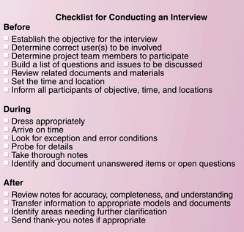
Sample Interview Checklist
Figure 4-8

Slide 18
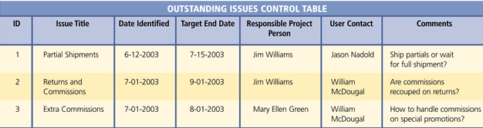
Sample Open-Items List
Figure 4-10

Slide 19
Observe and Document
Business Processes
From office walkthrough to performing actual tasks
May make users nervous
Not necessary to observe all processes at same level of detail
May be documented with workflow diagrams

Slide 20
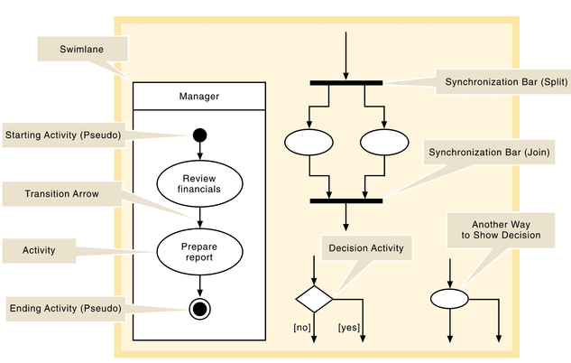
Activity Diagram Symbols
Figure 4-11

Slide 21
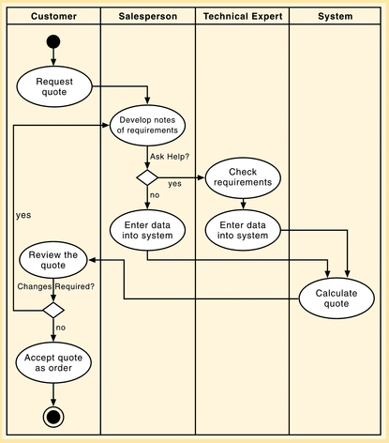
Simple Activity Diagram
Figure 4-12

Slide 22
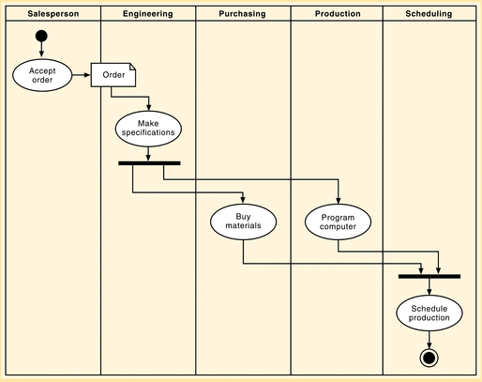
Activity Diagram with Concurrent Paths
Figure 4-13

Slide 23
Characteristics of Prototypes
Preliminary working model of a larger system
Operative
  Working model
Focused
  Accomplishes single objective
Quick
  Can be built and modified rapidly

Slide 24
Distribute and Collect Questionnaires
Limited and specific information from a large number of stakeholders
Preliminary insight
Not well suited for gathering detailed information
Open-ended questions vs. close-ended questions

Slide 25
JAD Sessions
Used to expedite the investigation of systems requirements
Seeks to compress fact-finding, modeling, policy formation, and verification activities into a shorter time frame
Critical factor is to have all important stakeholders present

Slide 26
JAD Participants
JAD session leader
Users
Technical staff
Project team members

Slide 27
JAD Facilities
Generally conducted in special room
  Limits interruptions
  May be off-site
Resources
  Overhead projector, white board, flip charts, and work material
  Electronic support
  CASE Tools
  Group support systems

Slide 28
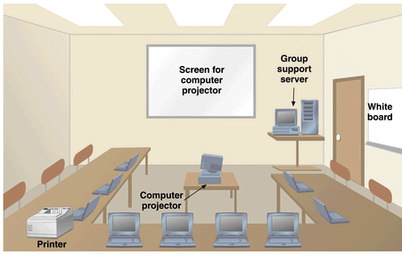
High-Tech JAD Facility
Figure 4-15

Slide 29
Research Vendor Solutions
Many problems have been solved by other companies
Positive contributions of vendor solutions
  Provide new ideas
  May be state of the art
  Cheaper and less risky
Danger
  May purchase solution without understanding problem fully

Slide 30
Techniques in Vendor Research
Demo or trial system
References of existing clients
On-site visits
Printout of screens and reports

Slide 31
Business Process Reengineering
Questions basic assumptions
Provides radical improvements
IT often used as integral part of BPR
System development project may include components of BPR

Slide 32
Validating Requirements
Make sure gathered information is correct
Structured walkthrough
  Effective means of implementing quality control early in project
  Verify and validate system requirements
  Review of findings from investigation and of models based on findings

Slide 33
Business Process Reengineering
Questions basic assumptions for doing business and seeks to find a better way
Uses IT as an enabler
Systems analyst may discover opportunities for business process improvement

