Slide 1
Chapter 5
Modeling System Requirements:
Events and Things

Slide 2
Objectives
Explain the many reasons for creating information system models
Describe three types of models and list some specific models used for analysis and design
Explain how events can be used to define system requirements
Identify and analyze events to which a system responds

Slide 3
Objectives
Explain how the concept of things in the system also defines requirements
Explain the similarities and the differences between data entities and objects
Identify and analyze data entities and objects needed in the system
Read, interpret, and create an entity-relationship diagram
Read, interpret, and create a class diagram

Slide 4
Models and Modeling
Analyst describes information system requirements using a collection of models
Complex systems require more than one type of model
Models represent some aspect of the system being built

Slide 5
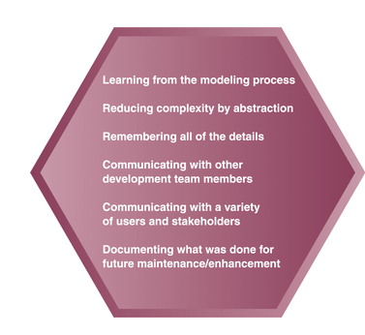
Reasons for Modeling
Figure 5-2

Slide 6
Types of Models
Different types of models are used in information systems development
  Mathematical - formulas that describe technical aspects of the system
  Descriptive - narrative memos, reports, or lists that describe aspects of the system
  Graphical - diagrams and schematic representations of some aspect of the system

Slide 7
Overview of Models Used in Analysis and Design
Analysis phase activity named “define system requirements”
  Logical models
  Provide detail without regard to specific technology
Design phase
  Physical models
  Provide technical details
  Extend logical models

Slide 8
Events and System Requirements
Events
  Occurrences at a specific time and place
  Trigger all system processing
Requirement definition
  Determine relevant events
    External events first
    Temporal events second
  Decompose system into manageable units

Slide 9
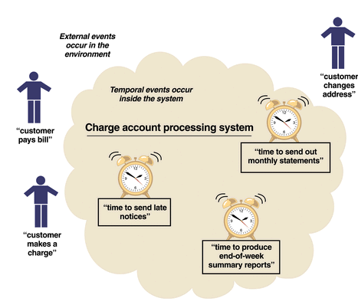
Events Affecting a Charge Account Processing System
Figure 5-6

Slide 10
Types of Events
External
  Outside system
  Initiated by external agent or actor
Temporal
  Occurs as result of reaching a point in time
  Based on system deadlines
State
  Something inside system triggers need for processing

Slide 11
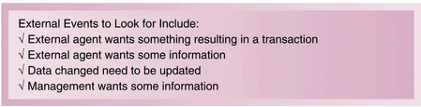
External Event Checklist
Figure 5-7

Slide 12
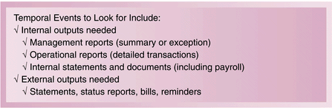
Temporal Event Checklist
Figure 5-8

Slide 13
Identifying Events
Can be difficult to determine
Often confused with conditions and responses
May be useful to trace a transaction’s life cycle
Certain events left to design phase
  Systems controls
  Perfect technology assumption

Slide 14
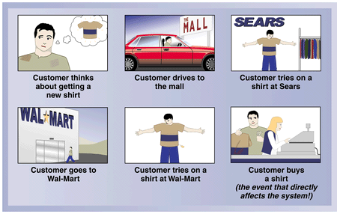
Sequence of Actions that Lead up to Only One Event Affecting the System
Figure 5-9

Slide 15
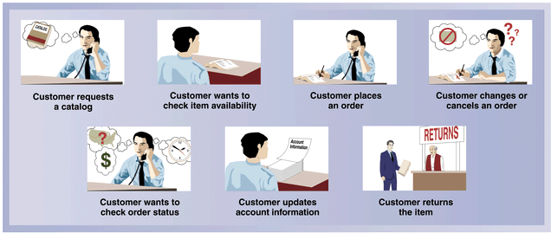
The Sequence of “Transactions”
for One Specific Customer
Resulting in Many Events
Figure 5-10

Slide 16
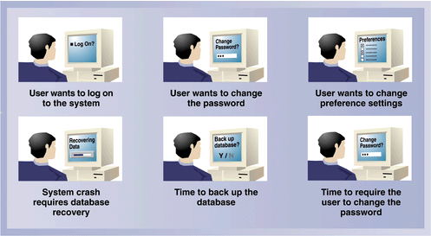
Events Deferred Until the Design Phase
Figure 5-11

Slide 17
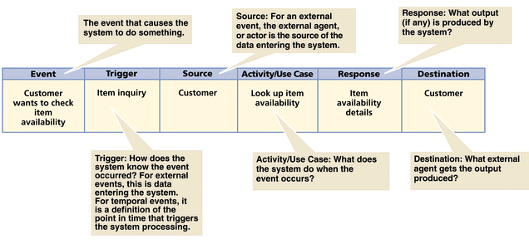
Information about each Event
in an Event Table
Figure 5-14

Slide 18
Things and System Requirements
What system information needs to be stored
Outcomes
  Understanding of system
  Set of models

Slide 19
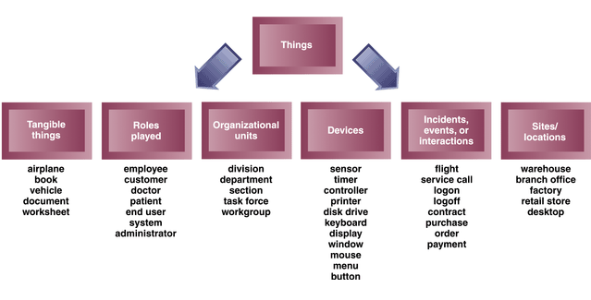
Types of Things
Figure 5-16

Slide 20
Developing an Initial List of Things
Step 1: Identify all nouns about the system
Step 2: Add items or categories of information needed
Step 3: Refine list and record assumptions or issues to explore

Slide 21
Characteristics of Things
Relationship
  Naturally occurring association among specific things
  Occur in two directions
  Cardinality/multiplicity
    Binary, unary, ternary, n-ary
Attribute
  One specific piece of information about a thing

Slide 22
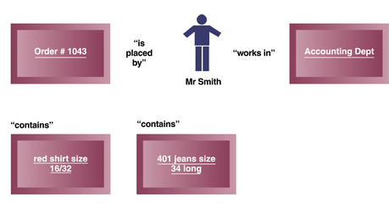
Relationships Naturally Occur Between Things
Figure 5-18

Slide 23
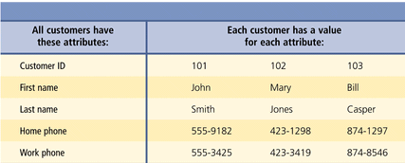
Attributes and Values
Figure 5-20

Slide 24
Data Entities
Things the system needs to store data about in traditional IS approach
Modeled with entity-relationship diagram
Generally used with relational database development

Slide 25
Objects
Do the work in the system and store information
Behaviors and attributes
Class: Type of thing
Object: Specific thing
Methods: Behaviors of objects

Slide 26
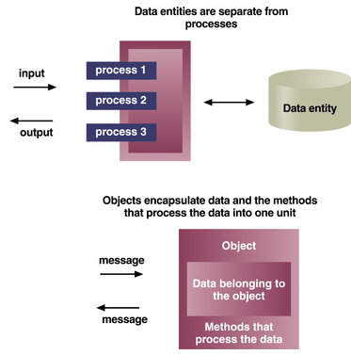
Data Entities Compared with Objects
Figure 5-21

Slide 27
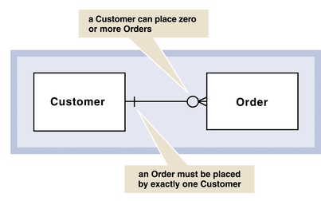
Simple ERD
Figure 5-22

Slide 28
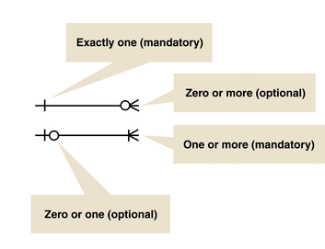
Cardinality Symbols of Relationships
Figure 5-23

Slide 29
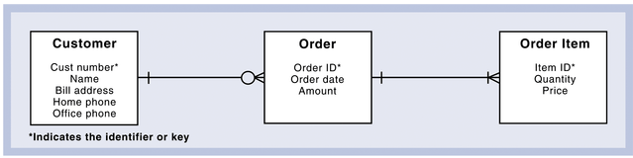
Expanded ERD with Attributes Shown
Figure 5-24

Slide 30
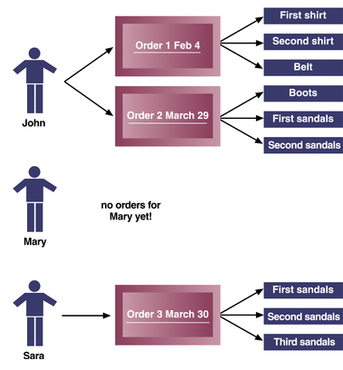
Customers, Orders, and Order Items
Figure 5-25

Slide 31
The Class Diagram
Classes objects rather than data entities
Generalization/specialization hierarchies
  General superclasses to specialized subclasses
  Inheritance allows subclasses to share characteristics of their superclasses
Aggregation (whole-part hierarchies)
  Relates objects and its parts
  Defines object in terms of its parts

Slide 32
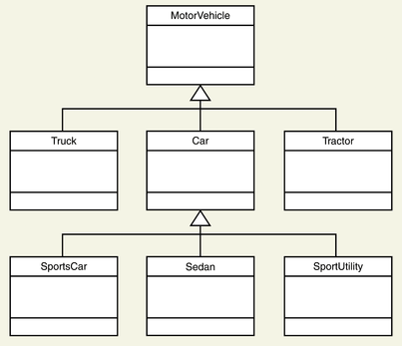
A Generalization/Specialization
Hierarchy for Motor Vehicles
Figure 5-29

Slide 33
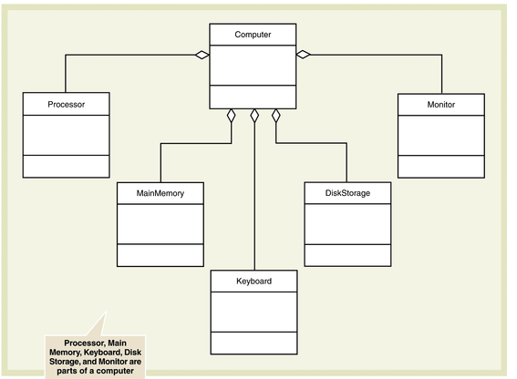
Aggregation or Whole-Part Relationships
Figure 5-31

Slide 34
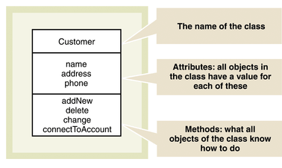
The Class Symbol
for the Class Diagram
Figure 5-32

Slide 35
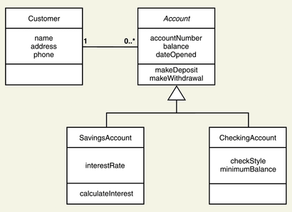
Bank Account System Class Diagram
Figure 5-33

Slide 36
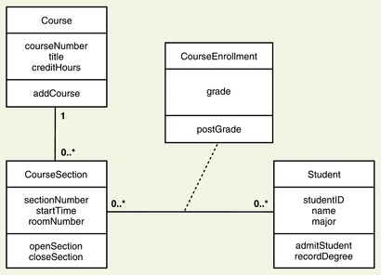
Enrollment Class Diagram
with Association Class
Figure 5-34

