Slide 1
What is Systems Analysis and Design (SAD)?
Systems Analysis: understanding and specifying in detail what an information system should do
System Design: specifying in detail how the parts of an information system should be implemented
Why is it important?
Success of information systems depends on good SAD
Widely used in industry - proven techniques
part of career growth in IT - lots of interesting and well-paying jobs! (rated 2nd best job in latest “Jobs Almanac”)
increasing demand for systems analysis skills

Slide 2
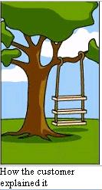

Slide 3
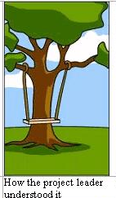

Slide 4
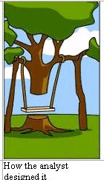

Slide 5
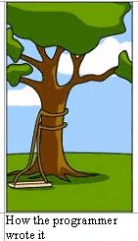

Slide 6
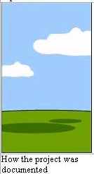

Slide 7
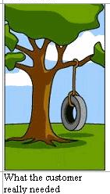

Slide 8
Course Topics
Introduction to systems analysis and design (Chapter 1)
  the analyst as problem solver
  required skills of systems analysts
  types of jobs and the analyst’s role
  Example: Rocky mountain outfitters
The analyst as project manager (Chapter 3)
  the systems development life cycle (SDLC)
    planning phase
    analysis phase
    design phase
    implementation phase
    support phase
  the project team

Slide 9
Topics (continued)
Approaches to Systems Development (chapter 2)
  Methodologies and Models
  2 approaches:
    structured approach
    object-oriented approach
  Waterfall Models for SDLC
  other variations
  computer-aided software engineering (CASE)

Slide 10
Topics (continued)
Identifying System Requirements (Chapter 4)
  stakeholders
  Methods - e.g. questionnaires, interviews, observation, build prototypes, others
Modelling System Requirements (Chapter 5,6,7 and 8)
  types of models - e.g. mathematical, descriptive, graphical
  identifying and modeling events
  identifying and modeling “things” in the world
  traditional and object-oriented methods

Slide 11
Topics (continued)
System Design (Chapters 9,10,11,14 and 15)
  going from requirements to design
  elements of design
  approaches
    structured approach
    object-oriented approach
  design of inputs and outputs
  designing databases
  designing user interfaces

Slide 12
Chapter 1: The World of the Modern System Analyst
System Analysis: the process of understanding and specifying in detail what the information system should do
System Design: the process of specifying in detail how the many component parts of the information system should be implemented
System Analyst: A professional who used analysis and design techniques to solve business problems (involving information technology)
A theme of the course: developing effective information systems is much more than just writing computer programs (involves cognitive skills in understanding problems and knowing where computer technology best “fits in”)

Slide 13
The Analysts’
Approach to Problem
Solving (Figure 1-1
in the text)
Research and understand the problem
Verify that the benefits of solving the
problem outweigh the costs
Develop a set of possible solutions
(alternatives)
Decide which solution is best,
and make a recommendation
Design the details of the chosen
solution
Implement the solution
Monitor to make sure the you
Obtain the desired results

Slide 14
Thinking in terms of “Systems”
What is a system?
A system is a collection of interrelated components (subsystems) that function together to achieve some outcome (e.g. biological system, computer system, social system)
An information system is a collection of interrelated components that collect, process, store and provide as output the information needed to complete business tasks (e.g. payroll system)

Slide 15
Characteristics of Systems
Systems are made up of interrelated subsystems (e.g. a nuclear reactor is composed of boilers, reactor components etc.)
Functional decomposition – dividing a system into components based on subsystems (which are in turn further divided into subsystems)
System boundary – the separation between a system and its environment (where inputs and outputs cross)
Automation boundary – separation between the automated part of system and the manual part

Slide 16
General Depiction of a System
input
boundary
interrelationship
subsystem
output
output

Slide 17
Overall production system (supersystem)
(figure 1-2 in the text)
Inventory
Management
System
Manufacturing
System
Customer
Maintenance
Subsystem
Order Entry
Subsystem
Customer Support System
Catalogue
Maintenance
Subsystem
Order Fulfillment
Subsystem

Slide 18
Figure 1-4: The system boundary and the automation boundary
Environment Surrounding the System
System
boundary
Manual Part of the System
Automation
boundary
Automated Part of
the System

Slide 19
“Systems” Thinking
Being able to identify something as a system
Involves being able to identify subsystems
Identifying system characteristics and functions
Identifying where the boundaries are (or should be)
Identifying inputs and outputs to systems
Identifying relationships among subsystems

Slide 20
Types of Information Systems
Transaction processing systems (TPS)
  Capture and record information about the transactions that affect the organization (e.g. the sale of an item, a withdrawal from an ATM etc.)
Management Information Systems (MIS)
  Take information captured by the transaction processing system and produce reports management needs for planning and controlling business

Slide 21
Executive Information Systems (EIS)
  Provide information for executives to use in strategic planning (could be from organizational database, or outside sources like stock market reports)
Decision Support Systems (DSS)
  Support human decision making and allows users to explore the potential impact of available options or decisions (e.g. can ask “what if”)
  Closely related to “expert systems” or “knowledge-based” systems

Slide 22
Required Skills of the Systems Analyst
Technical Knowledge and Skills
    Computers and how they work in general
    Programming languages
    Devices that interact with computers
    Communications networks
    Database and database management systems
    Operating systems and utilities
  Tools: software products used to help develop analysis and design specifications and completed system components
    e.g. Microsoft Access, Integrated development environments, computer-supported system engineering (CASE) tools

Slide 23
Business Knowledge and Skills
  What activities and processes do organizations perform?
  How are organizations structured?
  How are organizations managed?
  What type of work (activity) does on in the organization? (e.g. hospital, bank etc.)
  Who are the “actors” doing the activities
  About the organization (e.g. company) the system analyst needs to know:
    What the specific organization does
    What makes it successful
    What its strategies and plans are
    What its tradition (“culture”) and values are

Slide 24
People Knowledge and Skills
  Single most important interpersonal skill:
    To communicate clearly and effectively with others!
  Since analysts work on teams with others (e.g. team members, clients etc.) must understand about people:
    How people think
    How people learn
    How people react to change
    How people communicate
    How people work (“activities” and “actors”)
  Other areas:
    Skill in interviewing, listening and observing
    Good written and oral presentation
    Being able to work in a team

Slide 25
Typical Job Titles
Programmer/analyst
Business systems analyst
System liaison
End-user analyst
Business consultant
Systems consultant
System support analyst
System designer
Software engineer
System architect

Slide 26
Running Case Study: Rocky Mountains Outfitters (RMO)
Began in 1978 as dream of John and Liz Blankens
First started as direct mail-order sales to customers
By late 1990s had grown to a large regional sports clothing distributor in the Rocky Mountain and Western states
RMO now employs over 600 people and has almost $100 million annually in sales
Mail order is major source of revenue at 70 M
Recently completed an information systems strategic planning project (with help of consultants)

Slide 27
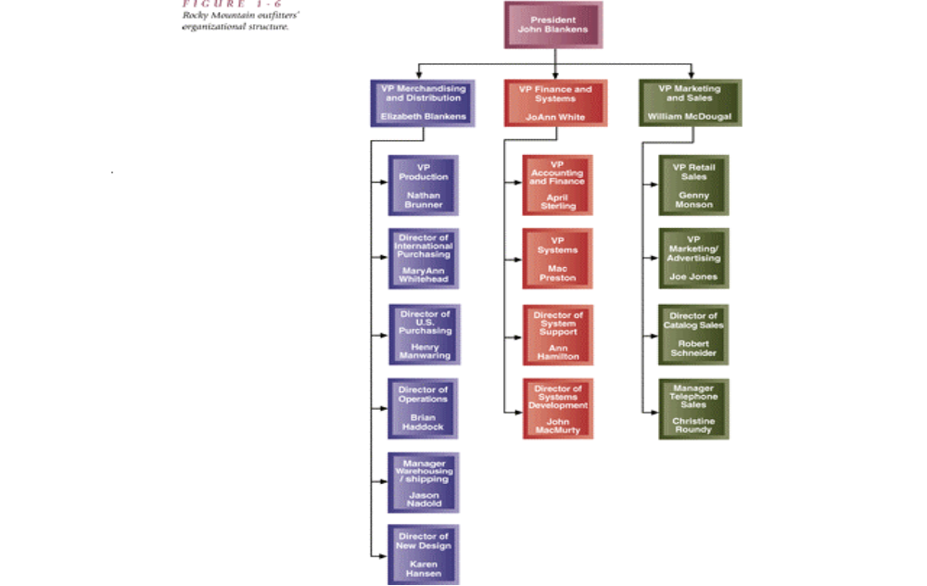

Slide 28
Information Systems Department at RMO
Organized into two areas:
  System support
    Includes telecommunications, database administration, operations and user support
  System development
    4 project managers, 6 systems analysts and 10 programmer analysts
Existing Systems
  Small mainframe computer runs from one site. Subsystems are:
    Retail store system
    Office systems
    Merchandising/Distribution
    Mail Order
    Phone Order
    Human resources
    Accounting/Finance

Slide 29
Information Systems Strategic Plan at RMO
Technology Architecture Plan
  Move business applications to client-server architecture
  Move towards conducting business via the Internet (start with web site, then move to transaction processing over the Web)
  Eventually move to intranet
Application Architecture Plan
  Customer Support System: new development integrating direct customer access via the Internet
  Inventory Management System: a merchandizing and inventory system that integrates with customer support

Slide 30
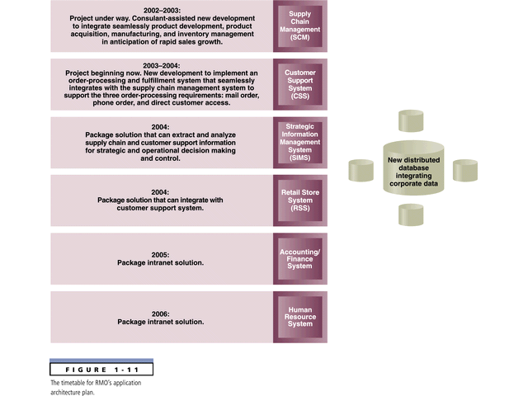

Slide 31
System Development
Project: a planned undertaking that has a beginning and an end, and which produces a predetermined result or product
Information System development project: planned undertaking that produces a system
Basic activities in development of any new system:
  Analysis – to understand information needs
  Design – define the system architecture (based on needs)
  Implementation – the actual construction of the system

Slide 32
System Development Life Cycle (SDLC)
The systems development life cycle (SDLC) is a general term used to describe the method and process of developing a new information system
Without the structure and organization provided by SDLC approach projects are at risk for missed deadline, low quality etc.
SDLC provides
  Structure
  Methods
  Controls
  Checklist
  Needed for successful development

Slide 33
Phases in the SDLC
Sets of related activities are organized into “phases”:
Project planning phase
Analysis phase
Design phase
Implementation phase
Support phase
In “classical” life cycle these phases are sequential, but there are variations as we will see

Slide 34
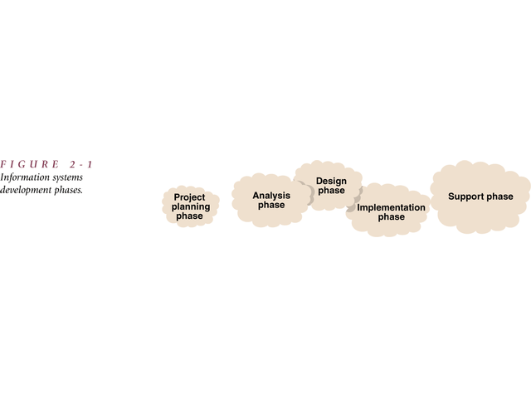

Slide 35
The Planning Phase
Define the problem (and its scope)
Confirm project feasibility
Produce the project schedule
Staff the project
Launch the project
After defining the scope and conducting feasibility study
the plan is reviewed and if it meets with approval, the project is launched

Slide 36
The Analysis Phase
Primary objective: to understand and document the information needs and processing requirements of the new system
  Gather information (e.g. interview, read, observe etc.)
  Define system requirements (reports, diagrams etc.)
  Build prototypes for discovery of requirements
  Prioritize requirements
  Generate and evaluate alternative solutions
  Review recommendations with management

Slide 37
Design Phase
Objective: to design the solution (not to implement it though)
Activities
  Design and integrate the network
  Design the application network
  Design the user interfaces
  Design the system interfaces
  Design and integrate the database
  Prototype for design details
  Design and integrate the system controls

Slide 38
Implementation Phase
Information system is built, tested and installed (actual programming of the information system)
Activities
  Construct software components
  Verify and test
  Develop prototypes for tuning
  Convert data
  Train and document
  Install the system

Slide 39
Support Phase
Objective is to keep the information system running after its installation
Activities
  Provide support to end users
    Help desks
    Training programs
  Maintain and enhance the computer system
    Simple program error correction
    Comprehensive enhancements
    upgrades

Slide 40
Scheduling of Project Phases
Traditional approach: “Waterfall method” – only when one phase is finished does the project team drop down (fall) to the next phase
  Fairly rigid approach
  Can’t easily go back to previous phases (each phase would get “signed off”)
  Good for traditional type of projects, e.g. payroll system or system with clearly definable requirements
  Not as good for many of the new types of interactive and highly complex applications

Slide 41
Newer Approaches
The waterfall approach is less used now
The activities are still planning, analysis, design and implementation
However, many activities are done now in an overlapping or concurrent manner
Done for efficiency – when activities are not dependent on the outcome of others they can also be carried out (but dependency limits overlap)

Slide 42
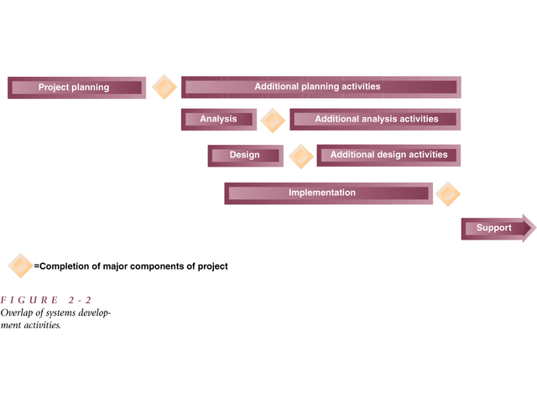

Slide 43
The Project Team
Like a “surgical team” – each member of the team performs a specialized task critical to the whole
Project team varies over duration of the project (as does project leadership)
  During planning team consists of only a few members (e.g. project manager and a couple of analysts)
  During analysis phase the team adds systems analysts, business analysts
  During design other experts may come in with technical expertise (e.g. database or network design)
  During implementation, programmers and quality control people are added

Slide 44
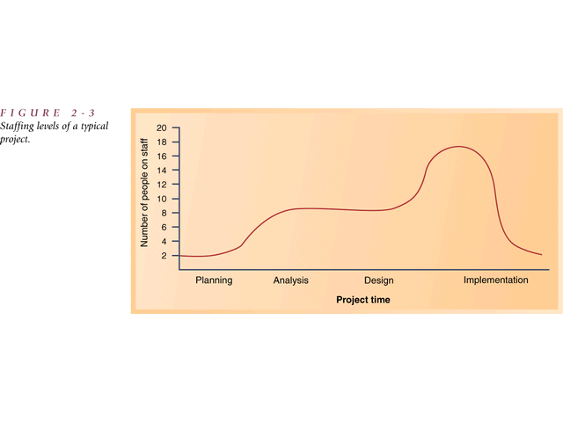

Slide 45
Project Management
Project Manager – has primary responsibility for the functioning of the team
Project Management – organizing and directing of other people to achieve a planned result within a predetermined schedule and budget
Good manager:
  Knows how to plan, execute the plan, anticipate problems and adjust for variances
Client – person or group who funds the project
Oversight committee – reviews and direct the project
User – the person or group who will use the system

Slide 46
Tasks of a Project Manager
Planning and Organization
  Identify scope of the project
  Develop a plan, with detailed task list and schedule
Directing
  Responsible for directing the execution of the project
  Responsible for monitoring the project - make sure that milestones (key events in a project) are met
  Overall control of the project
    Plan and organize project
    Define milestones and deliverables
    Monitor progress
    Allocate resources and determine roles
    Define methodologies
    Anticipate problems and manage staff

Slide 47
Project Initiation
Projects may be initiated as part of the long-term strategic plan (top-down)
  based on mission or objective statement come up with some competitive business strategy- usually involves IT)
  E.G. Rocky Mountain Outfitters example – to be more competitive wants to improve customer support – so moves towards Internet based re-development of systems
Projects may proceed bottom up
  To fill some immediate need that comes up
Projects may also be initiated due to some outside force
  E.g. change in tax structure may affect billing system

Slide 48
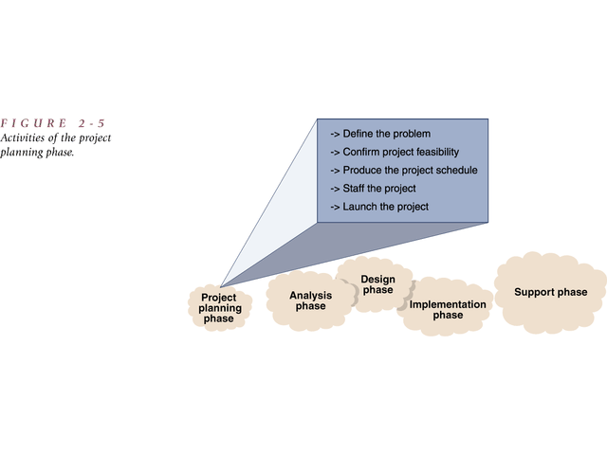

Slide 49
The Project Planning Phase
Defining the Problem
  Review the business needs and benefits (a brief paragraph)
  Identify the expected capabilities of the new system (define the scope of the project)
  May involve developing a context diagram to explain the scope of the project

Slide 50
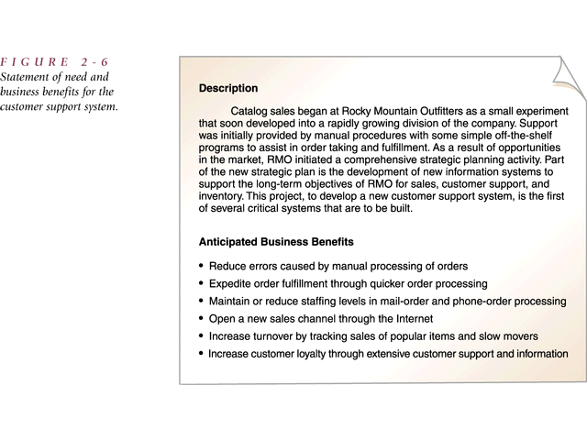

Slide 51
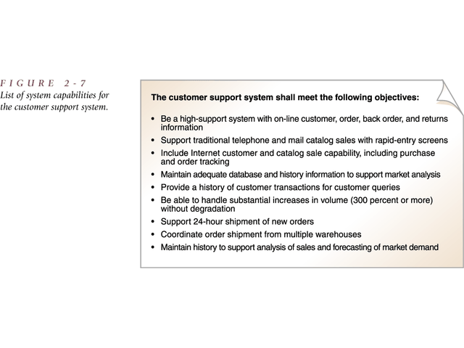

Slide 52
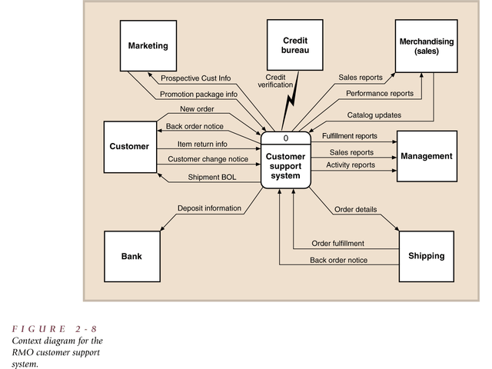

Slide 53
2. Confirming Project Feasibility
  Economic feasibility – cost-benefit analysis
  Organizational and cultural feasibility
    E.g. low level of computer literacy, fear of employment loss
  Technological feasibility
    Proposed technological requirements and available expertise
  Schedule feasibility
    How well can do in fixed time or deadline (e.g. Y2K projects)
  Resource feasibility
    Availability of team, computer resources, support staff
Economic Feasibility
  The analysis to compare costs and benefits to see whether the investment in the development of the system will be more beneficial than than costly

Slide 54
Costs
  Development costs : salaries and wages, equipment and installation, software and licenses, consulting fees and payments to third parties, training, facilities, utilities and tools, support staff, travel and miscellaneous
  Sources of Ongoing Costs of Operations: connectivity, equipment maintenance, computer operations, programming support, amortization of equipment, training and ongoing assistance (help desk), supplies

Slide 55
Benefits
  Tangible benefits - examples
    Reducing staff (due to automation)
    Maintaining constant staff
    Decreasing operating expenses
    Reducing error rates (due to automation)
    Ensuring quicker processing and turnabout
    Capturing lost discounts
    Reducing bad accounts or bad credit losses
    Reducing inventory or merchandise loss
    Collecting accounts receivable more quickly
    Capturing income lost due to “stock outs”
    Reducing the cost of goods with volume discounts
    Reducing paperwork costs

Slide 56
Benefits
  Intangible benefits – examples
    Increased customer satisfaction
    Survival
    Safety of a Patient
    The need to develop in-house expertise
  Note - also can have intangible costs for a project
    reduced employee moral
    lost productivity
    lost customer or sales

Slide 57
Conducting the feasibility study
Each category of cost is estimated
Salaries and wages are calculated based on staffing requirements
Other costs such as equipment, software licenses, training are also estimated
A summary of development costs and annual operating costs is created
A summary of benefits is created
Net present value (NPV) – present value of benefits and costs, is calculated for e.g. 5 year period
Decision is made to proceed with project or not

Slide 58
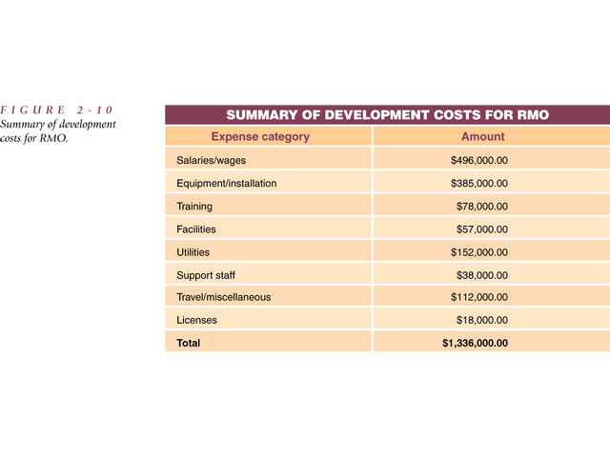

Slide 59
Job | Time | Salary | Total
Project Manager | 12 months | 90,000 | 90,000
System Analyst (3) | 9 months | 75,000 | 168,750
Programmers (6) | 7 months | 50,000 | 175,000
Network Designer | 5 months | 70,000 | 29,166
 |  |  | 462,916

Slide 60
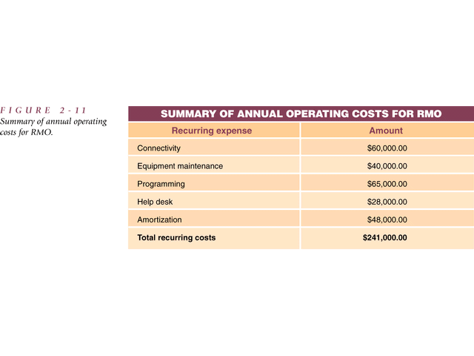

Slide 61
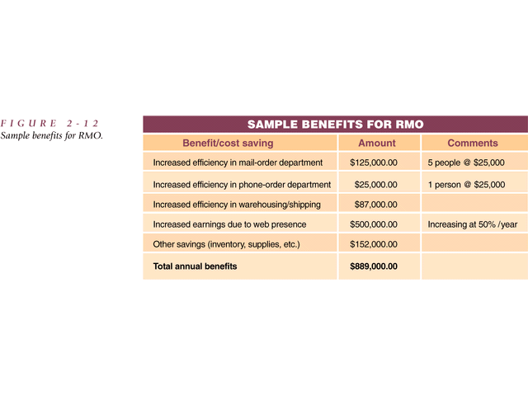

Slide 62
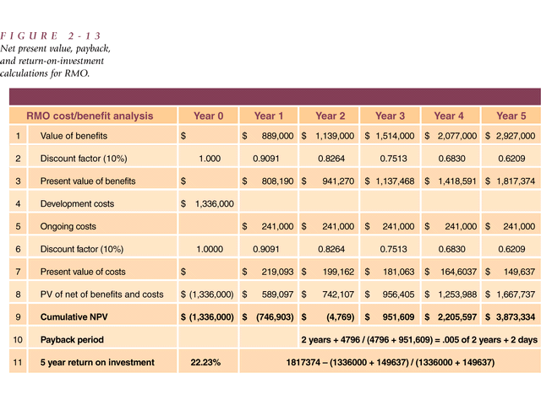

Slide 63
Some Terminology (see text – Appendix B)
Net present value: The present value of dollar benefits and costs for an investment such as a new system
  since $100 received one year in the future is worth only $94.34, using a discount rate of .06, the discount rate is used the calculation of Net present value (which equates future values to current values)
Payback period, or breakeven point: The time period at which the dollar benefits offset the dollar costs
Return on Investment (ROI): a measure of the percentage gain received from an investment such as a new system
ROI=(estimated time period Benefits – estimated time period costs) /
estimated time period costs
Tangible benefits: Benefits that can be measured or estimated in terms of dollars and that accrue
Intangible benefits: Benefits that accrue but that cannot be measured quantitatively or estimated accurately

Slide 64
Developing a Project Schedule
Identify individual tasks for each activity
  Top-down or bottom-up approach
Estimate the size of each task (time and resources) – optimistic, pessimistic and expected times
Determine the sequence for the tasks
Schedule the tasks
Charting methods (Appendix C)
  PERT/CPM (Project Evaluation and Review Technique/Critical Path Method) chart shows the relationships based on tasks or activities
    Defines tasks that can be done concurrently or not and critical path
  Gantt chart shows calendar information for each task as a bar chart
    Shows schedules well but not dependencies as well

Slide 65
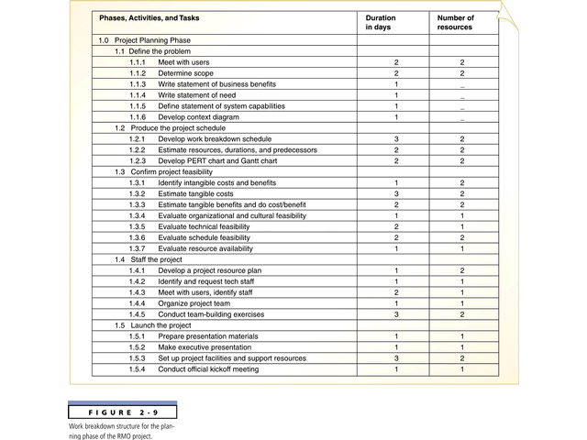

Slide 66
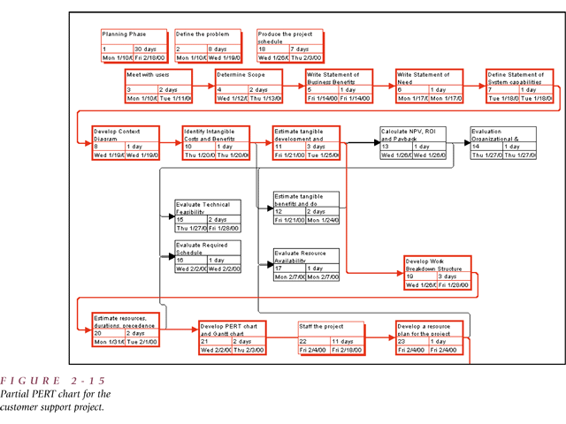

Slide 67
PERT Chart
Tasks represented by rectangles
Tasks on parallel paths can be done concurrently
Critical path – longest path of dependent tasks
  No allowable slack time on this path
  Other paths can have slack time (time that can slip without affecting the schedule)

Slide 68
Gantt Chart
Tasks represented by vertical bars
Vertical tick marks are calendar days and weeks
Shows calendar information in a way that is easy
Bars may be colored or darkened to show completed tasks
Vertical line indicates today’s date

Slide 69
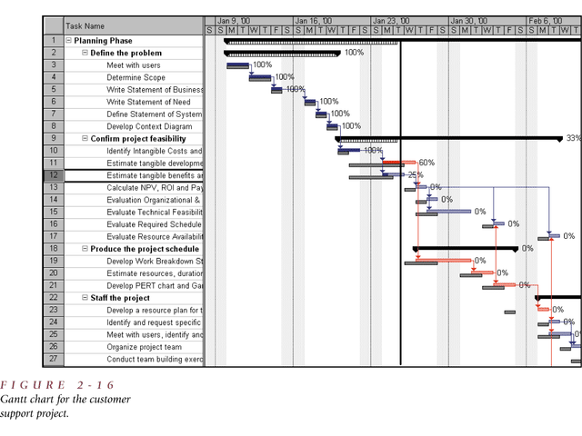

Slide 70
Review of Development of Feasibility Study (Cost-Benefit Analysis, Scheduling etc.)
Checklist of questions for generating documentation for feasibility study (during project planning phase)
History of the project request
Who requested it?
When did they request it?
What did they expect?
Who were the client (i.e. person or group who funds the project) representatives?

Slide 71
2. Objectives and Scope
What is this project to accomplish?
What is involved?
  determine software requirements
  Determine hardware requirements
  What kind of performance criteria is expected
3. Current Situation
What areas are you addressing?
Why are you addressing these areas?
What are the relevant procedures?
Who are the relevant people?
Problems with the current approach
What needs to be changed?

Slide 72
4. Solution Recommended
How will the thing work? (just a rough overview at this stage to show its feasible)
Who will do what?
How will they do it?
What will no longer be necessary?
5. Equipment Used
What equipment is to be used? (describe)
How much of it is already installed?
Where is the equipment installed?
For what purpose?
What else is needed?
Where is it needed?

Slide 73
6. Databases and Files Used
What databases or files will be used?
What databases will be created? (and what is involved?)
What size will they be?
What will they be available for?
7. Costs and benefits
List benefits
  in business, “tangible” benefits are particularly sought (e.g. hard $ savings)
  However, a project may result in “intangible” benefits
(b) List costs
  E.g. programming (69 day @ $370/day)
  batch processing (1.6 hrs at $2450/hr)
(c ) comparison of costs versus benefits – Net present value

Slide 74
8. Schedules
9. Next step
Recommendation about whether to proceed to next phase (ie Analysis phase) or scrap the project
NOTE – at this point the proposed project is reviewed
and if it receives go-ahead we move from the Planning
Phase to the Analysis Phase

