Slide 1
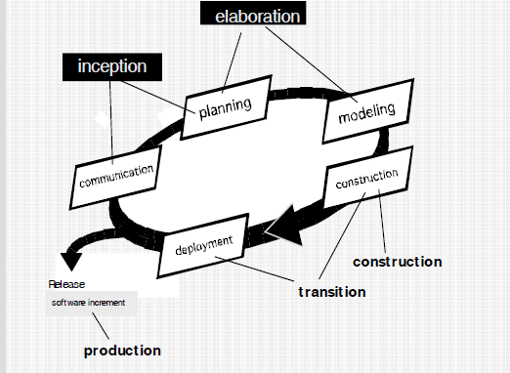
Unified Process

Slide 2
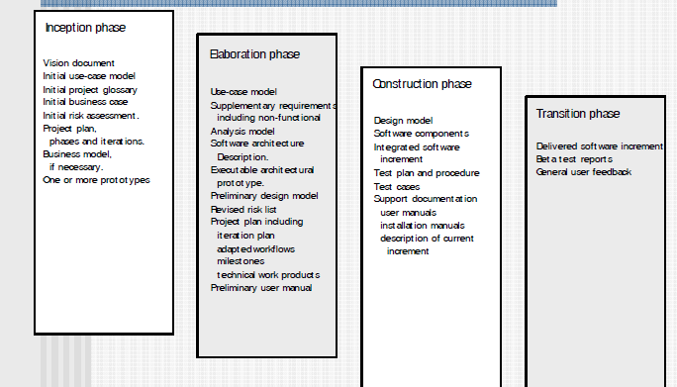
Unified Process

Slide 3
Agility Principles
1.Our highest priority is to satisfy the customer through early and continuous delivery of valuable software.
2. Welcome changing requirements, even late in development. Agile processes harness change for the customer's competitive advantage.
3. Deliver working software frequently,
4. Business people and developers must work together daily throughout the project.
5. Build projects around motivated individuals. Give them the environment and support they need, and trust them to get the job done.
6. The most efficient and effective method of conveying information to and within a development team is face–to–face conversation

Slide 4
Agility Principles
7.Working software is the primary measure of progress.
8. Agile processes promote sustainable development. The sponsors, developers, and users should be able to maintain a constant pace indefinitely.
9. Continuous attention to technical excellence and good design enhances agility.
10. Simplicity – the art of maximizing the amount of work not done – is essential.
11. The best architectures, requirements, and designs emerge from self–organizing teams.
12. At regular intervals, the team reflects on how to become more effective, then tunes and adjusts its behavior

Slide 5
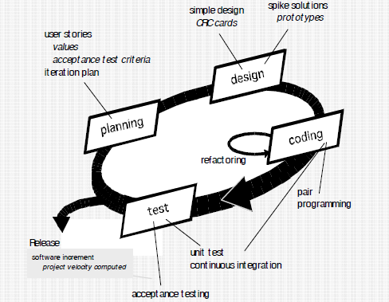
Extreme programming

Slide 6
Scrum ve Diger Modeller
Kriter | Waterfall | Spiral | İterative | Scrum
Tanımlı süreçler | Gerekli | Gerekli | Gerekli | Planlama ve kapatma aşamasında
Final ürün | Planlamada tanımlanmış | Planlamada tanımlanmış | Proje esnasında şekilleniyor | Proje esnasında şekilleniyor
Proje maliyeti | Planlama esnasında hesaplanıyor | Kısmen değişken | Proje esnasında şekilleniyor | Proje esnasında şekilleniyor
Tamamlanma tarihi | Planlama esnasında belirleniyor | Kısmen değişken | Proje esnasında şekilleniyor | Proje esnasında şekilleniyor
Dış çevreye duyarlılık | Sadece planlamada | Planlama öncelikli | İterasyon sonlarında | Her zaman
Takım esnekliği,yaratıcılığı | Limitli,fazla yaratıcılık ve esneklik desteklenmiyor | Limitli,fazla yaratıcılık ve esneklik desteklenmiyor | Limitli,fazla yaratıcılık ve esneklik desteklenmiyor | İterasyonlar boyunca yaratıcılıkta ve esneklikte limit yok
Bilirkişi desteği(Harici) | Proje eğitimi esnasında | Proje eğitimi esnasında | Proje eğitimi esnasında | Gerekirse proje içinde takıma bile dahil edilebiliyor
Başarı olasılığı | Düşük | Orta düşüklükte | Orta Seviye | Yüksek

Slide 7
Requirements Engineering
Inception—ask a set of questions that establish …
  basic understanding of the problem
  the people who want a solution
  the nature of the solution that is desired, and
  the effectiveness of preliminary communication and collaboration between the customer and the developer
Elicitation—elicit requirements from all stakeholders
Elaboration—create an analysis model that identifies data, function and behavioral requirements
Negotiation—agree on a deliverable system that is realistic for

Slide 8
Requirements Engineering
Specification—can be any one (or more) of the following:
  A written document
  A set of models
  A formal mathematical
  A collection of user scenarios (use-cases)
  A prototype
Validation—a review mechanism that looks for errors in content or interpretation
  areas where clarification may be required
  missing information
  inconsistencies (a major problem when large products or systems are engineered)
  conflicting or unrealistic (unachievable) requirements.
Requirements management

Slide 9
Understand the Problem
Who has a stake in the solution to the problem? That is, who are the stakeholders?
What are the unknowns? What data, functions, and features are required to properly solve the problem?
Can the problem be compartmentalized? Is it possible to represent smaller problems that may be easier to understand?
Can the problem be represented graphically?
Can an analysis model be created

Slide 10
Safehome
Every software project is precipitated by some
business need—
• the need to correct a defect in an existing application;
• the need to the need to adapt a ‘legacy system’ to a changing business environment;
• the need to extend the functions and features of an existing application, or
• the need to create a new product, service, or system.

