Slide 1
Software testing

Slide 2
Objectives
To discuss the distinctions between validation testing and defect testing
To describe the principles of system and component testing
To describe strategies for generating system test cases
To understand the essential characteristics of tool used for test automation

Slide 3
Topics covered
System testing
Component testing
Test case design
Test automation

Slide 4
The testing process
Component testing
  Testing of individual program components;
  Usually the responsibility of the component developer (except sometimes for critical systems);
  Tests are derived from the developer’s experience.
System testing
  Testing of groups of components integrated to create a system or sub-system;
  The responsibility of an independent testing team;
  Tests are based on a system specification.

Slide 5
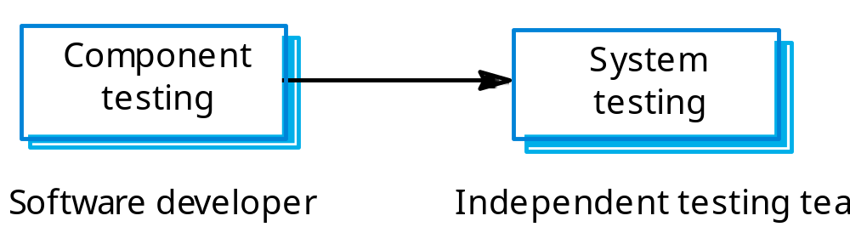
Testing phases

Slide 6
Defect testing
The goal of defect testing is to discover defects in programs
A successful defect test is a test which causes a program to behave in an anomalous way
Tests show the presence not the absence of defects

Slide 7
Testing process goals
Validation testing
  To demonstrate to the developer and the system customer that the software meets its requirements;
  A successful test shows that the system operates as intended.
Defect testing
  To discover faults or defects in the software where its behaviour is incorrect or not in conformance with its specification;
  A successful test is a test that makes the system perform incorrectly and so exposes a defect in the system.

Slide 8
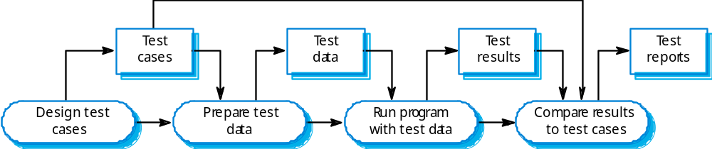
The software testing process

Slide 9
Testing policies
Only exhaustive testing can show a program is free from defects. However, exhaustive testing is impossible,
Testing policies define the approach to be used in selecting system tests:
  All functions accessed through menus should be tested;
  Combinations of functions accessed through the same menu should be tested;
  Where user input is required, all functions must be tested with correct and incorrect input.

Slide 10
System testing
Involves integrating components to create a system or sub-system.
May involve testing an increment to be delivered to the customer.
Two phases:
  Integration testing - the test team have access to the system source code. The system is tested as components are integrated.
  Release testing - the test team test the complete system to be delivered as a black-box.

Slide 11
Integration testing
Involves building a system from its components and testing it for problems that arise from component interactions.
Top-down integration
  Develop the skeleton of the system and populate it with components.
Bottom-up integration
  Integrate infrastructure components then add functional components.
To simplify error localisation, systems should be incrementally integrated.

Slide 12
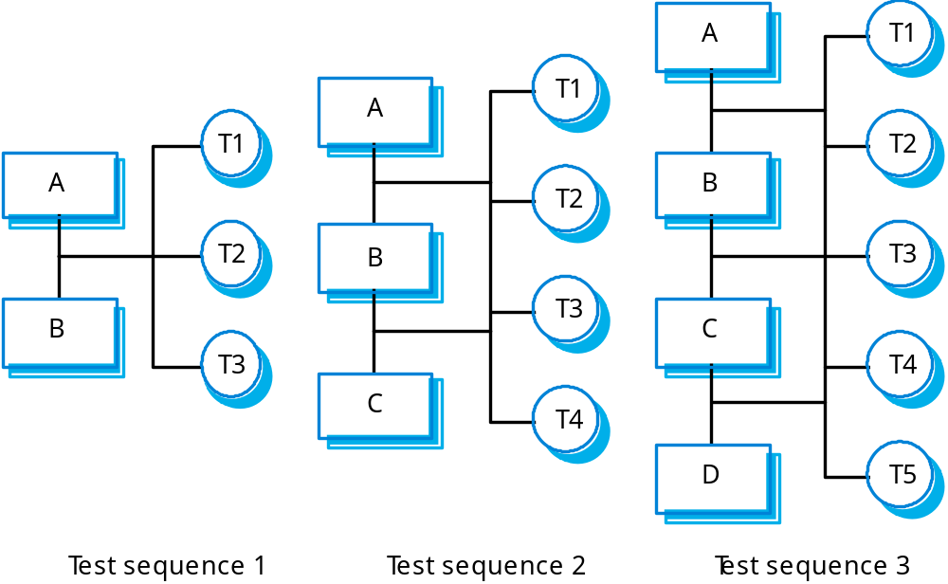
Incremental integration testing

Slide 13
Testing approaches
Architectural validation
  Top-down integration testing is better at discovering errors in the system architecture.
System demonstration
  Top-down integration testing allows a limited demonstration at an early stage in the development.
Test implementation
  Often easier with bottom-up integration testing.
Test observation
  Problems with both approaches. Extra code may be required to observe tests.

Slide 14
Release testing
The process of testing a release of a system that will be distributed to customers.
Primary goal is to increase the supplier’s confidence that the system meets its requirements.
Release testing is usually black-box or functional testing
  Based on the system specification only;
  Testers do not have knowledge of the system implementation.

Slide 15
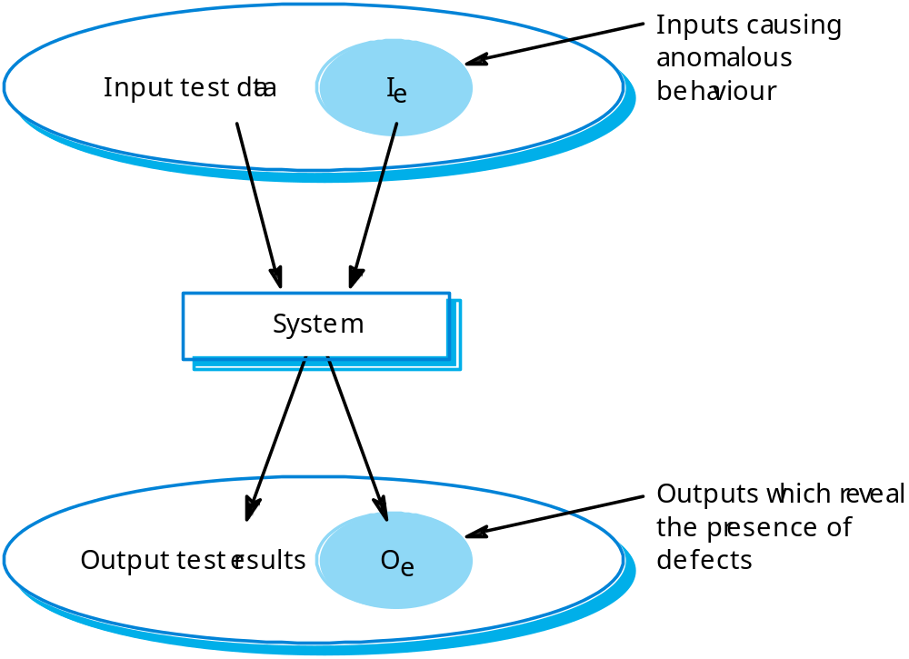
Black-box testing

Slide 16
Testing guidelines
Testing guidelines are hints for the testing team to help them choose tests that will reveal defects in the system
  Choose inputs that force the system to generate all error messages;
  Design inputs that cause buffers to overflow;
  Repeat the same input or input series several times;
  Force invalid outputs to be generated;
  Force computation results to be too large or too small.

Slide 17
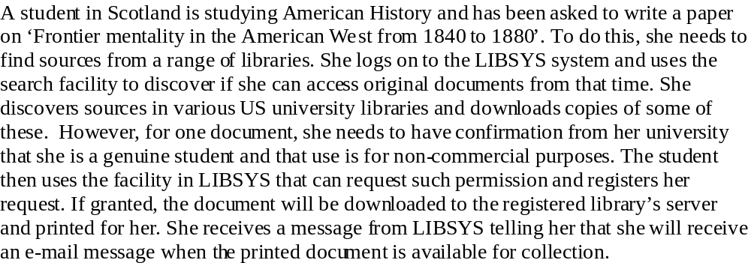
Testing scenario

Slide 18
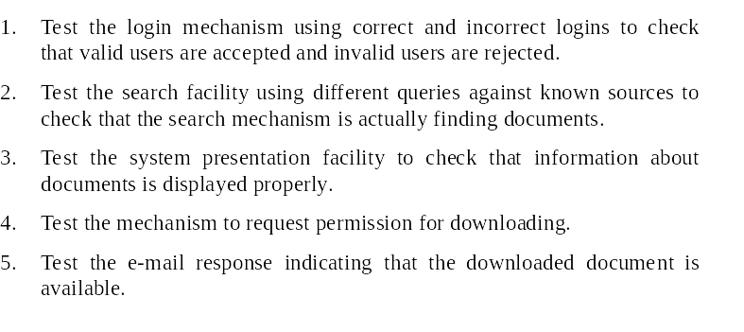
System tests

Slide 19
Use cases
Use cases can be a basis for deriving the tests for a system. They help identify operations to be tested and help design the required test cases.
From an associated sequence diagram, the inputs and outputs to be created for the tests can be identified.

Slide 20
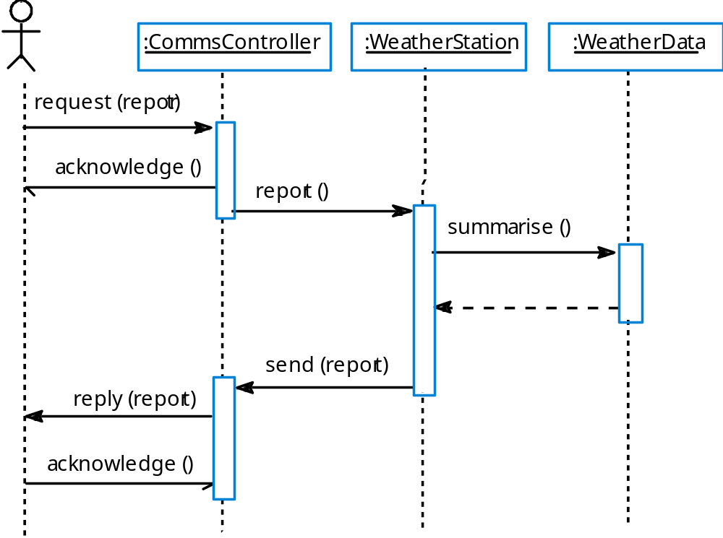
Collect weather data sequence chart

Slide 21
Performance testing
Part of release testing may involve testing the emergent properties of a system, such as performance and reliability.
Performance tests usually involve planning a series of tests where the load is steadily increased until the system performance becomes unacceptable.

Slide 22
Stress testing
Exercises the system beyond its maximum design load. Stressing the system often causes defects to
come to light.
Stressing the system test failure behaviour.. Systems should not fail catastrophically. Stress testing checks for unacceptable loss of service or data.
Stress testing is particularly relevant to distributed systems that can exhibit severe degradation as a
network becomes overloaded.

Slide 23
Component testing
Component or unit testing is the process of testing individual components in isolation.
It is a defect testing process.
Components may be:
  Individual functions or methods within an object;
  Object classes with several attributes and methods;
  Composite components with defined interfaces used to access their functionality.

Slide 24
Object class testing
Complete test coverage of a class involves
  Testing all operations associated with an object;
  Setting and interrogating all object attributes;
  Exercising the object in all possible states.
Inheritance makes it more difficult to design object class tests as the information to be tested is not localised.

Slide 25
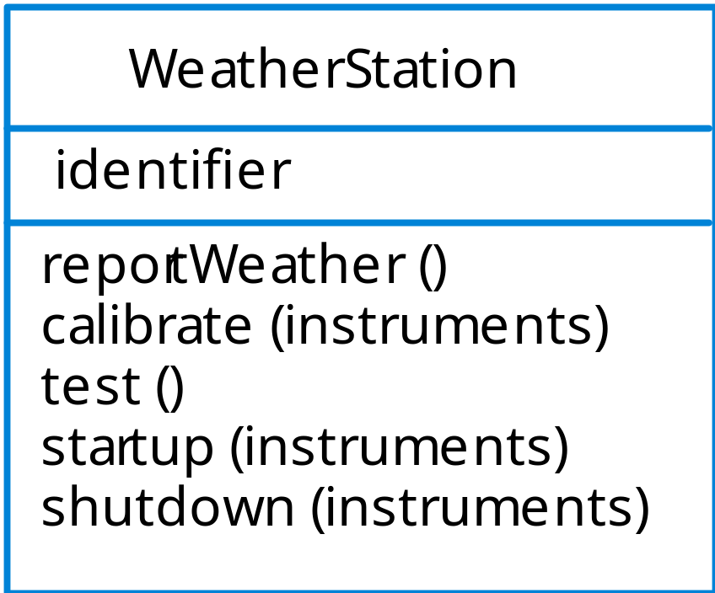
Weather station object interface

Slide 26
Weather station testing
Need to define test cases for reportWeather, calibrate, test, startup and shutdown.
Using a state model, identify sequences of state transitions to be tested and the event sequences to cause these transitions
For example:
  Waiting -> Calibrating -> Testing -> Transmitting -> Waiting

Slide 27
Interface testing
Objectives are to detect faults due to interface errors or invalid assumptions about interfaces.
Particularly important for object-oriented development as objects are defined by their interfaces.

Slide 28
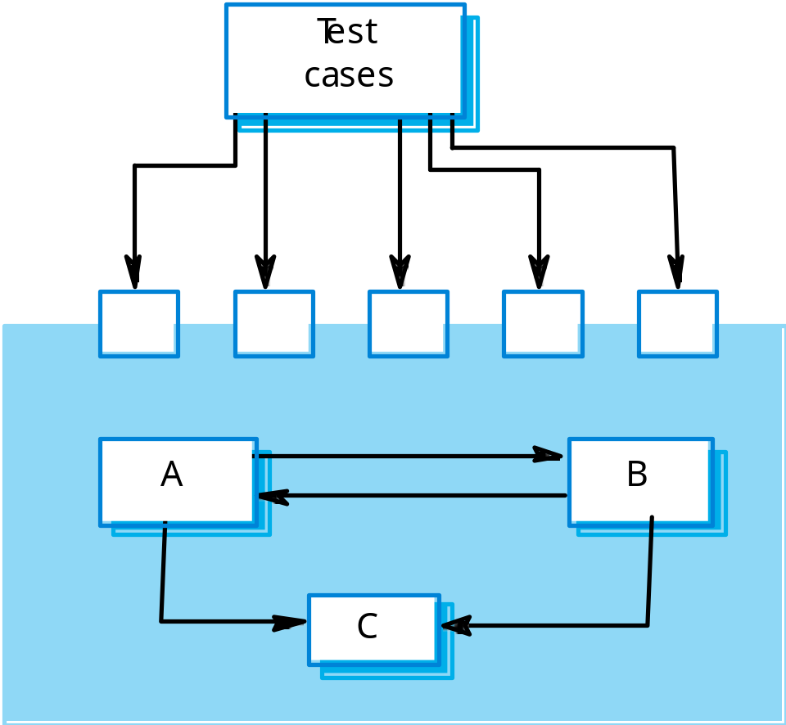
Interface testing

Slide 29
Interface types
Parameter interfaces
  Data passed from one procedure to another.
Shared memory interfaces
  Block of memory is shared between procedures or functions.
Procedural interfaces
  Sub-system encapsulates a set of procedures to be called by other sub-systems.
Message passing interfaces
  Sub-systems request services from other sub-system.s

Slide 30
Interface errors
Interface misuse
  A calling component calls another component and makes an error in its use of its interface e.g. parameters in the wrong order.
Interface misunderstanding
  A calling component embeds assumptions about the behaviour of the called component which are incorrect.
Timing errors
  The called and the calling component operate at different speeds and out-of-date information is accessed.

Slide 31
Interface testing guidelines
Design tests so that parameters to a called procedure are at the extreme ends of their ranges.
Always test pointer parameters with null pointers.
Design tests which cause the component to fail.
Use stress testing in message passing systems.
In shared memory systems, vary the order in which components are activated.

Slide 32
Test case design
Involves designing the test cases (inputs and outputs) used to test the system.
The goal of test case design is to create a set of tests that are effective in validation and defect testing.
Design approaches:
  Requirements-based testing;
  Partition testing;
  Structural testing.

Slide 33
Requirements based testing
A general principle of requirements engineering is that requirements should be testable.
Requirements-based testing is a validation testing technique where you consider each requirement and derive a set of tests for that requirement.

Slide 34
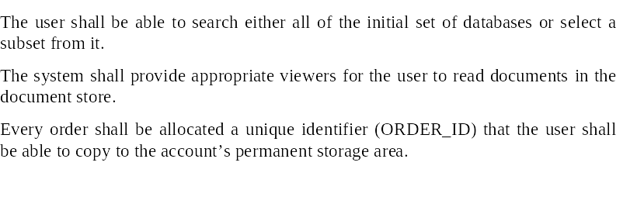
LIBSYS requirements

Slide 35
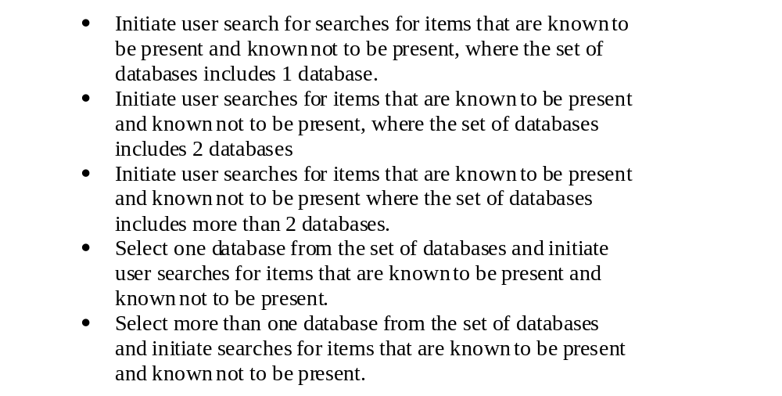
LIBSYS tests

Slide 36
Partition testing
Input data and output results often fall into different classes where all members of a class are related.
Each of these classes is an equivalence partition or domain where the program behaves in an equivalent way for each class member.
Test cases should be chosen from each partition.

Slide 37
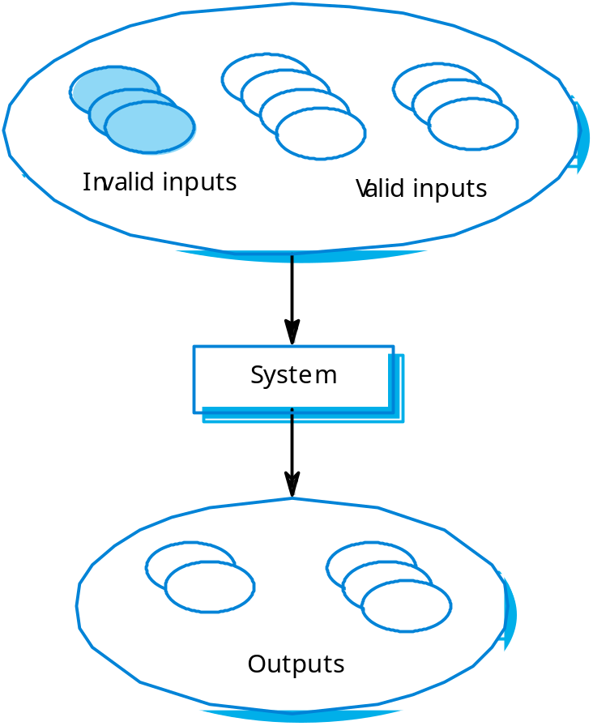
Equivalence partitioning

Slide 38
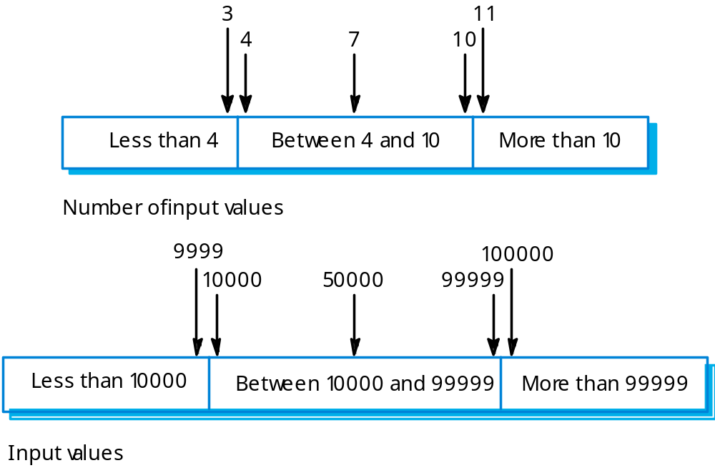
Equivalence partitions

Slide 39
Search routine specification
procedure Search (Key : ELEM ; T: SEQ of ELEM;
Found : in out BOOLEAN; L: in out ELEM_INDEX) ;
Pre-condition
-- the sequence has at least one element
T’FIRST <= T’LAST
Post-condition
-- the element is found and is referenced by L
( Found and T (L) = Key)
or
-- the element is not in the array
( not Found and
not (exists i, T’FIRST >= i <= T’LAST, T (i) = Key ))

Slide 40
Search routine - input partitions
Inputs which conform to the pre-conditions.
Inputs where a pre-condition does not hold.
Inputs where the key element is a member of
the array.
Inputs where the key element is not a member of the array.

Slide 41
Testing guidelines (sequences)
Test software with sequences which have only a single value.
Use sequences of different sizes in different tests.
Derive tests so that the first, middle and last elements of the sequence are accessed.
Test with sequences of zero length.

Slide 42
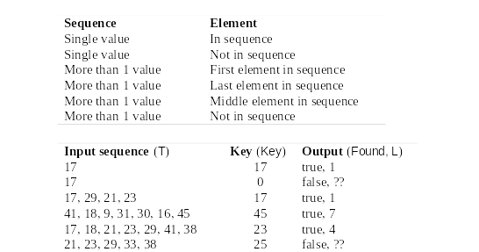
Search routine - input partitions

Slide 43
Structural testing
Sometime called white-box testing.
Derivation of test cases according to program structure. Knowledge of the program is used to identify additional test cases.
Objective is to exercise all program statements (not all path combinations).

Slide 44
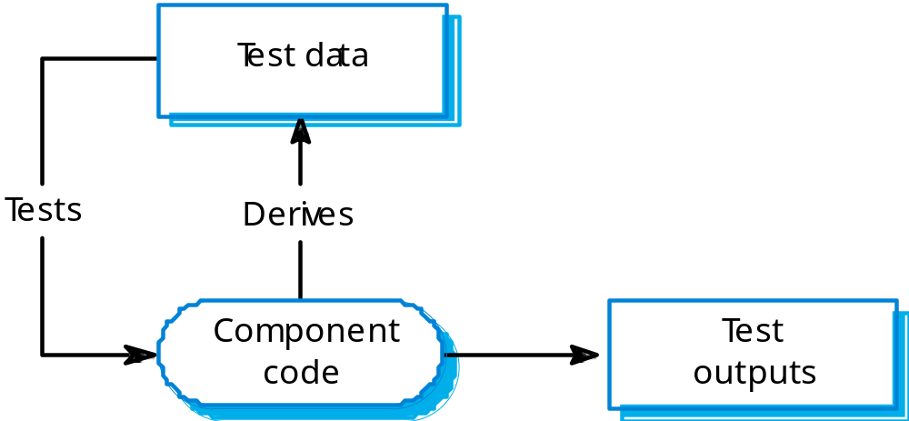
Structural testing

Slide 45
Binary search - equiv. partitions
Pre-conditions satisfied, key element in array.
Pre-conditions satisfied, key element not in
array.
Pre-conditions unsatisfied, key element in array.
Pre-conditions unsatisfied, key element not in array.
Input array has a single value.
Input array has an even number of values.
Input array has an odd number of values.

Slide 46
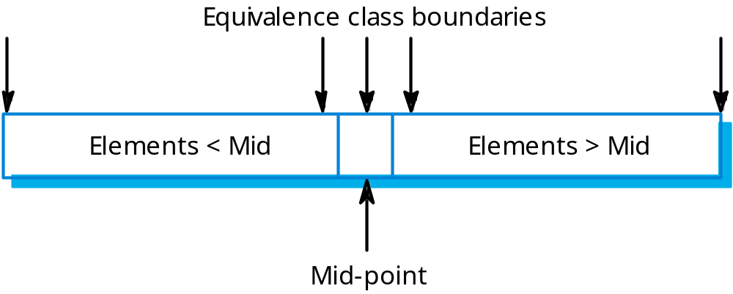
Binary search equiv. partitions

Slide 47
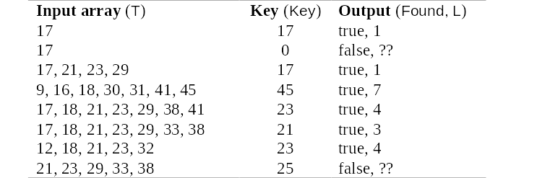
Binary search - test cases

Slide 48
Path testing
The objective of path testing is to ensure that the set of test cases is such that each path through the program is executed at least once.
The starting point for path testing is a program flow graph that shows nodes representing program decisions and arcs representing the flow of control.
Statements with conditions are therefore nodes in the flow graph.

Slide 49
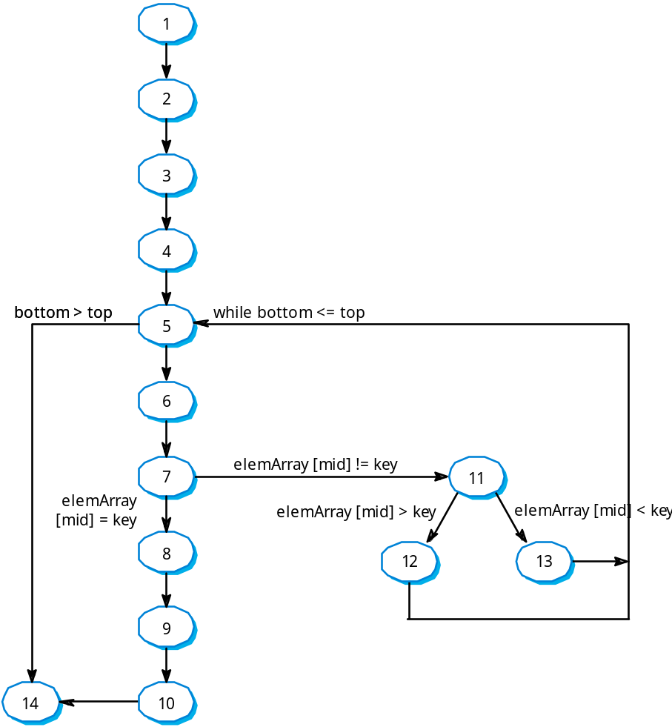
Binary search flow graph

Slide 50
Independent paths
1, 2, 3, 4, 5, 6, 7, 8, 9, 10, 14
1, 2, 3, 4, 5, 14
1, 2, 3, 4, 5, 6, 7, 11, 12, 5, …
1, 2, 3, 4, 6, 7, 2, 11, 13, 5, …
Test cases should be derived so that all of these paths are executed
A dynamic program analyser may be used to check that paths have been executed

Slide 51
Test automation
Testing is an expensive process phase. Testing workbenches provide a range of tools to reduce the time required and total testing costs.
Systems such as Junit support the automatic execution of tests.
Most testing workbenches are open systems because testing needs are organisation-specific.
They are sometimes difficult to integrate with closed design and analysis workbenches.

Slide 52
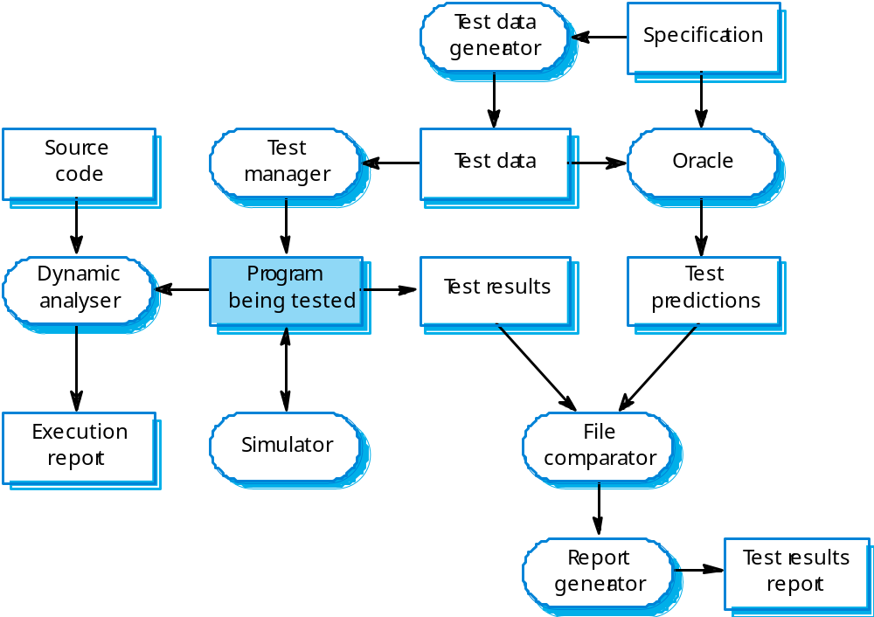
A testing workbench

Slide 53
Testing workbench adaptation
Scripts may be developed for user interface simulators and patterns for test data generators.
Test outputs may have to be prepared manually for comparison.
Special-purpose file comparators may be developed.

Slide 54
Key points
Testing can show the presence of faults in a system; it cannot prove there are no remaining faults.
Component developers are responsible for component testing; system testing is the responsibility of a separate team.
Integration testing is testing increments of the system; release testing involves testing a system to be released to a customer.
Use experience and guidelines to design test cases in defect testing.

Slide 55
Key points
Interface testing is designed to discover defects in the interfaces of composite components.
Equivalence partitioning is a way of discovering test cases - all cases in a partition should behave in the same way.
Structural analysis relies on analysing a program and deriving tests from this analysis.
Test automation reduces testing costs by supporting the test process with a range of software tools.

