Slide 1
Process Improvement

Slide 2
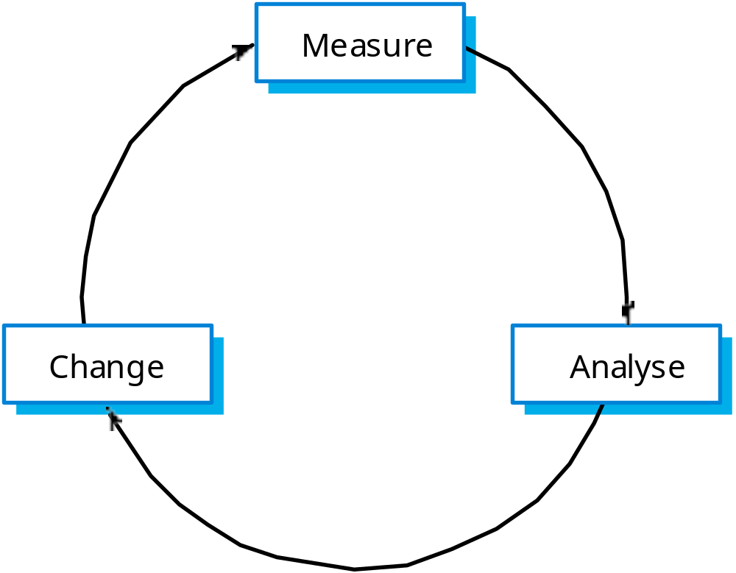
The process improvement cycle

Slide 3
Process improvement stages
Process measurement
  Attributes of the current process are measured. These are a baseline for assessing improvements.
Process analysis
  The current process is assessed and bottlenecks and weaknesses are identified.
Process change
  Changes to the process that have been identified during the analysis are introduced.

Slide 4
Process and product quality
Process quality and product quality are closely
related and process improvement benefits arise because the quality of the product depends on its development process.
A good process is usually required to produce a
good product.
For manufactured goods, process is the
principal quality determinant.
For design-based activity, other factors are also involved especially the capabilities of the designers.

Slide 5
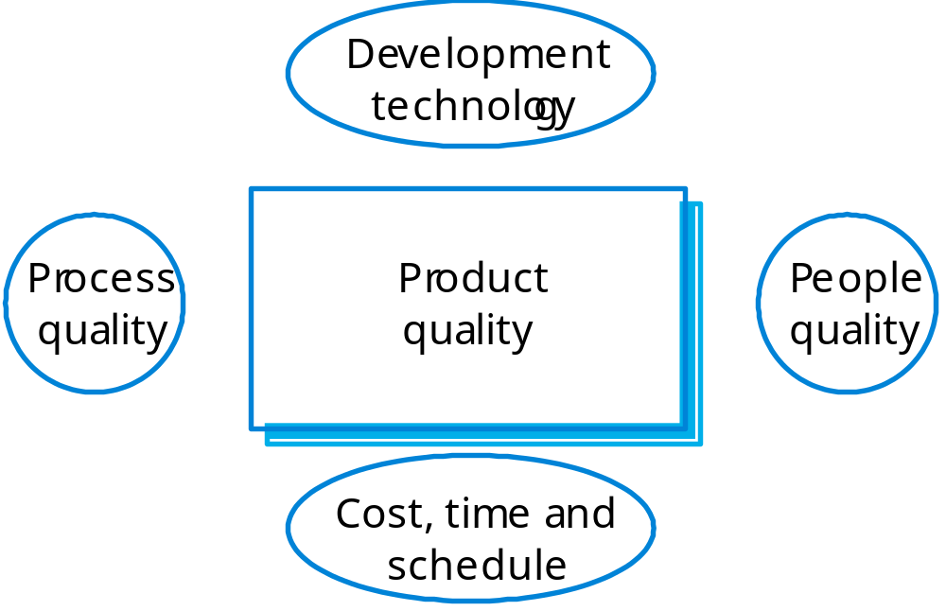
Principal product quality factors

Slide 6
Quality factors
For large projects with ‘average’ capabilities, the development process determines product quality.
For small projects, the capabilities of the developers is the main determinant.
The development technology is particularly significant for small projects.
In all cases, if an unrealistic schedule is imposed then product quality will suffer.

Slide 7
Goal-Question-Metric Paradigm
Goals
  What is the organisation trying to achieve? The objective of process improvement is to satisfy these goals.
Questions
  Questions about areas of uncertainty related to the goals. You need process knowledge to derive these.
Metrics
  Measurements to be collected to answer the questions.

Slide 8
Process change stages
Improvement identification.
Improvement prioritisation.
Process change introduction.
Process change training.
Change tuning.

Slide 9
The CMMI framework
The CMMI framework is the current stage of work on process assessment and improvement that started at the Software Engineering Institute in the 1980s.
The SEI’s mission is to promote software technology transfer particularly to US defence contractors.
It has had a profound influence on process improvement
  Capability Maturity Model introduced in the early 1990s.
  Revised maturity framework (CMMI) introduced in 2001.

Slide 10
Process capability assessment
Intended as a means to assess the extent to which an organisation’s processes follow best practice.
My providing a means for assessment, it is possible to identify areas of weakness for process improvement.
There have been various process assessment and improvement models but the SEI work has been most influential.

Slide 11
The SEI capability maturity model
Initial
  Essentially uncontrolled
Repeatable
  Product management procedures defined and used
Defined
  Process management procedures and strategies defined
  and used
Managed
  Quality management strategies defined and used
Optimising
  Process improvement strategies defined and used

Slide 12
The CMMI model
An integrated capability model that includes software and systems engineering capability assessment.
The model has two instantiations
  Staged where the model is expressed in terms of capability levels;
  Continuous where a capability rating is computed.

Slide 13
CMMI model components
Process areas
  24 process areas that are relevant to process capability and improvement are identified. These are organised into 4 groups.
Goals
  Goals are descriptions of desirable organisational states. Each process area has associated goals.
Practices
  Practices are ways of achieving a goal - however, they are advisory and other approaches to achieve the goal may be used.

Slide 14
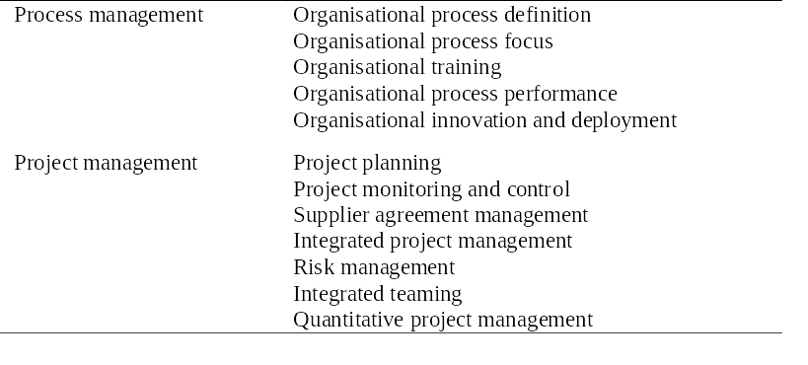
CMMI process areas 1

Slide 15
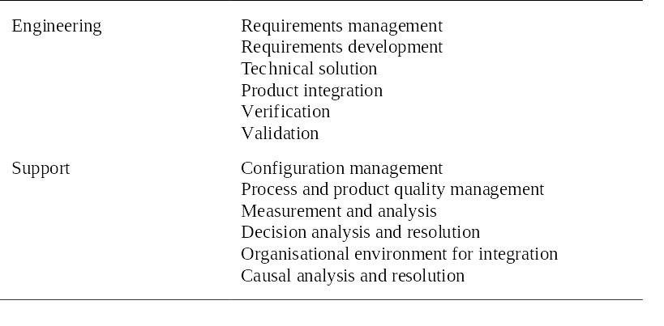
CMMI process areas 2

Slide 16
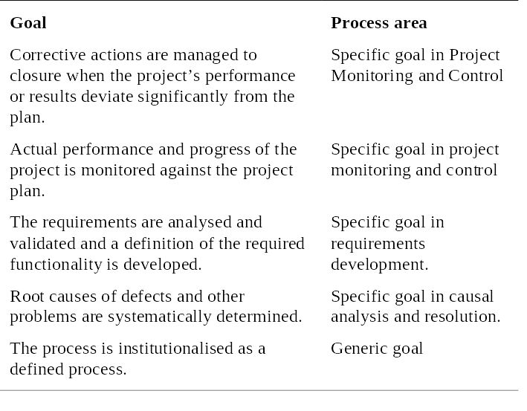
CMMI goals

Slide 17
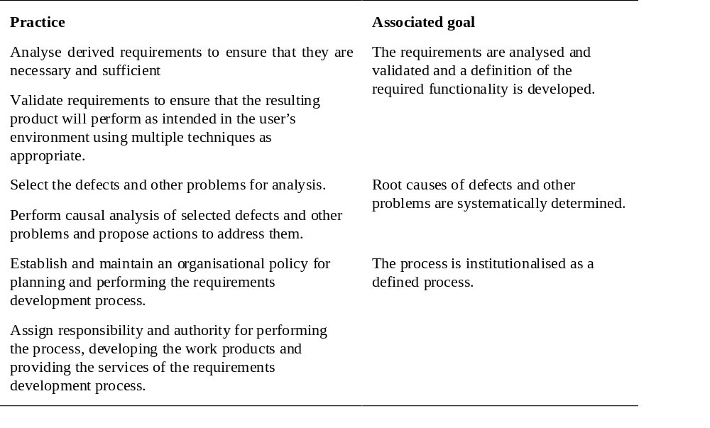
CMMI practices

Slide 18
CMMI assessment
Examines the processes used in an organisation and assesses their maturity in each process area.
Based on a 6-point scale:
  Not performed;
  Performed;
  Managed;
  Defined;
  Quantitatively managed;
  Optimizing.

Slide 19
The staged CMMI model
Comparable with the software CMM.
Each maturity level has process areas and goals. For example, the process area associated with the managed level include:
  Requirements management;
  Project planning;
  Project monitoring and control;
  Supplier agreement management;
  Measurement and analysis;
  Process and product quality assurance.

Slide 20
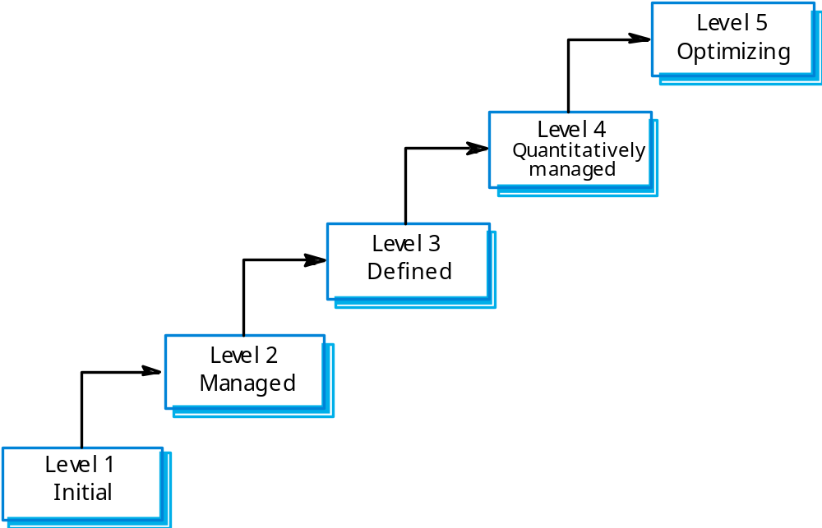
The staged CMMI model

Slide 21
Institutional practices
Institutions operating at the managed level should have institutionalised practices that are geared to standardisation.
  Establish and maintain policy for performing the project management process;
  Provide adequate resources for performing the project management process;
  Monitor and control the project planning process;
  Review the activities, status and results of the project planning process.

Slide 22
The continuous CMMI model
This is a finer-grain model that considers individual or groups of practices and assesses their use.
The maturity assessment is not a single value but is a set of values showing the organisations maturity in each area.
The CMMI rates each process area from levels 1 to 5.
The advantage of a continuous approach is that organisations can pick and choose process areas to improve according to their local needs.

Slide 23
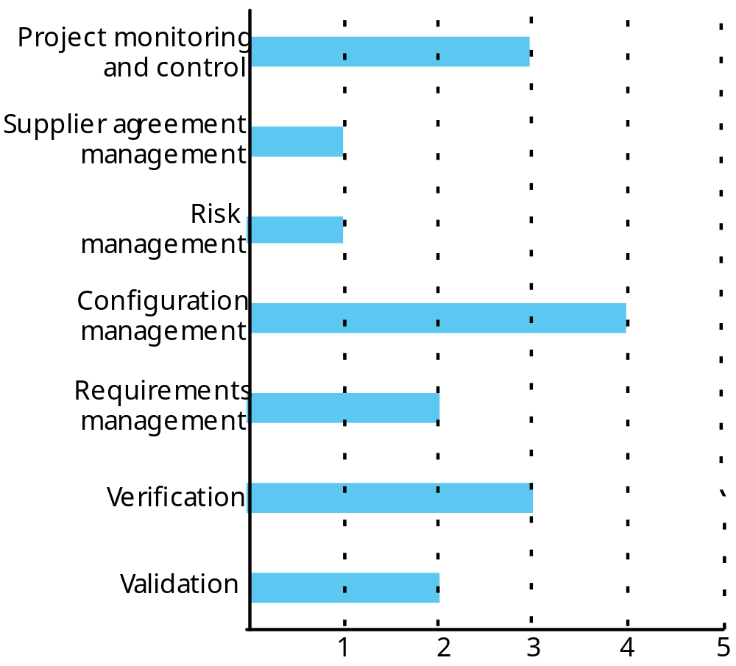
A process capability profile

