Slide 1
BBG2
Algorithms
Components of an Algorithm
Instructor: M.Fatih AMASYALI
E-mail:mfatih@ce.yildiz.edu.tr

Slide 2
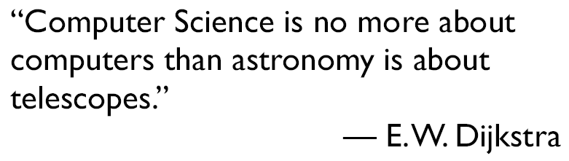

Slide 3
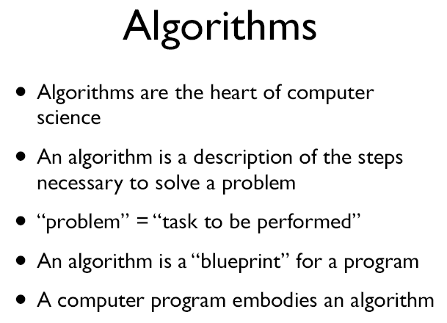

Slide 4
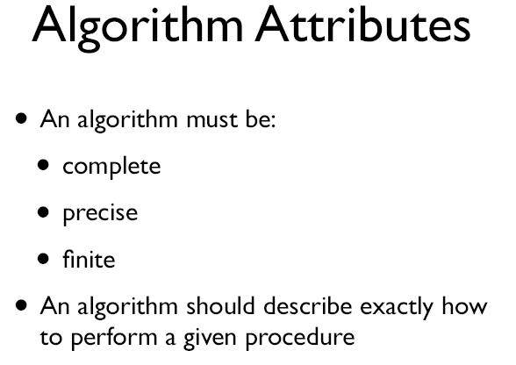

Slide 5
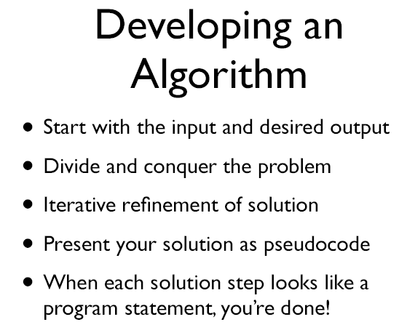

Slide 6
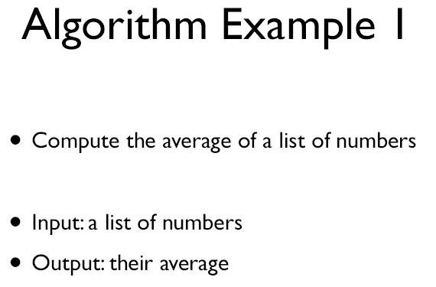

Slide 7
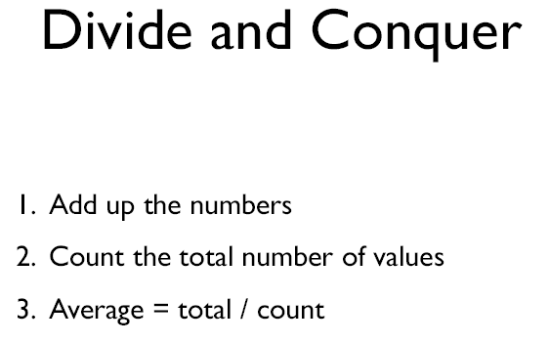

Slide 8
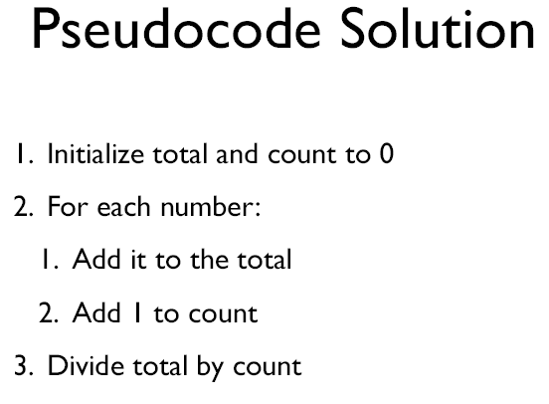

Slide 9
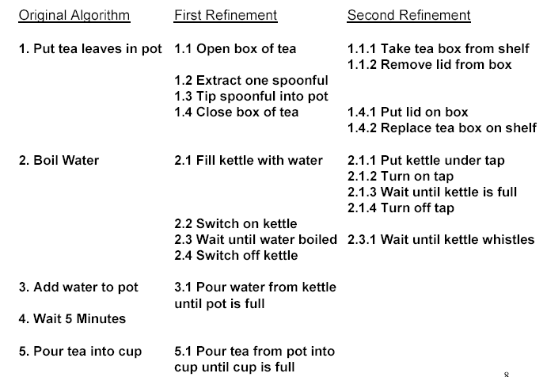
Making a tea

Slide 10
Components of an Algorithm
Values and Variables
Instruction (a.k.a. primitive)
  Sequence (of instructions)
  Procedure (involving instructions)
  Selection (between instructions)
  Repetition (of instructions)
Documentation (beside instructions)

Slide 11

Variables
Are containers for values – places to store
values
Example:
Variable
Values
10 cookies
50 grams of sugar
3 slices of cake
etc.
This jar
can contain
Notes:
One form: strain the juices, put aside and let cool …(further instruction)… now add the reserved mix
In mathematics much more precisely: Call the sum of all items X. Call the number of items N… divide X by N

Slide 12
Restrictions on Variables
Variables may be restricted to contain a specific type of value

Slide 13
Instructions (Primitives)
Some action that is
  simple
  unambiguous
  that the system knows about...
  ...and should be able to actually do

Slide 14


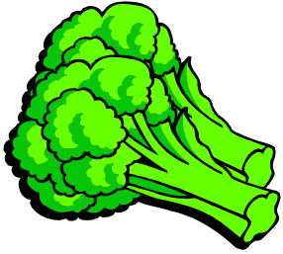




Instructions -- Application
Some instructions can only be applied to a specific type of values or variables
Examples:

Slide 15
Sequence
A series of instructions
...to be carried out one after the other...
...without hesitation or question

Slide 16
Procedure
A named sequence of instructions
So that you can
  Refer to it collectively (by name)
  ...instead of individually (by each instruction in the sequence)
Example:
  Drive_To_Uni

Slide 17
Procedure -- Example
procedure Drive_To_Uni
{
1. find car keys
2. disable car alarm
3. open car door
4. get in car
5. shut car door
6. put keys in ignition
7. start car
8. back car out of
driveway
9. drive to end of street
10. turn right
11. drive to end of street
12. turn left
...etc...etc...etc
...etc...etc...etc...
52. find parking space
53. pull into parking
space
54. turn off engine
55. remove keys from
ignition
56. open car door
57. get out
58. shut car door
59. lock car door
60. enable alarm
}

Slide 18
Procedure – Example (cont)
procedure Do_Wednesday
{
Wake_up
Have_Shower
Eat_Breakfast
Drive_To_Uni
Sit_1301_Lecture
...etc...etc...etc...
Drive_From_Uni
...etc...etc...etc...
}
procedure Do_Week
{
Do_Monday
Do_Tuesday
Do_Wednesday
Do_Thursday
...etc...etc...etc...
}

Slide 19
Procedure – Example (cont)
procedure Do_Wednesday
{
Wake_up
Have_Shower
Eat_Breakfast
Drive_To_Uni
Sit_1301_Lecture
...etc...etc...etc...
Drive_From_Uni
...etc...etc...etc...
}
In this subject, we also use the following words to refer to a “Procedure” :
Sub-routine
Module
Function

Slide 20
Procedure – Example (cont)
procedure Do_Wednesday
{
Wake_up
Have_Shower
Eat_Breakfast
Drive_To_Uni
Sit_1301_Lecture
...etc...etc...etc...
Drive_From_Uni
...etc...etc...etc...
}
We use brackets to mark the beginning and end of a sequence.

Slide 21
Procedure – Example (cont)
procedure Do_Wednesday
{
Wake_up
Have_Shower
Eat_Breakfast
Drive_To_Uni
Sit_1301_Lecture
...etc...etc...etc...
Drive_From_Uni
...etc...etc...etc...
}
An instruction invoking a procedure is known as a “procedure call”

Slide 22
Procedure
A procedure may have a set of parameters
procedure customerService ( myName ,timeOfDay )
{
say “Good timeOfDay”
say “My name is myName”
say “How can I help you?”
}
customerService ( “Ann”, “Morning” )
customerService (“Ann”, “Afternoon” )
customerService ( “Jeff”, “Afternoon” )

Slide 23
Selection
An instruction that decides which of two possible sequences is executed
The decision is based on a single true/false condition
Example:
  Car repair

Slide 24
Selection Example -- Car Repair
if (motor turns)
then
{
CheckFuel
CheckSparkPlugs
CheckCarburettor
}
else
{
CheckDistributor
CheckIgnitionCoil
}

Slide 25
Selection Example –
Car Repair (cont)
if (motor turns)
then
{
CheckFuel
CheckSparkPlugs
CheckCarburettor
}
else
{
CheckDistributor
CheckIgnitionCoil
}
Should be a true or false condition.

Slide 26
Selection Example --
Car Repair (cont)
if (motor turns)
then
{
CheckFuel
CheckSparkPlugs
CheckCarburettor
}
else
{
CheckDistributor
CheckIgnitionCoil
}
Sequence if the condition is true.

Slide 27
Selection Example --
Car Repair (cont)
if (motor turns)
then
{
CheckFuel
CheckSparkPlugs
CheckCarburettor
}
else
{
CheckDistributor
CheckIgnitionCoil
}
Sequence if the condition is false.

Slide 28
Selection -- Exercise
Will the following algorithms produce the same output?
Algorithm 1:
Algorithm 2:
input Num
if (Num is not equal 0)
then
{
output 1/Num
}
else
{
output "infinity"
}
input Num
if (Num is not equal 0)
then
{
output 1/Num
}
output "infinity"

Slide 29
Selection – Several Conditions
What if several conditions need to be satisfied?
if ( today is Wednesday and the time is 10.00am )
then
{
Go to CSE1301 Lecture
}
else
{
Go to Library
}
Solution 1

Slide 30
Selection – Several Conditions (cont)
if ( today is Wednesday )
then
{
if ( the time is 10.00am )
then
{
Go to CSE1301 Lecture
}
}
else
...etc...etc...etc...
Often called a “nested selection”
Solution 2

Slide 31
Selection – At Least One of Several Conditions
What if at least one of several conditions needs to be satisfied?
if ( I feel hungry or the time is 1.00pm or my mate has his eye on my lunch )
then
{
Eat my lunch now
}

Slide 32
Repetition
Repeat an instruction...
  ...while (or maybe until) some true or false condition occurs
  Test the condition each time before repeating the instruction
Also known as iteration or loop
Example:
  Algorithm for getting a date

Slide 33
Repetition -- Example
procedure AskOnDate ( name, time, location )
{
Phone(name)
Say("Hey", name, "it's your lucky day!")
Say("Wanna come to", location, "at", time, "?")
ListenToReply ( )
start begging count at zero
while (reply is "No" and begging count < 100)
{
Say("Oh please!")
add 1 to begging count
ListenToReply ( )
}
}

Slide 34
Repetition – Example (cont)
procedure AskOnDate ( name, time, location )
{
Phone(name)
Say("Hey", name, "it's your lucky day!")
Say("Wanna come to", location, "at", time, "?")
ListenToReply ( )
start begging count at zero
while ( reply is "No" and begging count < 100 )
{
Say("Oh please!")
add 1 to begging count
ListenToReply ( )
}
}
Condition is tested before sequence

Slide 35
Repetition – Example (cont)
Ensure initial values of variables used in the conditions are set correctly
procedure AskOnDate ( name, time, location )
{
Phone(name)
Say("Hey", name, "it's your lucky day!")
Say("Wanna come to", location, "at", time, "?")
ListenToReply ( )
start begging count at zero
while (reply is "No" and begging count < 100)
{
Say("Oh please!")
add 1 to begging count
ListenToReply ( )
}
}

Slide 36
Repetition – Example (cont)
procedure AskOnDate ( name, time, location )
{
Phone(name)
Say("Hey", name, "it's your lucky day!")
Say("Wanna come to", location, "at", time, "?")
ListenToReply ( )
start begging count at zero
while (reply is "No" and begging count < 100)
{
Say("Oh please!")
add 1 to begging count
ListenToReply ( )
}
}
Ensure the variables used in the conditions are updated in each iteration

Slide 37
Repetition – Example (cont)
What if we don’t increment the begging count?
procedure AskOnDate ( name, time, location )
{
Phone(name)
Say("Hey", name, "it's your lucky day!")
Say("Wanna come to", location, "at", time, "?")
ListenToReply ( )
start begging count at zero
while (reply is "No" and begging count < 100)
{
Say("Oh please!")
}
}
Infinite loop

Slide 38
Documentation
Records what the algorithm does
Describes how it does it
Explains the purpose of each component of the algorithm
Notes restrictions or expectations

Slide 39
The Software Development Process
Define the problem clearly
Analyse the problem thoroughly
Design an algorithm carefully
Code the algorithm efficiently
Test the code thoroughly
Document the system lucidly

Slide 40
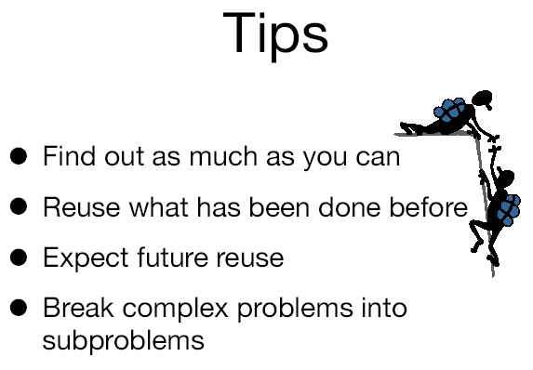

Slide 41
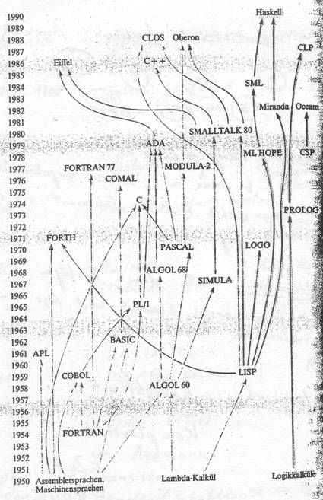
Family Tree of
Programming
Languages

Slide 42
Our Flow Chart
Start-stop
START
END
if
instruction blocks
for
while
write
read

Slide 43
Referance
http://gmm.fsksm.utm.my/~dzul/NoteC/

