Slide 1
Programming Languages -1
(Introduction to C) functions
Instructor: M.Fatih AMASYALI
E-mail:mfatih@ce.yildiz.edu.tr

Slide 2
A little bit about Functions
Should perform a well-defined task
Why?
Programs should be written as collections of small functions. This makes programs easier to write, debug, maintain and modify.
Code can be re-used, not just within one program but in others.
Recursion easier to do

Slide 3
More on functions
Function definition format
    return-value-type function-name( parameter-list )
    {
    declarations and statements
    }
  e.g. int factorial(int n)
  e.g. void execute_loop(char c, float f)
Call as:
  i=factorial(3);
  execute_loop(townInitial, distance);
Defining a function inside another function is a syntax error.
Functions with void type return can not be used in expressions. T=f( ); if (f( )<3) are not valid.

Slide 4
Example: A simple function
#include <stdio.h>
#include <conio.h>
int max( int a, int b );
int main()
{
int i = 8, j = 17;
printf( "Maximum of %d and %d is %d\n", i, j, max(i, j));
getch();
return(0);
}
int max( int a, int b )
{
if( a > b ) return a;
else return b;
}

Slide 5
Functions with input parameters
Parameters are by default input parameters and passed by value.
Output:
Triangular number 10 is 55
Triangular number 20 is 210
Triangular number 50 is 1275
#include <stdio.h>
void calculate_triangular_number(int n)
{
int i, triangular_number = 0;
for (i = 1; i <= n; i++)
triangular_number+=i;
printf("Triangular number %d is %d\n", n, triangular_number);
}
int main(void)
{
calculate_triangular_number(10);
calculate_triangular_number(20);
calculate_triangular_number(50);
return 0;
}
Calculating a triangular number, that is summing integers 1 to n.

Slide 6
Functions can return a single result
Which one is better? The previous one or this one?
#include <stdio.h>
int calculate_triangular_number(int n)
{
int i, triangular_number = 0;
for (i = 1; i <= n; i++)
triangular_number+=i;
return triangular_number;
}
int main(void)
{
printf(“Triangular number %d is %d\n”, 10, calculate_triangular_number(10));
printf(“Triangular number %d is %d\n”, 20, calculate_triangular_number(20));
printf(“Triangular number %d is %d\n”, 50, calculate_triangular_number(50));
return 0;
}
Output:
Triangular number 10 is 55
Triangular number 20 is 210
Triangular number 50 is 1275

Slide 7
Example 2 (Call by value)
What does it print?
A parameter of the function can be a constant, expression, variable etc. (anything that has a value!)
Only the value is passed (not variable!)
#include <stdio.h>
void printDouble( int x )
{
printf(“Double of %d”, x);
x *= 2;
printf(“is %d\n”, x);
}
int main()
{
int i = 13;
printDouble(i);
printf(“i=%d\n”, i);
}

Slide 8
Example: badswap.c
/* Swap the values of two variables. */
void badSwap ( int a, int b )
{
int temp;
temp = a;
a = b;
b = temp;
printf("%d %d\n", a, b);
}
int main(void)
{
int a = 3, b = 5;
printf("%d %d\n",a,b);
badSwap ( a, b );
printf("%d %d\n",a,b);
return 0;
}
Output:
3 5
5 3
3 5

Slide 9
Calling Functions: Call by Value
    int addone(int x)
    {
    return ++x;
    }
    int main ()
    {
    int i = 5, j;
    j=addone(i);
    printf(“%d %d\n”,i, j); 5 6
    }
    What if
    return ++x changes to
    return x++

Slide 10
Calling Functions: Call by Reference
(Passing Address)
    int addone(int *x)
    {
    return ++(*x);
    }
    int main ()
    {
    int i = 5, j;
    j=addone(&i);
    printf(“%d %d\n”,i, j); 6 6
    }

Slide 11
Function OverLoading
int byap (int a,int b)
{
return a+b;
}
int byap(int a)
{
return 2*a;
}
int main(int argc, char*argv[])
{
printf("%d\n",byap(1,2));
printf("%d\n",byap(3));
getch();
return 0;
}

Slide 12
Prototyping of Functions
Must declare functions before use (like variables)
Declaration is called a “prototype”
Specifies the name, parameters and return type of the function, but not the code

Slide 13
Example: isNegative.c
#include <stdio.h>
int isNegative (int);
int main (void)
{
int number;
printf ("Enter an integer: ");
scanf ("%d",&number);
if (isNegative(number))
{
printf("Negative\n");
}
else
{
printf("Positive\n");
}
return 0;
}
int
isNegative ( int n )
{
int result;
if ( n<0 )
{
result=1;
}
else
{
result = 0;
}
return result;
}

Slide 14
Example: isNegative.c
Function Prototype, don’t forget semicolon
#include <stdio.h>
int isNegative (int);
int main (void)
{
int number;
printf ("Enter an integer: ");
scanf ("%d",&number);
if (isNegative(number))
{
printf("Negative\n");
}
else
{
printf("Positive\n");
}
return 0;
}
int
isNegative ( int n )
{
int result;
if ( n<0 )
{
result=1;
}
else
{
result = 0;
}
return result;
}

Slide 15
Example: isNegative.c
#include <stdio.h>
int isNegative (int);
int main (void)
{
int number;
printf ("Enter an integer: ");
scanf ("%d",&number);
if (isNegative(number))
{
printf("Negative\n");
}
else
{
printf("Positive\n");
}
return 0;
}
int
isNegative ( int n )
{
int result;
if ( n<0 )
{
result=1;
}
else
{
result = 0;
}
return result;
}
Function Definition

Slide 16
Example: isNegative.c
#include <stdio.h>
int isNegative (int);
int main (void)
{
int number;
printf ("Enter an integer: ");
scanf ("%d",&number);
if (isNegative(number))
{
printf("Negative\n");
}
else
{
printf("Positive\n");
}
return 0;
}
int
isNegative ( int n )
{
int result;
if ( n<0 )
{
result=1;
}
else
{
result = 0;
}
return result;
}
Function Call
(Must be after prototype, but can be before definition)

Slide 17
Example: isNegative.c
#include <stdio.h>
int isNegative (int);
int main (void)
{
int number;
printf ("Enter an integer: ");
scanf ("%d",&number);
if (isNegative(number))
{
printf("Negative\n");
}
else
{
printf("Positive\n");
}
return 0;
}
int
isNegative ( int n )
{
int result;
if ( n<0 )
{
result=1;
}
else
{
result = 0;
}
return result;
}
Header files (filename.h) contain function prototypes and global variable declarations

Slide 18
Example: isNegative.c
#include <stdio.h>
int isNegative (int);
int main (void)
{
int number;
printf ("Enter an integer: ");
scanf ("%d",&number);
if (isNegative(number))
{
printf("Negative\n");
}
else
{
printf("Positive\n");
}
return 0;
}
int
isNegative ( int n )
{
int result;
if ( n<0 )
{
result=1;
}
else
{
result = 0;
}
return result;
}
stdio.h contains function prototypes for printf(), scanf(), and other I/O functions

Slide 19
Header files
You can make your own header files with prototypes of frequently used functions:
  #include "myFunctions.h"
Put the functions in a corresponding C file, and include those too:
  #include "myFunctions.c"

Slide 20
Example: isNegative.c
#include <stdio.h>
#include "myFunctions.h"
#include "myFunctions.c"
int main (void)
{
int number;
printf ("Enter an integer: ");
scanf ("%d",&number);
if (isNegative(number))
{
printf("Negative\n");
}
else
{
printf("Positive\n");
}
return 0;
}
Note:
" " around file name for user-defined files
< > for standard system files
isNegative() is declared in myFunctions.h and defined in myFunctions.c, not in this file!

Slide 21
Example: myFunctions.c
Example: myFunctions.h
int
isNegative ( int n )
{
int result;
if ( n<0 )
{
result=1;
}
else
{
result = 0;
}
return result;
}
int isNegative ( int );

Slide 22
Scope: Local Variables
Variables declared in a function body: only accessible whilst function executing
In fact, this is true of every block in a program

Slide 23
Example: isNegative.c
#include <stdio.h>
int
isNegative ( int n )
{
int result;
if (number<0)
{
result=1;
}
else
{
result = 0;
}
return result;
}
int main (void)
{
int number;
printf ("Enter an integer: ");
scanf ("%d",&number);
if (isNegative(number))
{
printf("Negative\n");
}
else
{
printf("Positive\n");
}
return 0;
}

Slide 24
Example: isNegative.c
#include <stdio.h>
int
isNegative ( int n )
{
int result;
if (number<0)
{
result=1;
}
else
{
result = 0;
}
return result;
}
int main (void)
{
int number;
printf ("Enter an integer: ");
scanf ("%d",&number);
if (isNegative(number))
{
printf("Negative\n");
}
else
{
printf("Positive\n");
}
return 0;
}
ERROR! Number is local to the main function, not accessible here

Slide 25
Example: isNegative.c
#include <stdio.h>
int
isNegative ( int n )
{
int result;
if ( n<0 )
{
result=1;
}
else
{
result = 0;
}
return result;
}
int main (void)
{
int number;
printf ("Enter an integer: ");
scanf ("%d",&number);
if (isNegative(number))
{
printf("Negative\n");
}
else
{
printf("Positive\n");
}
return 0;
}
Use the parameter n which is local to the function isNegative()

Slide 26
Example: isNegative.c
#include <stdio.h>
int
isNegative ( int n )
{
int result;
if ( n<0 )
{
result=1;
}
else
{
result = 0;
}
return result;
}
int main (void)
{
int number;
printf ("Enter an integer: ");
scanf ("%d",&number);
if (isNegative(number))
{
printf("Negative\n");
}
else
{
printf("Positive\n");
}
return 0;
}
result & n: local to isNegative()
number: local to main()

Slide 27
Scope: Global Variables
Global variables are accessible in any function after their declaration to the end of that source file
They're useful, but risky
  if any and every function can modify them, it can be difficult to keep track of their value
Better to use local variables and parameter passing if possible

Slide 28
Example: isNegativeGlobal.c
#include <stdio.h>
int number;
int
isNegative ( void )
{
int result;
if ( number <0 )
{
result=1;
}
else
{
result = 0;
}
return result;
}
int main (void)
{
printf ("Enter an integer: ");
scanf ("%d",&number);
if (isNegative())
{
printf("Negative\n");
}
else
{
printf("Positive\n");
}
return 0;
}

Slide 29
Example: isNegativeGlobal.c
#include <stdio.h>
int number;
int
isNegative ( void )
{
int result;
if ( number <0 )
{
result=1;
}
else
{
result = 0;
}
return result;
}
int main (void)
{
printf ("Enter an integer: ");
scanf ("%d",&number);
if (isNegative())
{
printf("Negative\n");
}
else
{
printf("Positive\n");
}
return 0;
}
number is now GLOBAL - declared outside any function, accessible in all functions (after the declaration)

Slide 30
Recursive functions
Functions that call themselves either directly or indirectly (through another function) is called a recursive function.
If a function is called with a simple case, the function actually knows how to solve the simplest case(s) - “base case” and simply returns a result.
If a function is called with a complex case - “recursive case” , it invokes itself again with simpler actual parameters.
Always specify the base case; otherwise, indefinite recursive will occur and cause “stack-overflow” error.

Slide 31
Recursive functions
      1. must resembles original problem but slightly simplified
      2. function will call itself (recursion step or recursive call) to solve slightly simplified problem
      3. process continues until the last recursive call is with the base case
      4. that call returns the result of the base case
      5. return to previous calling functions
      6. finally reaches main.c.

Slide 32
Recursion vs. Iteration
int main(int argc, char* argv[])
{
int N,top=0;
scanf("%d",&N);
for (int i=1 ;i<=N;i++)
top+=i;
printf("top=%d",top);
return 0;
}
int top(int x)
{
if (x==1) return 1;
else return x+top(x-1);
}
int main(int argc, char* argv[])
{
int N;
scanf("%d",&N);
printf("top=%d",top(N));
return 0;
}

Slide 33
Recursion vs. Iteration
Recursion:
#include <stdio.h>
int x_pow_y(int, int);
main()
{
printf(“enter x and y: \n”);
scanf(“%d, %d”, x, y);
z = x_pow_y(x,y);
printf(“z: %d\n”, z);
}
x_pow_y(int a, int b)
{
if (b==1)
return a;
else
return (a * x_pow_y(a, b-1))
}
Iteration:
x_pow_y = 1;
  for (i = y; i >=1; i--)
  x_pow_y*=x;
If x = 5, y = 4
x_pow_y = 1, x = 5, y = 4, i = 4;
1.) x_pow_y = 5*1 = 5, i = 3;
2.) x_pow_y = 5*5 = 25, i = 2;
3.) x_pow_y = 25*5 = 125, i = 1;
4.) x_pow_y = 125*5 = 625, i = 0;
x_pow_y(5,4)
x_pow_y(5,3)
x_pow_y(5,2)
x_pow_y(5,1)
…
x=5;
y=4;
x_pow_y(5,4);
…
is (4==1)?
↓
no
…
is (3==1)?
↓
no
…
is (2==1)?
↓
no
…
is (1==1)?
↓
yes
↓
return 5
625
125
25
5
main
Base Case

Slide 34
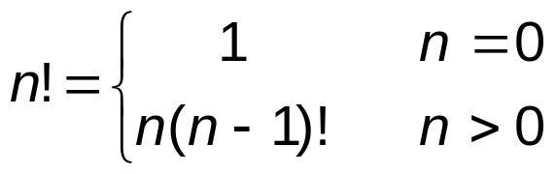
Example Using Recursion: Factorial
Example: factorials: 5! = 5 * 4 * 3 * 2 * 1
  Notice that
    5! = 5 * 4!
    4! = 4 * 3! …
  Can compute factorials recursively
  Solve base case (1! = 0! = 1) then plug in
    2! = 2 * 1! = 2 * 1 = 2;
    3! = 3 * 2! = 3 * 2 = 6;
    long factorial(int n)
    {
      if (n <= 1)
      return 1;
      else
      return n * factorial(n-1);
    }

Slide 35
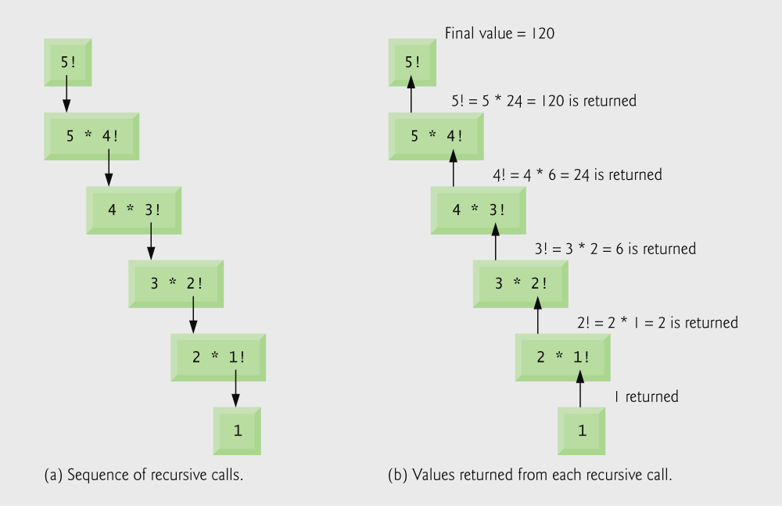
Example Using Recursion: Factorial

Slide 36
Example Using Recursion:
The Fibonacci Series
Example: Fibonacci series:
  F_{k} = F_{k-1} + F_{k-2}, F₀ = 1, F₁ = 1 ex: 0, 1, 1, 2, 3, 5, 8…
  Each number is the sum of the previous two
  Can be solved recursively:
    fib( n ) = fib( n - 1 ) + fib( n – 2 )
  Set of recursive calls to function fibonacci
  Code for the fibonacci function
    long fibonacci(long n)
    {
    if (n <= 1)
      return n;
      else;
      return fibonacci(n-1) + fibonacci(n-2);
    }
f( 3 )
return
f( 2 )
+
f( 1 )
return
f( 1 )
+
f( 0 )
return 1
return 1
return 0

Slide 37
#include <stdio.h>
#include <conio.h>
long fibonacci (long);
long fibonacci (long x)
{
if (x==1 || x==0)
return x;
else
return fibonacci(x-2)+fibonacci(x-1);
}
int main (void)
{
long number,fib;
printf ("Enter an integer: ");
scanf ("%ld",&number);
fib=fibonacci(number);
printf ("Fibonacci(%ld) = %ld",number,fib);
getch();
return 0;
}
Enter an integer: 0
Fibonacci(0) = 0
Enter an integer: 1
Fibonacci(1) = 1
Enter an integer: 2
Fibonacci(2) = 1
Enter an integer: 3
Fibonacci(3) = 2
Enter an integer: 4
Fibonacci(4) = 3
Enter an integer: 5
Fibonacci(5) = 5
Enter an integer: 6
Fibonacci(6) = 8
Enter an integer: 10
Fibonacci(10) = 55
Enter an integer: 20
Fibonacci(20) = 6765
Enter an integer: 30
Fibonacci(30) = 832040
Enter an integer: 35
Fibonacci(35) = 9227465

Slide 38
Recursion vs. Iteration
Both are based on the control structures
  Repetition (Iteration): explicitly uses repetition (loop).
  Recursion: implicitly use repetition by successive function calls
Both involve termination
  Iteration: loop condition fails
  Recursion: base case recognized
Both can lead infinite loops
  Loop termination is not met
  Base case is not reached
Balance
  Choice between performance (iteration) and good software engineering (recursion)
A reason to choose recursion is that an iterative solution may not apparent

Slide 39
Math Library Functions
Math library functions
  perform common mathematical calculations
  #include <math.h>
Format for calling functions
  printf( "%.2f", sqrt( 900.0 ) );
    Calls function sqrt, which returns the square root of its argument
    All math functions return data type double
  Arguments may be constants, variables, or expressions

Slide 40
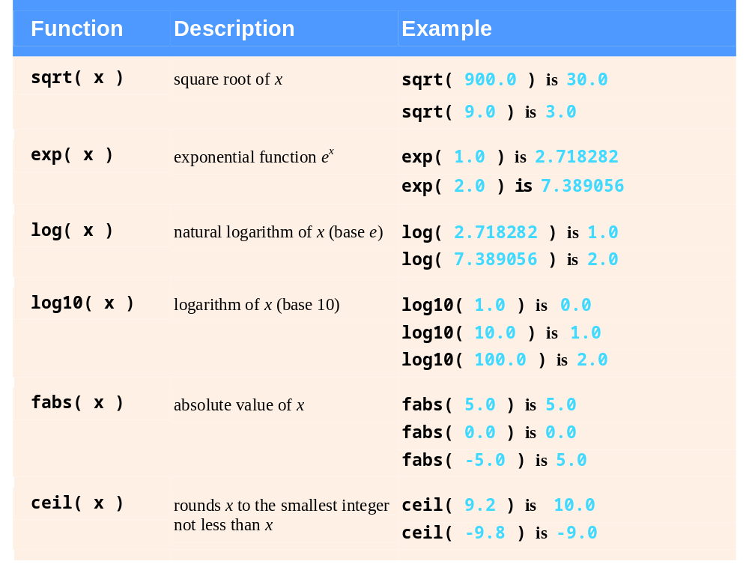

Slide 41
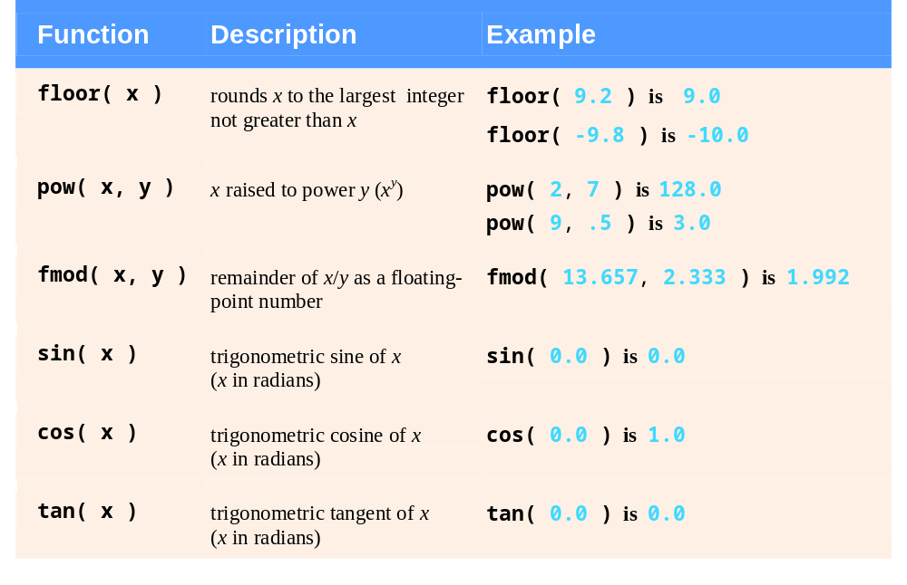

Slide 42
Random Number Generation
rand function
  Load <stdlib.h>
  Returns "random" number between 0 and RAND_MAX-1 (at least 32767)
      i = rand();
  Pseudorandom
    Preset sequence of "random" numbers
    Same sequence for every function call
Scaling
  To get a random number between 1 and n
      1 + ( rand() % n )
    rand() % n returns a number between 0 and n - 1
    Add 1 to make random number between 1 and n
      1 + ( rand() % 6)
      number between 1 and 6

Slide 43
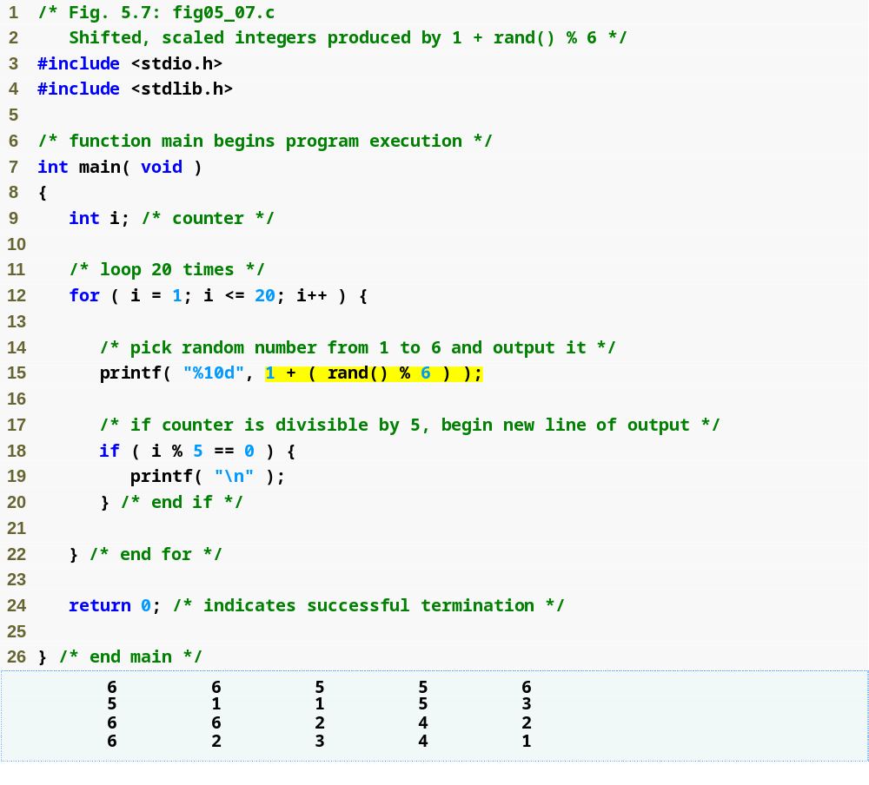
Generates a random number between 1 and 6

Slide 44
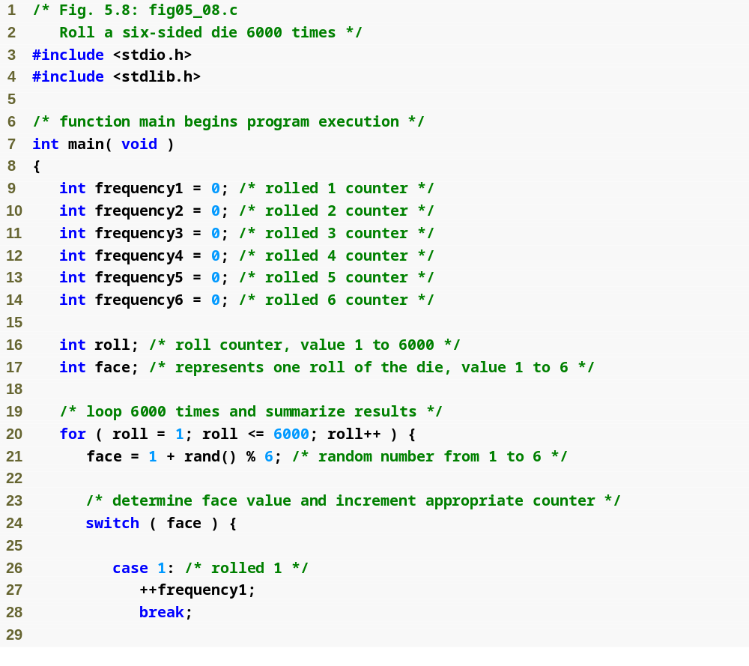

Slide 45
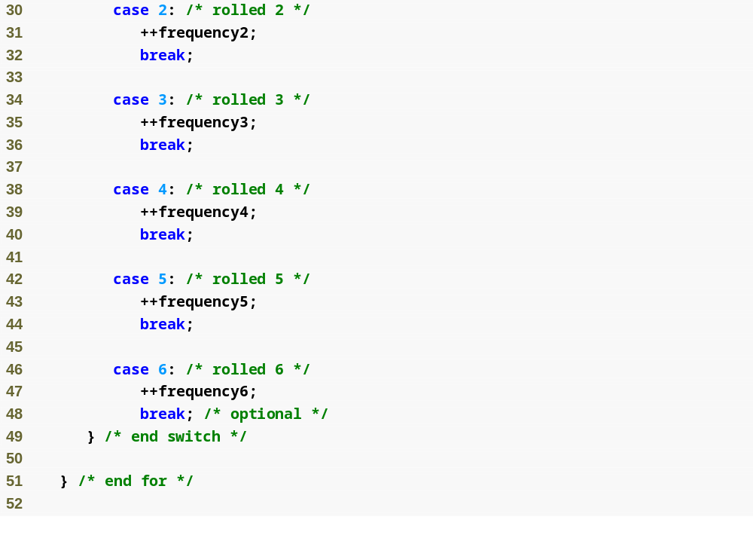

Slide 46
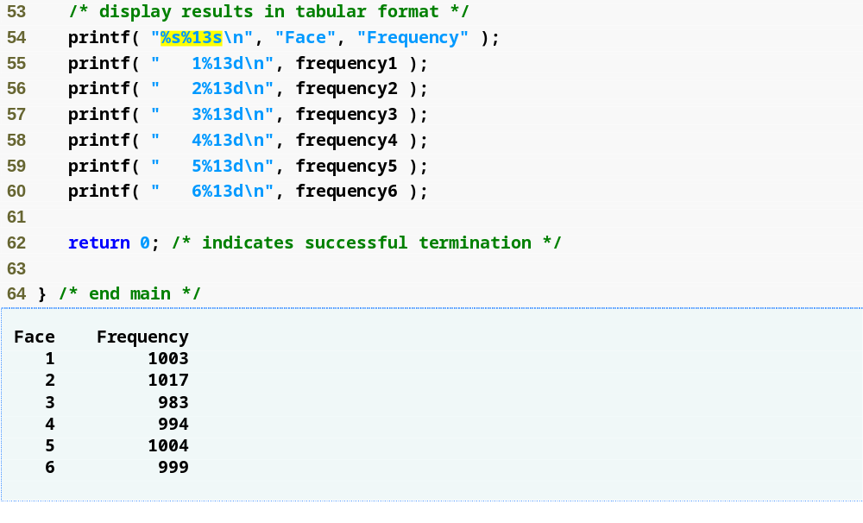

Slide 47
Random Number Generation
srand function
  <stdlib.h>
  Takes an integer seed and jumps to that location in its "random" sequence
    srand( seed );
  srand( time( NULL ) );/*load <time.h>*/
  time( NULL )
      Returns the number of seconds that have passed since January 1, 1970
      “Randomizes" the seed

Slide 48
Random Number Generation
#include <stdio.h>
#include <conio.h>
#include <stdlib.h>
#include <time.h>
int main()
{
int i,j;
srand( (unsigned int)time( NULL ) );
for (i=1;i<=10;i++)
{
j=rand();
printf("%d ",j);
}
getch();
return 0;
}

Slide 49
Time
#include <stdio.h>
#include <conio.h>
#include <stdlib.h>
#include <time.h>
int main()
{
int i,j;
time_t t1,t2;
/* t1 degiskeninin adresi fonksiyona gonderiliyor. o adrese o anki zaman yaziliyor*/
time(&t1);
for (i=1;i<=300;i++)
for (j=1;j<=300;j++)
printf("%d %d %d\n",i, i*i, i*i*i);
time(&t2);
printf(“\n Time to do 300 squares and cubes= %d seconds\n", t2-t1);
getch();
return 0;
}

Slide 50
Symbolic Constants
#define LOWER 0
#define UPPER 100
#define <name> <replacement text>
Replaces each occurrence of <name> with <replacement text>
e.g. fahr = LOWER
becomes fahr = 0
Can also define: #define SQ(X) X*X

Slide 51
Symbolic Constants
#define REPL 5+1
#define SQ(X) X*X
#include <stdio.h>
int main()
{
printf("%d\n", SQ(REPL));
}
Output = 36? NO! It’s 11!!!
Why? SQ(REPL) becomes REPL*REPL which is 5+1*5+1

Slide 52
Referance
Ioannis A. Vetsikas, Lecture notes
Dale Roberts, Lecture notes

