Slide 1
Case Base Reasoning
M.Fatih AMASYALI
Uzman Sistemler Ders Notları

Slide 2
Case Base Reasoning (CBR)
CBR(problem) = solution
Problem Space
p₂
p₃
p?
p?
p₁
Solution Space
s₄
s₁
s₃
s₂

Slide 3
CBR
3 Approaches to Case Based Reasoning
Structural Approach
Textual Approach
Conversational Approach

Slide 4
Structural Approach
Predicate Logic Representation
Problem/Solution from a case can be represented through predicates:
predicate
term
Case:
Symptoms:
Case(
symptoms(frontLight(dw),
carType(GolfII_1.6),
year(1993),
batteries(13.6),…),
diagnosis(broken(fls),
measures(rfls)))
Front-light = doesn’t work
Car-type = Golf II, 1.6
Year = 1993
Batteries = 13.6V
…
Solution:
Diagnosis:
Front-lights-safeguard = broken
Help measures:
“Replace front lights safeguard”

Slide 5
Structural Approach
Format of the cases (XML):
<case>
<name>text</name>
<symptoms>
<attribute₁>value₁</attribute₁>
<attribute₂>value₂</attribute₂>
…
</symptoms>
<solution>
<attribute>value</attribute>
<helpMeasures>text</helpMeasures>
</solution>
</case>

Slide 6
Textual Approach
Cases recorded as free text
Large collection of documents
Easy Case Acquisition
Keyword Matching (detaylar sonda)
Example: Frequently Asked Questions

Slide 7
Conversational Approach:
CCBR Steps
Input of problem description Qd
Computation of similarity s(Q,C)
Display of solutions of top ranked cases, Ds and unanswered questions, Dq
Selection by user
Re-computation of similarity
Successful/Unsuccessful Termination

Slide 8
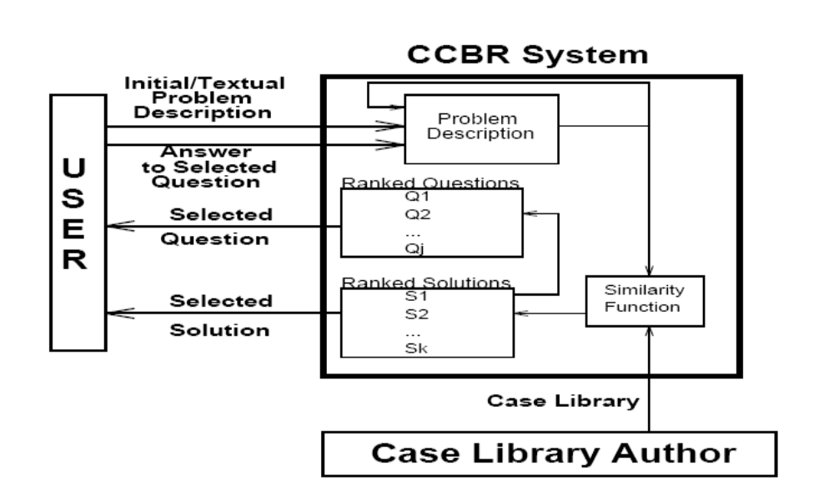
Generic CCBR problem solving process
Kullanıcı ya bir çözüm seçer
Ya da bir soru seçip cevaplar
Çözümü seçtiğinde işlem biter,
soru seçtiğinde cevaplar ve benzerlik tekrar hesaplanır.

Slide 9
Problem Description
Input: a collection of cases CB = {C₁, …C_{n}} and a new problem P
Output:
  The most similar case: A case C_{i} in CB such that sim(C_{i}, P) is minimal, or
  A collection of m most similar cases in CB {C_{i},…, C_{j}}, or
  A sufficiently similar case: case C_{i} in CB such that
  sim(C_{i}, P) > th
  where th is a predefined threshold

Slide 10
Sistemi iyileştirmek
Kullandıkça iyileşen bir sistemi nasıl tasarlarsınız?

Slide 11
DEFAULT KNOWLEDGE
A surprisingly powerful form of knowledge is "default knowledge." This is knowledge which is assumed to be true about an object unless specified otherwise. For example, a person object in a medical expert system may include default knowledge such as the following: Each person is assumed to have two arms, two eyes, two kidneys, two lungs, and so on. Only for persons who lack two of a specific organ or body part is it necessary to specify any additional information.

Slide 12
Computing Similarity
Similarity is the key concept in CBR

Slide 13
Meaning of Similarity
Observation 1: Similarity always concentrates on one aspect or task:
  There is no absolute similarity
  Example:
Two cars are similar if they have similar capacity (two compact cars may be similar to each other but not to a full-size car)
Two cars are similar if they have similar price (a new compact car may be similar to an old full-size car but not to an old compact car)

Slide 14
Meaning of Similarity (2)
Observation 2: Similarity is not always transitive:
  Example:
I define similar to mean “within walking distance”
“Lehigh’s book store” is similar to “Café Havana”
“Café Havana” is similar to “Perkins”
“Perkins” is similar to “Monrovia book store”
…
But: “Lehigh’s book store” is not similar to “Monrovia book store” !
The problem is that the property “small difference” cannot be propagated

Slide 15
Meaning of Similarity (3)
Observation 3: Similarity is not always symmetric:
  Example:
“Mike Tyson fights like a lion”
But do we really want to say that “a lion fights like Mike Tyson”?

Slide 16
Axioms for Similarity
There are 3 types of axioms:
  Binary similarity predicate “x and y are similar”
  Binary dissimilarity predicate “x and y are dissimilar”
  Similarity as order relation: “x is at least as similar to y as it is to z”
Observation:
  The first and the second are equivalent
  The third provides more information: grade of similarity

Slide 17
Similarity Metric
We want to assign a number to indicate the similarity between a case and a problem
Definition: A similarity metric over a set M is a function:
sim: M × M → [0,1]
Such that:
  For all x in M: sim(x,x) = 1 holds
  For all x, y in M: sim(x,y) = sim(y,x)
“ the closer the value of sim(x,y) to 1, the more similar is x to y”

Slide 18
Distance Metric
Definition: A distance function over a set M is a function:
d: M × M → [0,∞)
Such that:
  For all x in M: d(x,x) = 0 holds
  For all x, y in M: d(x,y) = d(y,x)
Definition: A distance function over a set M is a metric if:
  For all x, y in M: d(x,y) = 0 holds then x = y
  For all x, y, z in M: d(x,z) + d(z,y) ≥ d(x,y)

Slide 19
Relation between Similarity and Distance Metric (3)
F(x) can be used to construct sim giving d. Example of such a function is:
    if you have the Euclidean distance:
d((x,y),(u,v)) = sqr((x-u)² + (y-v)²)
    Since f(x) = 1 – (x/(x+1)) meets the property before
    Then:
    sim((x,y),(u,v))) = f(d((x,y),(u,v)))
    = 1 – (d((x,y),(u,v)) /(d((x,y),(u,v)) +1))
    is a similarity metric

Slide 20
Relation between Similarity and Distance Metric (3)
The function f(x) = 1 – (x/(x+1)) is a bijective function from [0,∞) into (0,1]:
1
0
Find another order-inverting function and prove it?

Slide 21
Other Similarity Metrics
Suppose that we have cases represented as attribute-value pairs (e.g., the restaurant domain)
Suppose initially that the values are binary
We want to define similarity between two cases of the form:
X = (X₁, …, X_{n}) where X_{i} = 0 or 1
Y = (Y₁, …,Y_{n}) where Y_{i} = 0 or 1

Slide 22
Preliminaries
Let:
  A = ∑_{(i=1,n)}X_{i}•Y_{i}
  B = ∑_{(i=1,n)}X_{i}•(1-Y_{i})
  C = ∑_{(i=1,n)}(1-X_{i})•Y_{i}
  D = ∑_{(i=1,n)}(1-X_{i}) •(1-Y_{i})
  Then, A + B + C + D =
(number of attributes for which X_{i} =1 and Y_{i} = 1)
(number of attributes for which X_{i} =1 and Y_{i} = 0)
(number of attributes for which X_{i} =0 and Y_{i} = 1)
(number of attributes for which X_{i} =0 and Y_{i} = 0)
n
A+D =
B+C=
“matching attributes”
“mismatching attributes”

Slide 23
Hamming Distance
H(X,Y) = n – ∑_{(i=1,n)}X_{i}•Y_{i} – ∑_{(i=1,n)}(1-X_{i})•(1-Y_{i})
Properties:
  Range of H:
  H counts the mismatch between the attribute values
  H is a distance metric:
  H((1-X₁, …, 1-X_{n}), (1-Y₁, …,1-Y_{n})) =
[0,n]
H(X,X) = 0
H(X,Y) = H(Y,X)
H((X₁, …, X_{n}), (Y₁, …,Y_{n}))

Slide 24
Simple-Matching-Coefficient (SMC)
# of mismatches
H(X,Y) =
n – (A + D) = B + C
Another distance-similarity compatible function is
  f(x) = 1 – x/max (where max is the maximum value for x)
Proportion of the difference
We can define the SMC similarity, sim_{H}:
sim_{H}(X,Y) = 1 – ((n – (A+D))/n) = (A+D)/n = 1- ((B+C)/n)

Slide 25
Variations of the SMC
The hamming similarity assign equal value to matches (both 0 or both 1)
There are situations in which you want to count different when both match with 1 as when both match with 0
  Thus, sim((1-X₁, …, 1-X_{n}), (1-Y₁, …,1-Y_{n})) =
  sim((X₁, …, X_{n}), (Y₁, …,Y_{n})) may not hold
  Example:
Two symptoms of patients are similar if they both have fever (X_{i} = 1 and Y_{i} = 1) but not similar if neither have fever (X_{i} = 0 and Y_{i} = 0)
Specific attributes may be more important than other attributes
Example: manufacturing domain: some parts of the workpiece are more important than others

Slide 26
Variations of SMC (III)
simH(X,Y) = (A+D)/n = (A+D)/(A+B+C+D)
We introduce a weight, α, with 0 < α < 1:
sim_{α}(X,Y) = (α(A+D))/ (α(A+D) + (1 - α)(B+C))
For which α is sim_{α}(X,Y) = sim_{H}(X,Y)?
α = 0.5
sim_{α}(X,Y) preserves the monotonic and symmetric conditions

Slide 27
The similarity depends only from A, B, C and D (3)
What is the role of α? What happens if α > 0.5? If α < 0.5?
sim_{α}(X,Y) = (α(A+D))/ (α(A+D) + (1 - α)(B+C))
If α > 0.5 we give more weights to the matching attributes than to the miss-matching
If α < 0.5 we give more weights to the miss-matching attributes than to the matching
1
α > 0.5
α = 0.5
α < 0.5
0
0
n

Slide 28
Discarding 0-match
Thus, sim((1-X₁, …, 1-X_{n}), (1-Y₁, …,1-Y_{n})) =
  sim((X₁, …, X_{n}), (Y₁, …,Y_{n})) may not hold
Only when the attribute occurs (i.e., X_{i} = 1 and Y_{i} = 1 ) will contribute to the similarity
Possible definition of the similarity:
sim = A / (A+ B+C)

Slide 29
Specific Attributes may be More Important Than Other Attributes
Significance of the attributes varies
Weighted Hamming distance:
There is a weight vector: (α₁, …, α_{n}) such that
∑_{(i=1,n)} α_{i} = 1
H_{W}(X,Y) = 1 – ∑_{(i=1,n)} α_{i} • X_{i}•Y_{i} – ∑_{(i=1,n)} α_{i} • (1-X_{i})•(1-Y_{i})
Example:
“Process planning: some features are more important than others”

Slide 30
Attributes May Have multiple Values
X = (X₁, …, X_{n}) where X_{i} ∈ T_{i}
Y = (Y₁, …,Y_{n}) where Y_{i} ∈ T_{i}
Each T_{i} is finite
a formula for the Hamming distance in this context ?

Slide 31
Tversky Contrast Model
Comparison of a situation S with a prototype P (i.e, a case)
S and P are sets of features
The following sets:
  A = S ∩ P
  B = P – S
  C = S – P
S
P
C
A
B

Slide 32
Tversky Contrast Model (2)
Tversky-distance:
Where f: → [0, ∞)
f, α, β, and γ are fixed and defined by the user
Example:
  If f(A) = # elements in A
  α = β = γ = 1
  T counts the number of elements in common minus the differences
T(P,S) = αf(A) - βf(B) - γf(C)

Slide 33
Kelimelerin Anlamsal Benzerliğini Bulma
İki temel yaklaşım
  Bağ sayma
    Taksonomi (kavramsal ağaç) yeterli.
  Ortak/ Müşterek bilgi (Mutual Information)
    Taksonomi ve corpus kullanır.
YILDIZ TEKNİK ÜNİVERSİTESİ
BİLGİSAYAR MÜHENDİSLİĞİ BÖLÜMÜ

Slide 34

Leacock & Chodorow (1998)
len(c1,c2) iki synset arasındaki en kısa yolun uzunluğu. (benzerlik değeriyle ters orantılı)
L, tüm taksonominin derinliği
YILDIZ TEKNİK ÜNİVERSİTESİ
BİLGİSAYAR MÜHENDİSLİĞİ BÖLÜMÜ

Slide 35

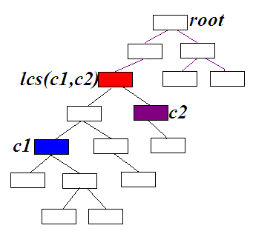
Wu & Palmer (1994)
N1 ve N2: c1 ve c2’nin en yakın ortak üst synset’lerine ( lcs(c1,c2) ) IS-A bağlarıyla uzaklıkları (benzerlik değeriyle ters orantılı)
N3, en yakın ortak üst synset’in kök synset’e IS-A bağlarıyla uzaklığı (büyüklüğü ortak üst synset’in spesifikliğini gösterir, benzerlikle doğru orantılı)
YILDIZ TEKNİK ÜNİVERSİTESİ
BİLGİSAYAR MÜHENDİSLİĞİ BÖLÜMÜ

Slide 36
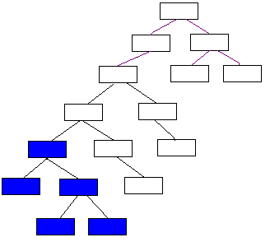
Jiang-Conrath (1997)- Lin (1998)
Bir kavramın bir korpus’taki olasılığı = corpus’ta geçme sayısı (frekansı)
P(concept) = freq(concept)/freq(root)
freq(x) → korpusta x synset’inin tepesinde bulunduğu
tüm synset’lerin frekanslarının toplamı
freq(x) = f(x)+f(x1)+f(x2)+f(x21)+f(x22)
x
x1
x2
x21
x22
YILDIZ TEKNİK ÜNİVERSİTESİ
BİLGİSAYAR MÜHENDİSLİĞİ BÖLÜMÜ

Slide 37

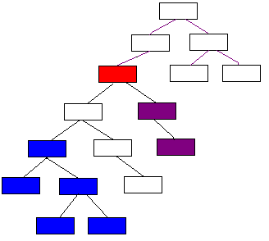
Jiang-Conrath (1997)- Lin (1998)
A
B
A
root
B
lcs(c1,c2)
c2
lcs(c1,c2) en yakın ortak üst synset
c1
A, her iki kavramı da içeren en spesifik kavramı kullanır
(İki kavramın beraber geçtiği doküman sayısına benzer)
B, iki kavramdan herhangi birini içeren doküman sayısına benzer
YILDIZ TEKNİK ÜNİVERSİTESİ
BİLGİSAYAR MÜHENDİSLİĞİ BÖLÜMÜ

Slide 38
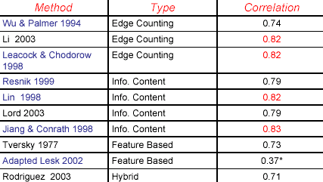
Benzerlik Metotlarının Karşılaştırılması
Bütün metotlar İngilizce 38 kelime çiftine uygulanmış.
Bulunan benzerlik değerlerinin, insan yargılarıyla olan korelasyonları yandaki tabloda.
YILDIZ TEKNİK ÜNİVERSİTESİ
BİLGİSAYAR MÜHENDİSLİĞİ BÖLÜMÜ

Slide 39
Kaynaklar
http://www.ise.gmu.edu/~carlotta/teaching/INFS-795-s06/readings/Similarity_in_WordNet.pdf
http://www.cs.utah.edu/~sidd/documents/msthesis03ppt.pdf
www.iiia.csic.es/People/enric/AICom.html
www.ai-cbr.org
YILDIZ TEKNİK ÜNİVERSİTESİ
BİLGİSAYAR MÜHENDİSLİĞİ BÖLÜMÜ

