Slide 1
Linux Kernel Module Programming
Arş. Grv. R. Can AYGÜN

Slide 2
Outline
Linux Kernel
Kernel Modules
Device Drivers
Parallel Port Device Driver Implementation

Slide 3

Linux Kernel
Monolithic kernel, Preemptive scheduling
But not a static kernel like the traditional monolithic kernels. Device drivers can be load to kernel as “Module”.
Abstraction of underlaying hardware
File system management, CPU scheduling, memory management, Networking, Security

Slide 4
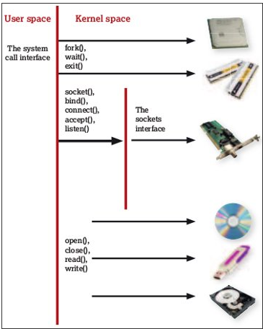
Linux Kernel

Slide 5
Kernel Module
Modules are pieces of code that can be loaded and unloaded into the kernel upon demand
Extents the kernel functionality
No reboot required to use new functionality
Loadable kernel modules can be device drivers,additional file system supports and new system calls

Slide 6
Kernel Module ~ Operations
List running modules → lsmod
Insert a module to kernel → insmod or modprobe
Delete a module from kernel → rmmod

Slide 7
Device Driver
A driver is the part of the OS that manages communication with devices.
Peripheral or internal devices allow users to communicate with the computer.
    keyboards, monitors, floppy and hard disks, CD-ROMs, printers, mice (serial/parallel), networks, modems, etc.

Slide 8
Device Drivers
Character Device Drivers:
Write and read operations are done char by char
Works in Blocking Mode; write and wait, synchronously
such as; LPT printer
Block Device Drivers:
Write and read → block by block
Working in Asynchronous mode.
Such as; usb drives, mouse

Slide 9
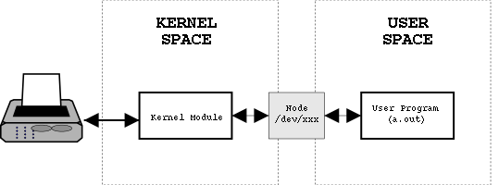
Device File
Interface between user space and kernel
User space applications can only access device via device file
Device files are placed in /dev directory
A major and minor number must be assigned to any device file.

Slide 10
Parallel Port Char Device Driver
Implementation
Output of the parallel port will be showed via led lambs.

Slide 11
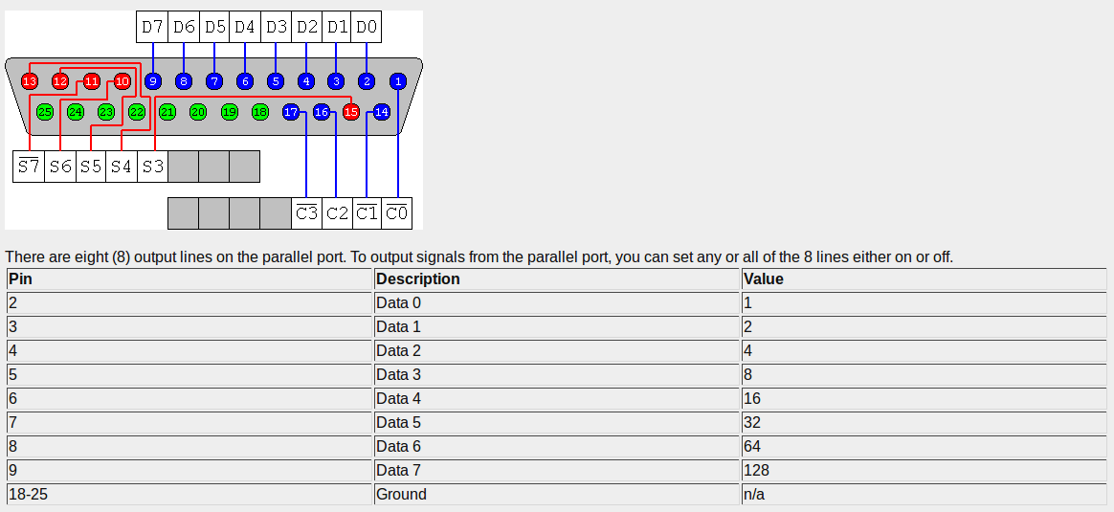
Parallel Port Pin Out

Slide 12
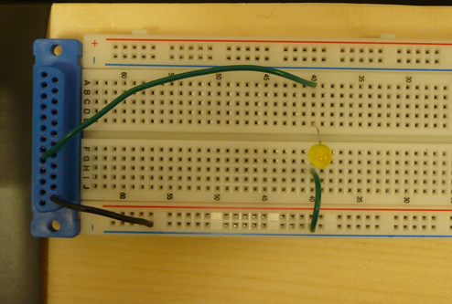
Breadboard Setup - 1

Slide 13
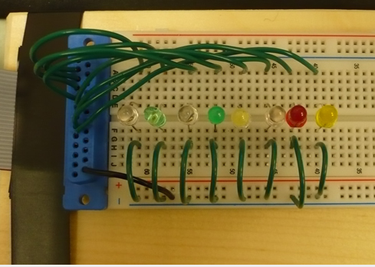
Breadboard Setup - 2

Slide 14
Parallel Port Device Driver Implementation Steps :
Steps :
Writing the module code
  Creating a make file which includes kernel libraries to compile the code as loadable kernel module
Check parallel port availability → cat proc/ioports (parallel port – ioport number: 0x378 )
Add to blacklist other drivers which use the parallel port(if it is necessary).
  /etc/modprobe.d/parport_pc.conf
  Edit parport_pc.conf's inside as “blacklist parport_pc”
  Restart the computer
Create device file → mknod dev/parlelport c 61 0
Give permissions to device file chmod 666 /dev/parlelport
İnstall our module to kernel → insmod pardrive.ko
Check if our module controls the parallel port or not ?
  cat proc/ioports
Testing: echo –n A >/dev/parlelport

Slide 15
References
http://tldp.org/LDP/lkmpg/2.6/html/
http://www.tuxradar.com/content/how-linux-kernel-works
http://www.linuxjournal.com/article/7353?page=0,1
http://matthias.vallentin.net/blog/2007/04/writing-a-linux-kernel-driver-for-an-unknown-usb-device/
http://www.jespersaur.com/drupal/book/export/html/21
http://d4web.net/sths/TEJ/U04Interfacing/A01Parallel/parallelPort.html

