Slide 1
Chapter 8
Lossy Compression Algorithms
8.1 Introduction
8.2 Distortion Measures
8.3 The Rate-Distortion Theory
8.4 Quantization
8.5 Transform Coding
8.6 Wavelet-Based Coding
8.7 Wavelet Packets
8.8 Embedded Zerotree of Wavelet Coefficients
8.9 Set Partitioning in Hierarchical Trees (SPIHT)
8.10 Further Exploration

Slide 2
8.1 Introduction
• Lossless compression algorithms do not deliver compression ratios that are high enough. Hence, most multimedia compression algorithms are lossy.
• What is lossy compression?
  – The compressed data is not the same as the original data, but a close approximation of it.
  – Yields a much higher compression ratio than that of lossless compression.
Li & Drew

Slide 3
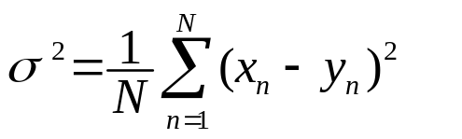
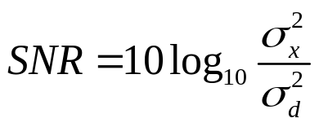


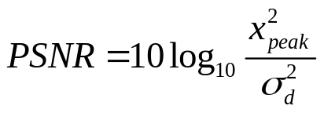
8.2 Distortion Measures
• The three most commonly used distortion measures in image compression are:
– mean square error (MSE) σ²,
(8.1)
where x_{n}, y_{n}, and N are the input data sequence, reconstructed data sequence, and length of the data sequence respectively.
– signal to noise ratio (SNR), in decibel units (dB),
(8.2)
where is the average square value of the original data sequence and is the MSE.
– peak signal to noise ratio (PSNR),
(8.3)
Li & Drew

Slide 4
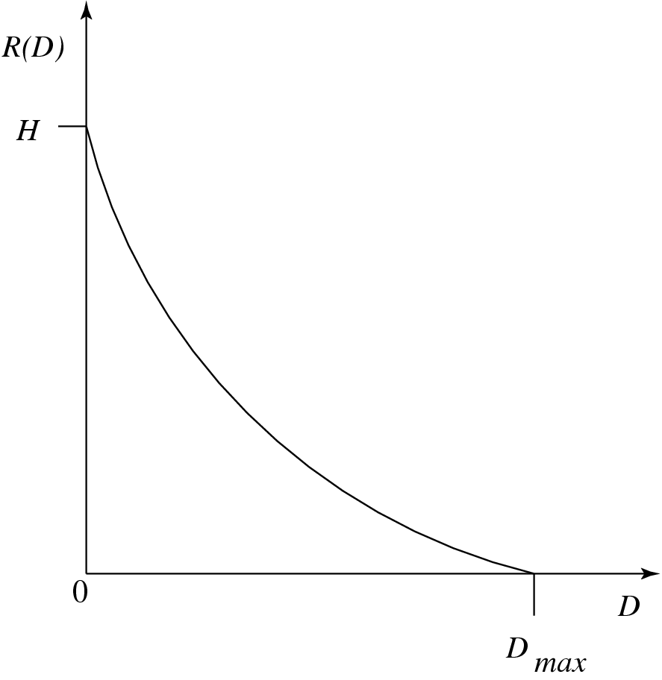
8.3 The Rate-Distortion Theory
• Provides a framework for the study of tradeoffs between Rate and Distortion.
Fig. 8.1: Typical Rate Distortion Function.
Li & Drew

Slide 5
8.4 Quantization
• Reduce the number of distinct output values to a much smaller set.
• Main source of the “loss” in lossy compression.
• Three different forms of quantization.
  – Uniform: midrise and midtread quantizers.
  – Nonuniform: companded quantizer.
  – Vector Quantization.
Li & Drew

Slide 6
Uniform Scalar Quantization
• A uniform scalar quantizer partitions the domain of input values into equally spaced intervals, except possibly at the two outer intervals.
  – The output or reconstruction value corresponding to each interval is taken to be the midpoint of the interval.
  – The length of each interval is referred to as the step size, denoted by the symbol Δ.
• Two types of uniform scalar quantizers:
  – Midrise quantizers have even number of output levels.
  – Midtread quantizers have odd number of output levels, including zero as one of them (see Fig. 8.2).
Li & Drew

Slide 7


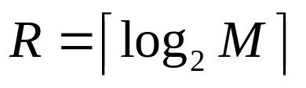
• For the special case where Δ = 1, we can simply compute the output values for these quantizers as:
(8.4)
(8.5)
• Performance of an M level quantizer. Let B = {b₀, b₁, . . . , b_{M}} be the set of decision boundaries and Y = {y₁, y₂, . . . , y_{M}} be the set of reconstruction or output values.
• Suppose the input is uniformly distributed in the interval [−X_{max},X_{max}]. The rate of the quantizer is:
(8.6)
Li & Drew

Slide 8
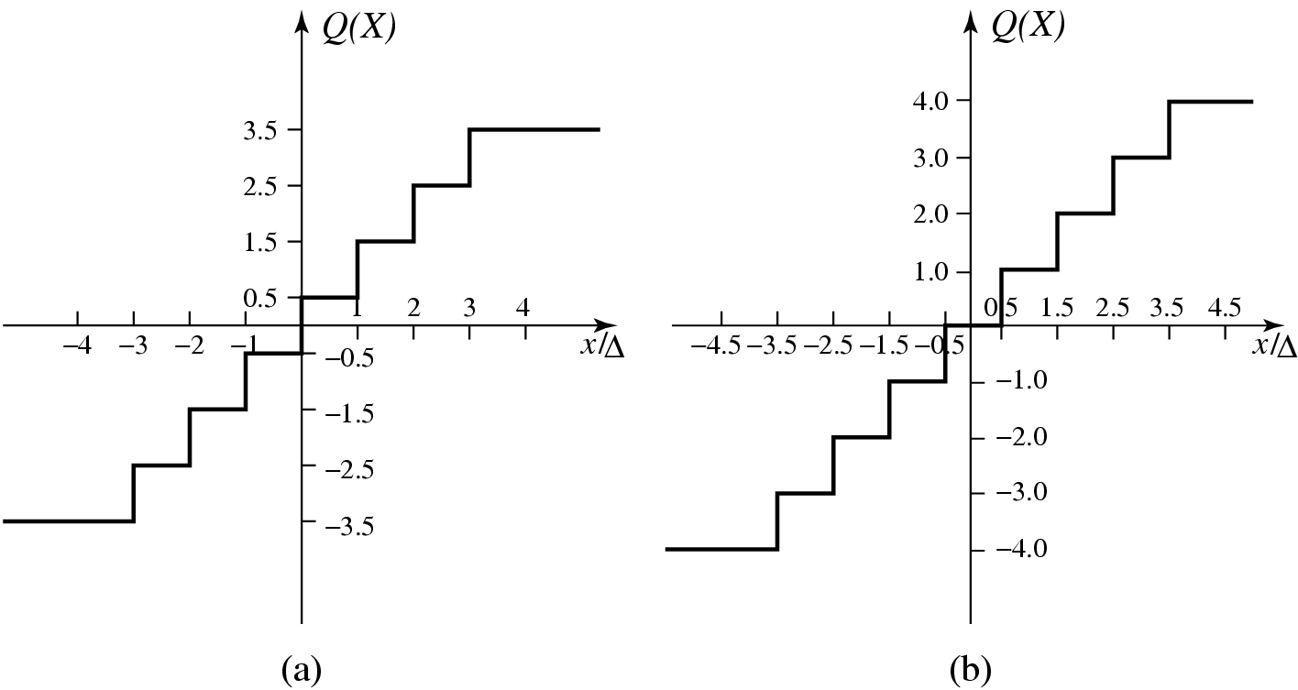
Fig. 8.2: Uniform Scalar Quantizers: (a) Midrise, (b) Midtread.
Li & Drew

Slide 9
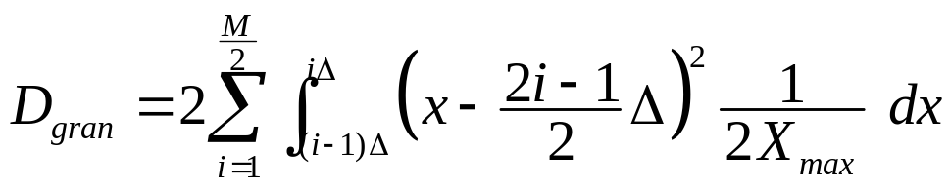

Quantization Error of Uniformly Distributed Source
• Granular distortion: quantization error caused by the quantizer for bounded input.
  – To get an overall figure for granular distortion, notice that decision boundaries b_{i} for a midrise quantizer are [(i − 1)Δ, iΔ], i = 1..M/2, covering positive data X (and another half for negative X values).
  – Output values y_{i} are the midpoints iΔ−Δ/2, i = 1..M/2, again just considering the positive data. The total distortion is twice the sum over the positive data, or
  (8.8)
• Since the reconstruction values y_{i} are the midpoints of each interval, the quantization error must lie within the values [− , ]. For a uniformly distributed source, the graph of the quantization error is shown in Fig. 8.3.
Li & Drew

Slide 10
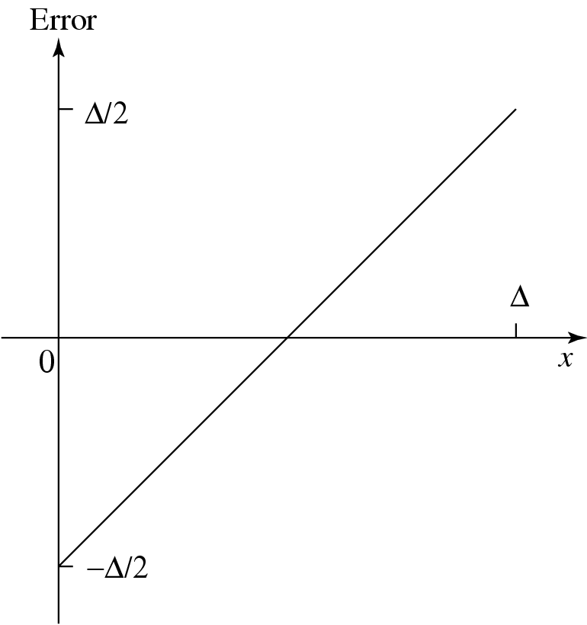
Fig. 8.3: Quantization error of a uniformly distributed source.
Li & Drew

Slide 11
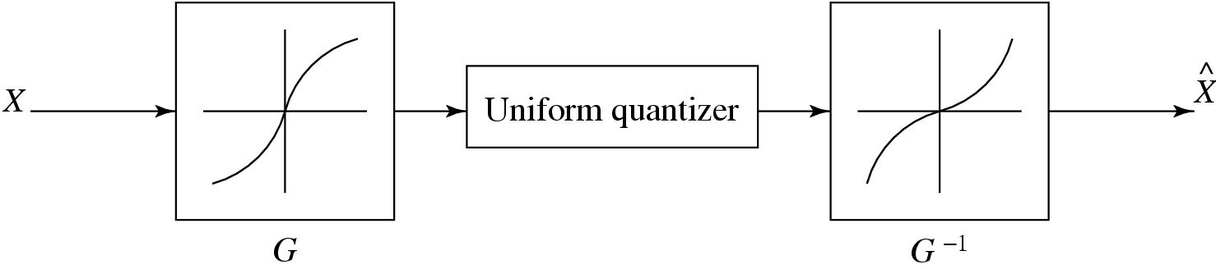
Fig. 8.4: Companded quantization.
• Companded quantization is nonlinear.
• As shown above, a compander consists of a compressor function G, a uniform quantizer, and an expander function G⁻¹.
• The two commonly used companders are the μ-law and A-law companders.
Li & Drew

Slide 12
Vector Quantization (VQ)
• According to Shannon’s original work on information theory, any compression system performs better if it operates on vectors or groups of samples rather than individual symbols or samples.
• Form vectors of input samples by simply concatenating a number of consecutive samples into a single vector.
• Instead of single reconstruction values as in scalar quantization, in VQ code vectors with n components are used. A collection of these code vectors form the codebook.
Li & Drew

Slide 13
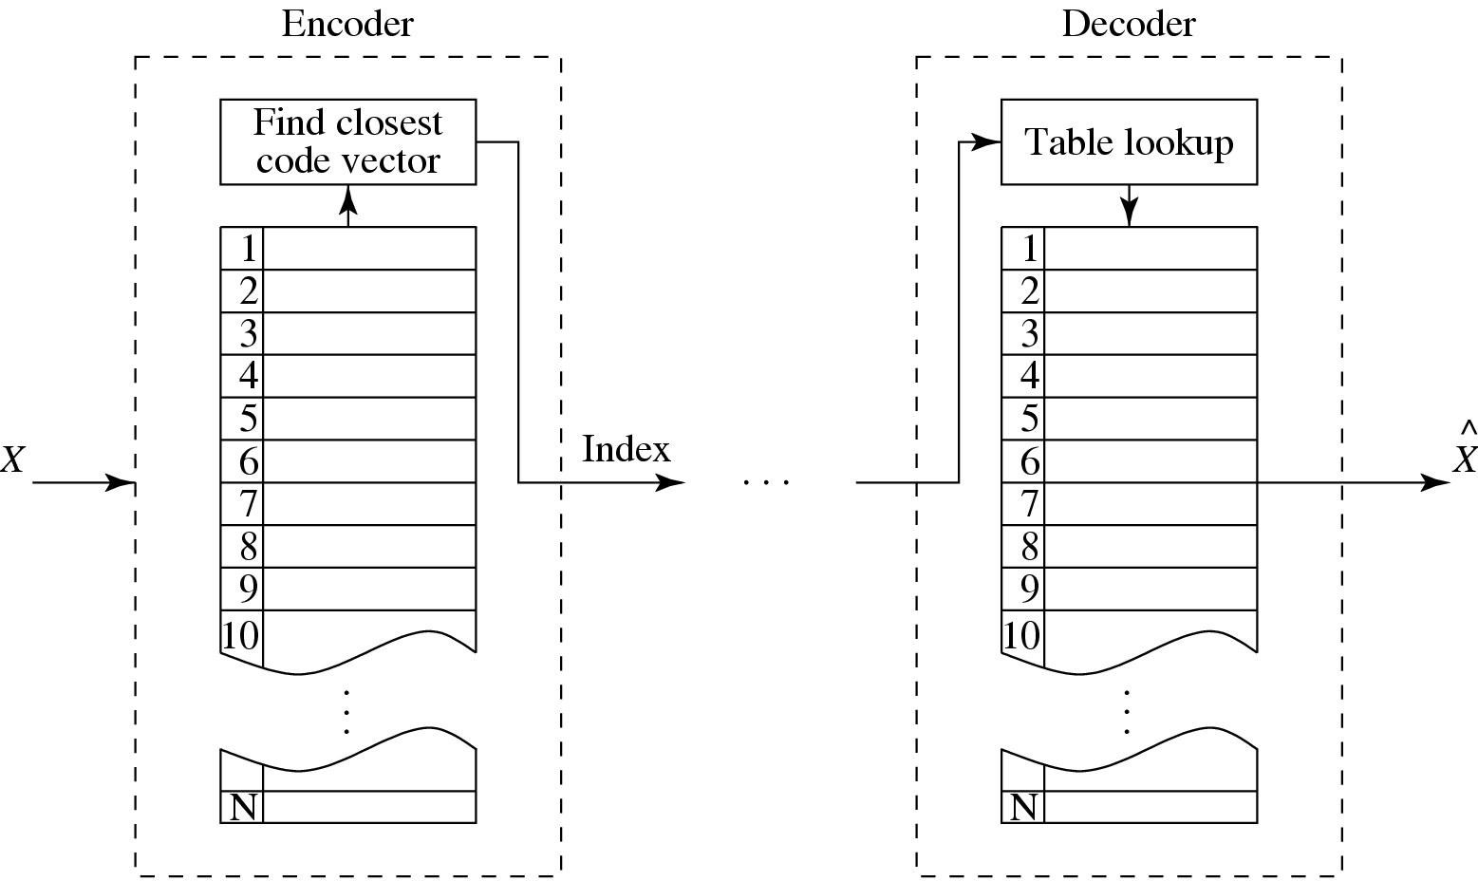
Fig. 8.5: Basic vector quantization procedure.
Li & Drew

Slide 14
8.5 Transform Coding
• The rationale behind transform coding:
If Y is the result of a linear transform T of the input vector X in such a way that the components of Y are much less correlated, then Y can be coded more efficiently than X.
• If most information is accurately described by the first few components of a transformed vector, then the remaining components can be coarsely quantized, or even set to zero, with little signal distortion.
• Discrete Cosine Transform (DCT) will be studied first. In addition, we will examine the Karhunen-Loève Transform (KLT) which optimally decorrelates the components of the input X.
Li & Drew

Slide 15
Spatial Frequency and DCT
• Spatial frequency indicates how many times pixel values change across an image block.
• The DCT formalizes this notion with a measure of how much the image contents change in correspondence to the number of cycles of a cosine wave per block.
• The role of the DCT is to decompose the original signal into its DC and AC components; the role of the IDCT is to reconstruct (re-compose) the signal.
Li & Drew

Slide 16
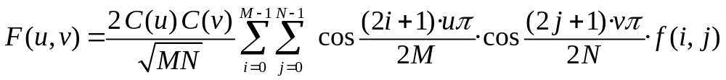
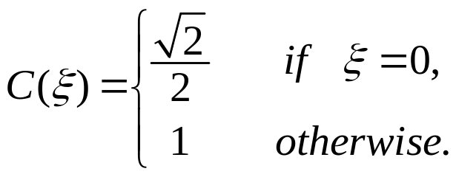
Definition of DCT:
Given an input function f(i, j) over two integer variables i and j (a piece of an image), the 2D DCT transforms it into a new function F(u, v), with integer u and v running over the same range as i and j. The general definition of the transform is:
(8.15)
where i, u = 0, 1, . . . ,M − 1; j, v = 0, 1, . . . ,N − 1; and the constants C(u) and C(v) are determined by
(8.16)
Li & Drew

Slide 17
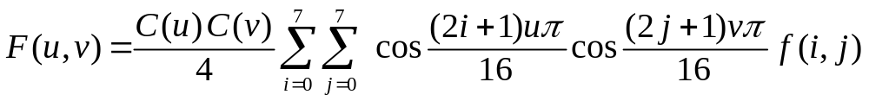
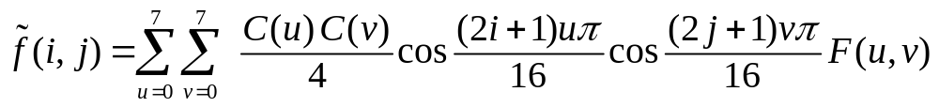
2D Discrete Cosine Transform (2D DCT):
(8.17)
where i, j, u, v = 0, 1, . . . , 7, and the constants C(u) and C(v) are determined by Eq. (8.5.16).
2D Inverse Discrete Cosine Transform (2D IDCT):
The inverse function is almost the same, with the roles of f(i, j) and F(u, v) reversed, except that now C(u)C(v) must stand inside the sums:
(8.18)
where i, j, u, v = 0, 1, . . . , 7.
Li & Drew

Slide 18
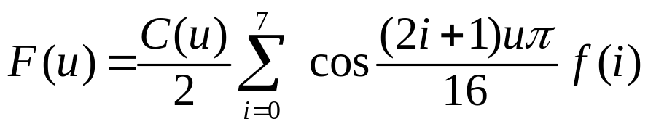
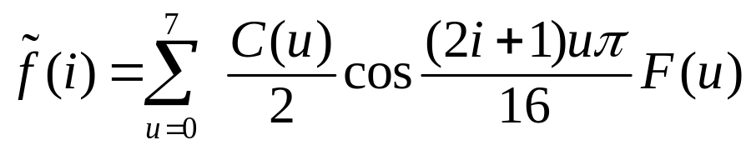
1D Discrete Cosine Transform (1D DCT):
(8.19)
where i = 0, 1, . . . , 7, u = 0, 1, . . . , 7.
1D Inverse Discrete Cosine Transform (1D IDCT):
(8.20)
where i = 0, 1, . . . , 7, u = 0, 1, . . . , 7.
Li & Drew

Slide 19
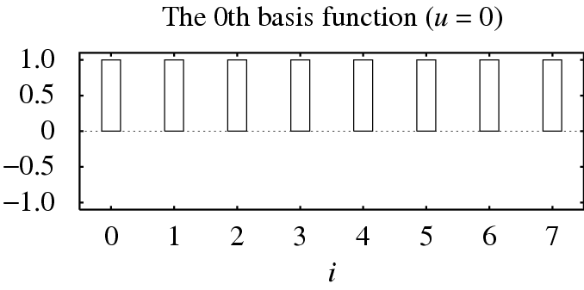
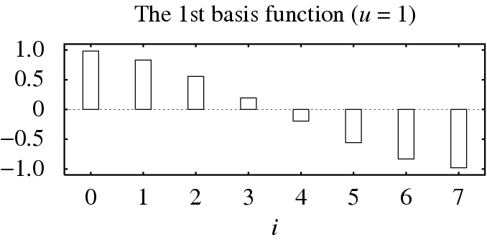
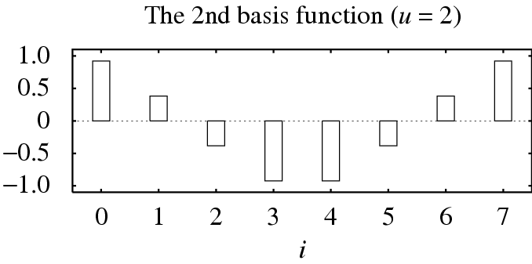
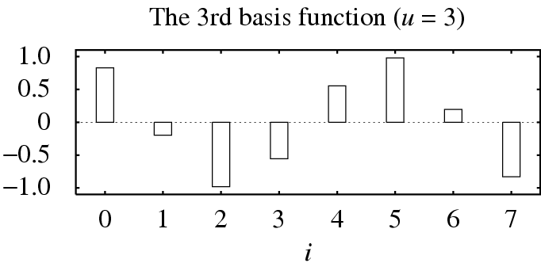
Fig. 8.6: The 1D DCT basis functions.
Li & Drew

Slide 20
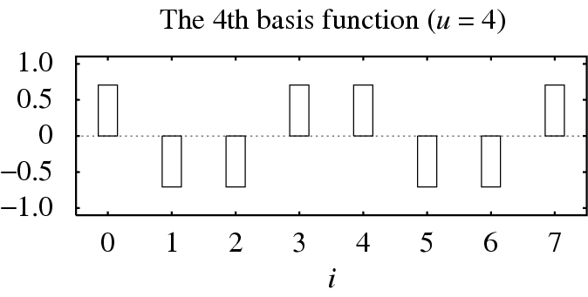
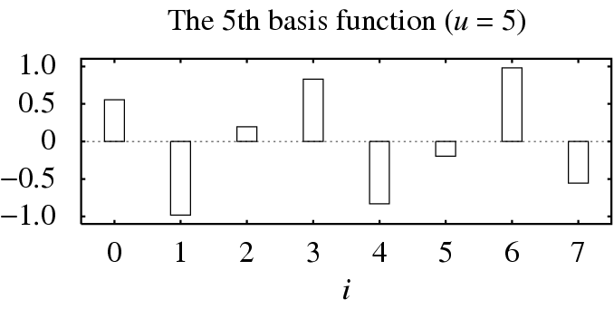
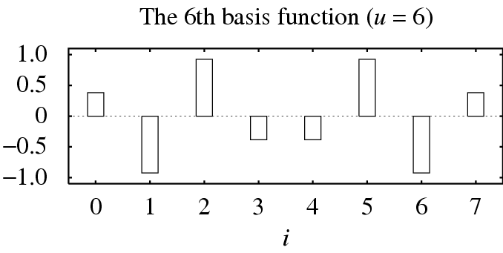
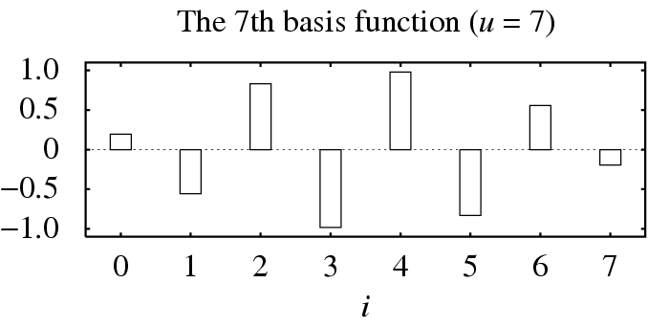
Fig. 8.6 (cont’d): The 1D DCT basis functions.
Li & Drew

Slide 21
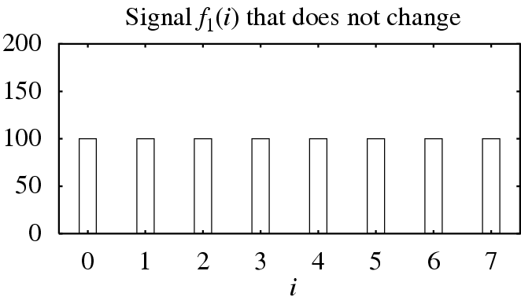
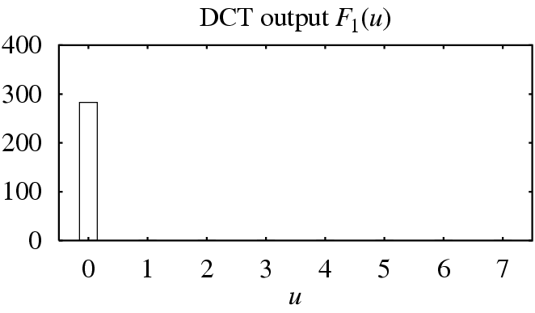
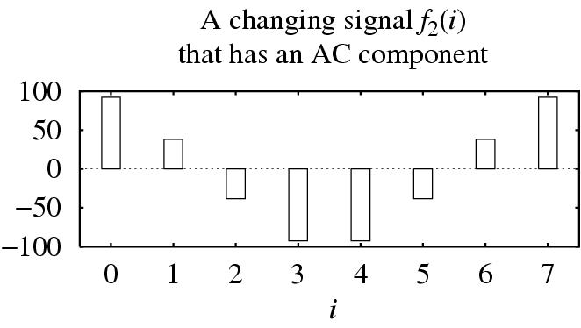
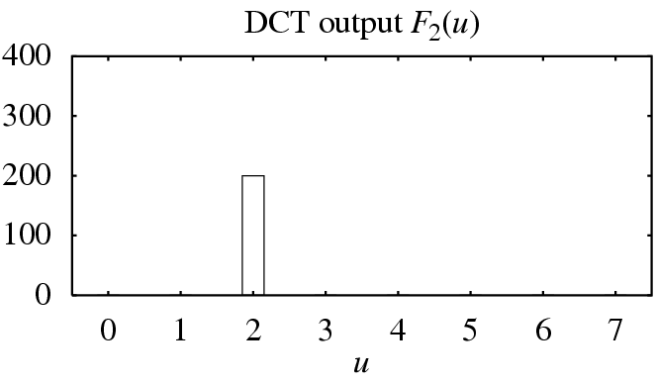
(a)
(b)
Fig. 8.7: Examples of 1D Discrete Cosine Transform: (a) A DC signal f₁(i), (b) An AC signal f₂(i).
Li & Drew

Slide 22
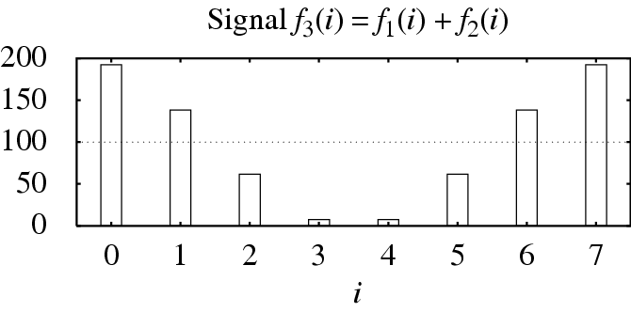
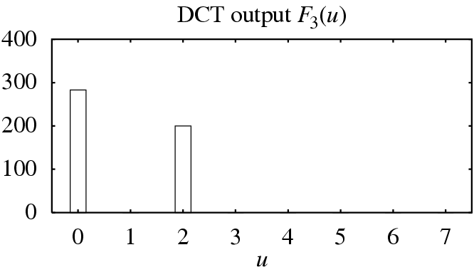
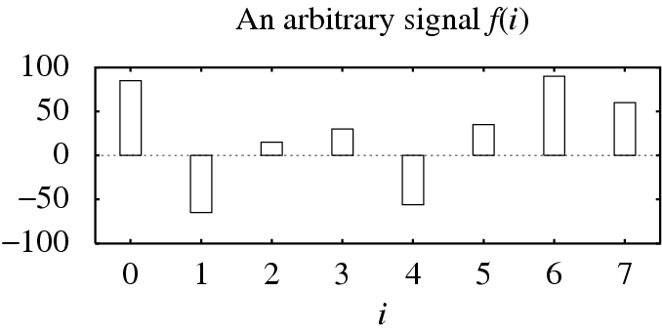
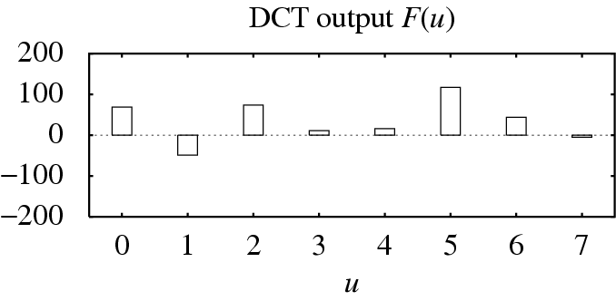
(c)
(d)
Fig. 8.7 (cont’d): Examples of 1D Discrete Cosine Transform: (c) f₃(i) = f₁(i)+f₂(i), and (d) an arbitrary signal f(i).
Li & Drew

Slide 23
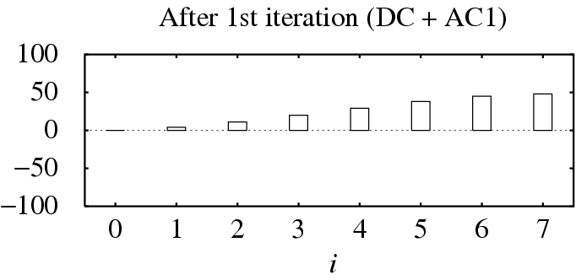
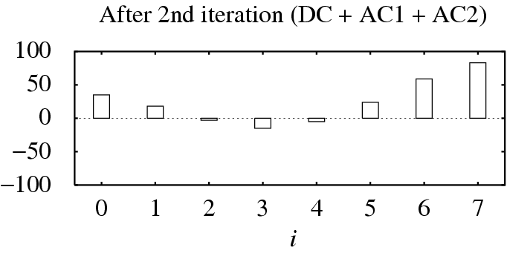
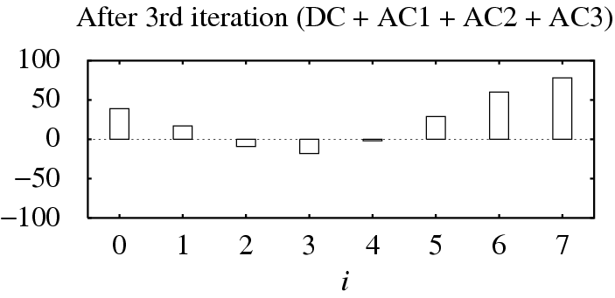
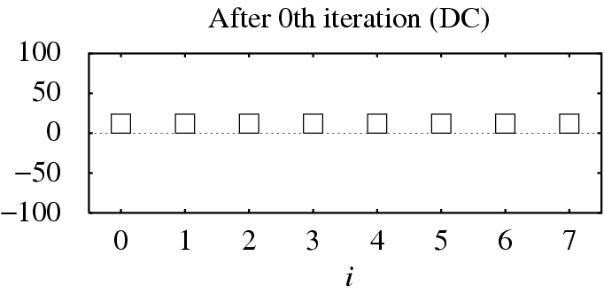
Fig. 8.8 An example of 1D IDCT.
Li & Drew

Slide 24
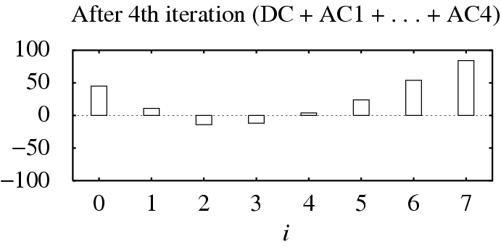
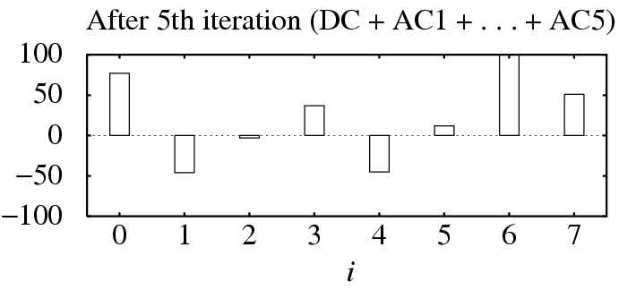
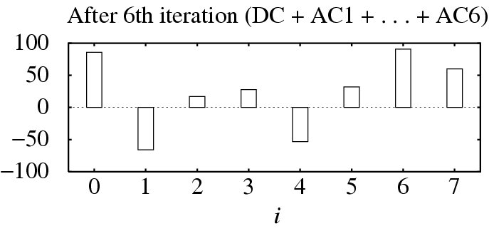
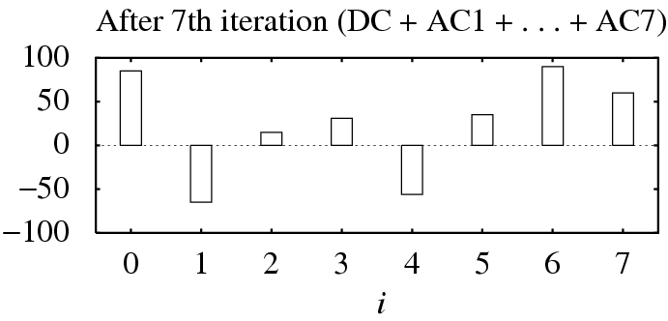
Fig. 8.8 (cont’d): An example of 1D IDCT.
Li & Drew

Slide 25
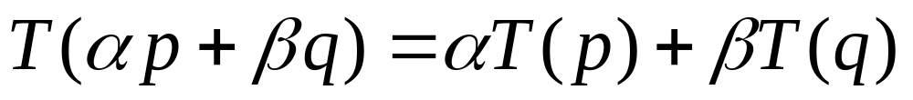
The DCT is a linear transform:
In general, a transform T (or function) is linear, iff
(8.21)
where α and β are constants, p and q are any functions, variables or constants.
From the definition in Eq. 8.17 or 8.19, this property can readily be proven for the DCT because it uses only simple arithmetic operations.
Li & Drew

Slide 26
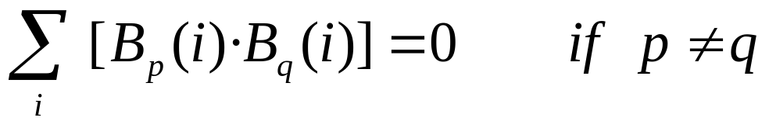
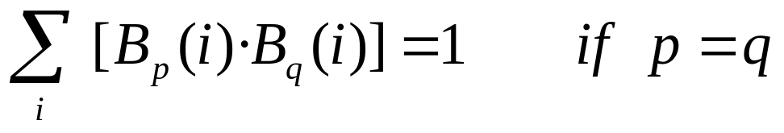
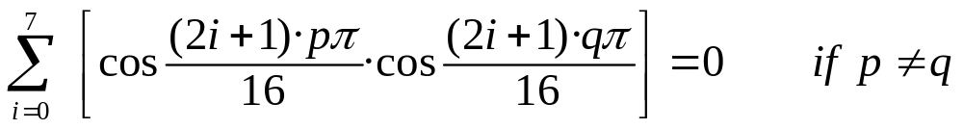
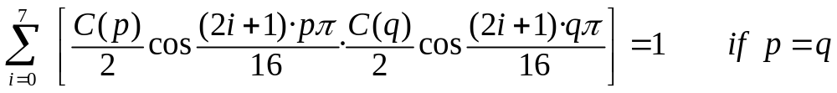
The Cosine Basis Functions
• Function B_{p}(i) and B_{q}(i) are orthogonal, if
(8.22)
• Function B_{p}(i) and B_{q}(i) are orthonormal, if they are orthogonal and
(8.23)
• It can be shown that:
Li & Drew

Slide 27
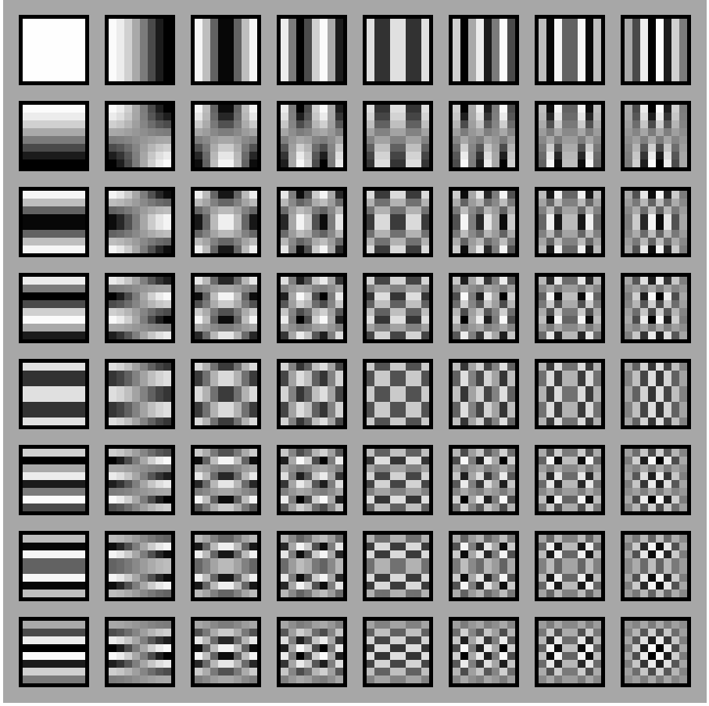
Fig. 8.9: Graphical Illustration of 8 × 8 2D DCT basis.
Li & Drew

Slide 28
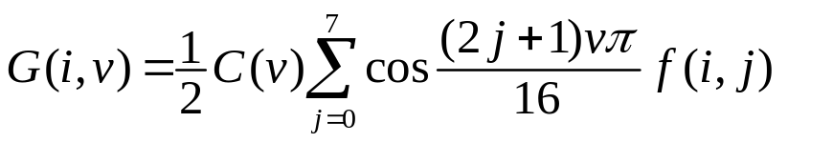
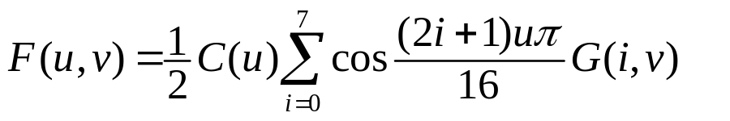
2D Separable Basis
• The 2D DCT can be separated into a sequence of two, 1D DCT steps:
(8.24)
(8.25)
• It is straightforward to see that this simple change saves
many arithmetic steps. The number of iterations required is reduced from 8 × 8 to 8+8.
Li & Drew

Slide 29
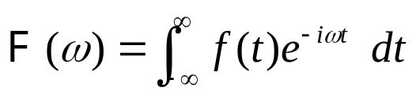

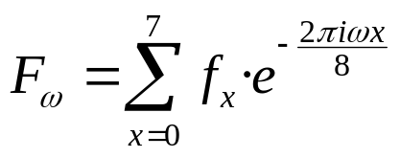
Comparison of DCT and DFT
• The discrete cosine transform is a close counterpart to the Discrete Fourier Transform (DFT). DCT is a transform that only involves the real part of the DFT.
• For a continuous signal, we define the continuous Fourier transform F as follows:
(8.26)
Using Euler’s formula, we have
(8.27)
• Because the use of digital computers requires us to discretize the input signal, we define a DFT that operates on 8 samples of the input signal {f₀, f₁, . . . , f₇} as:
(8.28)
Li & Drew

Slide 30

Writing the sine and cosine terms explicitly, we have
(8.29)
• The formulation of the DCT that allows it to use only the cosine basis functions of the DFT is that we can cancel out the imaginary part of the DFT by making a symmetric copy of the original input signal.
• DCT of 8 input samples corresponds to DFT of the 16 samples made up of original 8 input samples and a symmetric copy of these, as shown in Fig. 8.10.
Li & Drew

Slide 31

Fig. 8.10 Symmetric extension of the ramp function.
Li & Drew

Slide 32
A Simple Comparison of DCT and DFT
Table 8.1 and Fig. 8.11 show the comparison of DCT and DFT on a ramp function, if only the first three terms are used.
Table 8.1 DCT and DFT coefficients of the ramp function
Ramp | DCT | DFT
0 | 9.90 | 28.00
1 | -6.44 | -4.00
2 | 0.00 | 9.66
3 | -0.67 | -4.00
4 | 0.00 | 4.00
5 | -0.20 | -4.00
6 | 0.00 | 1.66
7 | -0.51 | -4.00
Li & Drew

Slide 33

Fig. 8.11: Approximation of the ramp function: (a) 3 Term DCT Approximation, (b) 3 Term DFT Approximation.
Li & Drew

Slide 34


Karhunen-Loève Transform (KLT)
• The Karhunen-Loève transform is a reversible linear transform that exploits the statistical properties of the vector representation.
• It optimally decorrelates the input signal.
• To understand the optimality of the KLT, consider the autocorrelation matrix R_{X} of the input vector X defined as
(8.30)
(8.31)
Li & Drew

Slide 35



• Our goal is to find a transform T such that the components of the output Y are uncorrelated, i.e E[Y_{t}Y_{s}] = 0, if t ≠ s. Thus, the autocorrelation matrix of Y takes on the form of a positive diagonal matrix.
• Since any autocorrelation matrix is symmetric and non-negative definite, there are k orthogonal eigenvectors u₁, u₂, . . . , u_{k} and k corresponding real and nonnegative eigenvalues λ₁ ≥ λ₂ ≥ ... ≥ λ_{k} ≥ 0.
• If we define the Karhunen-Loève transform as
(8.32)
• Then, the autocorrelation matrix of Y becomes
(8.35)
(8.36)
Li & Drew

Slide 36



KLT Example
To illustrate the mechanics of the KLT, consider the four 3D input vectors x₁ = (4, 4, 5),
x₂ = (3, 2, 5), x₃ = (5, 7, 6), and x₄ = (6, 7, 7).
• Estimate the mean:
• Estimate the autocorrelation matrix of the input:
(8.37)
Li & Drew

Slide 37


• The eigenvalues of R_{X} are λ₁ = 6.1963, λ₂ = 0.2147, and λ₃ = 0.0264. The corresponding eigenvectors are
• The KLT is given by the matrix
Li & Drew

Slide 38


• Subtracting the mean vector from each input vector and apply the KLT
• Since the rows of T are orthonormal vectors, the inverse transform is just the transpose: T⁻¹ = T^{T} , and
(8.38)
• In general, after the KLT most of the “energy” of the transform coefficients are concentrated within the first few components. This is the “energy compaction” property of the KLT.
Li & Drew

Slide 39
8.6 Wavelet-Based Coding
• The objective of the wavelet transform is to decompose the input signal into components that are easier to deal with, have special interpretations, or have some components that can be thresholded away, for compression purposes.
• We want to be able to at least approximately reconstruct the original signal given these components.
• The basis functions of the wavelet transform are localized in both time and frequency.
• There are two types of wavelet transforms: the continuous wavelet transform (CWT) and the discrete wavelet transform (DWT).
Li & Drew

Slide 40



The Continuous Wavelet Transform
• In general, a wavelet is a function ψ ∈ L²(R) with a zero average (the admissibility condition),
(8.49)
• Another way to state the admissibility condition is that the zeroth moment M₀ of ψ(t) is zero. The pth moment is defined as
(8.50)
• The function ψ is normalized, i.e., ||ψ|| = 1 and centered at t = 0. A family of wavelet functions is obtained by scaling and translating the “mother wavelet” ψ
(8.51)
Li & Drew

Slide 41



• The continuous wavelet transform (CWT) of f ∈ L²(R) at time u and scale s is defined as:
(8.52)
• The inverse of the continuous wavelet transform is:
(8.53)
where
(8.54)
and ψ(w) is the Fourier transform of ψ(t).
Li & Drew

Slide 42

The Discrete Wavelet Transform
• Discrete wavelets are again formed from a mother wavelet, but with scale and shift in discrete steps.
• The DWT makes the connection between wavelets in the continuous time domain and “filter banks” in the discrete time domain in a multiresolution analysis framework.
• It is possible to show that the dilated and translated family of wavelets ψ
(8.55)
form an orthonormal basis of L²(R).
Li & Drew

Slide 43
Multiresolution Analysis in the Wavelet Domain
• Multiresolution analysis provides the tool to adapt signal resolution to only relevant details for a particular task.
The approximation component is then recursively decomposed into approximation and detail at successively coarser scales.
• Wavelet functions ψ(t) are used to characterize detail information. The averaging (approximation) information is formally determined by a kind of dual to the mother wavelet, called the “scaling function” φ(t).
• Wavelets are set up such that the approximation at resolution 2^{−j} contains all the necessary information to compute an approximation at coarser resolution 2^{−(j+1)}.
Li & Drew

Slide 44



• The scaling function must satisfy the so-called dilation equation:
(8.56)
• The wavelet at the coarser level is also expressible as a sum of translated scaling functions:
(8.57)
(8.58)
• The vectors h₀[n] and h₁[n] are called the low-pass and high-pass analysis filters. To reconstruct the original input, an inverse operation is needed. The inverse filters are called synthesis filters.
Li & Drew

Slide 45

Block Diagram of 1D Dyadic Wavelet
Transform
Fig. 8.18: The block diagram of the 1D dyadic wavelet transform.
Li & Drew

Slide 46


Wavelet Transform Example
Suppose we are given the following input sequence.
{x_{n,i}} = {10, 13, 25, 26, 29, 21, 7, 15}
• Consider the transform that replaces the original sequence with its pairwise average x_{n−1},i and difference d_{n−1,i} defined as follows:
• The averages and differences are applied only on consecutive pairs of input sequences whose first element has an even index. Therefore, the number of elements in each set {x_{n−1,i}} and {d_{n−1,i}} is exactly half of the number of elements in the original sequence.
Li & Drew

Slide 47
• Form a new sequence having length equal to that of the original sequence by concatenating the two sequences {x_{n−1,i}} and {d_{n−1,i}}. The resulting sequence is
{x_{n−1,i}, d_{n−1,i}} = {11.5, 25.5, 25, 11,−1.5,−0.5, 4,−4}
• This sequence has exactly the same number of elements as the input sequence — the transform did not increase the amount of data.
• Since the first half of the above sequence contain averages from the original sequence, we can view it as a coarser approximation to the original signal. The second half of this sequence can be viewed as the details or approximation errors of the first half.
Li & Drew

Slide 48

• It is easily verified that the original sequence can be reconstructed from the transformed sequence using the relations
x_{n, 2i} = x_{n−1, i} + d_{n−1, i}
x_{n, 2i+1} = x_{n−1, i} − d_{n−1, i}
• This transform is the discrete Haar wavelet transform.
Fig. 8.12: Haar Transform: (a) scaling function, (b) wavelet function.
Li & Drew

Slide 49

Fig. 8.13: Input image for the 2D Haar Wavelet Transform.
(a) The pixel values. (b) Shown as an 8 × 8 image.
Li & Drew

Slide 50

Fig. 8.14: Intermediate output of the 2D Haar Wavelet Transform.
Li & Drew

Slide 51

Fig. 8.15: Output of the first level of the 2D Haar Wavelet
Transform.
Li & Drew

Slide 52

Fig. 8.16: A simple graphical illustration of Wavelet Transform.
Li & Drew

Slide 53

Fig. 8.17: A Mexican Hat Wavelet: (a) σ = 0.5, (b) its Fourier
transform.
Li & Drew

Slide 54





Biorthogonal Wavelets
• For orthonormal wavelets, the forward transform and its inverse are transposes of each other and the analysis filters are identical to the synthesis filters.
• Without orthogonality, the wavelets for analysis and synthesis are called “biorthogonal”. The synthesis filters are not identical to the analysis filters. We denote them as and .
• To specify a biorthogonal wavelet transform, we require both h₀[n] and .
(8.60)
(8.61)
Li & Drew

Slide 55
Table 8.2 Orthogonal Wavelet Filters
Wavelet | Num. Taps | Start Index | Coefficients
Haar | 2 | 0 | [0.707, 0.707]
Daubechies 4 | 4 | 0 | [0.483, 0.837, 0.224, -0.129]
Daubechies 6 | 6 | 0 | [0.332, 0.807, 0.460, -0.135, -0.085, 0.0352]
Daubechies 8 | 8 | 0 | [0.230, 0.715, 0.631, -0.028, -0.187, 0.031, 0.033, -0.011]
Li & Drew

Slide 56

Table 8.3 Biorthogonal Wavelet Filters
Wavelet | Filter | Num. Taps | Start Index | Coefficients
Antonini 9/7 |  | 9 | -4 | [0.038, -0.024, -0.111, 0.377, 0.853, 0.377, -0.111, -0.024, 0.038]
 |  | 7 | -3 | [-0.065, -0.041, 0.418, 0.788, 0.418, -0.041, -0.065]
Villa 10/18 |  | 10 | -4 | [0.029, 0.0000824, -0.158, 0.077, 0.759, 0.759, 0.077, -0.158, 0.0000824, 0.029]
 |  | 18 | -8 | [0.000954, -0.00000273, -0.009, -0.003, 0.031, -0.014, -0.086, 0.163, 0.623, 0.623, 0.163, -0.086, -0.014, 0.031, -0.003, -0.009, -0.00000273, 0.000954]
Brislawn |  | 10 | -4 | [0.027, -0.032, -0.241, 0.054, 0.900, 0.900, 0.054, -0.241, -0.032, 0.027]
 |  | 10 | -4 | [0.020, 0.024, -0.023, 0.146, 0.541, 0.541, 0.146, -0.023, 0.024, 0.020]
Li & Drew

Slide 57
2D Wavelet Transform
• For an N by N input image, the two-dimensional DWT proceeds as follows:
  – Convolve each row of the image with h₀[n] and h₁[n], discard the odd numbered columns of the resulting arrays, and concatenate them to form a transformed row.
  – After all rows have been transformed, convolve each column of the result with h₀[n] and h₁[n]. Again discard the odd numbered rows and concatenate the result.
• After the above two steps, one stage of the DWT is complete. The transformed image now contains four subbands LL, HL, LH, and HH, standing for low-low, high-low, etc.
• The LL subband can be further decomposed to yield yet another level of decomposition. This process can be continued until the desired number of decomposition levels is reached.
Li & Drew

Slide 58

Fig. 8.19: The two-dimensional discrete wavelet transform
(a) One level transform, (b) two level transform.
Li & Drew

Slide 59

2D Wavelet Transform Example
• The input image is a sub-sampled version of the image Lena. The size of the input is 16×16. The filter used in the example is the Antonini 9/7 filter set
Fig. 8.20: The Lena image: (a) Original 128 × 128 image.
(b) 16 × 16 sub-sampled image.
Li & Drew

Slide 60


• The input image is shown in numerical form below.
• First, we need to compute the analysis and synthesis high-pass filters.
Li & Drew

Slide 61
• Convolve the first row with both h₀[n] and h₁[n] and discarding the values with odd-numbered index. The results of these two operations are:
• Form the transformed output row by concatenating the resulting coefficients. The first row of the transformed image is then:
[245, 156, 171, 183, 184, 173, 228, 160,−30, 3, 0, 7,−5,−16,−3, 16]
• Continue the same process for the remaining rows.
Li & Drew

Slide 62


The result after all rows have been processed
Li & Drew

Slide 63


• Apply the filters to the columns of the resulting image. Apply both h₀[n] and h₁[n] to each column and discard the odd indexed results:
• Concatenate the above results into a single column and apply the same procedure to each of the remaining columns.
Li & Drew

Slide 64


• This completes one stage of the discrete wavelet transform. We can perform another stage of the DWT by applying the same transform procedure illustrated above to the upper left 8 × 8 DC image of I₁₂(x, y). The resulting two-stage transformed image is
Li & Drew

Slide 65

Fig. 8.21: Haar wavelet decomposition.
Li & Drew

Slide 66
8.7 Wavelet Packets
• In the usual dyadic wavelet decomposition, only the low-pass filtered subband is recursively decomposed and thus can be represented by a logarithmic tree structure.
• A wavelet packet decomposition allows the decomposition to be represented by any pruned subtree of the full tree topology.
• The wavelet packet decomposition is very flexible since a best wavelet basis in the sense of some cost metric can be found within a large library of permissible bases.
• The computational requirement for wavelet packet decomposition is relatively low as each decomposition can be computed in the order of N log N using fast filter banks.
Li & Drew

Slide 67
8.8 Embedded Zerotree of Wavelet Coefficients
• Effective and computationally efficient for image coding.
• The EZW algorithm addresses two problems:
  1. obtaining the best image quality for a given bit-rate, and
  2. accomplishing this task in an embedded fashion.
• Using an embedded code allows the encoder to terminate the encoding at any point. Hence, the encoder is able to meet any target bit-rate exactly.
• Similarly, a decoder can cease to decode at any point and can produce reconstructions corresponding to all lower-rate encodings.
Li & Drew

Slide 68
The Zerotree Data Structure
• The EZW algorithm efficiently codes the “significance map” which indicates the locations of nonzero quantized wavelet coefficients.
This is is achieved using a new data structure called the zerotree.
• Using the hierarchical wavelet decomposition presented earlier, we can relate every coefficient at a given scale to a set of coefficients at the next finer scale of similar orientation.
• The coefficient at the coarse scale is called the “parent” while all corresponding coefficients are the next finer scale of the same spatial location and similar orientation are called “children”.
Li & Drew

Slide 69

Fig. 8.22: Parent child relationship in a zerotree.
Li & Drew

Slide 70

Fig. 8.23: EZW scanning order.
Li & Drew

Slide 71
• Given a threshold T, a coefficient x is an element of the zerotree if it is insignificant and all of its descendants are insignificant as well.
• The significance map is coded using the zerotree with a four-symbol alphabet:
  – The zerotree root: The root of the zerotree is encoded with a special symbol indicating that the insignificance of the coefficients at finer scales is completely predictable.
  – Isolated zero: The coefficient is insignificant but has some significant descendants.
  – Positive significance: The coefficient is significant with a positive value.
  – Negative significance: The coefficient is significant with a negative value.
Li & Drew

Slide 72
Successive Approximation Quantization
• Motivation:
  – Takes advantage of the efficient encoding of the significance map using the zerotree data structure by allowing it to encode more significance maps.
  – Produce an embedded code that provides a coarse-to-fine, multiprecision logarithmic representation of the scale space corresponding to the wavelet-transformed image.
• The SAQ method sequentially applies a sequence of thresholds T₀, . . . , T_{N−1} to determine the significance of each coefficient.
• A dominant list and a subordinate list are maintained during the encoding and decoding process.
Li & Drew

Slide 73
Dominant Pass
• Coefficients having their coordinates on the dominant list implies that they are not yet significant.
• Coefficients are compared to the threshold T_{i} to determine their significance. If a coefficient is found to be significant, its magnitude is appended to the subordinate list and the coefficient in the wavelet transform array is set to 0 to enable the possibility of the occurrence of a zerotree on future dominant passes at smaller thresholds.
• The resulting significance map is zerotree coded.
Li & Drew

Slide 74
Subordinate Pass
• All coefficients on the subordinate list are scanned and their magnitude (as it is made available to the decoder) is refined to an additional bit of precision.
• The width of the uncertainty interval for the true magnitude of the coefficients is cut in half.
• For each magnitude on the subordinate list, the refinement can be encoded using a binary alphabet with a “1” indicating that the true value falls in the upper half of the uncertainty interval and a “0” indicating that it falls in the lower half.
• After the completion of the subordinate pass, the magnitudes on the subordinate list are sorted in decreasing order to theextent that the decoder can perform the same sort.
Li & Drew

Slide 75

EZW Example
Fig. 8.24: Coefficients of a three-stage wavelet transform used as input to the EZW algorithm.
Li & Drew

Slide 76
Encoding
• Since the largest coefficient is 57, the initial threshold T₀ is 32.
• At the beginning, the dominant list contains the coordinates of all the coefficients.
• The following is the list of coefficients visited in the order of the scan:
{57,−37,−29, 30, 39,−20, 17, 33, 14, 6, 10,
19, 3, 7, 8, 2, 2, 3, 12,−9, 33, 20, 2, 4}
• With respect to the threshold T₀ = 32, it is easy to see that the coefficients 57 and -37 are significant. Thus, we output a p and a n to represent them.
Li & Drew

Slide 77
• The coefficient −29 is insignificant, but contains a significant descendant 33 in LH1. Therefore, it is coded as z.
• Continuing in this manner, the dominant pass outputs the following symbols:
D₀ : pnztpttptzttttttttttpttt
• There are five coefficients found to be significant: 57, -37, 39, 33, and another 33. Since we know that no coefficients are greater than 2T₀ = 64 and the threshold used in the first dominant pass is 32, the uncertainty interval is thus [32, 64).
• The subordinate pass following the dominant pass refines the magnitude of these coefficients by indicating whether they lie in the first half or the second half of the uncertainty interval.
S₀ : 10000
Li & Drew

Slide 78
• Now the dominant list contains the coordinates of all the coefficients except those found to be significant and the subordinate list contains the values:
{57, 37, 39, 33, 33}.
• Now, we attempt to rearrange the values in the subordinate list such that larger coefficients appear before smaller ones, with the constraint that the decoder is able do exactly the same.
• The decoder is able to distinguish values from [32, 48) and [48, 64). Since 39 and 37 are not distinguishable in the decoder, their order will not be changed.
Li & Drew

Slide 79
• Before we move on to the second round of dominant and subordinate passes, we need to set the values of the significant coefficients to 0 in the wavelet transform array so that they do not prevent the emergence of a new zerotree.
• The new threshold for second dominant pass is T₁ = 16. Using the same procedure as above, the dominant pass outputs the following symbols
D₁: zznptnpttztptttttttttttttptttttt (8.65)
• The subordinate list is now:
{57, 37, 39, 33, 33, 29, 30, 20, 17, 19, 20}
Li & Drew

Slide 80
• The subordinate pass that follows will halve each of the three current uncertainty intervals [48, 64), [32, 48), and [16, 32). The subordinate pass outputs the following bits:
S₁ : 10000110000
• The output of the subsequent dominant and subordinate passes are shown below:
  D₂ : zzzzzzzzptpzpptnttptppttpttpttpnppttttttpttttttttttttttt
  S₂ : 01100111001101100000110110
  D₃ : zzzzzzztzpztztnttptttttptnnttttptttpptppttpttttt
  S₃ : 00100010001110100110001001111101100010
  D₄ : zzzzzttztztzztzzpttpppttttpttpttnpttptptttpt
  S₄ : 1111101001101011000001011101101100010010010101010
  D₅ : zzzztzttttztzzzzttpttptttttnptpptttppttp
Li & Drew

Slide 81

Decoding
• Suppose we only received information from the first dominant and subordinate pass. From the symbols in D₀ we can obtain the position of the significant coefficients. Then, using the bits decoded from S₀, we can reconstruct the value of these coefficients using the center of the uncertainty interval.
Fig. 8.25: Reconstructed transform coefficients from the first pass.
Li & Drew

Slide 82

• If the decoder received only D₀, S₀, D₁, S₁, D₂, and only the first 10 bits of S₂, then the reconstruction is
Fig. 8.26: Reconstructed transform coefficients from D₀,
S₀, D₁, S₁, D₂, and the first 10 bits of S₂.
Li & Drew

Slide 83
8.9 Set Partitioning in Hierarchical Trees
(SPIHT)
The SPIHT algorithm is an extension of the EZW algorithm.
• The SPIHT algorithm significantly improved the performance of its predecessor by changing the way subsets of coefficients are partitioned and how refinement information is conveyed.
• A unique property of the SPIHT bitstream is its compactness. The resulting bitstream from the SPIHT algorithm is so compact that passing it through an entropy coder would only produce very marginal gain in compression.
• No ordering information is explicitly transmitted to the decoder. Instead, the decoder reproduces the execution path of the encoder and recovers the ordering information.
Li & Drew

