Slide 1
Review (1/2)
Caches are NOT mandatory:
  Processor performs arithmetic
  Memory stores data
  Caches simply make data transfers go faster
Each level of memory hierarchy is just a subset of next higher level
Caches speed up due to temporal locality: store data used recently
Block size > 1 word speeds up due to spatial locality: store words adjacent to the ones used recently

Slide 2
Review (2/2)
Cache design choices:
  size of cache: speed v. capacity
  direct-mapped v. associative
  for N-way set assoc: choice of N
  block replacement policy
  2nd level cache?
  Write through v. write back?
Use performance model to pick between choices, depending on programs, technology, budget, ...

Slide 3
Overview
Generalized Caching
Address Translation
Virtual Memory / Page Tables
TLBs
Page Replacement Policy
Multi-level Page Tables

Slide 4
Generalized Caching
We’ve discussed memory caching in detail. Caching in general shows up over and over in computer systems
  File system cache
  Web page cache
  Software memorization
  Others?
General idea: if something is expensive but we want to do it repeatedly, just do it once and cache the result.

Slide 5
Generalized Caching
For any caching system:
  average access time =
  hit rate * hit time + miss rate * miss time
In general, hit time << miss time so we seek to improve performance by reducing the miss rate. Miss rate is influenced by:
  Cache size
  Layout policy (e.g., associativity)
  Replacement policy

Slide 6
Another View of the Memory Hierarchy
Regs
Upper Level
Instr. Operands
Faster
{
Cache
Blocks
Thus far
L2 Cache
Blocks
{
Memory
Next:
Virtual
Memory
Pages
Disk
Files
Larger
Tape
Lower Level

Slide 7
Memory Hierarchy Requirements
If Principle of Locality allows caches to offer (close to) speed of cache memory with size of DRAM memory, then recursively why not use at next level to give speed of DRAM memory, size of Disk memory?
In order to have the appearance of a large memory, we explore the relationship between main memory and hard disk.

Slide 8
Virtual Memory
With respect to large memory, not only do we want the entire virtual address space to appear to be main memory, but in most cases we would also like this complete space to appear to be available to each program that is executing.
The job of the software and hardware that implement the virtual memory is to map each virtual address for each program into a physical address in the main memory.
It is possible for a virtual address from one program and a virtual address from another program to map the same physical address.

Slide 9
Basic Issues in VM System Design
size of information blocks that are transferred from secondary to main storage (M)
block of information brought into M, and M is full, then some region of M must be released to make room for the new block --> replacement policy
which region of M is to hold the new block --> placement policy
missing item fetched from secondary memory only on the occurrence of a fault --> demand load policy

Slide 10
Memory Hierarchy Requirements
Share memory between multiple processes but still provide protection – don’t let one program read/write memory from another
Address space – give each program the illusion that it has its own private memory
  Suppose code starts at address 0x40000000. But different processes have different code, both residing at the same address. So each program has a different view of memory.

Slide 11
Virtual to Physical Addr. Translation
Program
operates in
its virtual
address
space
Physical
memory
(incl. caches)
HW
mapping
virtual
address
(inst. fetch
load, store)
physical
address
(inst. fetch
load, store)
Each program operates in its own virtual address space; ~only program running
Each is protected from the other
OS can decide where each goes in memory
Hardware (HW) provides virtual -> physical mapping

Slide 12
Simple Example: Base and Bound Reg
∞
User C
$base+
$bound
Enough space for User D,
but discontinuous
(“fragmentation problem”)
User B
$base
User A
Want discontinuous mapping
Process size >> mem
Addition not enough!
=> use Indirection!
0
OS

Slide 13
Paging Organization (assume 1 KB pages)
Physical
Address
Page is unit
of mapping
Virtual
Address
0
page 0
1K
0
page 0
1K
1K
1024
page 1
1K
1024
page 1
Addr
Trans
MAP
2048
page 2
1K
...
...
...
7168
page 7
1K
...
...
...
Physical
Memory
31744
page 31
1K
Virtual
Memory
Page also unit of transfer from disk to physical memory

Slide 14
Virtual Memory Mapping Function
Cannot have simple function to predict arbitrary mapping
Use table lookup of mappings
Page Number Offset
Use table lookup (“Page Table”) for mappings: Page number is index
Virtual Memory Mapping Function
  Physical Offset = Virtual Offset
  Physical Page Number
  = Page Table [Virtual Page Number]
  (P.P.N. also called “Page Frame”)

Slide 15
Address Mapping: Page Table
Virtual Address:
page no.
offset
Page Table
Page Table
Base Reg
...
V
A.R.
P. P. A.
index
into
page
table
Access
Rights
Physical
Page
Address
+
Valid
Physical
Memory
Address
.
...
Page Table located in physical memory

Slide 16
Page Table
A page table is an operating system structure which contains the mapping of virtual addresses to physical locations
  There are several different ways, all up to the operating system, to keep this data around
Each process running in the operating system has its own page table
  “State” of process is PC, all registers, plus page table
  OS changes page tables by changing contents of Page Table Base Register

Slide 17
Requirements revisited
Remember the motivation for VM:
Sharing memory with protection
  Different physical pages can be allocated to different processes (sharing)
  A process can only touch pages in its own page table (protection)
Separate address spaces
  Since programs work only with virtual addresses, different programs can have different data/code at the same address!
What about the memory hierarchy?

Slide 18
Page Table Entry (PTE) Format
Contains either Physical Page Number or indication not in Main Memory
OS maps to disk if Not Valid (V = 0)
...
Page Table
V
A.R.
P. P.N.
Valid
Access
Rights
Physical
Page
Number
P.T.E.
V
A.R.
P. P. N.
...
If valid, also check if have permission to use page: Access Rights (A.R.) may be Read Only, Read/Write, Executable

Slide 19
Address Map, Mathematically Speaking
V = {0, 1, . . . , n - 1} virtual address space (n > m)
M = {0, 1, . . . , m - 1} physical address space
MAP: V --> M U {θ} address mapping function
MAP(a) = a' if data at virtual address a is present in physical address a' and a' in M
= θ if data at virtual address a is not present in M
a
page fault
Name Space V
OS fault
handler
Processor
0
Addr Trans
Mechanism
Main
Memory
Disk
a
a'
physical
address
OS performs
this transfer

Slide 20
Comparing the 2 levels of hierarchy
Cache Version Virtual Memory version
Block or Line Page
Miss Page Fault
Block Size: 32-64B Page Size: 4K-8KB
Placement: Fully Associative
Direct Mapped,
N-way Set Associative
Replacement: Least Recently Used
LRU or Random (LRU)
Write Thru or Back Write Back

Slide 21
Notes on Page Table
Solves Fragmentation problem: all chunks same size, so all holes can be used
OS must reserve “Swap Space” on disk for each process
To grow a process, ask Operating System
  If unused pages, OS uses them first
  If not, OS swaps some old pages to disk
  (Least Recently Used to pick pages to swap)
Each process has own Page Table
Will add details, but Page Table is essence of Virtual Memory

Slide 22
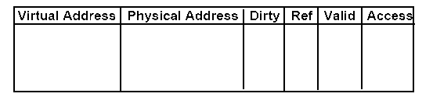
Translation Lookaside Buffer (TLBs)
A way to speed up VM translation is to use a special cache of recently used page table entries -- this has many names, but the most frequently used is Translation Lookaside Buffer or TLB
Really just a cache on the page table mappings TLB access time comparable to cache access time (much less than main memory access time)

Slide 23
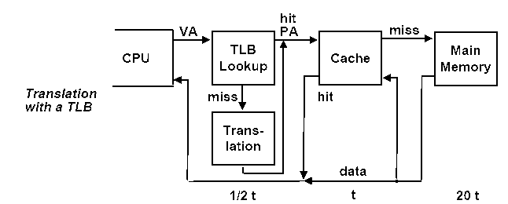
Translation Lookaside Buffer (TLBs)
Just like any other cache, the TLB can be organized as fully associative, set associative, or direct mapped.
TLBs are usually small, typically not more than 128 - 256 entries even on high end machines. This permits fully associative lookup on these machines. Most mid-range machines use small n-way set associative organizations.

Slide 24
Example-1
A virtual memory system uses 4KByte pages, 64-bit words, and a 48-bit virtual address. A particular program and its data require 4395 pages.
a- What is the minimum number of page tables required?
b-How many entries are there in the last page table.

Slide 25
Example-2
A small TLB has the following entries for a virtual page number of length 20 bits, a physical page number of 12 bits, and a page offset of 12 bits.
Valid-bit Dirty-bit Tag (Virtual Page Data (Physical
Number) Page Number)
1 1 01AF4 FFF
0 0 0E45F E03
0 0 012FF 2F0
1 0 01A37 788
1 0 02BB4 45C
0 1 03CA0 657
The page number and offset are hexadecimal. For each of the virtual address listed, indicate a hit occurs and if it does, give the physical address : (a) 02BB4A65 (b)0E45FB32 (c)0D34E9DC (d)03CA0777

Slide 26
Page Selection Policy
Demand paging:
– Load page in response to access (page fault)
– Predominant selection policy
l Pre-paging (prefetching):
– Predict what pages will be accessed in near future
– Prefetch pages in advance of access
– Problems:
* Hard to predict accurately (trace cache)
* Mispredictions can cause useful pages to be replaced
Overlays
– Application controls when pages loaded/replaced
– Only really relevant now for embedded/real-time systems

Slide 27
Page Replacement Policy
Random
– Works surprisingly well
FIFO (first in, first out)
– Throw out oldest pages
MIN (or OPTIMAL)
– Throw out page used farthest in the future
LRU (least recently used)
– Throw out page not used in longest time
NFU/Clock (not frequently used)
– Approximation to LRU _ do not throw out recently used pages

Slide 28
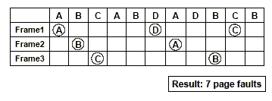
FIFO Page Replacement
FIFO: replace oldest page (first loaded)
Example:
– Memory system with three pages _ all initially free
– Reference string: A B C A B D A D B C B

Slide 29
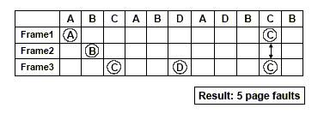
Optimal Page Replacement
Optimal: replace page used farthest in future
– If several equal candidates, select one at random
Example:
– Memory system with three pages _ all initially free
– Reference string: A B C A B D A D B C B

Slide 30
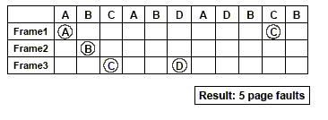
LRU Page Replacement
LRU: replace page used farthest in past
Example:
– Memory system with three pages _ all initially free
– Reference string: A B C A B D A D B C B

Slide 31
Example-1
In a paged system, suppose the following pages are requested
in the order shown;
12, 14, 2, 34, 56, 23, 14, 56, 34, 12
and the main memory partition can only hold four pages at any
instant (in practice usually many more pages can be held). List
the pages in the main memory after each page is transferred
using each of the following replacement algorithms:
(a) First-in-first-out replacement algorithm
(b) Least recently used replacement algorithm
(c) Clock replacement algorithm

Slide 32
Example-2
Using one use bit with each page entry, list the pages recorded in the following sequence and hence determine the pages removed using one use bit approximation to the least recently used algorithm:
13, 47, 13, 99, 47, 35, 13, 67, 47, 13, 34, 35, 99, 99, 14, 14, 47, 67
given that there are four pages in the memory partition. The use bits are only read at page fault time, and then scanned in the same order.
Suppose two use bits are provided. The first use bit is set when the page is first referenced. The second use bit is set when the page is referenced again. Deduce an algorithm to remove pages from the partition, and list the pages.

Slide 33
Things to Remember
Apply Principle of Locality Recursively
Manage memory to disk? Treat as cache
  Included protection as bonus, now critical
  Use Page Table of mappings vs. tag/data in cache
Virtual Memory allows protected sharing of memory between processes with less swapping to disk, less fragmentation than always swap or base/bound

