Slide 1
Reflectance Map: Photometric Stereo and Shape from Shading
Image Brightness
Radiometry
Image Formation
Bidirectional Reflectance Distribution Function
Surface Orientation
The Reflectance Map
Shading in Images
Photometric Stereo
Shape from Shading

Slide 2
Introduction
We examine the photometric stereo method for recovering the orientation of surface patches from a number of images taken under different lighting conditions. The photometric stereo method is simple to implement, but requires control of lighting.
Shape from shading is more difficult problem of recovering surface shape from a single image.

Slide 3
Introduction
We need to know something about radiometry.
We have to learn how image irradiance depends on scene radiance.
The detailed dependence of surface reflection on the geometry of incident and emitted rays is given by bidirectional reflectance distribution function (BRDF).
The reflectance map can be derived from that function and the distribution of light sources.

Slide 4
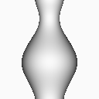
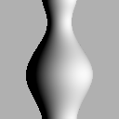
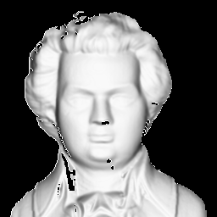
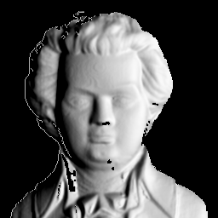
Image Brightness
The image of a three-dimensional object depends on its shape, its reflectance properties, and the distribution of light sources.

Slide 5
Radiometry
Irradiance: The amount of light falling on a surface is called the irradiance. It is the power per unit area(W.m⁻²-watts per square meter) incident on the surface.
Radiance: The amount of light radiated from a surface is called the radiance. It is the power per unit area per unit solid angle (W.m⁻².sr⁻¹-watt per square meter per steradian) emitted from the surface.

Slide 6
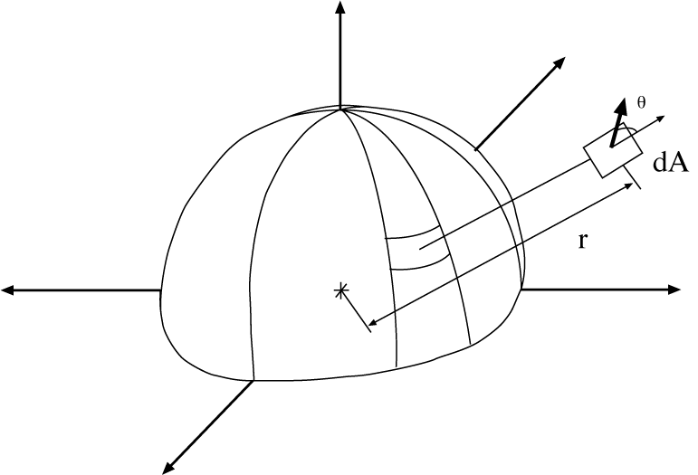
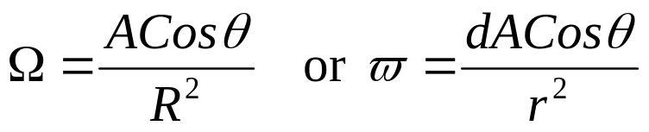
Radiometry
The solid angle subtended by a small patch is proportional to its area A and the cosine of the angle of inclination θ ; it is inversely proportional to the square of its distance R from the origin.
A
θ
R
where θ is the angle between a surface normal and a line connecting the patch to the origin.
Brightness is determined by amount of energy an image system receives per unit appereant area.

Slide 7
Image Formation
Consider a lens of diameter d at a distance f from the image plane.
Let a patch on the surface of the object have area δO, while the corresponding image patch has area δI.
Suppose that the ray from object patch to the center of the lens makes an angle α with the optical axis and that there is an angle θ between this ray and a surface normal.
The object patch is at a distance –z from the lens, measured along the optical axis.
The ratio of the area of the object patch to that of the image patch is determined by the distances of these patches from the lens and by foreshortening.

Slide 8
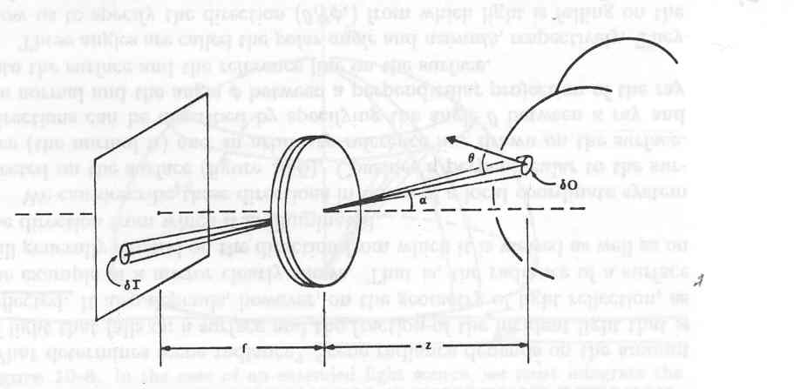
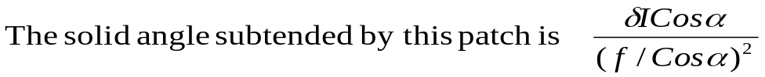
Image Formation
The solid angle of the cone of rays leading to the patch on the object is equal to the solid angle of the cone of rays leading to the corresponding patch in the image.
The apparent area of the image patch as seen from the center of the lens is δIcosα, while the distance of this patch from the center of the lens is f/Cosα.

Slide 9
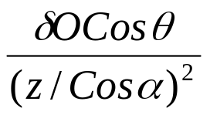
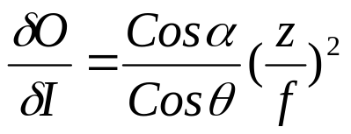
Image Formation
Similarly, the solid angle of the patch on the object as seen from the lens is
If these two solid angle are to be equal, we must have

Slide 10
Bidirectional Reflectance Distribution Function-BRDF
Scene radiance depends on the amount of light that falls on a surface and the fraction of the incident light that is reflected.
The radiance of a surface will generally depend on the direction from which it is viewed as well as on the direction from which it is illuminated.

Slide 11
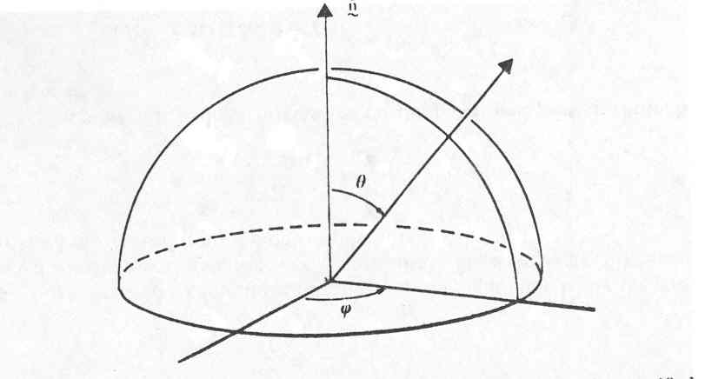
Bidirectional Reflectance Distribution Function-BRDF
Directions can be described by specifying the angle θ between a ray and the normal and the angle Ø between a perpendicular projection of the ray onto the surface and the reference line on the surface.
We can describe these directions in terms of a local coordinate system. The direction of incident and emitted light rays can be specified in a local coordinate system using the polar angle θ and the azimuth Ø.

Slide 12
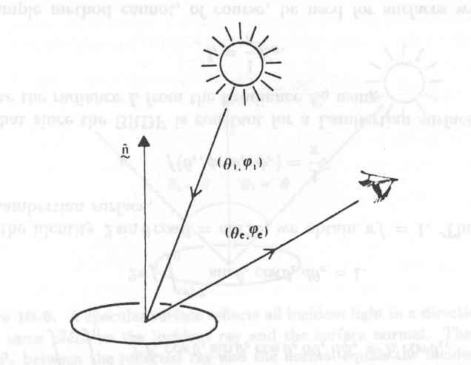
Bidirectional Reflectance Distribution Function-BRDF
The bidirectional reflectance distribution function is the ratio of the radiance of the surface patch as viewed from the direction (θ_{e}, ø_{e}) to the irradiance resulting from illumination from the direction (θ_{i}, ø_{i}).

Slide 13
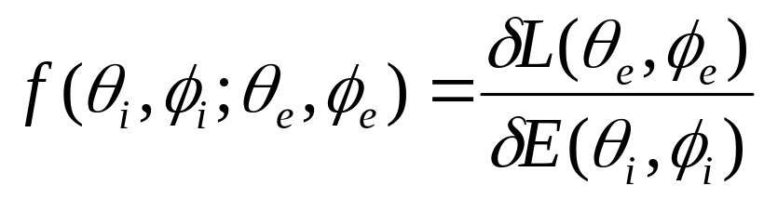
Bidirectional Reflectance Distribution Function-BRDF
Let the amount of light falling on the surface from the direction (θ_{i}, ø_{i}) –the irradiance- be δE(θ_{i}, ø_{i}).
Let the brightness of the surface as seen from the direction (θ_{e}, ø_{e}) –the radiance- be δL(θ_{e}, ø_{e}).
The BRDF is simply the ratio of radiance to irradiance,
Fortunalety, for many surfaces the radiance is not altered if the surface rotated about the surface normal. In this case, the BRDF depends only on the difference ø_{e} – ø_{i} , not on ø_{e} and ø_{i} separatly.

Slide 14
Surface Orientation
A smooth surface has a tangent plane at every point.
The surface normal, a unit vector perpendicular to the tangent plane is used for specifying the orientation of this plane.
The normal vector has two degrees of freedom, since it is a vector with three components and one constraint –that the sum of squares of the components must equal one.

Slide 15
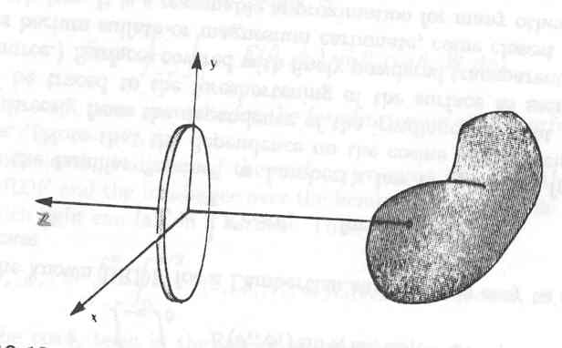
Surface Orientation
A portion of a surface can be described by its perpendicular distance –z from the lens plane.
This distance will depend on the lateral displacement (x,y).
A surface can be conveniently described in terms of its perpendicular distance –z(x,y) from some reference plane parallel to the image plane.

Slide 16
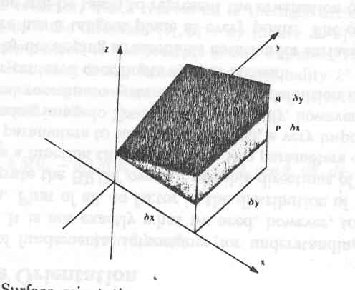
Surface Orientation
The surface normal is perpendicular to all lines in the tangent plane of the surface.
As a result, it can be found by taking the cross-product of any two (nonparallel) lines in the tangent plane.
Consider taking a small step δx in the x-direction starting from a given point (x,y).

Slide 17
Surface Orientation
We use the abbreviations p and q for the first partial derivatives of z with respect to x and y, respectively.
Thus p is the slope of the surface measured in the x-direction, while q is the slope in the y-direction.

Slide 18
Surface Orientation
A line parallel to the vector
r_{x}=(1,0,p)^{T}
lies in the tangent plane at (x,y).
Similarly, a line parallel to
r_{y}=(0,1,q)^{T}
lies in the tangent plane also.
A surface normal can be found by taking the cross-product of these two lines.
  N=r_{x}xr_{y}=(-p, -q, 1)^{T}
Appropriately enough, (p,q) is called the gradient of the surface, since its components, p and q, are the slopes of the surface in the x- and y-directions, respectively. p=∂z/∂x and q= ∂z/∂y

Slide 19
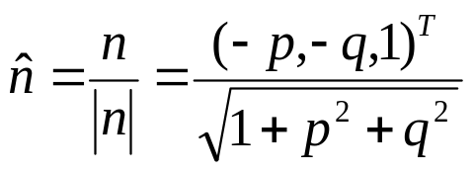
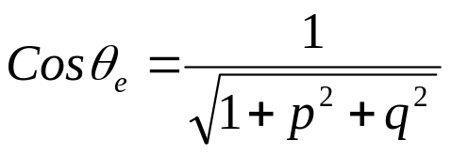
Surface Orientation
The unit surface normal is just
The unit view vector v from the object to the lens is (0,0,1)^{T}
We can calculate the angle θ_{e} between the surface normal and the direction to the lens by taking the dot product of the two unit vectors.

Slide 20
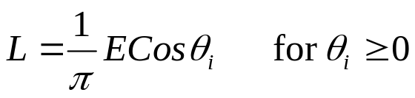
The Reflectance Map
The reflectance map makes explicit the relationship between surface orientation and brightness. It encodes information about surface reflectance properties and light-source distributions.
Consider a source of radiance E illuminating a Lambertian surface. The scene radiance is
Where θ_{i} is the angle between the surface normal and the direction toward the source.

Slide 21
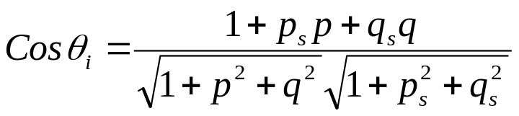
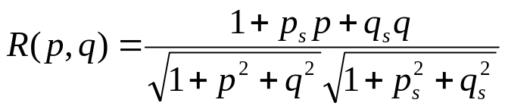
The Reflectance Map
Taking the dot product of the corresponding unit vectors, we obtain
The result is called the reflectance map, denoted R(p,q).
The reflectance map depends on the properties of the surface material of the object and the distribution of light sources. Note that radiance cannot be negative, so, we should, impose the restriction 0 ≤ θ_{i} ≤ π/2. The radiance will be zero for values of θ_{i} outside this range.

Slide 22
Photometric Stereo
Surface orientation can usually be determined uniquely for some special points, such as those where the brightness is a maximum or minimum of R(p,q). For a Lambertian surface, for example, R(p,q) =1 only when Cosθ_{i} =0º (means (p,q)=(p_{s},q_{s})).
In general, however, the mapping from brightness to surface orientation cannot be unique, since brightness only has one degree of freedom, while orientation has two.
To recover surface orientation locally, we must introduce additional information. To determine two unknowns, p and q, we need two equations.

Slide 23
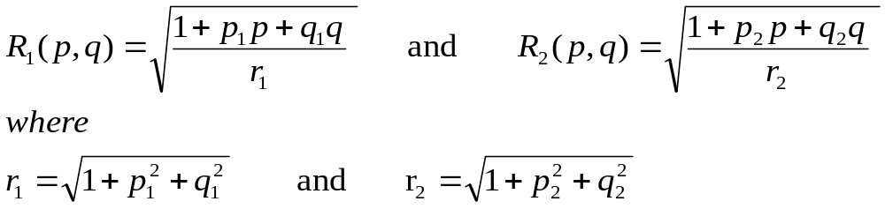
Photometric Stereo
Two images, taken with different lighting, will yield two equations for each image point
  R₁(p,q)=E₁ and R₂(p,q)=E₂
If these equations are linear and independent, there will be a unique solution for p and q.
Suppose, for example, that

Slide 24
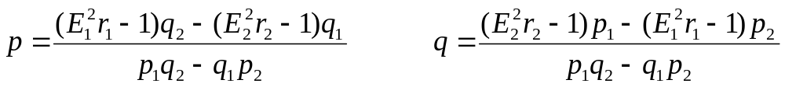
Photometric Stereo
Then
Provided p₁/q₁≠ p₂/q₂ .Thus a unique solution can be obtained for surface orientation at each point, given two registered images taken with different lighting conditions. This is an illustration of the method of photometric stereo.

