Slide 1
Binary Image Processing
Studying binary image analysis before going on to gray-tone and color image.
  Object Counting Algorithm
  Connected Component Labeling Operator
  Global thresholding
  Mathematical Morphology to join and separate components, close up holes
  Region Properties

Slide 2
Thresholding and Segmentation
Gray level thresholding is the simplest segmentation process.
Many objects or image regions are characterized by constant reflectivity or light absorption of their surface.
Thresholding is computationally inexpensive and fast.
Thresholding can easily be done in real time using specialized hardware

Slide 3


Thresholding
Complete segmentation can result from thresholding in simple scenes.
Thresholding

Slide 4
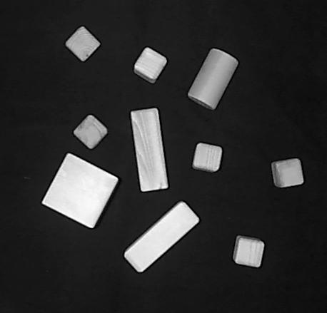

Thresholding - Example
Original Image
Thresholded Image (95)

Slide 5
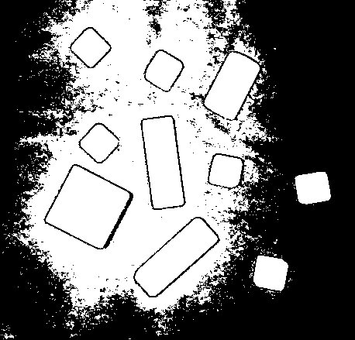
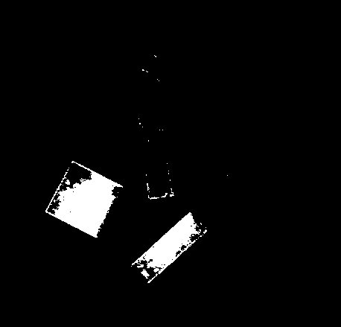
Thresholding Example
Over-segmentation (25)
Under-segmentation (225)

Slide 6
Algorithm
Thresholding algorithm
  Search all the pixels f(i,j) of the image f.
  An image element g(i,j) of the segmented image is an object pixel if f(i,j) >= T, and is a background pixel otherwise
Correct threshold selection is crucial for successful threshold segmentation
Threshold selection can be interactive or can be the result of some threshold detection method

Slide 7
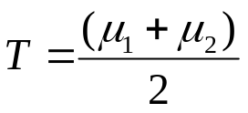
Global Thresholding
1- Select an initial estimate for T. A suggested initial estimate is the mid-point between the minimum and maximum intensity values in the image.
2- Segment the image using T. This will produce two groups of pixels:
G₁, consisting of all pixels with intensity values ≥T
G₂ consisting of pixels with value <T.
3- Compute the average intensity values μ₁ and μ₂ for the pixels in the regions G₁ and G₂.
4- Compute a new threshold value:
5- Repeat step 2 through 4 until the difference in T in successive iterations is smaller than a predefined parameter T₀.

Slide 8
Global Thresholding in Matlab
T=0.5*(double(min(f(:)))+ double(max(f(:))));
done = false;
while ~done
g= f>=T;
Tnext=0.5*(mean(f(g)) + mean(f(~g)));
done=abs(T-Tnext)>0.5;
T=Tnext;
end

Slide 9
Approaches
Single global threshold ... successful only under very unusual circumstances
gray level variations are likely - due to non-uniform lighting, non-uniform input device parameters or a number of other factors.

Slide 10
Another Approach
Variable thresholding (also adaptive thresholding), in which the threshold value varies over the image as a function of local image characteristics, can produce the solution in these cases.

Slide 11
Adaptive Algorithm
image f is divided into subimages f_{c}
a threshold is determined independently in each subimage
if a threshold cannot be determined in some subimage, it can be interpolated from thresholds determined in neighboring subimages.
each subimage is then processed with respect to its local threshold.

Slide 12

Thresholding modifications
Band-thresholding
  segment an image into regions of pixels with gray levels from a set D and into background otherwise
  Can also serve as border detection

Slide 13
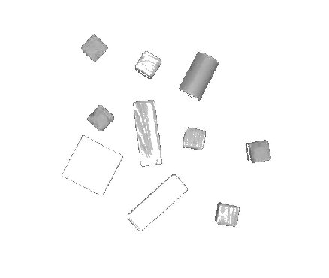
Example
Intensity values between 90 and 200

Slide 14
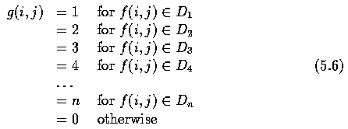
Other Thresholds
Multithresholding
  resulting image is no longer binary

Slide 15
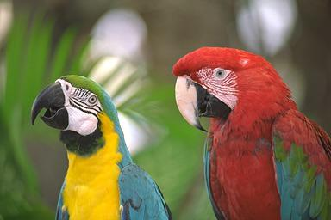
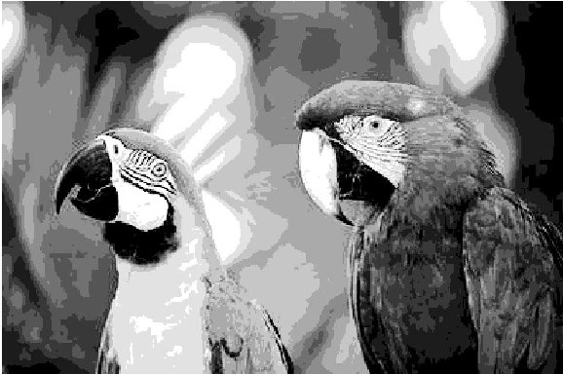
Example

Slide 16

Other Thresholds
Semi-thresholding
  aims to mask out the image background leaving gray level information present in the objects

Slide 17
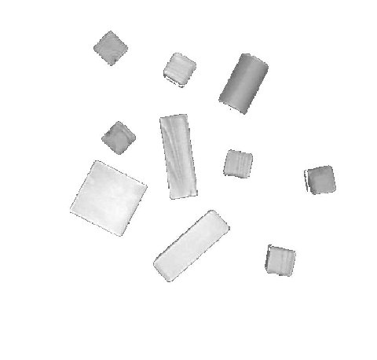
Example

Slide 18
Summary
Thresholding can also be applied to
  gradient
  local texture
  any other image decomposition criterion

Slide 19
Thresholding Gray-Scale Images
Binary images can be obtained from gray-scale images by thresholding operations.
A thresholding operation chooses some of the pixels as the foreground pixels that make up the objects of interest and the rest as background pixels.

Slide 20
Automatic Thresholding
Given the histogram, automatic procedures can be written to detect peaks and valleys of the histogram function.
The simplest case is when we are looking for a single threshold that separates the image into dark pixels and light pixels.
If the distributions of dark pixels and bright pixels are widely separated, then the image histogram will be bimodal.

Slide 21
Two image histogram
The histogram has two easily seperable modes
The histogram has overlapped modes that make it more difficult to find a suitable threshold

Slide 22
Automatic Thresholding: The Otsu Method
Otsu method selects the threshold based on the minimization of the within-group variance of the two groups of pixels seperated by the thresholding operator.
Specify the histogram function as a probability function P where P(0), . . . , P(I) represent the histogram probabilities of the observed gray values 0, . . . ,I
P(i)=|{(r,c)| Image(r,c)=i}| / |RxC| , where RxC is the spatial domain of the image.
If the histogram is bimodal, the histogram thresholding problem is to determine a best threshold t separating the two modes of the histogram from each other.

Slide 23
Automatic Thresholding: The Otsu Method (2)
A measure of group homogeneity is variance. A group with high homogeneity will have low variance.
One possible way to choose the dividing criterion is to choose a dividing score such that the resulting weighted sum of the within-group variance is minimized. This criterion emphasizes high group homogeneity.
A second way to choose the dividing criterion is to choose a dividing score that maximizes the resulting squared difference between the group means. This difference is related to the between-group variance.

Slide 24
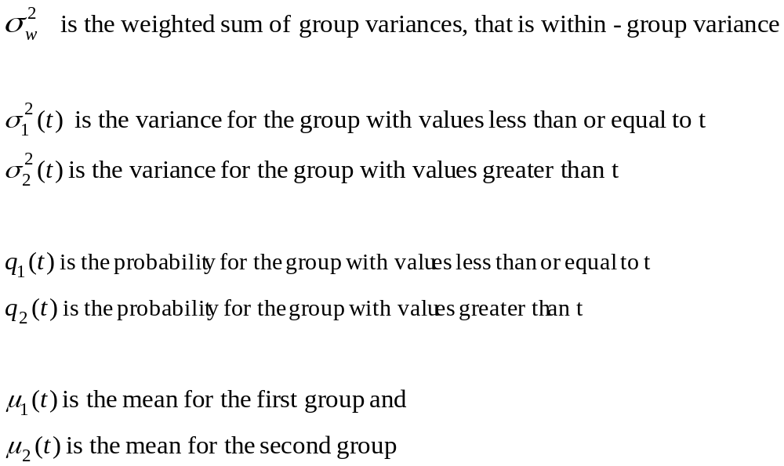
Automatic Thresholding: The Otsu Method (3)

Slide 25
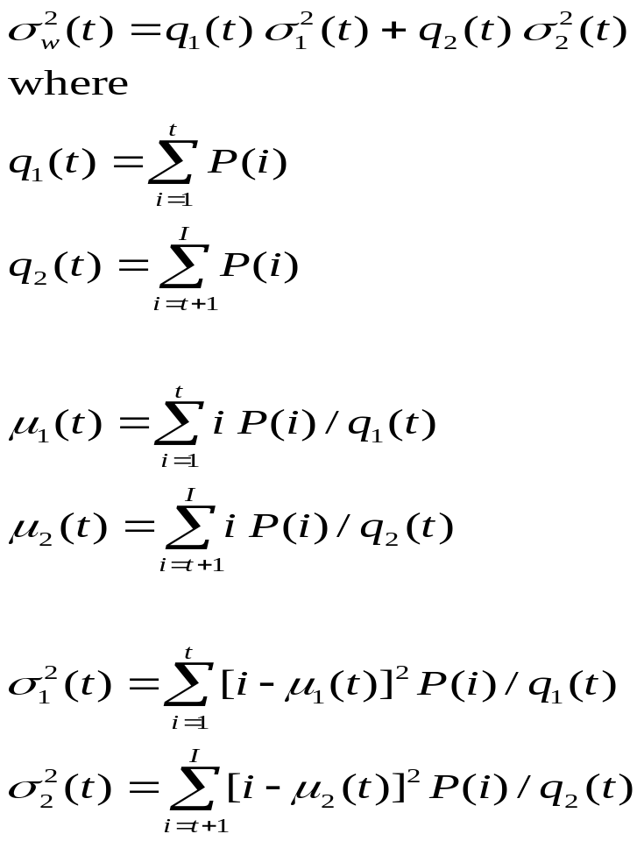
Automatic Thresholding: The Otsu Method (4)

Slide 26
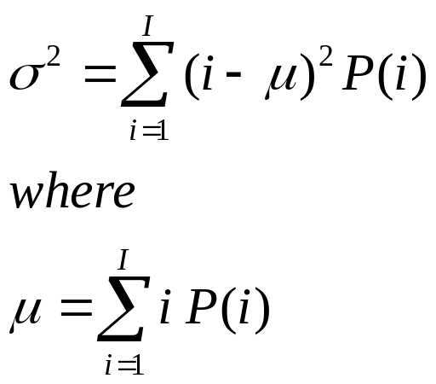
Automatic Thresholding: The Otsu Method (5)
The best threshold can be determined by a simple sequential search through all possible values of t to locate the threshold t that minimizes (t).
There is a relationship between the within-group variance σ²_{w}(t) and the total variance σ² that does not depend on the threshold.

Slide 27
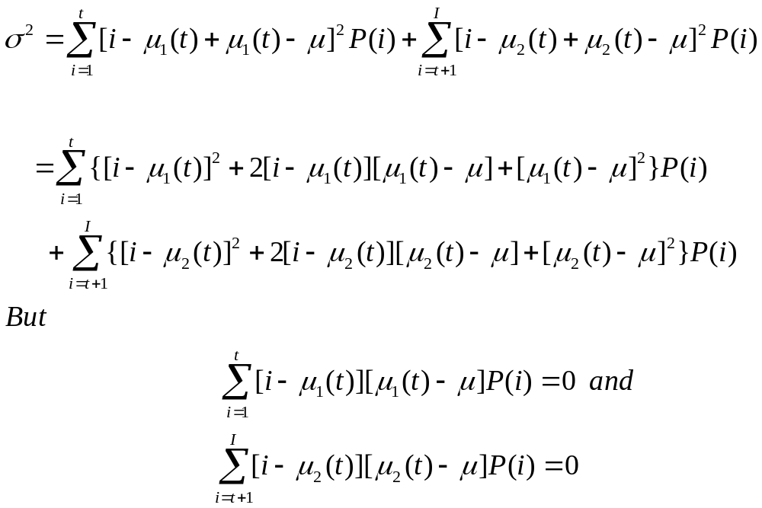
Automatic Thresholding: The Otsu Method (6)
The relationship between the total variance and the within-group variance can make the calculation of the best threshold less computationally complex.

Slide 28
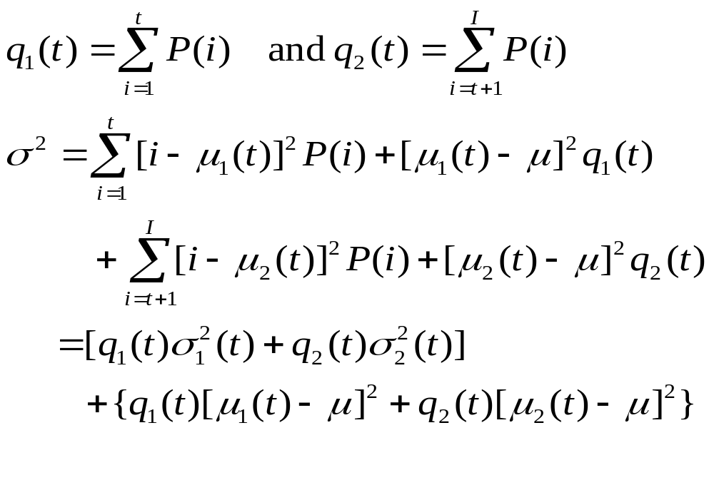
Automatic Thresholding: The Otsu Method (7)
The first bracketed term is the within-group variance σ²_{w}. It is just the sum of the weighted variance of each of the two groups. The second bracketed term is called the between-group variance σ²_{B} . It is just the sum of weighted squared distances between the means of each group and the grand mean.

Slide 29
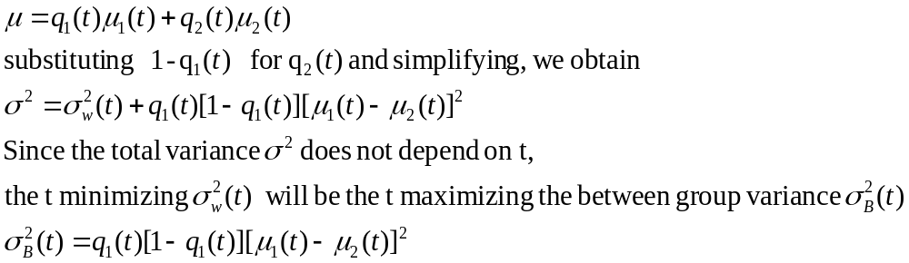
Automatic Thresholding: The Otsu Method (8)
Between-group variance can be simplified. Note that grand mean μ can be written as

Slide 30
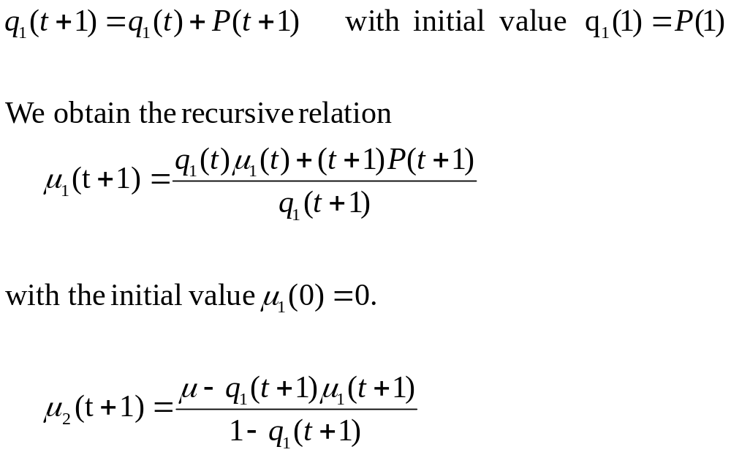
Automatic Thresholding: The Otsu Method (9)
To determine the maximizing t for σ²_{B} , this need not be done independently for each t. We have directly write the recursive relationship

Slide 31
Automatic Thresholding: The Otsu Method (10)
Automatic threshold-finding algorithms work well when the images to be thresholded satisfy their assumptions about the distribution of the gray-tone values over the image.
Otsu automatic threshold finder assumes a bimodal distribution of gray-tone values. If the image approximately fits this constraint, it will do a good job.
If the image is not at all bimodal, the results are not likely to be useful.

Slide 32
Otsu Thresholding in Matlab:
Function graythresh takes an image, computes its histogram, and finds the threshold value that maximizes between-class variance. The threshold is returned as a normalized value between 0 and 1. The calling syntax for graythresh is
T = graythresh(f);
where f is the input image and T is the resulting threshold.

Slide 33
Counting objects in an image
Can use our hole-counting algorithm – just negate the image (and the edge identification masks)
Convention for algorithms
  Global variables
  Procedures with return statements
  Trivial operations – no details

Slide 34
Object counting algorithm
Objects are 4-connected and simply connected
E – num of external corners
I – num of internal corners
procedure count_objects(B – binary image)
{
E = 0; I = 0;
for L = 0 to MaxRow – 1
  for P = 0 to MaxCol – 1
    {
      If external_match(L,P) then E = E+1;
      If internal_match(L,P) then I = I+1;
    }
return((E-I)/4);
}
0 | 0
0 | 1
0 | 0
1 | 0
1 | 0
0 | 0
0 | 1
0 | 0
E: External corner
1 | 1
1 | 0
1 | 1
0 | 1
0 | 1
1 | 1
1 | 0
1 | 1
I:Internal corner

Slide 35
Connected Components
Components are objects that share at least one common neighbor (in 4- or 8- neighborhood).
Defn: A connected component labeling of binary image B is a labeled image LB in which the value of each pixel is the label of its connected component.

Slide 36
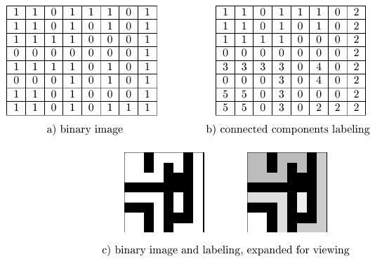

Slide 37
Recursive Labeling Algorithm
Given a binary image B
  Negate the image (make all 1-pixels to –1)
  Search and find a –1 pixel, label it and find its (4- or 8-) neighboring pixels with –1 and assign the same label.
  Recursively apply to resolve (merge or split) components.
  Cost?

Slide 38
Compute the connected components of a binary image
B is the original image
LB will be the labeled connected component image.
procedure recursive_connected_components(B,LB);
{
LB:=negate(B);
label:=0;
find_componets(LB,label);
print(LB);
}
procedure find_components(LB,label);
{
for L:=0 to MaxRow
for P:=0 to MaxCol
if LB[L,P]==-1 then
{
label:=label+1;
search(LB,label,L,P);
}
}
procedure search(LB,label,L,P);
{
LB[L,P]:=label;
Nset:=neighbors(L,P);
for each [L’,P’] in Nset
{
if LB[L’,P’]==-1
then search(LB,label,L’,P’);
}
}

Slide 39
Row-by-Row Labeling
Classic two-pass algorithm.
First pass creates equivalency table.
Second pass processes equivalency table to merge components.
Union-find algorithm.
Cost?

Slide 40
Binary Image Morphology
The operations of binary morphology input a binary image B and a structuring element S.
S is usually a smaller binary image.
S can be any shape, circular or square etc.
S acts as a probe of the binary image.
One pixel of S is designated as the origin.

Slide 41
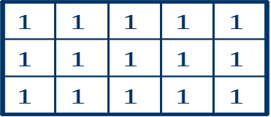
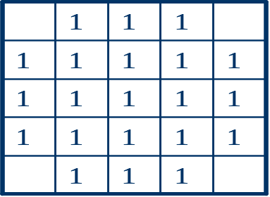
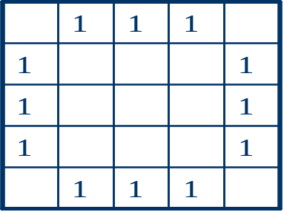
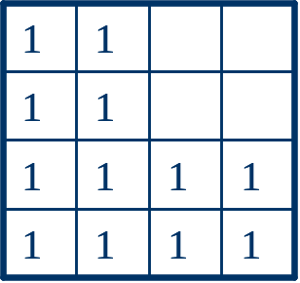
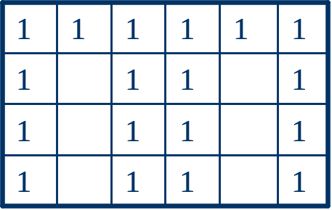

Structuring Elements
Box(3,5)
Disk(5)
Ring(5)
Example of structuring elements (blanks represent 0s)

Slide 42
Structuring elements
By placing the origin anywhere in the image, either the region can be enlarged by the shape or to check whether or not the shape fits inside a region.
Think of this as the template for template-matching in a binary image.

Slide 43
Basic morphologies
Translation – the translation X_{t} of a set of pixels X by a position vector t is defined by:
  X_{t} = {x + t | x є X}
  Vector t usually specific translation along the rows as well as the columns
Dilation – enlarges a region by one pixel along all directions.

Slide 44

Original Image
(Binary Image) B
After dilation:B S
Structuring
Element-S
1 | 1 | 1 | 1 | 1 | 1 | 1
 |  |  | 1 | 1 | 1 | 1
 |  |  | 1 | 1 | 1 | 1
 |  | 1 | 1 | 1 | 1 | 1
 |  |  | 1 | 1 | 1 | 1
 |  | 1 | 1
1 | 1 | 1 | 1 | 1 | 1 | 1 | 1
1 | 1 | 1 | 1 | 1 | 1 | 1 | 1
1 | 1 | 1 | 1 | 1 | 1 | 1 | 1
 | 1 | 1 | 1 | 1 | 1 | 1 | 1
 | 1 | 1 | 1 | 1 | 1 | 1 | 1
 | 1 | 1 | 1 | 1 | 1 | 1 | 1
 | 1 | 1 | 1 | 1 | 1 | 1 | 1
 | 1 | 1 | 1 | 1
1 | 1 | 1
1 | 1 | 1
1 | 1 | 1
Dilation: Each time the origin of the structuring element touches a binary 1-pixel, the entire translated structuring element shape is ORed to the output image, which has been initialized to all zeros.

Slide 45
More operations
Erosion – removes one pixel element from the borders: B Ө S
The Closing operation performs a dilation followed by an erosion: B●S=(B S) Ө S
The Opening operation performs an erosion followed by a dilation: BoS=(B Ө S) S

Slide 46
1 | 1 | 1 | 1 | 1 | 1 | 1
 |  |  | 1 | 1 | 1 | 1
 |  |  | 1 | 1 | 1 | 1
 |  | 1 | 1 | 1 | 1 | 1
 |  |  | 1 | 1 | 1 | 1
 |  | 1 | 1
Original Image B
 |  |  |  | 1 | 1
 |  |  |  | 1 | 1
 |  |  |  | 1 | 1
 | 1 | 1 | 1 | 1 | 1 | 1
 |  | 1 | 1 | 1 | 1 | 1
 |  | 1 | 1 | 1 | 1 | 1
 |  | 1 | 1 | 1 | 1 | 1
 |  | 1 | 1 | 1 | 1 | 1
 |  | 1 | 1
 |  |  | 1 | 1 | 1 | 1
 |  |  | 1 | 1 | 1 | 1
 |  |  | 1 | 1 | 1 | 1
 |  |  | 1 | 1 | 1 | 1
 |  |  | 1 | 1 | 1 | 1
Erosion: B Ө S
Closing:B●S=(B S) Ө S
Opening: BoS=(B Ө S) S

Slide 47
Applications
Closing and openings are useful in binary images with tiny holes in the connect components that should be separate.
Medical image analysis

Slide 48
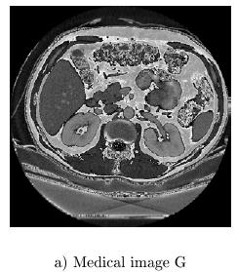
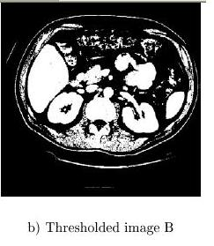
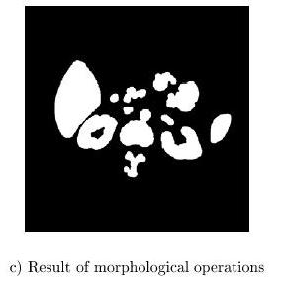

Slide 49
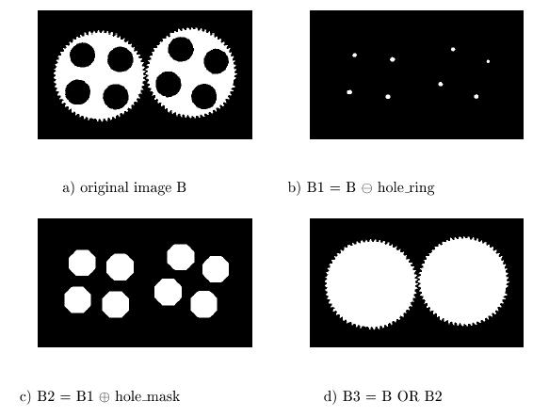
Another application

Slide 50
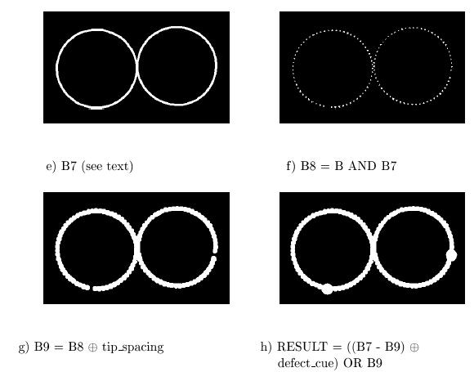

Slide 51
Morphological Operators -Erosion and Dilation
In a binary image this is also known as Expanding and Shrinking.
Expanding – Change a pixel from 0 to 1 if any of the neighbors of the pixel are 1.
Shrinking – Change a pixel from 1 to 0 if any neighbor of the pixel are 0.

Slide 52
Erosion and Dilation
  An erosion followed by a dilation (refered to as an "Open" operation) can be used to eliminate point noise.
  A dilation operation followed by erosion (referred to as a "Close" operation) can be used to close up holes or gaps in the object of interest.
  While erosion and dilation can employ arbitrary "structuring elements", a typical structuring element is simply a 3x3 matrix of 1's.

Slide 53
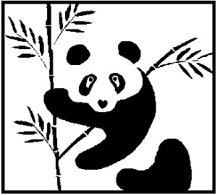

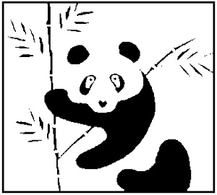
Original Image
After Dilation
After Erosion

Slide 54
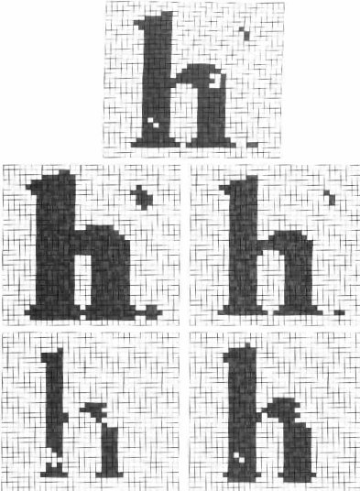

Slide 55
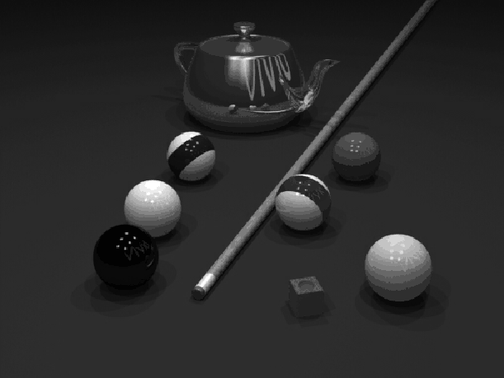
Erosion and Dilation in Grayscale Images
Original Image

Slide 56
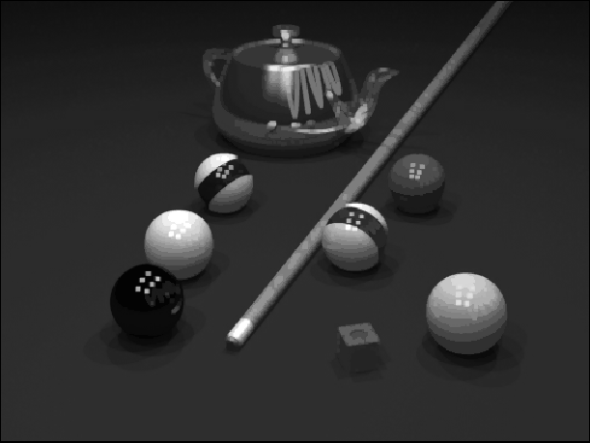
Resulting image after applying grayscale dilation

Slide 57
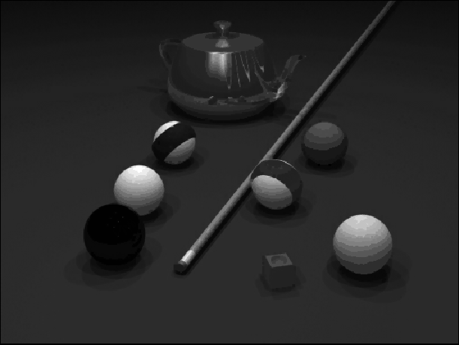
Resulting image after applying grayscale erosion.

Slide 58
Region Properties
Once a binary image has been processed we could obtain properties about the regions in the processed image.
Some of those properties are
  Area, centroid, perimeter, perimeter length, circularity of the region and second circularity measure

Slide 59
Area and Centroid
Area A = sum of all the 1-pixels in the region.
Centroid [r’,c’] is the average location of the pixels in the region
  r’ = 1/A*Sum of all the rows in the region
  c’ = 1/A*Sum of all the columns in the region.

Slide 60
The Perimeter
A simple definiton of the perimeter of a region without holes i set of its interior border pixels.
A pixel of a region is a border pixel if it has some neighboring pixel that is outside the region.
When 8-connectivity is used to determine whether a pixel inside the region is connected to a pixel outside the region, the resulting set of perimeter pixel is 4-connected.
When 4-connectivity is used to determine whether a pixel inside the region is connected to a pixel outside the region, the resulting set of perimeter pixel is 8-connected.

Slide 61

The Perimeter
Perimeter:

Slide 62

The Length of the Perimeter
To compute length |P| of perimeter P, the pixels in P must be ordered in a sequence P=<(r0,c0),. . . , (rk-1,ck-1)>, each pair of successive pixels in the sequence being neighbor, including the first and last pixels.

Slide 63

Circularity(1)
With the area A and perimeter P defined, a common measure of the circularity of the region is the length of the perimeter squared divided by the area.

Slide 64
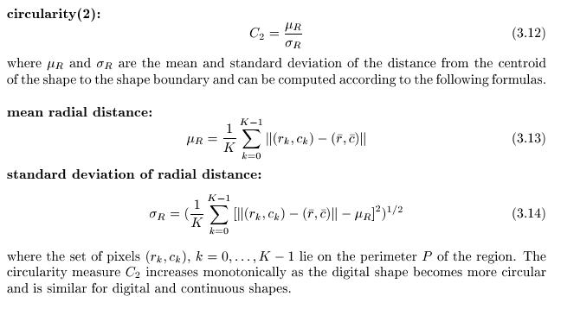
Circularity(2)

Slide 65
