Slide 1
Matching in 2D
Mapping:
  Scaling
  Rotation
  Translation
  Warp

Slide 2
Introduction
How to make and use correspondences between
  images and maps,
  images and models,
  images and other images
All work is done in two dimensions

Slide 3
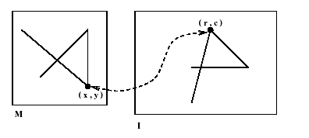
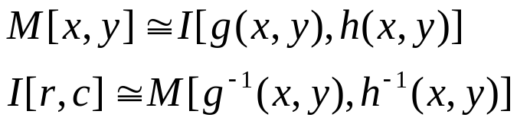
Registration of 2D Data
Equation and figure show an invertible mapping points of a model M and points of an image I. Actually, M and I can be any 2D coordinate space and each represent a map, a model, or image. The mapping is invertible: functions g⁻¹ and h⁻¹ exist.
Image registration is the process by which points of two images similar viewpoints of essentially the same scene are geometrically transformed so that corresponding feature points of the two images have the same coordinates after transformation.

Slide 4
Representation of points
A 2D point has two coordinates and is conveniently represented as either a row vector P=[x,y] or column vector P=[x,y]^{t} .
Homogeneous Coordinates: It is often convenient notationally for computer processing to use homogeneous coordinates for points, especially when affine transformations are used.
The homogeneous coordinates of a 2D point P=[x,y]^{t} are [sx,sy,s]^{t}, where s is a scale factor, commonly 1.0

Slide 5
AFFINE MAPPING FUNCTIONS
  A large class of useful spatial transformations can be represented by multiplication of a matrix and a homogeneous point.
    Scaling
    Rotation
    Translation

Slide 6
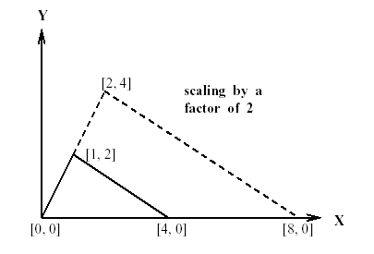
Scaling
A common operation is scaling
Uniform scaling changes all coordinates in the same way, or equivalently changes the size of all objects in the same way.
Figure shows a 2D point P=[1,2] scaled by a factor of 2 to obtain the new point P’=[2,4].

Slide 7
Scaling
Scaling is a linear transformation, meaning that it can be easily represented in terms of the scale factor applied to the two basis vectors for 2D Euclidean space. For example, [1,2]=1[1,0]+2[0,1] and 2[1,2]=2(1[1,0]+2[0,1] )=[2,4]

Slide 8
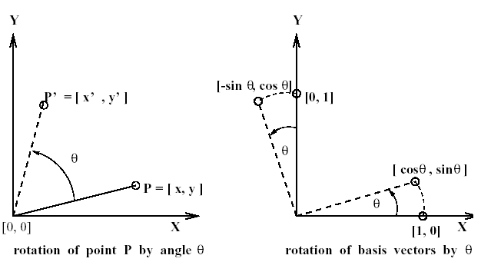
Rotation
A second common operation is rotation about a point in 2D space.
Figure shows a 2D point P=[x,y] rotated by angle θ counterclockwise about the origin to obtain the new point P’=[x’,y’].

Slide 9
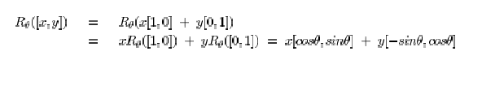

Rotation
As for any linear transformation, we take the columns of the matrix to be the result of the transformation applied to the basis vectors; transformation of any other vectors can be expressed as a linear combination of the basis vectors.

Slide 10
Orthogonal and Orthonormal Transformations
Orthogonal A set of vectors is orthogonal if all pairs of vectors in the set are perpendicular (have scalar product of zero).
Orthonormal A set of vectors is orthonormal if it is an orthogonal set and all vectors have unit length.
A rotation preserves both the length of the basis vectors and their orthogonality.

Slide 11
Translation
Often, point coordinates need to be shifted by some constant amount, which is equivalent to changing the origin of the coordinate system.
Since translation does not map the origin [0,0] to itself, we cannot model it using a simple 2x2 matrix as has been done for scaling and rotation: In other words, it is not a linear operation.

Slide 12
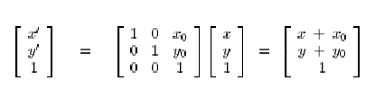
Translation
The matrix multiplication shown in equation can be used to model the translation D of point [x,y] so that [x’,y’]=D([x,y])=[x+x₀,y+y₀]

Slide 13
Exercise: Rotation about a point
Give the 3x3 matrix that represents a π/2 rotation of the plane about the point [5,8] .
Hint: First derive the matrix D_{-5,-8} that translates the point [5,8] to the origin of a new coordinate frame. The matrix which we want will be the combination D_{5,8}R_{π/2} D_{-5,-8}
Check that your matrix correctly transforms points [5,8], [6,8] and [5,9].

Slide 14
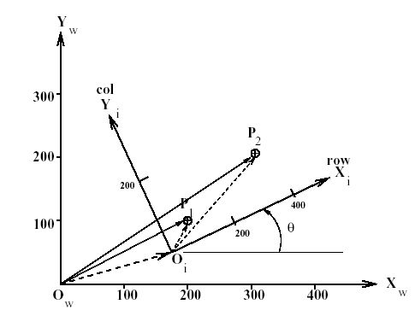
Rotation, Scaling and Translation
Figure shows a common situation: An image I[r,c] is taken by a square-pixel camera looking perpendicularly down on a planar workspace W[x,y]. This conversion can be done by composing a rotation R, a scaling S and a translation D as given and denoted ^{w}P_{j}=D_{x0,y0}S_{s}R_{θ}^{i}P_{j}.

Slide 15
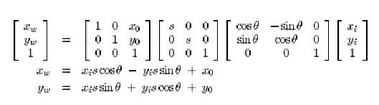
Rotation, Scaling and Translation

Slide 16
Rotation, Scaling and Translation
For example, we have
  ^{i}P₁=[100,60] and ^{w}P₁=[200,100].
  ^{i}P₂=[380,120] and ^{w}P₂=[300,200].
Control points are clearly distinguishable and easily measured points to establish known correspondences between different coordinate spaces.
θ is easily determined independent of the other parameters as follows:
  θ_{i}=arctan((^{i}y₂-^{i}y₁)/(^{i}x₂-^{i}x₁)) θ_{i}=arctan(60/280)=12.09º
  θ_{w}=arctan((^{w}y₂-^{w}y₁)/(^{w}x₂-^{w}x₁)) θ_{w}=arctan(100/100)=45º
  θ= θ_{w}- θ_{i} θ=32.91º
Once θ is determined, all sin and cos elements are known: There are 3 equations and 3 unknowns which can be solved for s and x₀ ,y₀.

Slide 17
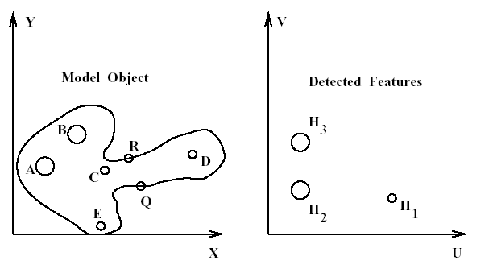
Object Recognition and Location Example
(left) Model object and (right) three holes detected in an image

Slide 18
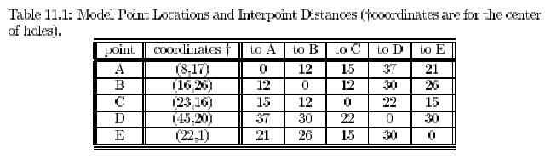

Object Recognition and Location Example
We will use the hypothesized correspondences (A,H₂) and (B,H₃) to deduce the transformation

Slide 19

Object Recognition and Location Example
The direction of the vector from A to B in the model is θ₁=arctan(9.0/8.0)=0.844
Corresponding vector from H₂ to H₃ in the image θ₂=arctan(12.0/0.0)= π/2=1.571
The rotation is thus θ=0.727 radians
The known matching coordinates for points A in the model and H₂ in the image, we obtain the following system, where u₀,v₀ are the unknown translation components in the image plane.
The two resulting equations readily produce u₀=15.3 and v₀=-5.95

Slide 20
Object Recognition and Location Example
Having a complete spatial transformation, we can now compute the location of any model points in the image space, including the grip points R=[29,19] and Q=[32,12].
As shown next, model point R transforms to image point ^{i}R=[24.4, 27.4]
Using Q=[32,12] as the input to the transformation outputs the image location ^{i}Q=[31.2, 24.2] for the other grip point.

Slide 21
2D OBJECT RECOGNITION VIA AFFINE MAPING
Methods of recognizing 2D objects through mapping of model points onto image points
  Local-Feature-Focus Method
  Pose-Clustering Algorithm
  Geometric Hashing
The methods are meant to determine if a given image contains an instance of an object model and to determine the pose (position and orientation) of the object with respect to camera.

Slide 22
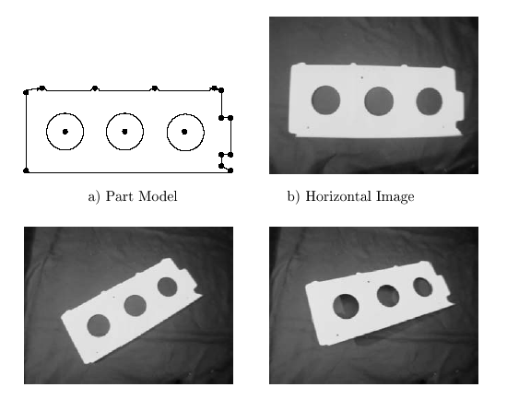
2D OBJECT RECOGNITION VIA AFFINE MAPING
A 2D model and 3 matching image of an airplane part

Slide 23
Pose Clustering
We have seen that an alignment between model and image features using an RST transformation can be obtained from two matching control points.
Obtaining the matching control points automatically may not be easy due to ambiguous matching possibilities.
The pose-clustering approach computes an RST alignment for all possible control point pairs and then checks for a cluster of similar parameter sets.

Slide 24
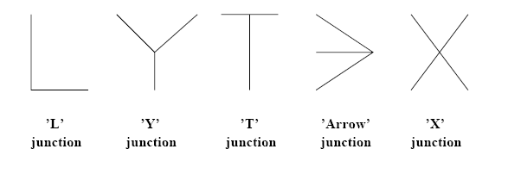
Common line-segment junctions used in matching

Slide 25
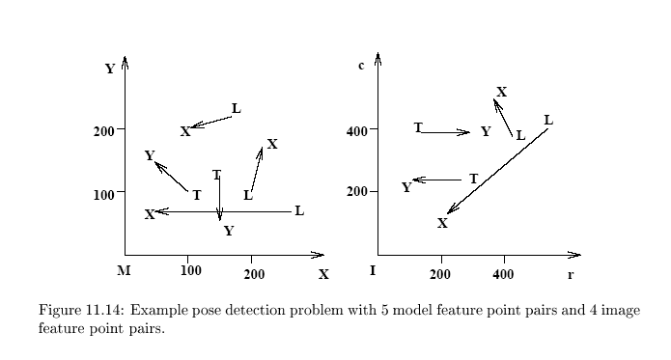
Example Pose Detection Problem
Assume that the pairs of combined type LX or TY are used in this example

Slide 26
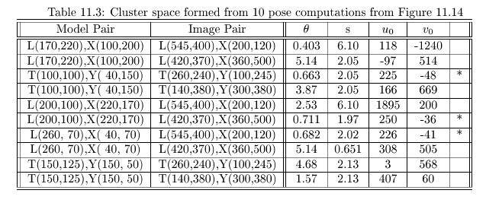
Example Pose Detection Problem

