Slide 1
Microprocessor System Design
Interrupt
Omid Fatemi
(omid@fatemi.net)

Slide 2
Outline
Interrupts
Processor steps
Interrupt service routine
Input device with interrupt
Polling vs. Interrupt

Slide 3
Interrupt
The microprocessor does not check if data is available.
The peripheral will interrupt the processor when data is available

Slide 4


Polling vs. Interrupt
instruction
While studying, I’ll check the bucket every 5 minutes to see if it is already full so that I can transfer the content of the bucket to the drum.
Input
Device
Memory
μP
POLLING

Slide 5
Polling vs. Interrupt
instruction
I’ll just study. When the speaker starts playing music it means that the bucket is full. I can then transfer the content of the bucket to the drum.
Input
Device
Memory
Interrupt
request
μP
INTERRUPT

Slide 6
Interrupt
Some terms to remember:
  Interrupt service routine
  Interrupt vectors
  Interrupt vector number
  Interrupt vector table

Slide 7
Interrupt Service Routine (ISR)
Is the routine that is executed when a certain interrupt request is granted
Is very similar to a procedure in assembly language except that it ends in IRET instead of RET

Slide 8
Interrupt Vector
Is the address of an ISR
Composed of four bytes
  2 bytes for IP
  2 bytes for CS

Slide 9
Interrupt Vector Number
Is a number that differentiates interrupt requests. Take note that there can be more than one device that can request for interrupt, in order for the processor to know which device requested an interrupt, the device gives an interrupt vector number
In 8088, there are at most 256 interrupt vector numbers (00 to FF)

Slide 10
Interrupt Vector Table
Reserved memory space where the interrupt vectors are stored
Can be viewed as an array of Interrupt Vector
  Each element of the array is four bytes in size composing of CS and IP
  There is a total of 256 elements in the array

Slide 11
How the Processor works?
External Action: The power is turned on or the reset button is pressed.
The processor is reset.
  DS, ES, SS, and IP are initialized to 0000
  CS is initialized to FFFF
  Interrupt Flag (IF) is cleared to 0
The processor fetches an instruction.
The processor increments the program counter (CS:IP) by 1.
The processor decodes and executes the instruction (if it is already complete).
Go back to step 2.

Slide 12
How the Processor works?
External Action: A peripheral requested an interrupt by pulling the interrupt line (INTR) to HIGH (Note: this action will only have an effect if IF is set to 1, and the interrupt line must be maintained HIGH until an acknowledgment is given).
The processor will complete and execute the last instruction before it acknowledges the interrupt.
The processor acknowledges the interrupt by giving a LOW pulse to its INTA’ line. At this point, the peripheral may stop pulling HIGH the interrupt line.
Receiving the LOW pulse (from INTA’ line), the peripheral which issued the interrupt request should provide an interrupt vector number through the data bus. The processor stores this interrupt vector number to a temporary register.

Slide 13
How the Processor works?
The processor pushes the contents of the status register (a 16-bit register containing all the status of the flags) to the stack.
The processor clears the Interrupt Flag (IF) and Trap Flag (TF) are cleared
The content of the CS register is pushed to the stack.
The content of the IP register is pushed to the stack.
The processor multiplies the interrupt vector number by 4. This value is the memory location (four bytes of memory location) where the interrupt vector is located. The first two bytes is copied to the IP register, and the next two bytes is copied to the CS register.
Go back to step 2.

Slide 14
Let’s incorporate Interrupt the hardware and software
The program makes a “running LED” effect (initially moving from down to up). Every time the lowest button is pressed, it changes the direction of the movement. When the highest button is pressed, the program terminates.

Slide 15
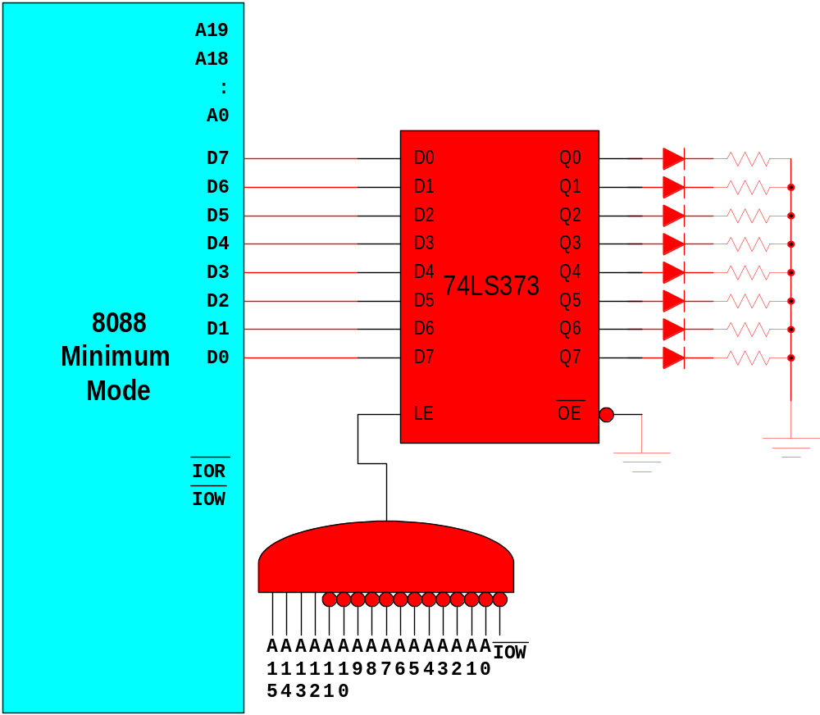
8088 and an Output Device

Slide 16
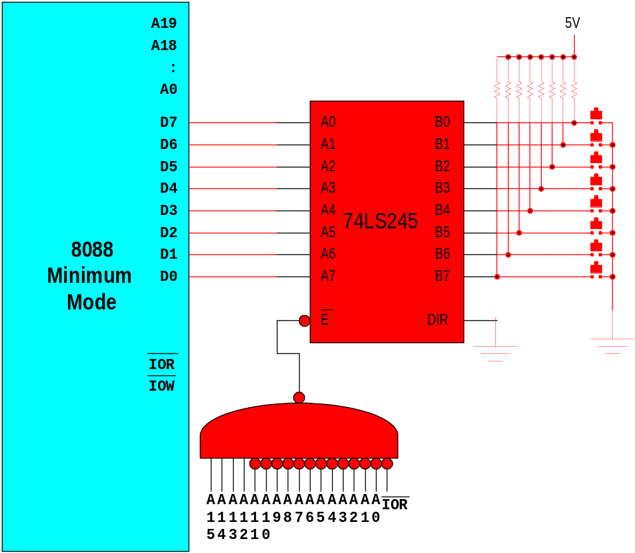
8088 and an Input Device

Slide 17
8088 and an Interrupt-driven Input Device
A19
5V
A18
:
A0
D7
A7
B7
D6
A6
B6
D5
A5
B5
D4
A4
B4
D3
A3
74LS245
B3
8088
D2
A2
B2
D1
A1
B1
Minimum
D0
A0
B0
Mode
E
DIR
IOR
IOW
INTR
INTA
INTR
A
A
A
A
A
A
A
A
A
A
A
A
A
A
A
A
IOR
1
1
1
1
1
1
9
8
7
6
5
4
3
2
1
0
5
4
3
2
1
0

Slide 18
8088 and an Interrupt-Driven Input Device
A19
5V
A18
:
A0
D7
A7
B0
D6
A6
B1
D5
A5
B2
D4
A4
B3
D3
A3
74LS245
B4
8088
D2
A2
B5
D1
A1
B6
Minimum
D0
A0
B7
Mode
E
DIR
IOR
IOW
5V
INTR
INTA
5V
D
set
Q
INTR
A
A
A
A
A
A
A
A
A
A
A
A
A
A
A
A
IOR
clr
Q
1
1
1
1
1
1
9
8
7
6
5
4
3
2
1
0
5
4
3
2
1
0
5V

Slide 19
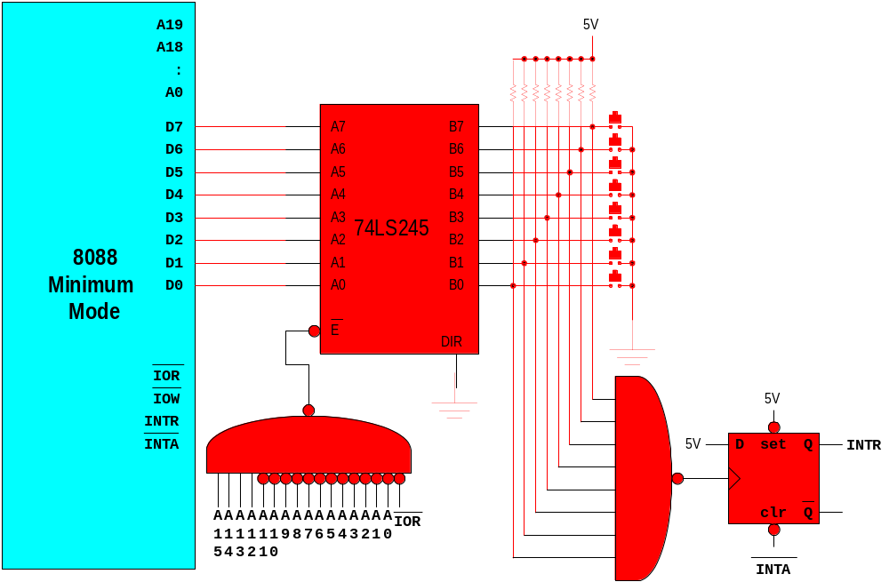
8088 and an Interrupt-driven Input Device

Slide 20
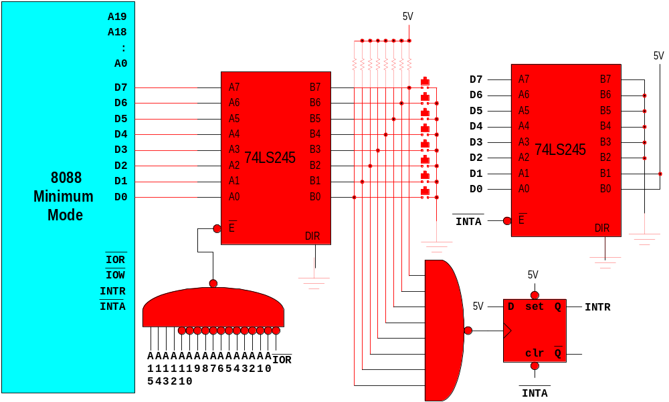
8088 and an Interrupt-Driven Input Device

Slide 21
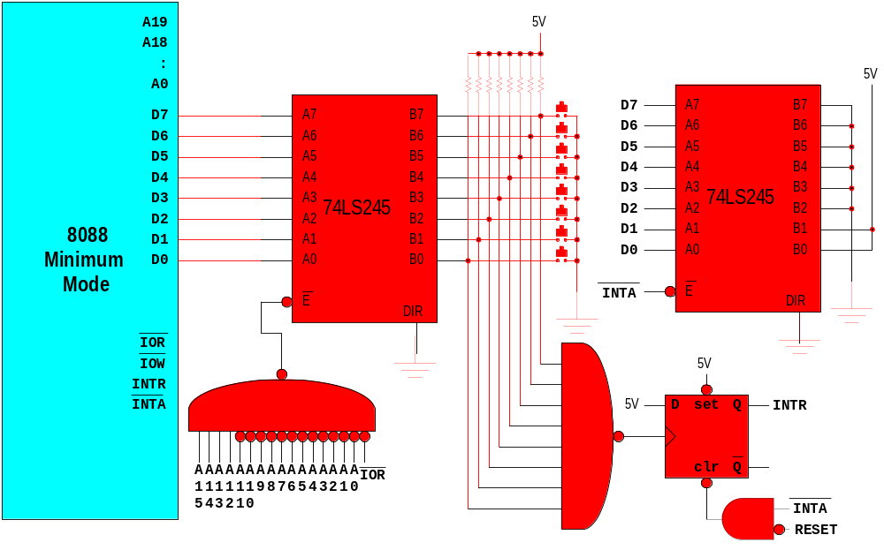
8088 and an Interrupt-Driven Input Device
INT 3

Slide 22
Example Polling program?
The program makes a “running LED” effect (initially moving from down to up). Every time the lowest button is pressed, it changes the direction of the movement. When the highest button is pressed, the program terminates.

Slide 23
The Circuit
A19
5V
A18
:
A0
D7
A0
B0
D6
A1
B1
D5
A2
B2
D4
A3
B3
D3
A4
74LS245
B4
8088
D2
A5
B5
D1
A6
B6
Minimum
D0
A7
B7
Mode
E
DIR
D0
Q0
IOR
D1
Q1
D2
Q2
IOW
D3
Q3
D4
Q4
D5
74LS373
Q5
D6
Q6
D7
Q7
A
A
A
A
A
A
A
A
A
A
A
A
A
A
A
A
IOR
LE
OE
1
1
1
1
1
1
9
8
7
6
5
4
3
2
1
0
5
4
3
2
1
0
A
A
A
A
A
A
A
A
A
A
A
A
A
A
A
A
IOW
1
1
1
1
1
1
9
8
7
6
5
4
3
2
1
0
5
4
3
2
1
0

Slide 24
Trace What the Program Does:
Checking the buttons
mov dx, F000
mov ah, 00
mov al, 01
L1: out dx, al
mov cx, FFFF
L2: dec cx
jnz L2
cmp ah, 00
jne L3
rol al, 1
cmp al, 01
jne L1
jmp L4
L3: ror al, 1
cmp al, 80
jne L1
L4: mov bl, al
in al, dx
cmp al, FF
je L6
test al, 01
jnz L5
xor ah, FF
jmp L6
L5: test al, 80
jz L7
L6: mov al, bl
jmp L1
L7:
delay
Ah =0 means left
Ah =ff means right

Slide 25
What’s the Problem With Polling in the Sample Program?
Running LED takes time
User might remove his/her finger from the switch
before the in al, dx instruction is executed
the microprocessor will not know that the user has pressed the button

Slide 26
Problem With Polling
mov dx, F000
mov ah, 00
mov al, 01
L1: out dx, al
mov cx, FFFF
L2: dec cx
jnz L2
cmp ah, 00
jne L3
rol al, 1
cmp al, 01
jne L1
jmp L4
L3: ror al, 1
cmp al, 80
jne L1
L4: mov bl, al
in al, dx
cmp al, FF
je L6
test al, 01
jnz L5
xor ah, FF
jmp L6
L5: test al, 80
jz L7
L6: mov al, bl
jmp L1
L7:

Slide 27
Program (Main) with Interrupt
ISR starts at 52800
88 means end
L1: cmp ah, 88
je L4
out dx, al
mov cx, FFFF
L2: dec cx
jnz L2
cmp ah, 00
jne L3
rol al, 1
jmp L1
L3: ror al, 1
jmp L1
L4:
mov ax,0000
mov ds, ax
mov bx, 000C
mov ax, 2800
mov [bx], ax
mov ax, 5000
mov [bx+02], ax
sti
mov dx, F000
mov ah, 00
mov al, 01

Slide 28
Program (ISR)
;assume that the
;ISR starts at
;location 52800
mov bl, al
in al, dx
test al, 01
jnz S1
xor ah, FF
jmp S2
S1: test al, 80
jnz S2
mov ah, 88
S2: mov al, bl
iret

