Slide 1

A Historical Background
The idea of calculating with a machine dates to before
500 B.C. when the Babylonians invented the abacus, the
first mechanical calculator.
BLM 3622- Microprocessors

Slide 2

Blaise Pascal (1623-1662)
The abacus was not improved until 1642, when Blaise Pascal invented a calculator constructed a gear and wheels.
BLM 3622- Microprocessors

Slide 3
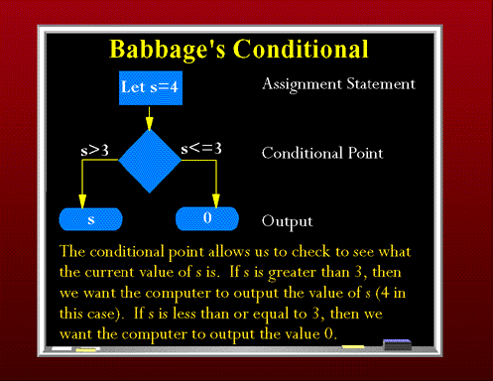
Charles Babbage
One early pioneer of mechanical computing machinery was Charles Babbage and produce a programmable calculating machine in 1823. He create the “Analytical Engine”. This machine was a mechanical computer that stored 1000 20-digit decimal numbers and variable program that could modify the function of the machine.
BLM 3622- Microprocessors

Slide 4
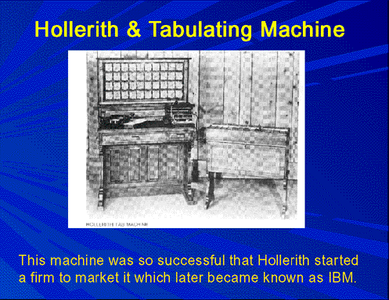
Herman Hollerith
In 1889, Herman Hollerith developed the punched card for storing data and also developed a mechanical machine-driven by one of the new electric motors. He was the former of IBM Corporation.
BLM 3622- Microprocessors

Slide 5
Konrad Zuse
The first electronic calculating machine invented in 1941 by Konrad Zuse. He had released the first programmable computer designed to solve complex engineering equations. It was also the first machine to work on the binary system, as opposed to the more familiar decimal system. His calculating computer was used in aircraft and missile design during World War II for the German war effort.
BLM 3622- Microprocessors

Slide 6
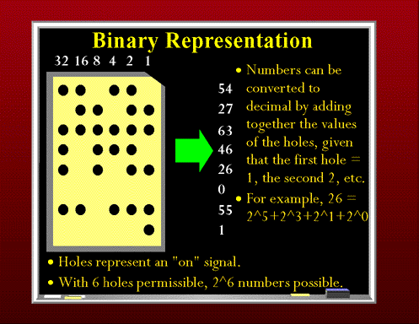
Binary System
BLM 3622- Microprocessors

Slide 7
Alan Turing
The first truly electronic computer was places into operation in 1943 to break secret German military codes. The first electronic computer system, which used vacuum tubes, was invented by Alan Turing who is a British mathematician . Turing called this machine Colossus, most likely because its size. A problem with Colossus was that although its design allowed it to break secret German military codes generated by mechanical Enigma machine, it could not solve other problems. Colossus was not programmable- it was a fixed program computer system.
BLM 3622- Microprocessors

Slide 8
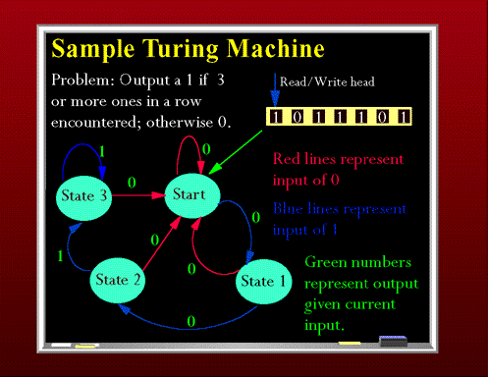
Sample Turing Machine
BLM 3622- Microprocessors

Slide 9
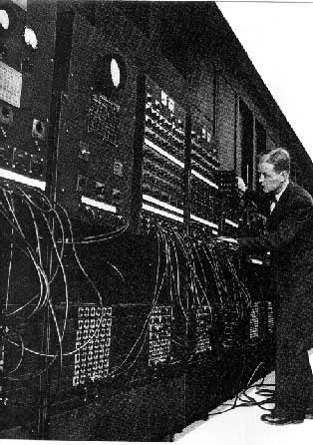
ENIAC
The first general purpose programmable computer system was developed in 1946 and called ENIAC. The ENIAC was a huge machine(30 tons) and performed about 100 000 operation per second.
BLM 3622- Microprocessors

Slide 10
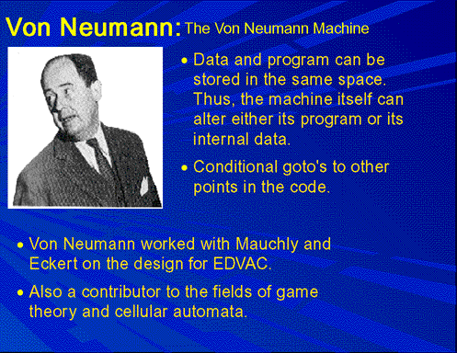
John von Neumann
In 1945, Von Neumann contributed a new understanding of how practical fast computers should be organized and built; these ideas, often referred to as the stored-program technique, became fundamental for future generations of high-speed digital computers and were universally adopted.
BLM 3622- Microprocessors

Slide 11
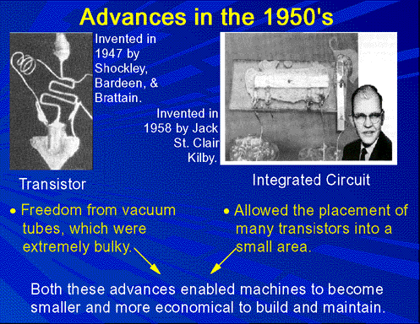
Transistor
BLM 3622- Microprocessors

Slide 12
INTEL 4004
The development of transistor in 1948, followed by the invention of the integrated circuits in 1958. In 1971, the first microprocessor Intel 4004 was developed. 4004 was a 4-bit microprocessor and instruction set contains 45 instruction. It performed about 50 000 instruction per second.
BLM 3622- Microprocessors

Slide 13
Intel 8086
In 1978, Intel released the 8086 microprocessor which was 16-bit microprocessor and performed 2.5 million instruction per second.
This microprocessor were called CISC(Complex Instruction Set Computers) because of the number and complexity of instructions.
The popularity of Intel family was ensured in 1981 when IBM Corp. decided to use 8088/8086 microprocessors in its personal computers.
BLM 3622- Microprocessors

Slide 14
Intel 8086/8088 Microprocessors
Intel 8086 and 8088 Microprocessors are the basis of all IBM-PC compatible computers
(8086 introduced in 1978, first IBM-PC released in 1981)
All Intel, AMD and other advanced microprocessors are based on and are compatible with the original 8086/8
At Power Up and Reset time, Pentiums, Athlons etc all look like 8086 processors
BLM 3622- Microprocessors

Slide 15
Intel 8086/8088 Microprocessors
Intel 8086 is a 16-bit microprocessor
16-bit data registers
16 or 8 bit external data bus
Some techniques to optimise the CPU performance when it’s executing programs
Segment: Offset memory model
Little-Endian Data Format
BLM 3622- Microprocessors

Slide 16
8086/8088 (1)
Original IBM PC used 8088 micrprocessor
8088 is similar to the 8086 microprocessor but it has an external 8-bit bus & only 4-deep queue
  For cost reduction reasons
We can consider 8086 and 8088 together
PC clones often used 8086 for better performance
8-bit bus reduces performance, but meant cheaper computers
BLM 3622- Microprocessors

Slide 17
8086/8088 (2)
Remember the Fetch-Decode-Execute cycle?
Fetching from EXTERNAL MEMORY is SLOW
The 8086/8 used an instruction queue to speed up performance
While the processor is decoding and executing an instruction, its bus interface can be reading new instructions, since at that time the bus is not actually in use
BLM 3622- Microprocessors

Slide 18
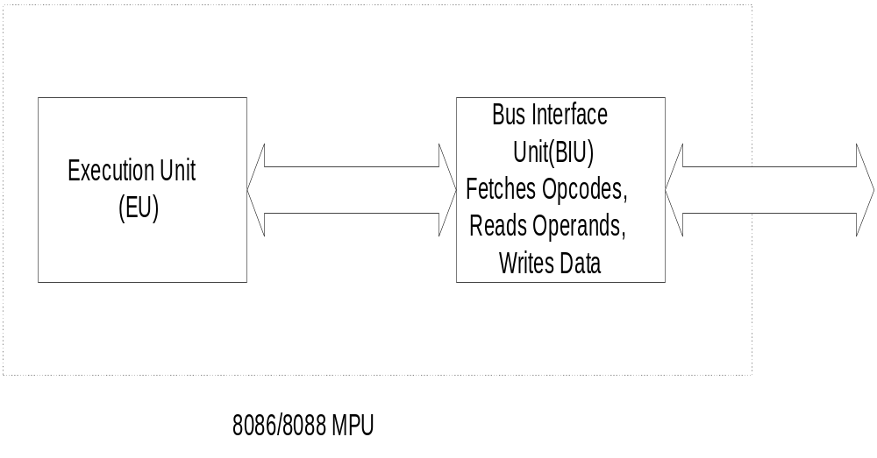
8086/8088 Functional Units
BLM 3622- Microprocessors

Slide 19
8086/8088 (3)
8086/8088 consists of two internal units
  The execution unit (EU) - executes the instructions
  The bus interface unit (BIU) - fetches instructions, reads operands and writes results
The 8086 has a 6-byte prefetch queue
The 8088 has a 4-byte prefetch queue
BLM 3622- Microprocessors

Slide 20
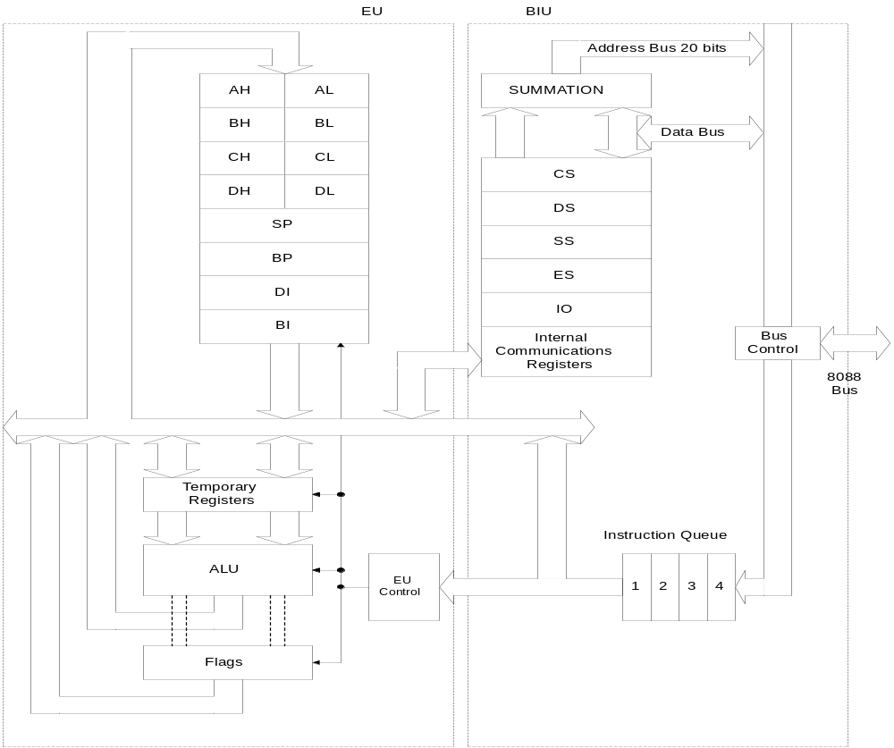
8086/8088 Internal Organisation
BLM 3622- Microprocessors

Slide 21
BIU Elements
Instruction Queue: the next instructions or data can be fetched from memory while the processor is executing the current instruction
  The memory interface is slower than the processor execution time so this speeds up overall performance
Segment Registers:
  CS, DS, SS and ES are 16-bit registers
  Used with the 16-bit Base registers to generate the 20-bit address
  Allow the 8086/8088 to address 1Mb of memory
  Changed under program control to point to different segments as a program executes
Instruction Pointer (IP) contains the Offset Address of the next instruction, the distance in bytes from the address given by the current CS register
BLM 3622- Microprocessors

Slide 22
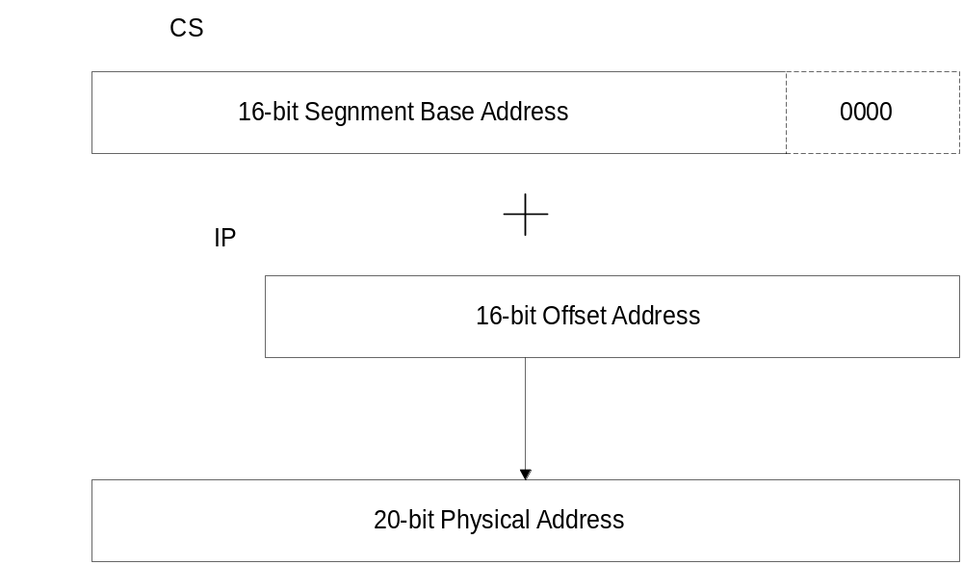
8086/8088 20-bit Addresses
BLM 3622- Microprocessors

Slide 23
Exercise: 20-bit Addressing
Memory
00000h
123A0h
157BBh
2239Fh
223A0h
CS=123Ah
IP=341Bh
341Bh
Range of Code Segment
BLM 3622- Microprocessors

Slide 24
Exercise: 20-bit Addressing
CS contains 0A820h,IP contains 0CE24h. What is the resulting physical address?
CS contains 0B500h, IP contains 0024h. What is the resulting physical address?
BLM 3622- Microprocessors

Slide 25
Segment Registers
The utilization of the segment registers
essentially divides the memory space into
overlapping segments, with each segment
being 64K bytes long and at an address that
is divisible by 16.
BLM 3622- Microprocessors

Slide 26
The advantage of using segment registers
Allow the memory capacity to be 1 M Byte even though the addresses associated with the individual instructions are only 16 bits wide.
Allow the instruction, data or stack portion of a program to be more than 64K Bytes long by allowing more than one code, data or stack segment.
Facilitate the use of separate memory areas for a program, its data and the stack.
Permit a program and/or its data to be put into different areas of memory each time the program is executed.
BLM 3622- Microprocessors

Slide 27
8086/8 In Circuit (1)
8086/8 microprocessors need support circuits in a microcomputer system
8086/8 multiplex the address and data buses on the same pins
This saves pins but at a price:
  Demultiplexing logic is needed to build up separate address and data buses to interface with RAMs and ROMs
BLM 3622- Microprocessors

Slide 28
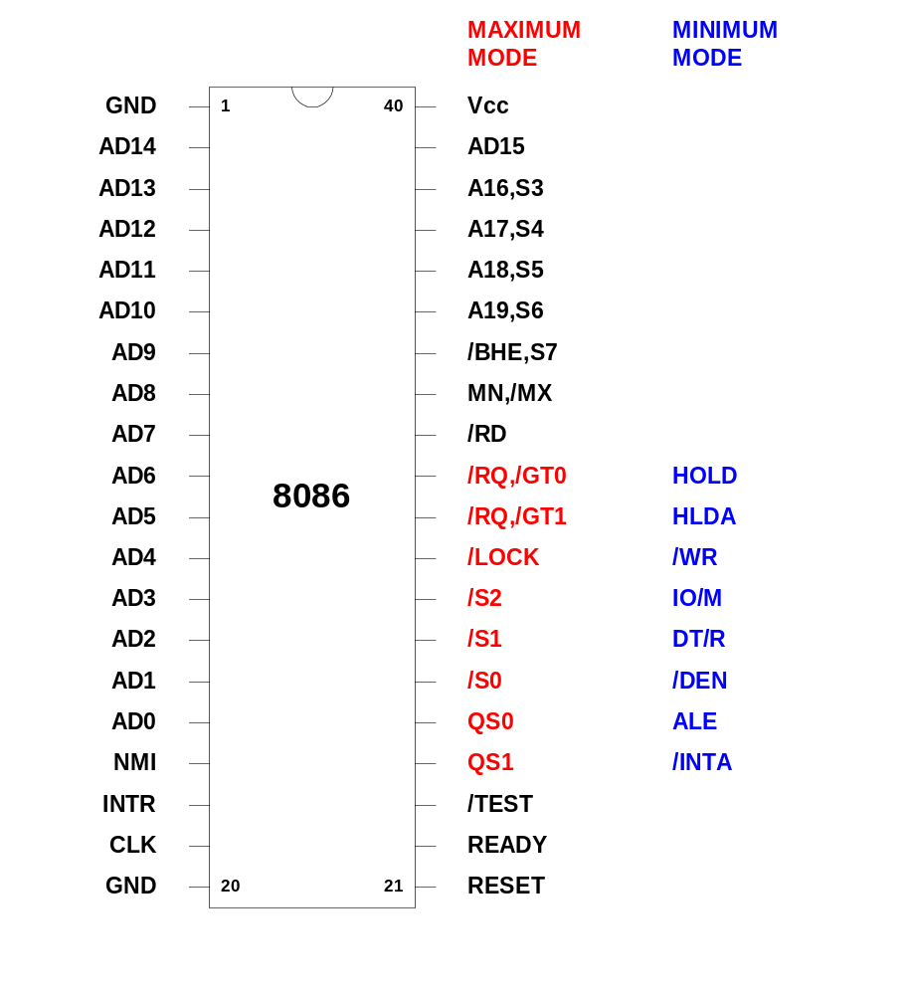
BLM 3622- Microprocessors

Slide 29
Pin Connections
AD₁₅-AD₀: (I/O-3)
The 8086 address/data bus lines compose
    the upper multiplexed address/data bus on
    8086. These lines contains address bits
    whenever ALE is logic 1. These pins enter
    a high-impedance state whenever a hold
acknowledge occurs.
BLM 3622- Microprocessors

Slide 30
Pin Connections
A₁₉/S₆-A₁₆/S₃: (O-3)
The address/status bus bits are multiplexed to
provide address signals A₁₉-A₁₆ and also status
bits S₆-S₃. The pins also attain a high-impedance
state during the hold acknowledge. S4 and S3
show which segment is accessed during the
current bus cycle.
BLM 3622- Microprocessors

Slide 31
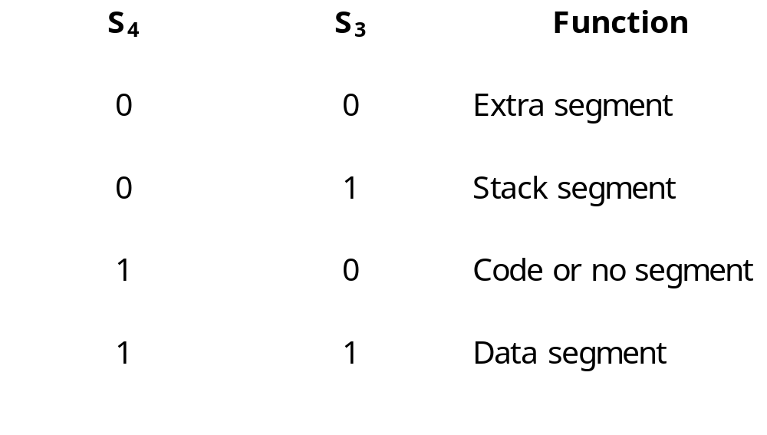
Pin Connections
BLM 3622- Microprocessors

Slide 32

Pin Connections
: (O-3)
Whenever the read signal is logic 0, the data bus
is receptive to data from the memory or I/O
devices connected to system.
READY: (I)
This input is controlled to insert wait states into
the timing of the microprocessor.
READY=0: μP enters into wait states and remain idle
READY=1: It has no effect on operation of μP
BLM 3622- Microprocessors

Slide 33

Pin Connections
: (I)
The test pin is an input that is tested by the WAIT
instruction.
NMI: (I)
The non-maskable interrupt input is similar to
INTR except that the NMI does not check to see
if IF flag bit is a logic 1. This interrupt input uses
interrupt vector 2.
BLM 3622- Microprocessors

Slide 34


Pin Connections
RESET: (I)
The reset input causes the μP to reset itself if this pin
is held high for a minimum four clocking periods.
It begins executing instructions at memory location
FFFF0H and disables future interrupts by clearing
the IF flag bit.
: (I)
Minimum/maximum mode pin select.
: (O-3)
BHE pin is used to enable the most sig. data bus
bits (D₁₅-D₈) during a read or write operation.
BLM 3622- Microprocessors

Slide 35


Minimum mode Pins
: (O-3)
The pin selects memory or I/O. This pin indicates that the microprocessor address bus contains either a memory address or an I/O port address.
: (O-3)
This line indicates that 8086 is outputting data to a memory or I/O device.
BLM 3622- Microprocessors

Slide 36


Minimum mode Pins
: (O-3)
The interrupt acknowledge signal is a response to the INTR input pin. This pin is normally used to gate the interrupt vector number onto the data bus in response to an interrupt request.
: (O)
Address latch enable shows that the 8086 address/data bus contains address information. This address can be a memory address or an I/O port number.
BLM 3622- Microprocessors

Slide 37


Minimum mode Pins
:(0-3)
The data transmit/receive signal shows that the microprocessor data bus is transmitting or receiving data.
: (O-3)
Data bus enable activates external data bus buffers.
BLM 3622- Microprocessors

Slide 38
Minimum mode Pins
HOLD : (I)
The hold input requests a direct memory access (DMA). If the HOLD signal is logic 1, the microprocessor stops executing software and places its address, data and control bus at the high- impedance state.
HLDA : (O)
Hold acknowledge indicates that the 8086 microprocessor entered the hold state.
BLM 3622- Microprocessors

Slide 39
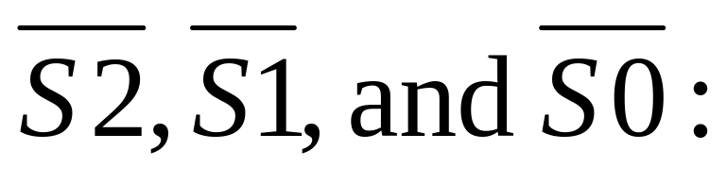
Maximum mode Pins
In order to achieve maximum mode for use with external coprocessors or multiprocessing applications.
(O)
The status bits indicate the function of the current bus cycle. These signals are normally decoded by the 8288 bus controller.
BLM 3622- Microprocessors

Slide 40
Satatus bits
S2 | S1 | S0 | Function
0 | 0 | 0 | Interrupt acknowledge
0 | 0 | 1 | I/O read
0 | 1 | 0 | I/O write
0 | 1 | 1 | Halt
1 | 0 | 0 | Opcode fetch
1 | 0 | 1 | Memory read
1 | 1 | 0 | Memory write
1 | 1 | 1 | Passive
BLM 3622- Microprocessors

Slide 41
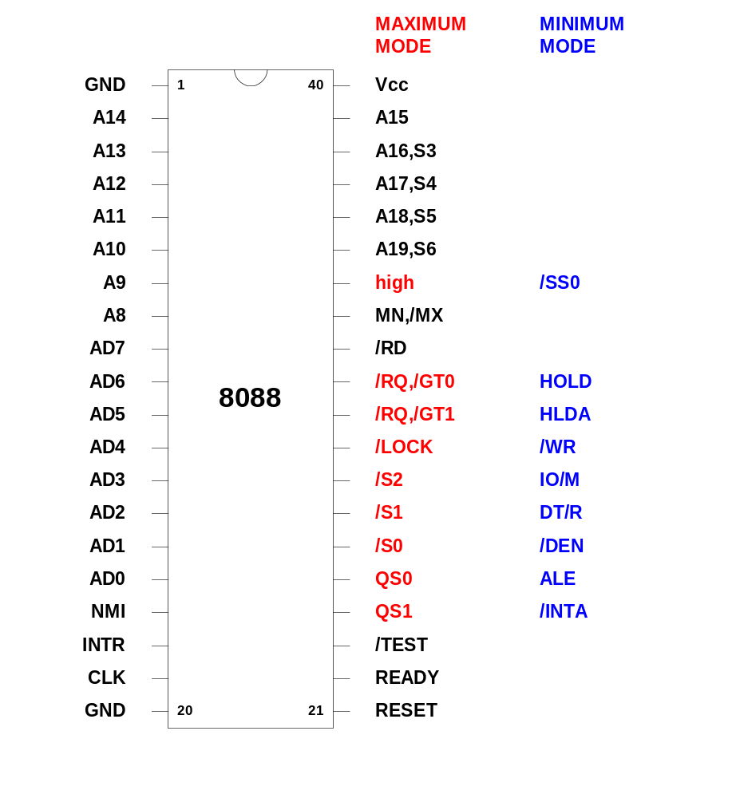
BLM 3622- Microprocessors

Slide 42
8086/8 In Circuit (2)
In Maximum Mode the 8086/8 needs at least the following: 8288 Bus Controller, 8284A Clock Generator, 74HC373s and 74HC245s
With the aid of these devices the 8086 begins to look like the ideal microprocessor we looked at earlier
BLM 3622- Microprocessors

Slide 43
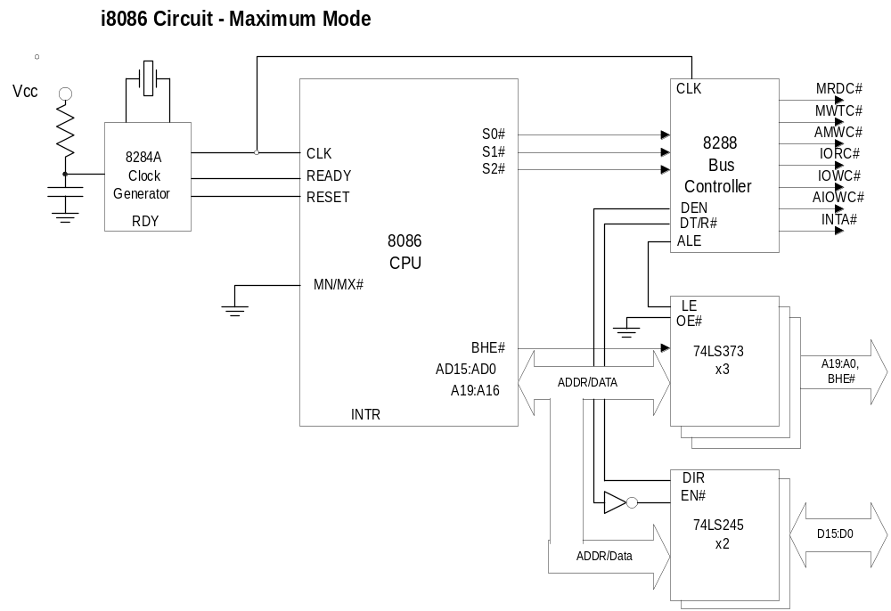
BLM 3622- Microprocessors

Slide 44
8086/8 Maximum Mode
In maximum mode, the 8288 uses a set of status signals (S0, S1, S2) to rebuild the normal bus control signals of the microprocessor
  MRDC#, MWTC#, IORC#, IOWC# etc
  Equivalent to MEMR# etc
Look at some special signals briefly
BLM 3622- Microprocessors

Slide 45
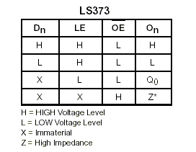
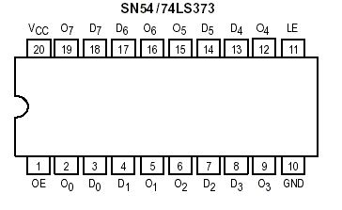
74LS373 Octal Transparent Latch with 3-state Outputs
BLM 3622- Microprocessors

Slide 46
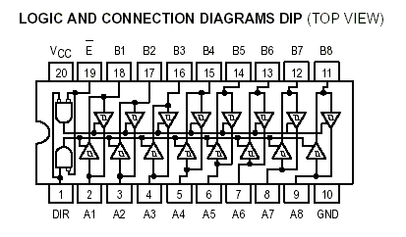
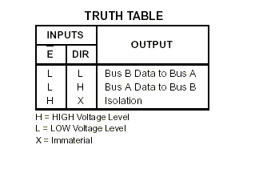
74LS245 Octal Bus Tranceiver
BLM 3622- Microprocessors

Slide 47
RESET# Signal
The Active low RESET# signal puts the 8086/8 into a defined state
Clears the flags register, segment registers etc.
Sets the effective program address to 0FFFF0h (CS=0F000h, IP=0FFF0h)
8086/8 Programs always start at FFFF0H after Reset has been asserted and removed
Continues into latest generation CPUs
BLM 3622- Microprocessors

Slide 48
BHE# Signal (8086 Only)
The 8086 processor can address memory a byte at a time
Its data bus is 16-bits wide
It uses the BHE# signal and A0 (sometimes called BLE#) to address bytes using its 16-bit bus
BLM 3622- Microprocessors

Slide 49
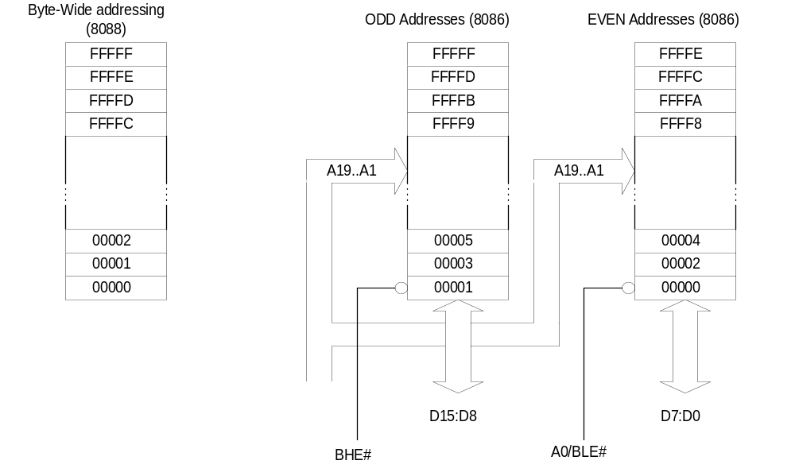
Use of BHE#/A0(BLE#)
BLM 3622- Microprocessors

Slide 50
Use of BHE#/BLE#
BHE#
A0/BLE#
Selection
0
0
Whole word (16-bits)
0
1
High byte to/from odd address
1
0
Low byte to/from even address
1
1
No selection
BLM 3622- Microprocessors

Slide 51
ALE and Address/data Bus Multiplexing
8086/8 Multiplexes the Address and Data signals onto the same set of pins
Need off-chip logic to separate the signals
Transparent latches designed just for address demultiplexing
BLM 3622- Microprocessors

Slide 52
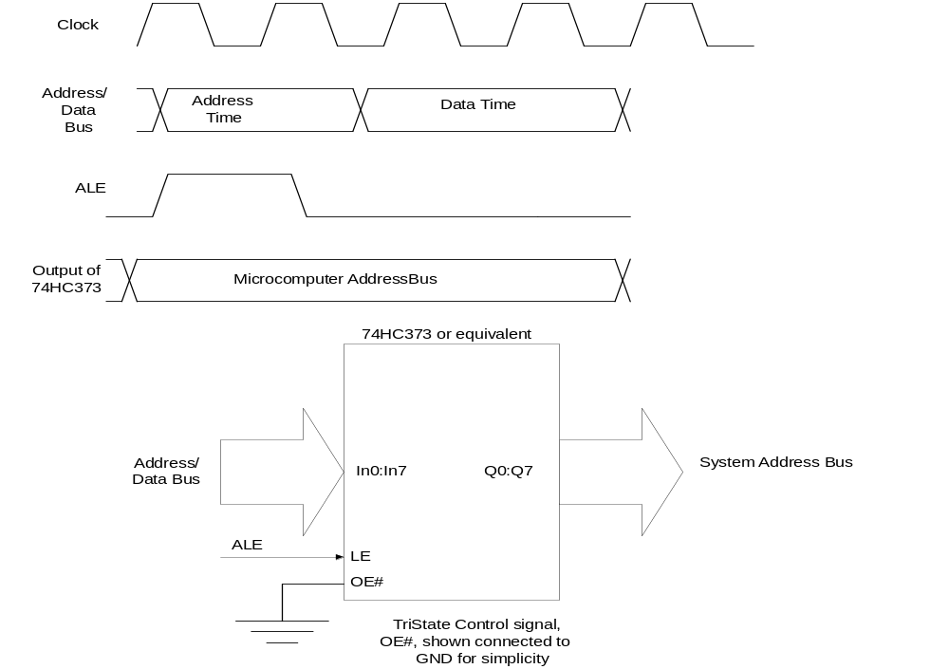
ALE and 74HC373 Transparent Latch
BLM 3622- Microprocessors

Slide 53
Use of ALE (Address Latch Enable)
ALE is used with an external latch (74HC373) to demultiplex the address and data lines
74HC373 is transparent when its LE input (connected to ALE) is high
When ALE goes low, the ‘373 holds the last data until ALE goes high again
BLM 3622- Microprocessors

Slide 54
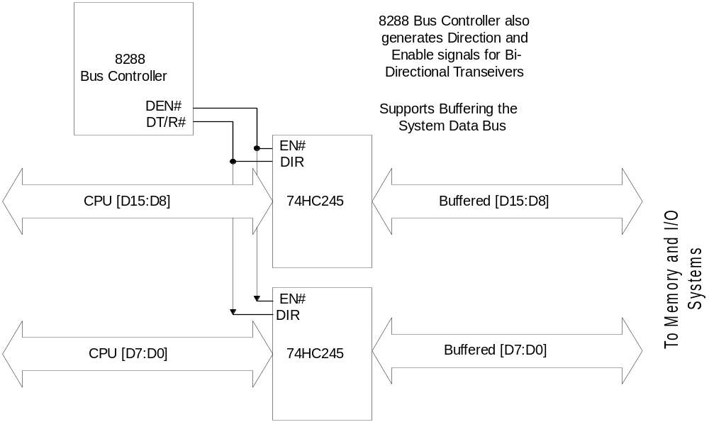
8288 Bus Controller and Bus Transceivers
BLM 3622- Microprocessors

Slide 55
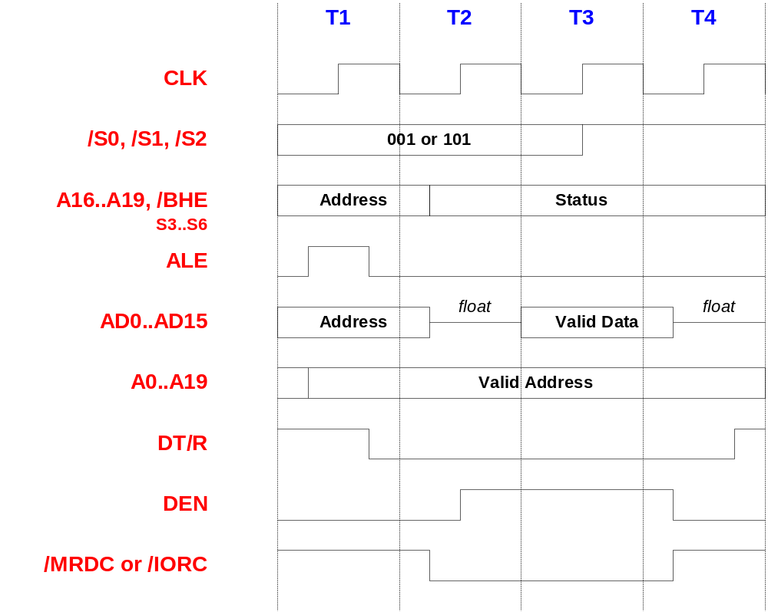
8086 Read Cycle
BLM 3622- Microprocessors

Slide 56
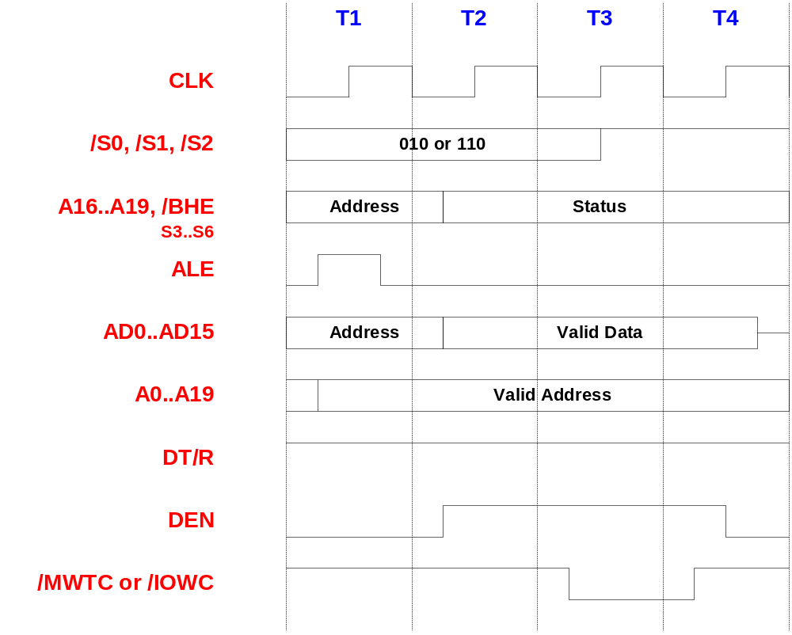
8086 Write Cycle
BLM 3622- Microprocessors

Slide 57
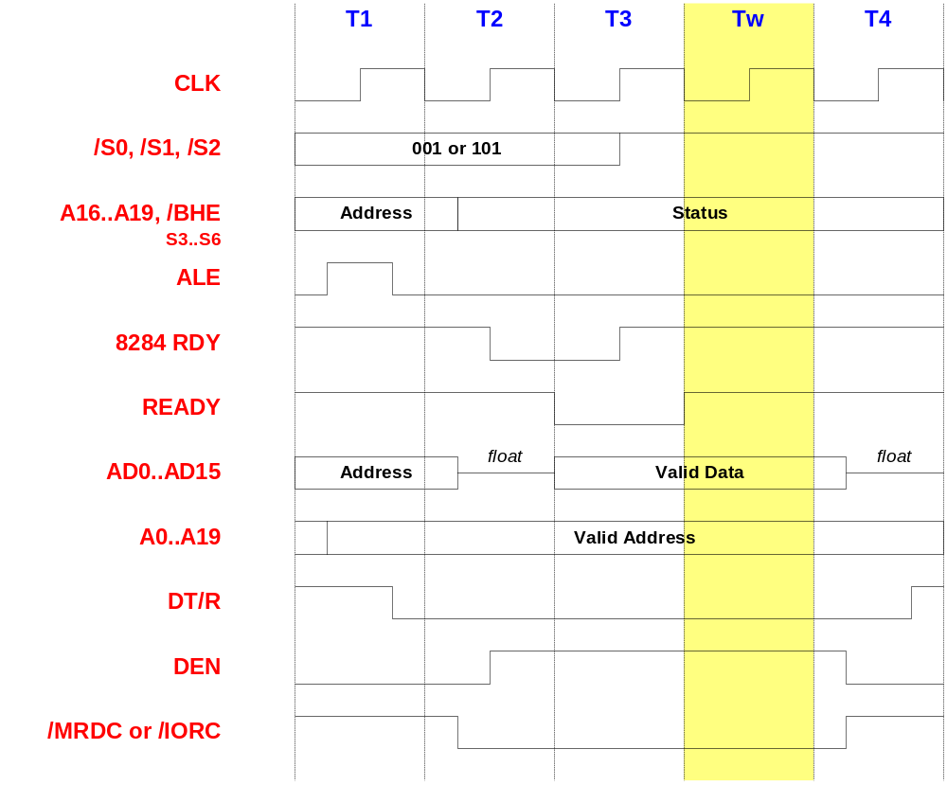
8086 Read Cycle (1 Wait State)
BLM 3622- Microprocessors

Slide 58
8086/8088 Summary
First Generation (introduced June 1978)
One of the first 16-bit processors on the market
16-bit internal registers
16/8-bit external data bus
20-bit address bus (1MB addressable)
Used in 1st generation IBM PCs (1981)
BLM 3622- Microprocessors

Slide 59
80186/80188
Evolution of 8086/8088 ⇨80186/80188
Increased instruction set
On-chip system components (Clock generator, DMA, Interrupt, Timers…)
Unsuccessful in PCs
Popular in embedded systems…
BLM 3622- Microprocessors

Slide 60
2nd Generation Processor 286
P2 (286) = 2nd Generation Processor
Introduced in 1981
CPU behind IBM AT
Throughput of original IBM AT (6MHz) was about 500% of IBM PC (4.77MHz)
Level of integration: 134k transistors (vs 29k in 8086)
Still a 16-bit processor…
Available in higher clock frequencies: 25MHz
BLM 3622- Microprocessors

Slide 61
2nd Generation Processors 286
Fully backwards compatible to 8086
80286 runs 8086 software without modification
Improved instruction execution
Average instruction takes 4.5 cycles vs. 12 cycles (8086)
Improved instruction set
Real mode and Protected Mode
Multitasking-support. What happens in one area of memory doesn’t affect other programs. Protected mode supported by Windows 3.0.
16MB addressable physical memory
On-chip MMU (1GB virtual memory)
Non-multiplexed address-bus and data-bus
BLM 3622- Microprocessors

Slide 62
Improving Computer Performance
We’ve seen how 16-bit computer technology based on the 8086 and 80286 processors developed
These computers are not powerful enough for today’s applications
How do you improve the performance of your computer?
Let’s start with the CPU
BLM 3622- Microprocessors

Slide 63
CPU Performance (1)
MOST OBVIOUS: Processor Clock Frequency
Increased frequency – increased execution rate
State of the Art: >2GHz (Jan 2002)
Memory and I/O access times can be performance bottleneck – unless you take some special measures
BLM 3622- Microprocessors

Slide 64
CPU Performance (2)
ALU register width
  A processor is an n-bit processor, where N represents the precision of the ALU – N can be 4, 8, 16, 32, or 64
  The wider the registers – the more processing per clock
Data bus width
  The wider the data bus the faster we can transfer data
  Since the memory and I/O device access times are finite, the more bits transferred per cycle the better
BLM 3622- Microprocessors

Slide 65
CPU Performance (3)
Address bus width
Increased address width doesn’t provide a ‘speed’ increase as such
CPU can directly address more memory
PCs use big programs, which would not fit in a smaller address space
Overcoming small address space takes time
  Impacts on overall system performance
BLM 3622- Microprocessors

Slide 66
3rd Generation Processor 386
P3 (386) = 3rd Generation Processor
Introduced: 10/1985
Full 32-bit processor
(32-bit registers. 32-bit internal and external databus. 32-bit address bus)
275k transistors. CMOS. 132-pin PGA package.
(Supply current Icc=400mA. Roughly the same as 8086 !)
Clock speeds: 16-33MHz
P3 processors were far ahead of their time:
It took 10 years before 32-bit operating systems became mainstream!
First 386 PCs early 1987
(COMPAQ)
BLM 3622- Microprocessors

Slide 67
3rd Generation Processor 386
Modes of operation:
  Real. Protected. Virtual Real.
Protected mode of 386 is fully compatible with 286
Protected mode=native mode of operation. Chips are designed for advanced operating systems such as Windows NT
New virtual real mode
Processor can run with hardware memory protection while simulating the 8086’s real-mode operation. Multiple copies of e.g. DOS can run simultaneously, each in a protected area of memory. If a program in one memory area crashes, the rest of the system is protected.
BLM 3622- Microprocessors

Slide 68
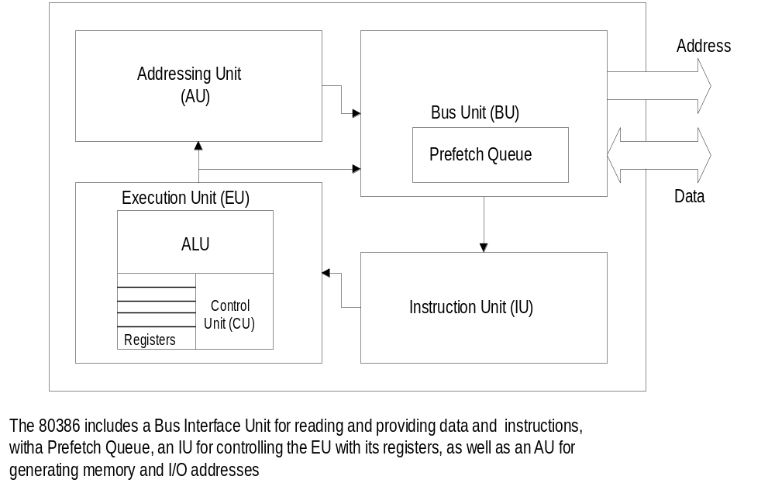
Intel 32-bit Architecture:IA-32
BLM 3622- Microprocessors

Slide 69
80386 Features
32-bit general and offset registers
16-byte prefetch queue
Memory management unit with segmentation unit and paging unit
32-bit address and data bus
4-Gbyte physical address space
64-Tbyte virtual address space
i387 numerical coprocessor
Implementation of real, protected and virtual 8086 modes
BLM 3622- Microprocessors

Slide 70
80386 Operating Modes
Protected Mode for Multitasking support
Real Mode (native 8086 mode)
  Processor powers up in Real Mode
System Management Mode
  Power management or system security
  Processor switches to separate address space, while saving the entire context of the currently running program or task
BLM 3622- Microprocessors

Slide 71
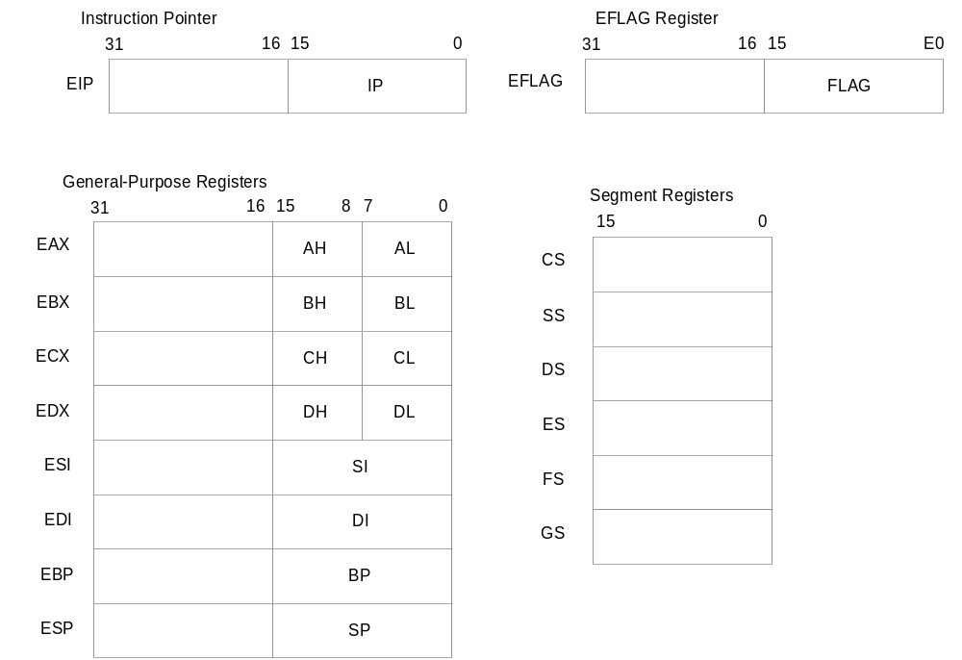
80386 Register Set
BLM 3622- Microprocessors

Slide 72
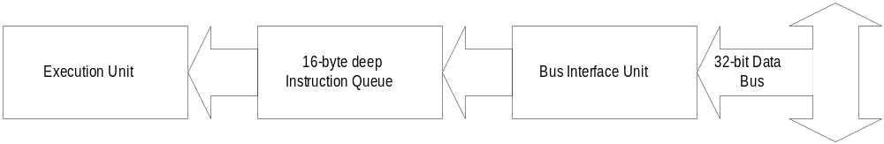
80386 Prefetch Queue
Fetching from on-chip Queue is fast
Reading from off-chip Memory is slow
BLM 3622- Microprocessors

Slide 73
80386 Prefetch Queue
80386 Prefetch queue is 16-bytes deep
The instruction fetch can read from the prefetch queue faster than from memory
The prefetcher can do some work while the execution unit is doing other tasks in parallel
BLM 3622- Microprocessors

Slide 74
Coprocessor: i387
The hardware implementation of floating point processing in the i387 means floating point operations run at much higher speed.
The i386 can execute all mathematical expressions using software emulation of the i387.
BLM 3622- Microprocessors

Slide 75
80386: Classic CISC Processor
CISC = Complex Instruction Set Computer
Complex instructions
...but code-size efficient
Micro-encoding of the machine instructions
Extensive addressing capabilities for memory operations
Few, but very useful CPU registers
BLM 3622- Microprocessors

Slide 76
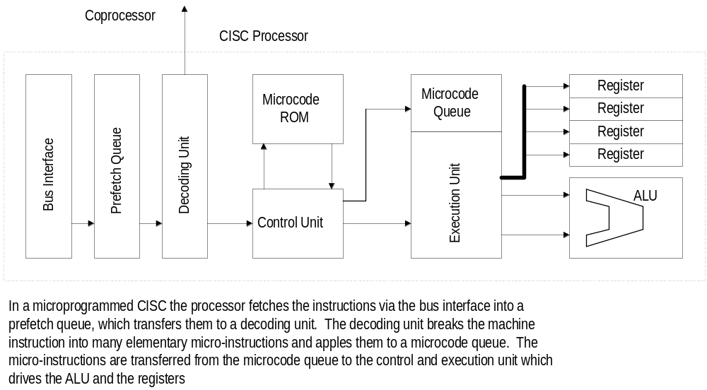
80386 Execution Sequence
BLM 3622- Microprocessors

Slide 77
80386 Complex Instructions
CISC drawback: Most instructions are so complicated, they have to be broken into a sequence of micro-steps
These steps are called Micro-Code
Stored in a ROM in the processor core
Micro-code ROM: Access-time and size...
They require extra ROM and decode logic
BLM 3622- Microprocessors

Slide 78
RISC: Less is More
RISC = Reduced Instruction Set Computer
20/80 Rule: 20% of the instructions take up 80% of the time
Sometimes executing a sequence of simple instructions runs quicker than a single complex machine instruction that has the same effect
BLM 3622- Microprocessors

Slide 79
RISC Ideas (1)
Reduce the instruction set to simplify the decoding
  Smaller Instruction Set -> Simpler Logic -> Smaller Logic -> Faster Execution
Eliminate microcode – hardwire all instruction execution
Pipeline instruction decoding and executing – do more operations in parallel
BLM 3622- Microprocessors

Slide 80
RISC Ideas (2)
Load/Store Architecture – only the load and store instructions can access memory
  All other instructions work with the processor internal registers
  This is necessary for single-cycle execution – the execution unit can’t wait for data to be read/written
BLM 3622- Microprocessors

Slide 81
RISC Ideas (3)
Increase number of internal register due to Load/Store Architecture
Also registers are more general purpose and less associated with specific functions
Compiler designed along with the RISC processor deesign. Compiler has to be aware of the processor architecture to produce code that can be executed efficiently
BLM 3622- Microprocessors

Slide 82
Instruction Pipelining - Operations Can Be Carried Out in Parallel
Read the instruction from memory or the prefetch queue (instruction fetch phase)
Decode the instruction (decode phase)
Where necessary, fetch the operands (operand fetch phase)
Execute the instruction (execute phase)
Write back the result (write-back phase)
BLM 3622- Microprocessors

Slide 83
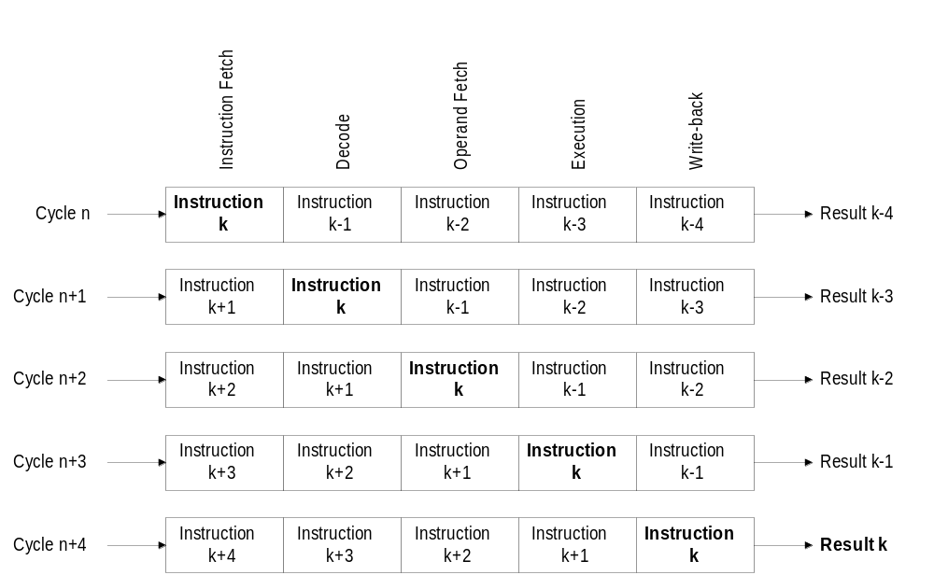
Pipelined Execution
BLM 3622- Microprocessors

Slide 84
Superscalar Architecture:
The processor may have more than one pipeline (Pentium…)
Where possible each pipeline works independently
  Not always possible
May achieve average completed execution of more more than one instruction per clock cycle
BLM 3622- Microprocessors

Slide 85
Pipelining problems
More logic per pipeline stage – same resource can’t be used twice
  E.g. can’t re-use ALU for computing implied addresses
Synchronisation Problems
Delayed Jump/Branch
Data and Register dependency, e.g.
ADD reg1, reg2, reg7
AND reg6, reg1, reg3
BLM 3622- Microprocessors

Slide 86
Getting the Benefits of Pipelining
Simplified Instruction decoding
  Simpler, faster logic
On-chip cache memories
  Local memory on-chip to avoid memory access bottlenecks
Floating Point pipeline for FP coprocessor
Speculative Execution to get around pipeline flushes
BLM 3622- Microprocessors

Slide 87
Software Implications of RISCs
Optimising Compiler must know how pipeline works
(Compiler must be aware of pipeline delays, and insert NOPs if need be)
Lower code density in RISC because instructions are less efficient
  PowerPC code takes up to 30% more code to do the same tasks as an x86 CPU
  more memory accesses, potential performance impact...
BLM 3622- Microprocessors

Slide 88
80486: IA-32 with RISC elements
Introduced 04/91
Greatly improved 80386 CPU
Hard-wired implementation of frequently used instructions (as in RISCs). On average 2 clock cycles/instruction.
5 stage instruction pipeline
Internal L1 Cache Memory (8kB) + cache controller
On-chip Floating Point coprocessor (FPU)
Longer Prefetch Queue (32-bytes as opposed to 16 on the 80386)
Higher frequency operation: up to 120MHz
>1.2M transistors, 0.8μm CMOS. 168-pin PGA.
BLM 3622- Microprocessors

Slide 89
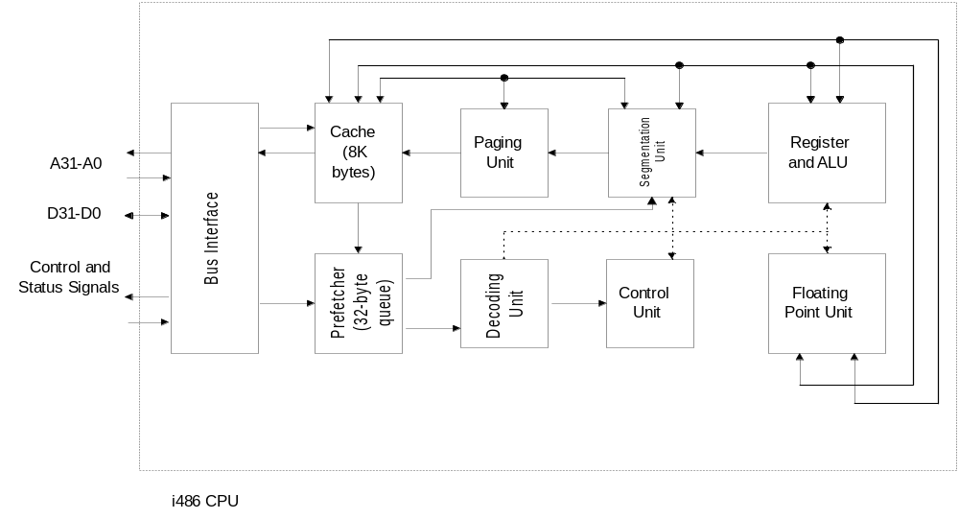
80486 Block Diagram
BLM 3622- Microprocessors

Slide 90
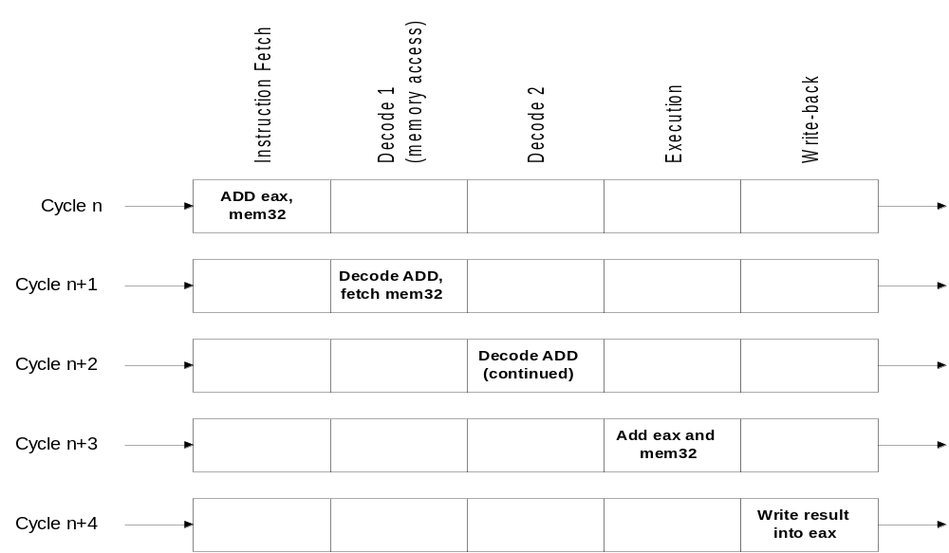
80486 Pipeline
BLM 3622- Microprocessors

