Slide 1
8254
Programmable Interval Timer

Slide 2
Outline
8254/3 description
Programming the counters
8253 in a PC
Various modes of operation
Frequency meter

Slide 3
8254 Description
The 82C54 solves one of the most common problems in any microcomputer system, the generation of accurate time delays under software control.
Instead of setting up timing loops in software, the programmer configures the 82C54 to match his requirements and programs one of the counters for the desired delay. After the desired delay, the 82C54 will interrupt the CPU. Software overhead is minimal and variable length delays can easily be accommodated

Slide 4
8254 Description
Some of the other counter/timer functions common to microcomputers which can be implemented with the 82C54 are:
  Real time clock
  Event counter
  Digital one-shot
  Programmable rate generator
  Square wave generator
  Binary rate multiplier
  Complex waveform generator
  Complex motor controller

Slide 5
8254 Chip
Main function:
  Dividing clock frequency
Three independent 16-bit counters
Models
  8253: 2 MHz
  8254: 8 MHz
  8254-2: 10 MHz

Slide 6
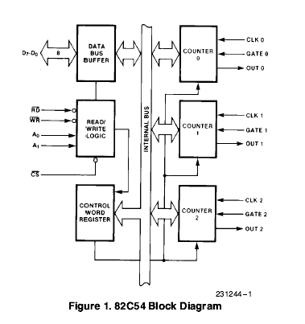

Slide 7
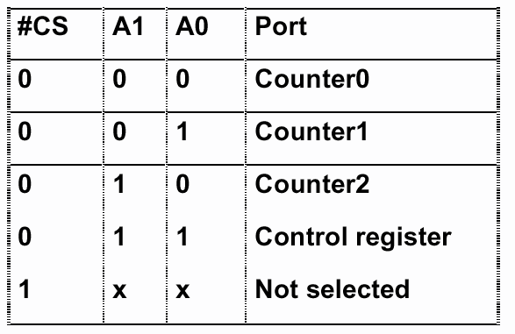
Addressing 8254

Slide 8
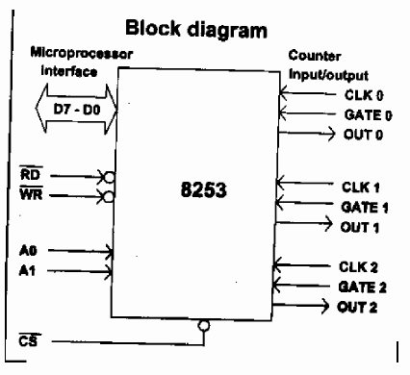
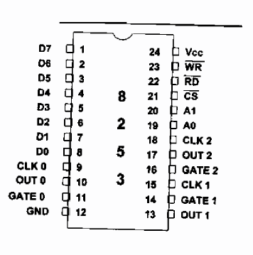
Pin Description

Slide 9
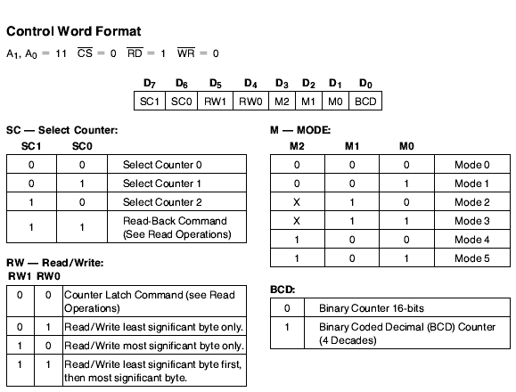
Control Word

Slide 10
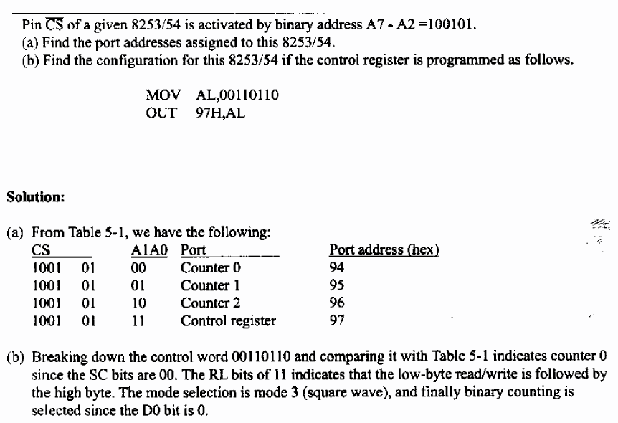
Example

Slide 11
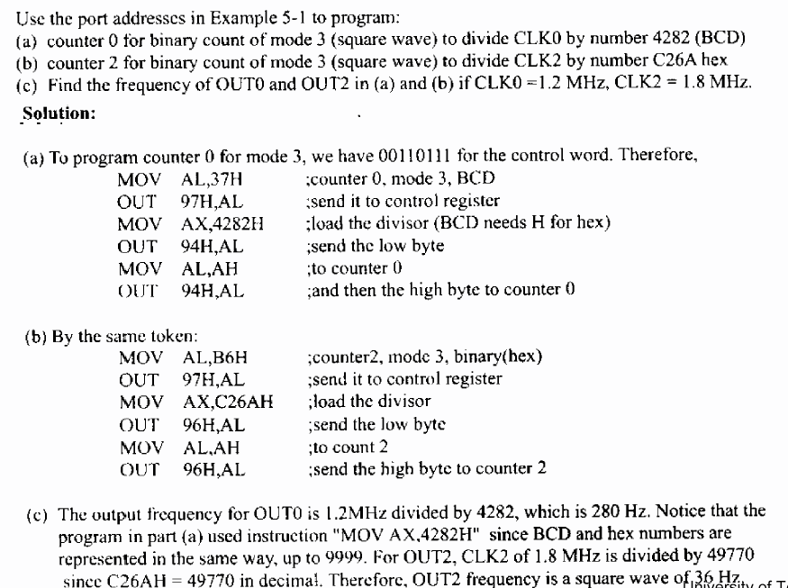
Example 5-2

Slide 12
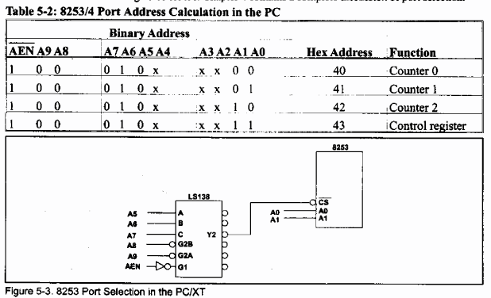
8253 Decoding in PC

Slide 13
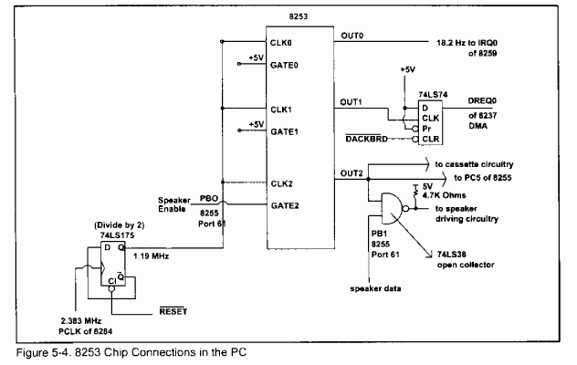
PC Board

Slide 14
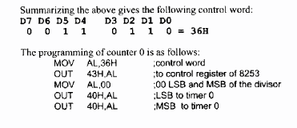
Timers in PC
Counter 0
  IRQ0 – TOD (time of day)
  18.2 Hz (1.193 MHz / 65536)
  Mode 3, control word: 36H
Counter 1
  DRAM refresh – using DMA (at least every .015ms)
  2 ms / 128 rows = .015 ms (.015ms = 66278Hz→1.193/18)
  Mode 2, control word: 54H
Counter 2
  Speaker and PC5
  896 Hz (1.193MHz / 1331)
  Mode 3, control word: B6H
  GATE2 is connected to PB0 (port 61H)

Slide 15
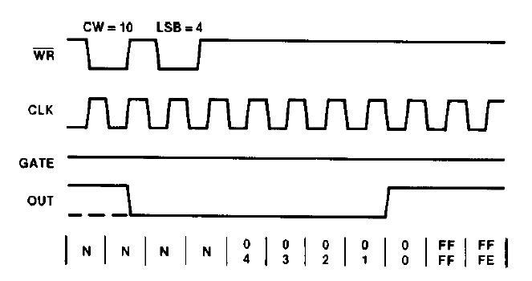
Mode 0: Interrupt on Terminal Count
Low for N*T then high (Remain high until new control word or count number)
Mode 0 is typically used for event counting. After the Control Word is written, OUT is initially low, and will remain low until the Counter reaches zero. OUT then goes high and remains high until a new count or a new Mode 0 Control Word is written into the Counter.

Slide 16
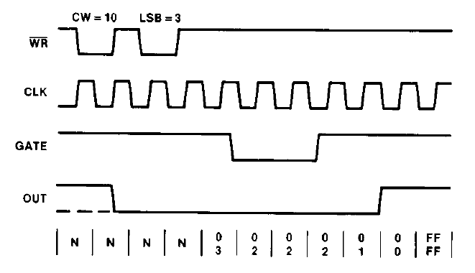
Mode 0: Interrupt on Terminal Count

Slide 17
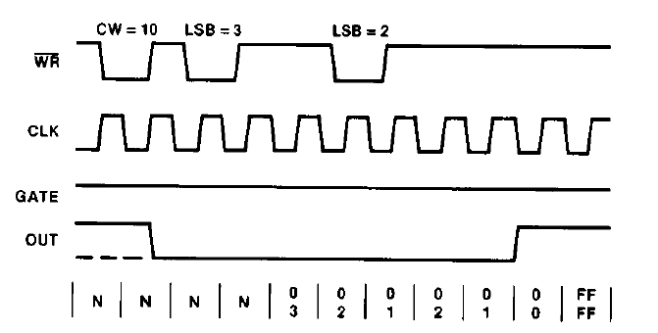
Mode 0: Interrupt on Terminal Count

Slide 18
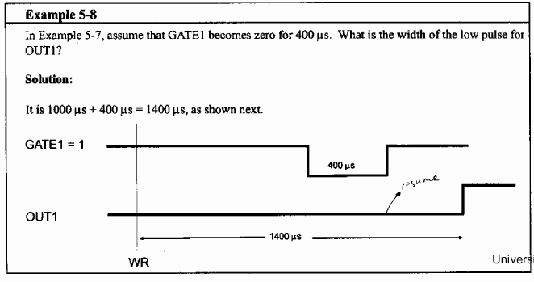
Mode 0: Example

Slide 19
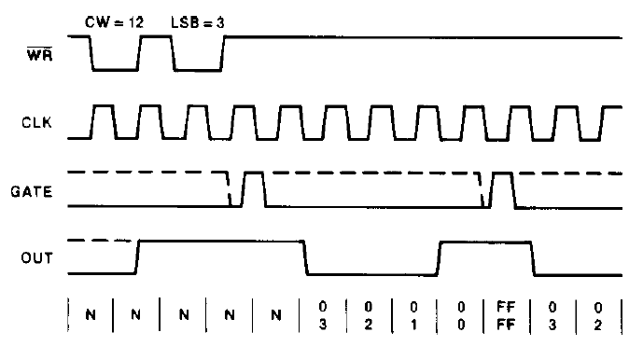
Mode 1: Hardware retriggerable one shot
0 to 1 on GATE (low for N*T)
OUT will be initially high. OUT will go low on the CLK pulse following a trigger to begin the one-shot pulse, and will remain low until the Counter reaches zero. OUT will then go high and remain high until the CLK pulse after the next trigger.

Slide 20
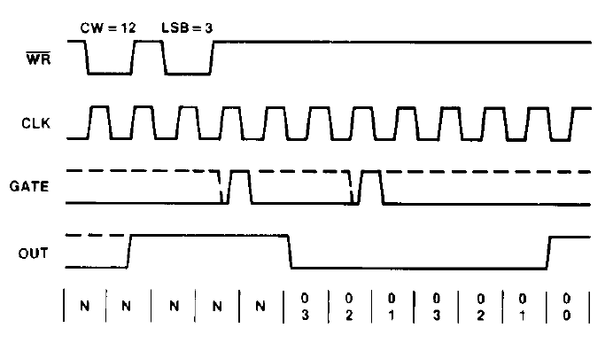
Mode 1: Hardware retriggerable one shot

Slide 21
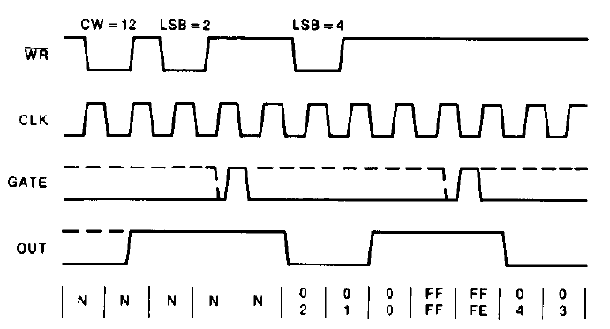
Mode 1: Hardware retriggerable one shot

Slide 22
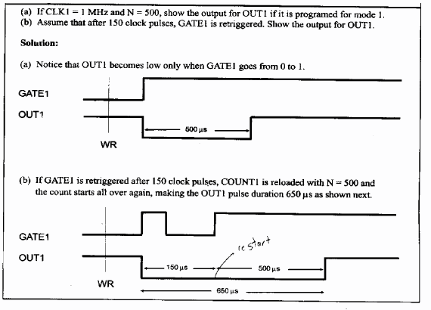
Mode 1:Example

Slide 23
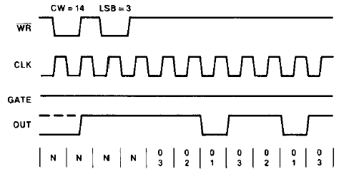
Mode 2: Rate Generator
Rate generator (divide by N counter)
High for (N-1)*T and low for 1*T
This Mode functions like a divide-by-N counter. It is typicially used to generate a Real Time Clock interrupt. OUT will initially be high. When the initial count has decremented to 1, OUT goes low for one CLK pulse. OUT then goes high again, the Counter reloads the initial count and the process is repeated. Mode 2 is periodic; the same sequence is repeated indefinitely. For an initial count of N, the sequence repeats every N CLK cycles.

Slide 24
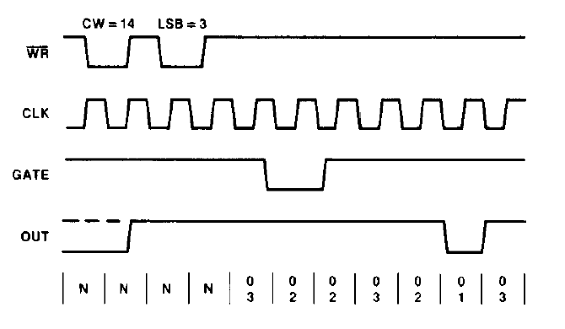
Mode 2: Rate Generator

Slide 25
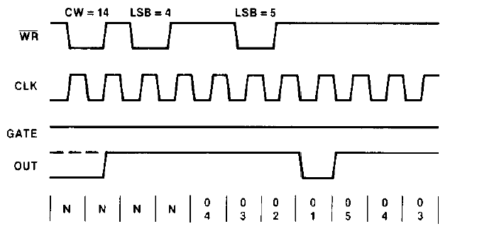
Mode 2: Rate Generator

Slide 26
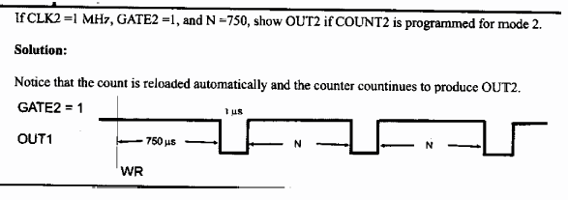
Mode 2: Example

Slide 27
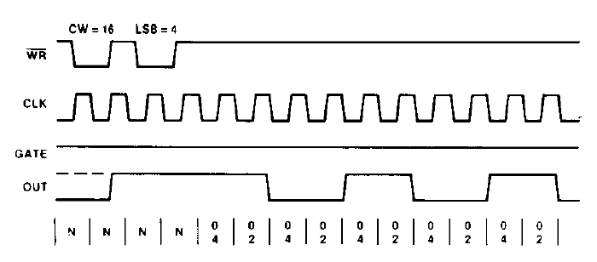
Mode 3: Square Wave Rate Generator
Low N/2 high N/2 ((N+1)/2 if N odd)
Mode 3 is typically used for Baud rate generation. Mode 3 is similar to Mode 2 except for the duty cycle of OUT. OUT will initially be high. When half the initial count has expired, OUT goes low for the remainder of the count. Mode 3 is periodic; the sequence above is repeated indefinitely. An initial count of N results in a square wave with a period of N CLK cycles.

Slide 28
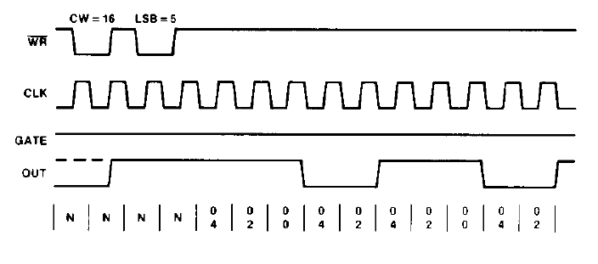
Mode 3: Square Wave Rate Generator

Slide 29
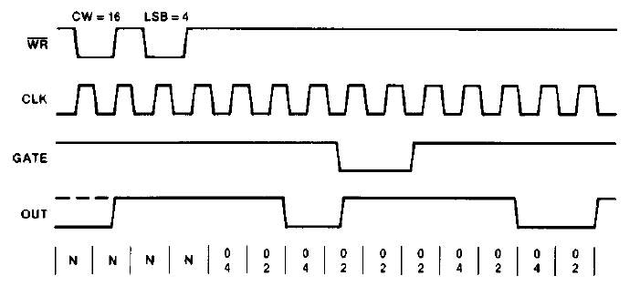
Mode 3: Square Wave Rate Generator

Slide 30
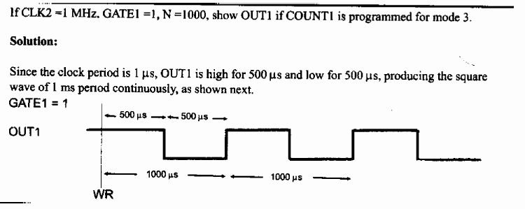
Mode 3: Example

Slide 31
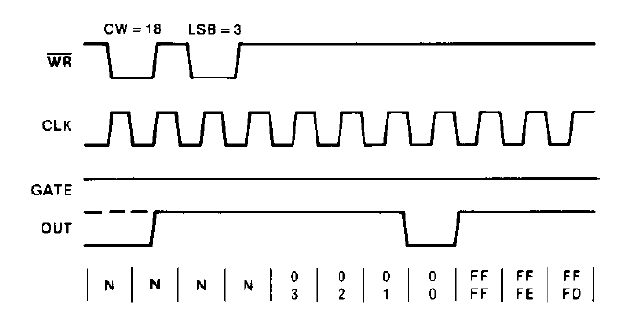
Mode 4 : Software Triggered Strobe
Starts upon loading the count
High for N*T low for 1 and then high
OUT will be initially high. When the initial count expires, OUT will go low for one CLK pulse and then go high again. The counting sequence is ``triggered'’ by writing the initial count.

Slide 32
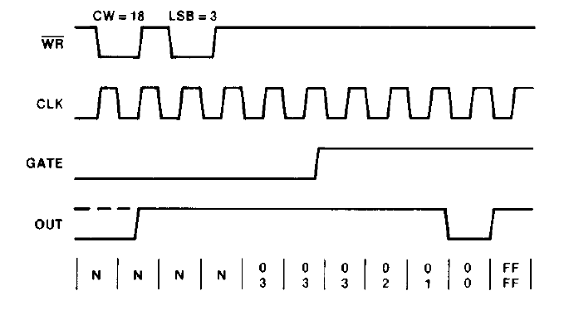
Mode 4 : Software Triggered Strobe

Slide 33
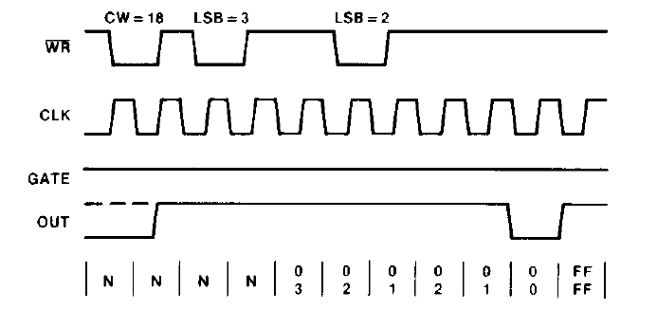
Mode 4 : Software Triggered Strobe

Slide 34
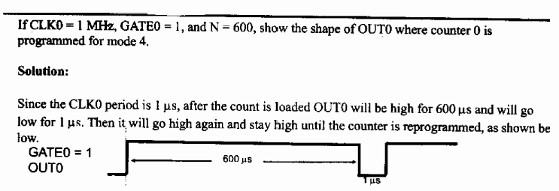
Mode 4: Example

Slide 35
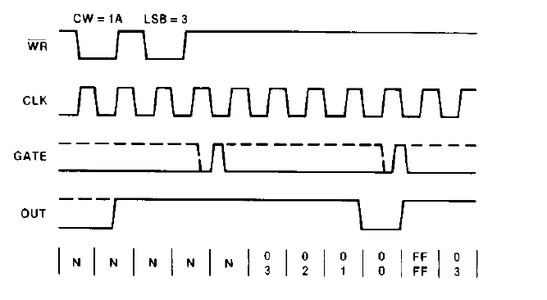
Mode 5 : Hardware triggered strobe
0 to 1 pulse on GATE
OUT will initially be high. Counting is triggered by a rising edge of GATE. When the initial count has expired, OUT will go low for one CLK pulse and then go high again.

Slide 36
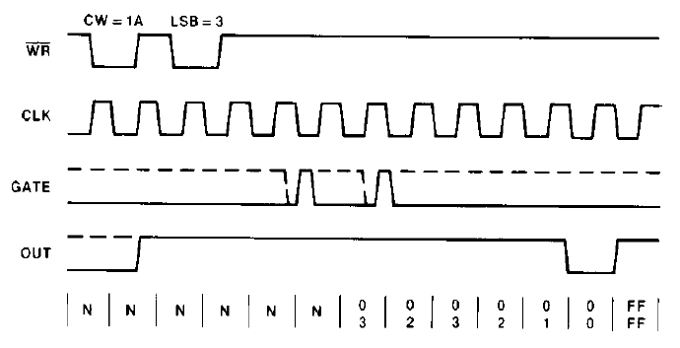
Mode 5 : Hardware triggered strobe

Slide 37
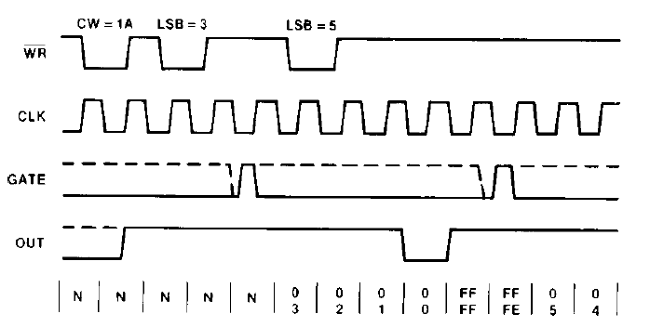
Mode 5 : Hardware triggered strobe

Slide 38
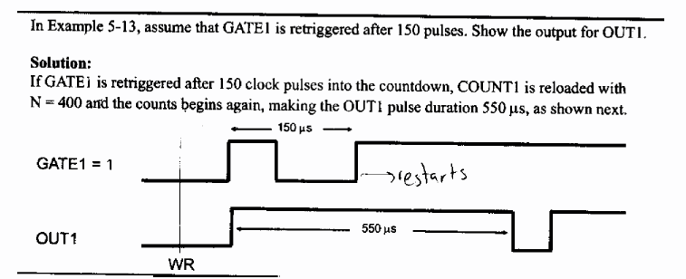
Mode 5: Example

Slide 39
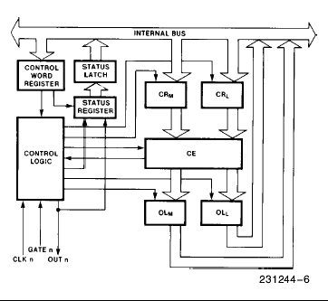
Internal Block Diagram of a Counter

Slide 40
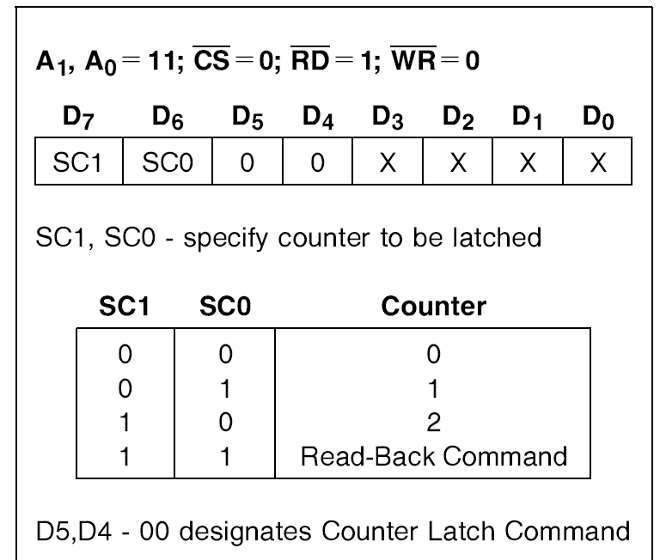
Counter Latch Command
The selected Counter's output latch (OL) latches the count at the time the Counter Latch Command is received.
This count is held in the latch until it is read by the CPU (or until the Counter is reprogrammed).
The count is then unlatched automatically and the OL returns to ``following'' the counting element (CE).

Slide 41
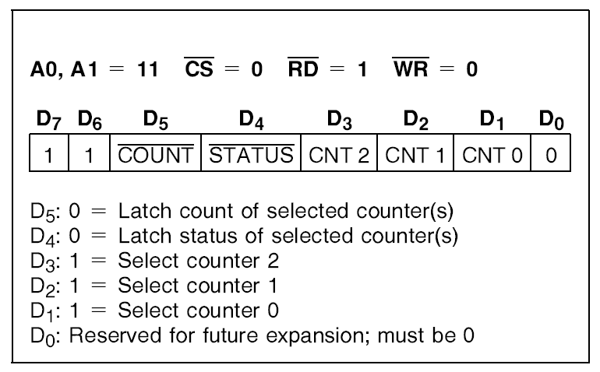
Read Back Command
This command allows the user to check the count value, programmed Mode, and current state of the OUT pin and Null Count flag of the selected counter(s).
The read-back command may be used to latch multiple counter output latches (OL) by setting the COUNT bit D5e0 and selecting the desired counter(s). This single command is functionally equivalent to several counter latch commands, one for each counter latched.

Slide 42
Read Back Command
If both count and status of a counter are latched, the first read operation of that counter will return latched status, regardless of which was latched first. The next one or two reads (depending on whether the counter is programmed for one or two type counts) return latched count. Subsequent reads return unlatched count.

Slide 43
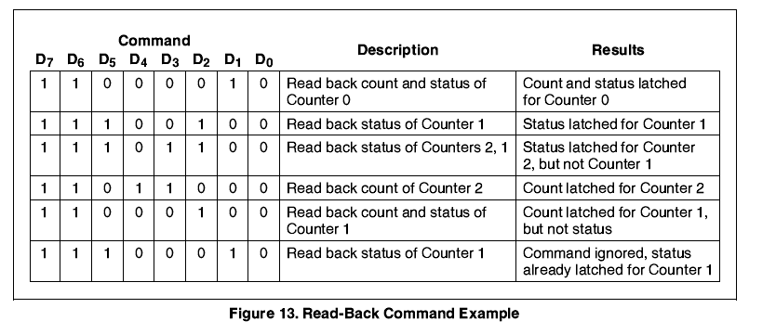
Read Back Command

Slide 44
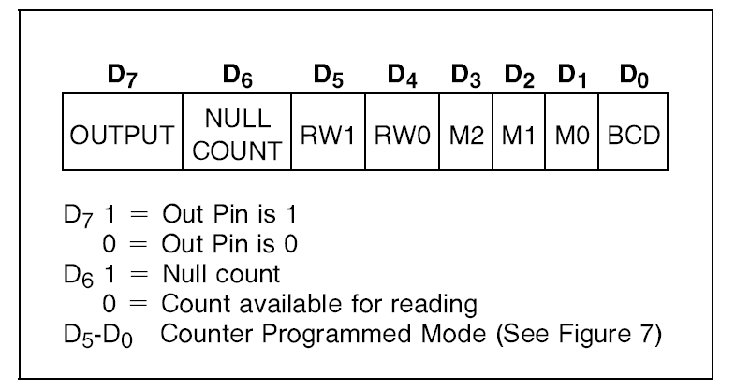
Status Byte

Slide 45
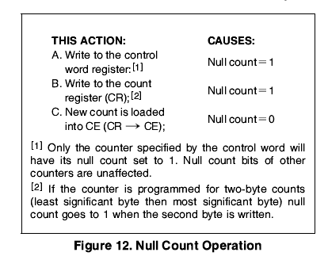
Status Byte

