Slide 1
Basic I/O Interface and Programming

Slide 2
Outline
Peripheral devices
  Input devices
  Output devices
Isolated I/O and Memory Mapped I/O
8 bit / 16-bit IO
Simple Input device - interfacing switches
Simple Output device - interfacing LEDs
Program controlled I/O example
Interrupt controlled I/O example
Block Transfers and DMA

Slide 3
Peripheral
is an input and/or output device
like a memory chip, it is mapped to a certain location (called the port address)
unlike a memory chip, a peripheral is usually mapped to a single location

Slide 4
Output Device
like a memory chip, you can write to an output device
You can write to a memory chip using the command
  mov [bx], al
You can write to an output device using the command
  out dx, al

Slide 5
Input Device
like a memory chip, you can read from an input device
You can read from a memory chip using the command
  mov al, [bx]
You can read from an input device using the command
  in al, dx

Slide 6
Device I/O Port Locations
As an example, a typical PC uses these I/O port locations
I/O address range (hex) Device
000 – 00f DMA controller
020 – 021 Interrupt controller
040 – 043 Timer
200 – 20f Game controller
2f8 – 2ff Serial port (secondary)
320 – 32f Hard disk controller
378 – 37f Parallel port
3d0 – 3df Graphics controller
3f0 – 3f7 Diskette drive controller
3f8 – 3ff Serial port (primary)

Slide 7
Input and Output Cycles
Intel Architecture processors have an I/O address space, separate from memory
Allow I/O devices to be decoded separately from memory devices
Use IOR# and IOW# signals for Input & Output

Slide 8
Isolated I/O and Instructions
Separate I/O instructions cause the IOR# or IOW# signals to be asserted
Instruction Data Width Function
  IN AL, 2Ch 8-bit A byte is input port 2C into AL
  IN AX, 2Ch 16-bit A word is input port 2C into AX
  IN AL, DX 8-bit A byte is input port addressed by DX into AL
  IN AX, DX 16-bit A word is input port addressed by DX into AX
  OUT 2Ch, AL 8-bit A byte is output from AL to port 2Ch
  OUT 2Ch, AX 16-bit A word is output from AX to port 2Ch
  OUT DX, AL 8-bit A byte is output from AL to port addressed by DX OUT DX, AX 16-bit A word is output from AX to port addressed by DX

Slide 9
Advantages of Separate I/O Mapping
All locations in memory map are available for memory
  No block removed for I/O
Smaller, faster instructions can be used for I/O
Less Hardware decoding for I/O
Easier to distinguish I/O accesses in assembly language

Slide 10
Memory-mapped I/O
Some processors only support a single address space - I/O devices are decoded in the memory map

Slide 11
Advantages of Memory Mapped I/O
I/O locations are read/written by normal instructions - no need for separate I/O instructions
  Size of instruction set reduced
Memory manipulations can be performed directly on I/O locations
No need for IOR# and IOW# pins

Slide 12
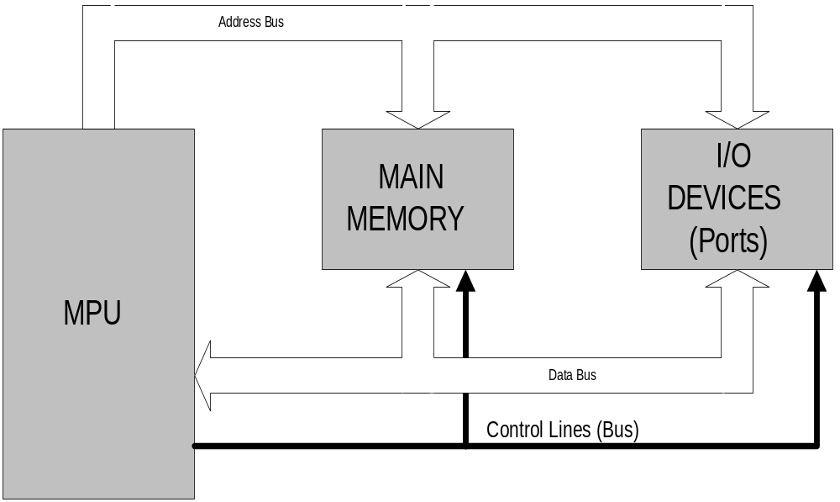
Simplified Block Diagram of a Microcomputer

Slide 13
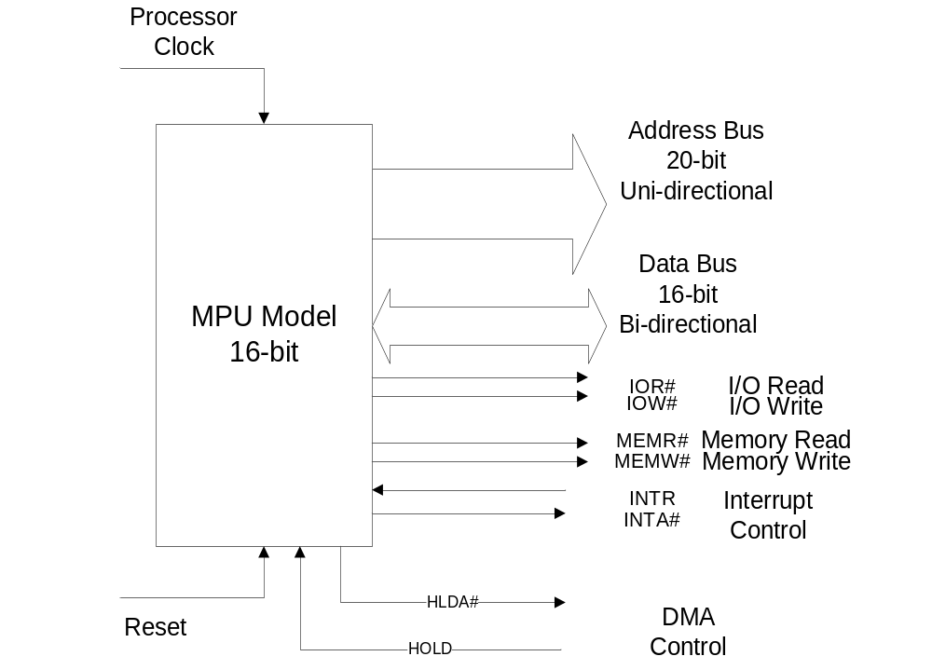
Simple Microprocessor Model

Slide 14
Creating a Simple Output Device
Use 8-LED’s
Use a chip and an address decoder such that the LED’s will respond only to the command out and a specific address
(let’s assume that the output address is F000h)

Slide 15
Use of 74LS245 and Address Decoder
A19
A18
:
A0
D7
A0
B0
D6
A1
B1
D5
A2
B2
D4
A3
B3
D3
A4
74LS245
B4
8086
D2
A5
B5
D1
A6
B6
Minimum
D0
A7
B7
Mode
E
DIR
5V
IOR
:
mov al, 55h
mov dx, 0F000h
out dx, al
:
IOW
A
A
A
A
A
A
A
A
A
A
A
A
A
A
A
A
IOW
1
1
1
1
1
1
9
8
7
6
5
4
3
2
1
0
5
4
3
2
1
0

Slide 16
Creating a Simple Input Device
Use 8-Switches (keys)
Use a chip and an address decoder such that the keys will be read only to the command in and a specific address
  (let’s assume that the input address is F000h)
How to interface a switch to computer?

Slide 17
Use of 74LS245 and Address Decoder
A19
5V
A18
:
A0
D7
A0
B0
D6
A1
B1
D5
A2
B2
D4
A3
B3
D3
A4
74LS245
B4
8086
D2
A5
B5
D1
A6
B6
Minimum
D0
A7
B7
Mode
E
DIR
IOR
:
mov dx, 0F000h
in al, dx
:
IOW
A
A
A
A
A
A
A
A
A
A
A
A
A
A
A
A
IOR
1
1
1
1
1
1
9
8
7
6
5
4
3
2
1
0
5
4
3
2
1
0
Same address for input and output?

Slide 18
How do you know if a user has pressed a button?
By Polling
By Interrupt

Slide 19
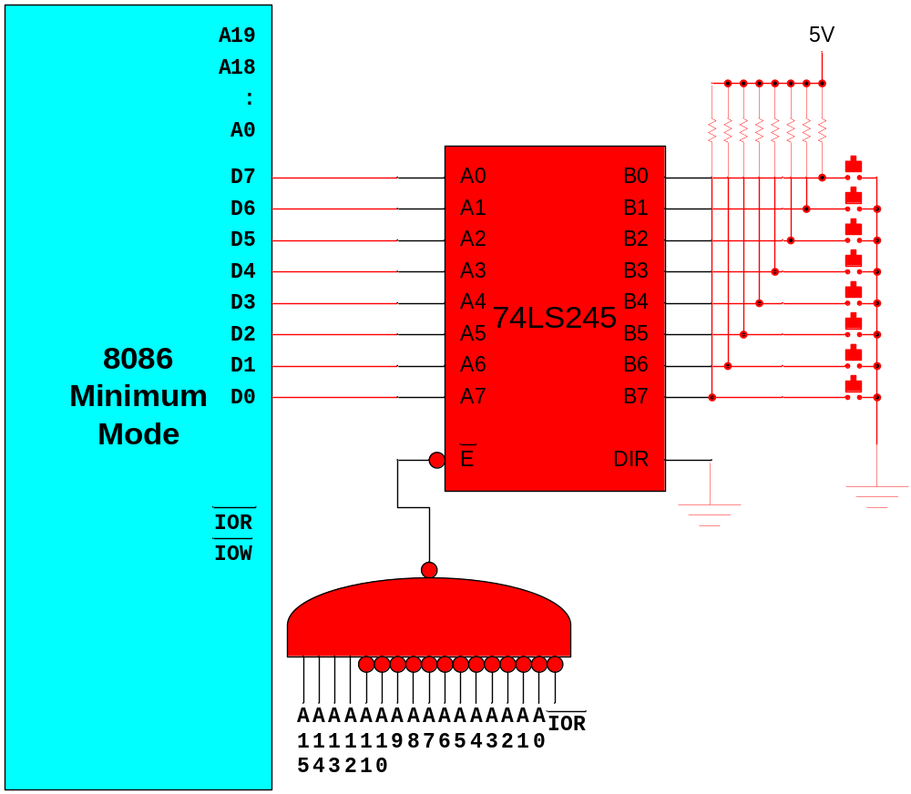
Polling
mov dx,0F000h
L1: in al, dx
cmp al, 0FFh
je L1
:
:

Slide 20
74AC138: 3-to-8 Decoder
Logic Diagram
Select
Inputs
A
0
1
2
3
4
5
6
7
B
C
‘138
Outputs
Enable
Inputs
E1
E2
E3

Slide 21
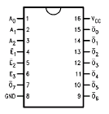
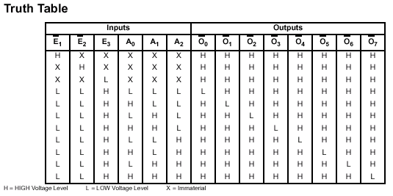
Example: Fairchild 74AC138

Slide 22
I/O Address Decoder with 74138
8-bit Input Port Address is 26h
0 0 1 0 0 1 1 0 – Binary I/O address
A A A A A A A A
7 6 5 4 3 2 1 0
A7
A6
A4
A3
A5
IORC
E3
0
1
2
3
4
5
6
7
E1
E2
‘138
A2
A1
A0
A₂
CS input of I/O interface
A₁
A₀

Slide 23
Interface for the programmed I/O
Programmed I/O consist of continually examining the status of an interface and performing an I/O operation with with the interface when its status indicates that it has data to be input or its data-out buffer register is ready to receive data from the CPU.

Slide 24
Interface for the programmed I/O
Address Bus
I/O Interface
MAIN
Data in buffer
0052
MEMORY
Data out buffer
0053
Status
0054
MPU
Data Bus
Control Lines (Bus)

Slide 25
An example of Interface
Suppose that a line of characters is to be input from a terminal to an 82-byte array begenning at BUFFER until a carriage return is encountered or more than 80 characters are input.
If a carrige return is not found in the first 81 characters then the message “BUFFER OVERFLOW” is to be output to the terminal;
otherwise, a line feed is to be automatically appended to the carrige return.

Slide 26
An example of Interface(2)
The 7-bit ASCII code is used and the eight bit,
bit 7, is often used as a parity bit during the transmission
from the terminal.
Assume that bit 7 is set according to even parity and
if an odd parity byte is detected, a branch is to be made
to ERROR
If there is no parity error, bit 7 is to be cleared before
the byte transferred to the memory buffer.
I/O address of data-in buffer register is 0052h
I/O address of data-out buffer register is 0053h
I/O address of status register is 0054h

Slide 27
Programmed I/O example
DATA_SEG SEGMENT
MESSAGE DB ‘BUFFER OVERFLOW’,ODH,0AH
-
-
DATA_SEG ENDS
COM_SEG SEGMENT COMMON
BUFFER DB 82 DUP(?) ;Reserve buffer area
COUNT DB ? ;and COUNT
COM_SEG ENDS
-
-
IN_BUFF EQU 52H ;assign names to
OUT_BUFF EQU 53H ;interface register
STATUS EQU 54H ;addresses
RRDY EQU 00000010B ;and ready bits
TRDY EQU 00000001B ;in status register
-
-
ASSUME DS:DATA_SEG, ES:COM_SEG
MOV AX,DATA_SEG ;initialize the DS
MOV DS,AX ;and ES registers
MOV AX,COM_SEG
MOV ES,AX
-
-

Slide 28
MOV DI,OFFSET BUFFER ;initialization needed
MOV COUNT,DI
MOV CX,81 ;for input
CLD ;clear DF for autoincrement
NEXT_IN: IN AL,STATUS ;idle until character
TEST AL,RRDY ;is put in input
JZ NEXT_IN ;buffer register
IN AL,IN_BUFF ;input charecter
OR AL,0 ;check parity and
JPE NO_ERROR ;branch to error
JMP NEAR PTR ERROR ;if parity is ODD
NO_ERROR: AND AL,7FH ;else, clear parity bit
STOSB ;move character to buffer
CMP AL,ODH ;check for carriage return
LOOPNE NEXT_IN ;loop if noCR or overflow
JNE OVERFLOW ;branch on overflow
MOV AL,OAH ;append line feed
STOSB
SUB DI,COUNT
MOV COUNT,DI ;store no. of characters
-
-
OVERFLOW: MOV SI,OFFSET MESSAGE ;initialization nedded
MOV CX,17 ;for output
NEXT_OUT IN AL,STATUS ;idle until output
TEST AL,TRDY ;buffer register
JZ NEXT_OUT ;is empty
LODSB ;output character
OUT OUT_BUFF,AL
LOOP NEXT_OUT ;loop until message complete

Slide 29
Priority Polling
If there is more than one device using the programmed I/O,
it is necessary to poll the ready bits of all of the devices.
Suppose there are three devices, the address of their status
registers have been equated to STAT1, STAT2 and STAT3
and their procedures PROC1, PROC2 and PROC3 are called
upon to perform the input. Bit 5 is taken to be the input
ready bit in all three of the status registers. The variable FLAG is for terminating the input process and is initially set to 0. It is assumed that the first input procedure will check a termination condition and set FLAG to 1,thereby causing the input process to cease after all currently pending inputs have been completed.

Slide 30
Priority Polling(2)
MOV FLAG,0 ;clear FLAG
INPUT: IN AL,STAT1 ;check STAT1
TEST AL,20H ;and if no input is
JZ DEV2 ;ready, go to DEV2
CALL FAR PTR PROC1 ;else input from DEVICE 1
CMP FLAG,1 ;if FLAG is clear
JNZ INPUT ;input another datum
DEV2: IN AL,STAT2 ;check STAT2
TEST AL,20H ;and if no input is
JZ DEV3 ;ready, go to DEV3
CALL FAR PTR PROC2 ;else, input from DEVICE 2
CMP FLAG,1 ;if FLAG is clear
JNZ INPUT ;input another datum
DEV3: IN AL,STAT3 ;check STAT3
TEST AL,20H ;and if
JZ NO_INPUT ;input is available
CALL FAR PTR PROC3 ;input from DEVICE 3
NO_INPUT CMP FLAG,1 ;else check flag, if clear
JNZ INPUT ;input another datum,
;else continue

Slide 31
F <= 0
No
Yes
Priority Polling
New input from dev1 ?
Read input from dev1
F = 1
Termination Cond. ?
F = 0
No
Yes
New input from dev2 ?
Read input from dev2
F = 1
Termination Cond. ?
F = 0
No
Yes
New input from dev3 ?
Read input from dev3
F = 1
Termination Cond. ?
F = 0

Slide 32
Round-robin polling
Round-robin arrangement essentially gives
all three devices the same priority. In this example,
FLAG is checked only at the bottom of the loop and,
if it is 1, the loop is exited without testing for
additional inputs.

Slide 33
Round-robin polling(2)
MOV FLAG,0 ;clear FLAG
INPUT: IN AL,STAT1 ;input from device 1
TEST AL,20H ;if input is ready
JZ DEV2 ;
CALL FAR PTR PROC1 ;
DEV2: IN AL,STAT2 ; input from device 2
TEST AL,20H ; if input is ready
JZ DEV3 ;
CALL FAR PTR PROC2 ;
DEV3: IN AL,STAT3 ; input from device 2
TEST AL,20H ; if input is ready
JZ NO_INPUT ;
CALL FAR PTR PROC3 ;
NO_INPUT CMP FLAG,1 ;repeat LOOP if flag
JNZ INPUT ;is still clear
;

Slide 34
F <= 0
Round-Robin Polling
No
Yes
New input from dev1 ?
Read input from dev1
No
Yes
New input from dev2 ?
Read input from dev2
No
Yes
New input from dev3 ?
Read input from dev3
F = 1
Termination Cond. ?
F = 0

Slide 35
Interrupts
Even though programmed I/O is conceptually simple,
it can waste considerable amount of time while waiting
for ready bits to become active. A different approach
is needed.

Slide 36
Interrupts(2)
Used to Halt the normal flow of instructions
Exceptions can be due to Hardware or Software
Hardware Interrupts are asynchronous to the processor
Could be asserted by an external device requesting action, e.g. a port ready to transfer data
Interrupts can be globally masked by the processor’s Interrupt Enable Flag (IE or I)
IE is set by STI and reset by CLI (or equivalent)

Slide 37
Maskable & Non Maskable Interrupts
Maskable interrupts can be enabled/disabled using a flag (usually in the flags register
Non Maskable Interrupts (NMI) are top priority interrupts that can’t be masked out
NMIs often used for Parity Errors, Power fails etc

Slide 38
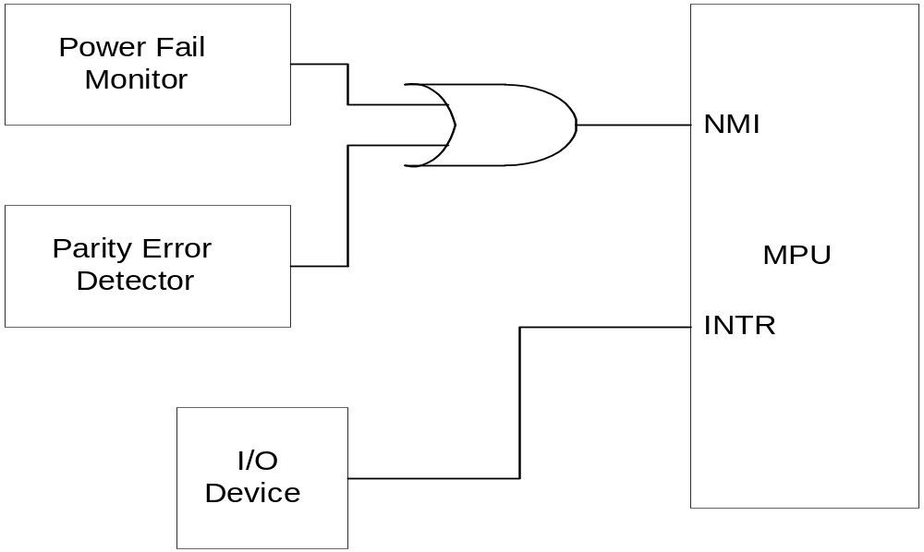
NMI Example

Slide 39
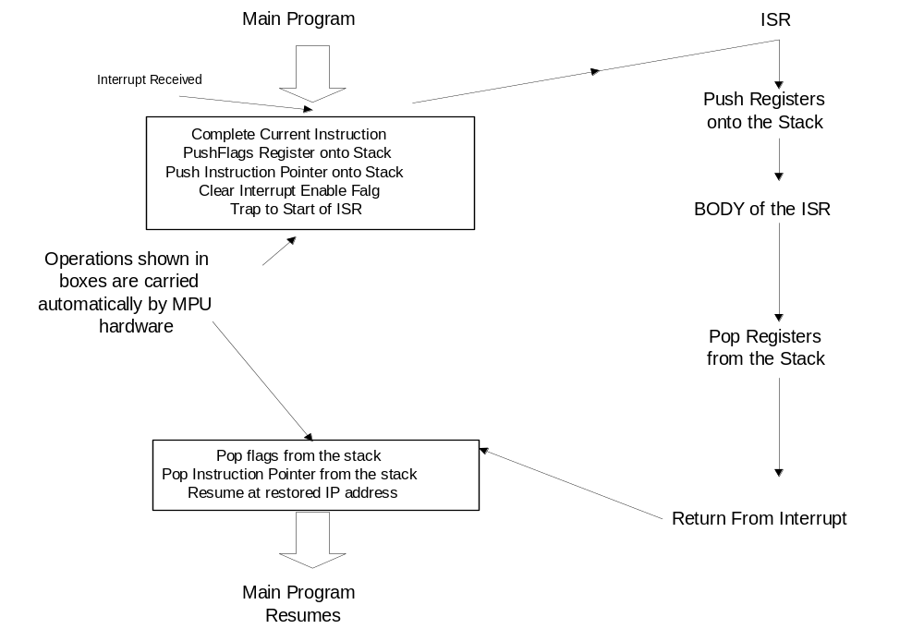
Interrupts

Slide 40
Example for Interrupt I/O
Interrupt I/O is used to input a line of characters to a buffer that is pointed by BUFF_POINT. It is assumed that all variables are defined in a segment DATA_SEG whose segment address has been stored in DS.
The location CODE, which is initially set to 0, is used
* to indicate when a complete line has been input (CODE=2)
or
* to indicate the input buffer has overflowed (CODE=1). An overflow occurs when 81 characters are received without a carriage return being detected.

Slide 41
Example for Interrupt I/O (2)
In a event of overflow, input interrupts are disabled and output interrupts are enabled, and interrupt I/O is used to output an error message from MESSAGE.

Slide 42
INT_SEG SEGMENT
ASSUME CS:INT_SEG, DS:DATA_SEG ;Parameters are accessible via DS
IN_BUF EQU 52H
OUT_BUF EQU 53H
CONTROL EQU 54H
ENABLE_OUT EQU 00000001B
INT_ROUT: PUSH AX ;Save registers
PUSH BX
IN AL,IN_BUF ;input character
MOV BX,BUF_POINT ;and store in
MOV [BX],AL ;memory buffer
INC BX ;increment buffer pointer
INC COUNT ;and count
MOV BUF_POINT,BX ;store buffer pointer
CMP AL,ODH ;check for carrige
JNZ NO_CR ;return and
MOV BYTE PTR [BX],OAH ;append a line feed
INC COUNT
MOV CODE,2 ;set CODE to 2 so main routine
XOR AL,AL ;may call procedure LINE_PROC
OUT CONTROL,AL ;also, disable ınput device
JMP CONT ;
NO_CR: CMP COUNT,81 ;check for overflow
JB CONT ;ıf no, return
MOV CODE,1 ;otherwise, set code to 1,
MOV MSGCOUNT,0 ;zero msgcount
MOV AL,ENABLE_OUT ;disable input and enable
OUT CONTROL,AL ;output
CONT: POP BX ;restore registers
POP AX
IRET

Slide 43
.
;The following interrupt service routine outputs one character
;from message when interrupt output device occurs
OVERFLOW: PUSH AX ;save registers
PUSH BX
MOV BX,MSGCOUNT
MOV AL,MESSAGE[BX] ;output a character
OUT OUT_BUF,AL
INC MSGCOUNT ;increment counter
CMP AL,OAH ;last character in message?
JNE RETURN ;no, return. Otherwise,
XOR AL,AL ;disable further interrupt
OUT CONTROL,AL ;from output
RETURN: POP BX ;restore registers
POP AX
IRET
INT_SEG ENDS

Slide 44
Program sequence for initializing the interrupt pointers
PUSH DS ;save DS
XOR AX,AX
MOV DS,AX ;clear DS so an absolute location
MOV AX,OFFSET INT_ROUT ;may be addressed
MOV BX,148H
MOV [BX],AX ;move offset of int_rout to 148H
MOV AX,OFFSET OVERFLOW
MOV [BX+4],AX ;move offset of overflow to 14CH
MOV AX,INT_SEG
MOV [BX+2],AX ;move segment base to 14AH
MOV [BX+6],AX ;move segment base to 14CH
POP DS ;restore DS
MOV AL,00000010B
OUT CONTROL,AL ;enable input device

Slide 45
Setting up an Interrupt-Pointer Table
The first 1 KB of memory is set aside as a table for storing the starting addresses of ISR
  these are address 00000H to 003FFH
  you need 4 bytes to store the CS and IP values for each ISR
  thus the table can hold the addresses for 256 ISR’s
Terms
  Interrupt vector/pointer - the starting address of an ISR
  Interrupt vector/pointer table - the table containing the starting addresses of the ISR’s

Slide 46
Classifying Interrupts
An ISR is identified by a number from 0 to 255
  this called its type
An interrupt pointer/vector is a doubleword
  the low word contains the IP value
  the high word contains the CS value

Slide 47
I/O Device Coordination via Interrupts
  A Pentium Vector Table
Vector number Description Vector number Description
0 divide error 11 segment not present
1 debug exception 12 stack fault
2 null interrupt 13 general protection
3 breakpoint 14 page fault
4 [overflow] 15 (reserved)
5 range exception 16 floating-point error
6 invalid opcode 17 alignment check
7 device not available 18 machine check
8 double fault 19-31 (reserved)
9 (reserved) 32-255 maskable interrupts
10 invalid TSS

Slide 48
Direct Memory Access (DMA)
DMA techniques improve system performance
External devices can transfer data directly to or from memory under hardware control
Other methods (e.g. interrupts) use software to transfer data and are slower
DMA is used when very high data rates are required

Slide 49
Code to Move Data From Input to Memory
READ_BYTE: IN AL, DX [13]
MOV [BX], AL [2]
INC BX [2]
DEC CL [2]
JNZ READ_BYTE [10]
This Code takes 29 clock cycles
At 20MHz:
fclk = 20MHz; Tclk = 1/fclk = 50ns; 29 x 50ns = 1450ns = 1.45us per byte
1/(1.45us/B) = 670KB/s (slow)
DMA could achieve 10MB/s at the same clock frequency

Slide 50
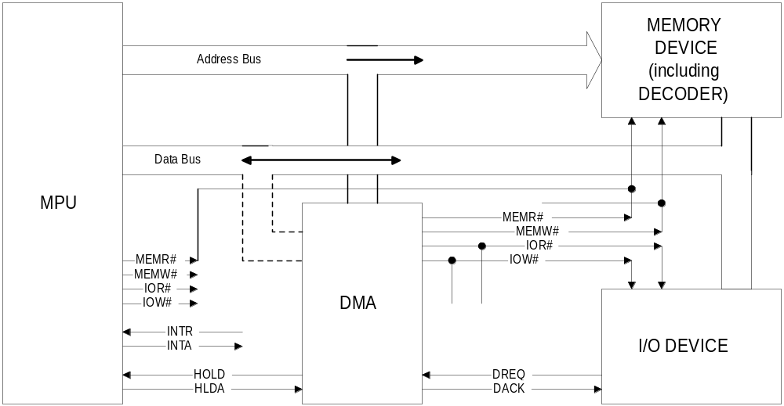
MPU + DMA Controller

Slide 51
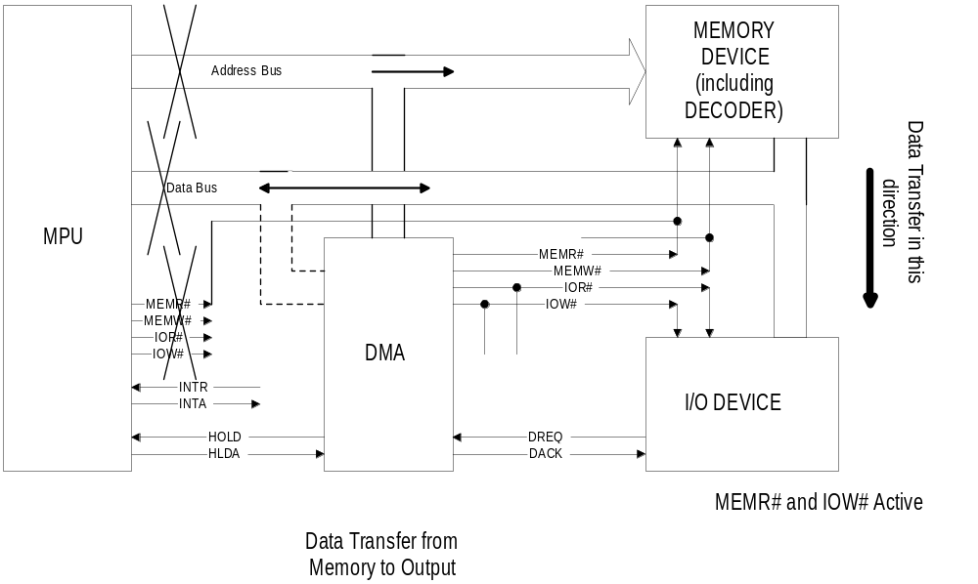
DMA In From Memory to I/O

Slide 52
DMA Timing, from Memory to Output Transfer
DREQ
HOLD
HLDA
DACK
ADDRESS
IOW
MEMR
DATA
address n
address n+1
valid
valid

Slide 53
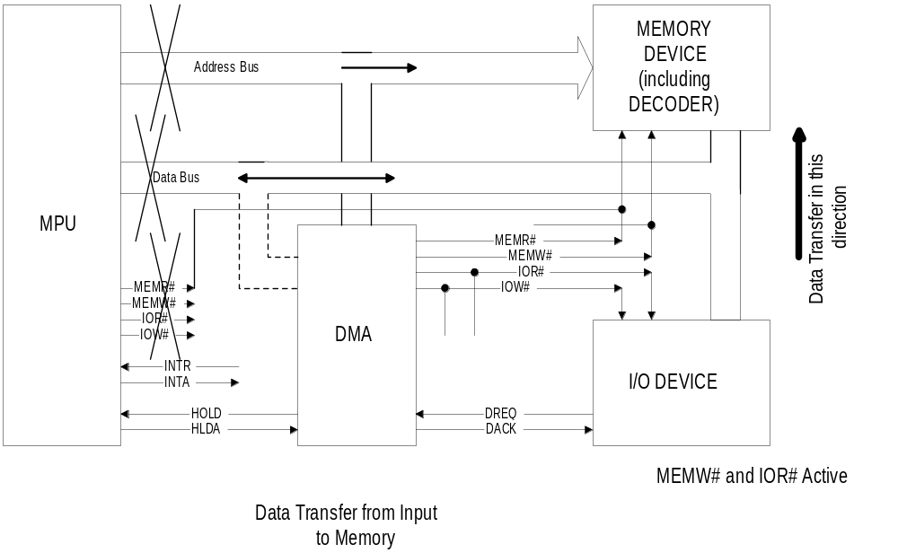
DMA In From I/O Out to Memory

Slide 54
DMA Timing, from Input to Memory Transfer
DREQ
HOLD
HLDA
DACK
ADDRESS
IOR
MEMW
DATA
address n
address n+1
valid
valid

