Slide 1
MEMORY INTERFACE
(ROMS, RAMS)

Slide 2
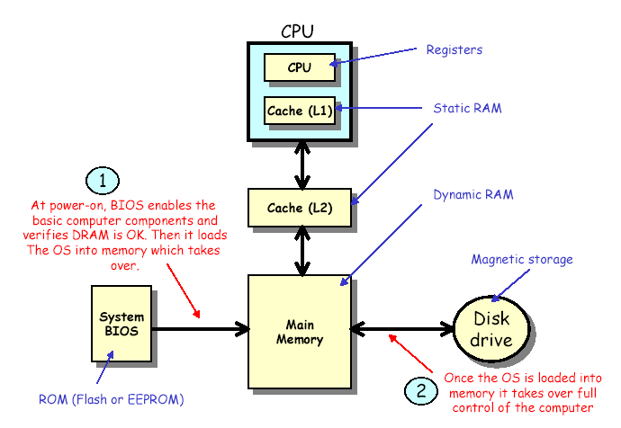
Computer Memory Overview

Slide 3
Memory Structure
MAIN MEMORY:
  - DRAM technology
  - cost effective
  - requires periodic refresh
  - multiplexed access (ROW then COL)
CACHE MEMORY:
  - SRAM technology
  - more expensive but fast
  - no refresh required
  - non-multiplexed access (ROW+COL at same time)
SYSTEM BIOS:
  - Permanent storage
  - inexpensive but very slow
  - used to initialize the computer for start up
DISK STORAGE:
  - magnetic memory

Slide 4
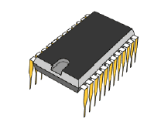
Read Only Memory (ROM)
ROM memory can only be read not written to during their “normal” operation.
ROMs are “non-volatile” meaning that they retain their contents over the power cycle.
There are five basic ROM types:
• ROM – “read only memory”.
Programmed by manufacturer
• PROM – “programmable read-only memory”
1 time programmable by user
• EPROM – “Erasable programmable read-only memory”
erasable by UV light
• EEPROM – “Electrically erasable programmable read-only memory”
change 1 byte at a time, which makes them versatile but slow
• Flash memory - Flash memory works much faster than traditional
EEPROMs because it writes data in chunks, usually 512 bytes
in size, instead of 1 byte at a time

Slide 5
Masked “ROM”
Programmed by manufacturer
Manufacturer uses photographic negative (a mask)
Not cost effective for low volumes to to high overhead
Very cost effective for high volumes.

Slide 6
Programmable “PROM”
Uses a fusable link technology
Programmable by customer instead of manufacturer
Can only be programmed 1 time
commonly referred to as “OTP” one-time-programmable

Slide 7
Erasable Programmable “EPROM”
User can erase and write many times
entire contents must be erased before rewriting
write process requires higher voltages (10-20V)
erase requires UV light and takes about 15-20 minutes

Slide 8
EEROM and Flash ROM
Electrically Erasable Programmable “EEPROM”
  In circuit programmable
  byte erasable. Does not require all to be cleared
Flash ROM
  bulk erasable (not as flexible as EEPROMs)

Slide 9
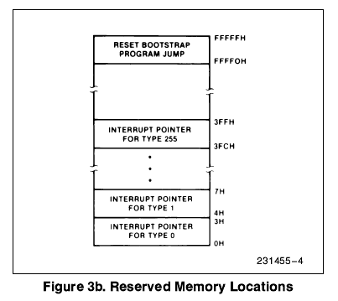
8086 Memory Organization
Locations from address FFFF0H through FFFFFH are reserved for operations including a jump to the initial program loading routine. Following RESET, the CPU will always begin execution at location FFFF0H where the jump must be.
Locations 00000H through 003FFH
are reserved for interrupt operations. Each of the 256 possible interrupt types has its service routine pointed to by a 4-byte pointer element consisting of a 16-bit segment address and a 16-bit offset address.
The pointer elements are assumed to have
been stored at the respective places in reserved memory prior to occurrence of interrupts.

