Slide 1
Microprocessors
8255 PPI
Programmable Peripheral Interface

Slide 2
Outline
8255 PPI
8255 PPI Pin Configuration
8255 operating modes
16-bit data bus to 8-bit peripherals
MODE 0 Application (Keyboard)
MODE 1 Application (Printer)
MODE 2 Application (Printer)

Slide 3
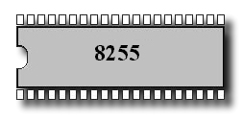
The 8255A is a programmable peripheral interface (PPI) device designed for use in Intel microcomputer systems. Its function is that of a general purposes I/O component to Interface peripheral equipment to the microcomputer system bush. The functional configuration of the 8255A is programmed by the systems software so that normally no external logic is necessary to interface peripheral devices or structures.

Slide 4
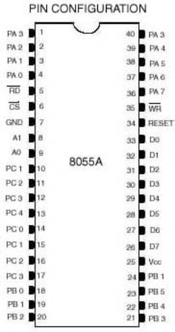
Pin Configuration

Slide 5
Pin Configuration
(CS)Chip Select. A “low’ on this input pin enables the communication between the 8255A, and the CPU.
(RD) Read. A “low” on this Input pin enables the 8255A to send the data or status information to the CPU on the data bus. In essence, it allows the CPU to “read from the 8255A.
(WR) Write. A. “ low” on the input pin enables the CPU to write data or control words into the 8255A.
(A0 and A1)
Port Select 0 and Port Select 1. The Input signals, in conjunction with the RD and WR Inputs, controls the selection of one of the three ports or the control word registers. They are normally connected to the least significant bits of the address bus (A0 and A1).

Slide 6
Interface Registers
A1 A0 RD WR CS Input Operation (Read)
0 0 0 1 0 Port A - Data Bus
0 1 0 1 0 Port B - Data Bus
1 0 0 1 0 Port C - Data Bus
1 1 0 1 0 Control Word - Data Bus
Output Operation (Write)
0 0 1 0 0 Data Bus - Port A
0 1 1 0 0 Data Bus - Port B
1 0 1 0 0 Data Bus - Port C
1 1 1 0 0 Data Bus - Control

Slide 7
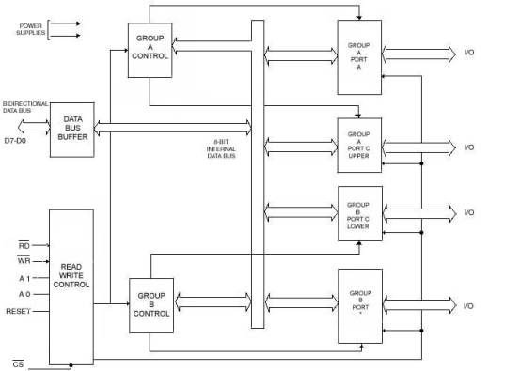
8255 A Block Diagram Showing Data Bus Buffer and Read/Write Control Logic Functions

Slide 8
Ports A, B and C
Ports A, B, and C
The 8255A contains three 8-bit ports (A , B, and C). All can be configured in a wide variety of functional characteristics by the system software but each has its own special features or personally to further enhance the power and flexibility of the 8255A.
Port A. One 8 bit data output latch/buffer and one 8-bit data input latch.
Port B. One 8-bit data output latch/buffer and one 8-bit data input buffer.
Port C. One 8-bit data output latch/buffer and one 8-bit data input buffer (no latch for input). This port can be divided into two 4-bit ports under the mode control. Each 4-bit port contains a 4-bit latch and it can be used for the controls signal outputs and status signal inputs in conjunction with ports A and B.

Slide 9
8255A OPERATIONAL DESCRIPTION
Mode Selection
There are three basic modes of operation that can be selected by the systems software:
Mode O – Basic Input/Output
Mode 1 – Strobed Input/Output
Mode 2 – Bi-Directional Bus

Slide 10
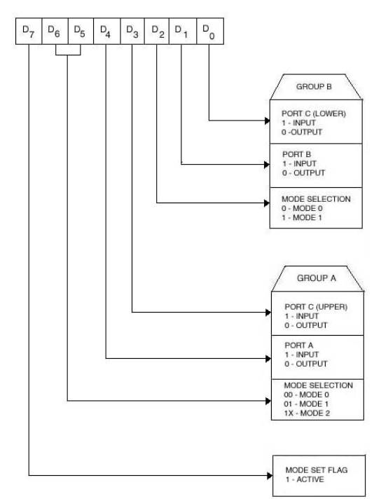
Mode Definition Format
Control word

Slide 11
16-bit data bus to 8-bit peripherals
The problem associated with connecting the 8-bit interface device to a 16-bit bus of an 8086 are releted to need to transfer even-addressed bytes over the lower half of the data bus and odd-addressed bytes over the upper half.
  BHE# A0 Transfer
  0 0 Not useful
  0 1 Odd addressed byte on upper half of bus
  1 0 Even addressed byte on lower half of bus
  1 1 Not possible

Slide 12
Solution 1: Use only even addresses
Example: We want to use a 8255 PPI with the starting I/O address of F8h. Use even adresses only.
  A7 A6 A5 A4 A3 A2 A1 A0
f8h 1 1 1 1 1 0 0 0 B : Port A
fah 1 1 1 1 1 0 1 0 B : Port B
fch 1 1 1 1 1 1 0 0 B : Port C
feh 1 1 1 1 1 1 1 0 B : Control Reg.
Register Select

Slide 13
Circuit Diagram
D0-D7
8255
PPI
CS
RD#
WR#
A1
A0
D0-D7
A3
A4
A5
A0
0
1
2
3
4
5
6
7
A1
From CPU
A2
‘138
M/IO#
A0
E1
E2
A7
A6
E3
IORDC#
IOWRC#
A2
A1

Slide 14
Access to Interface Registers
Port B and C are programmed as Mode 0 input port.
Port A is programmed as Mode 0 simple latched output port.
Write a code to implement the operation
PortA=PortB-PortC
mov AL,08Bh ;control word
out 0FEh,AL ;written to control reg.
in AL,0FCh ;Read Port C
mov BL,AL ;
in AL,OFAh ;Read Port B
sub AL,BL ;PortB-PortC
out 0F8h,AL ;write PortA

Slide 15
Solution 2: Use only odd addresses
Example: We want to use a 8255 PPI with the starting I/O address of F9h. Use odd adresses only.
  A7 A6 A5 A4 A3 A2 A1 A0
f9h 1 1 1 1 1 0 0 1 B : Port A
fbh 1 1 1 1 1 0 1 1 B : Port B
fdh 1 1 1 1 1 1 0 1 B : Port C
ffh 1 1 1 1 1 1 1 1 B : Control Reg.
Register Select

Slide 16
Circuit Diagram
D0-D7
8255
PPI
CS
RD#
WR#
A1
A0
D8-D15
A3
A4
A5
A0
0
1
2
3
4
5
6
7
A1
From CPU
A2
‘138
M/IO#
E1
A0
E2
A7
A6
E3
IORDC#
IOWRC#
A2
A1

Slide 17
Solution 3: Use consecutive even and odd address
Example: We want to use a 8255 PPI with the starting I/O address of C0h. Use even and odd adresses.
  A7 A6 A5 A4 A3 A2 A1 A0
C0h 1 1 0 0 0 0 0 0 B : Port A
C1h 1 1 0 0 0 0 0 1 B : Port B
C2h 1 1 0 0 0 0 1 0 B : Port C
C3h 1 1 0 0 0 0 1 1 B : Control Reg.
Register Select

Slide 18
D8-D15
BHE#
74
245
OE#
D0-D7
8255
PPI
CS
RD#
WR#
A1
A0
Y0
D0-D7
74
245
OE#
A4
A3
A2
A0
0
1
2
3
4
5
6
7
A1
From CPU
A2
‘138
M/IO#
A5
E1
E2
A7
A6
E3
IORDC#
IOWRC#
A1
A0

Slide 19
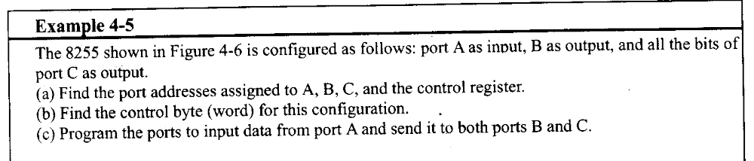
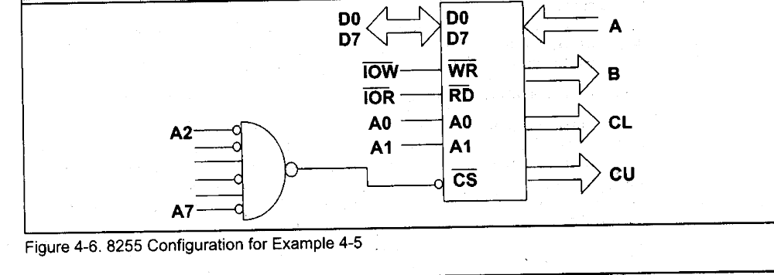
Example - Port addresses

Slide 20
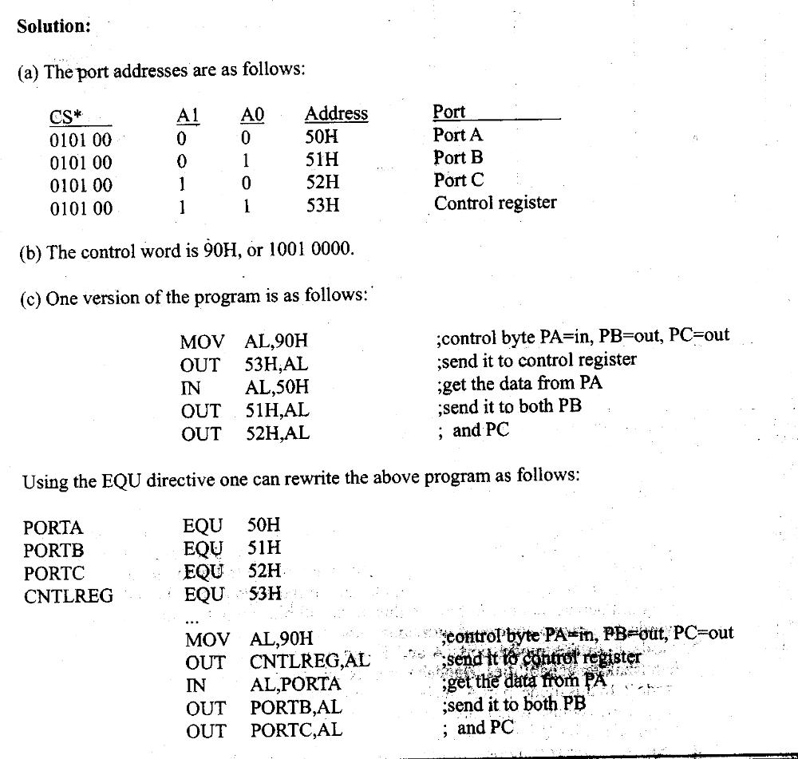
Solution

Slide 21
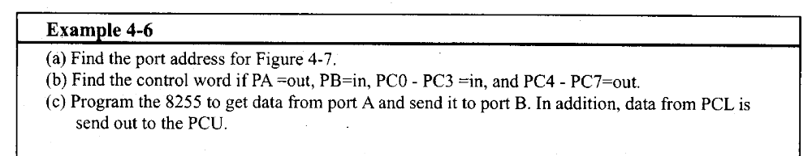
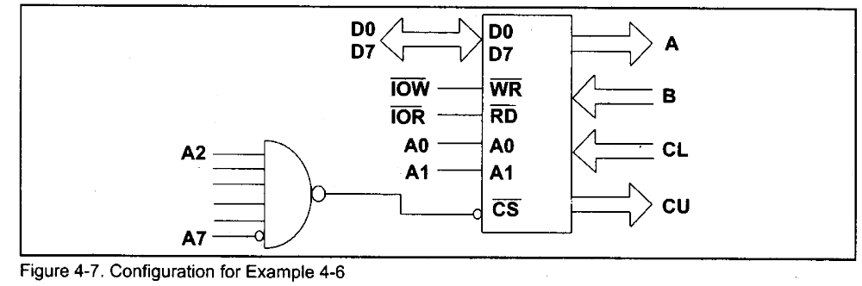
Example – Programming 8255

Slide 22
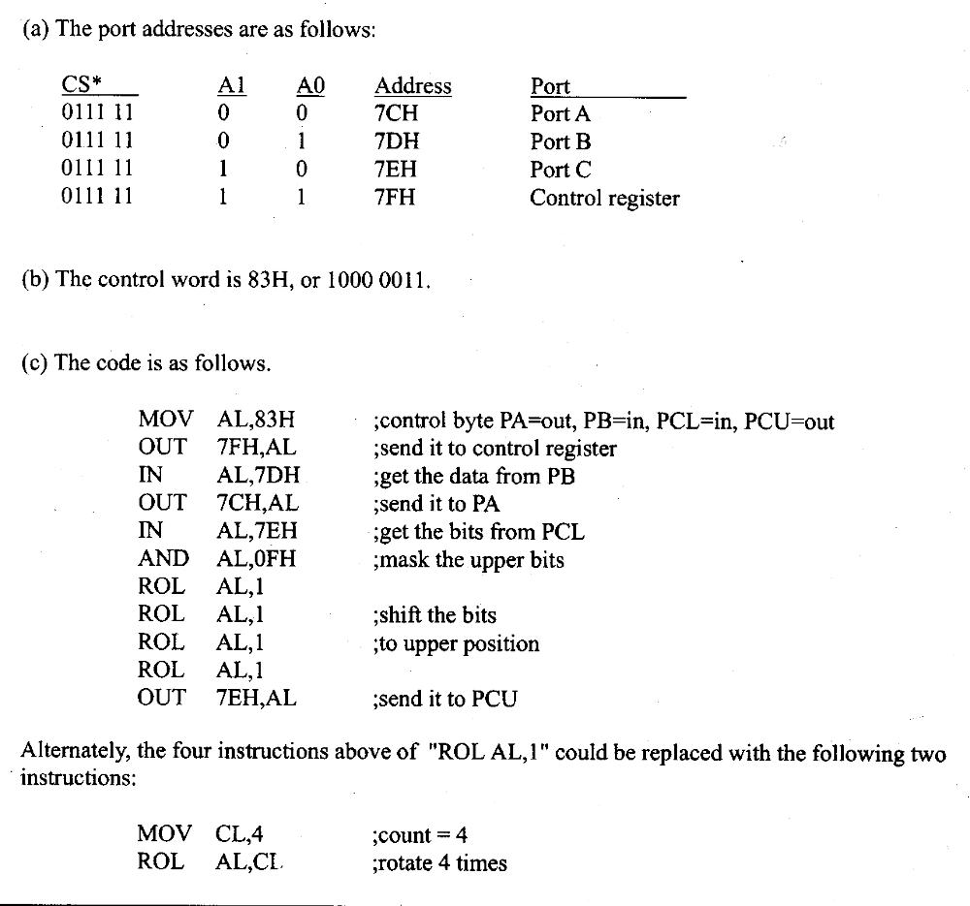
Solution

Slide 23
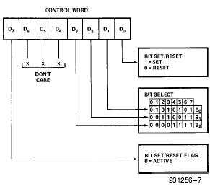
Bit Set Reset (BSR) mode

Slide 24
Example for BSR
Program 8255 for the following
  A) set PC2 to high
  B) Use PC6 to generate a square wave of 66% duty cycle
Solution
A)
  MOV AL, 00000101B
  OUT 92H,AL
B)
  AGAIN MOV AL, 0xxx1101
  OUT 92H, AL
  CALL Delay
  CALL Delay
  MOV AL, 0xxx1100
  OUT 92H, AL
  CALL Delay
  JMP AGAIN

Slide 25
Mode 0: Basic Input and Output
This functional configuration provides simple input and output operations for each of the three ports. No ``handshaking'‘ is required, data is simply written to or read from a specified port.
Mode 0 Basic Functional Definitions:
Two 8-bit ports and two 4-bit ports.
Any port can be input or output.
Outputs are latched.
Inputs are not latched.
16 different Input/Output configurations are possible
in this Mode.

Slide 26
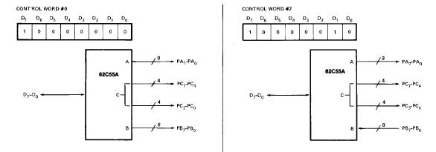
Mode 0

Slide 27
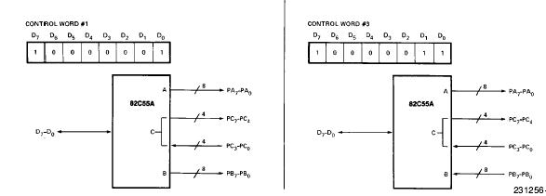
Mode 0

Slide 28
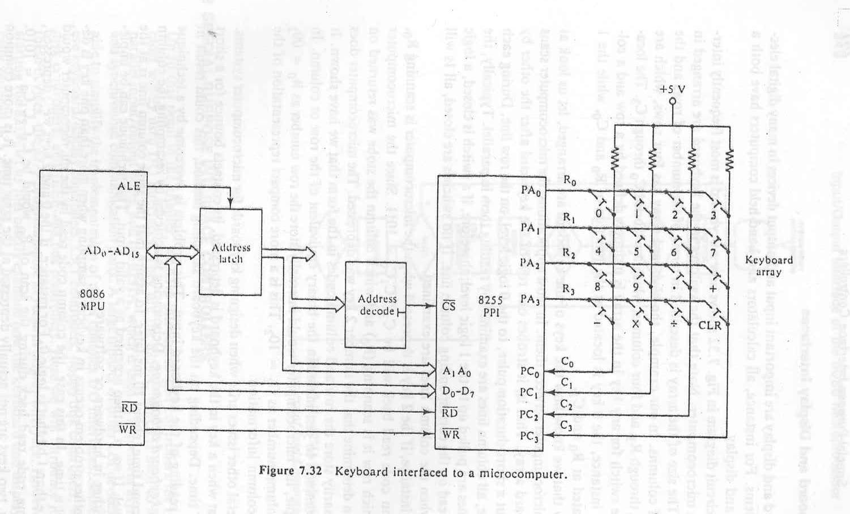
MODE 0 Application (Keyboard Interface)

Slide 29
MODE 0 Application (Keyboard Interface)
The switches in the keyboard are arranged in an array. The size of the array is described in terms of the number of rows and the number of the columns.
In our example, the keyboard array has four rows, which are labeled R₀ through R₃, and four columns, which are labeled C₀ through C₃. The location of the switch for any key in the array is uniquely defined by a row and a column.
For instance, the 0 key is located at the junction of R₀ and C₀, while the 1 key is located at R₀ and C₁.
In most applications, the microcomputer scans the keyboard array. That is, it strobes one row of the keyboard after the other by sending out a short-duration pulse, to the 0 logic level, on the row line. During each row strobe, all column lines are examined by reading them in parallel.
Typically, the column lines are pulled up to the 1 logic level; therefore, if a switch is closed, a logic 0 will be read on the corresponding column line. If no switches are closed, all 1s will be read when the lines are examined.

Slide 30
MODE 0 Application (Keyboard Interface)
The starting address for this I/O interface is 10H and consecutive even addresses are used.
10h: 0 0 0 1 0 0 0 0B -Port A (Output port)
12h: 0 0 0 1 0 0 1 0B -Port B (Unused output port)
14h: 0 0 0 1 0 1 0 0B -Port C (lower and higher input)
16h: 0 0 0 1 0 1 1 0B -Control Reg.
PORTA EQU 10h
PORTB EQU 12h
PORTA EQU 14h
CREG EQU 16h
CWD EQU 10001001b
MOV AL, CWD
OUT CREG,AL

Slide 31
MODE 0 Application (Keyboard Interface)
MATRIX DB ‘0123456789.+-x+*’
.
.
SCAN: MOV BL,0FEH ; send a short-duration pulse, to the 0 logic level,
SCAN1: MOV AL,BL ; on the row line0.
OUT PORTA,AL
IN AL,PORTC ;Read PortC
XOR AL,0FFH ;Complement AL
AND AL,0FH ;Mask unused nibble
CMP AL,0
JNE KEY ;if a key pressed go to KEY
ROL BL,1 ; if no key pressed, shift the ruration pulse to next row
CMP BL,0EFH
JNE SCAN1
JMP SCAN
.
.
KEY: .
.

Slide 32
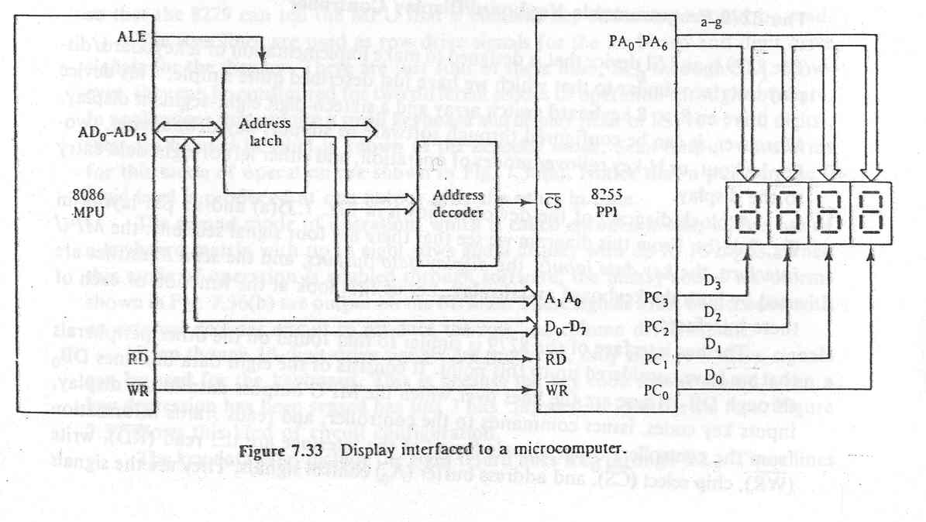
Mode 0 Application: Display Interface

Slide 33
MODE 1 (Strobed Input/Output).
This functional configuration provides a means for transferring I/O data to or from a specified port in conjunction with strobes or ``handshaking'' signals. In mode 1, Port A and Port B use the lines on Port C to generate or accept these ``handshaking'' signals.
Mode 1 Basic functional Definitions:
Two Groups (Group A and Group B).
Each group contains one 8-bit data port and one 4-bit control/data port.
The 8-bit data port can be either input or output
Both inputs and outputs are latched.
The 4-bit port is used for control and status of the 8-bit data port.

Slide 34
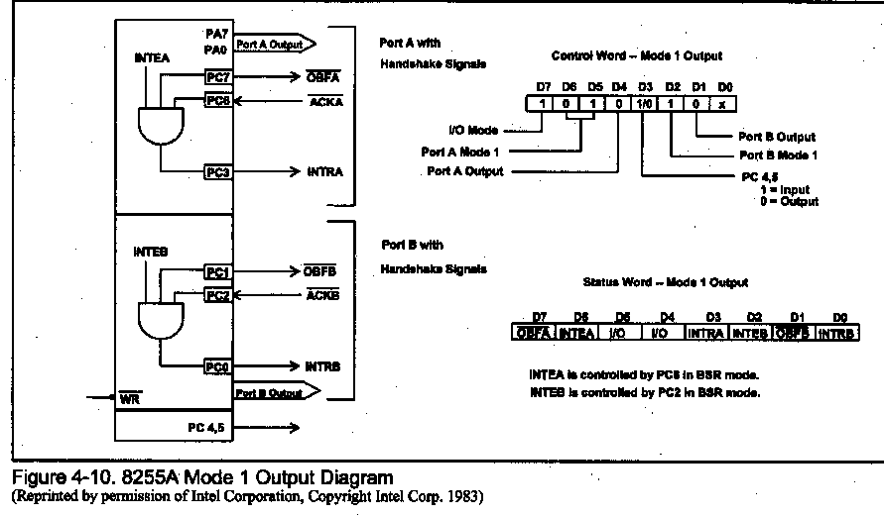
MODE 1 Output Operation
Notes:
Status word is read from port c
Intea and inteb are written using PC6 and PC2

Slide 35
Output Control Signal Definition
OBF (Output Buffer Full F/F):The OBF output will go ``low'' to indicate that the CPU has written data out to the specified port. The OBF F/F will be set by the rising edge of the WR input and reset by ACK Input being low.
ACK (Acknowledge Input): A ``low'' on this input informs the 82C55A that the data from Port A or Port B has been accepted. In essence, a response from the peripheral device indicating that it has received the data output by the CPU.
INTR (Interrupt Request): A ``high'' on this output can be used to interrupt the CPU when an output device has accepted data transmitted by the CPU. INTR is set when ACK is a ``one'', OBF is a ``one'‘ and INTE is a ``one''. It is reset by the falling edge of WR.
INTE A :Controlled by bit set/reset of PC6.
INTE B: Controlled by bit set/reset of PC2.

Slide 36
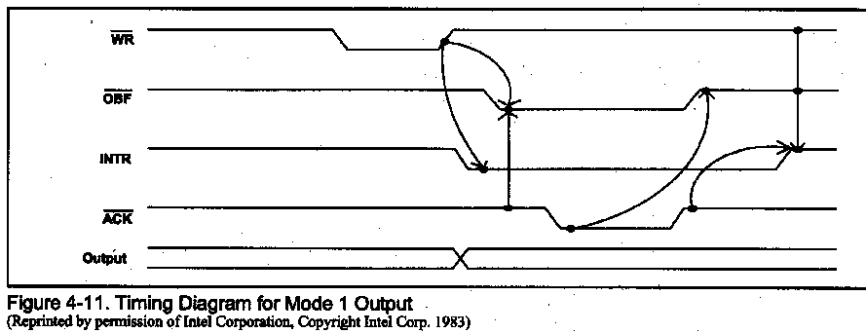
MODE 1 Timing (output)

Slide 37
Interrupt vs. Polling
CPU is interrupted whenever necessary
CPU can serve many devices
Require more hardware

Slide 38
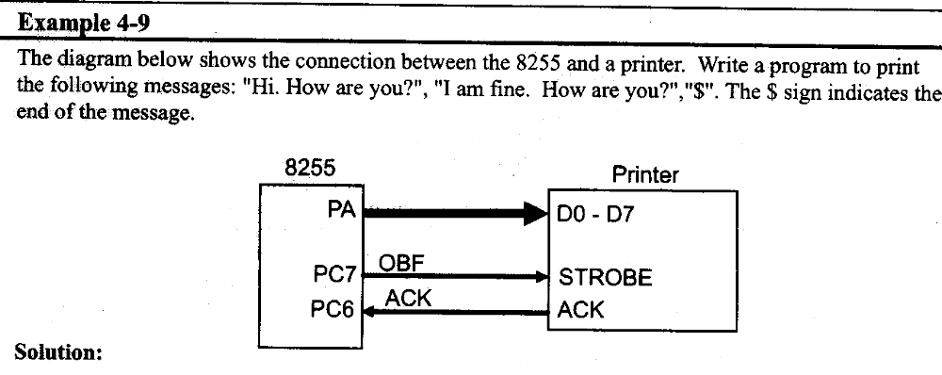
Using status to Poll

Slide 39
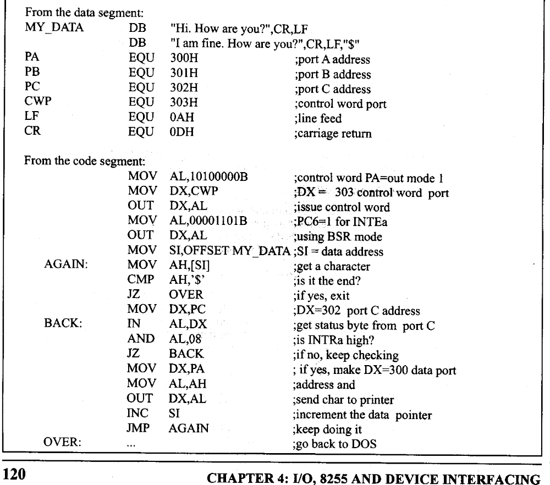
Solution

Slide 40
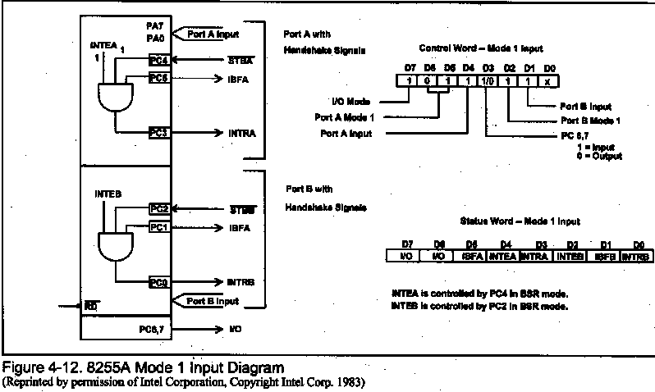
MODE 1 Input Operation

Slide 41
Input Control Signal Definition
STB (Strobe Input): A ``low'' on this input loads data into the input latch.
IBF (Input Buffer Full F/F): A ``high'' on this output indicates that the data hasbeen loaded into the input latch; in essence, an acknowledgement. IBF is set by STB input being low and is reset by the rising edge of the RD input.
INTR (Interrupt Request): A ``high'' on this output can be used to interrupt the CPU when an input device is requesting service.
INTR is set by the STB is a ``one'', IBF is a ``one'‘ and INTE is a ``one''. It is reset by the falling edge of RD. This procedure allows an input device to request service from the CPU by simply strobing its
data into the port.
INTE A: Controlled by bit set/reset of PC4.
INTE B: Controlled by bit set/reset of PC2.

Slide 42
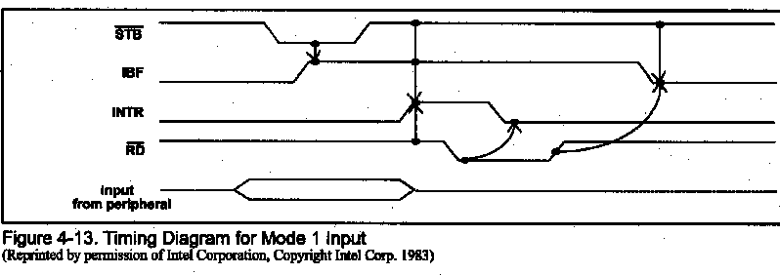
MODE 1 Timing (input)

Slide 43
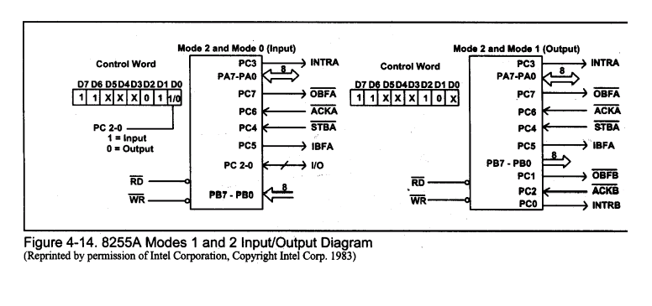
MODE 2 Operation

Slide 44
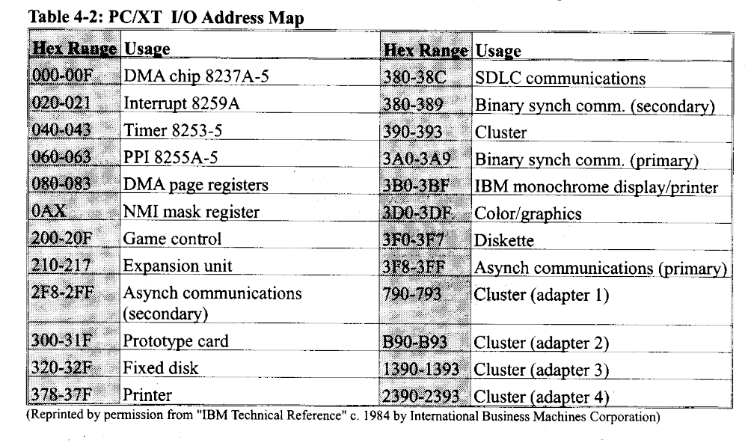
IBM PC IO MAP

Slide 45
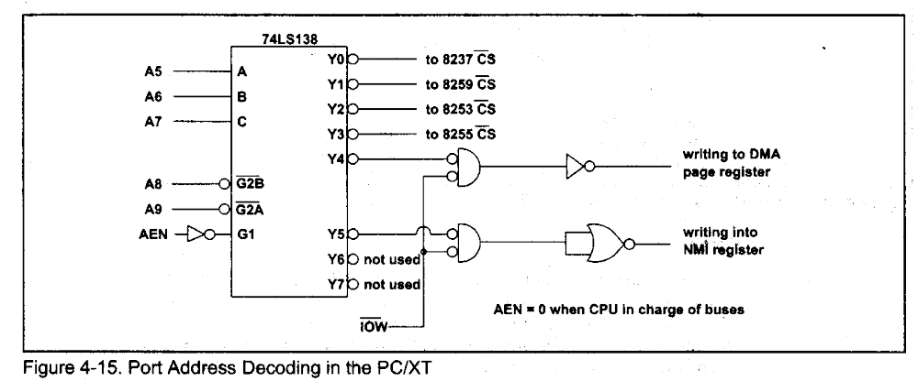
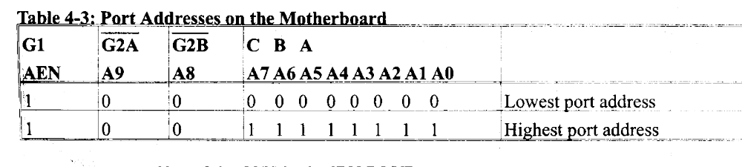
Decoding by 74138

Slide 46
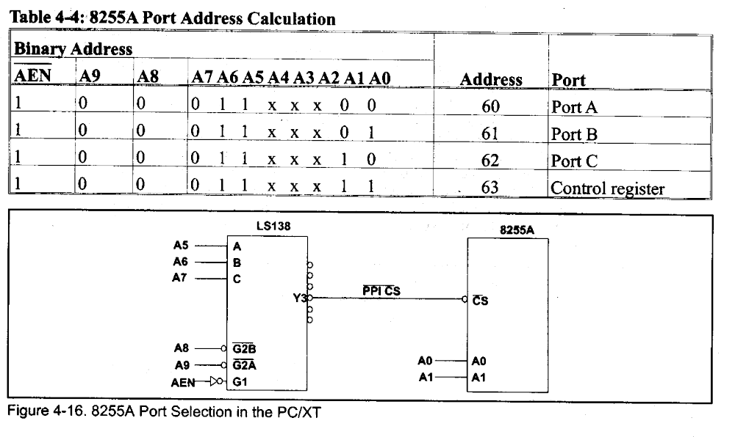
8255 Address in PC

Slide 47
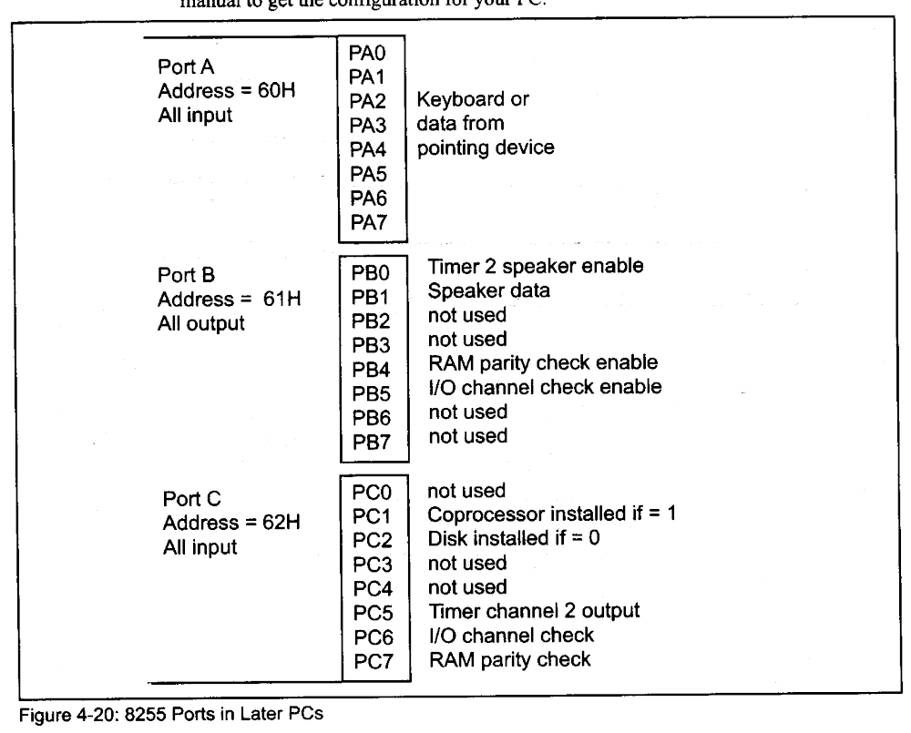
Use of 8255 ports in PC
MOV AL,99H
OUT 63, AL
Notes:
In earlier PC port A was used to read from DIP switches

