Slide 1
K-Nearest Neighbor Classification

Slide 2
Instance-based Learning
Two data-driven methods (no model)
  K-nearest neighbors
  Naïve Bayes

Slide 3
K-Nearest Neighbor
Features
  All instances correspond to points in an n-dimensional Euclidean space
  Classification is delayed till a new instance arrives
  Classification done by comparing feature vectors of the different points
  Target function may be discrete or real-valued

Slide 4
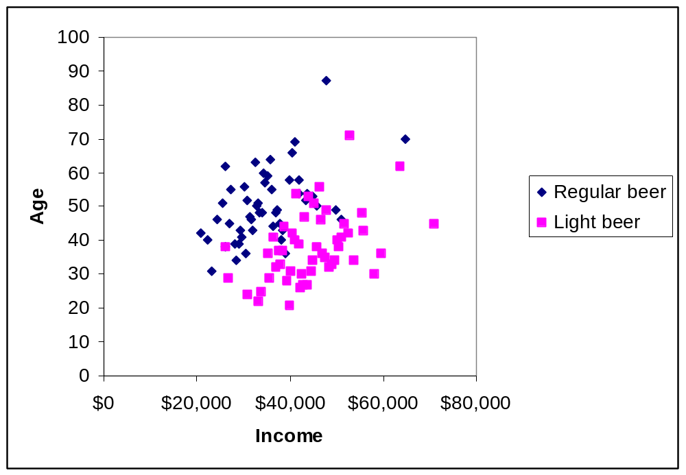
k-Nearest Neighbor
Find the k closest records to the one to be classified, and let them “vote”.

Slide 5
How does it work?
Computes the distance between the record to be classified and each of records in the training set
  Finds the k shortest distances
  Computes the vote of these k neighbors
  This is repeated for every record in the validation set

Slide 6
k NEAREST NEIGHBOR
k = 1:
Belongs to square class
k = 3:
Belongs to triangle class
?
k = 7:
Belongs to square class
Choosing the value of k:
  If k is too small, sensitive to noise points
  If k is too large, neighborhood may include points from other classes
  Choose an odd value for k, to eliminate ties

Slide 7
Distance between 2 samples
Multivariate case: Each observation is a vector of values.
  Customer1 = (Age=25,Exp=1,Income=49,…,CC=0)
  Customer2 = (Age=49,Exp=19,Income=34,…,CC=0)
The distance between obs i and j is denoted d_{ij}.
Distance Requirements:
  Non-negative ( d_{ij} > 0 )
  d_{ii} = 0
  Symmetry (d_{ij} = d_{ji} )
  Triangle inequality ( d_{ij} + d_{jk} ≥ d_{ik} )

Slide 8
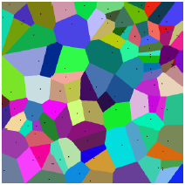
Decision Boundaries
The nearest neighbour algorithm does not explicitly compute decision boundaries. However, the decision boundaries form a subset of the Voronoi diagram for the training data.
The more examples that are stored, the more complex the decision boundaries can become

Slide 9
Distance-Weighted Nearest Neighbor Algorithm
Assign weights to the neighbors based on their ‘distance’ from the query point
  Weight ‘may’ be inverse square of the distances
All training points may influence a particular instance
  Shepard’s method

Slide 10
Remarks
+Highly effective inductive inference method for noisy training data and complex target functions
+Target function for a whole space may be described as a combination of less complex local approximations
+Learning is very simple
- Classification is time consuming

