Slide 1
Hardware and Software
Chapter 2

Slide 2
Principles and Learning Objectives
Information system users must work closely with information system professionals to define business needs, evaluate options, and select the hardware and software that provide a cost-effective solution to those needs.
  Identify and discuss the role of the essential hardware components of a computer system.
  List and describe popular classes of computer systems and discuss the role of each.
  Outline the role of the operating system and discuss how operating systems have evolved over time.
  Identify and briefly describe the functions of the two basic kinds of software.

Slide 3
Principles and Learning Objectives
Organizations do not develop proprietary application software unless doing so will meet a compelling business need that can provide a competitive advantage.
  Discuss how application software can support personal, workgroup, and enterprise business objectives.
  Identify three basic approaches to developing application software.

Slide 4
Principles and Learning Objectives
End users and IS professionals use a programming language whose functional characteristics are appropriate to the task at hand.
  Outline the overall evolution of programming languages and highlight the differences between programming languages used by end users and IS professionals.

Slide 5
Principles and Learning Objectives
The information system industry continues to undergo constant change; users need to be aware of recent trends and issues in software licensing to be effective in their business and personal life.
  Identify several key issues and trends in licensing that have an impact on organizations and individuals.

Slide 6
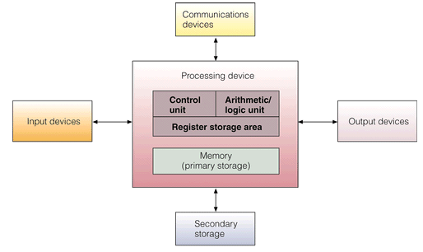
Computer System Components

Slide 7
Hardware Components in Action
Instruction phase
  Step 1: Fetch instruction
  Step 2: Decode instruction
Execution phase
  Step 3: Execute the instruction
  Step 4: Store the results

Slide 8
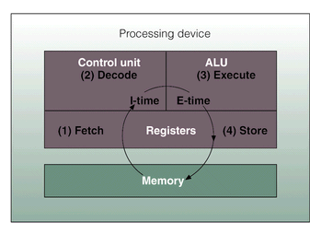
Execution of an Instruction

Slide 9
Processing and Memory Devices

Slide 10
Processing Characteristics and Functions
Machine cycle time
Clock speed
Wordlength
Superconductivity

Slide 11
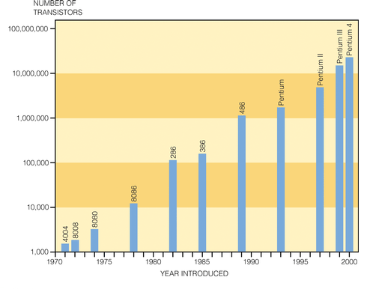
Moore’s Law

Slide 12
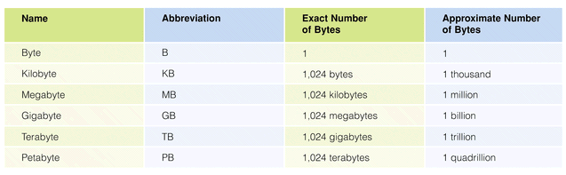
Number of Bytes

Slide 13
Types of Memory
Random access memory (RAM)
  EDO RAM
  SDRAM
  DRAM
Read-only memory (ROM)
  PROM
  EPROM

Slide 14
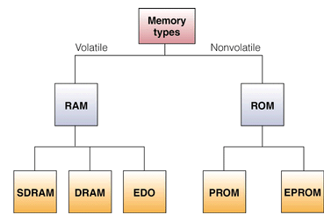
Basic Types of Memory Chips

Slide 15
Secondary Storage and Output Devices

Slide 16
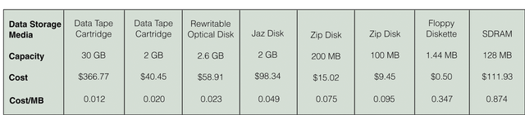
Cost Comparisons for Various Forms of Data Storage

Slide 17
Secondary Storage Access Methods
Sequential access
Direct access
Sequential access storage devices
Direct access storage devices

Slide 18
Secondary Storage Devices
Magnetic tapes
Magnetic discs
RAID
SAN
Optical discs
Magneto-optical discs
Digital versatile discs
Memory cards
Expandable storage

Slide 19
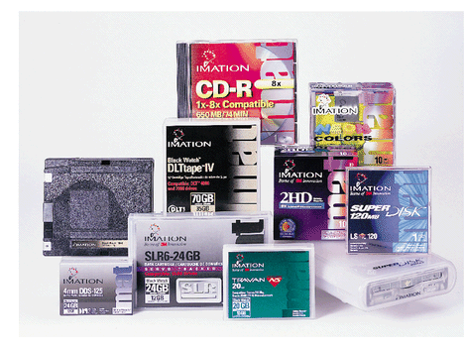
Types of Secondary Storage

Slide 20
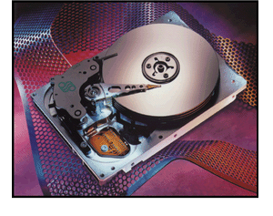
Hard Disc

Slide 21
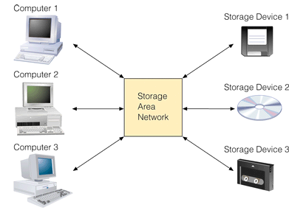
Storage Area Network

Slide 22
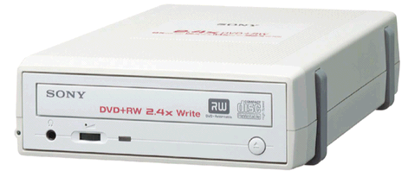
Digital Versatile Disc Player

Slide 23
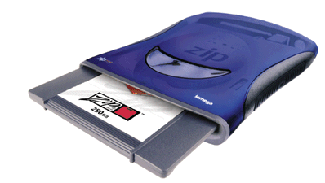
Expandable Storage

Slide 24
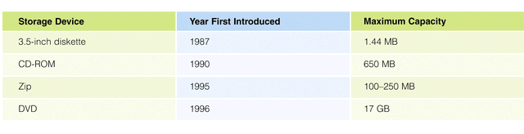
Comparison of Secondary Storage Devices

Slide 25
Input Devices
Personal computer input devices
Voice-recognition devices
Digital computer cameras
Terminals
Scanning devices

Slide 26
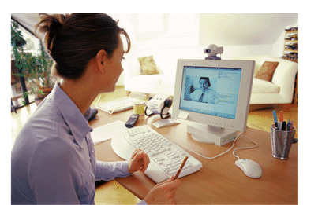
A PC Equipped with a Computer Camera

Slide 27
Output Devices
Display Monitors
Liquid Crystal Displays (LCDs)
Printers and Plotters
Music Devices

Slide 28
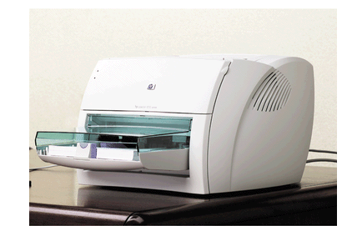
Laser Printer

Slide 29
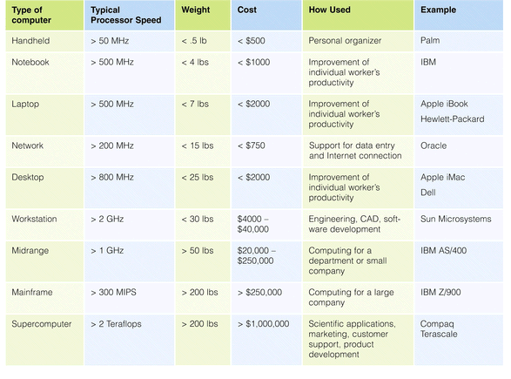
Types of Computer Systems

Slide 30
Overview of Software

Slide 31
Overview of Software
Computer programs
Documentation
Systems software
Computer system platform
Application software

Slide 32
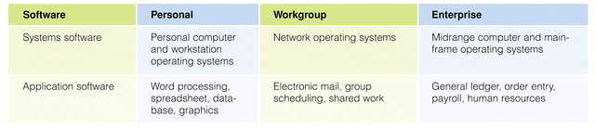
Classifying Software by Type and Sphere of Influence

Slide 33
Systems Software

Slide 34
Operating Systems
Perform common computer hardware functions
Provide a user interface
Provide a degree of hardware independence
Manage system memory
Manage processing tasks
Provide networking capability
Control access to system resources
Manage files

Slide 35
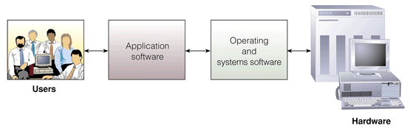
Role of the Operating System

Slide 36
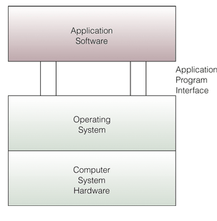
Application Program Interface

Slide 37
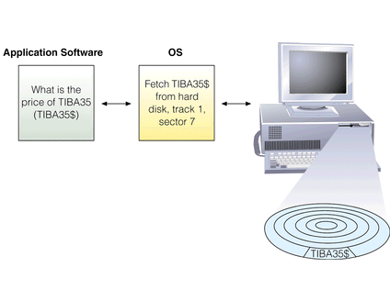
An Example of the Operating System Controlling Physical Access to Data

Slide 38
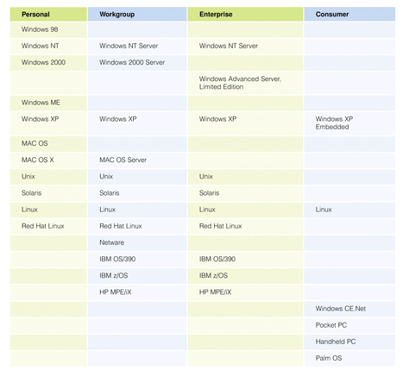
Popular Operating Systems

Slide 39
Workgroup Operating Systems
Windows 2000 Server
Unix
Netware
Red Hat Linux
Mac OS X Server

Slide 40
Consumer Appliance Operating Systems
Windows CE .NET
Windows XP Embedded
Handheld PC
Pocket PC
Palm OS

Slide 41
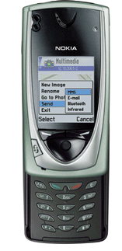
Nokia 7650

Slide 42
Application Software

Slide 43
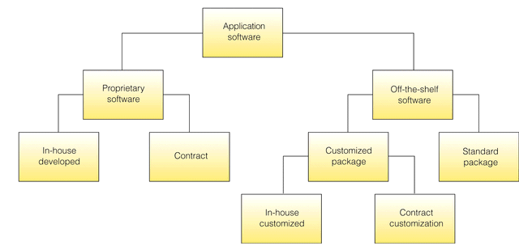
Sources of Software

Slide 44
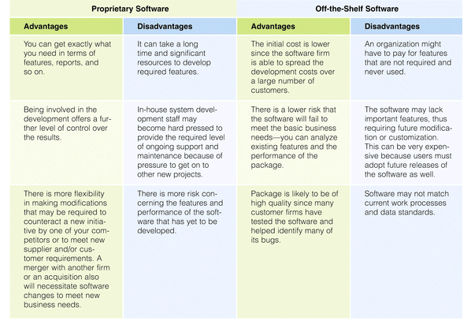
Proprietary and Off-the-Shelf Software

Slide 45
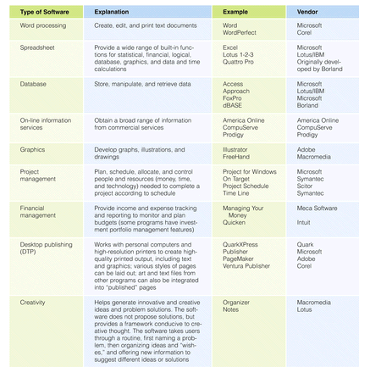
Examples of Personal Productivity Software

Slide 46
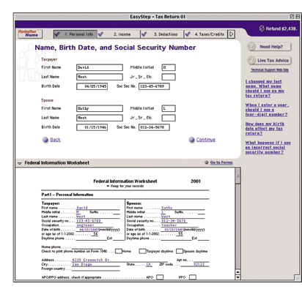
TurboTax

Slide 47
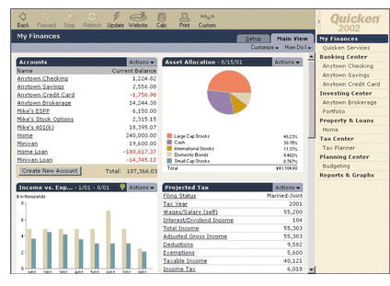
Quicken

Slide 48
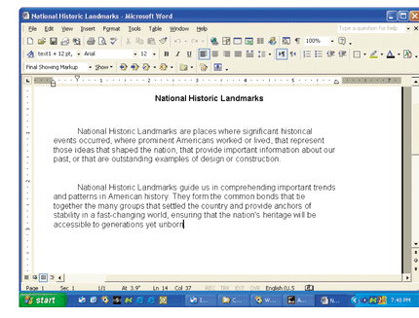
Word Processing Program

Slide 49
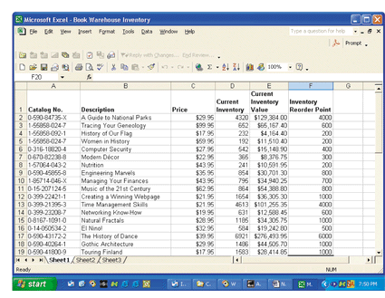
Spreadsheet Program

Slide 50
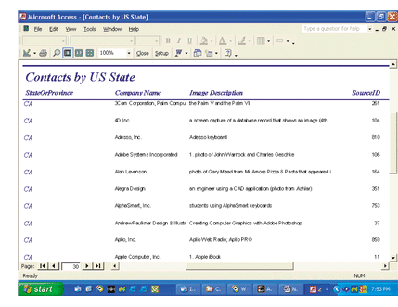
Database Program

Slide 51
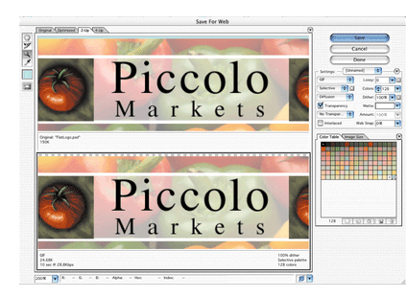
Graphics Program

Slide 52
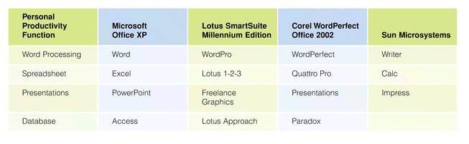
Software Suites

Slide 53
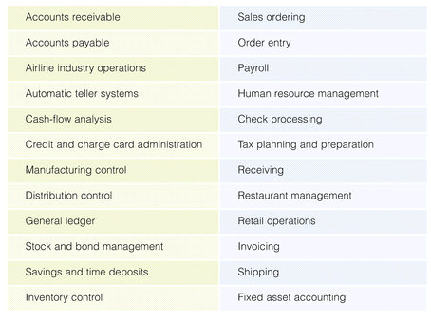
Enterprise Application Software

Slide 54
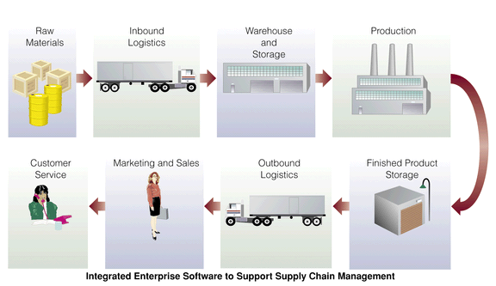
Use of Integrated Supply Chain
Management Software

Slide 55
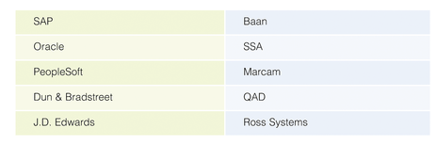
Selected Enterprise Resource Planning Vendors

Slide 56
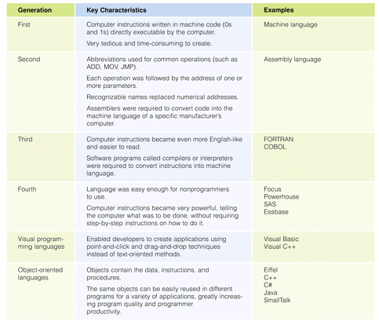
Summary of Programming Languages

Slide 57
Summary
Hardware devices work together to perform input, processing, data storage, and output.
There are two main categories of software: systems software and application software.
An operating system (OS) is a set of computer programs that controls the computer hardware to support users’ computing needs.
Application software may be proprietary or off-the-shelf.
There are five generations of programming languages, plus object-oriented programming languages.

