Slide 1
William Stallings
Computer Organization and Architecture
6th Edition
Chapter 10
Instruction Sets:
Characteristics
and Functions

Slide 2
What is an instruction set?
The complete collection of instructions that are understood by a CPU
Can be considered as a functional spec for a CPU
  Implementing the CPU in large part is implementing the machine instruction set
Machine Code is rarely used by humans
  Binary numbers / bits
  Machine code is usually represented by human readable assembly codes
  In general, one assembler instruction equals one machine instruction
Notes:
2

Slide 3
C
Fortran
Ada
etc.
Basic
Java
Compiler
Compiler
Assembly Language
Byte Code
Assembler
Interpreter
Executable
Instruction Set Architecture
HW
Implementation 1
HW
Implementation 2
HW
Implementation N

Slide 4
High Level language Constructs
High Level Language Constructs
a = b + c; /* add b and c and place in a */
d = e – f; /* subtract f from e and place in d */
x = y & z; /* AND y and z and place in x */
Assembly Language Constructs
add a, b, c; a ← b + c
sub d, e, f; d ← e – f
and x, y, z; x ← y & z

Slide 5
Elements of an Instruction
Operation code (Op code)
  Do this
Source Operand reference
  To this
Result Operand reference
  Put the answer here
Next Instruction Reference
  When you have done that, do this...
  Next instruction reference often implicit (sequential execution)
Notes:
3

Slide 6
the Operands?
Main memory (or virtual memory or cache)
  Requires address
CPU register
  Can be an implicit reference (e.g., x87 FADD) or explicit operands (add eax, ecx)
I/O device
  Several forms:
  Specify I/O module and device
  Specify address in I/O space
  Memory-mapped I/O just another memory address
Notes:
4

Slide 7
Instruction Representation
In machine code each instruction has a unique bit pattern
For human consumption (well, programmers anyway) a symbolic representation is used
  e.g. ADD, SUB, LOAD
  Called mnemonics
Operands can also be represented in this way
  ADD A,B
Notes:
5

Slide 8
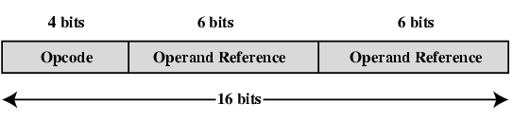
Simple Instruction Format

Slide 9
Instruction Types (for OpCode)
Data processing
  Arithmetic and logical instructions
Data storage (main memory)
Data movement (I/O)
Program flow control
  Conditional and unconditional branches
  Call and Return
Notes:
6

Slide 10
Design Issues: still in dispute
Operation Repertoire
  How many operations and how complex should they be? Few operations = simple silicon; many ops makes it easier to program
Data types
Instruction Format and Encoding
  Fixed or variable length? How many bits? How many addresses? This has some bearing on data types
Registers
  How many can be addressed and how are they used?
Addressing Modes
  Many of the same issues as Operation Repertoire

Slide 11
Number of Operands?
Architecture Styles:
Stack oriented
  Burroughs
Memory oriented
  IBM s/360 et al
Register oriented
  MIPS, Alpha, ARM
Hybrid
  Intel x86, Power PC

Slide 12
Number of Operands: Instruction Format
Zero Operand Instructions
  Halt, NOP
  Stack machines: Add
One Operand Instructions
  Inc, Dec, Neg, Not
  Accumulator machines: Load M, Add M
Two Operand Instructions
  Add r1, r2 (i.e. r1 = r1 + r2)
  Mov r1, r2
Three Operand Instructions
  Add r1, r2, r3
  Load rd, rb, offset

Slide 13
Number of Addresses (a)
3 addresses
  Operand 1, Operand 2, Result
  a = b + c;
  add ax, bx, cx
  May be a forth - next instruction (usually implicit)
  Not common
  Needs very long words to hold everything
3 address format rarely used
  Instructions are long because 3 or more operands have to be specified
Notes:
7

Slide 14
Number of Addresses (b)
2 addresses
  One address doubles as operand and result
  a = a + b
  add ax, bx
  Reduces length of instruction over 3-address format
  Requires some extra work by processor
    Temporary storage to hold some results
Notes:
8

Slide 15
Number of Addresses (c)
1 address
  Implicit second address
  Usually a register (accumulator)
  Common on early machines
Used in some Intel x86 instructions with implied operands
  mul ax
Notes:
9

Slide 16
Number of Addresses (d)
0 (zero) addresses
  All addresses implicit
  Uses a stack
  Example: c = a + b
  push a
  push b
  add ;st(1) <- a+b,
  pop c
Notes:
10

Slide 17
Computation of Y = (a-b) / (c + (d * e))
Three address instructions
    sub y,a,b
    mul t,d,e
    add t,t,c
    div y,y,t
Two address instructions
    mov y,a
    sub y,b
    mov t,d
    mul t,e
    add t,c
    div y,t

Slide 18
Computation of Y = (a-b) / (c + (d * e))
One address instructions
    load d
    mul e
    add c
    store y
    load a
    sub b
    div y
    store y

Slide 19
How Many Addresses
More addresses
  More complex (powerful?) instructions
  More registers
    Inter-register operations are quicker
  Fewer instructions per program
Fewer addresses
  Less complex (powerful?) instructions
  More instructions per program
  Faster fetch/execution of instructions
  Less complexity in processor
  One address format however limits you to one register
Notes:
11

Slide 20
Fixed/Var-Length Instruction Format
Fixed Length Instructions
Variable Length Instructions
Pros
  Simplifies implementation
  Can start interpreting
Cons
  May waste space
  May need additional logic in datapath
  Limits instruction set designer
Pros
  No wasted space
  Less constraints on designer
  More flexibility opcodes, addressing modes and operands
Cons
  Complicates implementation

Slide 21
Design Decisions (1)
Operation repertoire
  How many ops?
  What can they do?
  How complex are they?
Data types
Instruction formats
  Length of op code field
  Number of addresses
Notes:
12

Slide 22
Design Decisions (2)
Registers
  Number of CPU registers available
  Which operations can be performed on which registers?
Addressing modes (later…)
RISC v CISC
Notes:
13

Slide 23
Types of Operand
Addresses
Numbers
  Integer/floating point
  Binary / BCD integer representations
Characters
  ASCII etc.
Logical Data
  Bits or flags
(Aside: Is there any difference between numbers and characters? Ask a C programmer!)
Notes:
14

Slide 24
Pentium Data Types
8 bit Byte (unsigned or signed)
16 bit word (unsigned or signed)
32 bit double word (unsigned or signed)
64 bit quad word (unsigned or signed)
Memory is byte-addressable (Addressing is by 8 bit unit)
A 32 bit double word is read at addresses divisible by 4
Notes:
15

Slide 25
Specific Data Types
General - arbitrary binary contents
Integer - single binary value
Ordinal - unsigned integer
Unpacked BCD - One digit per byte
Packed BCD - 2 BCD digits per byte
Near Pointer - 32 bit offset within segment
Bit field
Byte String
Floating Point
Notes:
16

Slide 26
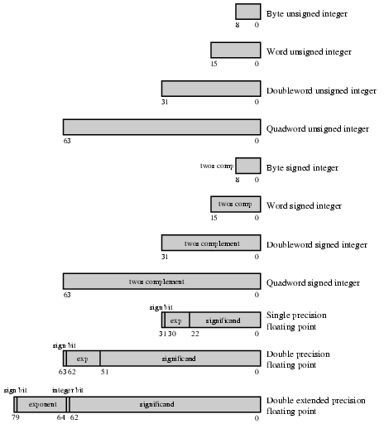
Pentium Floating Point Data Types
Notes:
17

Slide 27
Pentium Byte Strings
X86 processors have a set of 5 instructions called “string” instructions that can manipulate blocks of memory up to 2³² -1 bytes in length
Blocks of memory can be manipulated as bytes, words, or dwords
Operations:
  CMPS: mem-to-mem compare
  MOVS: mem-to-mem copy
  SCAS: scan memory for match to value in accumulator
  STOS: store accumulator to memory
  LODS: load accumulator from memory

Slide 28
Types of Operation
Data Transfer
Arithmetic
Logical
Conversion
I/O
System Control
Transfer of Control
Notes:
18

Slide 29
Data Transfer
Specify
  Source
  Destination
  Amount of data
May be different instructions for different movements source, destination, size
  e.g. IBM mainframes (370 series)
Or one instruction and different addresses
  e.g. VAX, Pentium (MOV)
Notes:
19

Slide 30

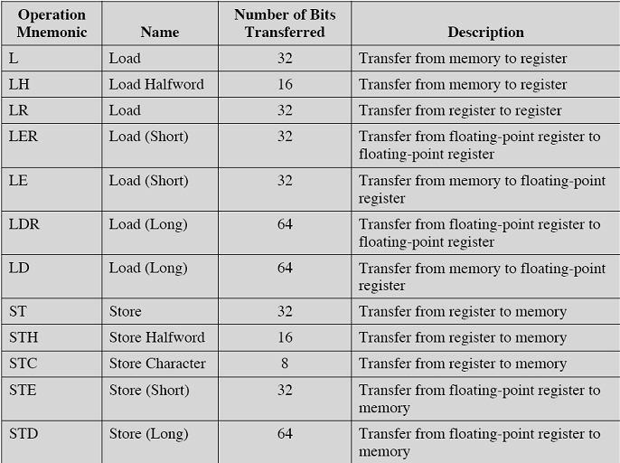
Example IBM EAS/390 Operations

Slide 31
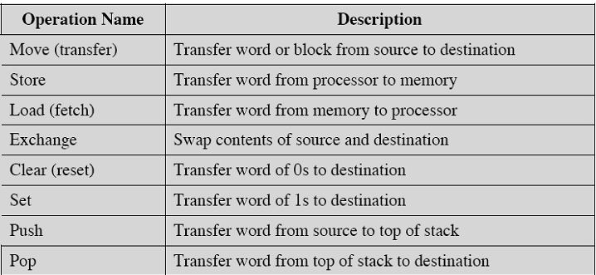
Types of data transfer operations

Slide 32
Arithmetic
Add, Subtract, Multiply, Divide
Signed Integer
Floating point ?
May include
  Increment (a++)
  Decrement (a--)
  Negate (-a)
Notes:
20

Slide 33
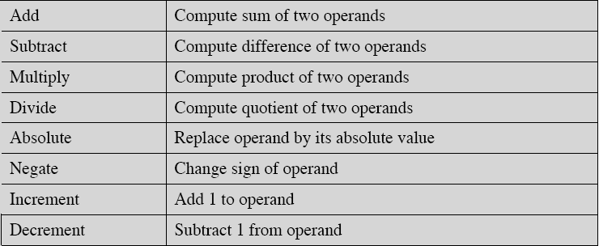
Arithmetic Operations
Comparison is usually considered an arithmetic operation – subtraction without storage of results

Slide 34
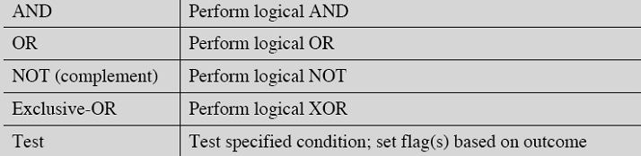
Logical
Bitwise operations
AND, OR, NOT
Notes:
21

Slide 35
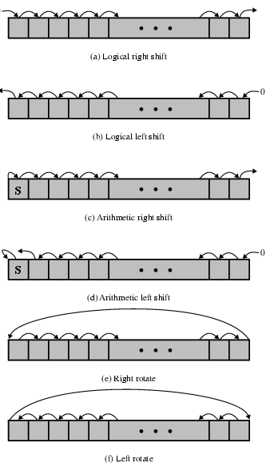
Shift and Rotate Operations

Slide 36
Translation and Conversion
Conversion: convert one representation to another. Ex: x87 load and store instructions perform conversions from any numeric format to IEEE and vice versa
Translate: table based translation
  S/390 translate instruction TR R1, R2, L
  R2 has address of a table of 8-bit codes
  L bytes at addr R1 are replaced by byte at table entry in R2 indexed by that byte
  Typically used for character code conversions
Intel XLATE instruction has implied operands
  Bx points to the table
  AL contains the index and is replaced by BX[al]
Notes:
22

Slide 37
Input/Output
May be specific instructions (Pentium IN and OUT)
May be done using data movement instructions (memory mapped)
May be done by a separate controller (DMA)
Notes:
23

Slide 38
Systems Control
Privileged instructions
CPU needs to be in specific state
  Ring 0 on 80386+
  Kernel mode
For operating systems use
Examples: Pentium
  — LGDTR (Load Global Descriptor Table Register)
  — LAR (Load Access Rights)
  — MOV to/from Control Register
Notes:
24

Slide 39
Transfer of Control
Branch (JMP in x86)
  — Unconditional == goto
  — Conditional
    Can be based on flags (condition codes) or other tests (BRP X, BRN X, BRO X, BRZ X)
    3 address format can have instructions such as bre r1,r2, dest ;branch to dest if r1=r2
Skip instructions
  — Skip the next instruction if condition is true
  — Implied address
  — May include other ops
    ISZ R1 ; increment R1 and skip if zero
— Not present in x86
Notes:
25

Slide 40
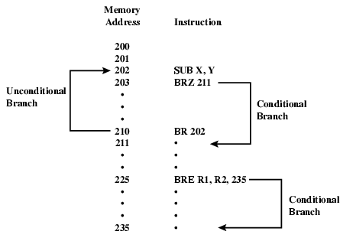
Branch Instruction

Slide 41
Procedure (Function) Calls
Two instructions: CALL and RETURN
Most machines use a stack mechanism:
  — CALL pushes return address on stack
  — RETURN pops stack into program counter
Other approaches:
  — Store return address in special register
    Rn←PC + d
    PC ← X
  — Store return address at start of procedure
These approaches all suffer from problems with re-entrancy (use a stack)

Slide 42
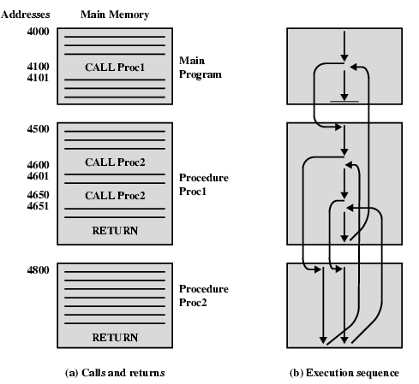
Nested Procedure Calls

Slide 43
Software Interrupts
Many architectures provide a software interrupt
  Intel x86 provides for 224 possible software interrupts
A software interrupt is an instruction, not an interrupt at all
Effect is similar to a CALL instruction
Return address and other data are pushed on the stack
Address to which transfer is passed is located using the same vectoring mechanism that hardware interrupts use
Intel x86 provides the IRET instruction for executing a RETURN from an interrupt

Slide 44
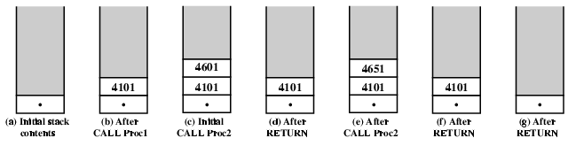
Use of Stack

Slide 45
Procedures and Functions
Most high-level languages make a syntactic distinction between Procedures (no return value) and Functions (returns a value as a result of the call)
At the machine level this distinction does not exist
We have only a CALL with RETURN to the instruction after the call

Slide 46
Stack Frames and Parameters
Stacks provide a very flexible mechanism for parameter passing
To call a procedure, first push parameters on the stack
Issue the CALL instruction
The procedure may also use the stack for storage of local (volatile) variables
The entire structure (parameters, frame pointer, return address, local storage) is called a Stack Frame
Notes:
27

Slide 47
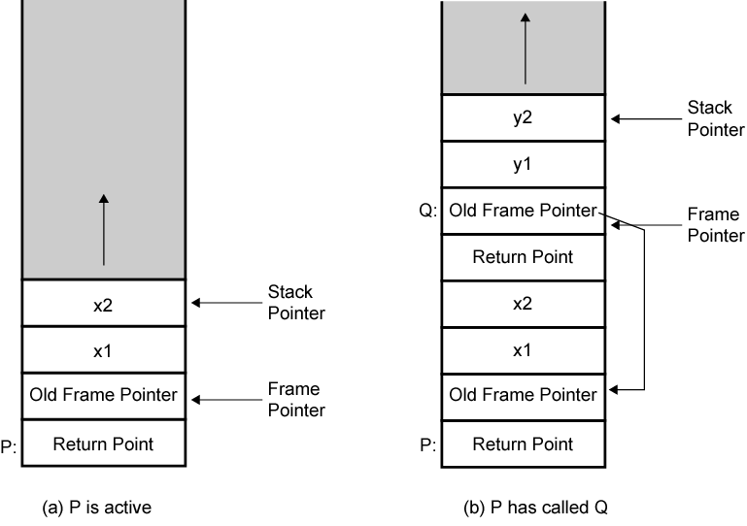
Stack Frame Example (P calling Q)

Slide 48
Byte Order Names
The problem is called Endian
The system on the left has the least significant byte in the lowest address
This is called big-endian
The system on the right has the least significant byte in the highest address
This is called little-endian
Notes:
29

Slide 49
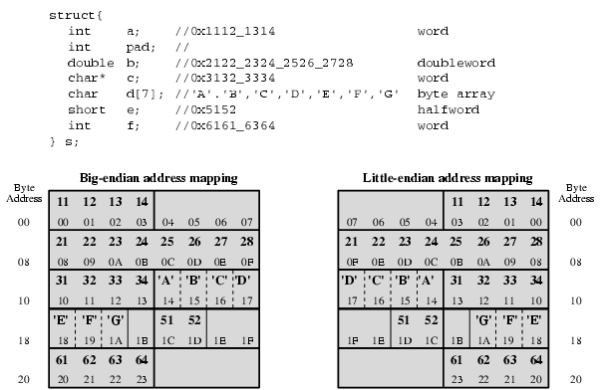
Example of C Data Structure

Slide 50
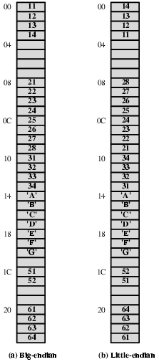
Alternative View of Memory Map

Slide 51
Standard…What Standard?
Pentium (80x86), VAX are little-endian
IBM 370, Motorola 680x0 (Mac), and most RISC are big-endian
Internet is big-endian
  Makes writing Internet programs on PC more awkward!
  WinSock provides htoi and itoh (Host to Internet & Internet to Host) functions to convert
Notes:
30

