Slide 1
William Stallings
Computer Organization and Architecture
6th Edition
Chap. 11 Instruction Sets:
Addressing Modes and Formats

Slide 2
Instruction set
Instruction set is key differentiation between different processors (e.g. Intel x86 & Power PC)
  MIPS: All loads and stores 32 bits; Special instructions exist for extracting bytes
  DEC Alpha: Instructions for loading and storing different sizes
  Some arch. have predefined values e.g. 0, 1, etc.
  DEC Vax: Single instruction to load or store all registers
High-level language constructs shape ISA
  Expr and assignment stmts
  Conditional stmts
  Loops
  Procedure calls
Compiling high-level language constructs into efficient code

Slide 3
Instruction Set Design Goals (Genel)
Maximize
Performance
Easy to Build
Compiler(s)
Easy to Build
Hardware
Minimize
Cost

Slide 4
Instruction Set Design (specific)
One goal is to minimize instruction length
Another goal (in CISC design) is to maximize flexibility
Many instructions were designed with compilers in mind
Operand in an instruction is actual value (immediate) or a reference to address (of operand)
Determining instruction format, how of operand address modes: key of instruction set design
Instruction format: layout fields in the instruction
  Legth (fixed or variable)
  Number of bits in opcodes and in each operand
How addressing mode is determined
  We want to reference a large range of locations in main memory
  Employ addressing techniques

Slide 5
Addressing Modes
Different types of addresses involve tradeoffs(denge) b/w instruction length, addressing flexibility(range), complexity of address calculation
How address of an operand specified (opcode / mode field)
How bits of an instruction organized to define operand address
(Most Common) Addressing Modes
  Immediate (actual value)
  Direct (operand address in address field)
  Indirect(address field points to a loc that has operand address)
  Register
  Register Indirect
  Displacement forms: reg value + address value (Indexed)
  Implied (Stack, and few others)
Notes:
2

Slide 6

Immediate Addressing
To set initial values of variables
Operand value is part of instruction
Operand = one address field
e.g. ADD 5
  Add 5 to contents of accumulator
  5 is operand
No memory reference to fetch data
Fast and simple
Can have limited range in machines with fixed length instructions
Address calculation
Notes:
3

Slide 7
Immediate Addressing and Small Operands
Many immediate mode instructions use small operands (8 bits)
In 32 or 64 bit machines with variable length instructions, space is wasted if immediate operands are required to be the same size as the register size
Some instruction formats include a bit that allows small operands to be used in immediate instructions
ALU will zero-extend or sign-extend the operand to the register size

Slide 8
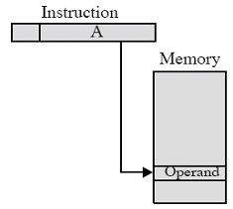
Direct Addressing
Address field contains address of operand
Effective address (EA) = address field (A)
e.g. ADD A
  Add contents of cell A to accumulator
  Look in memory at address A for operand
Single memory reference to access data
No additional calculations to work out effective address
Limited address space
Notes:
5

Slide 9
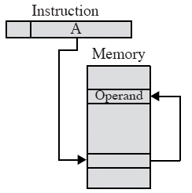
(Memory-) Indirect Addressing
Memory cell pointed to by address field contains the address of (pointer to) the operand
EA = (A)
  Look in A, find address (A) and look there for operand
e.g. ADD (A)
  Add contents of cell pointed to by contents of A to accumulator
  Two memory references to fetch the operand
Notes:
7

Slide 10
Indirect Addressing (2)
Large address space; 2^{n} where n = word length
May be nested, multilevel, cascaded
  e.g. EA = (((A)))
    Draw the diagram yourself
    ( ) : contents of
  Rarely used;
  Multiple memory accesses to find operand
  Implemented by using one bit of full-word address as an indirect flag; flag bit I=1 (indirection), I=0 then EA
    Allows unlimited depth of indirection
Multiple memory accesses; hence slower than any other type of addressing
Notes:
8

Slide 11
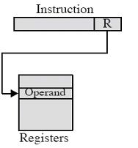
Register Addressing (1)
Similar to direct addressing
Address field refers to a register (not a memory address). Operand is held in this register.
EA = R (not contents of R)
Limited number of general-purpose registers (8-32) exist
  Therefore a small address field needed
  Shorter instructions
  Faster instruction fetch
  X86: 3 bits used to specify one of 8 registers
Notes:
10

Slide 12
Register Addressing (2)
No memory access needed to fetch EA
Very fast execution
Very limited address space
Multiple registers can help performance
  Requires good assembly programming or compiler writing (use a value in register many times)
  Note: in C you can specify register variables
register int a;
  This is only advisory to the compiler
  No guarantees
Notes:
11

Slide 13
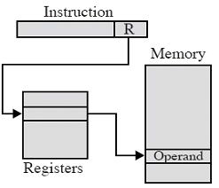
Register Indirect Addressing
Similar to memory-indirect addressing;
Much more common
EA = (R)
Operand is in memory cell pointed to by contents of reg R
Large address space (2^{n})
One fewer memory access than indirect addressing
Notes:
13

Slide 14
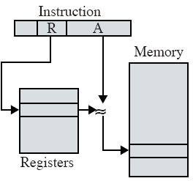
Displacement Addressing
Very powerful addressing mode
EA = A + (R)
Combines reg. indirect addressing with direct addressing
Address field hold two values, one explicit
  A =base value (used directly)
  R =register that holds displacement, contents+A->EA
  or vice versa
Notes:
15

Slide 15
Types of Displacement Addressing
3 most common types are
  Relative Addressing (implicit R is PC)
  Base-register addressing(reg R:mem address, offset)
  Indexing (mem address a, R:+offset from a)

Slide 16
Relative Addressing
A type of displacement addressing
R = Program counter, PC
Sometimes called PC-relative addressing
Address field A treated as 2’s complement integer to allow backward references
EA = A + (PC)
  i.e. get operand from A cells from current location pointed to by PC
Can be very efficient because of locality of reference & cache usage
  But in large programs code and data may be widely separated in memory
Notes:
17

Slide 17
Base-Register Addressing
A holds displacement
R holds pointer to base address
R may be explicit or implicit
  e.g. segment registers in 80x86 are base registers and are involved in all EA computations
x86 processors have a wide variety of base addressing formats
  mov eax, [edi + 4 * ecx]
  sub [bx+si-12],2
Uses locality of memory references
To implement segmentation
Notes:
18

Slide 18
Indexed Addressing
Opposite usage w.r.t. base-register addressing
  A = base (memory address)
  R = displacement (+offset)
  EA = A + R
Good for accessing arrays (i.e. A[]) (R called index reg)
  EA = A + R
  R++
Iterative access to sequential memory locations is very common
Some architectures provide auto-increment or auto-decrement as auto-indexing
  Preindex EA = A + (R++)
  Postindex EA = A + (++R)
Notes:
19

Slide 19
Stack Addressing
Stack: a linear array of locations
top of the stack pointer is associated (in register)
Operand is (implicitly) on top of stack
e.g.
  ADD Pop top two items from stack and add
  PUSH
  POP
X87 is a stack machine so it has instructions such as
FADDP ; st(1)<- st(1) + st(0) ;pop; result left in st(0)
Notes:
21

Slide 20

Örnekler:

Slide 21
Pentium Addressing Modes
Virtual or effective address is offset into segment
  Starting address plus offset gives linear address
  This goes through page translation if paging enabled
  6 Segment registers: subject of reference
12 addressing modes available
  Immediate (operand in instr)
  Register operand (operand in register)
  Displacement
  Base
  Base with displacement
  Scaled index with displacement
  Base with index and displacement
  Base scaled index with displacement
  Relative

Slide 22
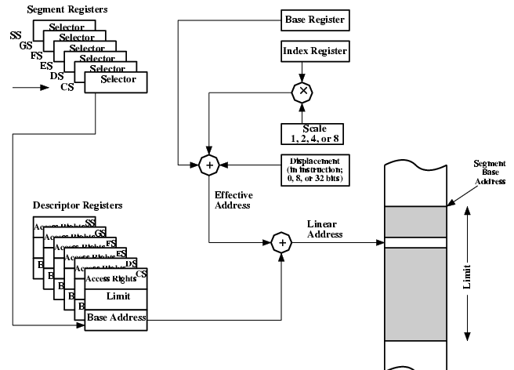
Pentium Addressing Mode Calculation

Slide 23
ARM Addressing Modes
A typical RISC characteristic is a small and simple set of addressing modes
ARM departs somewhat from this convention with a relatively rich set of addressing modes
But Load and Store are the only instructions that can reference memory
  Always indirect through a base register plus offset
Three alternatives
  — Offset
  — Preindex
  — Postindex

Slide 24
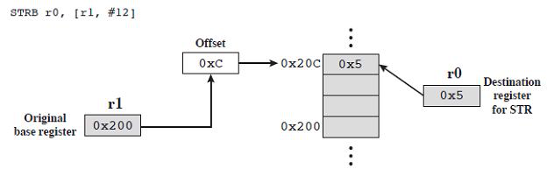
Offset Addressing
Offset added or subtracted from value in base register
Example: store byte, base register is R1 and displacement is decimal 12. This is the address where the byte from r0 is stored

Slide 25
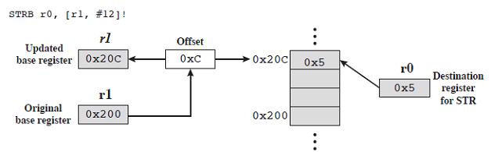
Preindex Addressing
Memory address formed same way as offset addressing, but the memory address is written back to the base register after adding or subtracting the displacement
With preindexing the writeback occurs before the store to memory

Slide 26
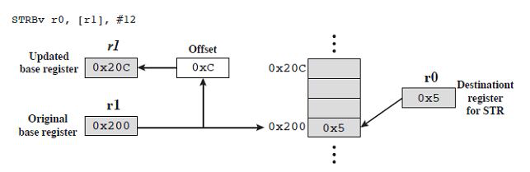
Postindex Addressing
Like preindex addressing but the writeback of the effective address occurs after the store

Slide 27
Indexed Addressing Operands
Previous examples had immediate values but the offset or displacement can also be in another register
If a register is used then addresses can be scaled
The value in the offset register is scaled by one of the shift operators
  — Logical Shift Left / Right
  — Arithmetic Shift Right
  — Rotate Right
  — Rotate Right Extended
  Amount of shift is an immediate operand in the instruction

Slide 28
Arithmetic and Logical Instructions
Use register and immediate operands only
For register addressing one of the register operands can be scaled by one of the five shift operations mentioned previously
Branch Instructions
Only form of addressing is immediate
Branch instruction contains a 24-bit immediate value
For address calculation this value is shifted left by 2 bits so the address is on a word boundary
This provides a range of 26 bits so we have backwards or forwards branches of 32MB

Slide 29
Load/Store Multiple
Load/Store multiple loads or stores a subset of general purpose registers (possibly all) from/to memory
List of registers is specified in a 16-bit field in the instruction (one bit/register)
Memory addresses are sequential; low address has lowest numbered register
Found addressing modes:
— Increment/decrement before/after
— Base reg specifies a main memory address
— Inc/Dec starts before/after the first memory access

Slide 30
Instruction Formats
Defines Layout of bits in an instruction
Includes opcode
Includes (implicit or explicit) operand(s)
Usually more than one instruction format in an instruction set
Includes implicit or explicit operand(s)
Usually there are several instruction formats in an instruction set
Huge variety of instruction formats have been designed; they vary widely from processor to processor

Slide 31
Instruction Length
The most basic issue
Affected by and affects:
  — Memory size
  — Memory organization
  — Bus structure
  — CPU complexity
  — CPU speed
Trade off between a powerful instruction repertoire and saving space with shorter instructions

Slide 32
Instruction format trade-offs
Large instruction set => small programs
Small instruction set => large programs
Large memory => longer instructions
Fixed length instructions same size or multiple of bus width => fast fetch
Variable length instructions may need extra bus cycles
Processor may execute faster than fetch
Use cache memory or use shorter instructions
Complex relationship between word size, character size, instruction size and bus transfer width
In almost all modern computers these are all multiples of 8 and related to each other by powers of 2

Slide 33
Allocation of Bits: Determines several important factors
Number of addressing modes
  — Implicit operands don’t need bits
  — X86 uses 2-bit mode field to specify interpretation of 3-bit operand fields
Number of operands
  — 3 operand formats are rare,
  For two operand instructions we can use one or two operand mode indicators
Register versus memory
  Tradeoff between # of registers and program size
  Studies suggest optimal number between 8 and 32
  Most newer architectures have 32 or more

Slide 34
Allocation of Bits
Number of register sets
  RISC architectures tend to have larger sets of uniform registers
  Small register sets require fewer opcode bits
  Specialized register sets can reduce opcode bits further by implicit reference (address vs. data registers)
Address range
  Large address space requires large instructions for direct addressing
  Many architectures have some restricted or short forms of displacement addressing

Slide 35
PDP-8
Very simple machine and instruction set
Has one register (the Accumulator)
12-bit instructions operate on 12-bit words
Very efficient implementation
  35 operations along with indirect addressing, displacement addressing and indexing in 12 bits
The lack of registers is handled by using part of the first physical page of memory as a register file

Slide 36
Instruction Formats
A 3-bit opcode and three types of instructions
  For opcodes 0 – 5 (6 basic instructions) we have single address mem ref with Z/C I/D bits
Opcode 6 is I/O with 6 device-select bits and 3 operation bits
Opcode 7 defines a register reference or microinstruction
  — Three groups, where bits are used to specify operation (e.g., clear accumulator)
  — Forerunner of modern microprogramming

Slide 37
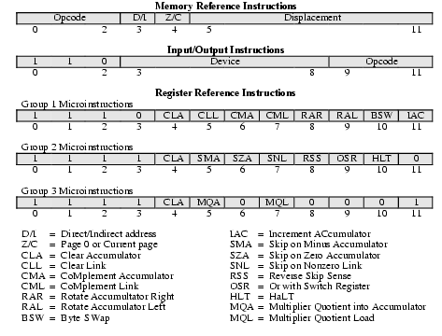
PDP-8 Instruction Format

Slide 38
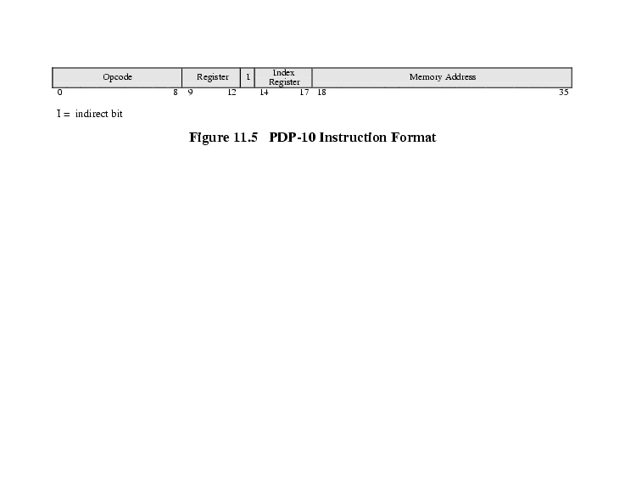
PDP-10 Instruction Format

Slide 39
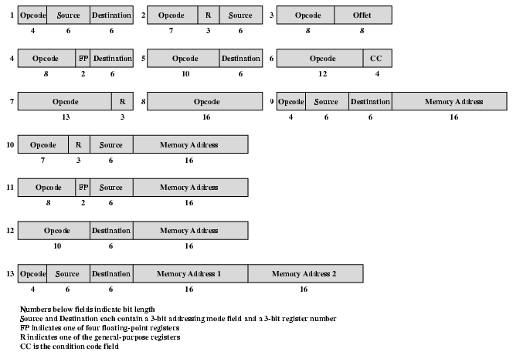
PDP-11 Instruction Format

Slide 40
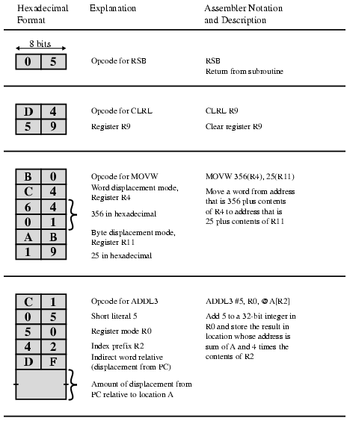
VAX Instruction Examples

Slide 41
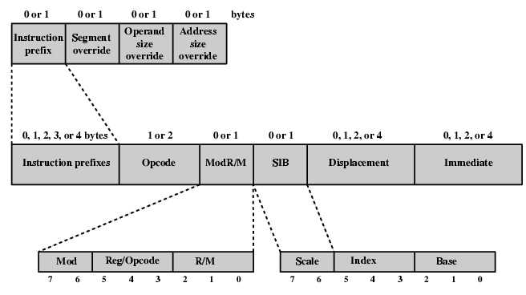
Pentium Instruction Format

Slide 42
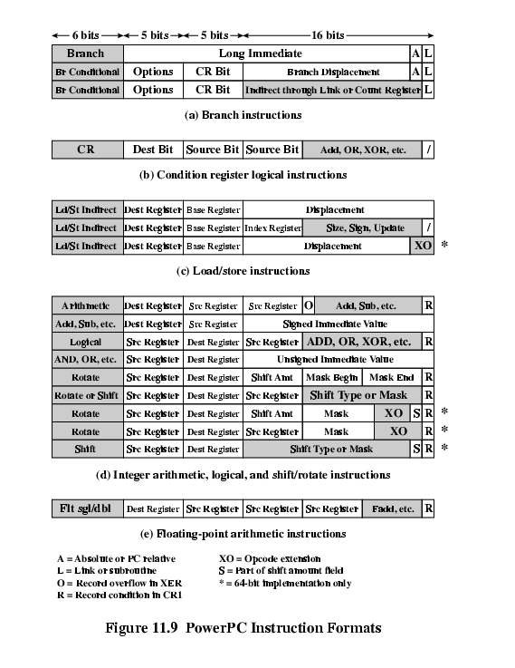
PowerPC Instruction Formats (1)

Slide 43
PowerPC Instruction Formats (2)

Slide 44
VAX Design Philosophy
Most architectures provide a fairly small number of fixed instruction formats
  Addressing mode and opcode are not orthogonal
  Instructions typically limited to reg/mem, reg/reg etc
  Only 2 or 3 operands max can be accommodated; some instructions inherently require more (ex: integer division with 2 inputs and 2 outputs)
VAX design principles were:
  All instructions should have the “natural” number of operands
  All operands should have the same generality in specification

Slide 45
VAX Instructions
Highly variable instruction format
Opcode is one or two bytes long
  First by FF or FD indicates two byte opcode
Followed by 0 to 6 operand specifiers
Minimum instruction length is one byte
Maximum is 37 bytes!

Slide 46
Operand Specifiers
At a minimum, 1 byte in which leftmost 4 bits are the address mode specifier
  except “literal” mode (00 followed by 6 literal bits)
  4 bits specify one of 16 registers
Operand specifier can be extended by immediate or displacement 8 – 32 bits
Indexed addressing mode 0010 + 4 bit index reg id, followed by base address 8-32 bits
Example: 6 operand instruction
ADDP6 OP1, OP2, OP3, OP4, OP5, OP6
  Adds two packed decimal strings
  Op1 and op2 are length and start addr of one string; op3 and 4 are second string- Result is in length/location op5,op6

Slide 47
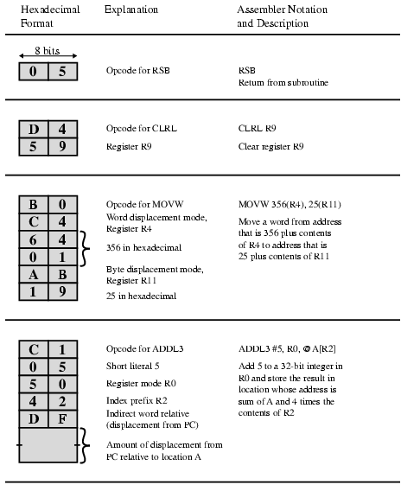
VAX Instruction Examples

