Slide 1
William Stallings
Computer Organization and Architecture
6th Edition
Chapter 12
CPU Structure
and Function

Slide 2
CPU Structure
CPU must:
  Fetch instructions
  Interpret instructions
  Fetch data
  Process data
  Write data
These functions require
  internal temporary storage
  remembering location of instruction to fetch next
Notes:
22

Slide 3
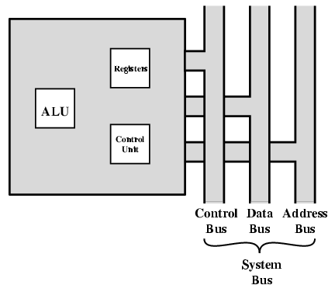
CPU With Systems Bus

Slide 4
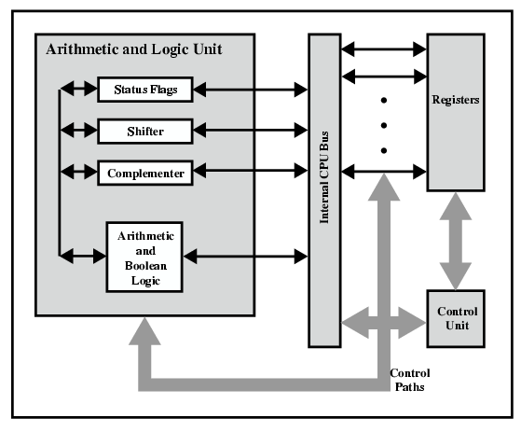
CPU Internal Structure

Slide 5
Registers
CPU must have some working space (temporary storage), called registers
Number and function vary between processor designs
  One of the major design decisions
  Top level of memory hierarchy
Two main roles
1. User Visible Registers
2. Control and Status Registers
Notes:
23

Slide 6
User Visible Registers
A user visible register is simply a register that can be referenced with the machine language of the processor
Four categories
  General Purpose
  Data
  Address
  Condition Codes
Notes:
24

Slide 7
General Purpose Registers (1)
May be true general purpose (all registers are the same)
  Orthogonal to the instruction set: any register can hold any operand for any instruction (clearly not the case with X86!)
  May be restricted (each register has special functions)
In some machines GP registers can be used for data or addressing
In other machines there is a separation:
  Data: Accumulator and count registers
  Addressing: Segment, index, autoindex registers, Stack pointer
Even on machines with true general purpose registers, if there is user-visible stack addressing then the stack pointer is special purpose
Notes:
25

Slide 8
General Purpose Registers (2): Design Decision
Make them general purpose
  Increase flexibility and programmer options
  Increase instruction size & complexity
Make them specialized
  Smaller (faster) instructions
  Less flexibility
Notes:
26

Slide 9
How Many GP Registers?
Between 8 - 32
Fewer = more memory references
More registers do not reduce memory references and but they do take up processor real estate
See also RISC – hundreds of registers in the machine (but only a few in use at any given moment)
Notes:
27

Slide 10
How big?
Large enough to hold full address
  This was Intel’s engineering kludge: 8086 index registers CANNOT hold a full address
Large enough to hold full word
Sometimes possible to combine two data registers for double-precision values
Notes:
28

Slide 11
Condition Code (Flag) Registers
Typically partially user-visible
Sets of individual bits
  e.g. result of last operation was zero
Can be read (implicitly) by programs
  e.g. Jump if zero
Cannot (usually) be set directly (addressed) by programs
X86 has direct ops for carry flag only
  STC, CLC, CMC
  BT (Bit Test) Instruction
Notes:
29

Slide 12
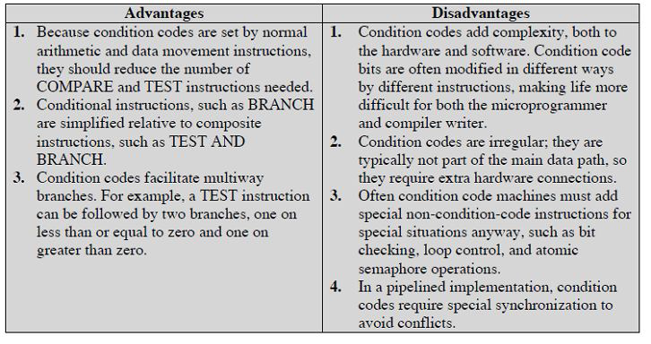
Machines without Condition Code Regs
IA-64 (Itanium) and MIPS processors do not use condition code registers
Conditional branch instructions specify a comparison and act on the result without storing the result in condition codes

Slide 13
Control & Status Registers
Four registers essential to instruction execution:
  Program Counter (PC): Address of next instruction to be fetched
  Instruction Register (IR): Current instruction fetched from mem
  Memory Address Register (MAR): Pointer to mem
  Memory Buffer Register (MBR): Word of data read or to be written
Not all processors explicitly have MAR/MBR but equivalent functionality is present in all.
Notes:
30

Slide 14
MAR/MBR
A “staging area” for memory access
  MAR connects to address bus
  MBR connects to data bus
  User registers exchange data with MBR
Processor updates PC after instruction fetch; branch or skip can also update PC
Fetched instruction is loaded into IR for decoding
Data are exchanged with memory using MAR/MBR
User-visible regs exchange data with MBR
ALU:
ALU typically has direct access to MBR and user registers
Additional buffering registers typically are present at the “boundary”
Serve as input and output registers for the ALU;
exchange data with MBR and user-visible regs

Slide 15
Program Status Word
Present in many processors –a set of bits indicating machine status (including condition codes)
Typical:
  Sign of last result
  Zero
  Carry
  Equal
  Overflow
  Interrupt enable/disable
  Supervisor mode (enable privileged instructions)
X86 has flags/eflags plus control registers
Notes:
31

Slide 16
Supervisor Mode
AKA Kernel mode, or with x86, Ring 0
  Allows privileged instructions to execute
  Used by operating system
  Not available to user programs
  Most control registers are only available in supervisor mode
Notes:
32

Slide 17
Other Status and Control Registers
These vary by machine. Examples:
  Pointer to current process information (x86 TR=Task Register)
  Interrupt vector pointer (x86 IDTR)
  System stack pointer (x86 SS:esp)
  Page table pointer (x86 CR3)
  I/O registers (not used in Intel x86)
CPU design and operating system design are closely linked
Notes:
33

Slide 18

Example Register Organizations

Slide 19
Data Flow (Instruction Fetch)
Depends on CPU design
In general:
Fetch
  PC contains address of next instruction
  Address moved to MAR
  Address placed on address bus
  Control unit requests memory read
  Result placed on data bus, copied to MBR, then to IR
  Meanwhile PC incremented by 1

Slide 20
Prefetch and Improved Performance
Fetch accessing main memory
Execution usually does not access main memory
Can fetch next instruction during execution of current instruction
Called instruction prefetch
But not doubled:
  Fetch usually shorter than execution
    Prefetch more than one instruction?
  Any jump or branch means that prefetched instructions are not the required instructions
Add more stages to improve performance
Notes:
36

Slide 21
Pipelining
In pipelining we divide instruction execution into a number of stages: Overlap these operations
  Fetch instruction
  Decode instruction
  Calculate operands (i.e. EAs)
  Fetch operands
  Execute instructions
  Write result
After one stage has completed, instruction moves down the pipeline to the next stage while the next instruction is started
  Similar to a factory assembly line – we don’t have to wait for a product to exit the line before starting to assemble another
Notes:
38

Slide 22
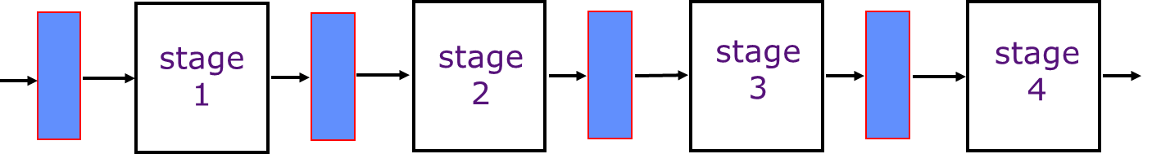
An Ideal Pipeline
Complex instruction sets difficult to pipeline, so difficult to increase performance as gate count grew
Load-Store RISC ISAs designed for efficient pipelined implementations
All objects go through the same stages
No sharing of resources between any two stages
Propagation delay through all pipeline stages is equal
The scheduling of an object entering the pipeline is not affected by the objects in other stages

Slide 23
Sample Pipeline
time t0 t1 t2 t3 t4 t5 t6 t7 . . . .
instruction1 IF₁ ID₁ EX₁ MA₁ WB₁
instruction2 IF₂ ID₂ EX₂ MA₂ WB₂
instruction3 IF₃ ID₃ EX₃ MA₃ WB₃
instruction4 IF₄ ID₄ EX₄ MA₄ WB₄
instruction5 IF₅ ID₅ EX₅ MA₅ WB₅
Instruction-Fetch (IF)
Decode, Reg. Fetch (ID)
Execute (EX)
Memory (MA)
Write-Back (WB)
5 stages = 5 instr execution at the same time (see t4)

Slide 24
Instructions interact with each other in pipeline
An instruction in the pipeline may need a resource being used by another instruction in the pipeline → structural hazard
An instruction may depend on something produced by an earlier instruction
  Dependence may be for a data value
  → data hazard
  Dependence may be for the next instruction’s address
  → control hazard (branches, exceptions)
Notes:
CS252 S05

Slide 25
Foreground Reading
Processor examples
Stallings Chapter 12
Web pages etc.
Notes:
48

